Slide 1
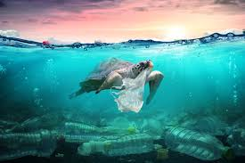
Climate change and Sea level

Slide 2
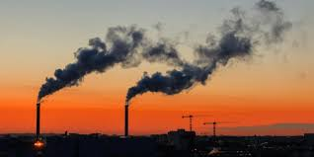
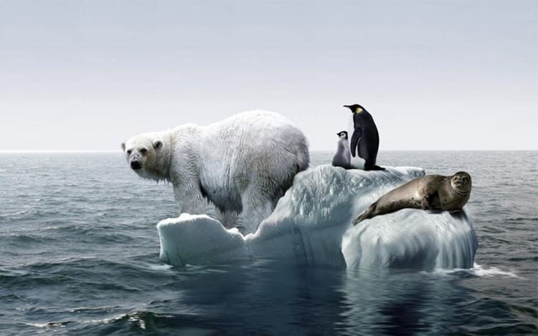
What is Global warming?
What is pollution? Pollution is the excessive act of soiling a place.
But what is Global warming? I think you know, except if you live under a rock.
But I can…explain how it’s.
Global Warming became a big problem by a small problem(pollution), and today it affects the whole world.
Here some images
2

Slide 3
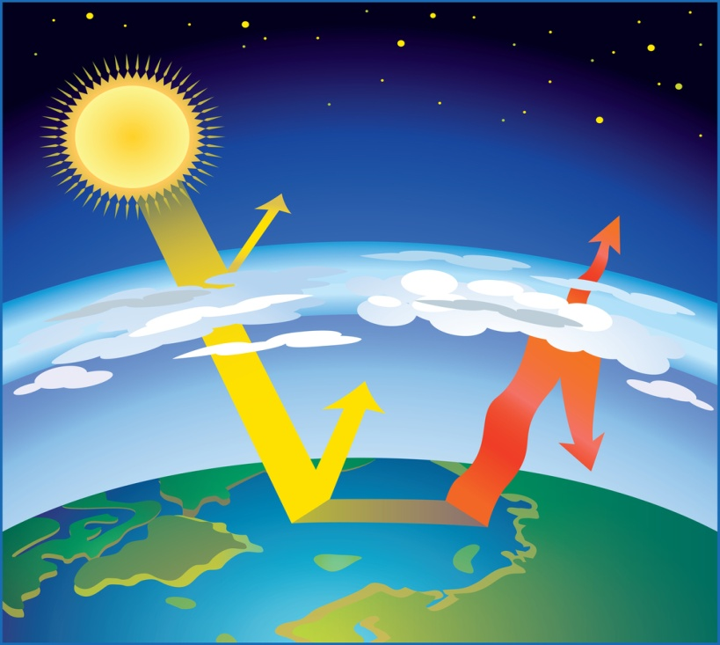
What causes Global warming?
What causes Global warming? Pollution.
Because of people's slouch, and their excessive acts, now the planet, including us, is dealing with their bad results. I’ll try to explain with an image:
Pollution ruins the ozone layer and the greenhouse effect, so sunlight enters more easily ,warming the planet
3

Slide 4
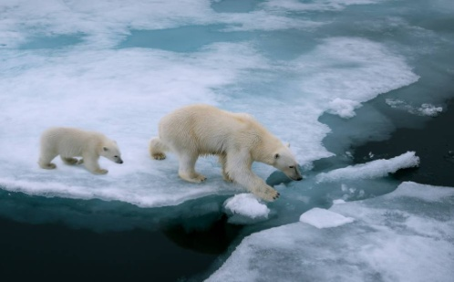
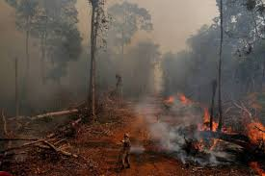
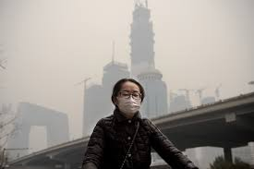
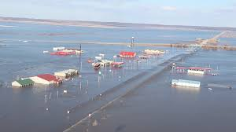
What consequences does pollution have?
Because pollution, today there are many bad consequences, because people chose to be ignorant and dirty. I don't even think I can say them all here on this slide. So, I will say some:
Destroyed habitats
Animals in danger
Very bad air quality
Global warming
Sea level has upped
4

Slide 5
What we can do?
Núria Jesus
Well,we can help by, first, warn others. We can also try recycling. If we're willing, we can even pick up garbage from some places, people will thank you. But you don’t have to do this alone…you can call your friends! Do a recycling contest among you. Many people are creating online accounts to sensitive people too.
So the planet can be cleaner
5

