Slide 1
EU4Algae WG5/WG6 joint meeting
Algae industry recovering nutrients and carbon from effluents to use in (organic) agricultural products
25/06/2024
Efthalia Arvaniti, s.Pro - sustainable projects GmbH

Slide 2
Agenda for today
Time | Title | Confirmed Speakers | Notes
14.00 – 14.10 | Welcome, new faces & recap on WG5 | Efthalia Arvaniti, EU4Algae | Recording starts, house rules (Mic, chat, Q&A); Welcome intro + 3 slides
14.15 – 14.30 | EU4Algae Bioremediation potential with algae: nutrient recovery by algae | Efthalia | EA shares PPT
14.30 – 14.45 | Introduction to microalgae-based biofertilisers produced with circulated nutrients | Gabriel Acien, University of Almeria/ EABA | Gabriel shares PPT
14.45 – 15.00 | Tentative title: Microalgae biomass obtained from nutrients recovered from urban wastewaters | Frank Rogalla, Aqualia | Frank shares PPT
15.00 - 15.10 | Q&A with 1’ Comfort break |  | Efthalia invites questions from audience
15.10 - 15.25 | Microalgae-based biostimulants products | Joaquín Pozo Dengra, Biorizon Biotech | Joachim share PPT
15.25– 15.45 | Study to support a Sustainable Algae Industry: Nutrients for organic microalgae/cyanobacteria production Use of algae for wastewater and water treatment and use of resulting algae biomass in fertilisation | Efthalia/Tina; Marcella de Souza, University Ghent | Efthalia and Marcella share PPT
15.45 - 15.55 | Q&A | Ethalia/ Tina/ Marcella | Efthalia invites questions from audience
15.55 – 16.00 | AOB followup and next steps | Efthalia
16.00 | End of meeting

Slide 3
Outcomes
Algae cultivation
Algae products
Developing a Monitoring Framework to Assess the Bioremediation Ecosystem Services Offered by Algae in Europe
Developments of a restorative ocean farming & use for offshore cultivation (O1.25)
3. Verification of high potential Algae products & possible criteria, labels, tools (LCAs) to assess environmental footprint
4. List of social aspects related to the algae industry growth

Slide 4
Upcoming Outcomes of EU4Agae
Efthalia Arvaniti, s.Pro - sustainable projects GmbH

Slide 5
Developing a Monitoring Framework to Assess the Bioremediation Ecosystem Services Offered by Algae in Europe
This report will summarize finding of EU projects and studies:
On the ecosystems services based on the bioremediation potential of algae.
On carrying capacities of EU waters for seaweed aquaculture and marine permaculture (regeneration)
Assess impacts of algae cultivation, restoration and harvesting on the health of the ocean and humans
Assess and synthesise findings on the frameworks, methodologies and tools, for quantifying ecosystem services on bioremediation potential of algae.
Compile knowledge gaps and provide further recommendations for developing a monitoring framework and targets for quantifying ecosystem services.

Slide 6
Approach
Use cases to record barriers & gaps
Round up knowledge gaps and recommendations
Connecting the dots from project results, studies & consultations

Slide 7
EU Algae Initiative action taken
Relevant EU Algae Initiative actions | This work
8) Work with the algae industry and Member States to: identify valid and safe alternatives to the use of nutrients and CO2 from various sources for microalgae cultivation and organic certification. promote the extraction of nutrients from algae biomass support the life cycle assessment of the environmental and climate impact of algae cultivation and production by considering the development of monitoring methodologies and indicators to measure the environmental impact and sustainability of seaweed cultivation; | This work will contribute to: By showcasing algae bioremediation solutions and available N P discharges and CO2 emission points relevant for microalgae cultivation by presenting European NA consolidate knowledge on methods to measure environmental impacts and bioremediation ecosystem services of seaweed cultivation.
12) by the end of 2023, integrate algae sector knowledge into the EU aquaculture assistance mechanism; | This work is well aligned with the parallel Aquaculture Assistance Mechanism that updates guidelines, especially the Environmental Performance chapter. For this, findings and recommendations are informed and integrated.
13) by the end of 2025 and in collaboration with relevant stakeholders, do a study to gain better knowledge of seaweed climate change mitigation opportunities and the role of seaweed as blue carbon sinks; | The work will contribute with identifying bioremediation ecosystem service solutions relevant to seaweed and climate mitigation as opportunities, and address knowledge gaps

Slide 8
10 algae bioremediation solutions
 | Regulating/ supporting ES
Industrial systems on land /Microalgae
Solution #1: Algae using nutrient-rich side-streams at enclosed Industrial Systems | Water Quality
Solution #2: A mixture of microalgae and aerobic bacteria in open ponds for treating wastewaters | Water Quality
Solution #3: Algae for blue carbon capture and utilization in enclosed industrial systems | Climate Regulation
Solution #4: Using nutrient-rich industrial side-streams in dark fermenters | Water Quality
Open water systems / Macroalgae
Solution #5: Seaweed farming as nutrient catch-crop in open water systems | Water Quality
Solution #6: IMTA as nutrient catch-crop in open water systems | Water Quality
Solution #7: Seaweed farming for Blue Carbon Capture | Climate Regulation
Solution #8: Wild harvesting of seaweed from coastal waters for nutrient removal | Water Quality
Solution #9: Collection of algal blooms for nutrient removal | Water Quality, Biodiversity
Solution #10: Collection of algae beach-cast for nutrient removal | Water Quality, Biodiversity

Slide 9
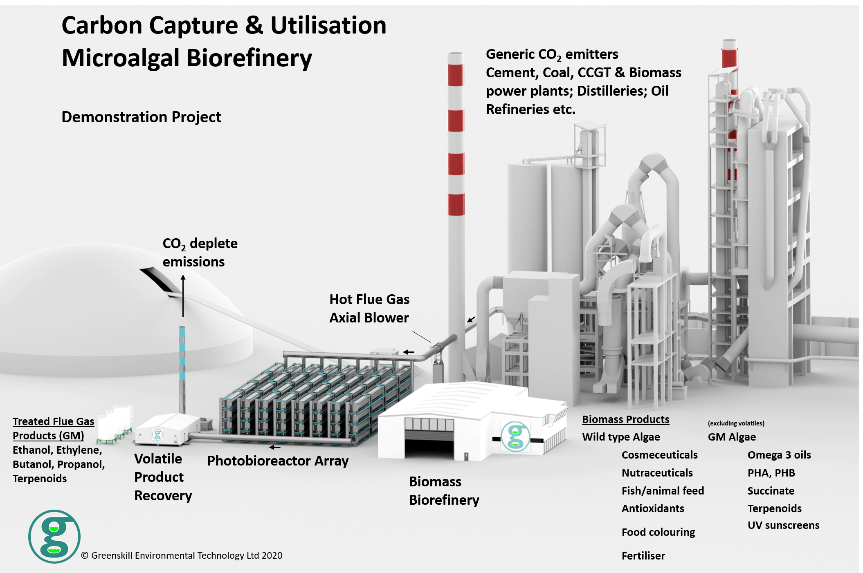
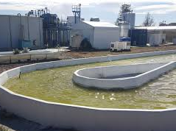
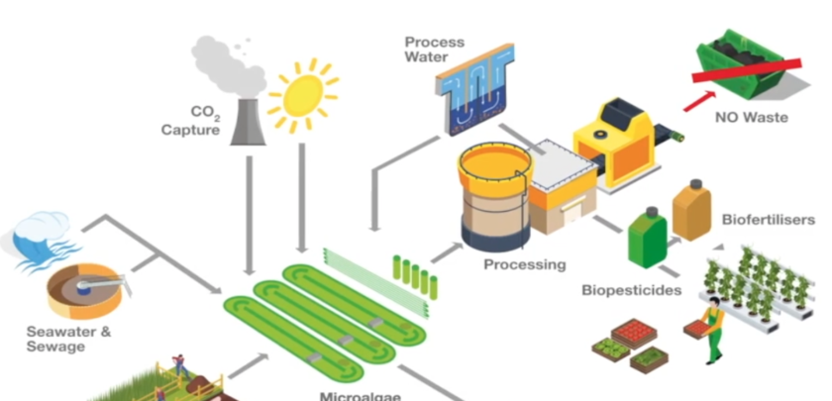
Three Industrial Algae Bioremediation Solutions on Land
S2: Use of a mixture of microalgae and aerobic bacteria in open ponds for treating (urban) wastewaters
Water2return
S3: Algae for blue carbon capture and utilization (CCU) in enclosed industrial systems
S1: IS using industrial nutrient-rich side-streams at enclosed industrial systems (incl. IMTA)

Slide 10
Solution #1 flashcard
Solution #1 | IS using industrial nutrient-rich side-streams at enclosed industrial systems | TRL7-8
Relevant EU projects: | Alg-AD, SCALE, AlgaeNauts, LOCALITY, REALM, AlgaeProBanos, FertiManure, CIRCALGAE, xx
Industry practitioners: | A4F (PT), Necton (PT), Biorizon Biotech (SP), Pure Algae (DK), Algiecel (DK), Swedish Algae Factory (SE), Sotenas Symbiose (SE)

Slide 11
Benchmarking #1
Environmental impacts | KPIs | Solutions #1: | Benchmark technology: denitrification | No treatment
Pollution prevention | Nutrient recycling | Yes; nutrients are recovered in the algae | Yes; xxx
Climate | Energy recovery | Partly; solar energy is captured and stored in algae in the form of lipids and carbohydrates | No
 | Energy use | ? | ?
 | Carbon recovery | Fed CO2 is captured by algae and produces biomass (lipids & carbohydrates) | No
Soil health* | Soil improvement | Yes; algae can have crop biostimulants activity | No
Biosecurity |  | Partly; the system is land-locked, but there is a risk for algae escapism. If algae is invasive, it can be problem. | ?
Biodiversity loss |  | No | No
Socioeconomic risks | Large land use | No, the system is compacted in PBR | No

Slide 12
Solution #2 flashcard
Solution #2 | Use of a mixture of microalgae and aerobic bacteria in open ponds for treating (urban) wastewaters | TRL 8-9
Relevant EU projects: | SABANA, AlgaeNauts, Water2Return?
Industry practitioners: | Industry practitioners: Aqualia (SP), Biorizon Biotech (SP)

Slide 13
Environmental impacts | KPI | Solution #2 | Benchmark technology: Aerobic treatment/ Activated sludge | No treatment
Pollution prevention | Nutrient recycling | Yes; xx | Yes; xx | Limited; for some byproducts such as manure, nutrients can be recovered when applied without treatment.
Climate | Energy recovery | Partly; solar energy is captured and stored in the form of lipids and carbohydrates | No | No
 | Energy use | ? | ? | ?
 | Carbon recovery | Yes; Activated sludge converts organic carbon to CO2, but microalgae converts CO2 into algae biomass (lipids, carbohydrates) | No; Activated sludge converts organic carbon to CO2 | No
Soil health* | Soil improvement | Yes; the product contributes to humus formation and algae can have crop biostimulants activity | No | No; untreated organic waste or byproducts can result in high concentration of minerals in a reduced place, with risks for soil health.
Biosecurity |  | ? | ? | No
Contaminants |  | ? | ? | ?
Socioeconomic risks | Large land use | Yes; estimated xx m2 per inhabitant | Yes; estimated xx m2 per inhabitant | No
Table 10 Comparison of Solution #2 WW, the benchmark technology, and 3) no treatment as organic waste management practices [adapted from EBA report]

Slide 14
How to get involved – before October 2024
Provide consultation
Content validation
Interview (written)
DPN secured
Shared Word Document

Slide 15
How to get involved – before October 2024
Algae cultivation
Algae products
Developing a Monitoring Framework to Assess the Bioremediation Ecosystem Services Offered by Algae in Europe
Developments of a restorative ocean farming & use for offshore cultivation (O1.25)
3. Verification of high potential Algae products & possible criteria, labels, tools (LCAs) to assess environmental footprint
4. List of social aspects related to the algae industry growth

Slide 16
Thank you
© European Union 2023
Unless otherwise noted the reuse of this presentation is authorised under the CC BY 4.0 license. For any use or reproduction of elements that are not owned by the EU, permission may need to be sought directly from the respective right holders.
Slide xx: element concerned, source: e.g. Fotolia.com; Slide xx: element concerned, source: e.g. iStock.com
Notes:
Update/add/delete parts of the copy right notice where appropriate.
More information: https://myintracomm.ec.europa.eu/corp/intellectual-property/Documents/2019_Reuse-guidelines%28CC-BY%29.pdf

Slide 17
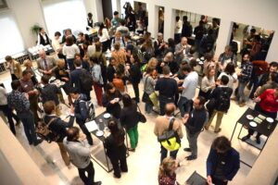
Next WG5 meetings
EU4Algae Info day September 2024 tbd
Tentative title:
Legal status of algae fertilizers/biostimulants produced with recycled nutrients

