Slide 1
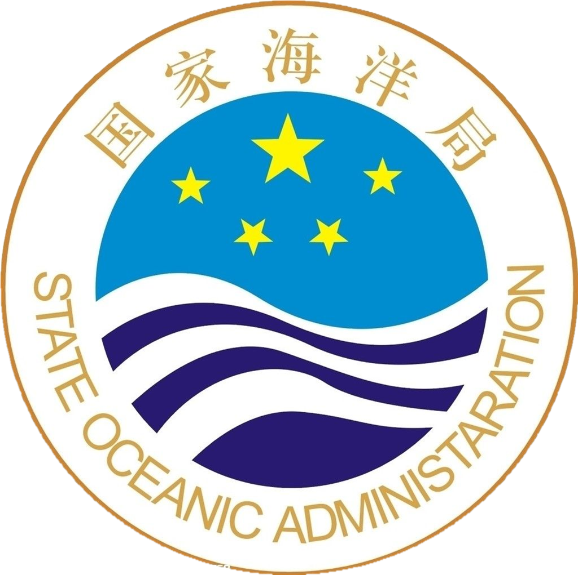
The State Oceanic Administration
People’s Republic Of China

Slide 2
FURTHER MORE
The State Oceanic Administration Profile
Founded in 1964, SOA has about 30,000 staff.
SOA is consisted of 11 departments and more than 20 affiliated institutes and research centers, including:
3 branches
12 national research centers
5 national marine research centers
2 offices for polar affaires
China Ocean News (newspaper)
China Ocean Press
Notes:
10. to undertake the routine work of National ocean Committee, to carry out other relevant work required by the State Council, National Ocean Committee and the Ministry of Land Resources.

Slide 3
FURTHER MORE
The State Oceanic Administration Profile
SOA operates one ten-thounsand-tonne ocean-going research ship and more than 50 thousand-tonne ships, one of which is ice breaker for polar expedition and transportation. The second new ice breaker is under construction.
SOA operates 10 aircrafts and 2 marine satellites.
SOA operates 5 research stations in Arctic and Antarctic.
Notes:
10. to undertake the routine work of National ocean Committee, to carry out other relevant work required by the State Council, National Ocean Committee and the Ministry of Land Resources.

Slide 6
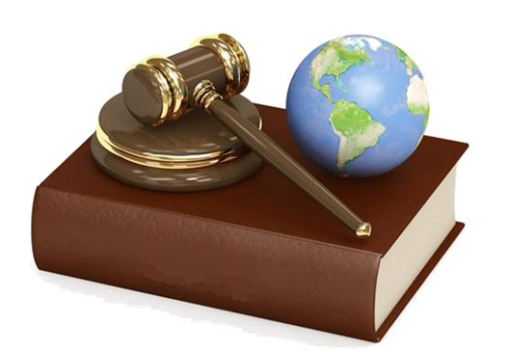
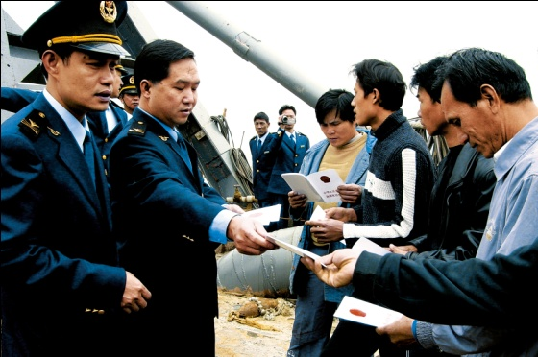
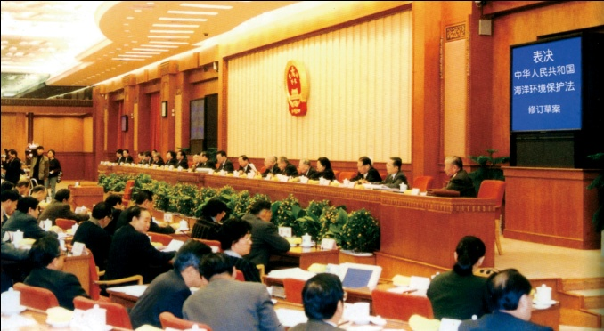
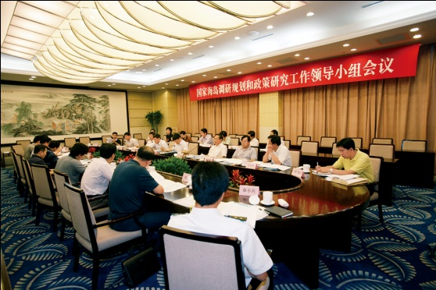
Responsibilities
1.Ocean Policy, Laws and Regulations
Law
AREA: Inland sea, territorial sea, contiguous zone, exclusive economic zone, continental shelves and other sea areas
RULES on : sea use, marine eco-environment protection, ocean survey and scientific research, protection of island
DRAFT COORDINATE UTILIZATION
The State Oceanic Administration
Notes:
To draft laws and regulations, as well as rules on sea use, marine eco-environment protection, ocean survey and scientific research, protection of island of inland sea, territorial sea, contiguous zone, exclusive economic zone, continental shelves and other sea areas; in collaboration with other relevant government agencies, to coordinate the formulation of marine development strategy and national plans for ocean development programme, major marine functional zoning scheme, marine eco-environment protection, marine economic development, island protection and the development and utilization of non-inhabitant islandas well as the the supervision of the imlementation; to further promote and develop the integrated planning and coordinating mechanism .

Slide 7
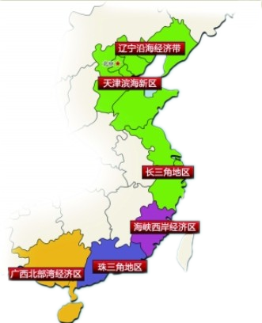
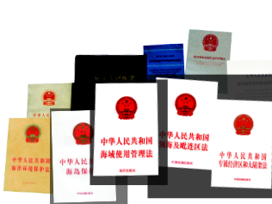
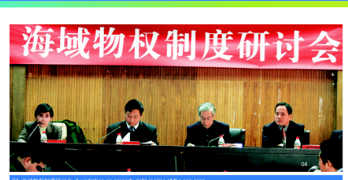
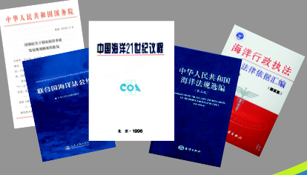
Responsibilities
2.Marine Integrated Management
Marine functional zoning scheme
Sea area use and management scheme
Coast line and sea area boundary delimitation at provincial level
Draft and supervise the implementation of regulation on the construction of artificial islands, installation and structure in the exclusive economic zone and on the continental shelf
FUNCTIONAL ZONE ISLANDS COASTLINE
Notes:
3. To formulate and supervise the implementation of marine functional zoning scheme, to draft and supervise the implementation of sea area use and management scheme, to conduct coast line and sea area boundary delimitation at provincial level, to draft and supervise the implementation of regulation on the construction of artificial islands, installation and structure in the exclusive economic zone and on the continental shelf.

Slide 8
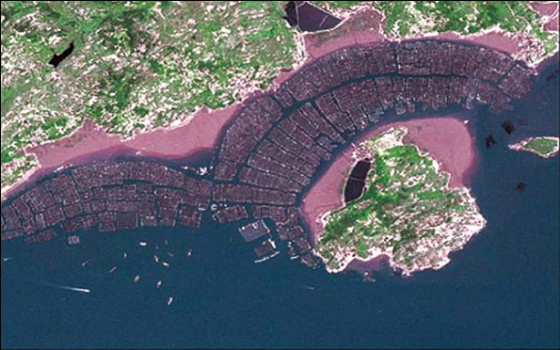
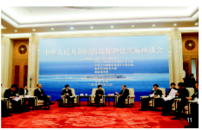
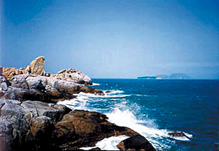
Responsibilities
3.Protection and Management of Sea Islands
Island protection and non-inhabitants island development and utilization
Management of names of the sea area, non-inhabitant island, undersea feature beyond the scope of coast zone of China
Islands protection with specific use for baseline point of the territorial sea
PROTECTION BASELINE MANAGEMENT
Notes:
4.To draft and supervise the implementation of regulation on island protection and non-inhabitants island development and utilization, to be responsible for the management of names of the sea area, non-inhabitant island, undersea feature beyond the scope of coast zone of China, to formulate and supervise the implementation of regulation on islands protection with specific use for baseline point of the territorial sea.

Slide 9
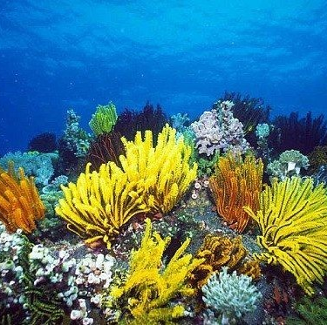
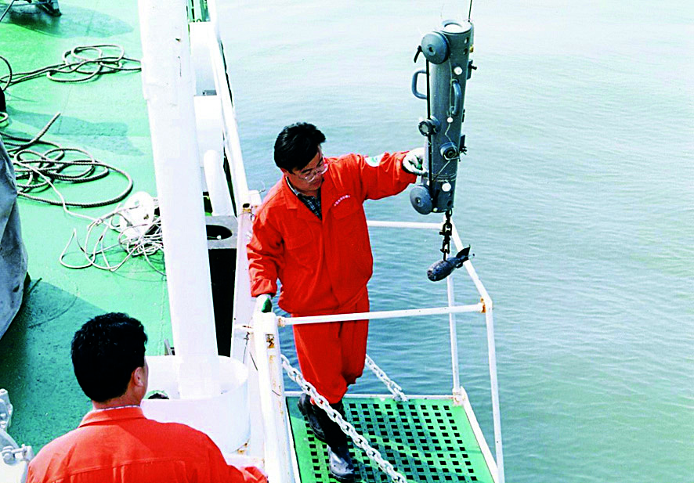
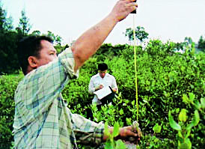
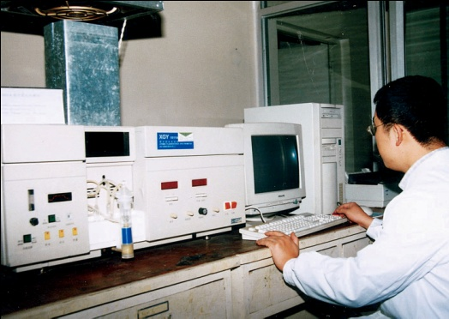
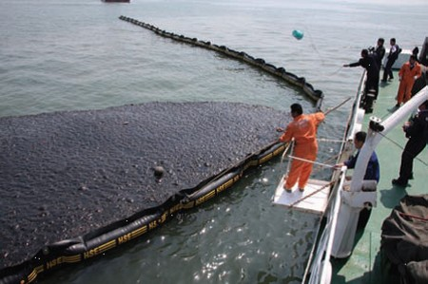
Responsibilities
4.Marine Environmental Protection
Marine eco-environment protection & Publish marine environment information
Charge of compensation claim for marine eco-environment damages
Total discharge loading control of pollutants into the sea
Criteria for marine environment monitoring and evaluation
Climate change in terms of adaption and response
ECO-ENVIRONMENT COMPENSATION CLIMATE CHANGE
Notes:
5. To conduct marine eco-environment protection, to draft and supervise the implementation of the standards and norms for marine eco-environment protection and the regime for total discharge loading control of pollutants into the sea, to formulate and supervise the implementation of criteria for marine environment monitoring and evaluation, to publish marine environment information; to take a charge of compensation claim for marine eco-environment damages, to conduct work related to climate change in terms of adaption and response.

Slide 10
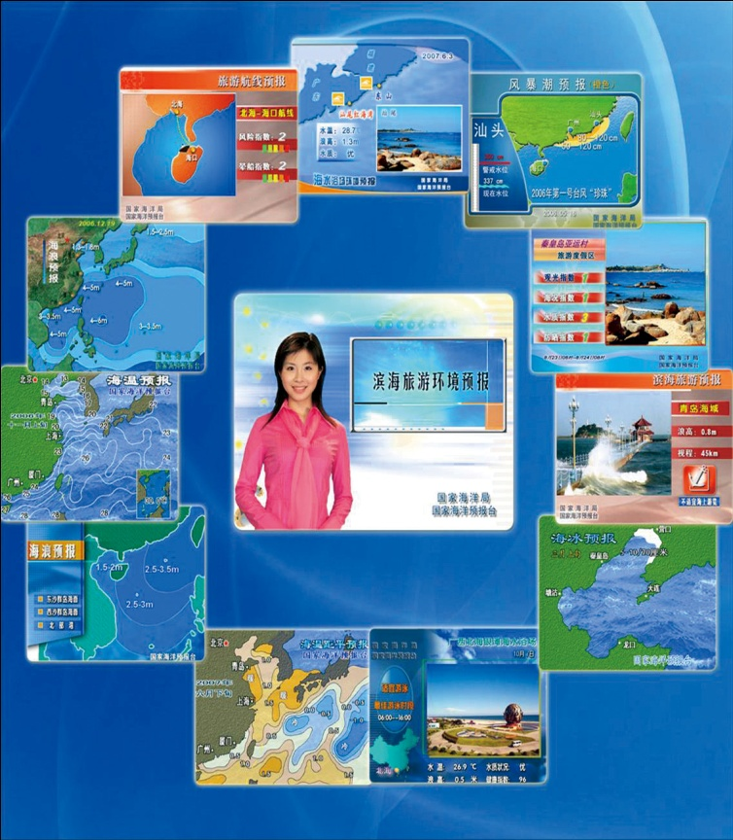
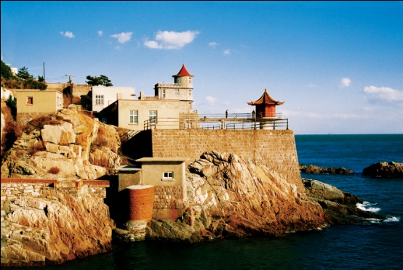
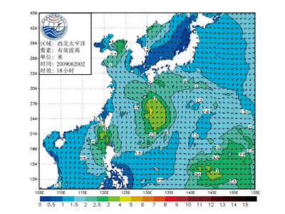
Responsibilities
5.Marine Public Service
Ocean observation and forecasting, marine hazards warning
Develop ocean observation network program
Issue ocean forecasting, marine hazards warning and ocean bulletin
Construct ocean environment security system
Participate in major marine disaster emergency response and its handling
ECO-ENVIRONMENT COMPENSATION CLIMATE CHANGE
Notes:
6. to draft and supervise the implementation of regulations on ocean observation and forecasting, marine hazards warning , to develop ocean observation network programme, to issueocean forecasting, marine hazards warning and ocean bulletin; to construct ocean environment security system; to participate in major marine disaster emergency response and its handling..

Slide 11
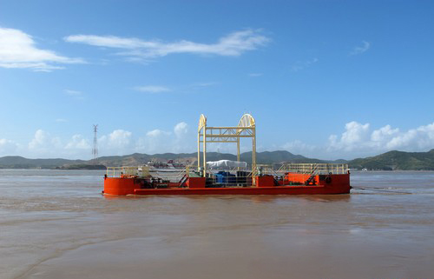
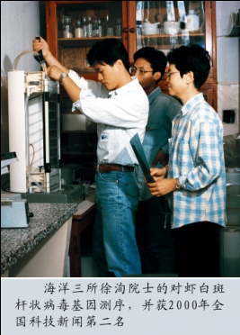
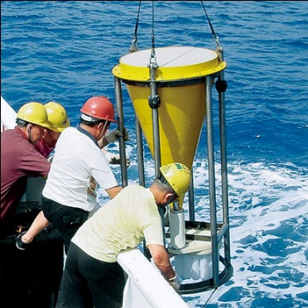
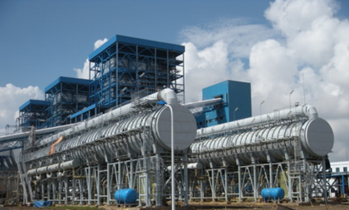
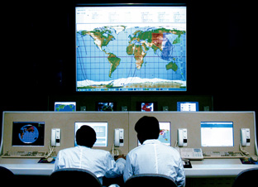
Responsibilities
6.Marine Science and Technology Development
Draft and implement marine science and technology development plan
Draft standards, metrology and norms for marine technology
Conduct ocean survey
Establish mechanism for furthering marine scientific and technological innovation
MARINE SCIENCE STANDARDS AND NORMS FURTHER INNOVATION
Notes:
standards, metrology and norms for marine technology, to conduct ocean survey, to establish mechanism for furthering marine scientific and technological innovation.

Slide 12
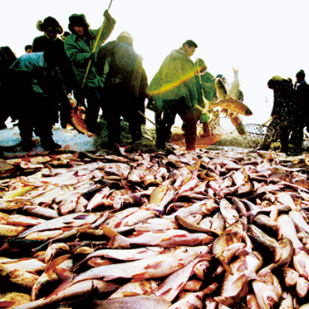
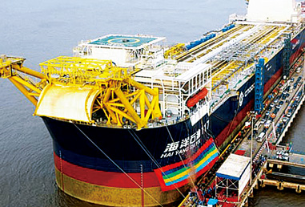
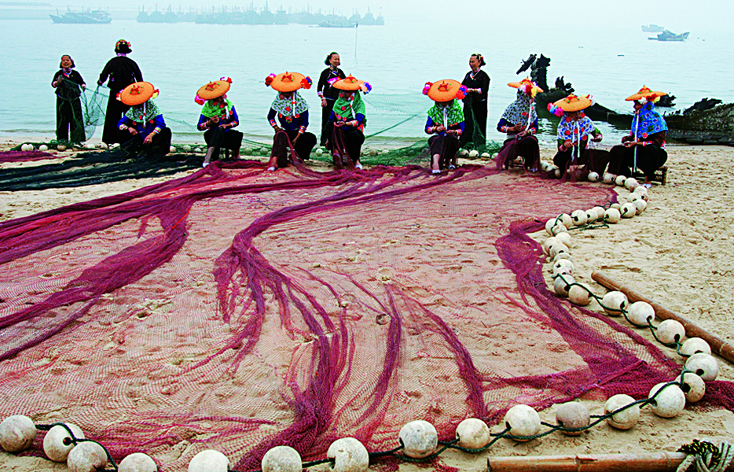
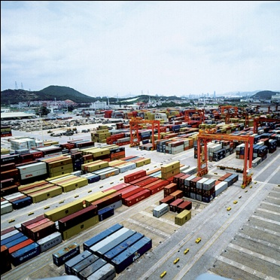
Responsibilities
7.Ocean Economic Development
Conduct the comprehensive monitoring of operation of marine economy, statistics accounting, assessment and information dissemination
Provide the policy recommendation with regard to the optimization of marine industry structure
MARINE ECONOMY ASSESSMENT RECOMMENDATION
Notes:
8. to conduct the comprehensive monitoring of operation of marine economy, statistics accounting, assessment and information dissemination, to provide the policy recommendation with regard to the optimization of marine industry structure.

Slide 13
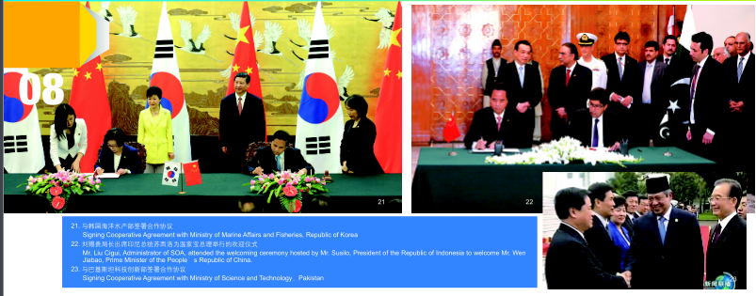
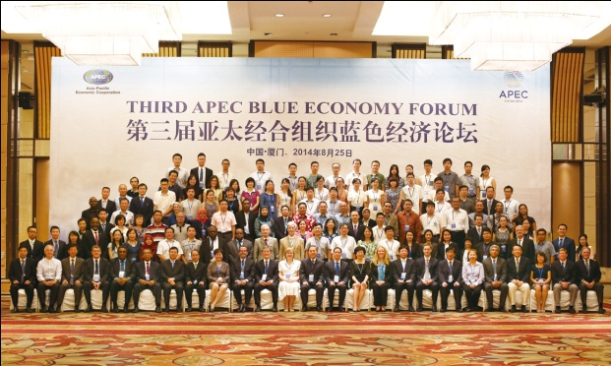
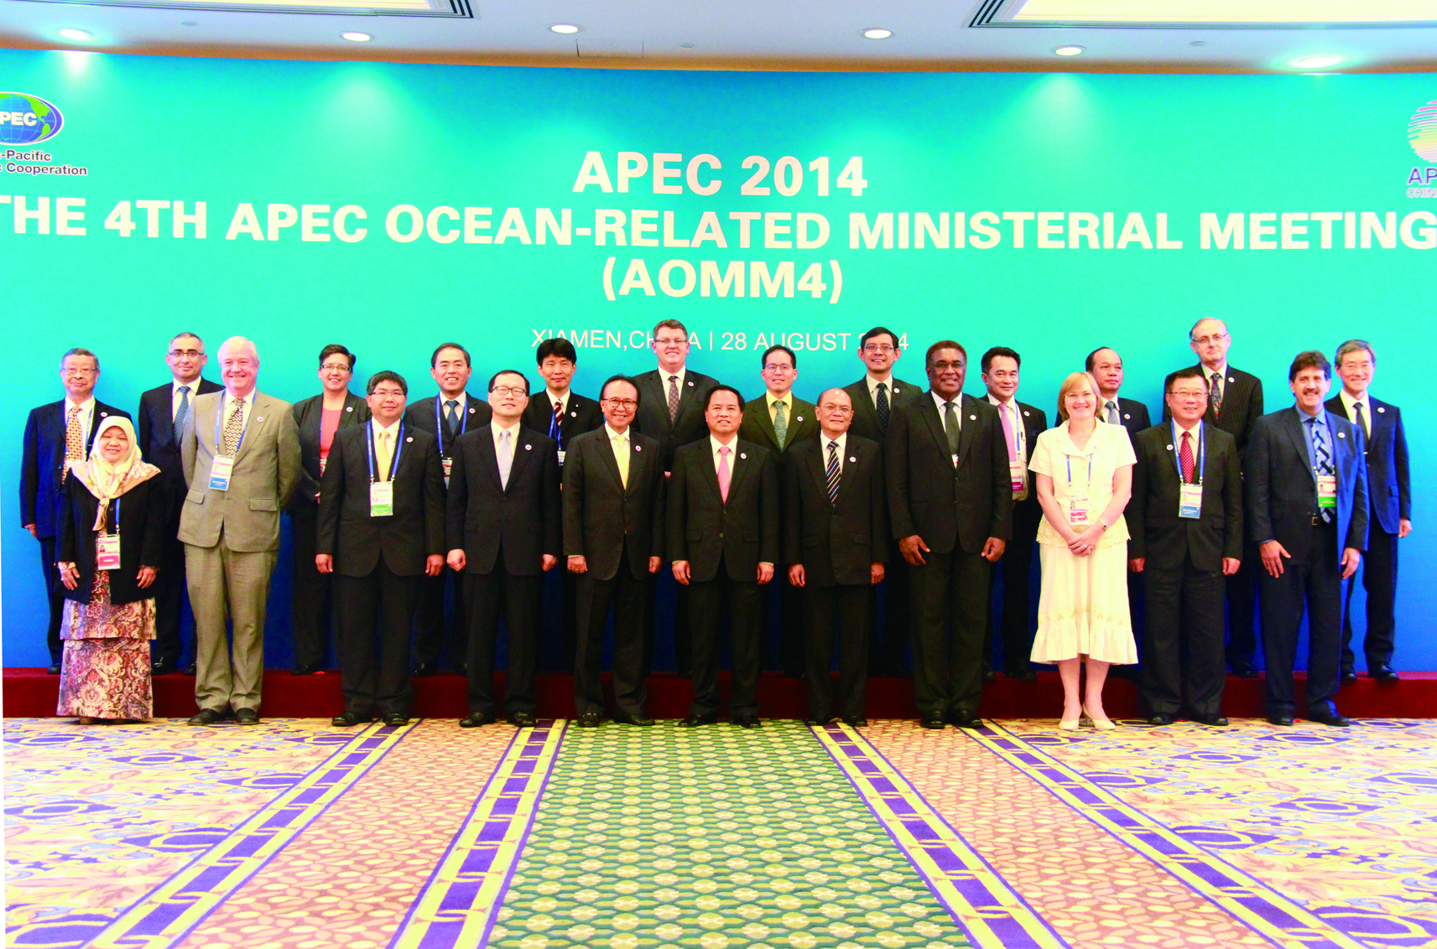
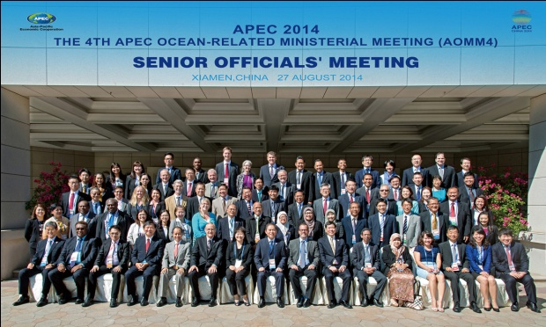
Responsibilities
8.Ocean International Cooperation
Conduct international cooperation and exchange
Participate in ocean-related international consultation and negotiation
Organize the implementation of international ocean-related conventions and treaties like UN Convention on the Law of the Sea, the Treaty on Antarctica
Affairs related to China of polar regions, high sea and international seabed area
CONSULATION CONVENTIONS AND TREATIES POLAR AND HIGH SEA
Notes:
9. to conduct international cooperation and exchange, to participate in ocean-related international consultation and negotiation, to organize the implementation of international ocean-related conventions and treaties like UN Convention on the Law of the Sea, the Treaty on Antarctica and so on, and take a charge of affairs related to China in the fields of polar regions, high sea and international seabed area.

Slide 14
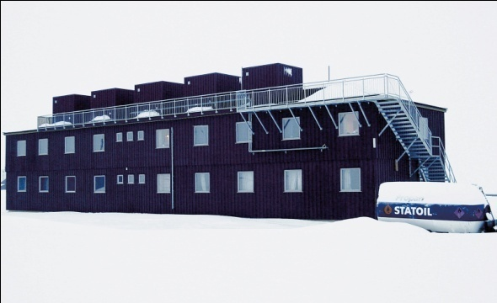
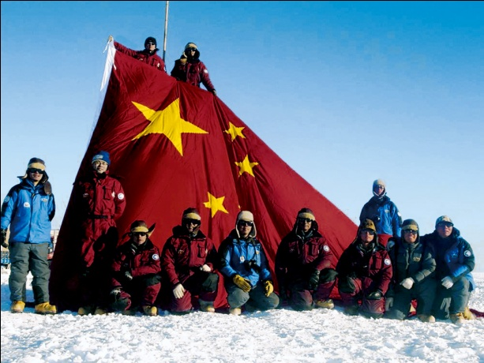
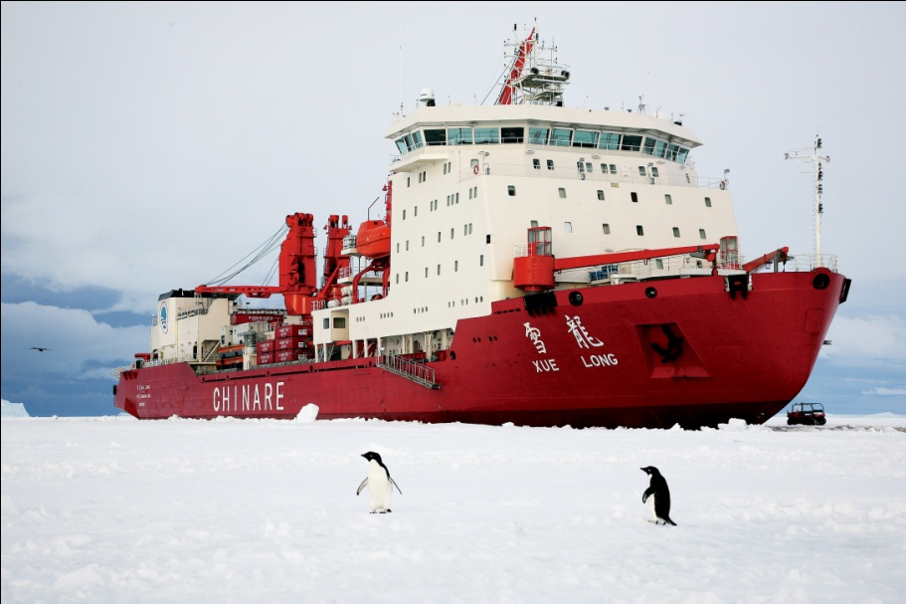
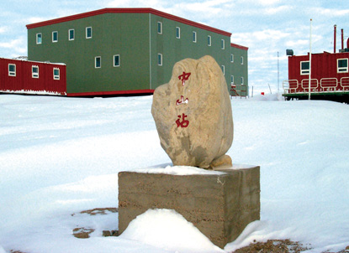
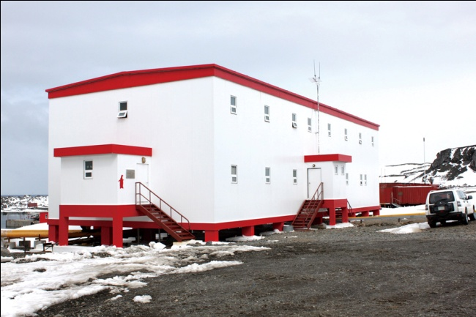
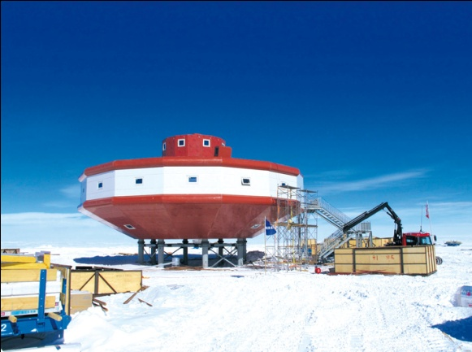
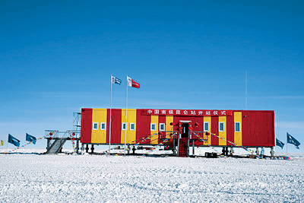
Polar Scientific Expedition

Slide 15
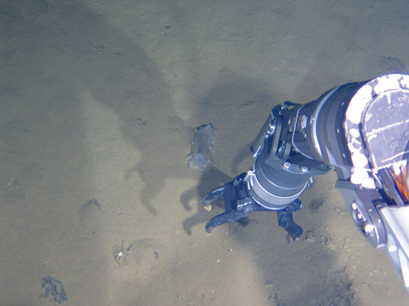
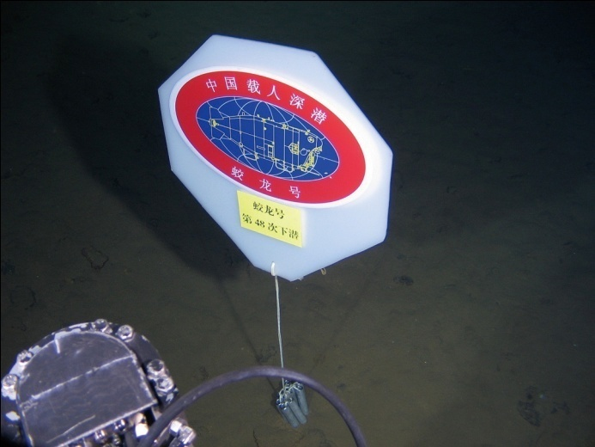
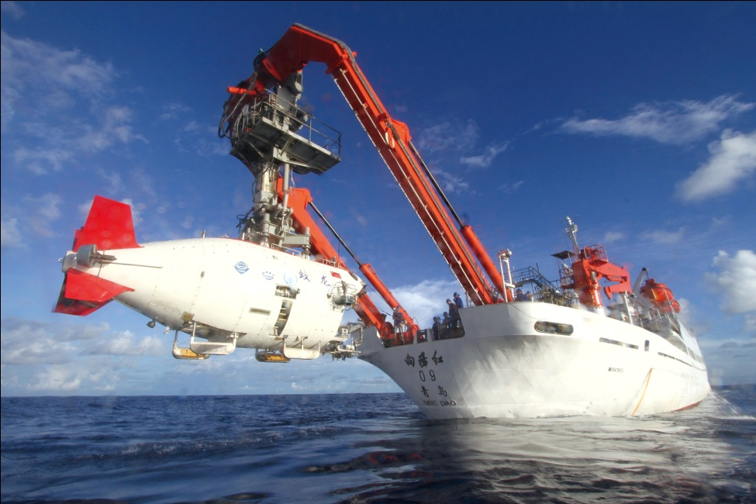
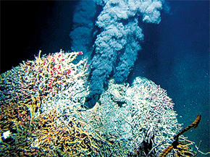
JIAOLONG SUBMERSIBLE

Slide 16
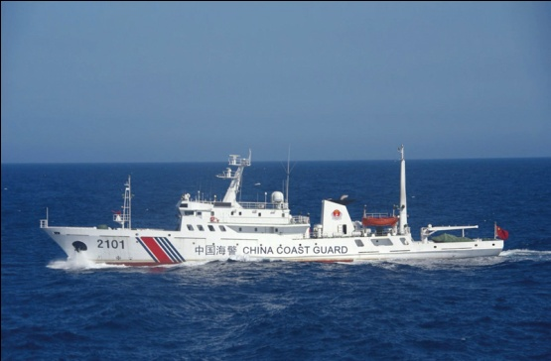
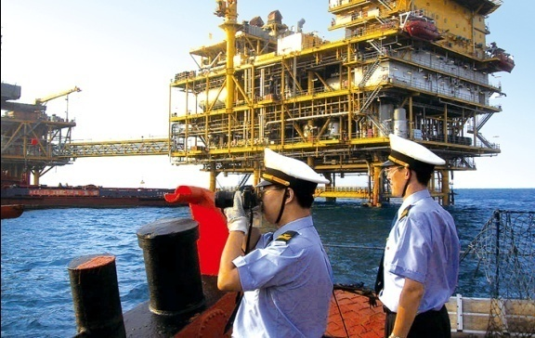
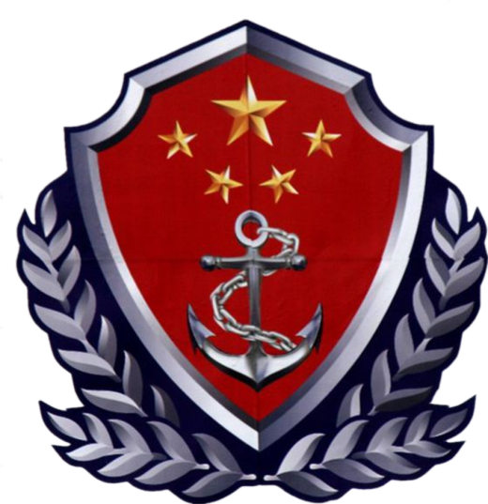
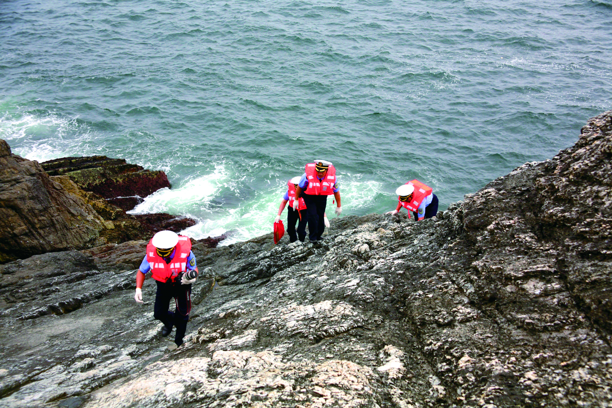
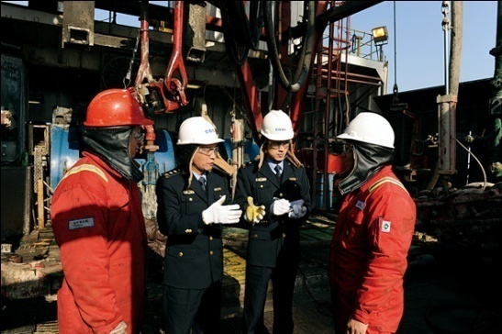
Responsibilities
Ocean Administrative Law Enforcement
Conduct maritime law enforcement in the sea areas under China’s jurisdiction
National maritime safety and security, Fishery, sea area use and management, island affairs, ocean mineral resource, sea bed cable and pipeline laying, ocean survey, and inspect on foreign related marine scientific research activities
investigation and prosecution on marine environment pollution accident
JURISDICTION SAFEGUARD PRESECUTION
Notes:
2.To be responsible for the drafting and formulation of the regime and measures on safeguarding maritime rights and interests, to develop norms and procedures for law enforcement; to conduct maritime law enforcement in the sea areas under China’s jurisdiction; to carry out maritime boundary patrol, to prevent and crack down on criminal activities such as smuggling, illegal immigration, and drug trafficking, to safeguard national maritime safety and security, and the maintaining of public order; to guard against the security of the important targets at the sea, to cope with the occurrence of maritime emergencies; to conduct fishery law enforcement and inspection in the area outward of the prohibited fishing zone for motor trawlers, and specifically-designated fishing grounds , and to investigate and handle with disbutes over the fishing activities; to conduct law enforcement and inspection and on sea area use and management, island protection, development and utilization of non-inhabitants islands, ocean mineral resource exploration and exploitation, sea bed cable and pipeline laying, ocean survey, and to make inspection on foreign related marine scientific research activities; to guide and coordinate with local government on maritime law enforcement activities; to participate in maritime search and rescue and emergency response, to lead or participate in the investigation and prosecution on fishing production accidents in terms of safety in accordance with laws, and to conduct investigation and prosecution on marine environment pollution accident in line with the authority entrusted by laws and regulations.

Slide 17
FURTHER MORE
The State Oceanic Administration
As a government agency, SOA also undertake the routine work of National ocean Committee, to carry out other relevant work required by the State Council, National Ocean Committee and the Ministry of Land Resources
Notes:
10. to undertake the routine work of National ocean Committee, to carry out other relevant work required by the State Council, National Ocean Committee and the Ministry of Land Resources.

Slide 18
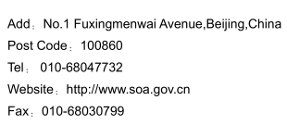
THANK YOU
FOR YOUR ATTENTION!

