Slide 1

Access to data from MSFD reporting
Trine Christiansen
European Environment Agency

Slide 2
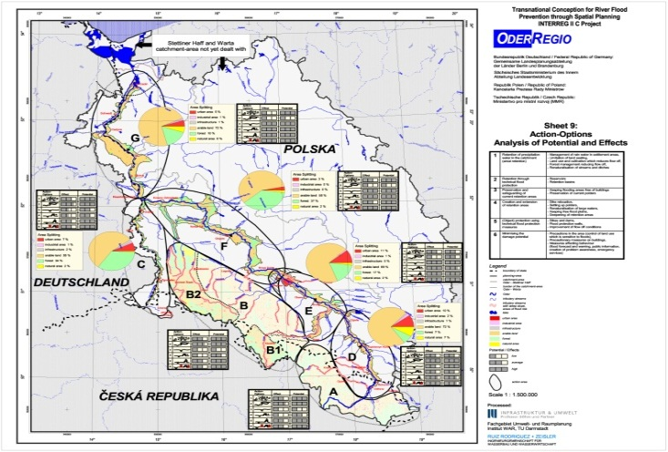
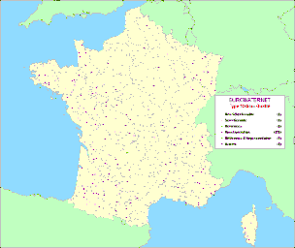
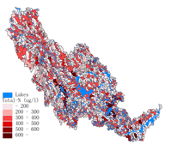
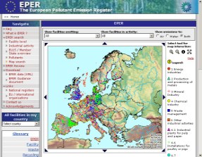
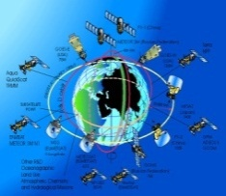


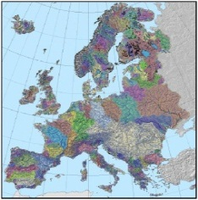
The vision for information systems at EEA
EEA
information services
Research projects
National
Data
Centres
Sub-national
Data
Centres
INSPIRE
User
MSFD and
WFD data
GMES
International
Conventions
Data from
other
Directives
Geo-ref.
Notes:
For example, as the Marine Strategy Framework Directive, develops, more and more data on the marine environment will be made available to the EEA and this will happen through WISE-Marine. Wise Marine will be based on SEIS principles which are:
SEIS Principles
information should be managed as close as possible to its source
information is provided once and shared with others for many purposes
data and information should be readily accessible to end-users to enable them to access it timely
information should be made available to the public after due consideration of the appropriate level of aggregation, given possible confidentiality constraints, and at national level in the national language(s)
WISE-Marine under development as part of MSFD implementation. Preparatory work lead by the EEA and DG ENV over 2007-12
Partnership of a wide range of data providers at different level, keeping data as close as possible to its source, to ensure quality and maintenance, e.g. FP projects
Links to data sources include the Integrated Maritime Policy’s EMODNET and the Sea bottom mapping project (highlighted with fly-in)
WISE-Marine should allow access to the data and information but it mainly aims at providing an ‘interpretation’ of this information such as Indicators and assessments

Slide 3
Ecosystem based approach
UN regular process for marine assessments
Coastal areas
ICZM
EU Integrated Maritime Policy, incl. CFP and MSP
Marine Strategy Framework Directive for the Protection
and Conservation of the
Marine Environment
Marine Protected Areas
(e.g. Natura2000)
Water Framework Directive
Notes:
Now (beyond the WFD – pioneer!) there is stronger promotion of the ecosystem-based approach to the management of human activities in the EU’s marine environment:
Marine Strategy Framework Directive (entry into force June 2008)
Integrated Maritime Policy driving also the Common Fisheries Policy and all other sectoral actions (endorsement of ‘Blue book’ by European Council 14 December 2007), the MSFD is its ‘environmental pillar’
Marine Strategy Framework Directive (MSFD) sets 'boundary conditions' (sustainability) for maritime activities – including fisheries - in Europe, which will need to work towards achieving 'good environmental status' (GES) in marine waters by 2020. GES = the ultimate aim of the Directive).
The MSFD also:
Places the Habitats and Birds directives into a GES context => Clearly indicates that marine protected areas (MPAs) within Natura2000 are a TOOL to achieve GES
Reinforces marine biodiversity international commitments/agreements, such as the CBDs’ halting of biodiversity loss’ (2010) and MPA network establishment (2012)

Slide 4
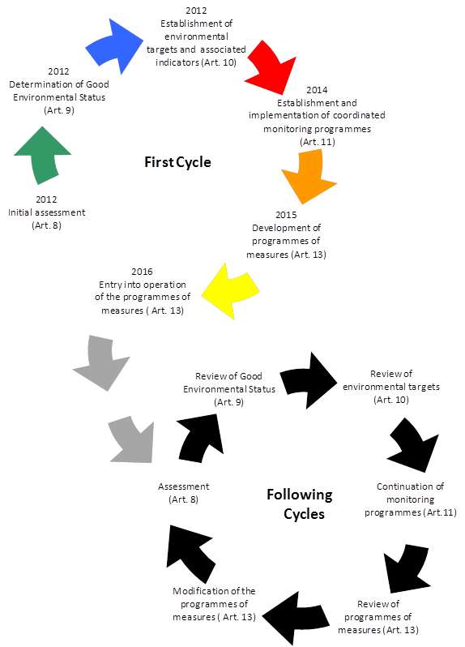
MSFD: 6 year cycles of assessments
Some upcoming milestones
2014: review of initial assessments
2014: Ecosystem assessment
2015: next EEA SoER
2019/2020 EC and EEA MSFD assessment obligation

Slide 5
Developing information & knowledge
DATA
INDICATORS
ASSESSMENTS
ENVIRONMENTAL INFORMATION SERVICES for
Decision-makers / The public / NGO’s / Researchers
Notes:
The 3 aspects (called ‘tools’ for EEA work on the previous slide):
Indicators
Assessments (both methods and outputs)
Information systems
are highlighted here as there are ‘entry points’ for addressing deep-sea issues in all of them that could be strengthened (with help from HERMES). This will be illustrated in detail as we go along

Slide 6
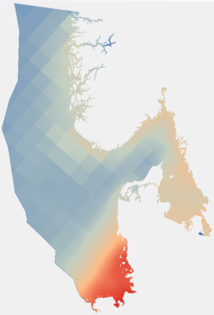
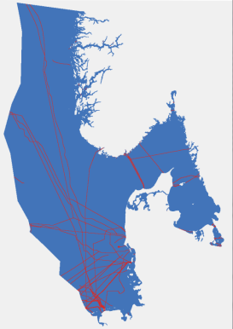
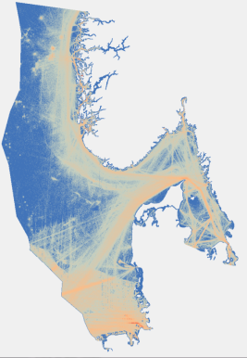
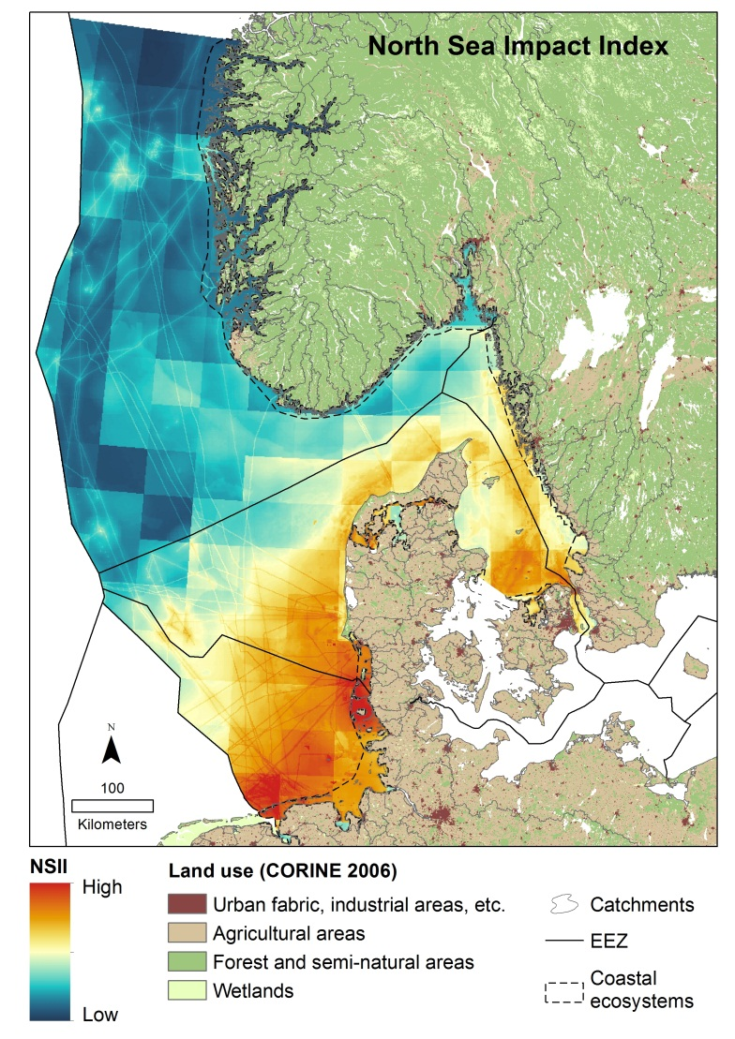

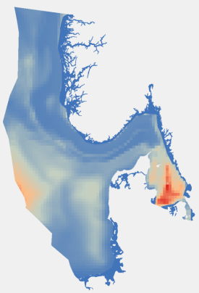
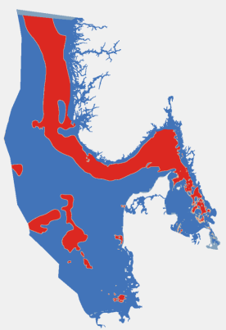
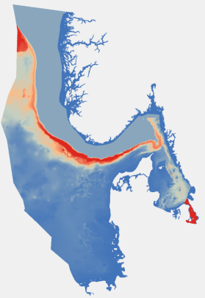
General Approach e.g. Halpern et al 2008
Human uses and land-based
pollution of the sea (33 data sets)
Cumulative (additive) human impacts
Pressures?
Distances?
Sensitivity?
Nutrients
Cables
Shipping
Expert judgment (53)
Harbour porpoise (probability of presence)
Aphotic mud (presence/absence)
Cod (norma-lized biomass)
Ecosystem components (28 data sets)
Courtesy: HARMONY project

Slide 7



Objectives for WISE-Marine
To develop European data sets relevant for GES indicators and monitoring programmes
  Prioritized;
  Agreed content and format according to the needs of MSFD for use in assessments and to relevant INSPIRE standards;
  Ready for assembly.
To have established effective and efficient data management mechanisms at national and EU levels which allow ready access to the data;
To have established public access to the data via web portals, preferably via a single portal.

Slide 8
First and foremost, the objective of WISE-Marine should
be to develop data layers/products/indicators at the
EU scale, to eventually allow quantitative assessments to
be performed.
Not sure which legal arguments to use for this, but the
Directive is indirectly quantitative by making reference
to both indicators and underlying data.
A quantitative approach will help fulfill multiple objectives
in the long term: MSFD, BD strategy, UN-regular process,
Regional sea assessments, and probably others

Slide 9
Wise-Marine Governance
WISE-Marine steering group Commission and EEA
(infrastructure providers)
WG-DIKE
MS
(data providers)
WG-GES
MS
(assessment providers)
WISE-Marine
Reportnet (EEA) Initial assessment reports
Reporting sheet reports
Underlying data reports (metadata links)
EMODnet: Infrastructure INSPIRE compliant Data and metadata standards
Technology
Data access, data assembly and visualisation
Dissimination of assessments at EU-level: MSFD specific indicators, MSFD assessments (art 8 and 20.3.b)
Data users: MS - RSC- EEA – EC – research - public
and uses outside of MSFD context

Slide 10
In the long term: an operational structure
Wise Marine and EMODnet need a working structure that can consider normal data management issues:
  Quality assurance and feedback mechanisms to data providers on e.g. meta data and data;
  Features and functions needed by users of the system;
  Development of specific data products: specific analyses, data layers for specific purposes.
MS and researchers are important users because both can contribute with data and needs.

Slide 11
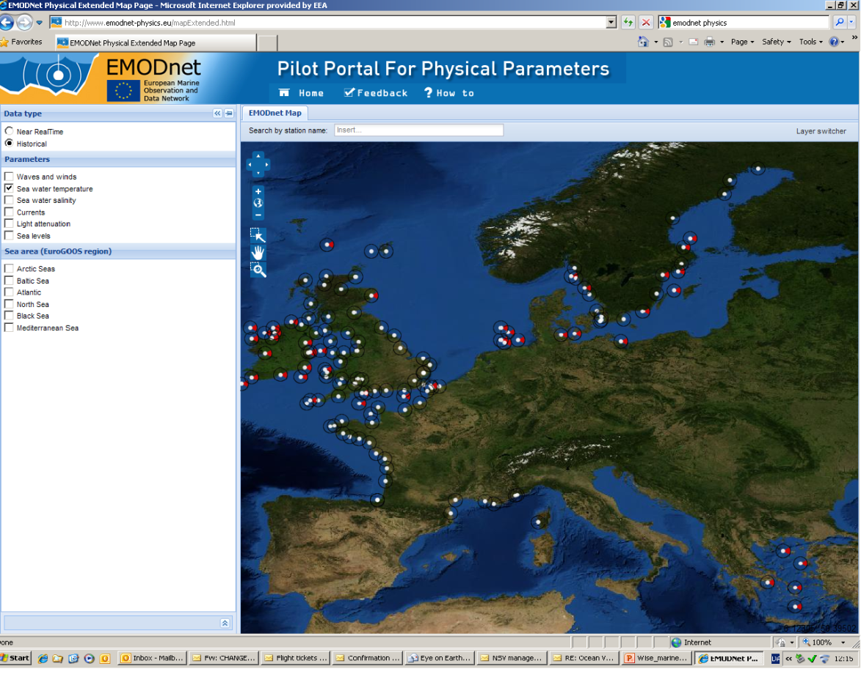
An experience is that it is more productive to develop a
data flow from a specific need, than to ask for ‘all data’ and
see if they happen to fit your need.
WG-DIKE
MS
(data providers)
WG-GES
MS
(indicator providers)

Slide 12
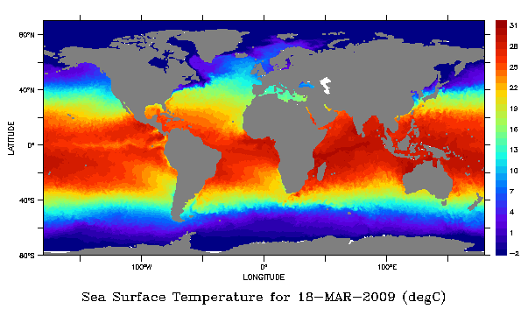
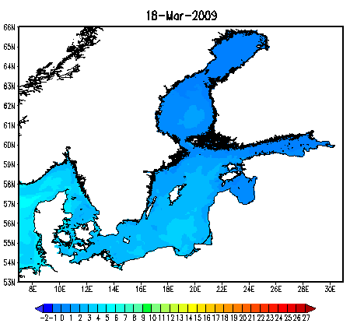
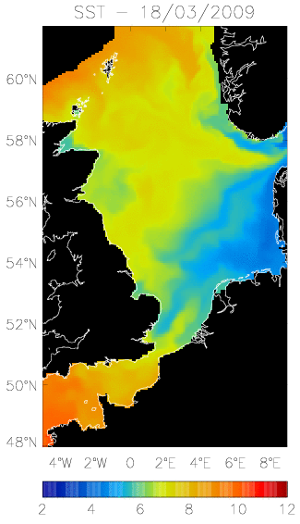
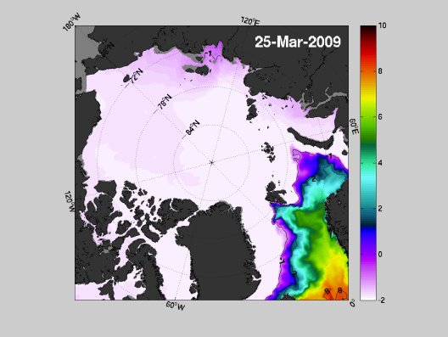
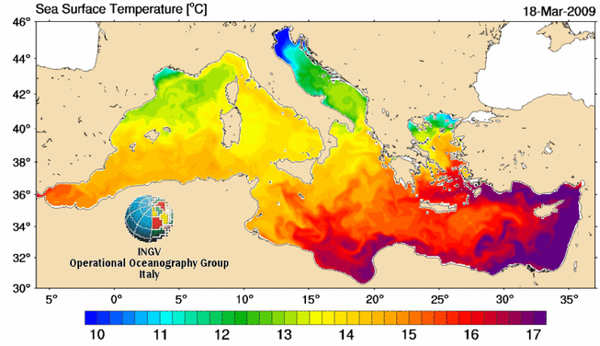
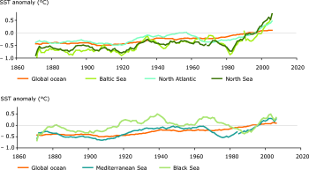
Data input: sea surface temperature
Analysis:
Assessment:
Over the past 25 years the rate of increase in sea surface temperature in all European seas has been about 10 times faster than the average rate of increase during the past century. In five European seas the warming occurs even more rapidly. In the North and Baltic Seas temperature rose five to six times faster than the global average over the past 25 years, and three times faster in the Black and Mediterranean Seas.

Slide 13
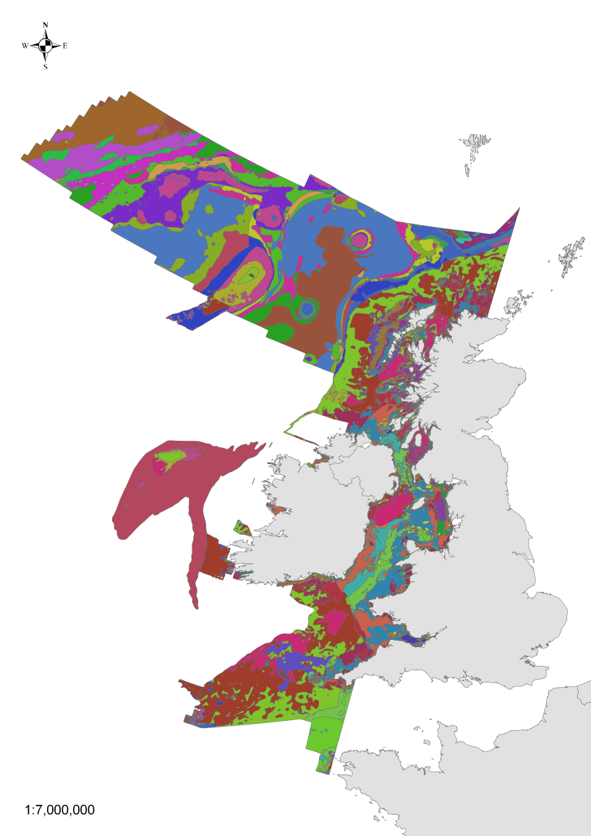
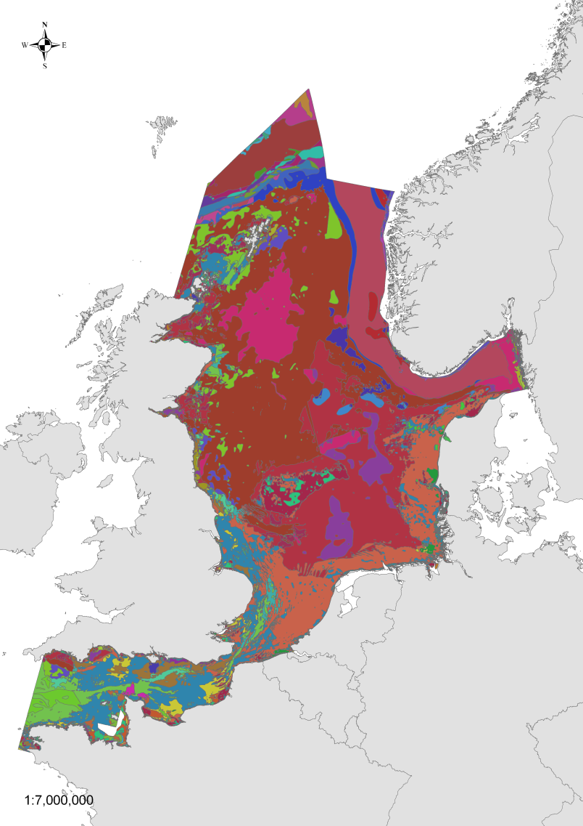
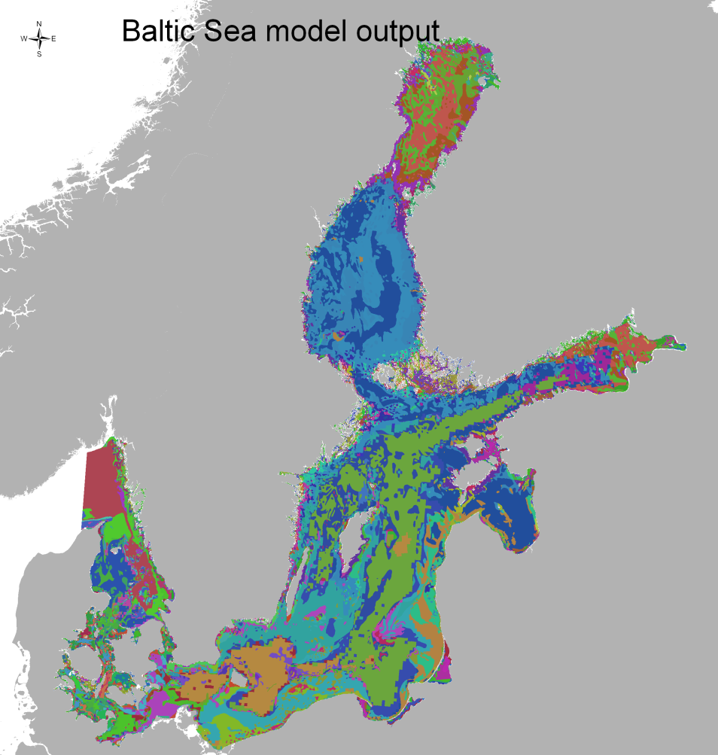
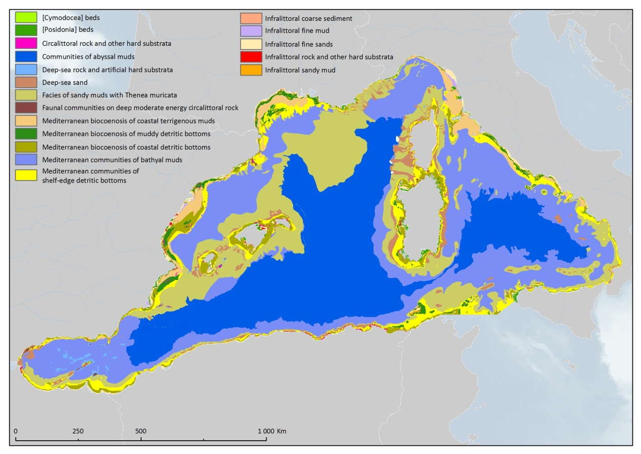
Predominant habitat maps
Courtesy: EUSEAMAP

Slide 14
Bringing WISE-Marine and EMODnet together
WISE-Marine/MSFD process
Use of EMODnet for MSFD purposes should be operational, where possible, from 2012 onwards and fully support MSFD reporting by 2018 *
‘Making data available’
EMODNET (goal for pilot):
Develop, test, operate and maintain a portal for data access;
*WG-DIKE doc. DIKE 5/2012/09.a

Slide 15
EMODnet

Slide 16
But how far away is 2018?
EMODNET:
Is having success in: formats, data discovery and making data available;
Is finding it harder to develop meaningful overall datasets and data products – they will typically need interactions with users.
An inverted process?
Outside EMODnet, most used datasets/products arise from a specific need, and the need drives the request for data.

Slide 17
Practical issues
data through EMODnet
physical and chemical portals
The ‘dataset’ entity varies in definition between the EMODNET lots
A dataset can consist of one depth profile (EMD Chem.), therefore 1000’s of dataset files would be required to gather enough information
A dataset can consist of an entire data collection of 1000’s of measurements (EMD Bio)
Large data extractions are not practical:
shopping basket issues
timings
permissions
definition of a dataset file

Slide 18
MSFD – linking data access to future processes
Oct.
Jan.
Oct.
Oct.
Jan.
2012 | 2013 | 2014 | 2015 | 2016 | 2017 | 2018 | 2019
Data collected to support future assessments for specified indicators
IA, GES & targets
Monitoring programmes
Updated assessment, GES & targets
Indicators (Art 9/10) defined for future assessments
Methods defined for data collection, sample design & assessment
Assessments using GES indicators and data from monitoring
Focus on priority data for longer perspective:
Consistent format/content
Data can be aggregated at regional/EU level
- INSPIRE compliant
- access via distributed networks (e.g. EMODnet)
- regular updating
Data used in Initial Assessment:
-Some using ‘future’ indicators
-Some using ‘old’ methods
Access to data
Access to data

Slide 19
The four phases
2012-2013: Phase 1 - Quick wins;
2012-2014: Phase 2 -Indicators and monitoring;
2014-2016: Phase 3 - Developing more data sets and indicators, and
2016-2018: Phase 4 - Preparing for reporting in 2018.

Slide 20
Phase 1- quick wins
an overview to allow prioritisation and identification of data used in initial assessments, based on reporting of metadata;
development of a mechanism for reporting of nutrients, chlorophyll and dissolved oxygen into EMODnet;
support to future EMODnet projects on human activities and chemicals;
streamlining of reporting requirements for habitats and species, and
developing experience for reporting assessment outcomes in a grid-based system.

Slide 21

Thanks for your attention
Trine.christiansen@eea.europa.eu

