Slide 1
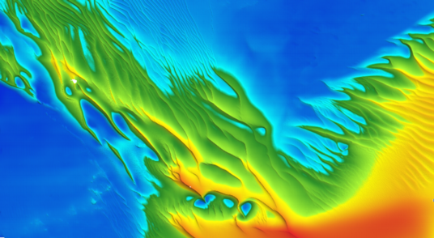
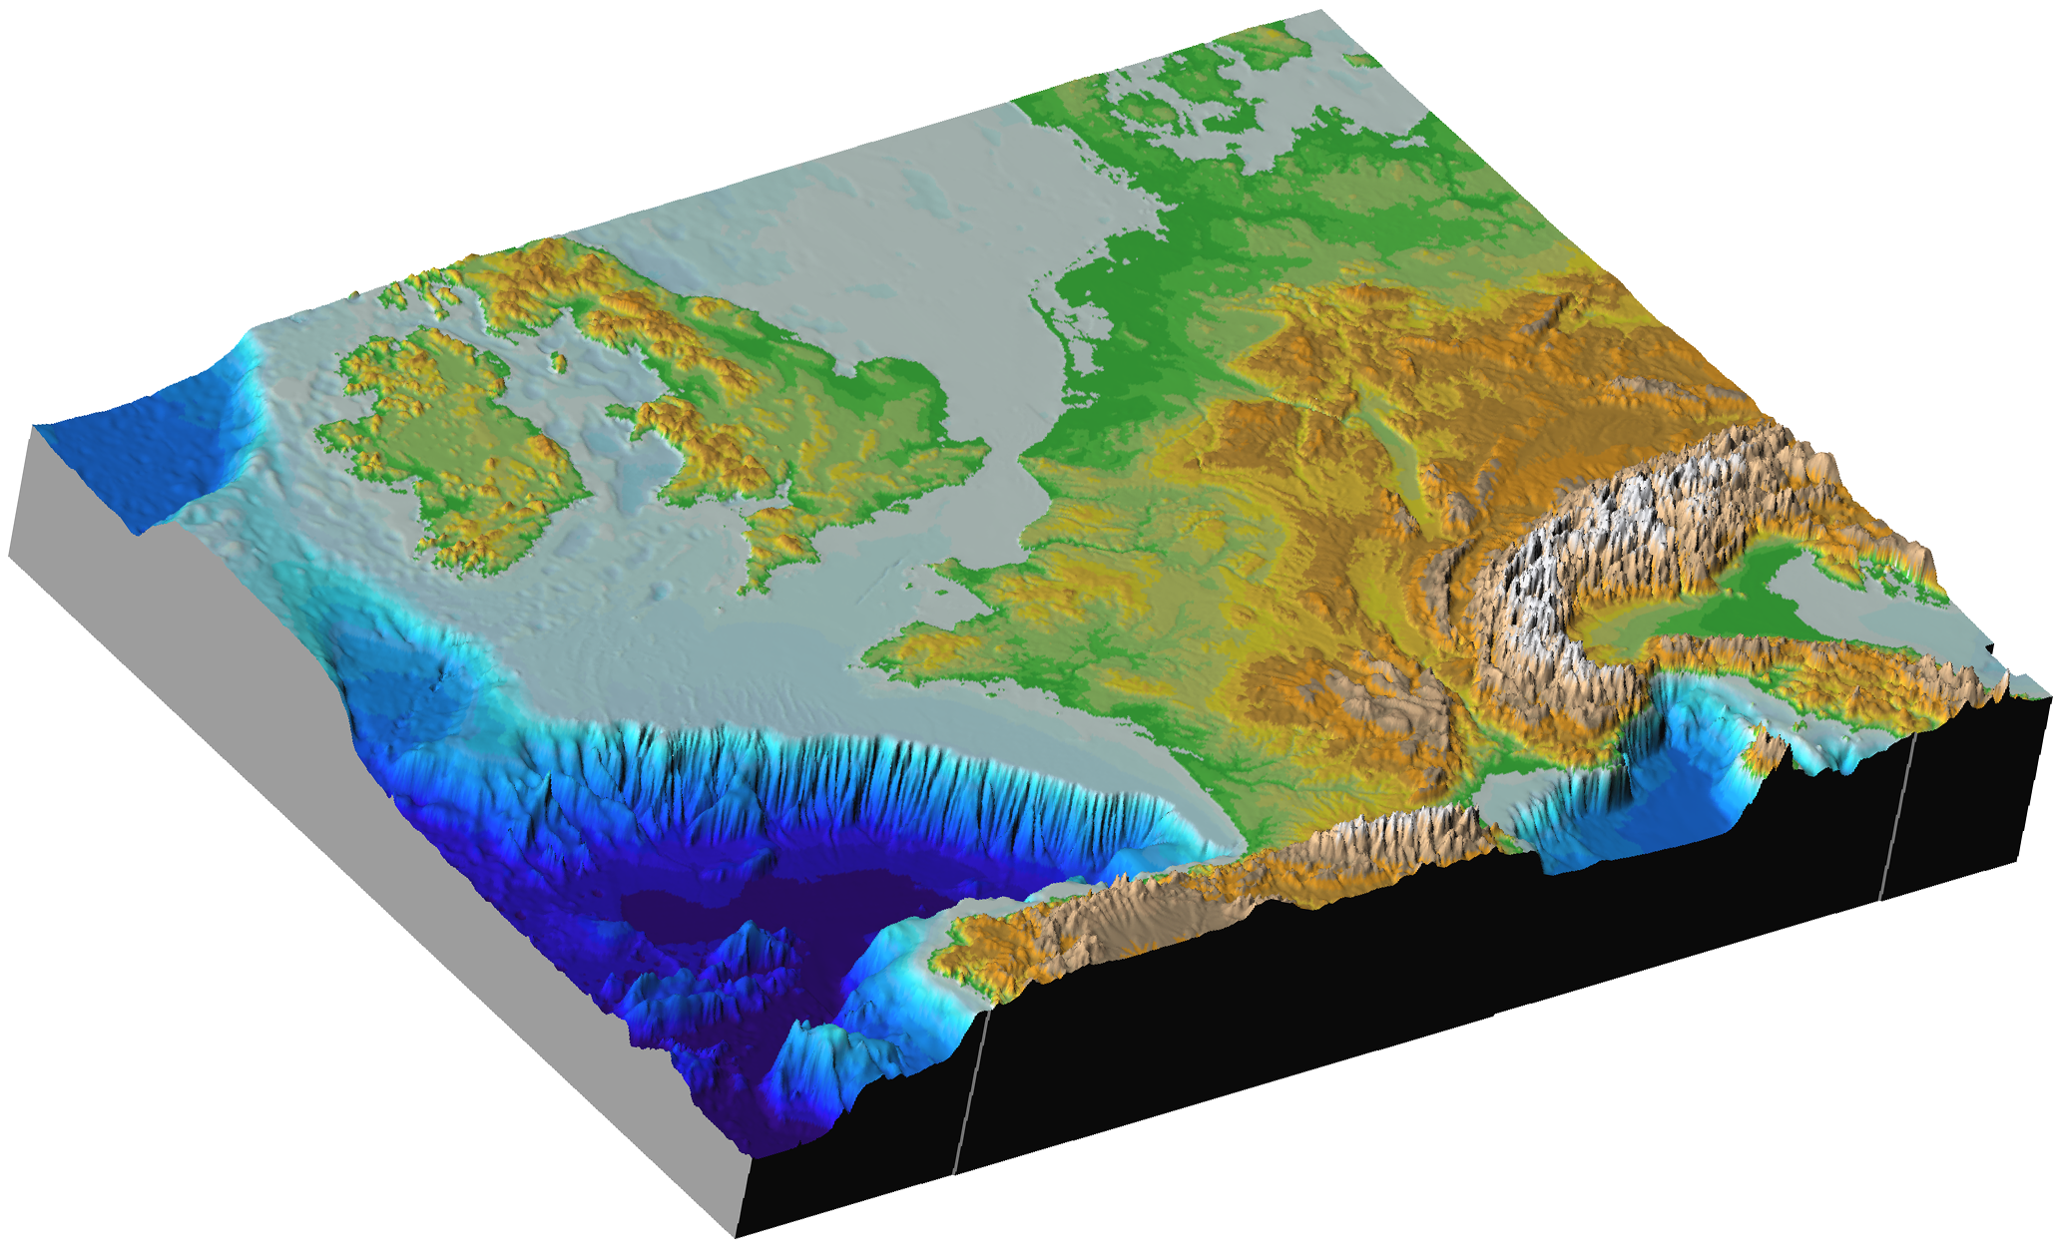
Mapping of European sea-beds
What for ? With what means ?
Why is sea-bed mapping important?
  Why do we need accurate maps ?
  Where should the Directives be applied ?
  For who ?
What are the tools and products?
Assessment of effort needed
and where are the gaps ?
A European project ?
R/V Atalante - EM710
Jean-François Bourillet
marine geologist
Notes:
My talk will concern the importance of sea-bed mapping, the gaps in information, the necessary effort to fill the gaps and the input from the EC maritime policy.

Slide 2
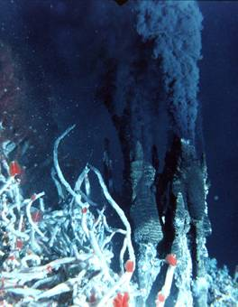
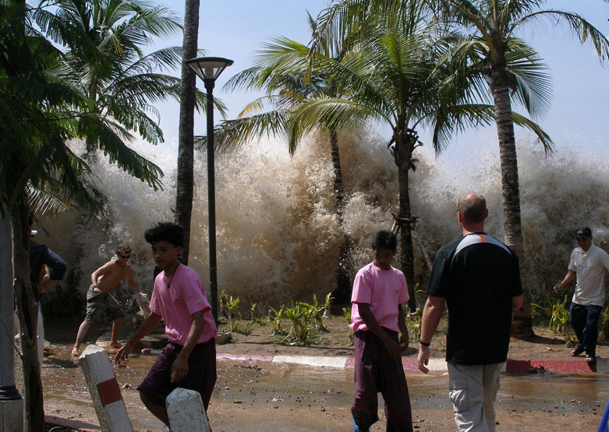
Why is sea-bed mapping important ?
To improve the scientific knowledge
  Records of past climate changes, sea-level rise, geohazard, …
  Natural resources : sand&gravel, minerals, oil, fisheries, …
  Basic data : habitat, biodiversity, renewable energy….
To provide references to states for ocean management
  Safety and Defense
  Natural resources
  Crisis prevention and management : tsunamis, landslides, oil spills …
To allow states to fulfill their international duties
  Legal continental shelf extension (UNCLOS) 2009
  Marine Protected Area 2012 (Rio, OSPAR, Barcelona & Helscom)
  European Directives : Bird & Fauna, WFD 2015, European Maritime Strategy 2021
  © Ifremer
Notes:
There are 3 main reasons for sea-bed mapping.
It is important to improve the scientific knowledge of numerous subjects : climat change,sea-level rise, geohazard processes, for natural resources but also to provide basic data for other studies. I will present you one case study.
Sea-bed mapping provides references to states for ocean management including Safety and Defense, natural resources and crisis prevention and management.
Sea-bed mapping is necessary to allow states to fulfill their international duties such as the extension of the continental shelf according to article 76 of the Law of the Sea, Marine Protected Areas according to the convention of Rio and others, European directives such as the Water Framework Directive for 2015 and European Maritime Strategy for 2021. As they have very close deadlines, it is urgent that both states and the EC react rapidly.

Slide 3
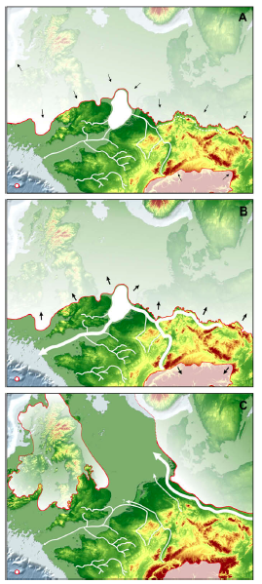
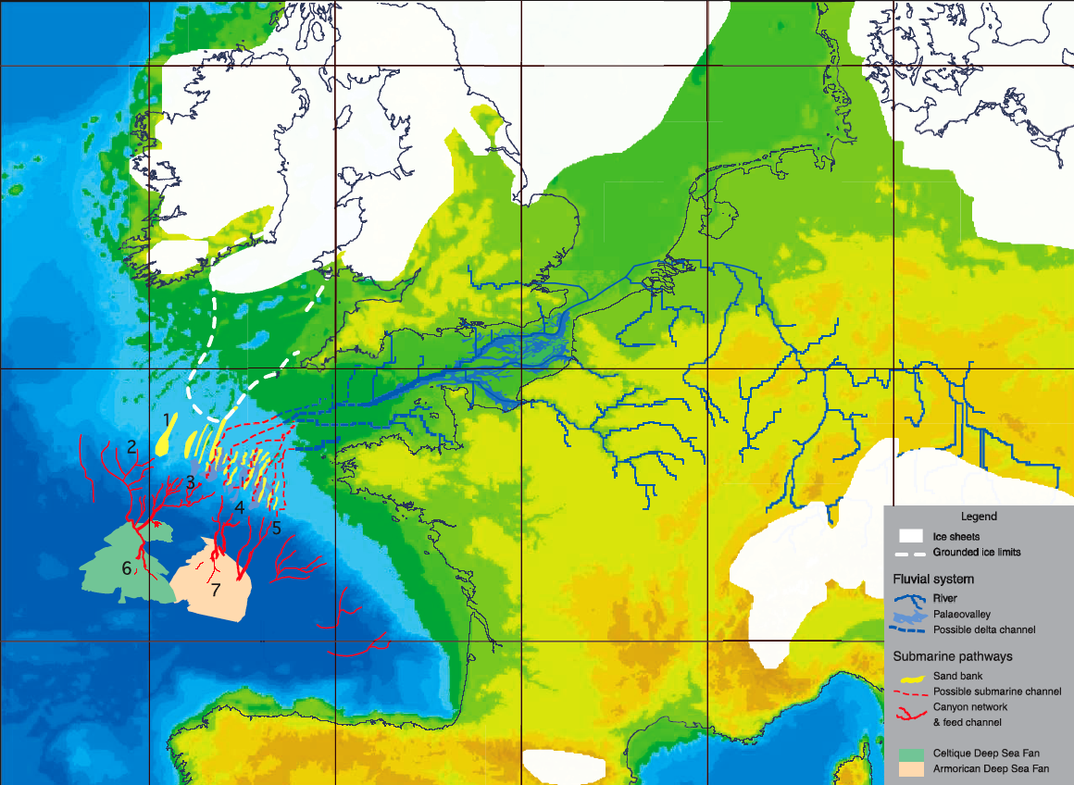
Records of past sea level and palaeoenvironment
175 - 160 ka
LGM 18 ka
MIS6 155 ka
150 - 130 ka
(Bourillet et al., 2003)
(Toucanne et al., 2009)

Slide 4
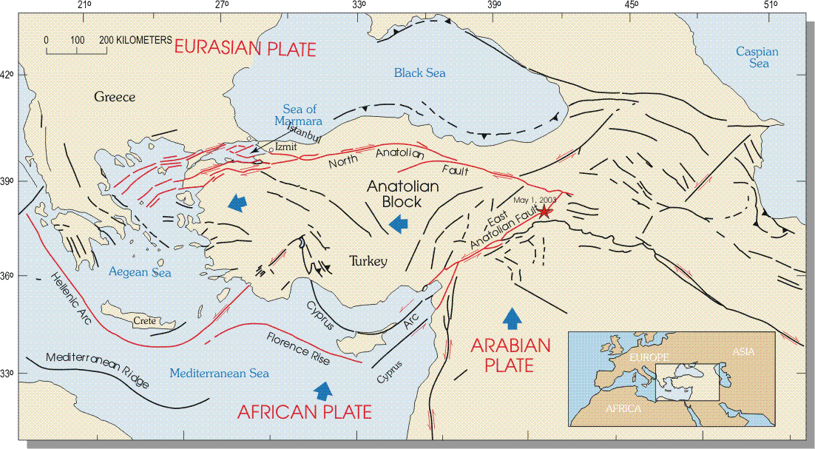
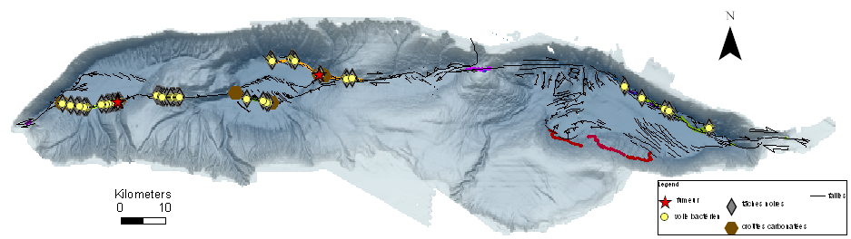
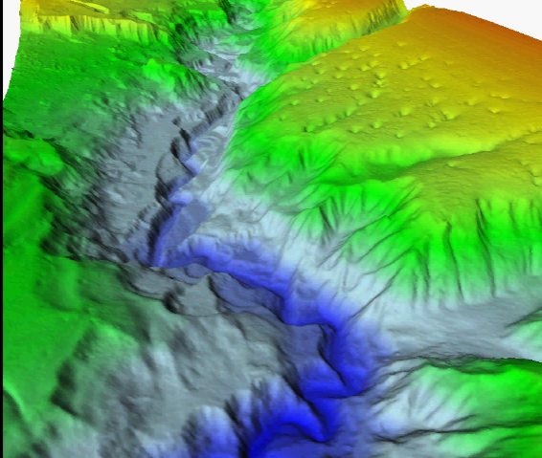
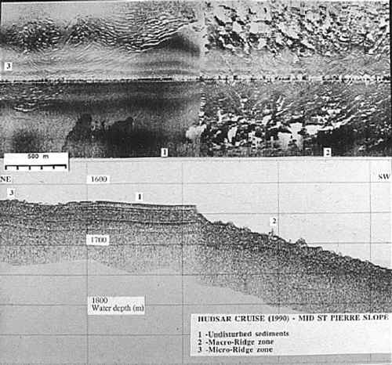
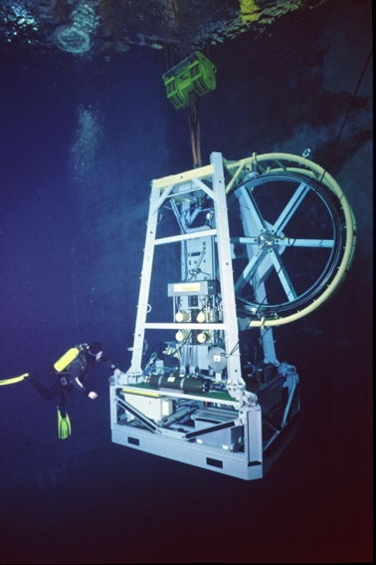
Geohazards
Seismicity, tsunami, sub-marine landslide
  Potential risk areas
  Characterisation
  Triggerring factors
  Forecast
  (Géli et al, 2002)
  © Ifremer
  (Bourillet et al, 2007)
  (Cochonat & Piper, 1995)

Slide 5
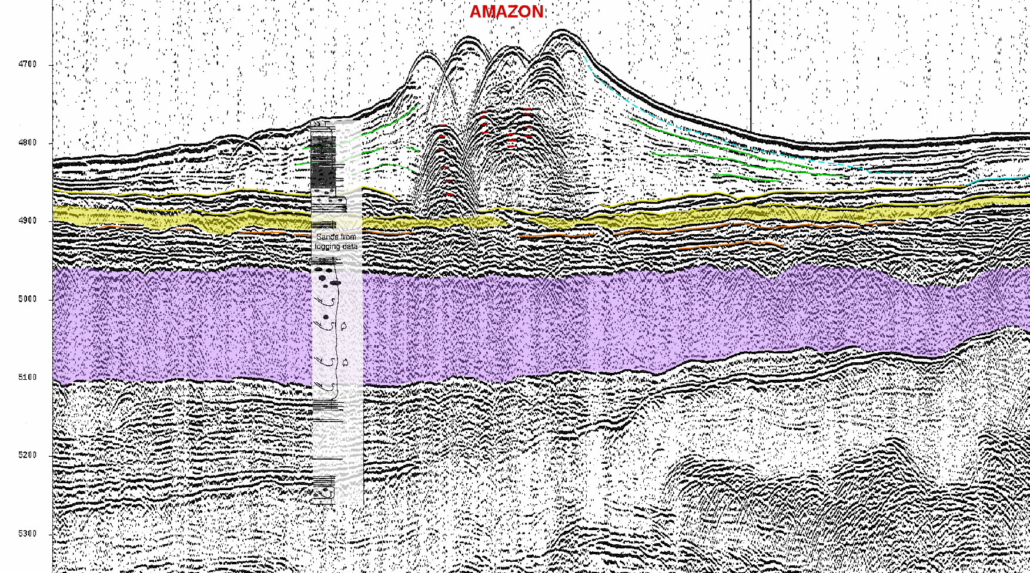
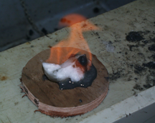
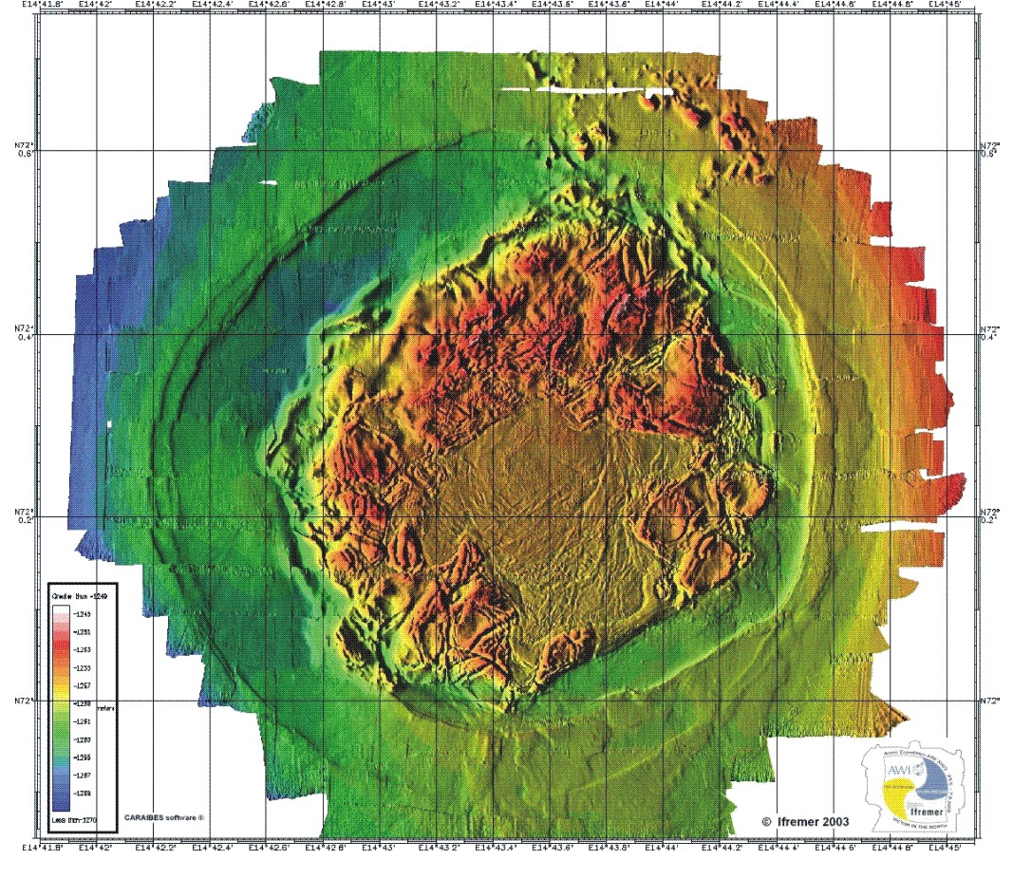
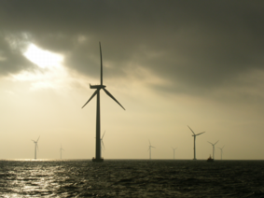
Applications to resources of energy
  Present analogues of deep oil traps (sand/mud ratio)
  Characterisation of fluid and hydrates
  Discovery of native H₂
  Site survey for renewable energy (windfarm, thermal energy, ….)

Slide 6
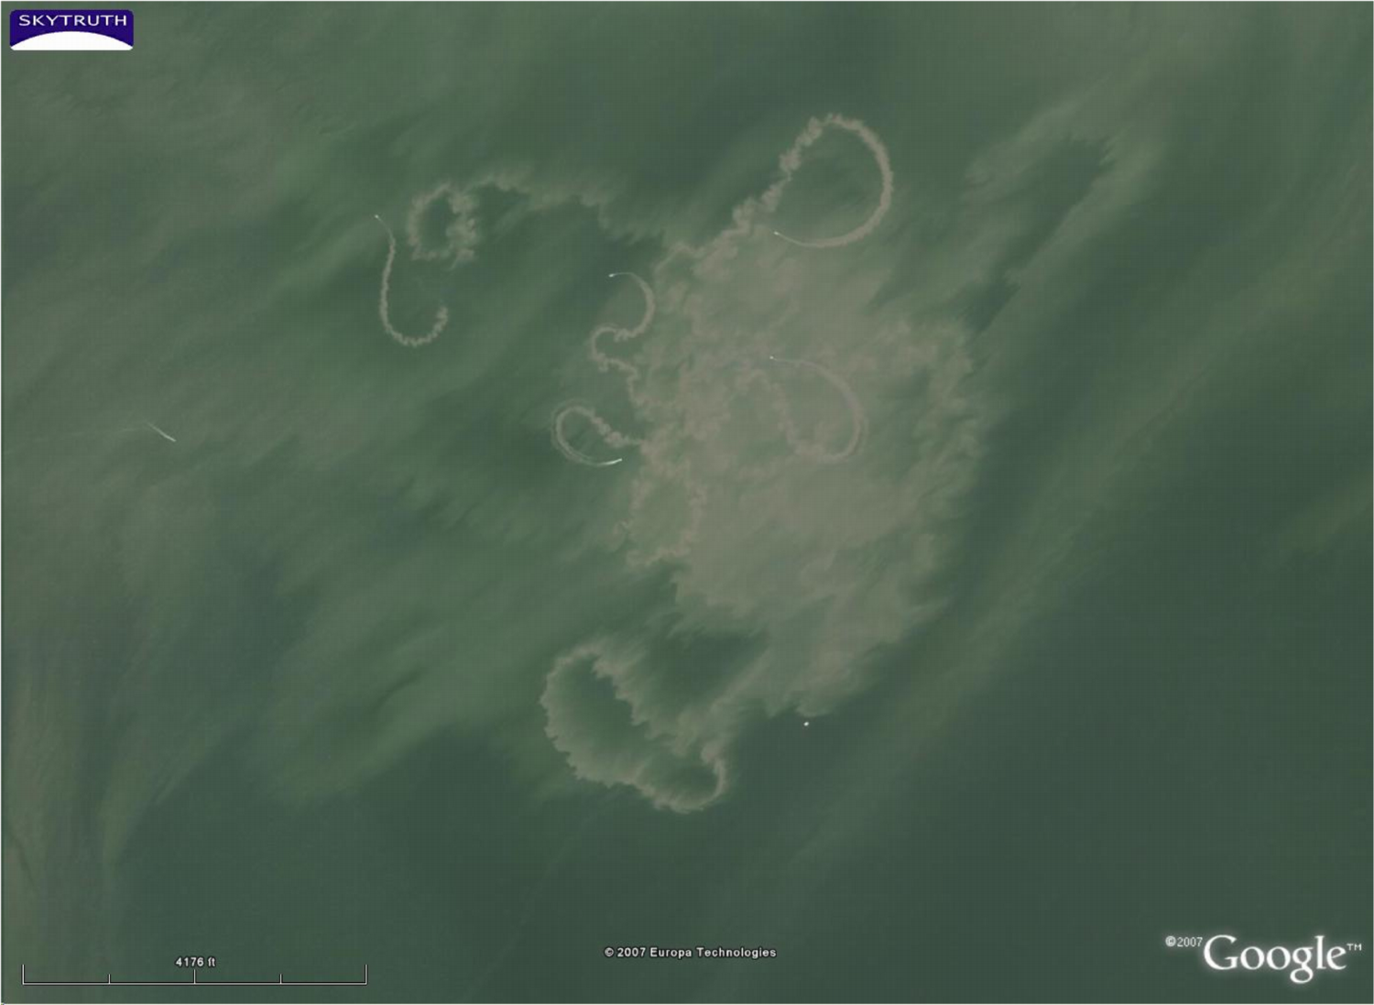
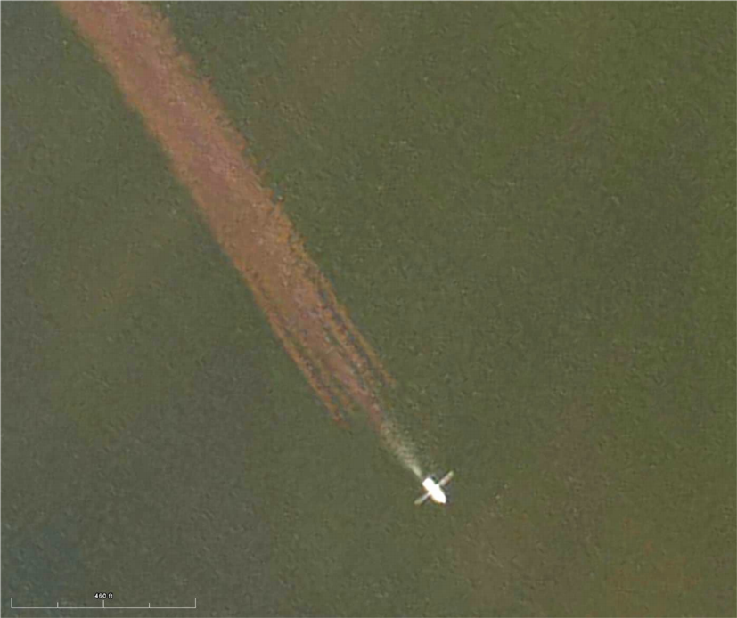
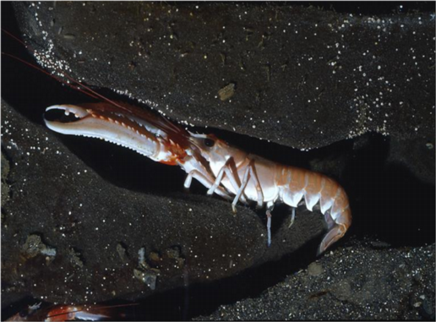
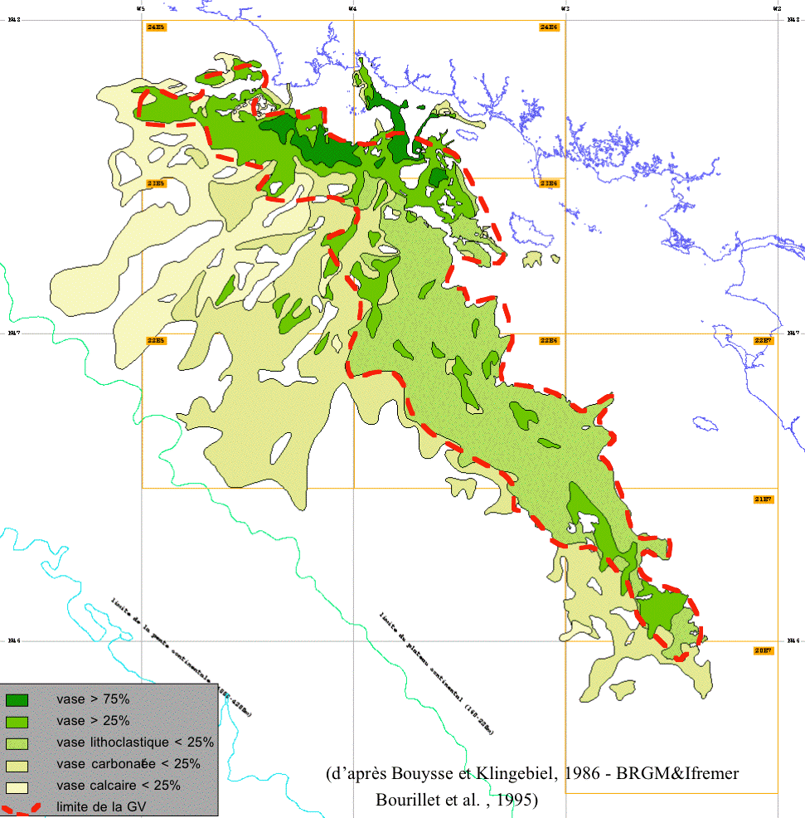
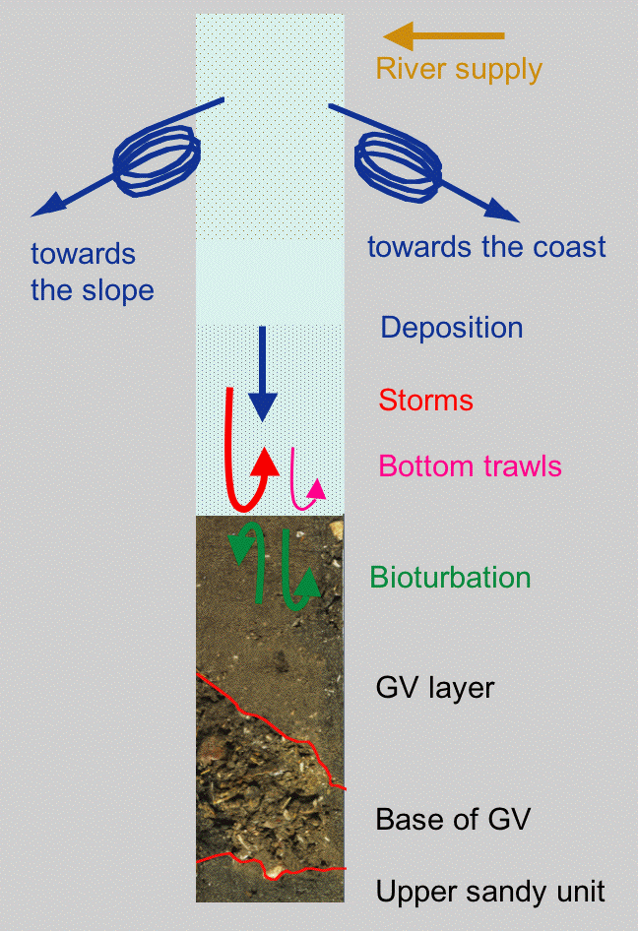
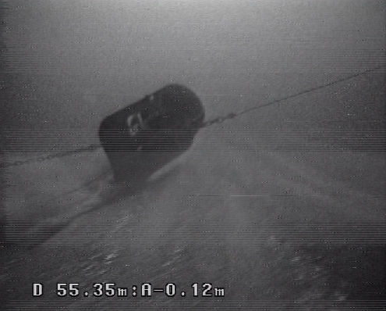
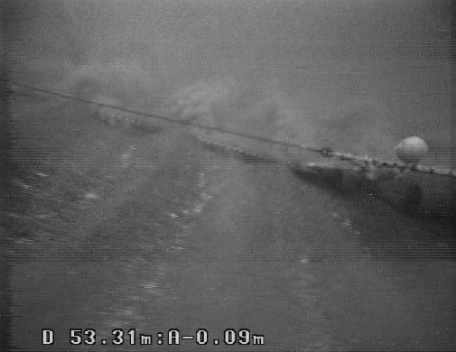
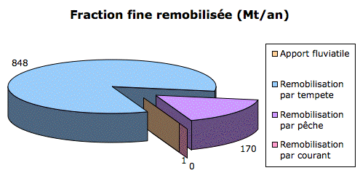
Why do we need accurate maps ? (1)
The Nephrops of “la Grande Vasière”
  Study of the sedimentary evolution over the past 30 years : the muddy fraction decreases
  Storm effects : steady
  Fishing effort : 1 million miles (2002)
  Resuspension : anthropogenic action from 20% to 50% of natural factor
© Océanopolis
(B. Vincent)
(B. Vincent)
(Leynaud & Bourillet., 2006)
Notes:
This image is not of worms and microorganisms. The white spots are aerial viewed fishing vessels and the plumes are sediment trails due to the action of gear on the sea-bed. They fish benthic fishes and prawns. The usual habitat is muddy sand. A study of the main fishing area off France “la grande Vasière” over the last 30 years has shown that muddy fraction decreases, meaning a change in the characteristics of the habitat and potential danger for the biomasse. The quantification of the resuspended sediment shows that the anthropogenic factor represents 20 to 50 % of the natural factor.
To understand the processes we have to know where the mud goes ?

Slide 7
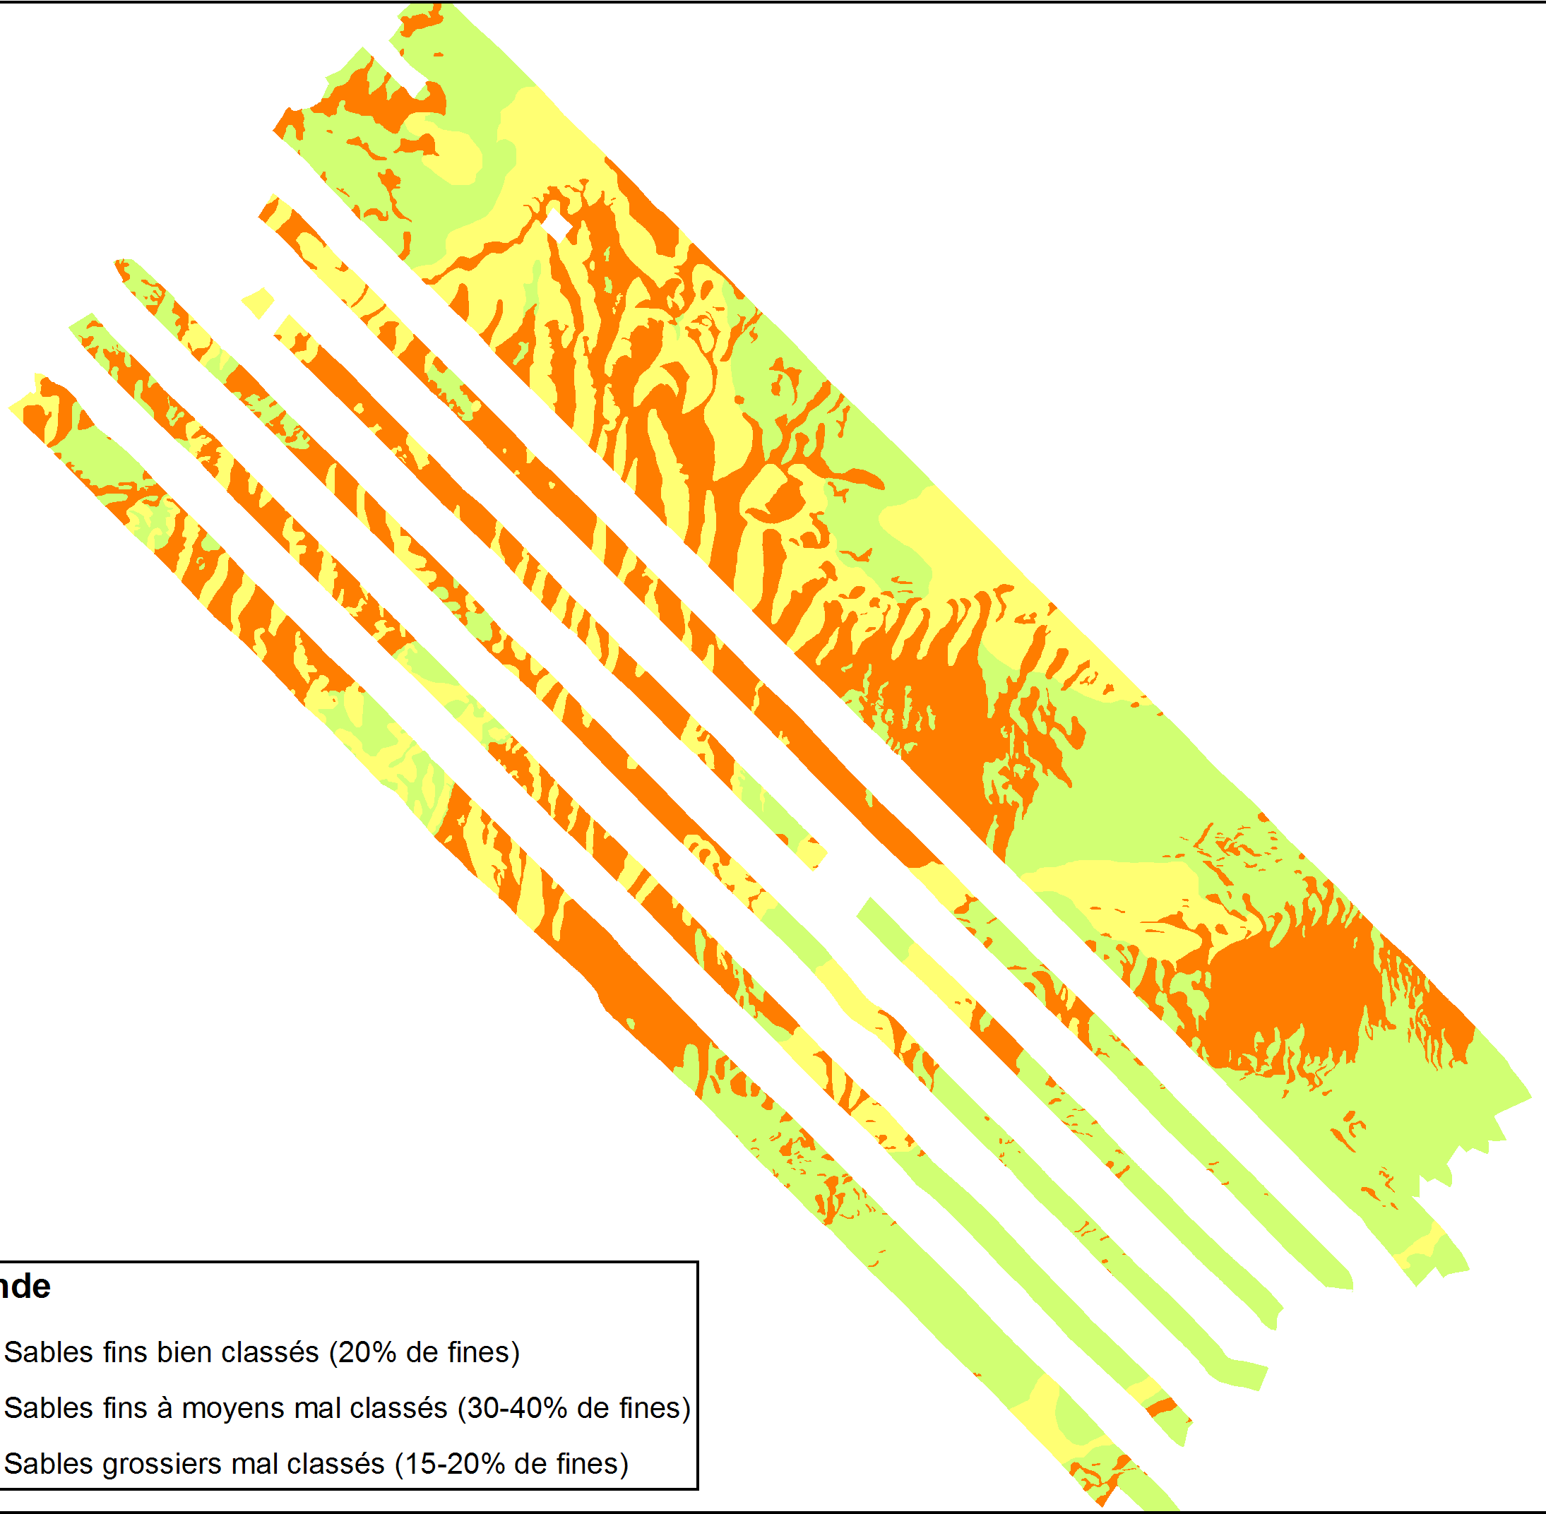
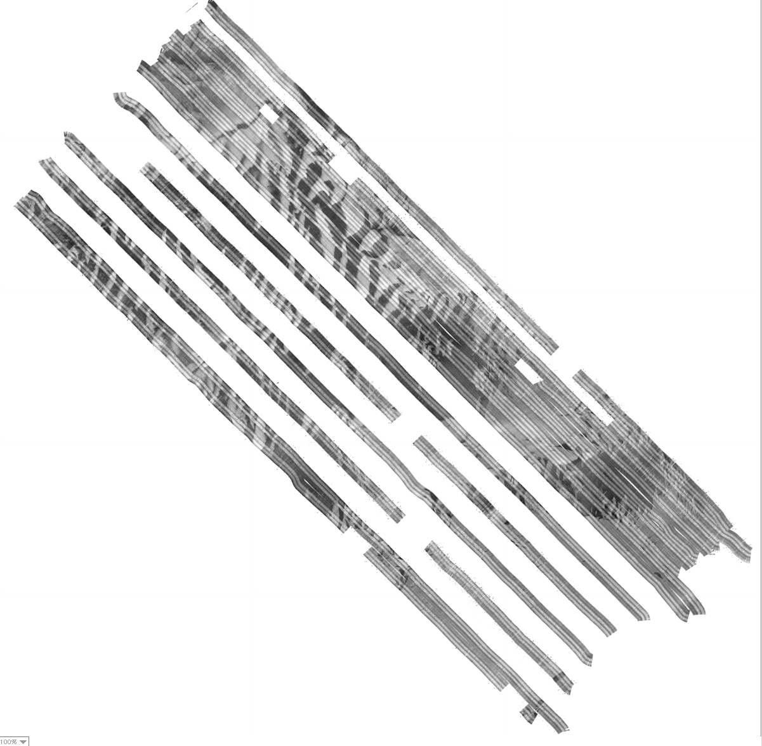
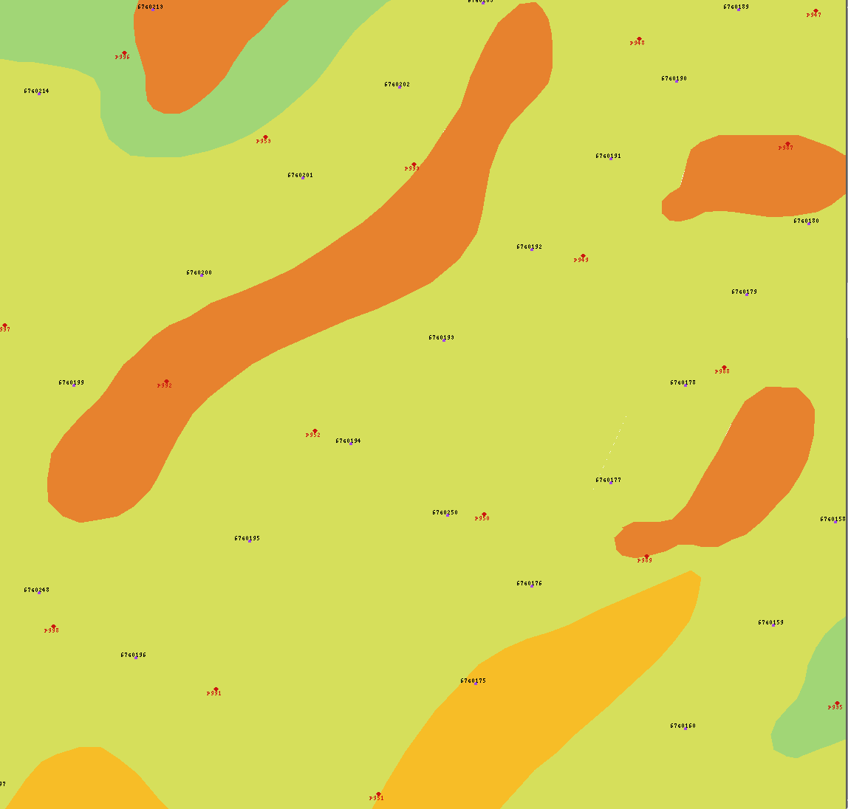
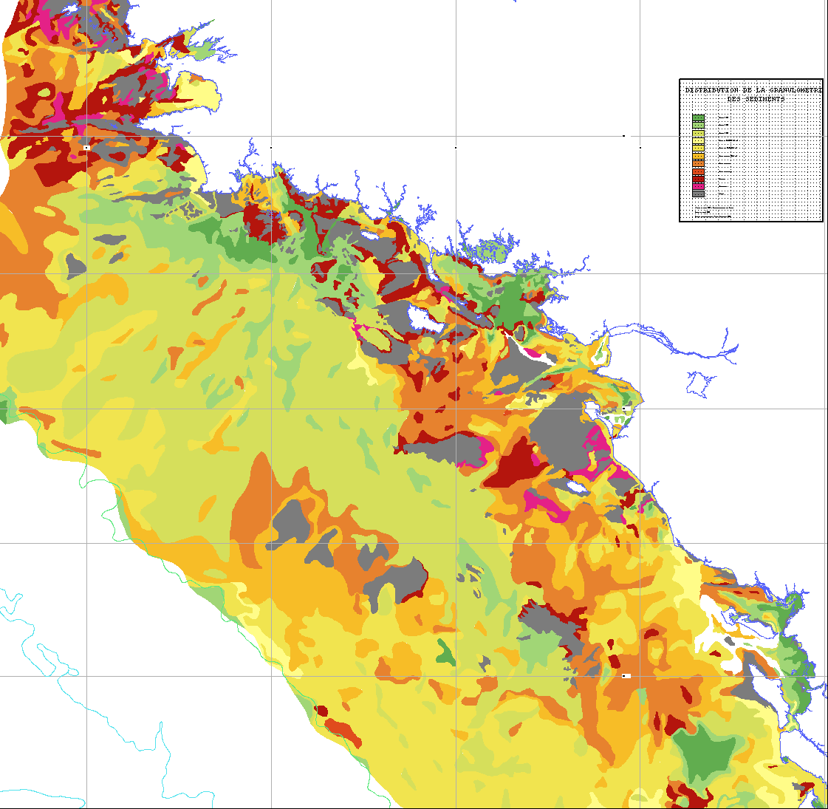
Why do we need accurate maps ? (2)
Is the mud eroded and where does the mud go ?
Mapping up to the 1990’s: Interpolation from samples
New mapping approach: from sectorial coverage to sea-bed nature
erosion
deposition
(Bouysse et al., 1986)
20 km
20 km
(Gautier et al., 2009)
Understanding of the processes
Fisheries management
Notes:
Currently, we haven’t the answer because there is a lack of accurate sea-bed maps.
Here is the sea-bed map of the area drawn in the 90’s : the geologist has interpolated limits from samples.
The new mapping approach with acoustic tools consists in determining the limits of homogeneous facies and then calibrating them thanks to samples. The spatial distribution of sediment looks quite different
The comparison with a subsequent survey should allow to determine if the habitat is in erosion or not.
So accurate maps help to better understand the biological or geological processes and also to better manage fisheries.

Slide 8
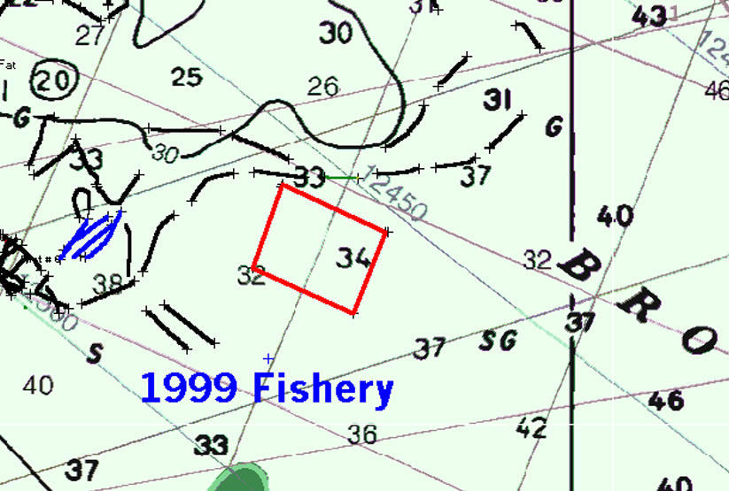
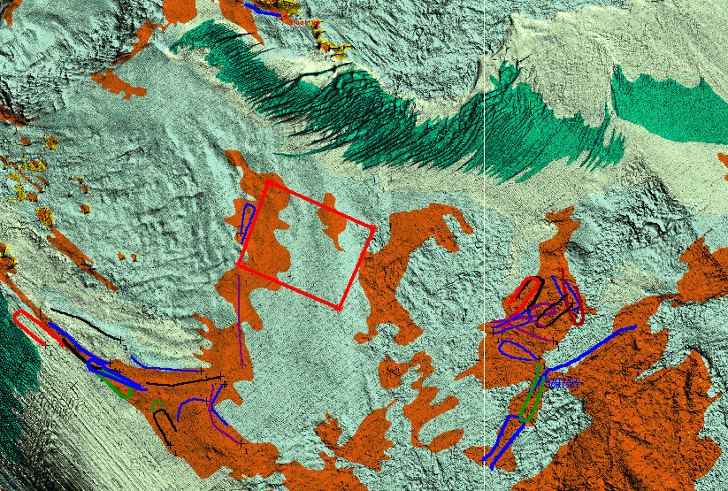
Why do we need accurate maps ? (3)
Benefits of Mapping: Scallop Fishery
1999:
Without
IMPACTS
Economic efficiencies: 30-40% gain
Environmental disturbances: 73% reduction by use of light equipment
2000:
With
Notes:
This is also illustrated by a Canadian study. an accurate map of the nature of the sea-bed allowed fishermen to use light gear and consequently to reduce by 75% environmental disturbance.

Slide 9
Marine spatial planning
Mariculture
Marine Recreation
Renewable Energy
Fishing
Submarine Cables
Dredging & Disposal
Conservation
Culture
Military Activities
Navigation & Ports
Coastal Defence
Oil &Gas
(Weaver, 2008)
Mapping at a very fine scale

Slide 10

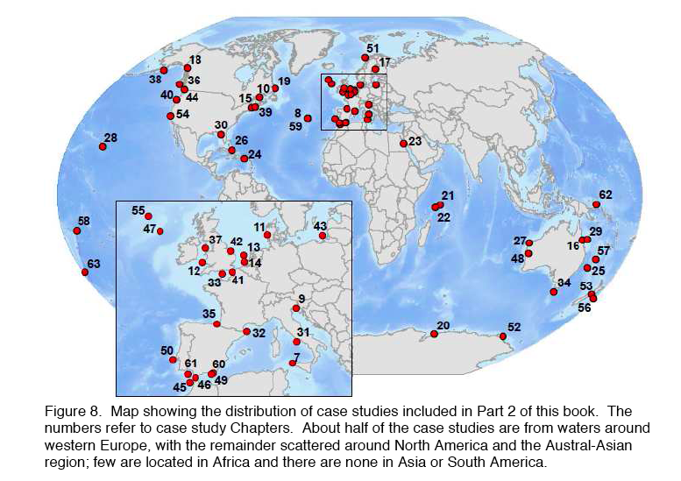
Lessons from Geohab Atlas
Atlas of seafloor geomorphic features and benthic habitats
57 case studies and a questionnaire (end of 2011)
Harris, P.T., Baker, E.K., (in press). GeoHab Atlas of seafloor geomorphic features and benthic habitats - synthesis and lessons learned. In: Harris, P.T., Baker, E.K. (Eds.), Seafloor Geomorphology as Benthic Habitat: GeoHab Atlas of seafloor geomorphic features and benthic habitats. Elsevier, Amsterdam.

Slide 11
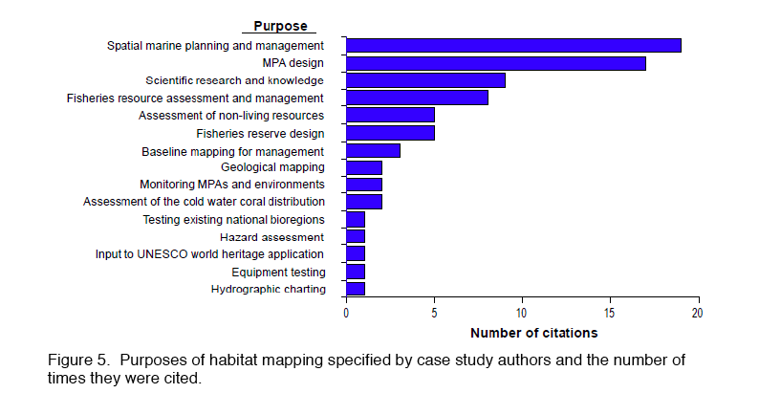
Lessons from Geohab Atlas : What for?
(Harris & Baker, in press)

Slide 12
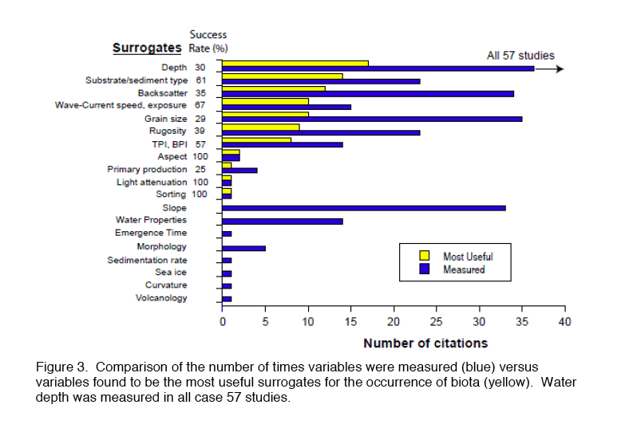
Lessons from Geohab Atlas : which kind of parameters ?
(Harris & Baker, in press)

Slide 13
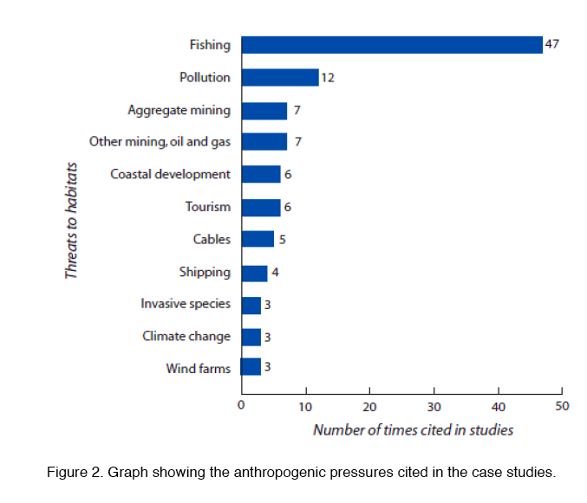
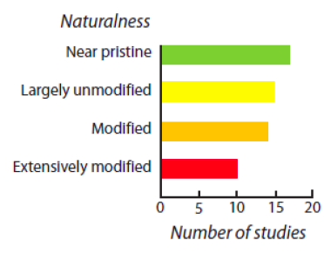
Lessons from Geohab Atlas : anthropogenic pressure
(Harris & Baker, in press)

Slide 14
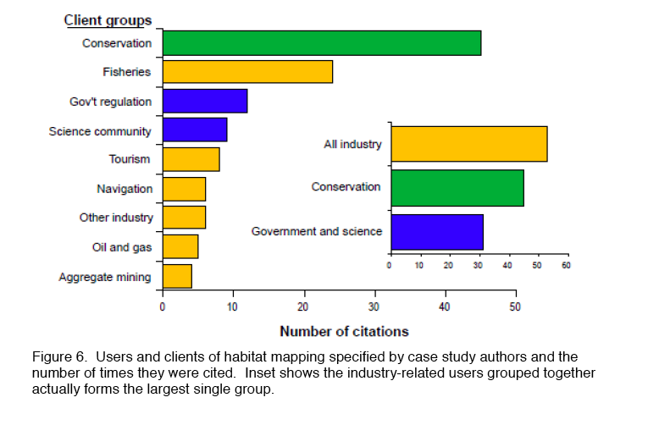
Lessons from Geohab Atlas : for who ?
Sources of funds:
governments 84%
(or government funded agencies)
Industry 11%
non-governmental organisations 6%
(Harris & Baker, in press)

Slide 15
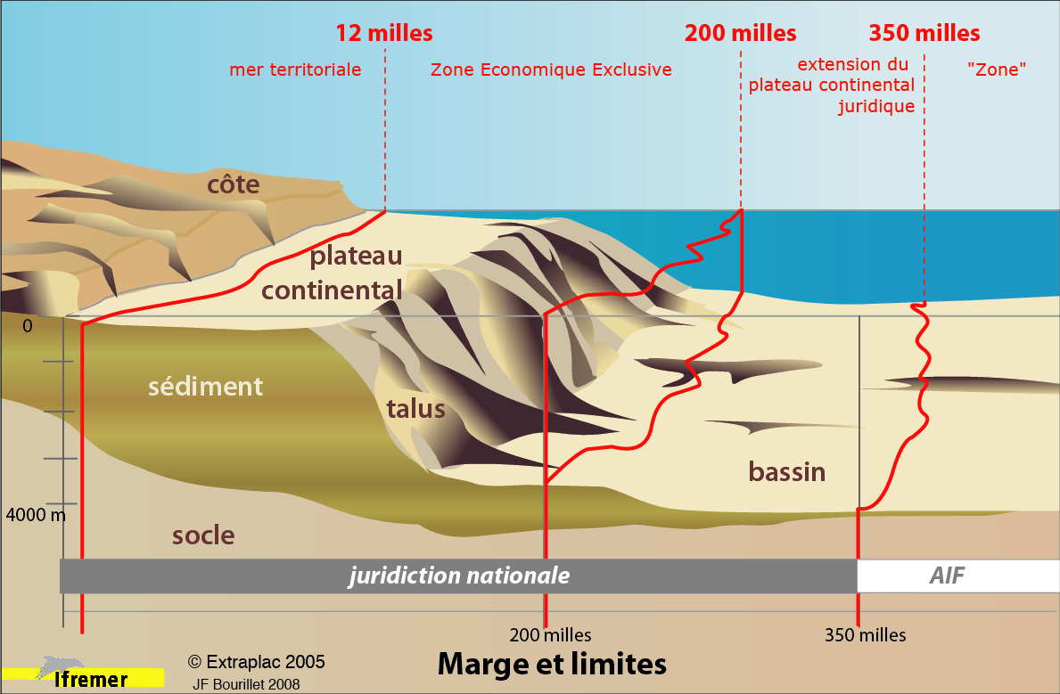
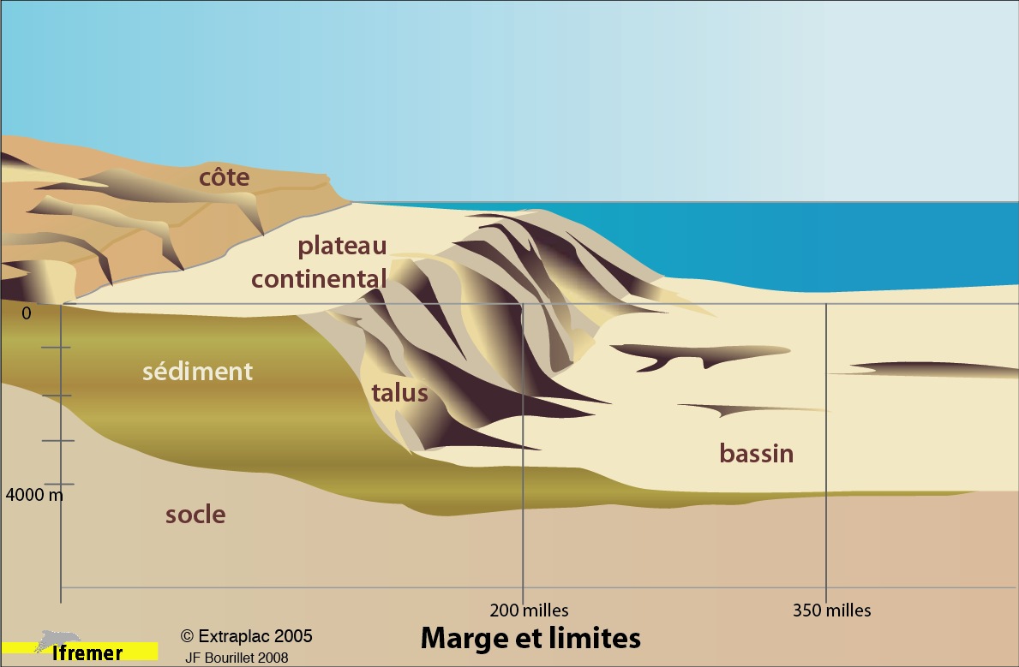
Where should the Directives be applied ? (1)
Notes:
The 3rd main reason of sea-bed mapping is to allow states to fulfill their duties.
I will remind where the physical and legal limits are.
For most of the European states, the seafloor is composed by 3 provinces : the continental shelf from the coast to the shelfbreak (up to 200 m of water depth), the continental slope (from 200 m to 2000 or 4000 m) and then the continental rise.
The legal limits are :
- the 12 n miles from the coast limits the territorial sea where the state fully exerts its sovereignty
- the 200 n miles limits the Economic exclusive zone where the state manages its natural resources
- the 350 nm line represents the maximum extension of “legal” continental shelf.The resources on and below the sea-bed are concerned.
Beyond this limits, it is what the UN calls the “Area” managed by the International Seabed Authority.
So physical and legal boundaries are totally disconnected.

Slide 16
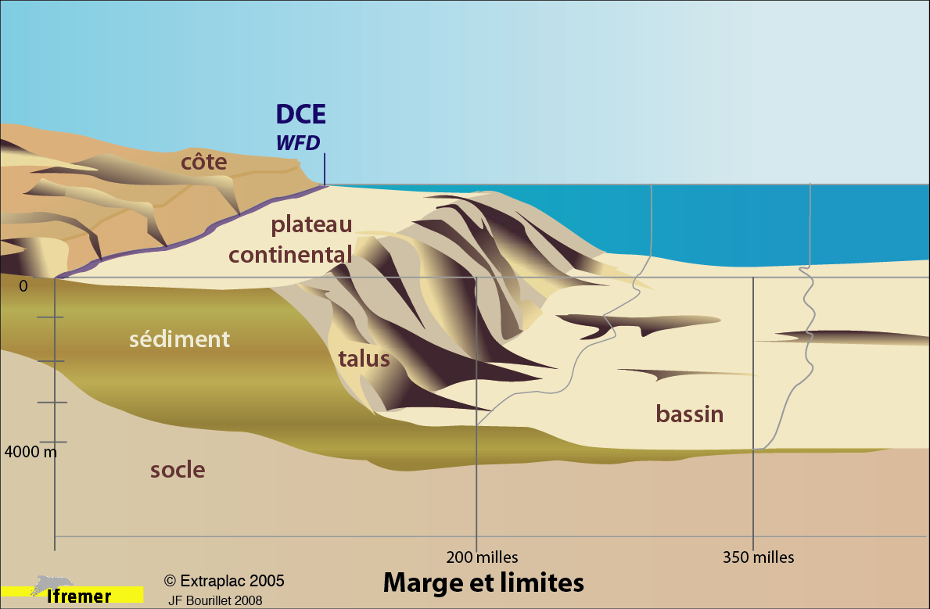
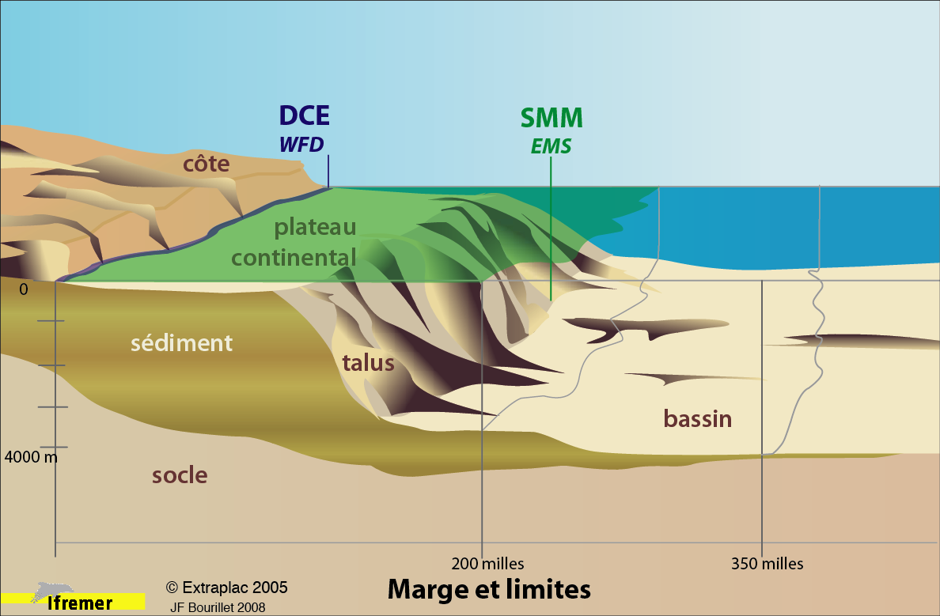
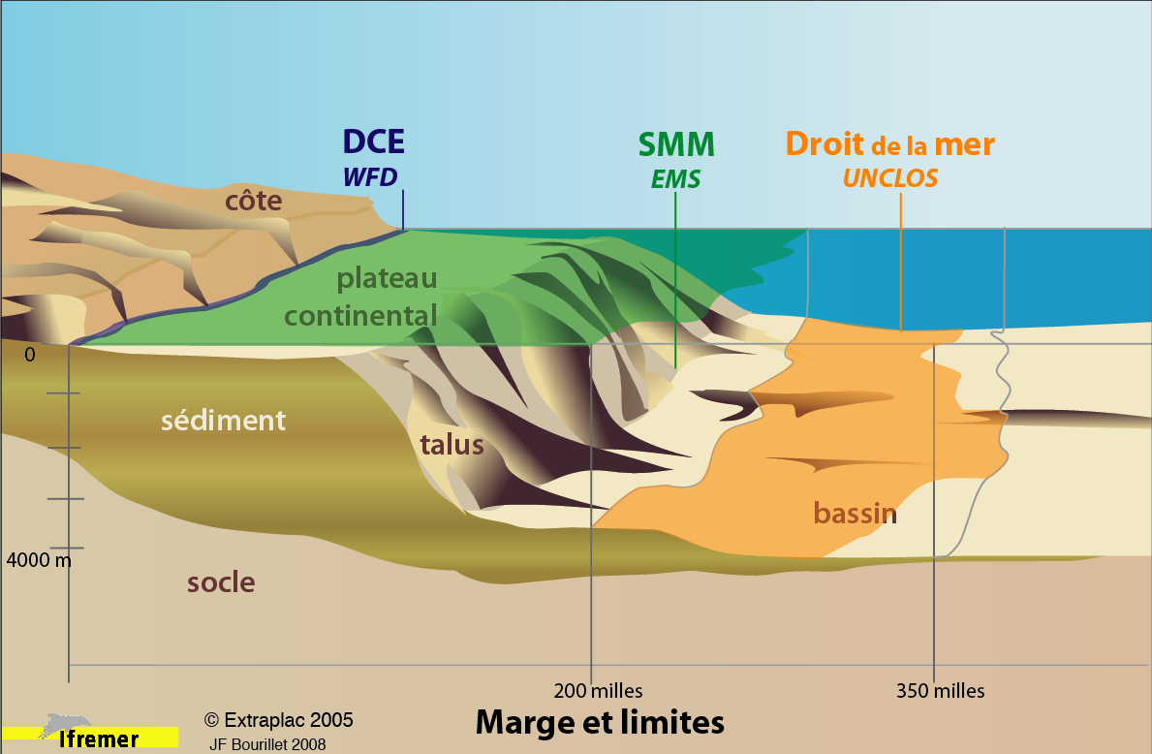
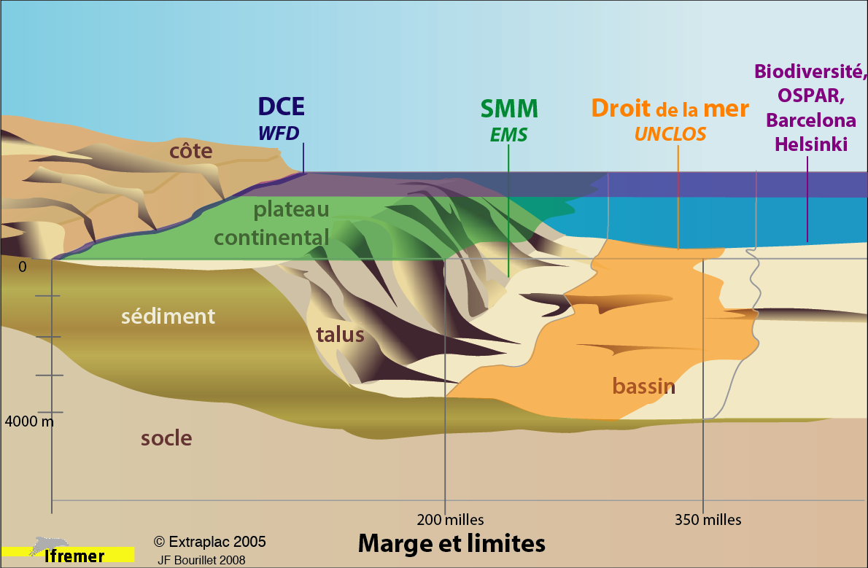
Where should the Directives be applied ? (2)
WFD-2015
Water Framework
EMS - 2021
Eu Maritime Strat.
UNCLOS - 2009
UN Con. Law Sea
BDC - 2012
10 to 30 % of MPA and Ospar, Barcelona, Helscom
Notes:
Directives and conventions focus on different parts of the ocean :
the Water Framework Directive concerns a thin corridor of 1 nm close to the coast.
The Eu Maritime Strategy concerns the water and the sea-bed of the EEZ of each Member state
The extension of the legal continental shelf concerns the sea-bed of the deep ocean
The Biological Diversity Convention, OSPAR convention for the NE Atlantic, Barcelona for the Mediterranean sea and Helsinki for the Baltic concern the whole area of the ocean. But BDC proposed that each state delimites 10 to 30% of its EEZ as Marine Protected area. are going beyond the EEZ limits.
So, except for the WFD, large areas are concerned.

Slide 17
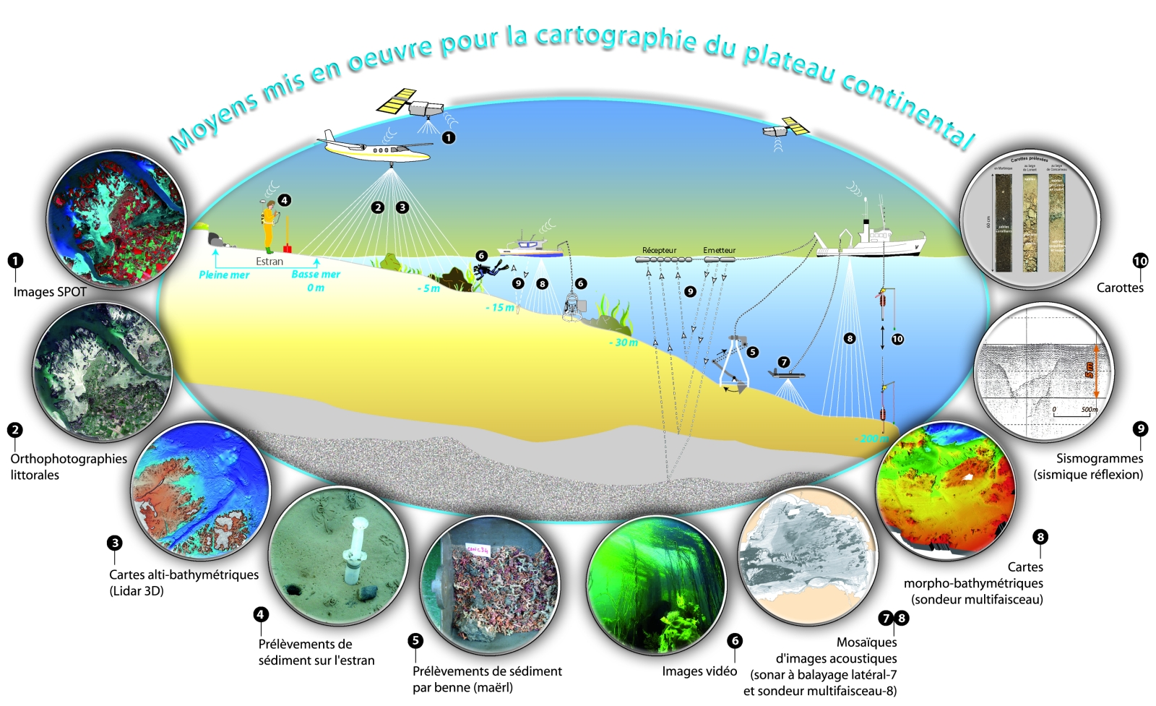
The tools
(Rollet et al., 2009)

Slide 18
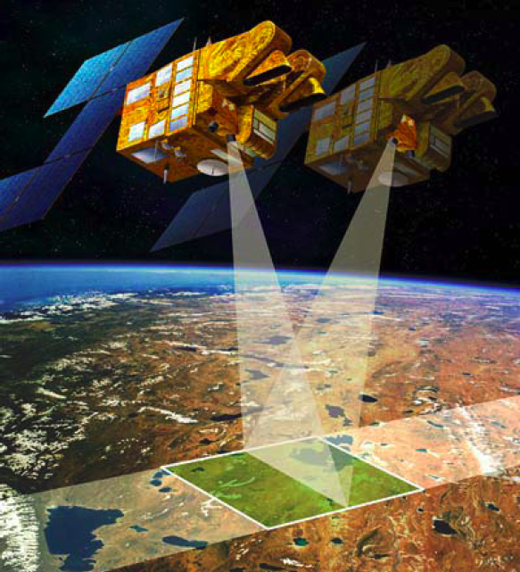
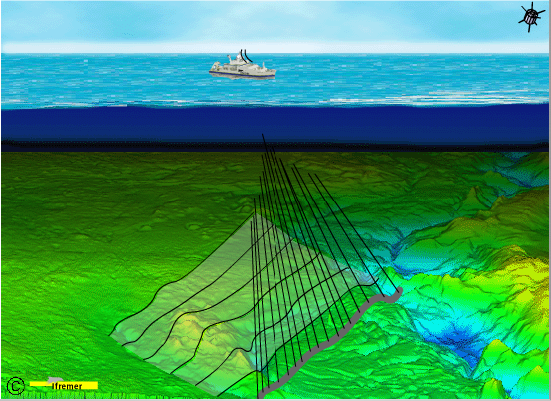

MultiBeam EchoSounder (MBES)
Same principle than Spot satellite
but some differences
z ( 0 à 10 km)
4°
830 km
<150°
7xz
(0 à 20 km)
23000km/h
60 km
8 à 20 km/h
Variable width and accuracy according to water depth
Pixel size: 1 m to 100 m
Pixel size: 2.5 m to 5 m
No direct measurment of bathymetry
Full coverage of all oceanic seafloor: 4 to 5 centuries
Full coverage of Earth floor: 15 days
Notes:
JF

Slide 19
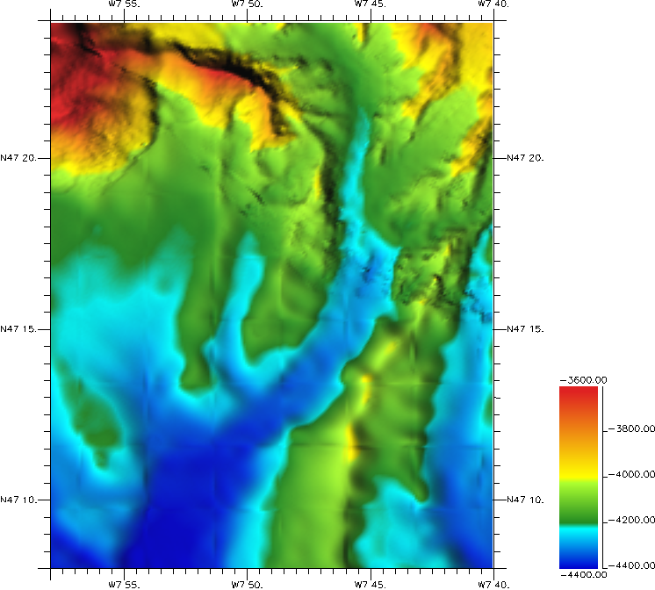
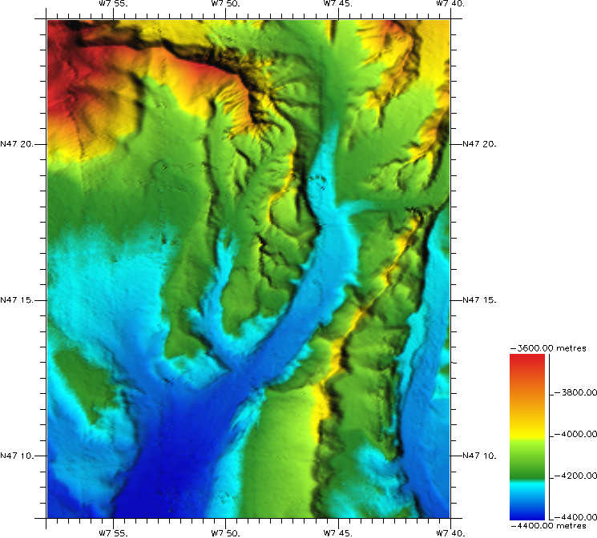
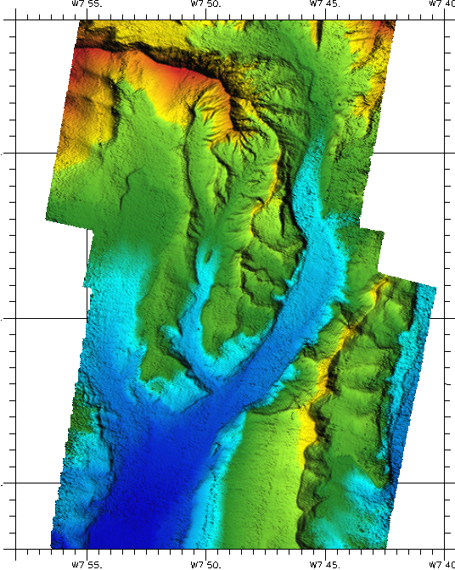
Evolution of MBES
Seabeam R/V Jean Charcot
1977 - 12 kHz
12 beams ; s = 0.6 Z
EM12D L’Atalante
1992 - 12 kHz
120 beams ; S = 5 x Z & BS
grid cell : 125 m ; z=4000 m
7150 12 kHz Pourquoi pas?
2007-12 kHz
400 beams ; Z & BS
grid cell : 75 m
7150 24 kHz Pourquoi pas?
2007- 24 kHz
800 beams ; Z & BS
grid cell : 50 m

Slide 20
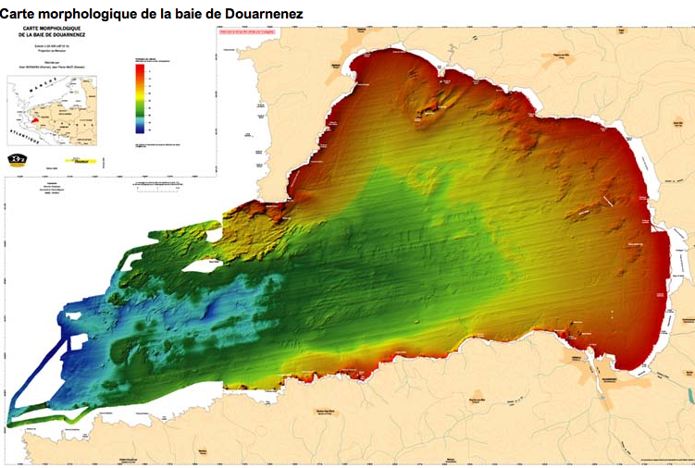
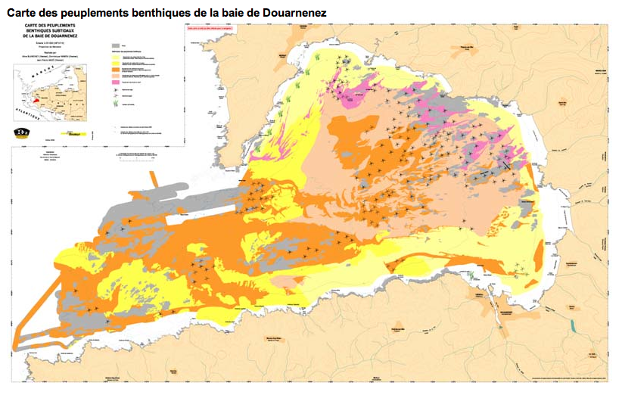
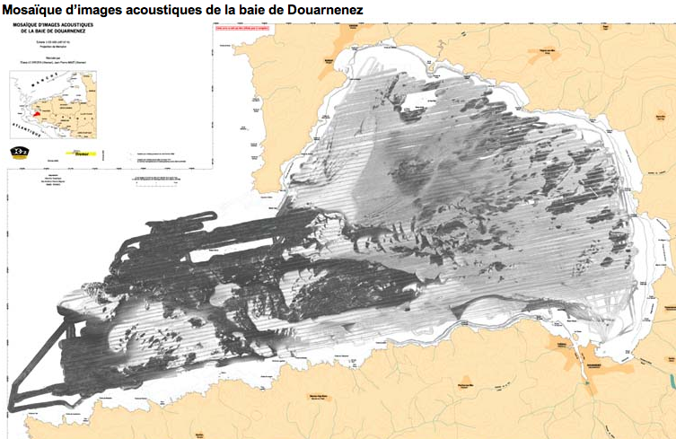

The products
Basic maps
  Bathymetry: twoway travel time of signal
  Backscatter: intensity of reflected signal
Derived maps
  Surficial sediments
  Benthic population
  …
(Augris et al., 2005)

Slide 21



Details of MBES
R/V L’Atalante MBES: EM710
(Biscay et al., 2010)
(Ehrhold et al., 2006)
ROV Victor
MBES: Reson 8125

Slide 22







Geomorphological classification from MBES (1)
DTM @25m from MBES data (R/V Pourquoi pas ?)
Complemented with interpolation a former DTM @125 m
Penmach canyon
Guilvinec canyon
Odet canyon
Blavet canyon
Belle Ile canyon
Le Croisic
canyon
50 km
vertical exag. x 2
Residual bathymetry
Distance to a canyon
Instant slope
(de Chambure al., 2010)
Notes:
HABILLAGE : mettre les distances et surfaces couvertes , ( + depth range)
mettre les NOMS DES CANYONS

Slide 23


Geomorphological classification from MBES (2)
Penmach canyon
Guilvinec canyon
Odet canyon
Blavet canyon
Belle Ile canyon
Le Croisic
canyon
(Bourillet et al., 2011)

Slide 24

Performance versus frequency
Higher frequency, higher resolution but lower water depth and smaller swath
High resolution in the deep: sonar, ROV, AUV
(Bourillet et al., 2011)
Area (3000 km²) | water depth | frequency | # of profiles (50 km) | speed | duration
60 x 50 km² | 50 m | 100 kHz | 200 | 8 kn | 20 days
60 x 50 km² | 1000 m | 30 kHz | 10 | 8 kn | 1 day
Linear relationship between waterdepth and duration of a survey

Slide 25


Assessment of effort needed
EU EEZ | Deep > 200 m | Shelf < 200 m
area | 6.4 M km² | 2.2 M km²
cost per 1,000 km² cost | 20 k€ 130 M€ | 400 k€ 900 M €
(Bourillet, 2008)
EEZ of M states
8.6 M km²
= 2 x on shore EU
Notes:
Marine area of the EEZ of the Member states of EU covers 9 M km2, it represents twice the on-shore EU surface area : 7 M for the deep and 2 M km2 for the continental shelf. Shallow water mapping takes 20 times longer than deep water mapping for the same surface.
So, the main factor that controls the magnitude of marine mapping effort is the surface of continental shelf. Here is the distribution of the shelf for European countries.
We very roughly assess the budget at 130 M € for the deep and 900 M€ for the shelf. For comparison, the budget of the Japanese mapping project is 600 M€.
There are national projects in progress in Ireland, Italy, Denmark and some in preparation in the UK, France. Outside Europe, Canada, USA, Australia, China, Japan have mapping project.The best example is the Irish INFOMAR project launched in 1999. They started with the deepest part and now 80% of the Irish waters are mapped.
But these are national initiatives and the EU has both to promote an European approach and to encourage national efforts.

Slide 26



National projects
Norway (NGU)
  Mareano (>2005)
  140.000 km² 26 M€
Irlande (GSI - MI)
  INSS (1999-2005)
  7ans ; 32 M€
  INFOMAR (2006-)
  2x10 ans ; 4 M€/an
Italy : Magic
UK (NERC - BGS - NOC)
  MAREMAP (>2011)
France (Ifremer - SHOM)
  ZEPLA (?)

Slide 27


Where are the gaps ?
Variable coverage:
in progress for the deep ;
scarce for the shelf
No catalogue for multibeam data
Emodnet-hydrography
Task 2.4 Complete Coverage
for each sea basin:
  the total area, the total area of deep water, the area within the EEZs or continental shelves of EU Member States,
  the area already covered by surveys,
  the total effort (in time and money) required to map the deep and shallow water at high resolution.
(André & Satra, 2006)
Notes:
Currently, there is no common catalogue at European scale. Some large marine institutions and hydrographic services maintain catalogues for their own data or at a national level.
The coverage is variable according to provinces ; the image shows available maps. Deep French EEZ is fully covered ; the continental shelf coverage remains scarce due to lack of data or to unprocessed data.
It is generally the same outline for the other countries.
So, we need to find existing data, to identify the gaps and to acquire information through sea surveys.

Slide 28




European initiatives
Emodnet : European Maritime Observatory Data NETwork
Prototype 2008-2013: ur-emodnet
  6 preparatory actions (data assembly, portals, …)
  needs for end-users (…, bathymetry, sea floor nature), gaps (parameters, areas, …)
Operational phase from 2014
application
observation
and data collection
archiving at national data centres
thematic assembly groups
sea basin checkpoint
national organisms
+
national organisms +
2008-2010 : 6 M€
2011-2013 : 22 M€
2014 -2020 : ?

Slide 29
Mapping of sea-beds: an European project ?
Questions and suggestions to initiate discussion
Does the project be focused only on at sea data collection, validation and archiving ? Links with the National institutes ad NODC ?
How could we stimulate sea surveys ?
  enlarging the “Data Collection Framework” scope for sea-floor data ?
  Example of R/V Thalassa
Could we encourage common surveys based on ecoregions ?
  Increasing the budget of EuroFleet on this specific topic
  Proposing this topic for Interreg projects, MyOcean, … or other short terms research projects?
  Encouraging new projects (FP8, …?) to contribute to the sea-bed mapping with a specific WP or specific standards ?
……

Slide 30
Many reasons for sea-bed mapping
Deadlines are close and the gap is on continental shelf
Sea data acquisition is a very slow process
23,000km/h
8 à 20 km/h
Ocean sea-bed : 500 years
Earth surface : 15 days
Notes:
In conclusion, there are many reasons for sea-bed mapping, deadlines are very close, gaps are mainly on the shelf but we have to keep in mind that sea acquisition is a very slow process.
Thank you for your attention.

