Slide 1
Wave and tidal demonstration projects - Technology risk “Insurance”
October 2015
Michael Bullock – September 2012

Slide 2
The Issues
Prior operating data is very limited;
OEM power curve & availability warranties limited or non-existent;
Insurance excludes machinery breakdown / defect;
Technology risk mainly falls on project developers with limited balance sheets;
Equity investment harder to attract, commercial project finance harder still.

Slide 3
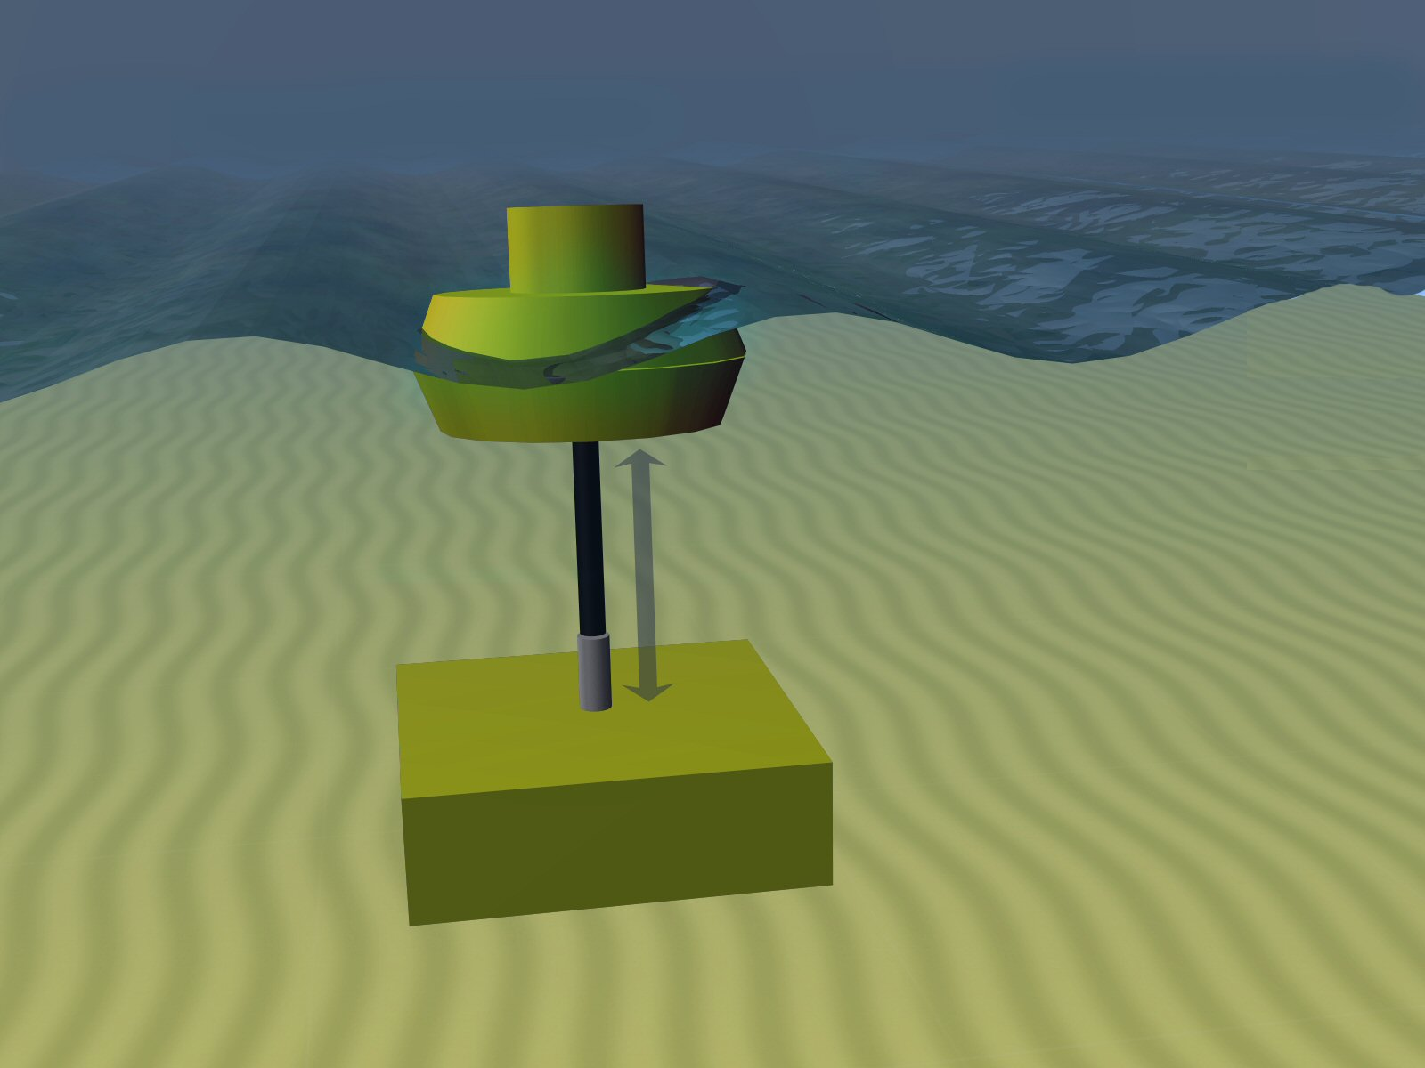
Source:www.aquaret.com

Slide 4
Example tidal project
Insurance ex. defect and machinery breakdown;
Some power curve / parts warranties, risks shared on intervention cost, no availability warranty;
Period of continuous running prior handover;
Interventions balance: vessel costs v revenue;
Agreements on spares holdings;
Project contingency funds topped up from revenue;
Liquidated damages on performance etc.
Phase 2 broader warranties and insurance?

Slide 5
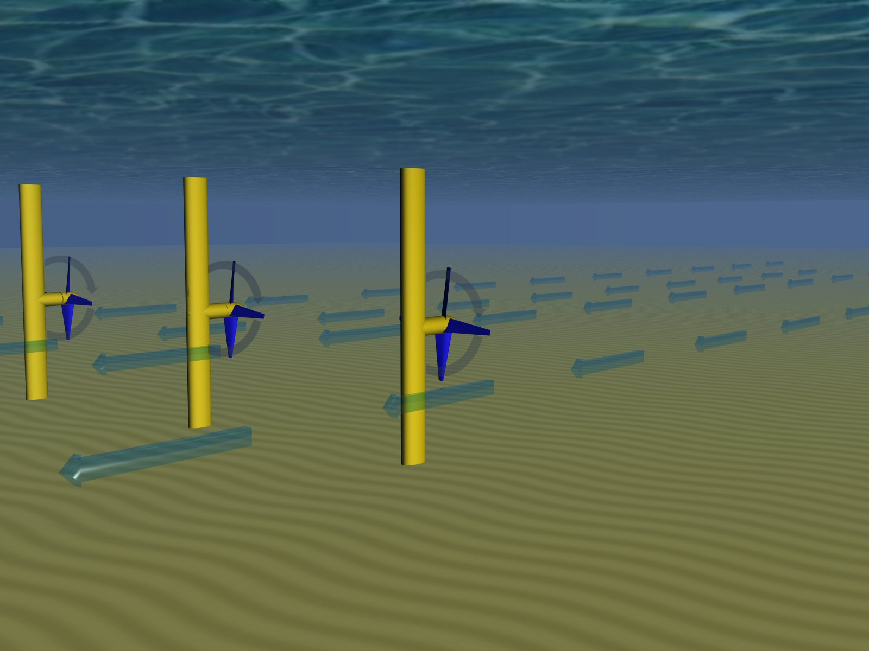
Source:www.aquaret.com

Slide 6
Potential solution and scale
Fund providing insurance “wrap” for demo projects;
Insured events just to “plug the gaps”, potentially including decommissioning;
Captive reinsurer using well rated insurer “front”;
Gradual ability to add capacity via reinsurance;
Charge premium (& claw back losses?) and recycle funds as individual projects mature;
Limit per project t.b.a., e.g.< €20m “notional”;
Maximum fund capital requirement e.g. €50-70m?
Duration 3 - 5 years per project - Rollovers?

Slide 7
Availability risk sharing mechanism
Retained by Project developer / financier
10% Co-insured by OEM
90% of revenue shortfalls Insured by Risk Fund for availability below 95% down to the retained availability level per year
Insured “tranche” above REL
REL rises through time, e.g. Y1: 75%, Y2 80%, Y3 85% etc.
Insured tranche reduces: Y1 90% of 20%, Y2 90% of 15%, Y3 90% of 10% etc.
RETAINED AVAILABILITY LEVEL (REL): Self-insured by OEM 100% for the amount by which availability drops below this point

Slide 8
Possible due diligence requirements
Earlier ”successful” full scale prototype in comparable environment / conditions;
Handover criteria;
Spares assessed v. MTBF and lead times to replace;
Link to reliability studies via test centres etc.;
Contractual assessment: penalties, SLA’s, length of warranties etc.;
Project contingency levels and top-up mechanisms;
Agreed intervention procedures.

Slide 9
Benefits
Structuring mitigates risk e.g. of loan guarantees;
Criteria act as guideline for financial, contracting and spares strategies;
Risk sharing mechanisms keep all parties involved to appropriate levels;
Initial risk capital can stimulate other risk bearing capital and reinsurance;
Risk bearing structure leverages much greater amount of equity investment and project finance.

Slide 10
Next Steps
Indication of interest;
Refine variables to identify bottom line gaps – limits, duration, benchmark versus offshore wind, level of availability needed (difference between 95% and 75%)… liaise with financiers, reinsurers, developers, OEM’s;
Refine business plan: detailed structure, definitions of heads of cover, criteria etc.

Slide 11
Any Questions?
Michael Bullock
mjb@renewablerisk.com

