Slide 1
To Secure the Safety of Fishery Products
Joji Morishita
Fisheries Agency of Japan

Slide 2
Contents
Provisional Regulatory Values
Monitoring of fishery products and its results
Restriction on Fishing Activities and Market Distribution
For Smooth Transaction and Exports to EU

Slide 3
1. Provisional Regulatory Values
The Japanese government sets the Provisional Regulatory Values at 2,000 Bq/kg for Iodine and at 500Bq/kg for Cesium for fishery products.
Japanese Value (500Bq/kg) for Cesium is rather conservative compared to those of other countries.

Slide 4
Comparison of regulatory indices for fishery products

Slide 5
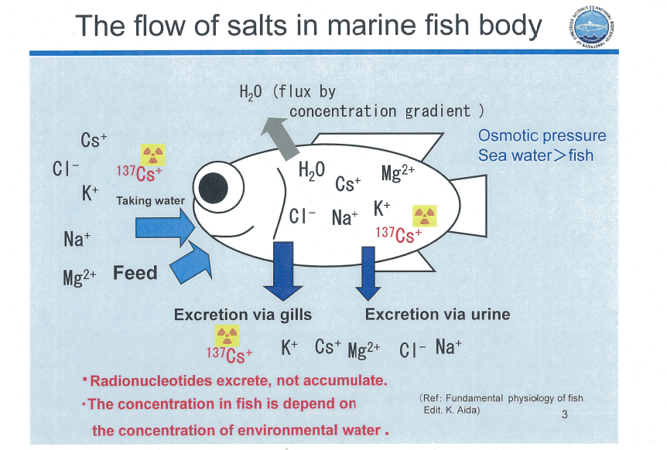

Slide 6
2. Monitoring of fishery products and its results
The Fisheries Agency, in coordination with relevant prefectural governments and relevant fishery industries, has been promoting sampling programs to measure levels of radioactive substances in fishery products.
Samplings have been carried out at major fishing ports once a week in principle for each major target species.

Slide 7
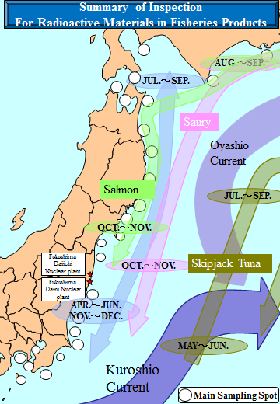

Slide 8
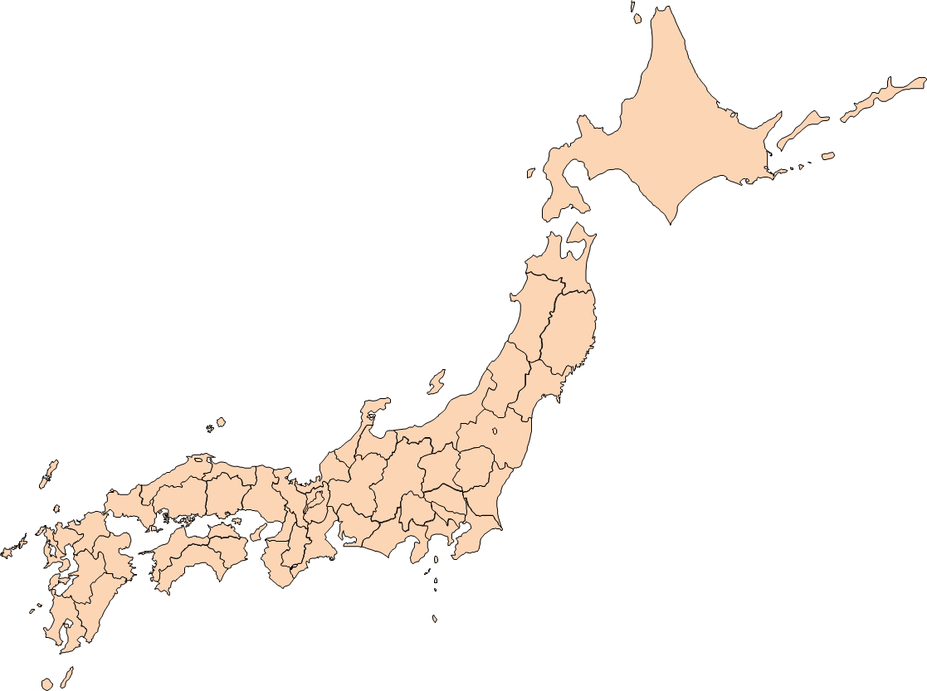
680km
Fukushima Daiichi & Daini Nuclear Plants
1,190km

Slide 9
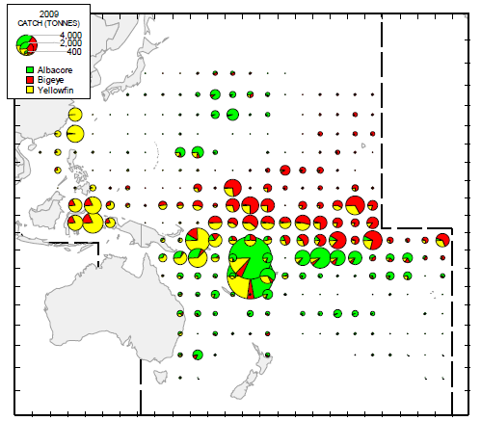
WCPFC area – Distribution of Longline Tuna Catch
(WCPFC: Tuna Fishery Year book 2009)

Slide 10
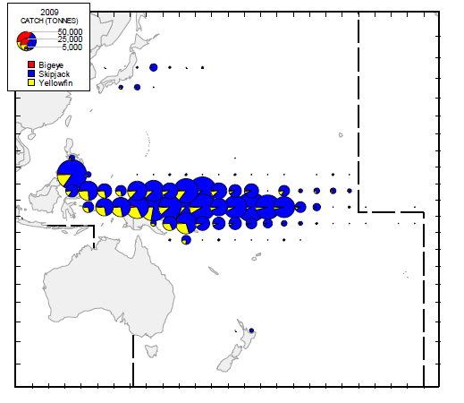
WCPFC area – Distribution of Purse Sein Catch
(WCPFC: Tuna Fishery Year book 2009)

Slide 11
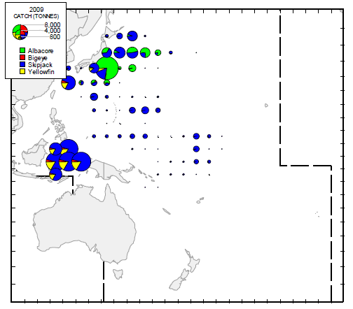
WCPFC area – Distribution of Pole-and-line Catch
(WCPFC: Tuna Fishery Year book 2009)

Slide 12
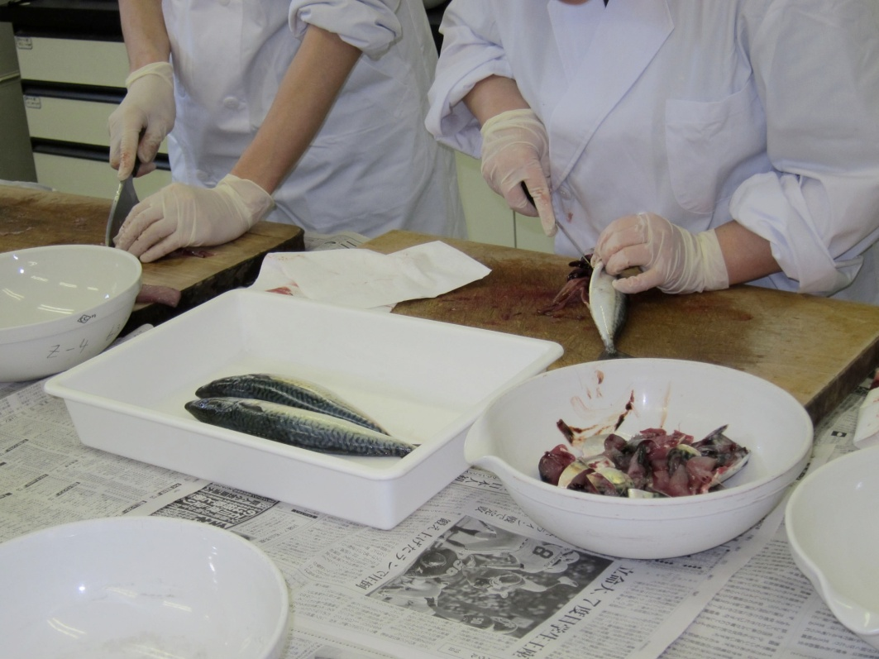
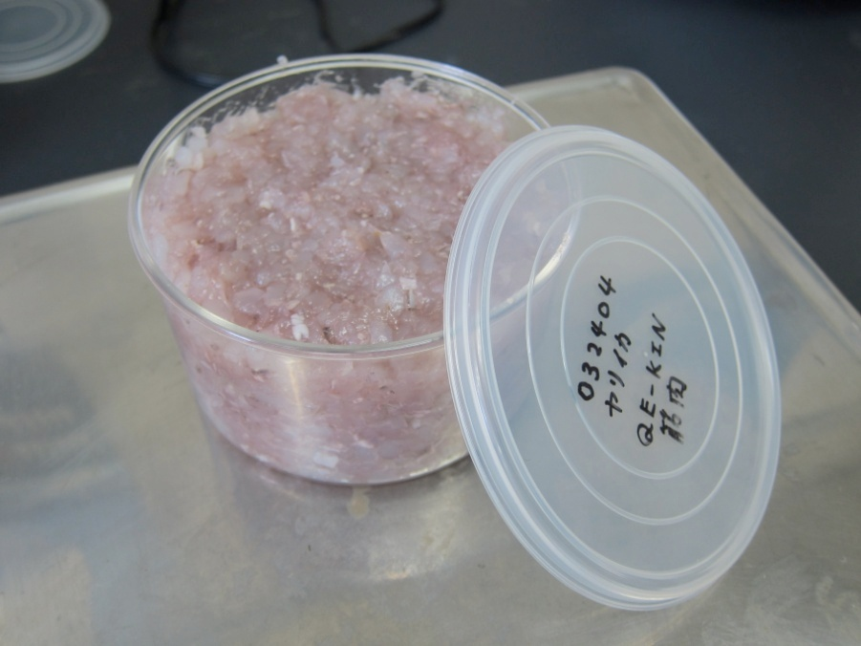
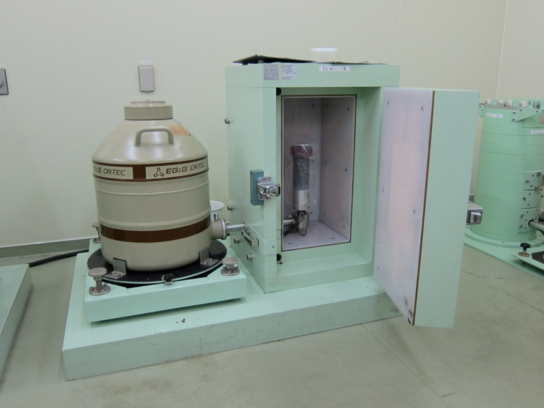
-Germanium Semiconductor
Detector
-300g ~400g
-2,000 seconds

Slide 13
Following points will be explained:
The monitoring results have been publicized through the website of FAJ.
Samples of marine species that exceed the provisional regulatory values were caught in ONLY coastal areas of Fukushima (northern-Ibaraki is the only exception (6 Japanese sandlance and 1 Brown hakeling)).
No fishing activities have been conducted in coastal area of Fukushima, and No bottom trawler is operating in northern Ibaraki.
The number of monitoring samples have been increasing. On the other hand, the proportion of samples exceed the provisional regulatory values has been decreasing.

Slide 14
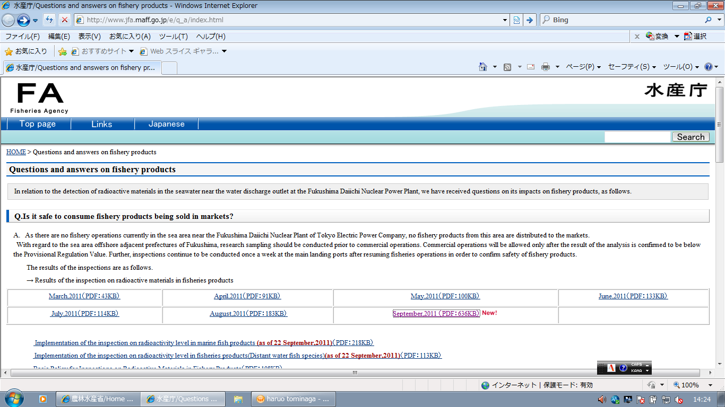
http://www.jfa.maff.go.jp/e/q_a/index.html

Slide 15
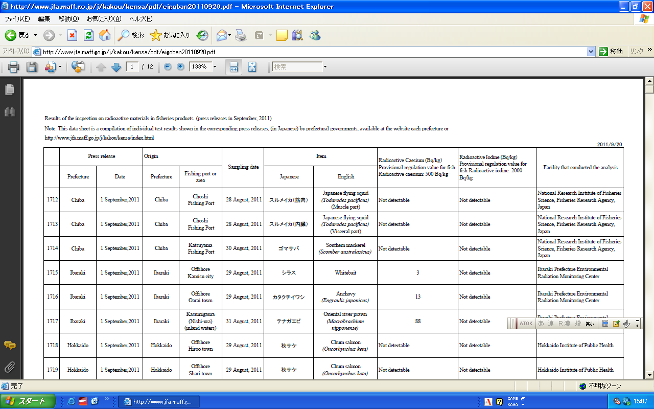

Slide 16
Fisheries Agency of Japan http://www.jfa.maff.go.jp/j/kakou/kensa/pdf/eigoban_chizu20110909.pdf

Slide 19
Summary of monitoring Results
(as of September 26, 2010)
Saltwater fish 1370 (61*)
Japanese sandlance (12), white bait (4), Fat greenling (9), Brown hakeling (6), Stone flounder (3), Goldeye rockfish (2), Rockfish (4), Ocellate spot skate (12), Slime flounder (1), Olive flounder (3), Marbled flounder (2), Seabass (1), Black rockfish (1)
Invertebrates 336(12*)
Mediterranean mussel (1), Surf clam (4), Northern sea urchin (6), Japanese mitten crab (1)
(*) Figures in brackets show the number of samples with results exceeding the Provisional Regulatory Values

Slide 20
Summary of monitoring Results Cont.
Seaweed 55 (8*)
Wakame seaweed (1), Hijiki seaweed (1),
Arame seaweed (6)
Processed Sea foods 22 (0*)
Freshwater fish 411 (41*)
Ayu sweetfish (21), land-locked cherry salmon (8), Japanese smelt (5), Japanese dace (4), White spotted char (2), Willow gudgeon (1)
Marine Mammals 27 (0*)
(*) Figures in brackets show the number of samples with results exceeding the Provisional Regulatory Values

Slide 21
Summary of monitoring results (Cont.)

Slide 22
3. Restriction of Fishing Activities and
Market Distribution
In case where a sampling measurement for a species detects radioactive substances exceeding the Provisional Regulatory Values, related fishing activities and landing of that species are immediately suspended.
If an area where radioactive substances in samples of the species exceed the Provisional Regulatory Values is considered to expand, shipment of the products of the species from the expanded area is suspended .

Slide 23
Such suspension can only be lifted after all the sampling measurements for the species at more than three sampling spots in the last one month show below the Provisional Regulatory Values.

Slide 24
Current situation near Fukushima (coastal areas)
Fukushima Area
No fishing activities have been conducted.
Miyagi Area
Part of fishing activities resumed, after all the sampling results of species to be caught confirmed below the Provisional Regulatory Values.
Ibaraki Area
Part of fishing activities resumed, after all the sampling results of species to be caught confirmed below the Provisional Regulatory Values.
Fishing activities for Brown hakeling have been suspended since sampling measurements showed that the result exceeded the Provisional Regulatory Values. Fishing for Japanese sandlance was also suspended, however, the Fishing season was over in this year.

Slide 25
No fish that exceeds the provisional regulatory values will be exported to EU.

Slide 26
For Smooth Transaction and
Exports to EU
As of 26 September 2011, 511 certifications are issued.
EU has implemented inspection for imported Japanese products, though, Japan has received no report that detection of radioactive substances exceeds the Provisional Regulatory Values from the imported products.

Slide 27
Thank you

