Slide 1
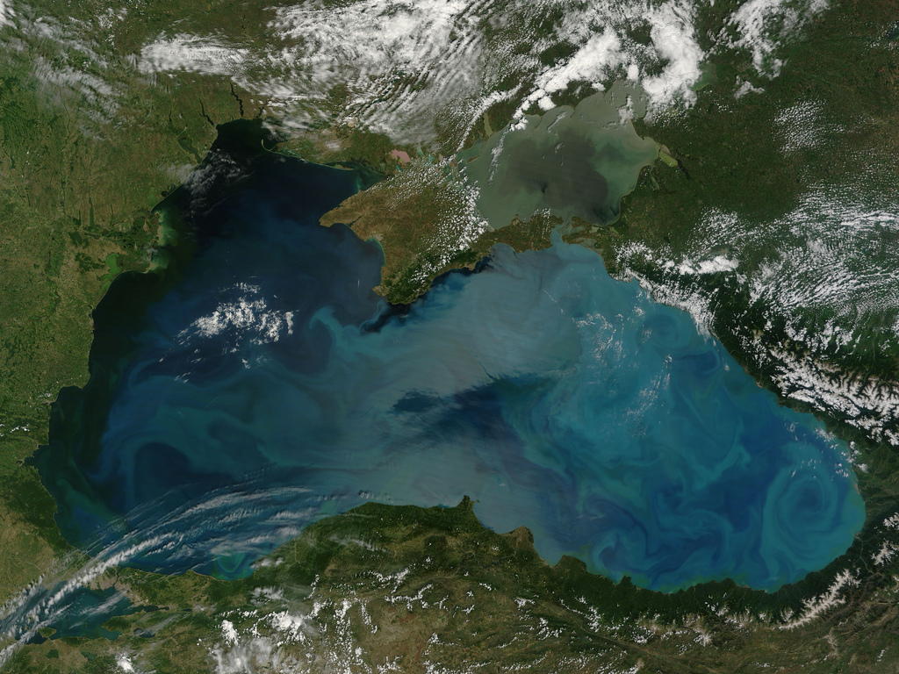
3rd meeting for developing a Blue Growth Initiative for Research and Innovation in the Black Sea
Evaluation of Black Sea Projects, Research Gaps & Needs Matrices and a Roadmap for a new R&I Strategic Agenda
Contribution of:
Institute of Marine Sciences, Middle East Technical University, TURKEY
Compiled by:
Barış Salihoğlu, Ayşe Gazihan, Ezgi Şahin, Mustafa Yücel

Slide 2
3rd meeting for developing a Blue Growth Initiative for Research and Innovation in the Black Sea
The matrix of marine research projects
Matrix A. Analysing gaps and research & innovation opportunities providing the necessary justification/drivers
Matrix B. Regional and national boundary framework conditions
Roadmap to new SRIA for the Black Sea

Slide 3
3rd meeting for developing a Blue Growth Initiative for Research and Innovation in the Black Sea
The matrix of marine research projects
Matrix A. Analysing gaps and research & innovation opportunities providing the necessary justification/drivers
Matrix B. Regional and national boundary framework conditions
Roadmap to new SRIA for the Black Sea

Slide 4
The matrix of marine research projects
Country based information was collected on;
Marine research project information (collected from Turkey, Bulgaria and Romania, EU funded Black Sea Projects)
Matrix A. Analysing gaps and research & innovation opportunities providing the necessary justification/drivers
Matrix B. Regional and national boundary/framework conditions for the R&I needs and opportunities for successful implementation (limited contribution)

Slide 5
Defined Main R&I Areas
Revised version
(During September 2017 Batumi Meeting)
First version
Biodiversity
Biological Invasions
Blue Biotechnology
Climate Change & Impacts
Deep sea Ecosystems
Deep sea mining, Oil and Gas Sustainable Exploitation
Living Marine Resources (fishery, aquaculture, etc.)
Marine Hazards
Marine Pollution
Maritime Transport
MSP - ICZM
Ocean renewable Energy
Oceans and Human Health
Operational Oceanography/Observing Systems
Other/Multiple areas (specify in column B)
Socioeconomic & Policy Research
Training & Technology Transfer
Biodiversity
Biological Invasions
Blue Biotechnology
Catchment-Sea Interaction
Climate Change & Impacts
Cultural Heritage
Deep Sea Ecosystems
Deep sea mining, Oil and Gas Sustainable Exploitation
Ecosystem Multiple Stressors
Eutrophication and Deoxygenation
Interconnections of Basins
Living Marine Resources (fishery, aquaculture, etc.)
Marine and Coastal Hazards
Marine Ecosystem Services
Marine Pollution and Litter
Marine Renewable Energy
Maritime Transport
MSP, ICZM
Operational Oceanography/Observing Systems and Monitoring
Other/Multiple areas (specify in column B)
Seas and Human Health
Socioeconomic & Policy Research
Tourism and Surrounding Economy
Training & Technology Transfer

Slide 6
The matrix of marine research projects
Turkey; 79 Projects
% distribution of projects according to main R&I areas

Slide 7
The matrix of marine research projects
Turkey; 79 Projects
% distribution of projects according to main R&I areas

Slide 8
The matrix of marine research projects
Bulgaria; 82 projects
% distribution of projects according to main R&I areas

Slide 9
The matrix of marine research projects
Bulgaria; 82 projects
% distribution of projects according to main R&I areas

Slide 10
The matrix of marine research projects
Romania; 52 projects
% distribution of projects according to main R&I areas

Slide 11
The matrix of marine research projects
Romania; 52 projects
% distribution of projects according to main R&I areas

Slide 12
The matrix of marine research projects
FP7 and Horizon2020 Projects
% distribution of projects according to main R&I areas

Slide 13
The matrix of marine research projects
FP7 and Horizon2020 Projects
% distribution of projects according to main R&I areas

Slide 14
The matrix of marine research projects
Black Sea Total; 279 projects
% distribution of projects according to main R&I areas

Slide 15
The matrix of marine research projects
Black Sea Total; 279 projects
% distribution of projects according to main R&I areas

Slide 16
The matrix of marine research projects
Black Sea Total; 279 projects
% distribution of projects according to main R&I areas

Slide 17
No similar distribution between top three study areas within Black Sea countries
 | Turkey | Bulgaria | Romania | FP7 and Horizon2020 Projects | Total # of Projects in Black Sea
1 | Living Marine Resources (fishery, aquaculture, etc.) | Biodiversity | Other/Multiple areas | Living Marine Resources (fishery, aquaculture, etc.) | Living Marine Resources (fishery, aquaculture, etc.)
2 | Marine Pollution and Litter | Living Marine Resources (fishery, aquaculture, etc.) | Deep sea mining, Oil and Gas Sustainable Exploitation | Operational Oceanography/Observing Systems and Monitoring | Other/Multiple areas
3 | Maritime Transport | Other/Multiple areas | Marine Pollution and Litter | Other/Multiple areas | Biodiversity

Slide 18
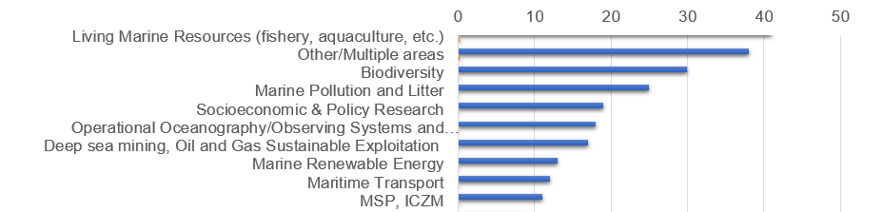
...However, prominent themes such as
Biodiversity, pollution, living resources and MSP/ICZM rank within the highest in all analyses

Slide 19
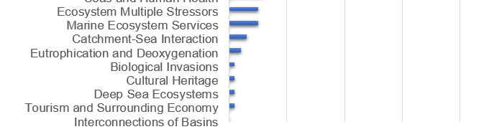
Emerging and more multidisciplinary topics are less studied…
Many of these areas underpin Blue Growth in other basins

Slide 20
3rd meeting for developing a Blue Growth Initiative for Research and Innovation in the Black Sea
The matrix of marine research projects
Matrix A. Analysing gaps and research & innovation opportunities providing the necessary justification/drivers
Matrix B. Regional and national boundary framework conditions
Roadmap to new SRIA for the Black Sea

Slide 21
Matrix A. Analysing gaps and research & innovation opportunities providing the necessary justification/drivers
First summary of major trends
Prominent high-ranking subjects:
What are the still existing gaps in seemingly well-studied areas?
Less studied, low ranking themes:
What are the major opportunities? If no opportunity defined, will we still stick to the theme?
Matrix A. Analysing gaps and research & innovation opportunities providing the necessary justification/drivers for MAIN R&I AREAS
IDENTIFIED GAPS | JUSTIFICATION | R&I NEEDS/OPPORTUNITIES | JUSTIFICATION

Slide 22
Matrix A. Analysing gaps and research & innovation opportunities
R&I Area 1. Biodiversity
IDENTIFIED GAPS | R&I NEEDS/OPPORTUNITIES
The functional assessment of the diversity (BEF concept) and the impact of the changing environmental conditions on biodiversity | the role of diversity in marine ecosystem functioning the impact of the changing environmental conditions on biodiversity potential impact of the biodiversity on blue economy Supplementary process based experiments
Species adaptation to climatic changes | Ecosystem model development to study evolutionary adaptive changes in diversity and the impact of biodiversity on blue economy services under changing environmental conditions
Diversity of some groups (microbes, viruses, fungi) is missing and/or investigated only for needs of sanitary control in limited areas of coastal waters. Shelf and especially Deep sea biodiversity is poorly studied | Observation data from microbes to fish Operational techniques (remote sensors, biological sensors) at adequate scale of natural variability New generation techniques together with classical methodologies, and training
Long-term support of research projects and programmes on biodiversity | ECAP and MSFD biodiversity indicators should be applied
Long -term changes in diatom and non diatom production, abundance and spatial/temporal distributions in the NW shelf, western basin and eastern basin | Long-term climatic changes and enhanced DON+DIN, TP inputs demand basin wide planning to increase Si/N ratio in the BS surface waters, keep over 7-10 especially during the spring bloom period on the rim currents

Slide 23
Matrix A. Analysing gaps and research & innovation opportunities
R&I Area 2. Biological Invasions
IDENTIFIED GAPS | R&I NEEDS/OPPORTUNITIES
Only one targeted study of biological invasions at all levels of species diversity. Pathways of invasions not commonly addressed | Combination of molecular techniques and traditional monitoring of invasive species for proper species identity and origin.
Poor understanding of alterations of ecosystem functions, because of invasive species | Studies on life cycle, multiple impacts and development of options for combating negative effects and alternatively make use of positive effects if any.
An effective ballast water management plan is missing at regional level | Investigation on ballast water management at regional level shall be supported.
Management plans of invasive species, especially in fisheries, is missing with emphasis on prevention control | Learning from the historical biological invasion events, todays and future invasion threats should be analysed considering its two way interaction with Blue Economy.

Slide 24
Matrix A. Analysing gaps and research & innovation opportunities
R&I Area 3. Catchment-Sea Interaction
IDENTIFIED GAPS | R&I NEEDS/OPPORTUNITIES
Lack of up-to-date regional scale assessment of catchment area inputs to the Black Sea | Further development of catchment area -sea coupled hydrological and biogeochemical models

Slide 25
Matrix A. Analysing gaps and research & innovation opportunities
R&I Area 4. Climate Change & Impacts
IDENTIFIED GAPS | R&I NEEDS/OPPORTUNITIES
Scenarios for climate driven changes in order to assess the impacts is scarce. | Climate induced alterations in thermohaline circulation, acidification, sea level rise, erosion and flooding. Study the vulnerability of the coastal zone and adaptations to climate change. Exploring the recent technological developments (real-time data from Argo floats, satellite measurements etc.).
Carbon sequestration studies in the deep waters is missing | The risks and the adaptation of policies to sea level rise. Potential changes (because of climate changes) in thermohaline circulation. Acidification. Study the vulnerability of the coastal zone and adaptations to climate change.
Assessment of impacts of climate change in biodiversity, especially in coastal ecosystems.
Long term measurements and observations are missing.
Quantification of consequences/impacts of climate change. Like intensity and severity of storms, coastal (especially beach) erosion, vulnerability of protected areas and human settlements. | Tailored research programs
The impact of Climate change and its impacts on blue economy is not known. | End-to-end ecosystem model applications

Slide 26
Matrix A. Analysing gaps and research & innovation opportunities
R&I Area 5. Cultural Heritage
IDENTIFIED GAPS | R&I NEEDS/OPPORTUNITIES
Limited knowledge on cultural heritage in the Black Sea. | New techniques and methodologies should be developed and applied for discovering, protecting and valuing the cultural heritage in the Black Sea.
Lack of coordination along the neighbouring countries | A common management policy should be developed and applied via a coordination network

Slide 27
Matrix A. Analysing gaps and research & innovation opportunities
R&I Area 6. Deep Sea Ecosystems
IDENTIFIED GAPS | R&I NEEDS/OPPORTUNITIES
Very limited information on the functioning of deep marine ecosystems in the Black Sea There are some studies mainly from geological surveys and focused on palaeontological aspects. The processes in the deep waters is missing | Biogeochemical cycles in the deep waters Microbial food web, carbon sequestration and particle deposition in the deep. Research of specific habitats that support specific biodiversity and ecosystem functions such as mud volcanos, gas seepages.
With the deployment of Argo profilers some recent information on physical and some chemical parameters (on-line data ) are available, but still missing biochemical measurements. | Energy resources, gas hydrates and hydrogen sulphide It also has importance of representing potential future deep sea ecosystem under predicted hypoxia in the future oceans.
Carbon sequestration in deep waters is also missing
Marine resources in the deep waters is not really registered.
There are only very few studies that allow to discover the morphology of the bottom.
Specific habitats that support specific biodiversity that may underpin blue biotechnology and ecosystem functions such as mud volcanos, gas seepages are very poorly studed.

Slide 28
Matrix A. Analysing gaps and research & innovation opportunities
R&I Area 7. Ecosystem Multiple Stressors
IDENTIFIED GAPS | R&I NEEDS/OPPORTUNITIES
The analysis of ‘synergistic impact of eutrophication, fisheries, biological invasion and climate change on the ecosystem’ on blue economy have not embarked yet. | Ecosystem multiple stressors studies should be further extended to include the final impact on the Blue Economy services. New generation ecosystem models studies can be used to explore the synergistic impact of multiple stressors

Slide 29
Matrix A. Analysing gaps and research & innovation opportunities
R&I Area 8. Eutrophication and Deoxygenation
IDENTIFIED GAPS | R&I NEEDS/OPPORTUNITIES
Limited historical and systematic data sets on bio-chemical properties of the open and coastal Southern Black Sea Therefore, long-term impacts of enhanced eutrophication on the basic bio-chemical properties/vertical features have not been well understood. No systematic monthly/seasonal monitoring programmes have yet implemented to fully assess medium and long-term ecological changes in the shelf, coastal and open Black Sea ecosystem due to both climatic and human-induced impacts | Assessments of “good environment status” limits for the direct and indirect eutrophication indicators in the Black Sea. Determination of reachable reference ecological conditions of the BS must based on limited historical, new observations and model simulations Total nutrient inputs, their major sources. Novel tools are needed to asses basin wide natural and human-induced nutrient and organic matter inputs to BS. This tool must be coupled to the Black Sea ecosystem models for the estimation of tolerable GES targets in the Black Sea Impact Assessment of of enhanced nutrient inputs and changes in N/P/Si ratios in the inputs and surface waters on both chemical and major biological properties of BS and also on the BS commercial fisheries feeding on diatom consuming food-web.

Slide 30
Matrix A. Analysing gaps and research & innovation opportunities
R&I Area 9. Interconnections of Basins
IDENTIFIED GAPS | R&I NEEDS/OPPORTUNITIES
Long-term changes in the nutrient and TOC contents of NW shelf waters reaching the Bosphorus region and flowing into the Marmara basin | For the Marmara Region Envionmental Management, seasonal and annual variability in the organic+inorganic nutrient loads of western BS inflow to the Marmara Sea is needed, together with their temporal variations in their major sources (mainly the Danube)
Knowledge on connection of the Black Sea with the Mediterranean via the Bosphorus Channel and with Azov Sea is limited | Salination and enhancing stratification in the Black Sea mean lower vertical mixing and limited oxygen penetrating to deeper water. This phenomena results with shallower oxic surface waters limiting oxygen depended organisms in it. Salination and enhancing stratification in the Black Sea due to saline water income from the Mediterranean Sea should be studied

Slide 31
Matrix A. Analysing gaps and research & innovation opportunities
R&I Area 10. Marine Ecosystem Services
IDENTIFIED GAPS | R&I NEEDS/OPPORTUNITIES
Limited knowledge on the ecosystem services of the Black Sea | R&I needed to discover, protect and value the ecosystem services of the Black Sea

Slide 32
Matrix A. Analysing gaps and research & innovation opportunities
R&I Area 11. Marine Pollution and Litter
IDENTIFIED GAPS | R&I NEEDS/OPPORTUNITIES
Common methodology for analysis for marine monitoring is lack in regional level in BS. Significant legal, politic and technical gaps in marine litter management in coastal areas. Monitoring of dangerous substances and measures taken for those substances are very limited in BS region and shall be harmonized. The pollutant loads sourced from point and diffused sources are not defined regularly. | Pollution from modern technologies eg. plastics, pharmaceuticals, nanopollutants, noise, e-wastes etc., and their effects on the marine environment Investigation on marine litter pollution and dangerous substances and definition of measures necessary for protection of BS are strictly required in the region. To evaluate existing pressures and effectiveness of the measures taken, pollutant loads shall be monitored regularly.
Impacts and biological effects of pollutants are scarce. This requires experiments in a broad spectrum of organisms.
There is lack of capacity (human expertise and equipment) for pollutants and marine litter analysis (especially microplastics).

Slide 33
Matrix A. Analysing gaps and research & innovation opportunities
R&I Area 12. Marine and Coastal Hazards
IDENTIFIED GAPS | R&I NEEDS/OPPORTUNITIES
Marine Hazards are related to flood and earthquake | R&I projects on Marine Hazards are related to flood and earthquake
Beach protection and management | Tailored research programs, training opportunities

Slide 34
Matrix A. Analysing gaps and research & innovation opportunities
R&I Area 13. Seas and Human Health
IDENTIFIED GAPS | R&I NEEDS/OPPORTUNITIES
Effective management of wastewater effluent, still there is a direct effluent of un-treated waters | There is a need of targeted research of phytoplankton and other species outbreaks on human health even if they originally are of local scale. Application of new methods for species identity (genomics) and monitoring ( remote sensing, drones, argo buoys etc.)
An underestimated threat at basin scale is the presence of potentially toxic phytoplankton species, the impacts of phytoplankton blooms on human health.
Effective bathing water management system shall be established along BS coastal areas. | Bathing water quality monitoring and dissemination of results to the public research studies shall be supported by regional programmes. Need for brine production avoidance/closing the loop of water in the desalination sector

Slide 35
Matrix A. Analysing gaps and research & innovation opportunities
R&I Area 14. Blue Biotechnology
IDENTIFIED GAPS | R&I NEEDS/OPPORTUNITIES
Very limited knowledge on blue biotechnology potential of the Black Sea, only at EU level | R&I projects are needed to discover the ways to sustainably benefit from Black Sea biological resources, including prokaryotes protists and algae, by biotechnology applications

Slide 36
Matrix A. Analysing gaps and research & innovation opportunities
R&I Area 15. Deep sea mining, Oil and Gas Sustainable Exploitation
IDENTIFIED GAPS | R&I NEEDS/OPPORTUNITIES
Very little is known of the oil and gas exploration research in the Black Sea, albeit the few exploration initiatives | Concept to explore alternative recourses of the deep sea is missing along with a strategy for environmental protection. In the Black Sea recent pilot research show the potential to explore H2S as a recourse for alternative energy (in Bulgaria), as well as the gas hydrates.
In the Turkish EEZ of the Black Sea, Turkish Petroleum Company has been exploring hydrocarbon resources with the support of universities. However as the information are confidential, the access to the data is very limited. | There is a large hydrocarbon exploration capacity in Turkey (Two 3D seismic vessels, plans to buy a drillship)
A n interest on governmental level exists. In recent years "ANADARKO Petroleum Corporation" (US) has been carried out works in Georgian territorial area, but for the reason of insufficient funding operations were stopped. | At present, preliminary negotiatioins are conducted with the leading EU and US companies. In the case of reaching some agreements it is intended to anounce a call for tendering of licensed lots.

Slide 37
Matrix A. Analysing gaps and research & innovation opportunities
R&I Area 16. Living Marine Resources (fishery, aquaculture, etc.)
IDENTIFIED GAPS | R&I NEEDS/OPPORTUNITIES
Over-exploitation of many stocks, poor data, the depletion of key predator and prey species and consequent food web effects, link between the fisheries resources and the lower trophic levels and environmental drivers to promote an ecosystem approach to fisheries management. The lack of availability of reliable and accurate measures of the capacity and overcapacity of the fleet. Monitoring system dedicated to Water Framework Directive and Marine Strategy Framework Directives. Absence of systematic long term monitoring of the southeastern Black Sea anchovy fish stock. The gap between the natural and the social and economic sciences, in order to meet the scientific requirements for the implementation of the ecosystem approach to management. | Integrated Management using the Ecosystem Approach requires science to support a few steps: Setting objectives for the overall condition in the ecosystem, translated into operational targets and limits for ecosystem status Monitoring and research, to provide updated information on the status and trends and insight into the relationships and mechanisms in the ecosystem Adaptive management, where measures are tailored to the current situation in order to achieve the agreed objectives, and assimilate new information as it becomes available.
Habitat destruction | Development and use of environment friendly fishing gears and methodologies
Design and application of marine protected areas | MSP
Mariculture growth, careful management to minimise potential impacts | Research on the impact of fish diet composition to the organoleptic properties of aquacultured fish. Integrated multi-trophic aquaculture. Open-sea (off-shore) aquaculture

Slide 38
Matrix A. Analysing gaps and research & innovation opportunities
R&I Area 17. Tourism and Surrounding Economy
IDENTIFIED GAPS | R&I NEEDS/OPPORTUNITIES
Undeveloped of cruise and yacht tourism on the North coast, its infrastructure and related business - ship repair, supply of spare parts, bunkering, etc. | Analysis of possibilities and needs for the development of event tourism and MICE segment, all-season infrastructure of active recreation and entertainment, infrastructure and related services for cruise and yacht tourism.
Undeveloped air and marine transport between neighbouring territories. Marine touristic cruises is not developed. | Analysis of the related legislation of the countries surrounding the Black and Azov seas with the development of proposals for its convergence, the optimization of border and customs procedures.
Weak navigation support approaches to ports, information visits and mooring in the ports, information about events. | The analysis of existing regional information and navigation systems with the elaborating of proposals on introduction of similar systems in the Black sea.
Overlaps in recreational zones | It should be underlined that in coastal territories the medical, health-improving and cognitive recreational zones are overlapped
Undeveloped touristic infrastructure | In number of areas touristic infrastructure should be developed to satisfy modern requirements of touristic industry.
The seasonality of tourism on the Black sea. The duration of touristic season is quite short.

Slide 39
Matrix A. Analysing gaps and research & innovation opportunities
R&I Area 18. Marine Renewable Energy
IDENTIFIED GAPS | R&I NEEDS/OPPORTUNITIES
There are limited studies on the renewable energy potential of the Black Sea, such as wave, offshore wind energy, gas hydrates, H₂S | Energy resources based on new technologies. Industry involvement and cutting edge research.
Spatial planning is missing to locate marine renewable energy infrustructure in the Black Sea. | MSP
New technologies has not been introduced in the regions | Connection with industry in order to define the way that new technologies could help getting the energy without destroying the marine envrionment.
Environmental impact assessment of marine renewable energy is missing | Possible impacts of renewable energy applications should be studied to promote sustainable growth of the marine energy sector in the Black Sea

Slide 40
Matrix A. Analysing gaps and research & innovation opportunities
R&I Area 18. Marine Renewable Energy
IDENTIFIED GAPS | R&I NEEDS/OPPORTUNITIES
There are limited studies on the renewable energy potential of the Black Sea, such as wave, offshore wind energy, gas hydrates, H₂S | Energy resources based on new technologies. Industry involvement and cutting edge research.
Spatial planning is missing to locate marine renewable energy infrustructure in the Black Sea. | MSP
New technologies has not been introduced in the regions | Connection with industry in order to define the way that new technologies could help getting the energy without destroying the marine envrionment.
Environmental impact assessment of marine renewable energy is missing | Possible impacts of renewable energy applications should be studied to promote sustainable growth of the marine energy sector in the Black Sea

Slide 41
Matrix A. Analysing gaps and research & innovation opportunities
R&I Area 19. Maritime Transport
IDENTIFIED GAPS | R&I NEEDS/OPPORTUNITIES
Assessment of the effects of various ship traffic impacts on the ecosystem, as one of the major vector of biological invasions and a prevention policy. The BWM Convention will enter into force on 8 September 2017, but its effective implementation will need more time. | Research for an envelope of operational and policy measures and practices can provide a sustainable framework for shipping (and for all related actions).
Risk reduction for maritime accidents which is an important threat in the Black Sea due to high crude oil and other harmful hazards transportation across the region | Region based integrated control mechanisms should be developed
Regulation of maritime traffic | MSP

Slide 42
Matrix A. Analysing gaps and research & innovation opportunities
R&I Area 20. MSP, ICZM
IDENTIFIED GAPS | R&I NEEDS/OPPORTUNITIES
National MSP's have different priorities and methodological approaches. This will create difficulties for the development of common Azov and Black sea MSP | It is necessary to analyse national legislations in terms of goals, principles, lists and formats of the input and output MSP data layers and to develop recommendations for their convergence. The establishment of MSP Working group, the discussions on peculiarities of national legislations in the field of MSP and the development of the recommendations for their convergence.
There are not much opportunities for research in both Integrated Coastal Management (ICM) and MSP. The main gaps in both issues are capacity building (national and regional) and regional collaboration. | University degree programs in Integrated Coastal and Marine Management (including MSP) would be valuable. Tailored training programs similar to MEDCOAST Institute would help capacity building in human resources. Networking at regional level among de-centralized institutions of BS countries, creation of experience sharing opportunities (joint projects, regional conferences) would help.
MSP practice and methods undeveloped in non-EU Black Sea countries, only emerging in EU countries (RO, BG) through EU supported initiatives. | Establish common MSP methodology at national and regional levels e.g. through transboundary pilot schemes and common methodology for the Black Sea Basin.
No SEA expertise and framework exists for assessment of MSP strategic impacts. | Develop compact, comprehensive and commonly agreed SEA guidelines for area-specific (sub-national), national, as well as the Black Sea Basin-wide regional MSPs.
There is no MSP application in Turkey. Along to the Turkish coast of the BS, a few cities have ICZ plans, but they should be combine with MSP. | An MSP regulation compatible with the other countries in the Black Sea is needed. METU is supported to prepare a pilot MSP project to provide info to the ministries for the regulation.

Slide 43
Matrix A. Analysing gaps and research & innovation opportunities
R&I Area 21. Operational Oceanography/Observing Systems and Monitoring
IDENTIFIED GAPS | R&I NEEDS/OPPORTUNITIES
Building of multi-platform integrated observatories for recording a variety of parameters in different space and time scales Harmonized monitoring programs including similar frequency, parameters (hydromorphological, biological, chemical, physicochemical), environmental quality standards), matrices and analysis methods in the level of BS Region. | Establishment of the Black Sea coordinated and integrated effort for the definition of the needs. Definition of effective marine monitoring strategy and programme at the regional level is required. METU is planning to perform several cruises, deploy an oceanographic / meterological mooring system on the shelf off the Sinop Peninsula and support some local institutes in Black Sea to make time series measurements
Inefficient image analysis techniques especially for biochemical assessments due to the lack of unified algorithms (although this is a field of recent very active research). Generating data on the biochemical properties of the ecosystem Biogeochemical measurements through the operational oceanography platforms | Building of multi-platform integrated observatories for recording a variety of parameters in different space and time scales. Increased availability of biogeochemical parameters will provide a solid background for the evaluation and further development of the existing ecosystem numerical models.

Slide 44
Matrix A. Analysing gaps and research & innovation opportunities
R&I Area 21. Operational Oceanography/Observing Systems and Monitoring
continued
IDENTIFIED GAPS | R&I NEEDS/OPPORTUNITIES
Coordination and improvement of operational observing systems | Establishment of key operational platforms in significant locations. Integrated and coordinated effort at Black Sea scale through the use of several operational oceanography platforms (moorings, profilers, ferry boxes, gliders, ships of opportunity).
Limited systematic data are available on BS chemical inputs to the Marmara upper layer and Bosphorus under flow regime to estimate their impacts and contributions to the Marmara nutrient and organic matter budgets as well as the ventilation of BS suboxic/anoxic waters and water exchange rates in the Bosphorus | New observation systems should be deployed in the Boshorus Exits and at least monthly monitoring in the exit regions and along the Bosphorus are needed
Very few measurements of wind waves along the BS coast, improved operational wave forecasting | A coordinated system of continuous wave measurements at selected locations along the BS coast. This could be a regional project. Networking and collaboration among the meteorological offices of the BS countries.

Slide 45
Matrix A. Analysing gaps and research & innovation opportunities
R&I Area 22. Socioeconomic & Policy Research
IDENTIFIED GAPS | R&I NEEDS/OPPORTUNITIES
Policies need to be developed based on results from indicators for the WFD and MSFD. Targets for achieving the GES are missing as well as an efficient cooperation between the socio-economic and environmental science. | Design of Integrated monitoring system by combining traditional monitoring, observing systems and models. Research in support of policies and the society. Training/awareness of the regions of the country on the potential of the marine environment. Implementation of the MSFD needs to be addressed with new incentives for research. Involvement of different groups of stakeholders from the beginning.
Policies need to be developed based on results from indicators for the WFD and MSFD. Targets for achieving the GES are missing. | Design of "clever" monitoring system by combining traditional monitoring and repeated cruises, observing systems and models. Research in support of policies and the society. Training/awareness of the regions of the country on the potential of the marine environment. Implementation of the MSFD needs to be addressed with new incentives for research. Involvement of different groups of stakeholders from the beginning.

Slide 46
Matrix A. Analysing gaps and research & innovation opportunities
R&I Area 23. Training & Technology Transfer
IDENTIFIED GAPS | R&I NEEDS/OPPORTUNITIES
Capacity Building and Technology transfer | In almost all fields of research in order to achieve a better understanding of the Black Sea ecosystem and implement scientifically based adequate management strategies.
Applied education in the Black sea countries – analysis of programs and their convergence, mutual recognition of certificates. Decreasing the gaps between the level of training of specialists in the sectors of Blue economy Cooperation in education to lead a mutual improvement. Very few training opportunities in several sectors of Blue economy. Thoughts provided for ICM and MSP applies to this area as well. | Mutual improvement of training programs in applied sciences and professions by investigation of training programs of the participating countries, their expert evaluation and recommendations for improvements, creating the "ideal model" of coordinated national and transnational training programs for different specialities.
Implementation of national programmes for the development of the Blue economy, compiled without influence of neighbouring countries can lead to excessive ecological load on the Black sea. | Mutual coordination and correlation of programs of the Blue Growth of the Black sea coastal countries. To elaborate a criteria and appropriate parameters (indicators) of the ecological status of the sea waters
The difference in the level of training of specialists in the sectors of Blue economy leads to difficulties in their interaction, the quality of their work and services. | Coordination of the training of specialists of related specialties; Use the exchange of students and teachers programs. Establishment of a unified minimum requirements for the training programs for specialists of similar professions and minimum requirements for their certification.

Slide 47
Matrix A. Analysing gaps and research & innovation opportunities
R&I Area 24. Other/Multiple areas
IDENTIFIED GAPS | R&I NEEDS/OPPORTUNITIES
Implementation of national programmes for the development of the Blue economy, compiled without influence of neighbouring countries can lead to excessive ecological load on the Black sea. | Mutual coordination and correlation of programs of the Blue Growth of the Black sea coastal countries. Elaborate of criteria and appropriate parameters (indicators) of the ecological status of the sea waters

Slide 48
3rd meeting for developing a Blue Growth Initiative for Research and Innovation in the Black Sea
The matrix of marine research projects
Matrix A. Analysing gaps and research & innovation opportunities providing the necessary justification/drivers
Matrix B. Regional and national boundary framework conditions
Roadmap to new SRIA for the Black Sea

Slide 49
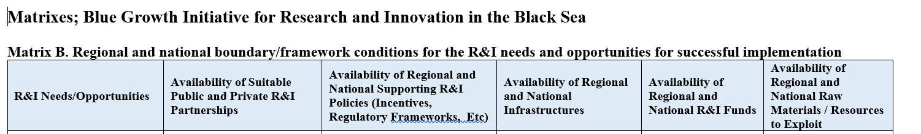
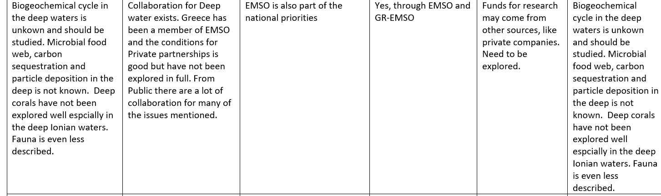

Slide 50
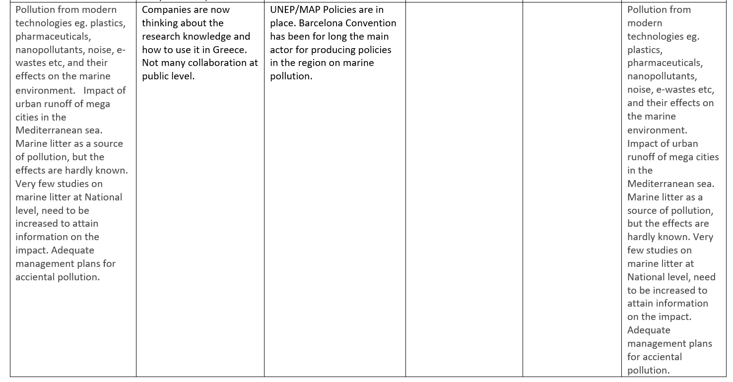

Slide 51
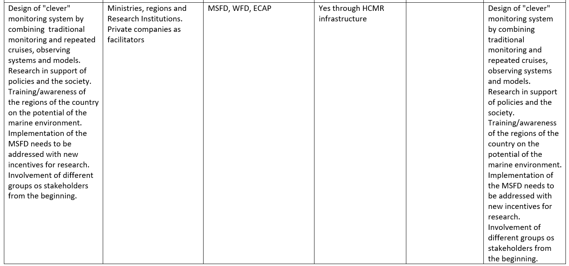

Slide 52
Matrix B
Need more information on
National Policies
National Infrastructure
Regional and National Funds

Slide 53
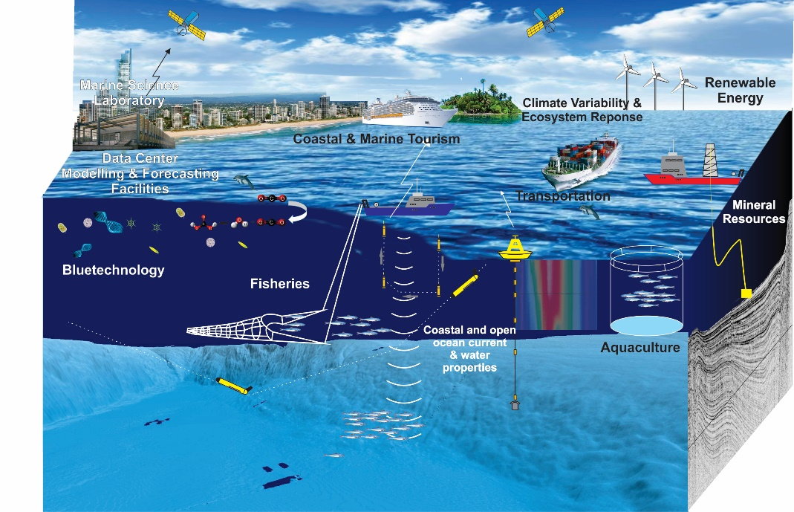
Talk outline
National strategies/policies
Alignment with BLUEMED themes and priorities
  Theme 1: Key enabling knowledge for the Mediterranean
  Theme 2: Key sectoral enablers in the Mediterranean
  Theme 3: Enabling technology and capacity creation for the Mediterranean Innovative human potential and infrastructure required
Regional approach for the Eastern Mediterranean towards partnership
The Turkish Eastern Mediterranean Region Potential for Blue Growth

Slide 54


Blue Growth Related National Strategic Plans
The Ministry of Transport, Maritime Affairs and Communication
  Strategic plan 2017-2021
  Developing action plans for short and long term maritime transport
  Contributing to the development of the maritime affairs
  Developing combined transport
  Developing maritime security strategies
The Ministry of Energy and Natural Resources
  Strategic plan 2014-2018
  Increasing green energy capacity from solar, wind and wave energy.
  Exploration of new marine hydrocarbon resources in Turkish and international waters
  Generating new geological, geophysical and oceanographic dataset for natural hazard, climate change, coastal protection researches

Slide 55



Blue Growth Related National Strategic Plans
The Ministry of Environment and Urbanisation
  Strategic Plan 2013-2017
  Preparing marine spatial plans
  Implementation of Integrated Coastal Zone Management
  Preparing action plans to decrease the marine pollutants including marine litter
Creating a water quality monitoring action plan from watershed to deep sea
The Ministry of Forestry and Water Affairs
  Strategic plan 2017-2021
  Creating a national water information system to protect the
  water resources
  Monitoring the quality of water to comply the related EU directives.
The Ministry of Food, Agriculture and Livestock
    Strategic Plan 2013-2017
    Creating a Vessel Monitoring System
    Controlling the quality of water sources for aquaculture
    Directorate for fisheries and aquaculture

Slide 56
Blue Growth Related National Strategic Plans
The Ministry of Development
Responsible for national infrastructure investment
Marine Ecosystem and Climate Research Centre (DEKOSİM) – 2012
The Turkish National Marine Research Strategy (TUDAS) – 2014
Evaluation of the Marine Research Capacity in Turkey – 2017
DEKOSİM2 - 2019

Slide 57
Blue Growth Related National Strategic Plans
Action Plans
National Biological Diversity Strategy and Action Plan (2008-2017) of the 9th Developmental Plan
Turkish Climate Change Strategy (2010-2023)
National Sciences and Technology Policy (2003-2023): Developing new technologies for sustainable water management resources, and for marine pollution
National Basin Management Strategy (2014-2023)
National Strategy for Marine and Coastal Protected Areas (draft)
United Nations Decade on Biodiversity - Aichi Targets agreement that contributes to the implementation of the Strategic Plan for Biodiversity for the period 2011-2020.
Marine ecosystem research is also a strategic field of activity for Middle East Technical University along with renewable energy and sustainability (jointly entitled I-REES, http://yesap.metu.edu.tr/about).
Ministry of Development, National Strategy For Regional Development (2014-2023)

Slide 58
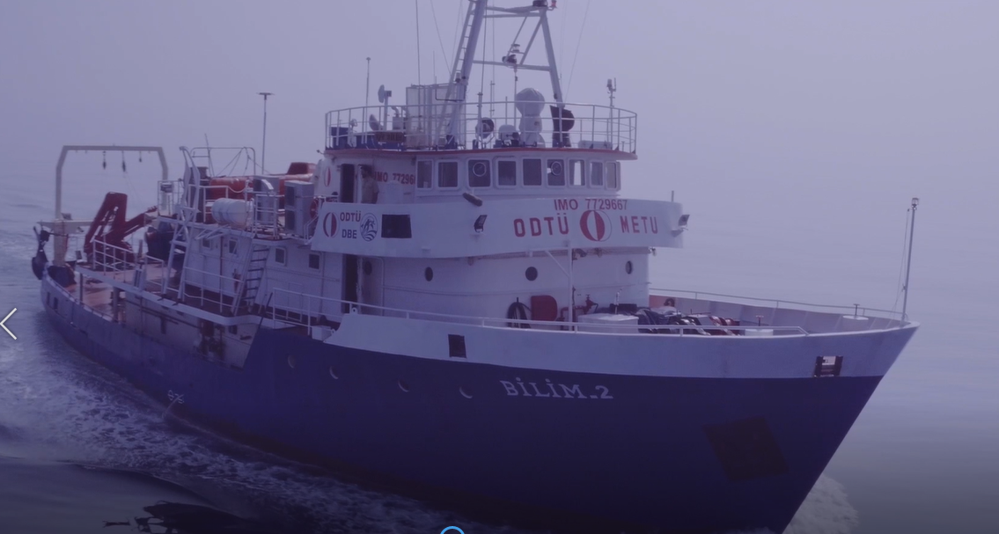
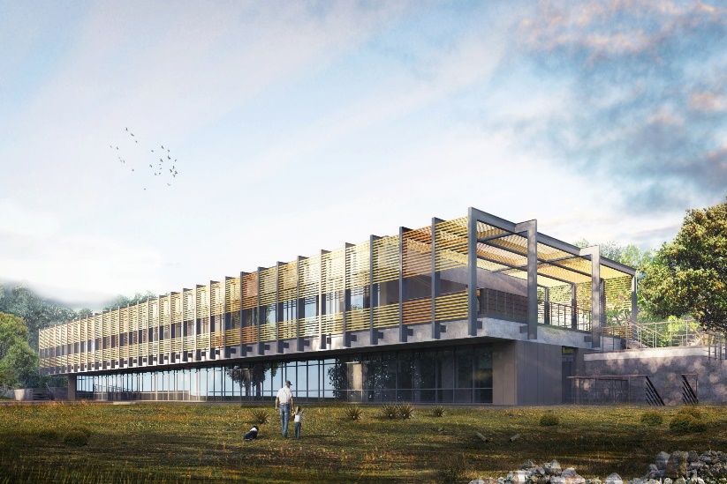
Middle East Technical University - Institute of Marine Sciences
Blue Growth Related National Strategic Plans
Center for Marine Ecosystems and Climate Research
Novel Labs - Networked Observation – Time Series
(DEKOSIM) Project (2012-2018) – DEKOSİM2 Project 2019-2023
  Supported by the Turkish Government
    New Laboratory dedicated to Marine Sciences
    New Observing Systems: Mooring, Argo, Scanfsih, Gliders, Time Series, …
    Cruises in Eastern Mediterranean and Black Sea
State of the art
Marine Laboratories
Sea Expeditions
Time Series

Slide 59
Matrix B. Regional and national boundary framework conditions
Limited input received for Matrix B
Matrix B should be revisited according to the final R&I NEEDS/OPPORTUNITIES defined in Matrix A
Matrix B. Regional and national boundary/framework conditions for the R&I needs and opportunities for successful implementation
Matrix A
R&I NEEDS/OPPORTUNITIES | AVAILABILITY OF SUITABLE PUBLIC AND PRIVATE R&I PARTNERHIPS | AVAILABILITY OF REGIONAL AND NATIONAL SUPPORTING R&I POLICIES (INCENTIVES, REGULATORY FRAMEWORKS, ETC)
AVAILABILITY OF REGIONAL AND NATIONAL INFRASTRUCTURES | AVAILABILITY OF REGIONAL AND NATIONAL R&I FUNDS | AVAILABILITY OF REGIONAL AND NATIONAL RAW MATERIALS / RESOURCES TO EXPLOIT

Slide 60
3rd meeting for developing a Blue Growth Initiative for Research and Innovation in the Black Sea
The matrix of marine research projects
Matrix A. Analysing gaps and research & innovation opportunities providing the necessary justification/drivers
Matrix B. Regional and national boundary framework conditions
Roadmap to new SRIA for the Black Sea

Slide 61

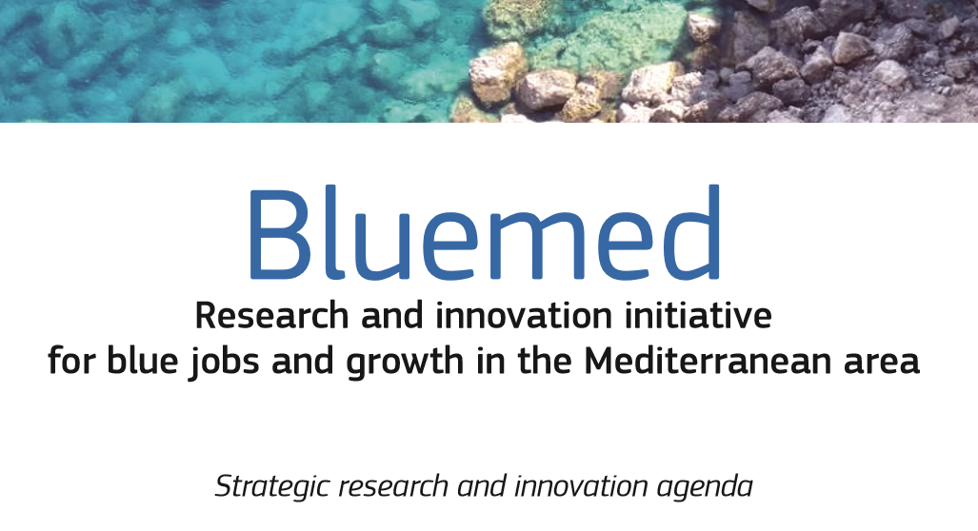

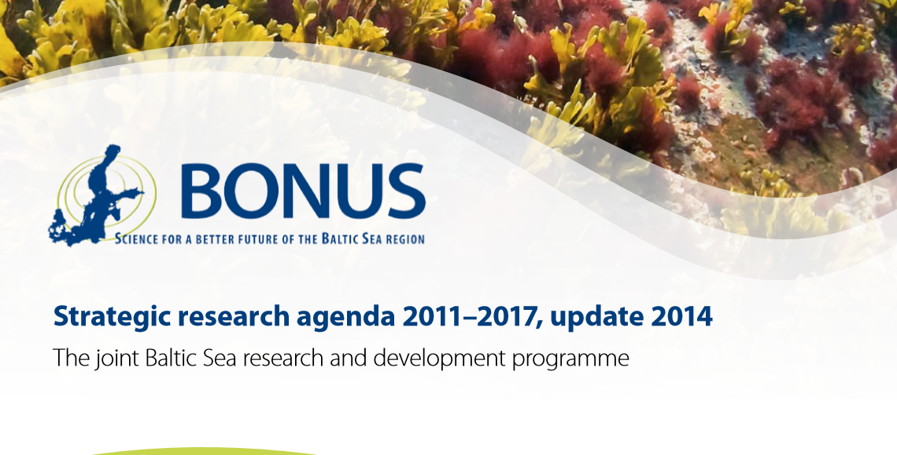
Next steps: The basis for a new Research and
Innovation Strategy in the Black Sea

Slide 62
The basis for a new Research and
Innovation Strategy in the Black Sea
Typical Flow of a SRA document:
Mutually agreed vision and goals
Mutually agreed challenges
Policies, broader context driving the future
Strategic Objectives and Sub-Headings – each section explained in a succinct, well written manner
Annexes, declarations, etc.

Slide 63
Four Questions that we should be thinking about
today for preparation towards the new SRA
What are our shared vision and mutually agreed challenges
for the Black Sea?
What can be in common with the new Black Sea SRA
and existing SRAs?
How and to what extent should the new Black Sea SRA
differentiate from other basin strategies?
If we decide to move forward, what will be the main pillars
and major strategic objectives of the SRA?

Slide 64
1- What are our shared vision and
mutually agreed challenges for the Black Sea?
Vision for Black Sea – some phrases that must be in there
…Black Sea as a shared resource (Atlantic SeasEra, 2014)
…Sustainable, productive, healthy ecosystem for blue growth and blue jobs
…Cooperation and integration of knowledge
…
…

Slide 65
1- What are our shared vision and
mutually agreed challenges for the Black Sea?
Major Challenges for the Black Sea:
Ecosystem degradation due to anthropogenic impact, pollution, climate change and resource extraction
Underdeveloped predictive capability due to increasingly complex array of multi-stressors and their less-known interactions
Lack of integrated, multidisciplinary, blue-growth tailored knowledge
Lack of emergent blue sectors and research-public-private cooperation (i.e. clusters) inhibiting the growth of blue economy

Slide 66


2- What can be in common with the new
Black Sea SRA and existing SRAs?
SEAS ERA
Atlantic 2014
Black Sea 2012
Understanding the Baltic Sea
ecosystem structure and functioning
Basic Research and
New Knowledge
Key enabling knowledge
for the Mediterranean
Meeting the multifaceted challenges
in linking the Baltic Sea
with its coast and catchment
Applied Research - Science supporting Society and Economy
Key sectoral enablers
in the Mediterranean
Enhancing sustainable use of coastal and marine goods and services of the Baltic Sea
Improving the capabilities of the society
to respond to challenges directed
to the Baltic Sea region
Critical Supports/
Infrastructure needs
Enabling technology
and capacity creation
for the Mediterranean
Innovative human potential
and infrastructure required
Developing improved and
innovative observation and
data management systems

Slide 67
2- What can be in common with the new
Black Sea SRA and existing SRAs?
Atlantic 2013
Black Sea Seas Era
Final SRA – (2012)
BlueMed
Basic Research and New Knowledge
Ecosystem Function – Biodiversity- Complexity and Connectivity;
Coping with Uncertainty and Change –the impacts of global climate change.
Basic Research and New Knowledge
Geological structure and dynamics of the Black Sea Basin
Physical climate, hydrological cycle, ventilation and inter‐basin coupling
Climatic variability, ocean acidification
Biodiversity, invasive species
Euthropication, good ecosystem health
Deep sea research
Key enabling knowledge for the Mediterranean
Mediterranean Sea ecosystems: services, resources, vulnerability and resilience to natural and anthropogenic pressures
Mediterranean Sea dynamics: developing services in the field of sustainable adaptation to climate change and plans for mitigation
Hazards and the protection of coastal areas in the Mediterranean
Applied Research - Science supporting Society and Economy:
Protecting the Marine Environment – Implementing the MSFD;
Marine Renewable Energy - Powering Europe;
The Greening of Maritime Transport - Safety, Surveillance and Logistics;
Reclaiming Our Ocean Heritage - Marine/Maritime Leisure and Tourism;
The Marine (Blue) Bioeconomy: Fisheries, Aquaculture, Seafood;
Harvesting the oceans non-living resources: Sustainable mineral, oil and gas extraction from coastal and offshore areas.
Applied Research - Science supporting Society and Economy:
Renewable energy, mineral resources, communication projects
Maritime Transport
Sustainable fisheries and aquaculture
Marine biotechnology
Natural hazards
Socio-economic research
MSP, MPA, ICZM
Key sectoral enablers in the Mediterranean
Innovative businesses based on marine bio-resources in the Mediterranean
Ecosystem-based management of Mediterranean aquaculture and fisheries
Sustainable tourism in the Mediterranean
Maritime clusters in the Mediterranean
Maritime Spatial Planning and Integrated Coastal Zone Management in the Mediterranean
Enabling technology and capacity creation for the Mediterranean Innovative human potential and infrastructure required
A. Smart, greener maritime transport and facilities in the Mediterranean
Observing systems and operational oceanography capacities in the Mediterranean
Multi-purpose offshore platforms in the Mediterranean
DMarine and coastal cultural heritage in the Mediterranean: discovering, protecting and valuing
Critical Supports/Infrastructure needs:
A European Atlantic Ocean Observing and Forecasting Capability (including seabed mapping);
An Atlantic Marine Socio-Economic Assessment Capability and Database;
11. A European Atlantic Marine Science and Technology Foresight Platform.
Critical Supports/Infrastructure needs:
Tools for policy implementation
Observation and forecasting systems
Marine research infrastructure
Human capacity building

Slide 68
2- What can be in common with the new
Black Sea SRA and existing SRAs?
Atlantic 2013
Black Sea Seas Era
Final SRA – D 8.1.1.
BlueMed
Basic Research and New Knowledge
Ecosystem Function – Biodiversity- Complexity and Connectivity;
Coping with Uncertainty and Change –the impacts of global climate change.
Basic Research and New Knowledge
Geological structure and dynamics of the Black Sea Basin
Physical climate, hydrological cycle, ventilation and inter‐basin coupling
Climatic variability, ocean acidification
Biodiversity, invasive species
Euthropication, good ecosystem health
Deep sea research
Key enabling knowledge for the Mediterranean
Mediterranean Sea ecosystems: services, resources, vulnerability and resilience to natural and anthropogenic pressures
Mediterranean Sea dynamics: developing services in the field of sustainable adaptation to climate change and plans for mitigation
Hazards and the protection of coastal areas in the Mediterranean
Applied Research - Science supporting Society and Economy:
Protecting the Marine Environment – Implementing the MSFD;
Marine Renewable Energy - Powering Europe;
The Greening of Maritime Transport - Safety, Surveillance and Logistics;
Reclaiming Our Ocean Heritage - Marine/Maritime Leisure and Tourism;
The Marine (Blue) Bioeconomy: Fisheries, Aquaculture, Seafood;
Harvesting the oceans non-living resources: Sustainable mineral, oil and gas extraction from coastal and offshore areas.
Applied Research - Science supporting Society and Economy:
Renewable energy, mineral resources, communication projects
Maritime Transport
Sustainable fisheries and aquaculture
Marine biotechnology
Natural hazards
Socio-economic research
MSP, MPA, ICZM
Key sectoral enablers in the Mediterranean
Innovative businesses based on marine bio-resources in the Mediterranean
Ecosystem-based management of Mediterranean aquaculture and fisheries
Sustainable tourism in the Mediterranean
Maritime clusters in the Mediterranean
Maritime Spatial Planning and Integrated Coastal Zone Management in the Mediterranean
Enabling technology and capacity creation for the Mediterranean Innovative human potential and infrastructure required
Smart, greener maritime transport and facilities in the Mediterranean
Observing systems and operational oceanography capacities in the Mediterranean
Multi-purpose offshore platforms in the Mediterranean
Marine and coastal cultural heritage in the Mediterranean: discovering, protecting and valuing
Critical Supports/Infrastructure needs:
A European Atlantic Ocean Observing and Forecasting Capability (including seabed mapping);
An Atlantic Marine Socio-Economic Assessment Capability and Database;
11. A European Atlantic Marine Science and Technology Foresight Platform.
Critical Supports/Infrastructure needs:
Tools for policy implementation
Observation and forecasting systems
Marine research infrastructure
Human capacity building
RED TOPICS: LACKING IN PRESENT BS SRA

Slide 69
2- What can be in common with the new
Black Sea SRA and existing SRAs?
Major Challenges for the Black Sea:
Need for more knowledge… but integrated and multidisciplinary
Applied science, but also integrated, holistic and towards blue economy. Developing solutions and products that will have to broad applications and decrease costs
Emphasis on technology and observing systems

Slide 70
3- What will be the differentiation strategy of the
Black Sea R&I SRA
Differentiation to ‘fundamental research’ pillar:
To be based on gaps/opportunities analyses
Specific topics to be addressed: fisheries and aquaculture, multistressors, hypoxia, microbe-to-fish ecosystem models as prediction tools, litter and microplastics, vulnerable seafloor ecosystems in the context of deep-sea resource extraction, basin interconnections
Form/foster scientific excellence centers, ‘pockets of excellence’

Slide 71
3- What will be the differentiation strategy of the
Black Sea R&I SRA
Differentiation to ‘applied research for blue economy’ pillar
Need also to emphasize institution/capacity building but not only research capacity. Strong need to build a ‘blue economy sectors’. Engage also more non-marine science academic and research community (economists)
Regional ‘clusters’ where close partnership between private sector, public local governance and and research institutions
METU-IMS is currently embarking to start one, but already a slow and cumbersome process.

Slide 72
New Regional Vision for the Mediterrenenan and the Black sea
Development of products with high economic (along the whole value chains) and by
guaranteeing environmental benefits

Slide 73
3- What will be the differentiation strategy of the
Black Sea R&I SRA
In the ‘critical infrastructure’ pillar:
See the Atlantic Observing System vision: Need a similar large scale infrastructure for Black Sea
‘…. a European Atlantic Ocean Observing and Predictive Capability, based on existing structures, platforms and mechanisms, to support the implementation of EU policies, reduce costs to industry, public authorities and research institutions, stimulate innovation and reduce uncertainty in our understanding of the behaviour of the Atlantic Ocean and the impacts of climate change…’

Slide 74
4- What will be the main strategic objectives
or main pillars of the Black Sea SRA?
A preliminary proposition:
Adopt BlueMed/Atlantic ERA three-pillar strategic approach
But use differentiation strategy for Black Sea. Some aspects (land-sea, emphasis on management) maybe from BONUS.
Tailored for a BONUS-type implementation

Slide 75
What will be the main strategic objectives
or main pillars of the Black Sea SRA?
To be filled…
Pillar 1: Fundamental Research addressing Black Sea challenges
…
…
Pillar 2: Developing Products, Solutions and Clusters underpinning Black Sea Blue Growth
…
…
Pillar 3: Critical Support and Innovative Infrastructure Building
…
…
…

Slide 76
What will be the main strategic objectives
or main pillars of the Black Sea SRA?
To be filled… OUR KEYWORDS DISTRIBUTED
Pillar 1: Fundamental Research addressing Black Sea challenges
Biodiversity
Biological Invasions
Catchment-Sea Interaction
Climate Change & Impacts
Cultural Heritage
Deep Sea Ecosystems
Ecosystem Multiple Stressors
Eutrophication and Deoxygenation
Interconnections of Basins
Marine and Coastal Hazards
Marine Ecosystem Services
Seas and Human Health
Socioeconomic & Policy Research
…
Pillar 2: Developing Products, Solutions and Clusters underpinning Black Sea Blue Growth
Blue Biotechnology
Deep sea mining, Oil and Gas Sustainable Exploitation
Living Marine Resources (fishery, aquaculture, etc.)
Marine Renewable Energy
Maritime Transport
MSP, ICZM
Tourism and Surrounding Economy
Pillar 3: Critical Support and Innovative Infrastructure Building
Operational Oceanography/Observing Systems and Monitoring
Training & Technology Transfer
Other/Multiple areas (specify in column B)
…
…
…
BUT RESEARCH KEYWORDS DO NOT NECESSARILY BE AGENDA SUBHEADINGS… NEED TO CONSTRUCT INCLUSIVE WORDING

Slide 77
Four Questions that we should be thinking about
today for preparation towards the new SRA
What are our shared vision and mutually agreed challenges
for the Black Sea?
What can be in common with the new Black Sea SRA
and existing SRAs?
How and to what extent should the new Black Sea SRA
differentiate from other basin strategies?
If we decide to move forward, what will be the main pillars
and major strategic objectives of the SRA?

Slide 78
Black Sea Region Potential for Blue Growth
OPPORTUNITIES
Existing sectors such as Fisheries, Maritime, Aquaculture, Tourism, Energy
Shelf and deep sea areas, potential for new energy, mineral and biotechnology
Existing Key knowledge base, Human capacity and institutions
National plans superimposed by global trends such as ‘belt and road’ project
CHALLENGES
Multiple stressors: increasing temperatures, litter/pollution and oxygen depletion
Changing climate is influencing the hydrological systems as well as the formation of dense waters
Lack of a science based integrated management plan for important sectors such as tourism, aquaculture, energy and transportation in the region.
WAY FORWARD
Facilitate stakeholder and scientist exchange
Coordinate marine spatial planning in the region
Define new and emerging sectors
Generate science-based products and solutions
New high value products
(e.g., pharmaceutucals, enyzmes)

