Slide 1
EOSCpilot
Brian Matthews
STFC
Brian.Matthews@stfc.ac.uk

Slide 2
EOSC-Pilot Project
Setting the EOSC in the right direction
First of the EOSC projects
10M€ over 2 years
Jan 2017 – Dec 2018
33 Partners + 15 3rd parties
Led by STFC
A range of e-Infrastructure providers, research institutes, research consortia, across disciplines.
Try to answer some basic questions
What is the EOSC going to provide?
How is the EOSC going to operate ?
How is the EOSC going to change how science is done ?

Slide 3
EOSCpilot Challenges
Three types of challenges addressed by the EOSCpilot:
Scientific Challenges: deploying the EOSC to deliver Open Science
Scientific Challenges are really Opportunities
Technical Challenges: developing technical solutions that meet the scientific needs
Technical Challenges are Barriers to overcome
Cultural Challenges: adopting new, more open ways of working
Cultural Challenges are also Barriers
www.eoscpilot.eu

Slide 4
EOSCpilot: High Level Aims
The EOSCpilot project will support the first phase in the development of the EOSC.
Establish the governance framework for the EOSC
contribute to the development of European open science policy and best practice;
Develop a number of demonstrators
high-profile pilots that integrate services and infrastructures
show interoperability in a number of scientific domains;
Engage with a broad range of stakeholders,
crossing borders and communities,
build the trust and skills required for adoption of an open approach to scientific research.

Slide 5
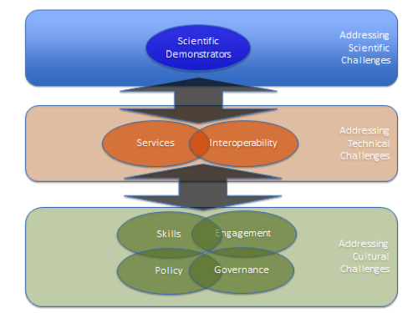
Workpackages
Governance
Propose a governance framework
Policy
Devise a policy environment
Demonstrators
Use real demonstrators to drive the requirements for the EOSC
Services
Specify service architecture, catalogue and pilot services
Interoperability
Identify interfaces and standards to drive interoperability
Skills
Specify a skills and competencies framework for the EOSC
Engagement
involve as many stakeholders as possible.
www.eoscpilot.eu

Slide 6
Science Demonstrators
First 5 Demonstrators
Environmental & Earth Sciences - ENVRI Radiative Forcing Integration to enable harmonised data access and integration across multiple research communities
High Energy Physics - WLCG: large-scale, long-term preservation and re-use of HEP data in the EOSC open to other researchers
Humanities – TEXTCROWD: Collaborative semantic enrichment of text-based datasets by make new software available on the EOSC.
Life Sciences - Pan-Cancer Analyses & Cloud Computing within the EOSC to accelerate genomic analysis on the EOSC
Physics - The photon-neutron community to improve the community’s computing facilities by creating a virtual platform for all users
10 more demonstrators later in the project
2 calls for new demonstrators
1st call next month

Slide 7
Thank you brian.matthews@stfc.ac.uk
Twitter: @eoscpilot
Linkedin: /eoscpilot

Slide 8
Future Challenges
Brian Matthews
STFC
Brian.Matthews@stfc.ac.uk

Slide 9
Challenges : Interoperability
Accessing and understanding data within and across disciplines
Interoperability of data, tools and services
Common services, common APIs, service catalogues
Common formats, common metadata
Persistent Identifiers: constancy of reference for data, people, software, things …
Deepening understanding
Context and provenance: assessing the quality of data
Comparison between experiment/observation and simulation;
Preserving the record of science
Reproducible Science
Working internationally
crossing borders and communities,
across the world

Slide 10
Challenges : Social and cultural
Changing culture to make the most of open science
Sharing of data and services
Data: “You can use mine”
Services : “I will use yours”
Developing Skills
Data Scientists : data engineers, data custodians, data analysts
Expertise in quality software engineering
Credit where credit’s due
Recognition for sharing
Recognition for contributing
Rewards should follow the contribution

Slide 11
Challenges : Infrastructure
Accessing shared resources to realise the promise of data intensive open science
Accessing Data
Storing, accessing and integrating data at scale: common data centres and services
Moving data at scale: limitations of networks
Keeping data for the long-term: digital preservation
Accessing Compute
Access to scarce large-scale computing architectures (HPC, HTC, HPDA)
Co-location of data and compute
Cloud interfaces and Virtual Research Environments
User identity and trusted work-spaces
Accessing Software
Complex code for computational modelling and simulation
Adapting code to large-scale computing architectures
Data analysis algorithms becoming more sophisticated
Sustainability of software for the long-term

Slide 12
Thank you brian.matthews@stfc.ac.uk
Twitter: @eoscpilot
Linkedin: /eoscpilot

