Slide 1
Workshop on Offshore Renewable Energy
: the COREWIND project
October 2022
Dr. Jose Luis Domínguez-García
IREC – Project coordinator

Slide 2





Project information
Starting Date: 01/09/2019 Ending Date: 28/02/2023
Duration: 42 month
Project webpage and social media profiles:
corewind.eu
@corewindeu
https://www.linkedin.com/company/corewind/
M36

Slide 3
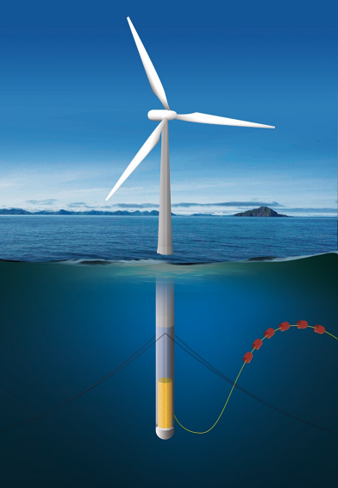
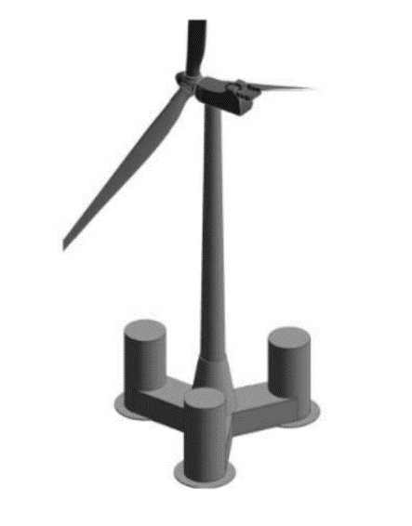
Project introduction
The COREWIND project provides disruptive and cost-effective solutions for floating offshore wind technology, leading to cost reduction, by developing innovative research, modelling and optimization for floating substructure concepts. This is achieved by developing research on the mooring and anchoring systems, power dynamic cables, O&M as well as digitalization, standardization and validation.
The project will achieve at least a 15% LCOE reduction by the end of the project (i.e. 100€/MWh approximately) through disruptive technologies and procedures for floating wind sector; paving the way for achieving future cost objectives earlier (i.e. ≈ 80 €/MWh by 2040, 10 years ahead expectations).
With special focus on 2 concrete-based floaters:
WindCrete and ActiveFloat

Slide 4
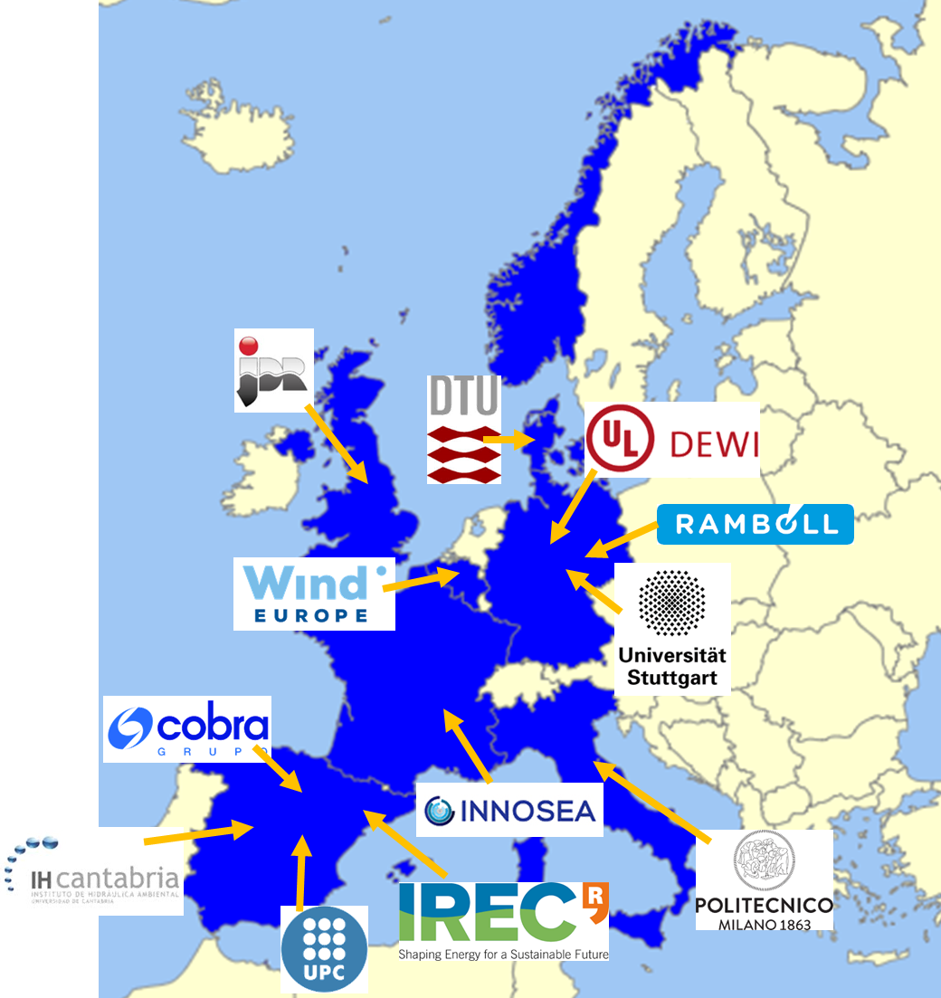








Project partners and advisory board
Third Parties
External Advisory Board

Slide 5
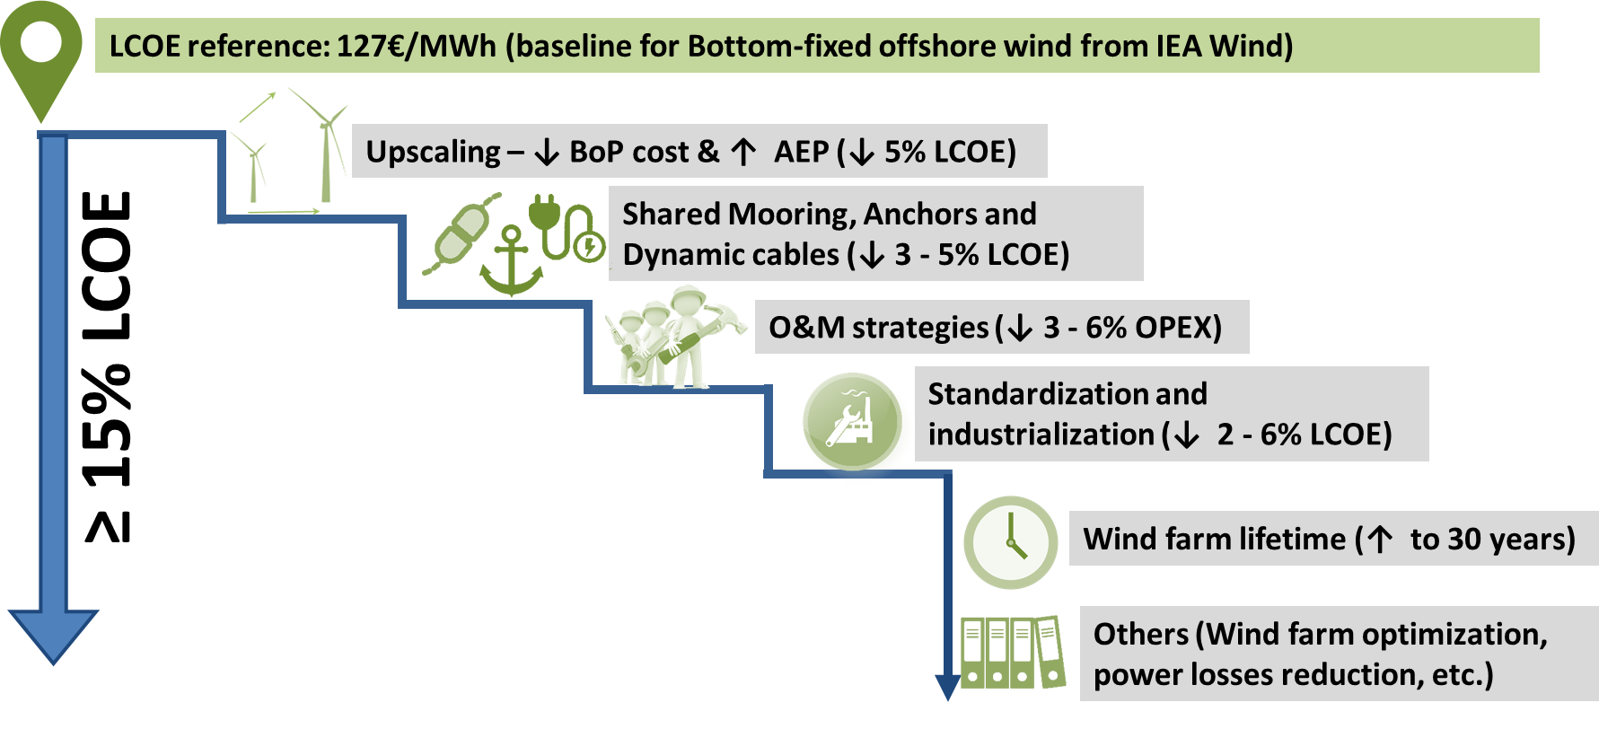
Project expected impacts and outcomes
Advanced numerical tools
Reference models:
  15 MW WT reference model
  2 floater (semi-sub & spar) models
Design and operation tools:
  1 BIM toolbox for floating wind industry
  1 Open and agnostic Digital Twin for floating wind
  1 O&M planning and assessment tool
Economic tools:
  1 LCOE and LCA calculation tool
  Floating Wind Farm optimization modules for cost minimization

Slide 6
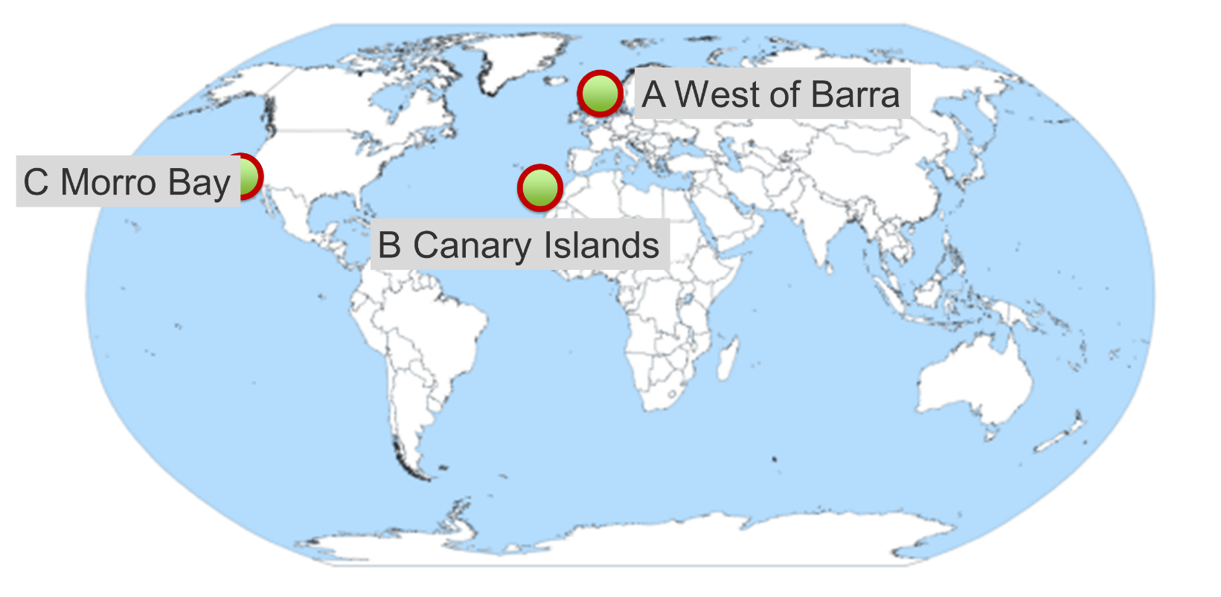
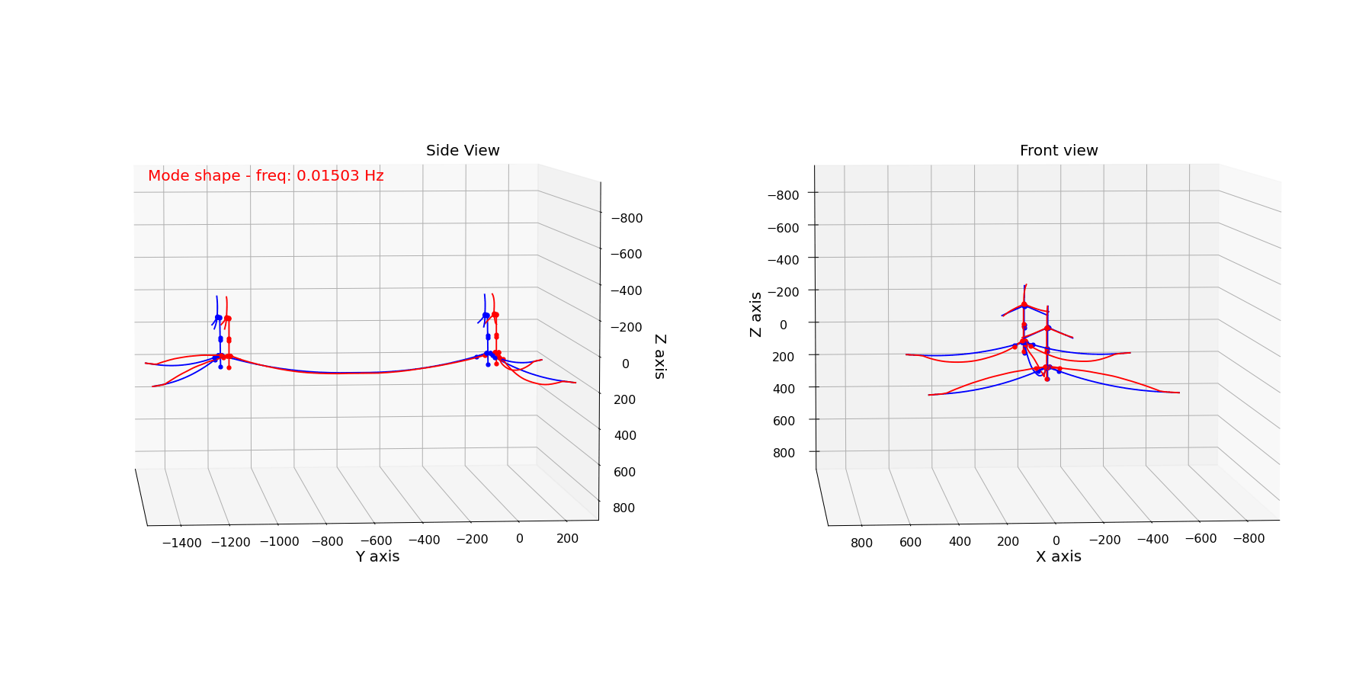
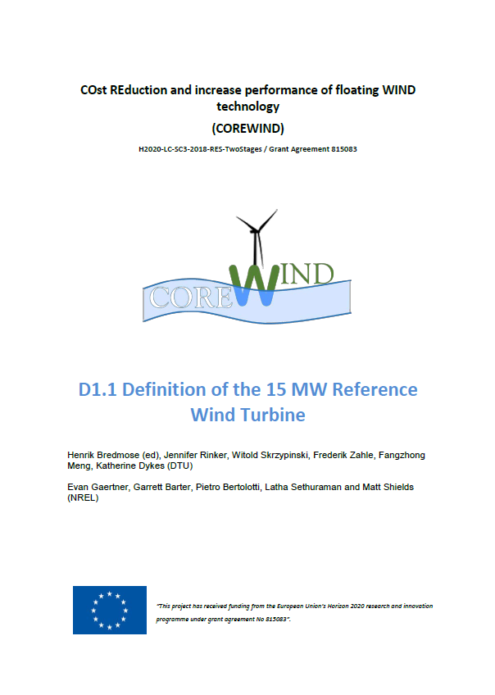
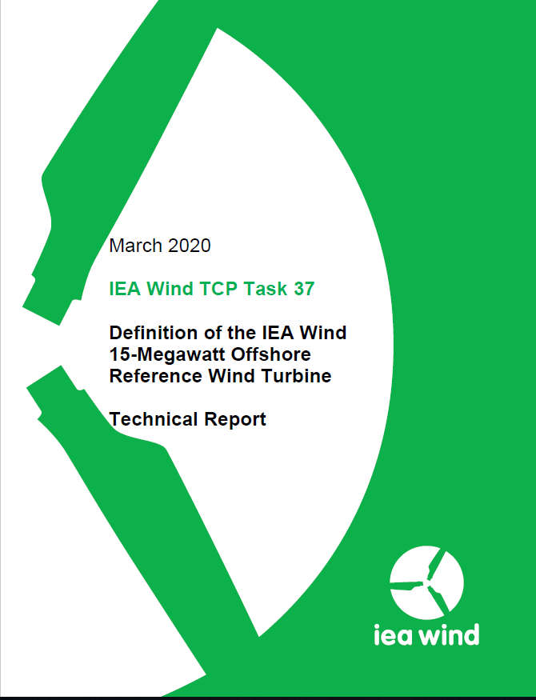
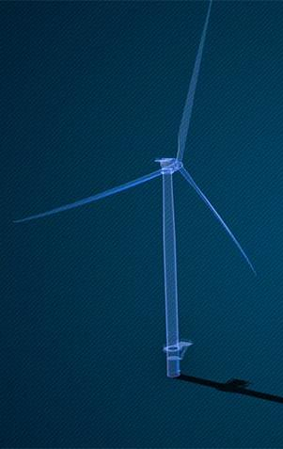
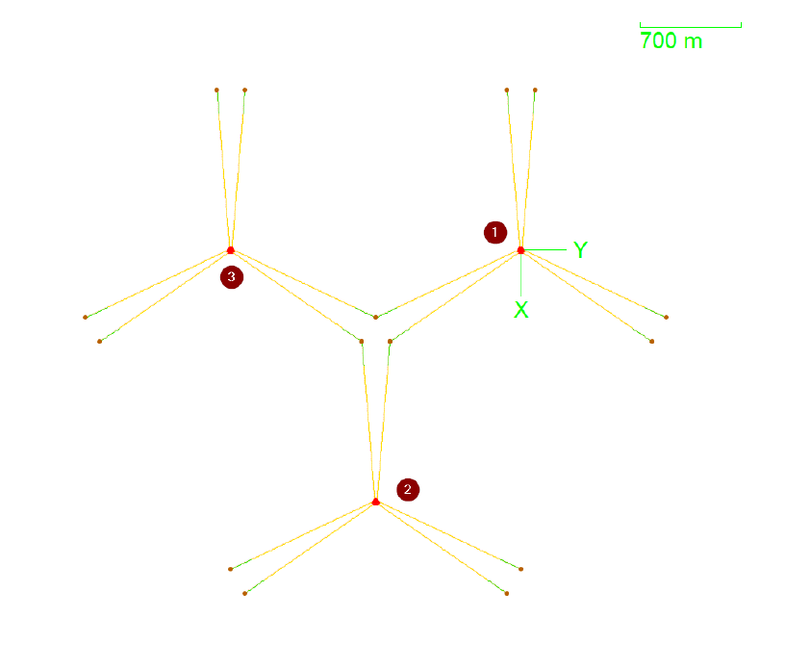
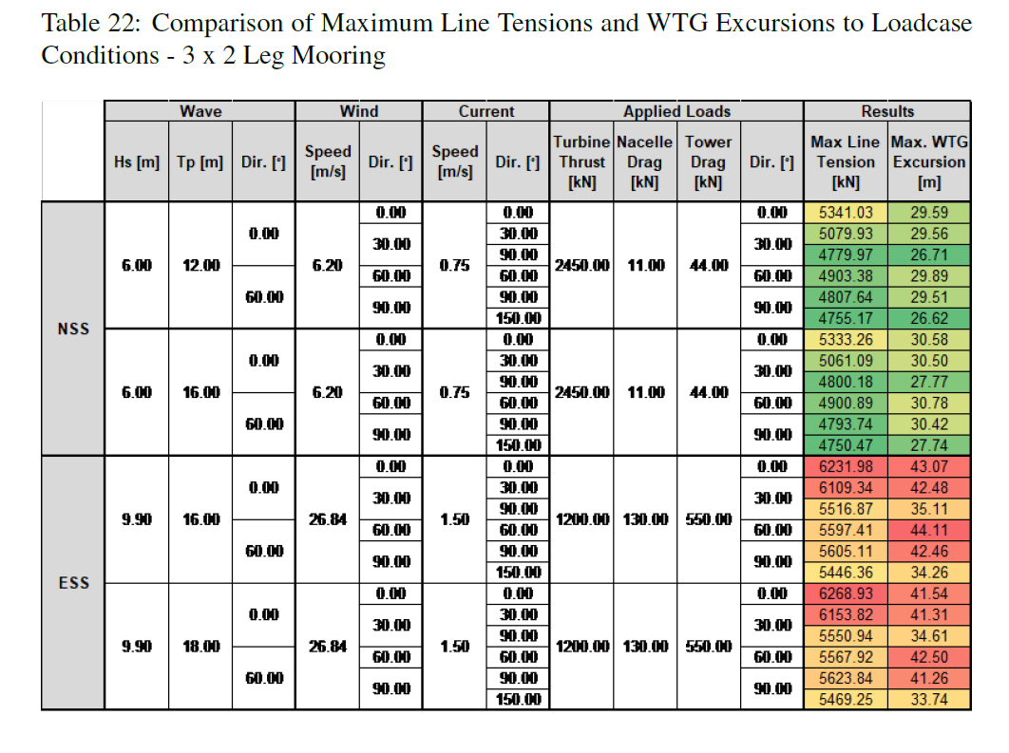
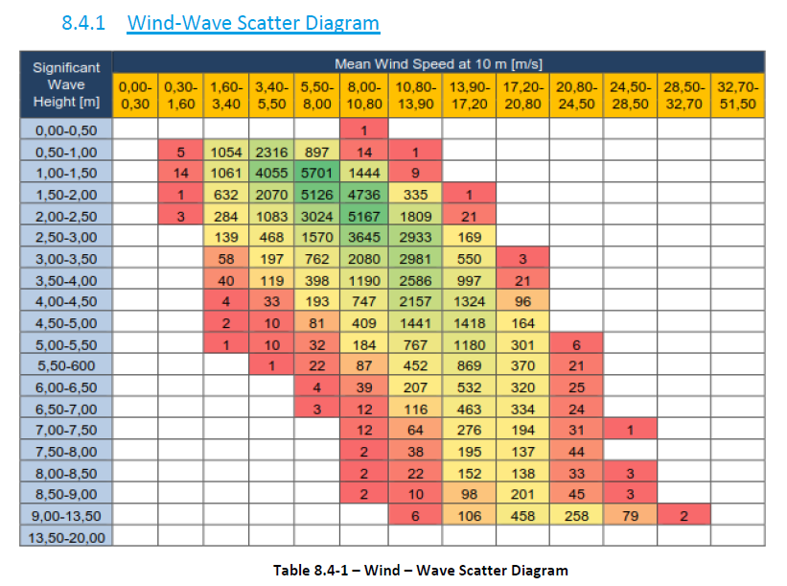
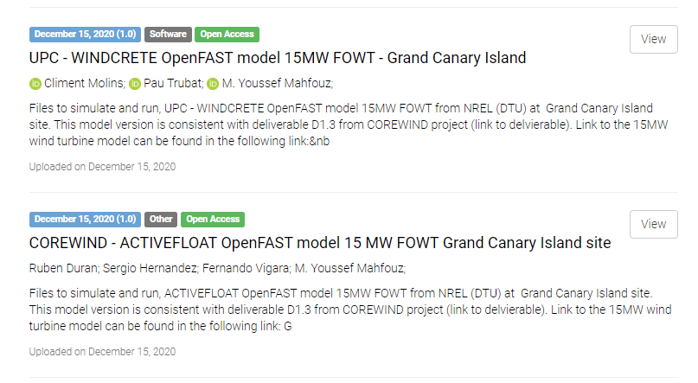
WP1: Efficient design tools for floating wind turbines
OpenFAST model
IEA Wind 15MW RNA
Mooring system
Tuned ROSCO controller
WindCrete
(floater +tower)
Shared mooring lines
Floater upscaling model
Load assessment for shared anchors

Slide 7
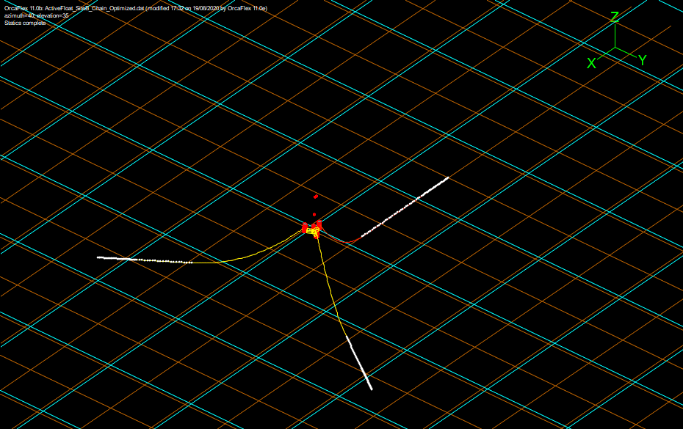
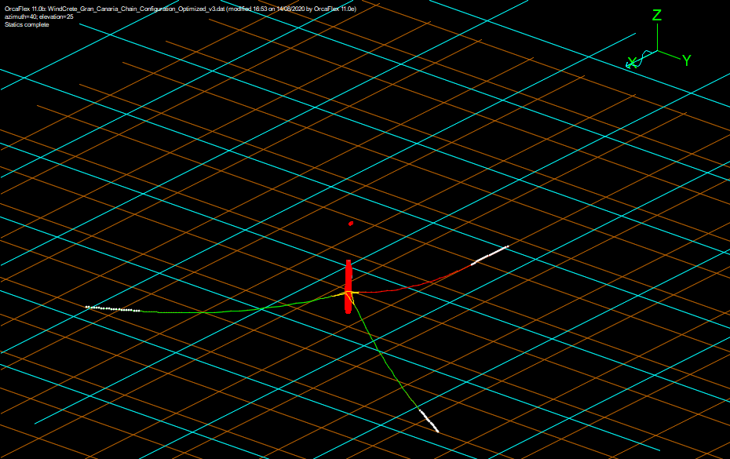
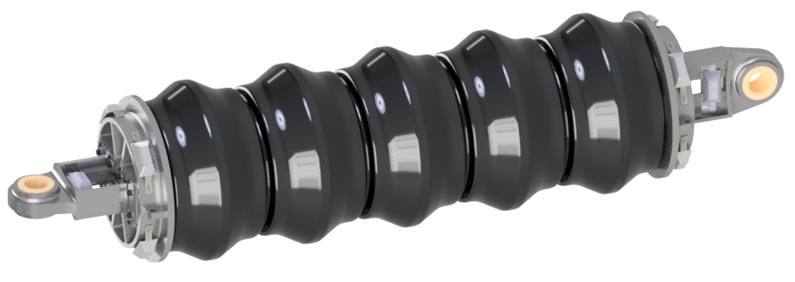
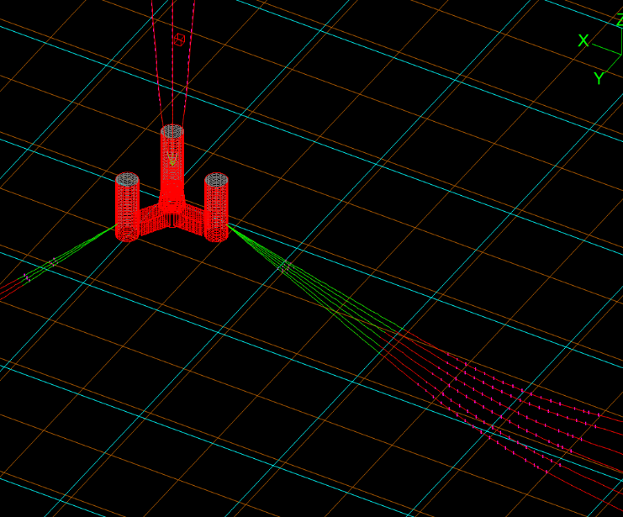
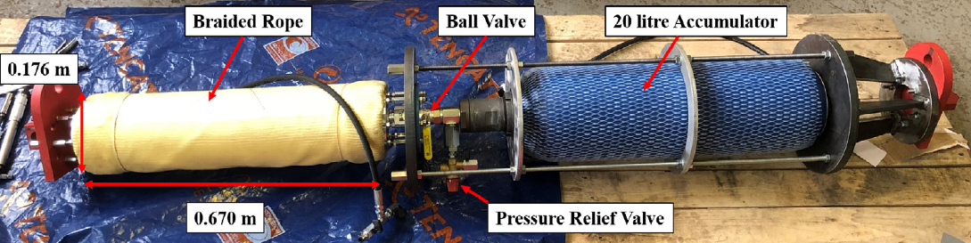
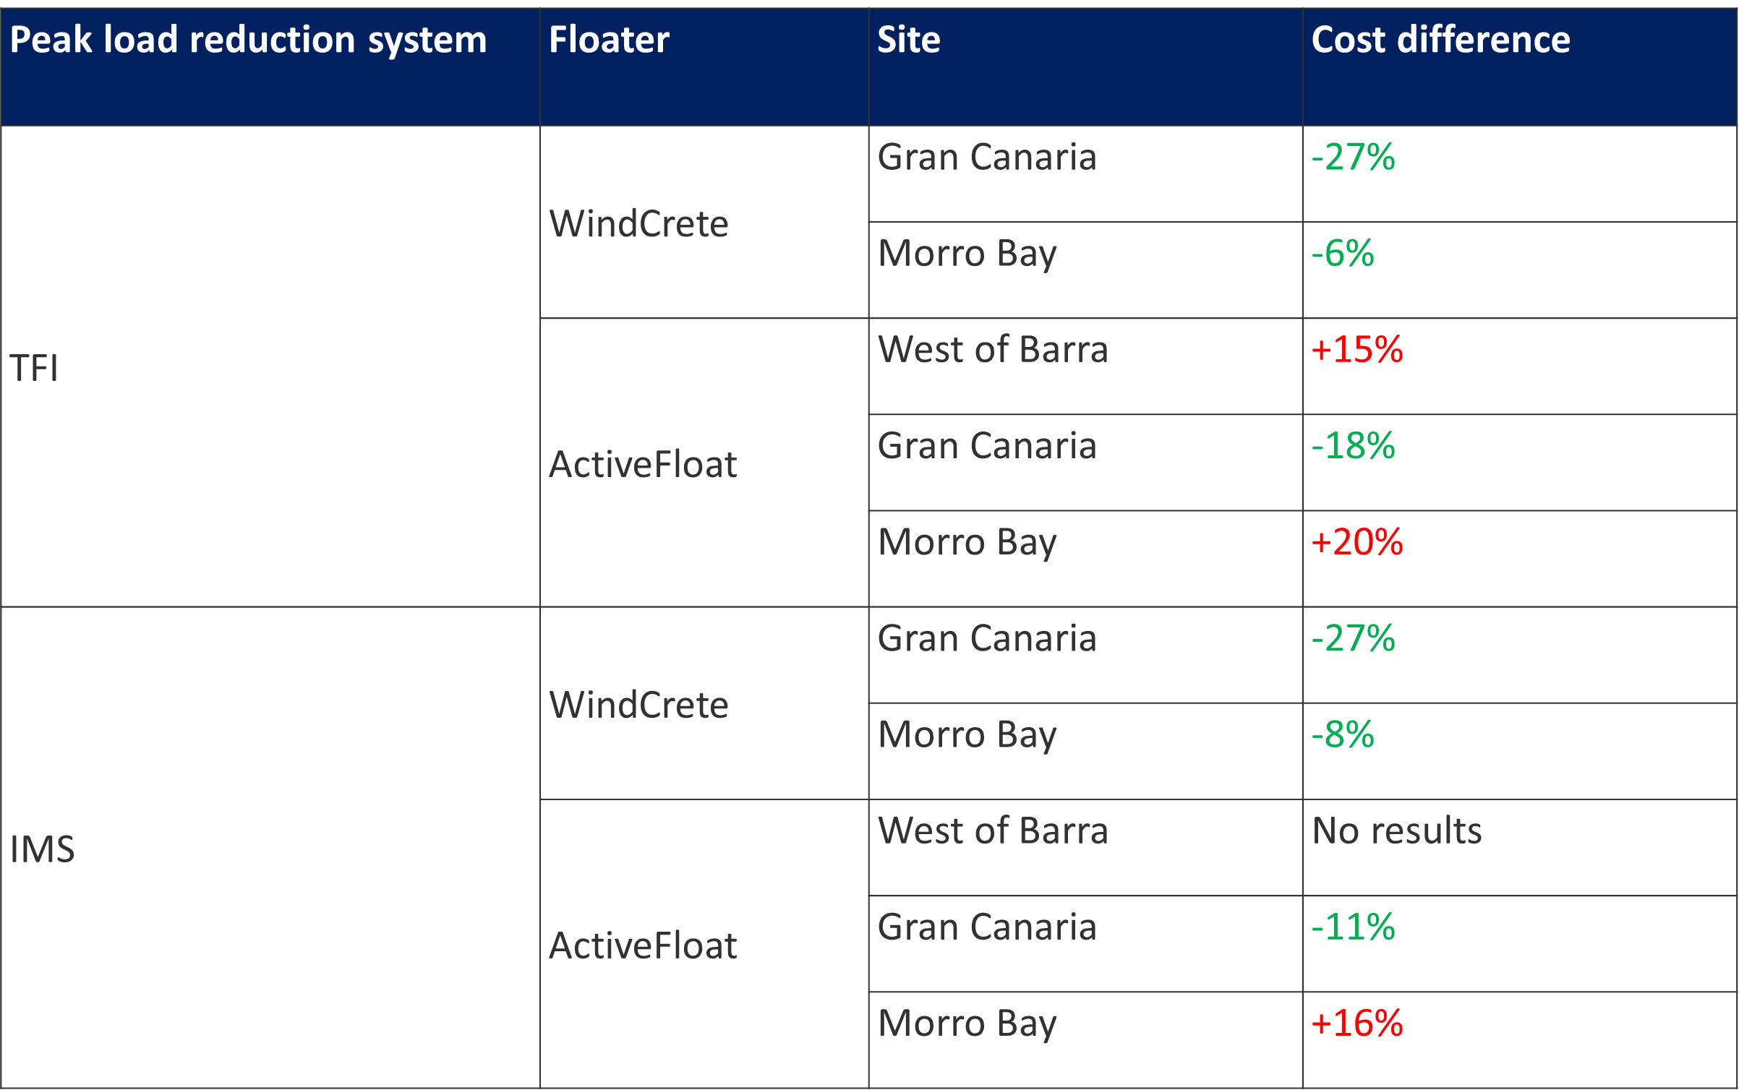
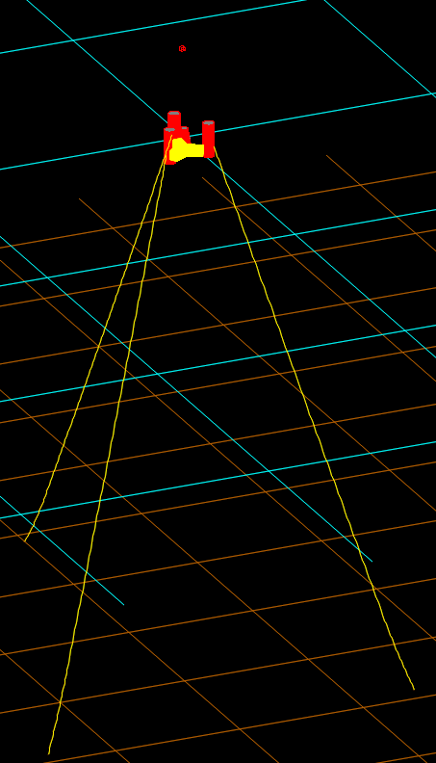
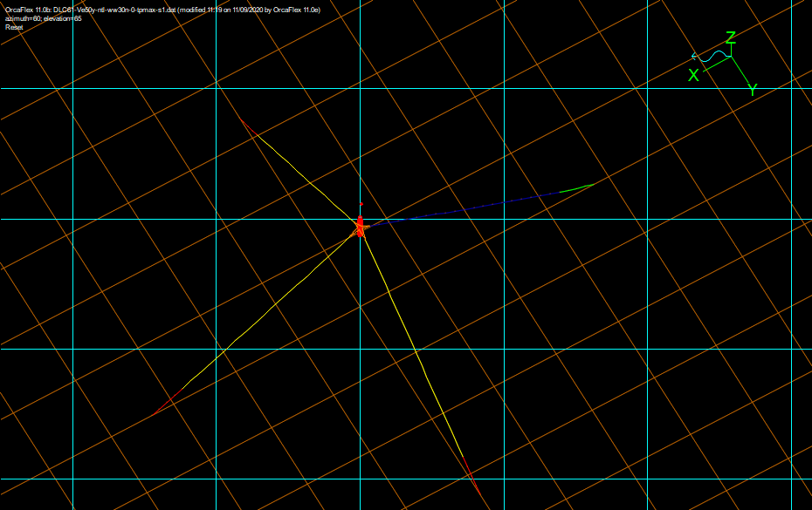
WP2: Design and optimization of station keeping systems
Optimisation tool developed
Optimized mooring:
Peak Load reduction:
Gran Canaria
Environmental conditions
Mooring configuration (Number of Lines, Materials, Number of Sections, etc.)
FAST model definition
Orcaflex model definition
Parameters configuration (Boundaries, Initial Values, etc.)
West of Barra
Isight model configuration
Orcaflex simulation
Isight Optimization
Python interface
FAST simulation
Morro Bay
Objective: minimize costs
Constraints: criteria satisfied & limited motions/acceleration
Design parameters (diameters, line length, steel grade, etc.)
Model set up
Design criteria verification
Motions (excursions & angles) & accelerations calculations
Costs estimation

Slide 8
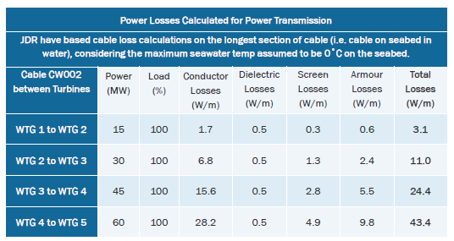
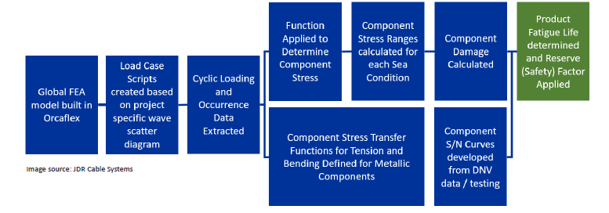
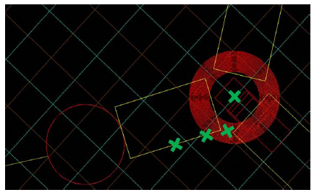
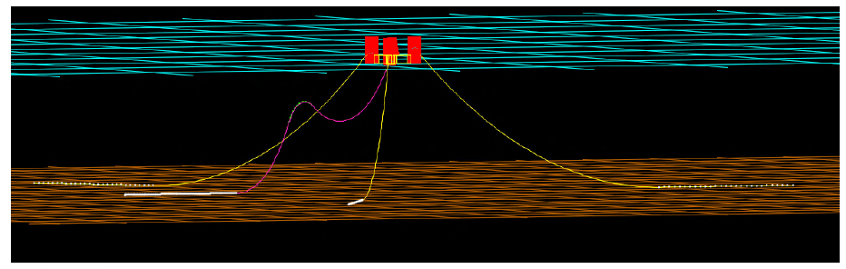
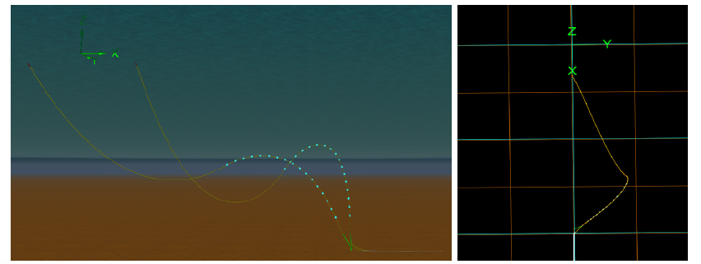
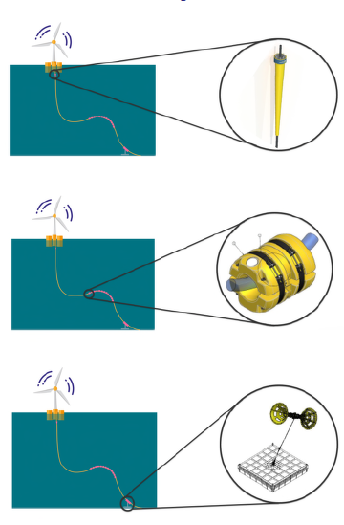
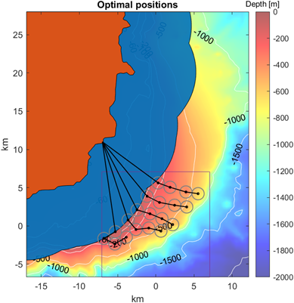
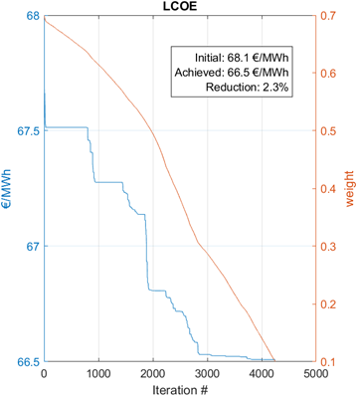
WP3: Dynamic Cable Design optimization
Preliminary Estimations:
Fatigue Evaluation and modelling
Equipment:
Bend restriction
Optimisation of layout
Buoyancy modules
Hold Back Tether

Slide 9
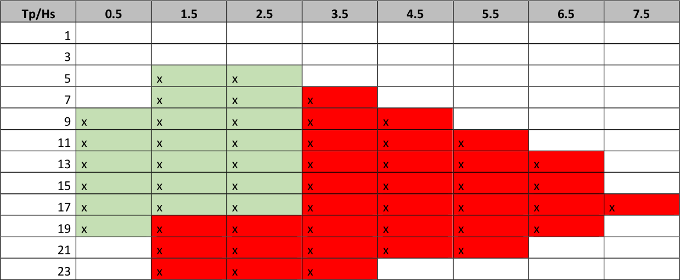
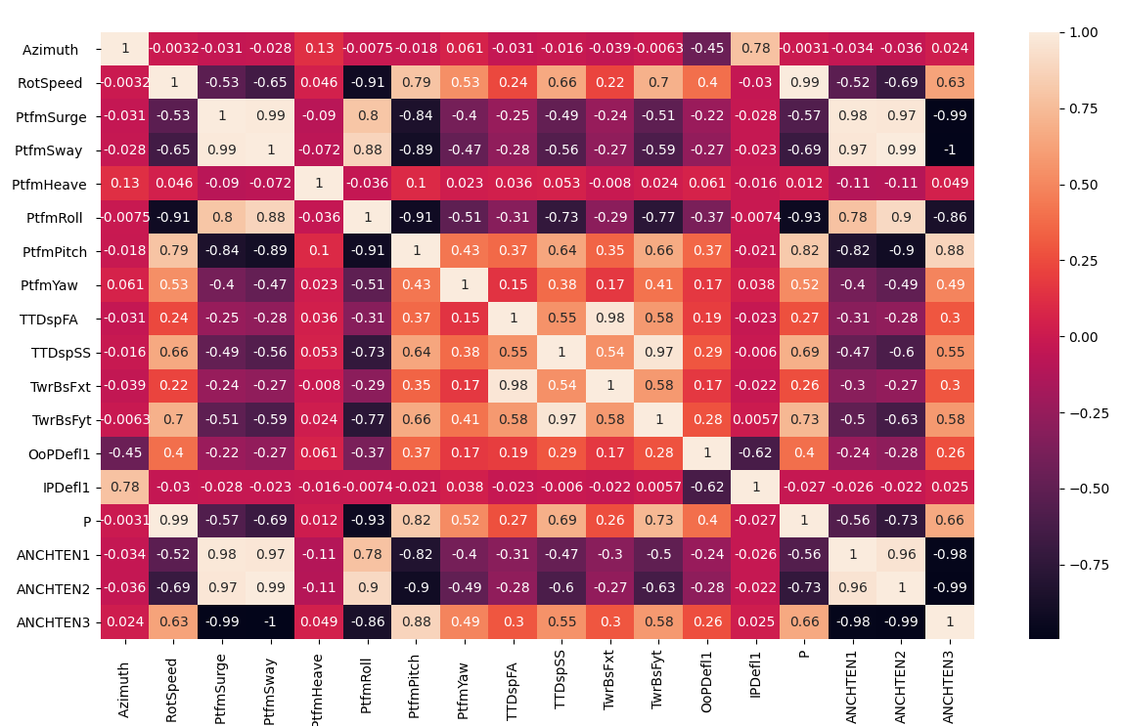
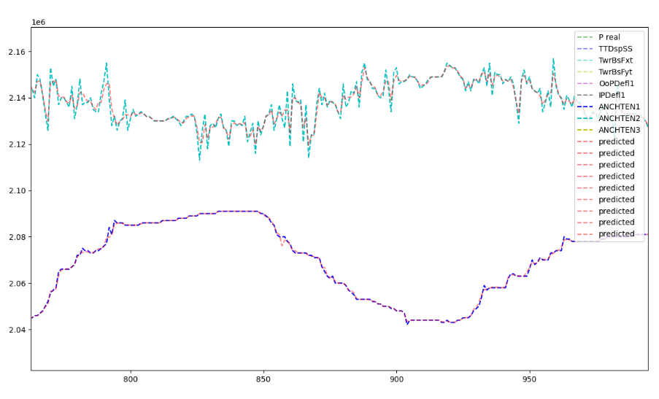
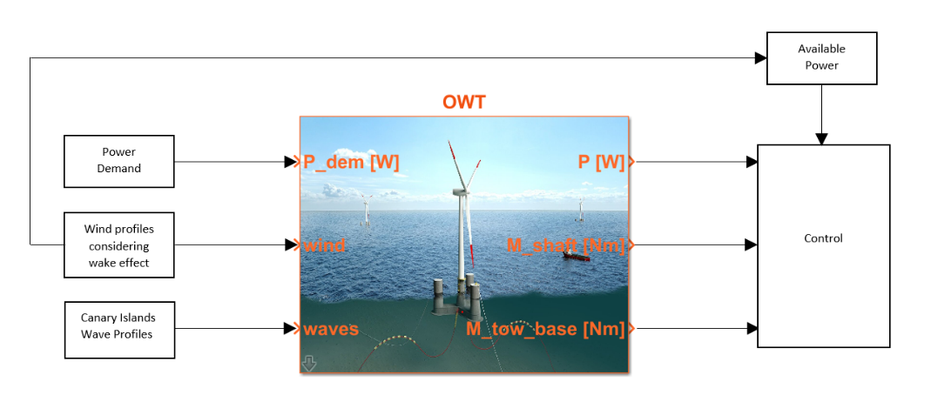
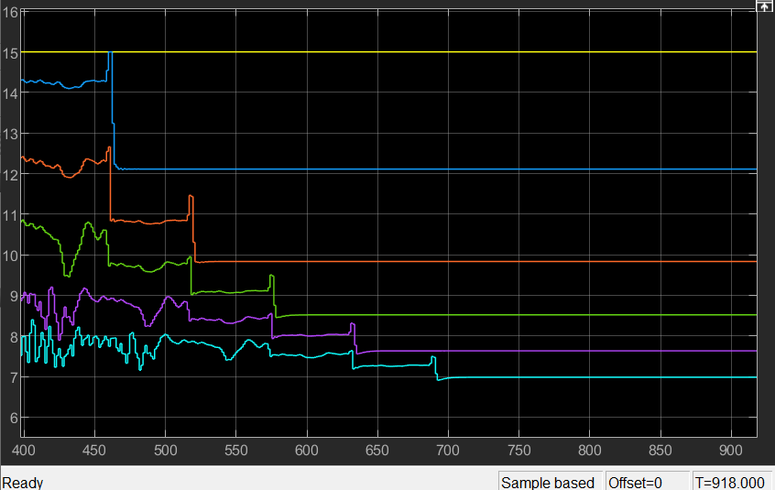
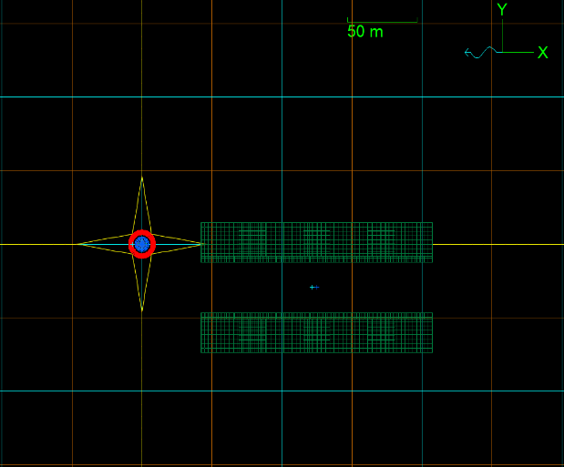
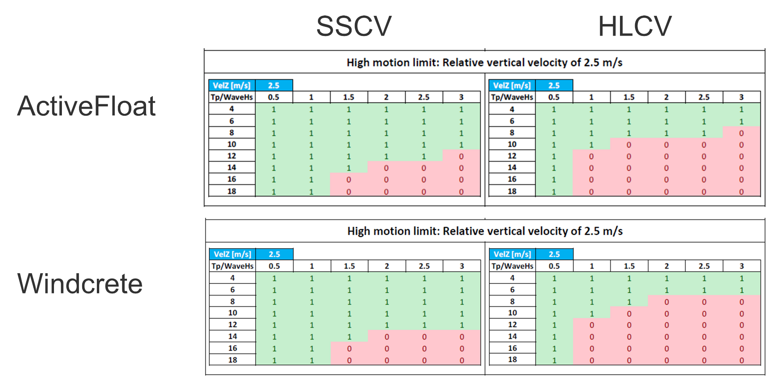
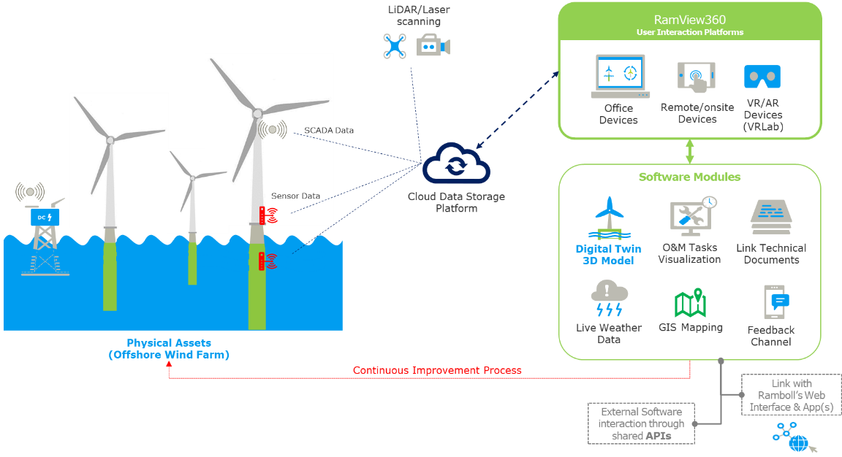
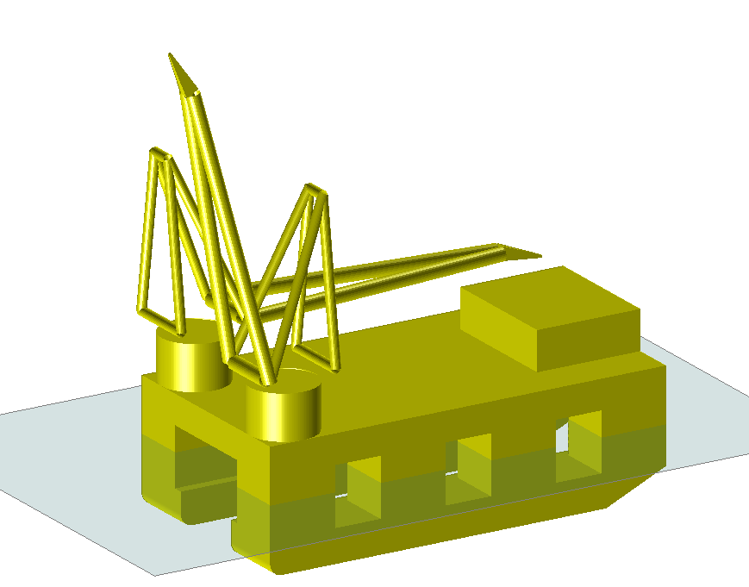

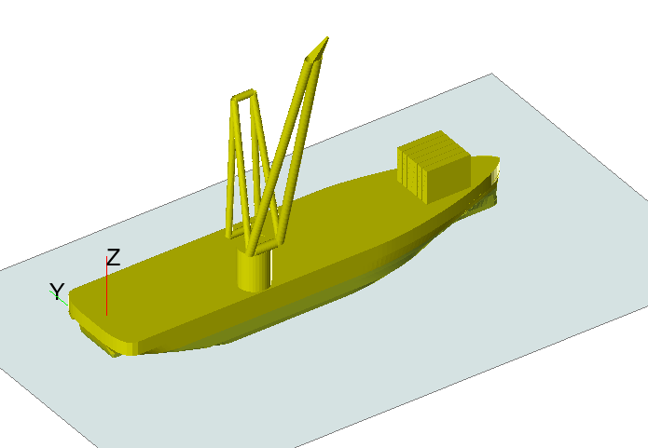
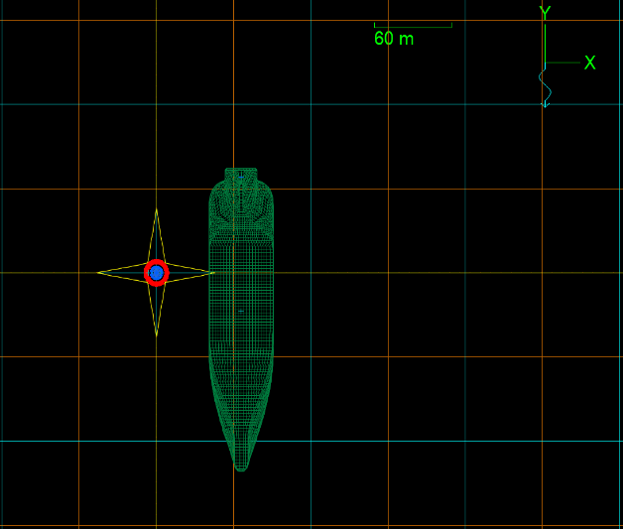
WP4: Optimizing O&M Strategies and Installation Techniques
Workability Assessment:
Digital Models
Machine Learning
For O&M DigitalTwin
Workability Index of ActiveFloat concept. Green: Sea states fulfilling acceptance criteria. Red: Sea states not fulfilling acceptance criteria.
Diagram showing possible weather window for tow-in of Windcrete concept. Green: Sea states fulfilling acceptance criteria. Red: Sea states not fulfilling acceptance criteria.
Model
and
MPC
Vessel comparison for O&M:
SemiSub
90°
0°
N
BIM model
(based on
RamView360)
270°
90°
MonoHull
180°
90°

Slide 10
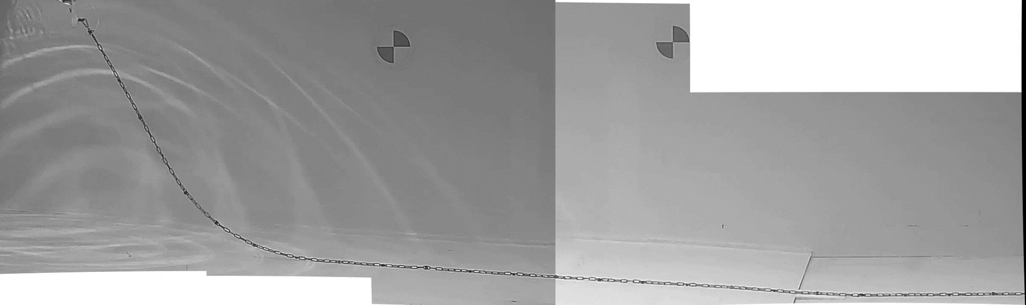
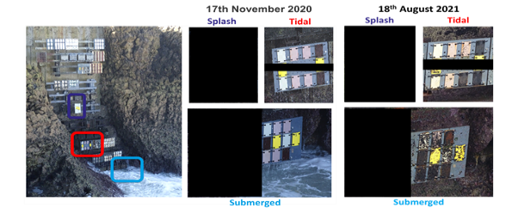
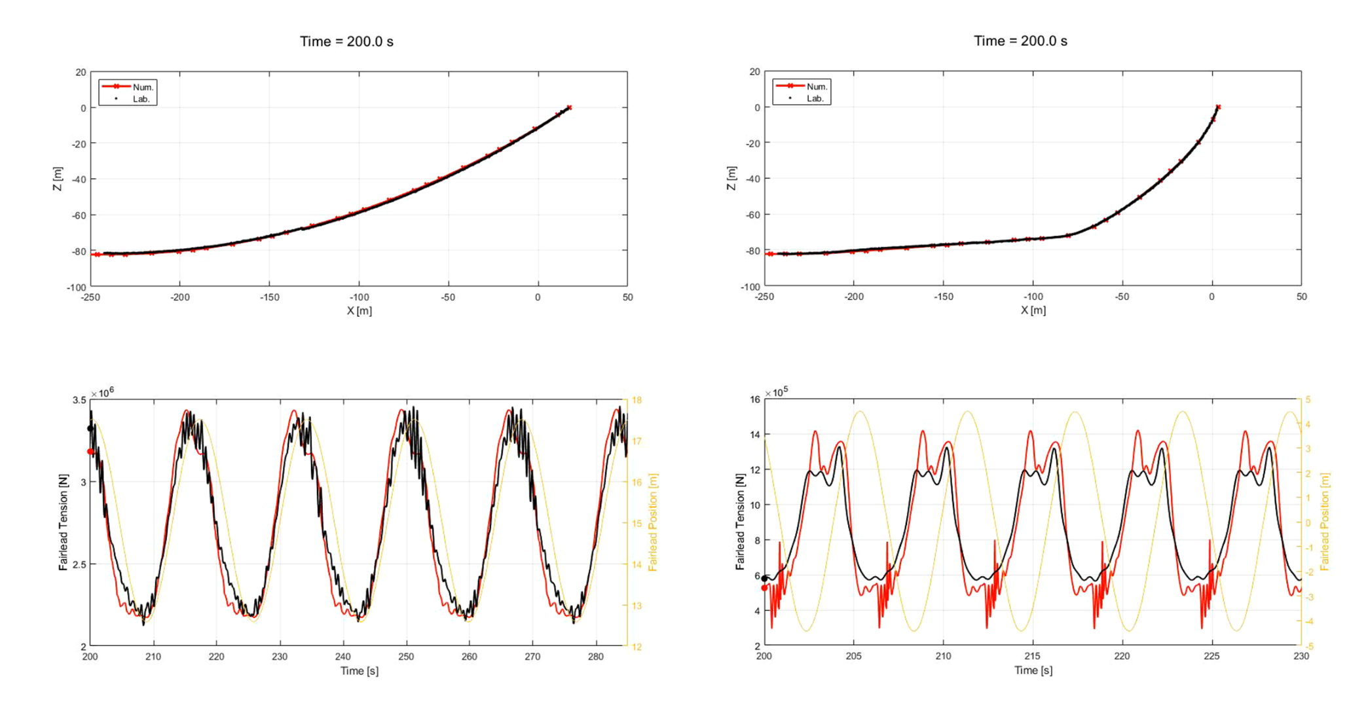
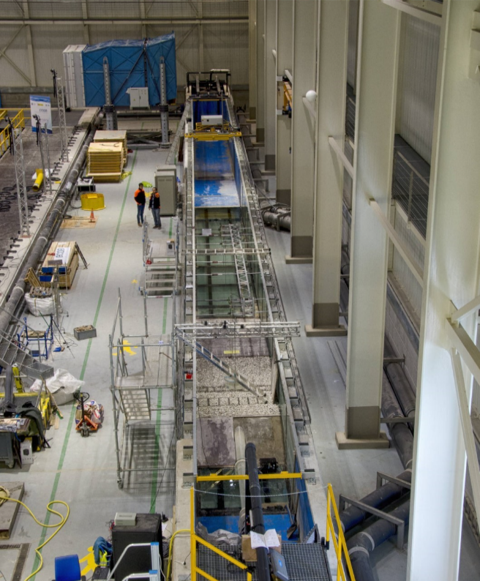
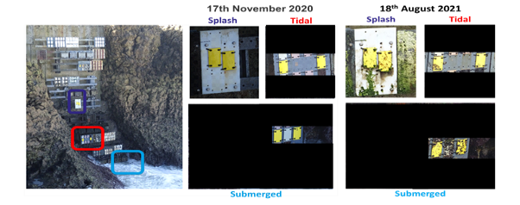
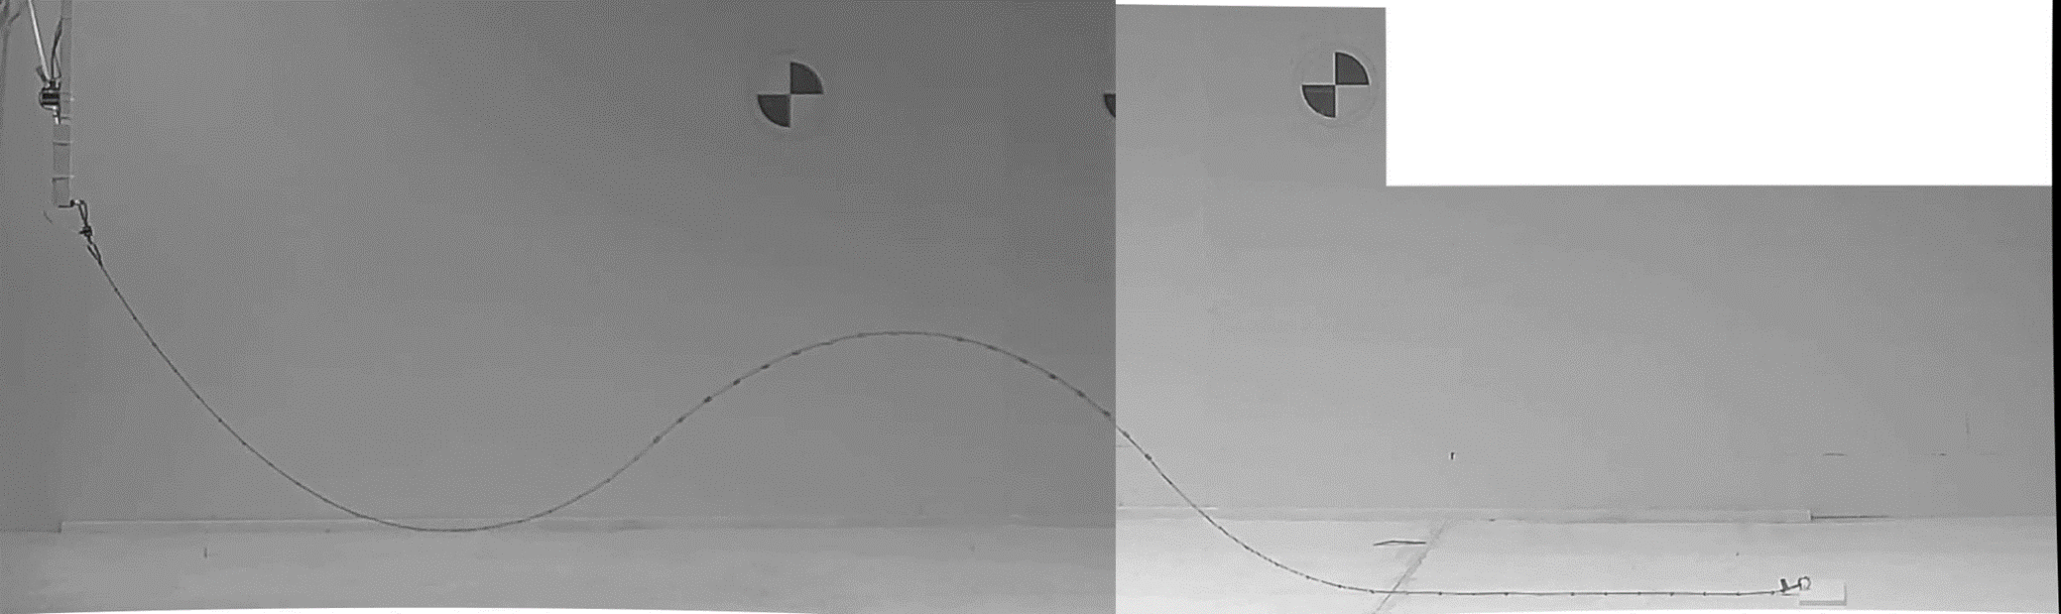
WP5: Experimental testing
Flume Testing
Field Testing of materials
Mooring chain
Dynamic Cable
coating

Slide 11
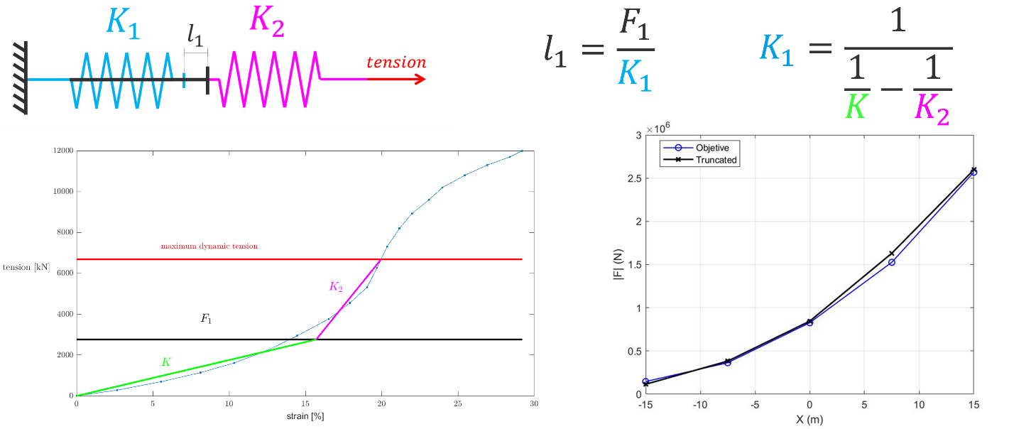
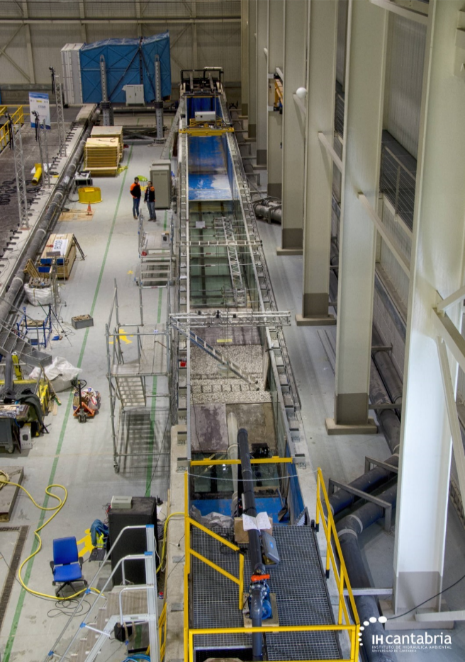
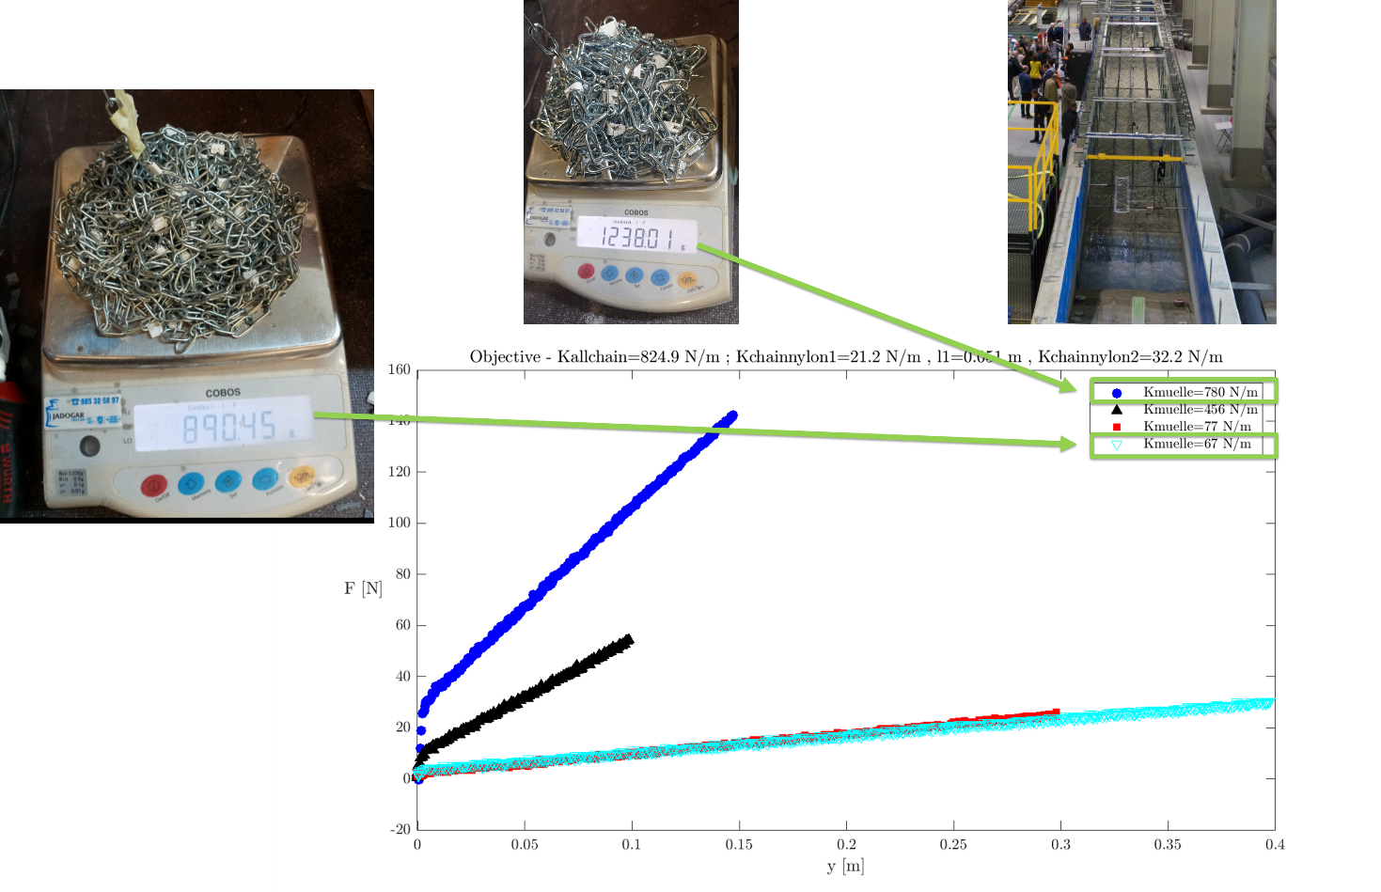
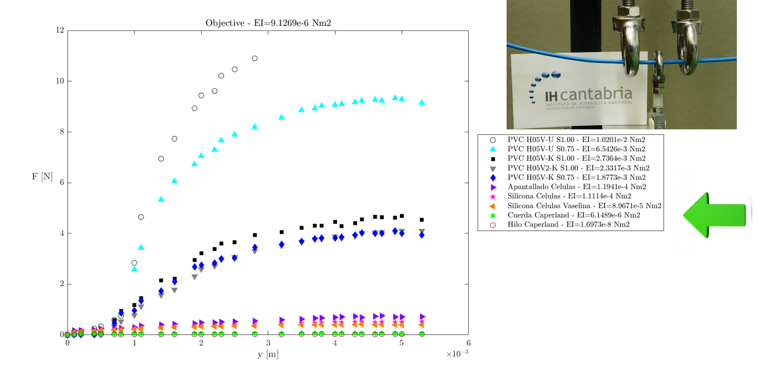
WP5: Experimental testing
Experimental tests:
Field Testing of materials
Mooring chain
Dynamic
Cable
coating

Slide 12





WP6: LCOE analysis & Life Cycle Assessment

Slide 13
WP6: LCOE analysis & Life Cycle Assessment
4 turbines – 60 MW
20 turbines – 300 MW
80 turbines – 1.2 GW

Slide 14
Where to find our results and outputs
Public Deliverables and other reports:
  They can be found at: http://corewind.eu/publications/
  https://zenodo.org/communities/corewind/?page=1&size=20 (including some papers)
Public models (available under different CC licenses):
https://zenodo.org/communities/corewind/?page=1&size=20
  UPC-WindCRETE OpenFAST – Grand Canary Island
  COREWIND - ACTIVEFLOAT OpenFAST model 15 MW FOWT Grand Canary Island site
  Other locations to come soon

Slide 15
Join the conversation
#corewind
Stay tuned and follow us for updates
https://twitter.com/corewindeu
https://www.linkedin.com/company/corewind/

