Slide 1
Interact
Ivano Magazzù
7 July 2022

Slide 2
What did we learn?
Cohesion Policy Reform (2014-2020):
«place-based approach» and «focus on results» principles (Barca Report, 2009)
Thematic concentration (11 Thematic Objectives, common for all EU CP Programmes and in line with EU strategies and policies)
4 generations of Interreg programmes (25 years)
Thousands of funded projects (several topics www.keep.eu)
New programming period(s) ahead and budget reduction
EFFICIENCY and ENANCED RESULTS (more focussed and place-based → territorial dimension of cooperation)

Slide 3
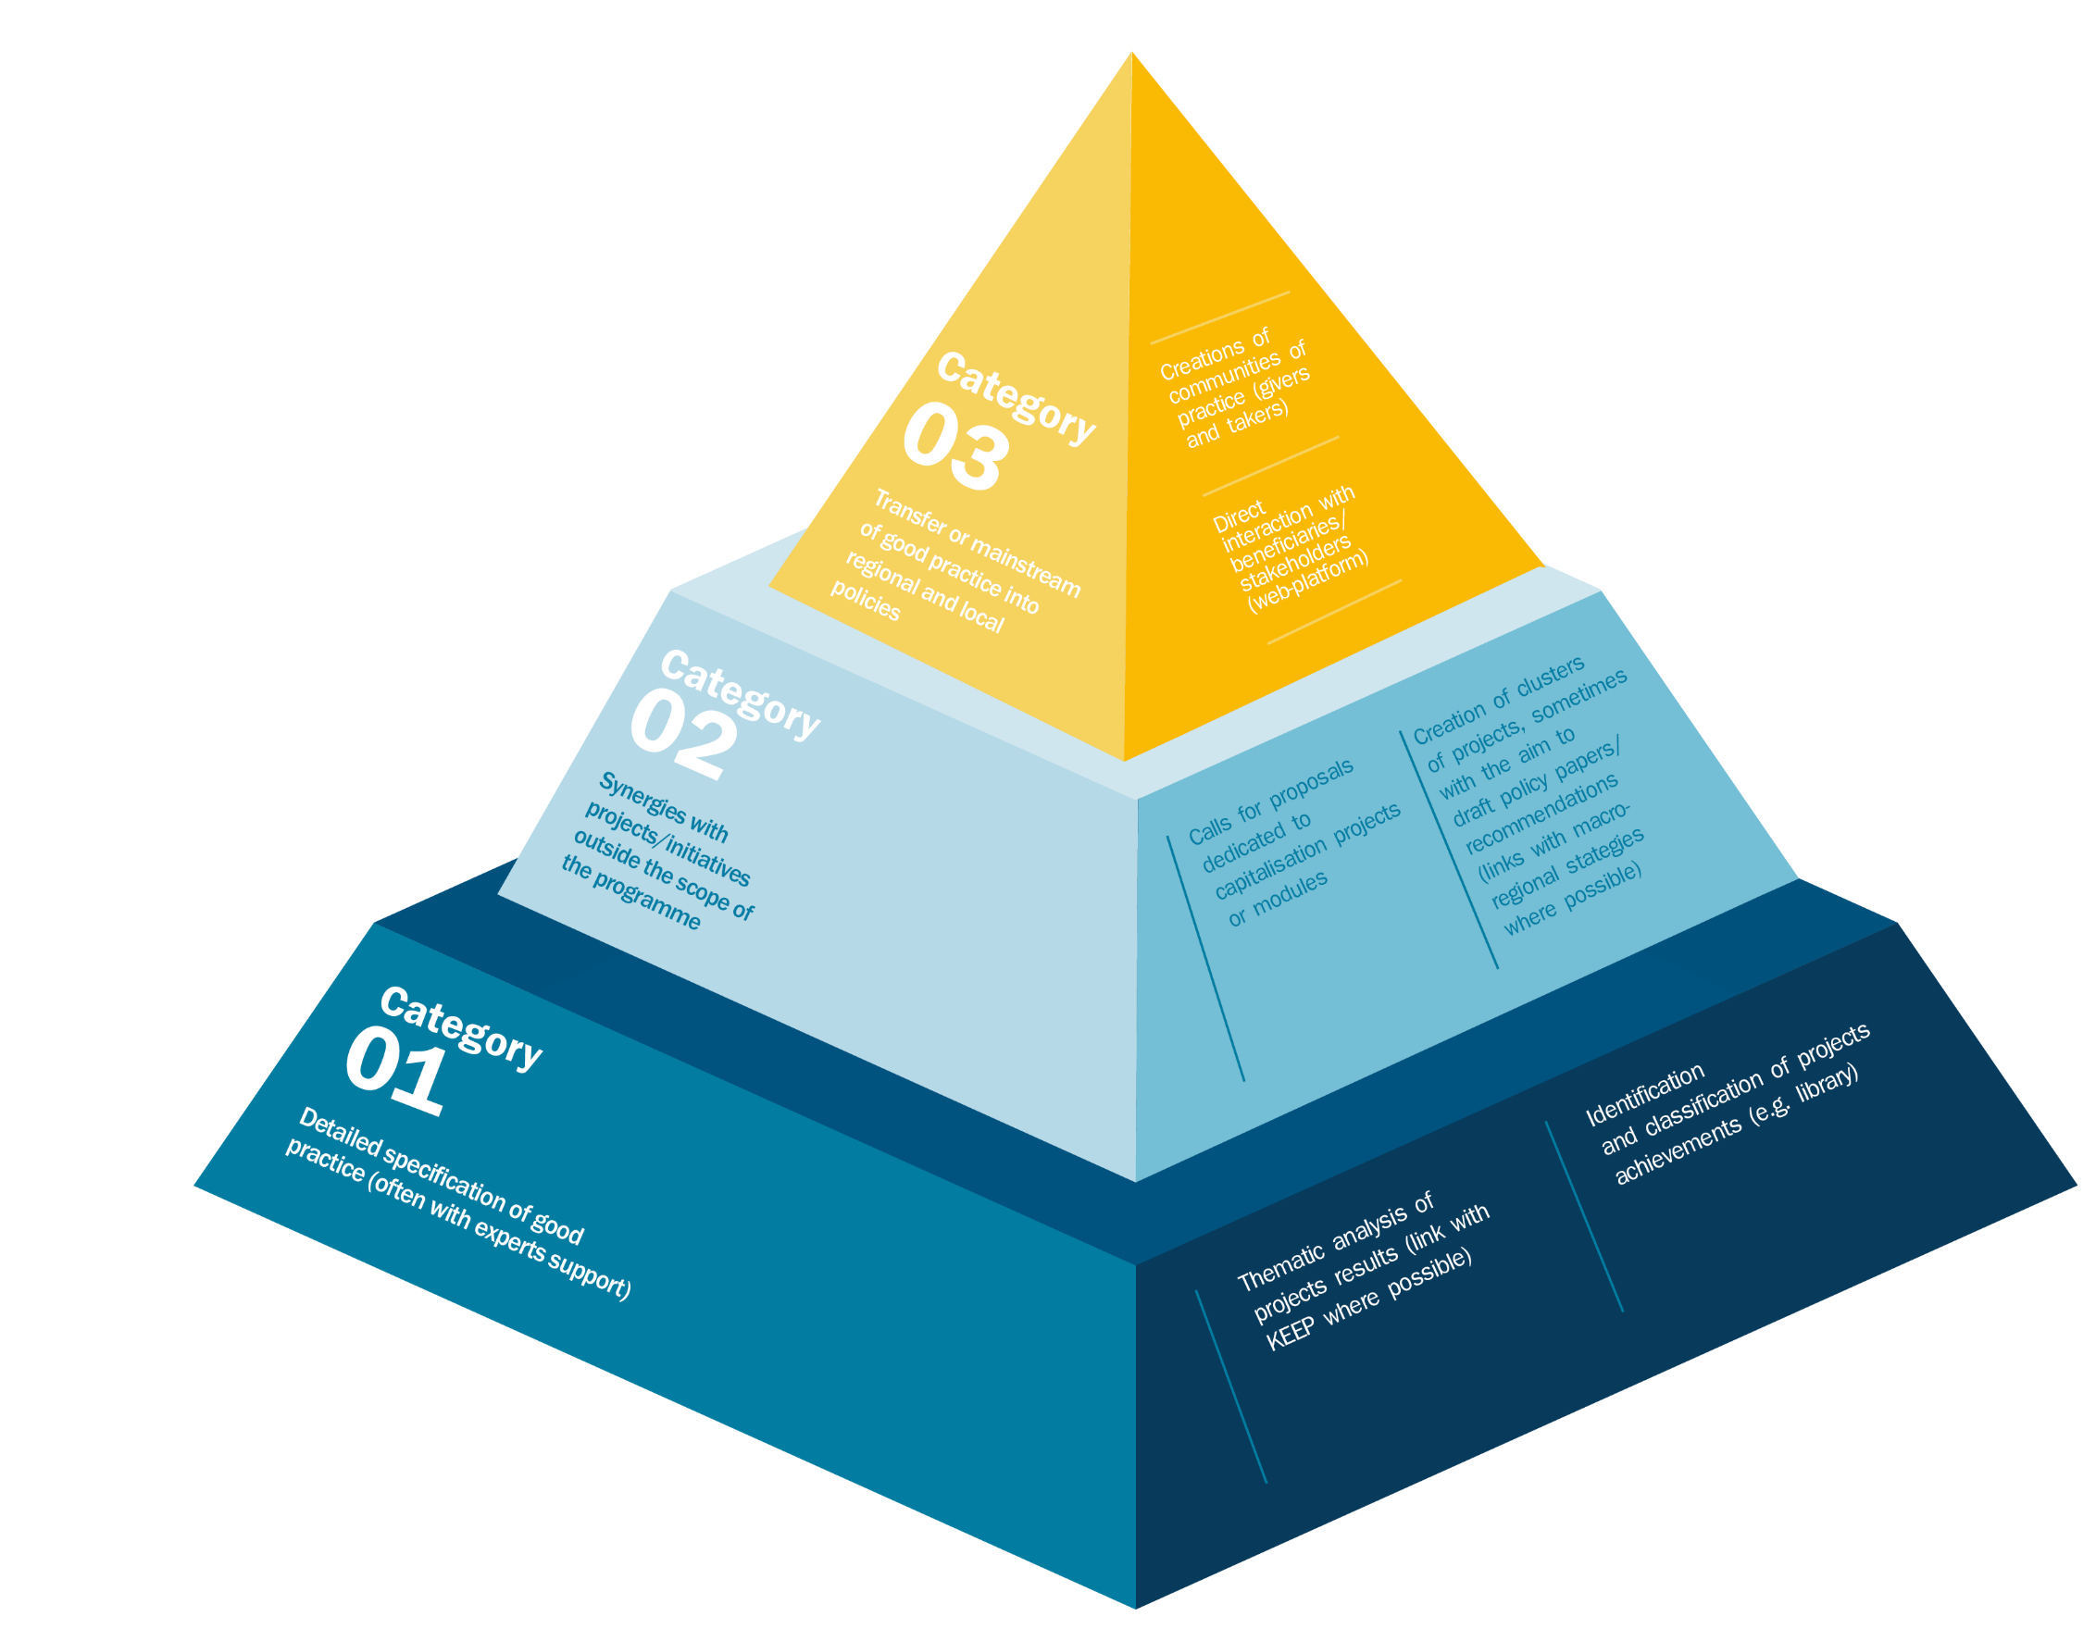
Capitalisation Work

Slide 5
Exploiting Interreg Results
PROJECT CHAIN CONCEPT & RESULTS’ EXPLOITATION
EIB
Direct Mgmt
ESIF
ETC + ENI
Others
SECTORAL/TERRITORIAL/MRSs or SEA BASIN (Embedding)

Slide 6
Exploiting Interreg Results
(Informal) PLATFORMS FOR EXCHANGE
Interreg MAs’ networks
EUSAIR/EUSBSR
Labs/SH platform
‘Governance’ structure
Coord Mech
MED AREA COORD MECHANISM
Flagship
Thematic alignement and identification of results and topics
Pilots on common Topics
Common criteria
Joint Calls
Reinforced ‘tools’
Common criteria
Synchro Calls
Improved Flagship projects and MRS actions
Impact and expected outcomes
Improved and coherent prj in the MED area

Slide 7
Best practices
PHARO4MPAs – Interreg MED
Seeking for interactions in marine sectors and environment, based on some existing guidelines to be further diffused and transferred
Gathering partners with diverse competences, involved in previous projects related to MPAs
Definition of baselines, definition and diffusion of recomendations on the necessary practical collaboration between MPAs and the maritime sectors
New communication (and capitalisation) tools, especially networks and capacity building
Care Peat – Interreg North-West Europe
develop a uniform methodology for the assessment of greenhouse gas emissions from peatlands to be widely applicable
involve farmers and farmers’ organisations as a new target group
definition of a management and decision support tool and a set of socio-economic models concerning the best options for peatland restoration in regard to carbon storage
Involvement of new partners, restore the carbon storage capacity of peatlands in two new regions, reduction of emissions for the whole cooperation area.

