Slide 1
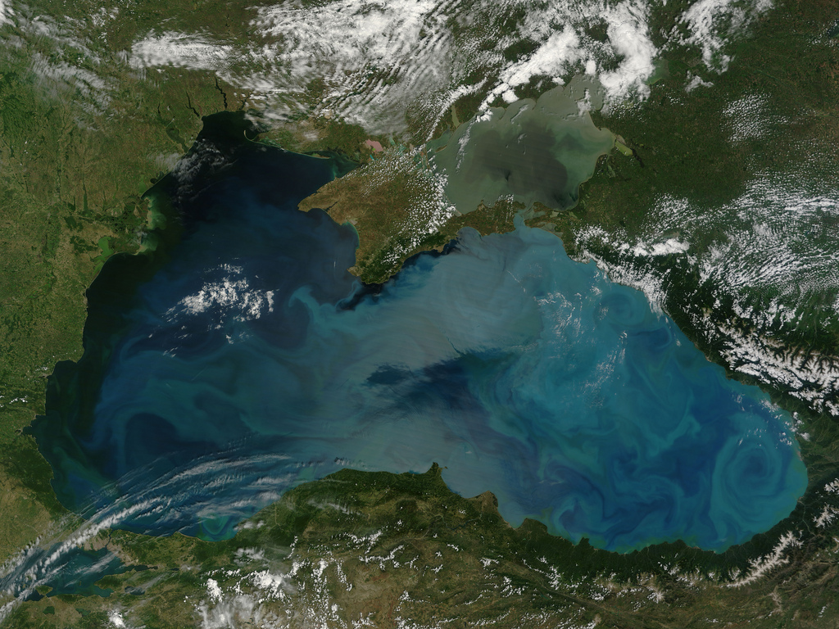
4rd Meeting for Developing a Blue Growth Initiative for Research and Innovation in the Black Sea İstanbul, Turkey
Evaluation of Black Sea Projects
Matrix of Research Gaps & Needs
A Revised Roadmap for a new SRIA for Blue Growth in the Black Sea
Compiled and Collated by
Institute of Marine Sciences, Middle East Technical University, (METU-IMS), TURKEY

Slide 2
4rd meeting for developing a Blue Growth Initiative for Research and Innovation in the Black Sea
The matrix of marine research projects
Matrix A. Analysing gaps and research & innovation opportunities providing the necessary justification/drivers
Matrix B. Regional and national boundary framework conditions
Revised Roadmap to new SRIA for the Black Sea

Slide 3
The matrix of marine research projects
Information was collected on;
Marine research project information
Matrix A. Analysing gaps and research & innovation opportunities providing the necessary justification/drivers
Matrix B. Regional and national boundary/framework conditions for the R&I needs and opportunities for successful implementation

Slide 4
Defined Main R&I Areas
Revised version
(During September 2017 Batumi Meeting)
First version
Biodiversity
Biological Invasions
Blue Biotechnology
Climate Change & Impacts
Deep sea Ecosystems
Deep sea mining, Oil and Gas Sustainable Exploitation
Living Marine Resources (fishery, aquaculture, etc.)
Marine Hazards
Marine Pollution
Maritime Transport
MSP - ICZM
Ocean renewable Energy
Oceans and Human Health
Operational Oceanography/Observing Systems
Other/Multiple areas (specify in column B)
Socioeconomic & Policy Research
Training & Technology Transfer
Biodiversity
Biological Invasions
Blue Biotechnology
Catchment-Sea Interaction
Climate Change & Impacts
Cultural Heritage
Deep Sea Ecosystems
Sustinable Oil and Gas Exploitation and deep sea mining
Ecosystem Multiple Stressors
Eutrophication and Deoxygenation
Interconnections of Basins
Living Marine Resources (fishery, aquaculture, etc.)
Marine and Coastal Hazards
Marine Ecosystem Services
Marine Pollution and Litter
Marine Renewable Energy
Maritime Transport
MSP, ICZM
Operational Oceanography/Observing Systems and Monitoring
Other/Multiple areas (specify in column B)
Seas and Human Health
Socioeconomic & Policy Research
Tourism and Surrounding Economy
Training & Technology Transfer

Slide 5
The matrix of marine research projects
Bulgaria – 82 Projects

Slide 6
The matrix of marine research projects
Bulgaria – 82 Projects

Slide 7
The matrix of marine research projects
Georgia – 13 Projects

Slide 8
The matrix of marine research projects
Georgia – 13 Projects

Slide 9
The matrix of marine research projects
Moldova – 13 Projects

Slide 10
The matrix of marine research projects
Moldova – 13 Projects

Slide 11
The matrix of marine research projects
Romania – 52 Projects

Slide 12
The matrix of marine research projects
Romania – 52 Projects

Slide 13
The matrix of marine research projects
Ukraine - 38 Projects

Slide 14
The matrix of marine research projects
Ukraine - 38 Projects

Slide 15
The matrix of marine research projects
Turkey - 79 Projects

Slide 16
The matrix of marine research projects
Turkey - 79 Projects

Slide 17
The matrix of marine research projects
Total Projects of Black Sea Countries - 274 Projects

Slide 18
The matrix of marine research projects
Total Projects of Black Sea Countries - 274 Projects

Slide 19
The matrix of marine research projects
European Union FP7 and Horizon2020 Projects - 93 Projects

Slide 20
The matrix of marine research projects
European Union FP7 and Horizon2020 Projects - 93 Projects

Slide 21
Top-ranking marine research areas
National Projects
Biodiversity
Other
Marina Poll. Litter
Living Marine Resources
Operational Ocea./Obs. Systems Monitoring
EU Projects
Socioeconomis & Policy
Operational Oceanography/Obs. Systems Monitoring
Training and Tech. Transfer
Blue Biotechnology
Climate Change & Impacts

Slide 22
The matrix of marine research projects
Total Projects of Black Sea (BS Countries + EU) - 367 Projects

Slide 23
The matrix of marine research projects
Total Projects of Black Sea (BS Countries + EU) - 367 Projects

Slide 24
Matrix A. Analysing gaps and research & innovation opportunities providing the necessary justification/drivers
First summary of major trends
High-ranking areas based on keywords:
What are the still existing gaps in seemingly well-studied areas?
Less studied, low ranking areas:
What are the major opportunities? What is missing?
Matrix A. Analysing gaps and research & innovation opportunities providing the necessary justification/drivers for MAIN R&I AREAS
IDENTIFIED GAPS | JUSTIFICATION | R&I NEEDS/OPPORTUNITIES | JUSTIFICATION

Slide 25
Matrix A. Analysing gaps and research & innovation opportunities

Slide 26
Matrix A. Analysing gaps and research & innovation opportunities

Slide 27
Comparison between Projects and Matrix A

Slide 28
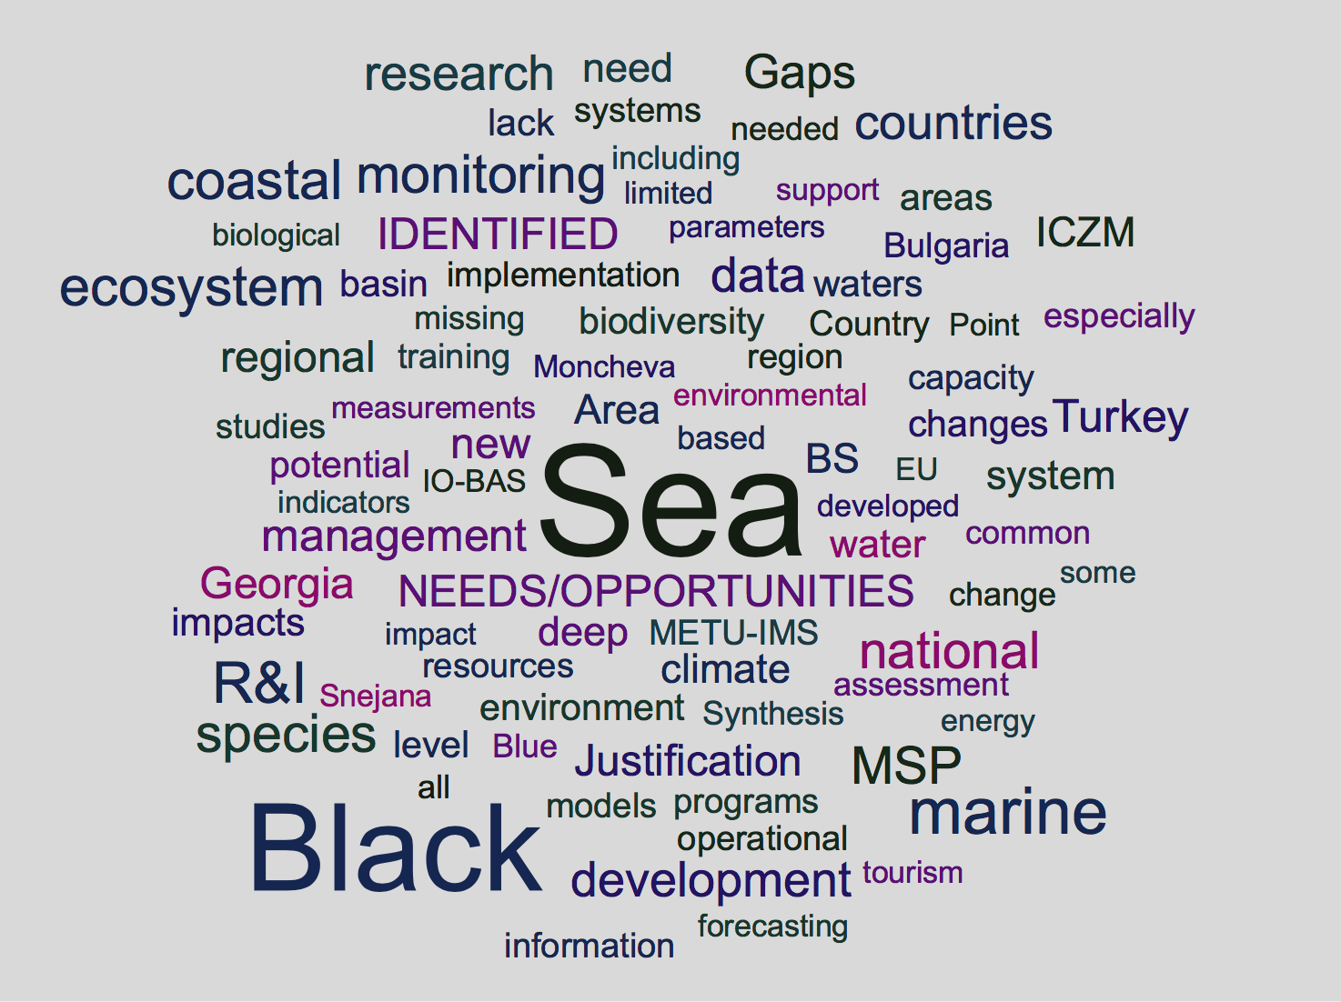
Matrix A. Analysing gaps and research & innovation opportunities

Slide 29
Matrix A. Analysing gaps and research & innovation opportunities
R&I Area 1. Biodiversity
Identified Gaps | R & I Needs / Opportunities
Shelf and deep biodiversity poorly known Biodiversity – ecosystem functioning (BEF) knowledge gaps Forecasting capability of biodiversity Long-term dynamics Microbial diversity almost unknown Insufficient use of modern methods | Operational/high frequency monitoring approaches Genomics: eDNA, NGS, barcoding Remote sensing National programmes for long term monitoring

Slide 30
Matrix A. Analysing gaps and research & innovation opportunities
R&I Area 2. Biological Invasions
Identified Gaps | R & I Needs / Opportunities
Pathways of invasions poorly assessed Alterations of ecosystem functions due to invasions Few studies centers around invasive species | Need rapid detection methods for invasive species Development of joint actions by BS countries targeting invasions Combination of molecular techniques and monitoring

Slide 31
Matrix A. Analysing gaps and research & innovation opportunities
R&I Area 3. Catchment-Sea Interaction
Identified Gaps | R & I Needs / Opportunities
Catchment loads and sea inputs unknown Water, chemicals and sediments linkages and mutual close and distant interactions between the rivers catchments and the sea are not sufficiently known. Poor data resolution Large uncertainties In load estimations | Integration of marine-coastal and river basin observatories Catchment-sea coupled biogeochemical and ecosystem models Scenarios for management ICZM / MSP considering land-sea interaction Indicators for catchment-sea interaction

Slide 32
Matrix A. Analysing gaps and research & innovation opportunities
R&I Area 4. Climate Change & Impacts
Identified Gaps | R & I Needs / Opportunities
Scenarios for climate change in order to assess the impacts is scarce. Direct climate-related drivers are multiple and complex Extreme events, subsequent vulnerability of protected areas and human settlements Downscaled spatial maps of climate changes influence of climate change on the dynamics of the hydrogen sulphide layer, impact of climate change on the development of seasonal hypoxia on the shelf, and impact of climate change on potential bio-invasions | Assess of exposure, sensitivity and adaptive capacity by using the mathematical models of the Black Sea ecosystems .Study the vulnerability of the coastal zone and adaptations to climate change. Exploring the recent technological developments (real-time data from Argo floats, satelite measurements etc). Research for combining various types of information as well as for assessment of economic damage

Slide 33
Matrix A. Analysing gaps and research & innovation opportunities
R&I Area 5. Cultural Heritage
Identified Gaps | R & I Needs / Opportunities
Weak cultural cooperation and protection of the cultural heritage in the Black Sea Region. Mapping of cultural heritage is non uniform and incomplete | A common management policy should be developed and applied via a coordination network Technology, robotics and observatories to track and explore culture heritage Consider cultural heritage in the context of blue economy, i.e. tourism, MSP etc.

Slide 34
Matrix A. Analysing gaps and research & innovation opportunities
R&I Area 6. Deep Sea Ecosystems
Identified Gaps | R & I Needs / Opportunities
Functioning of Deep Marine Ecosystems in the Black Sea is not really known. Carbon cycle of deep waters unknown Bottom morphology largely uncharted Gas hydrates information only recently emerging The balance of H₂S in deep part of the Black Sea; the role of anaerobic zones in biogeochemical cycle of organic and inorganic substances. | Development of a special international system for deep-water hydrogen sulfide monitoring, including automatic methods (ARGO-buoys), and forecasting models of deep-water hydrogen sulfide dynamics Research and innovation on gas hydrates Black Sea deep sea ecosystem has unique characteristics and bear several opportunities. It also has importance of representing potential future deep sea ecosystem under predicted hypoxia in the future oceans.

Slide 35
Matrix A. Analysing gaps and research & innovation opportunities
R&I Area 7. Ecosystem Multiple Stressors
Identified Gaps | R & I Needs / Opportunities
Gaps in mathematical models for assessment and forecast of the effect of the complex of multiple stressors on marine ecosystem. The result of ‘synergistic impact of eutrophication, fisheries, biological invasion and climate change on the ecosystem’ on blue economy is not studied | Ecosystem multiple stressors studies should be further extended to include the final impact on the Blue Economy services. New generation ecosystem models studies can be used to explore the synergistic impact of multiple stressors

Slide 36
Matrix A. Analysing gaps and research & innovation opportunities
R&I Area 8. Euthropication and Deoxygenation
Identified Gaps | R & I Needs / Opportunities
Limited historical and systematic data sets on bio-chemical properties Therefore, long-term impacts of enhanced eutrophication on the basic bio-chemical properties/vertical features have not been well understood. No systematic monthly/seasonal monitoring programmes have yet been implemented to fully assess medium and long-term ecological changes in the shelf, coastal and open Black Sea ecosystem | Determination of reachable reference ecological conditions of the BS must based on limited historical, new observations and model simulations Then the total nutrient inputs, their major sources. Novel tools are needed to assess basin wide natural and human-induced nutrient and organic matter inputs to BS. This tool must be coupled to the Black Sea ecosystem models for the estimation of tolerable GES targets in the Black Sea

Slide 37
Matrix A. Analysing gaps and research & innovation opportunities
R&I Area 9. Interconnections of Basins and Land-Sea
Identified Gaps | R & I Needs / Opportunities
Long-term changes in the nutrient and TOC contents of NW shelf waters reaching the Bosphorus region and flowing into the Marmara basin Knowledge on connection of the Black Sea with the Mediterranean via the Bosphorus Channel and with Azov Sea is limited | N, C and P biogeochemical fluxes between Black Sea land-river across Bosporus to Marmara need to be assessed Salination and enhancing stratification in the Black Sea due to saline water income from the Mediterranean Sea should be studied

Slide 38
Matrix A. Analysing gaps and research & innovation opportunities
R&I Area 10. Marine Ecosystem Services
Identified Gaps | R & I Needs / Opportunities
Limited knowledge on the ecosystem services of the Black Sea | Development of modern models/approaches that allow us to quantify the value of the Black Sea ecosystem services

Slide 39
Matrix A. Analysing gaps and research & innovation opportunities
R&I Area 11. Marine Pollution and Litter
Identified Gaps | R & I Needs / Opportunities
Common methodology for analysis for marine monitoring is lacking. Significant legal, politic and technical gaps in marine litter management in coastal areas. The pollutant loads sourced from point and diffused sources are not defined regularly. There is lack of capacity (human expertise and equipment) for pollutants and marine litter analysis (especially microplastics). | Impacts and biological effects of pollutants are scarce. This requires experiments in a broad spectrum of organisms. Pollution from modern technologies eg. plastics, pharmaceuticals, nanopollutants, noise, e-wastes etc., and their effects on the marine environment To evaluate existing pressures and effectiveness of the measures taken, pollutant loads shall be monitored regularly.

Slide 40
Matrix A. Analysing gaps and research & innovation opportunities
R&I Area 12. Marine and Coastal Hazards
Identified Gaps | R & I Needs / Opportunities
Lack of beach/coastal erosion and ptorection studies Cliffs protection and management Lacking views on marine hazards related to floods and earthquakes | Renewed research paradigm in the light of extreme climate events and earthquakes To implement innovative methods of beach restoration, basing on the knowledge gained in previous years and other sea basins

Slide 41
Matrix A. Analysing gaps and research & innovation opportunities
R&I Area 13. Seas and Human Health
Identified Gaps | R & I Needs / Opportunities
Effective management of wastewater effluent, still there is a direct effluent of un-treated waters Potentially toxic phytoplankton species, the impacts of phytoplankton blooms on human health. Effective bathing/swimming water management system shall be established along BS coastal areas. | Targeted research of phytoplankton and other species outbreaks on human health even if they originally are of local scale. Application of new methods for species identity (genomics) and monitoring (remote sensing, drones, argo buoys etc.) Bathing/swimming water quality monitoring and dissemination of results to the public research studies shall be supported by regional programmes

Slide 42
Matrix A. Analysing gaps and research & innovation opportunities
R&I Area 14. Blue Biotechnology
Identified Gaps | R & I Needs / Opportunities
Lacking the knowledge of the genetic diversity of deep sea anaerobic prokaryotes, which have large potential for the future biotechnology development Very few studies and projects, only at EU level. Lacking national funding towards blue biotech and other emerging Blue Growth sectors | Using metagenomics and metatranscriptomics methods for the understanding genetic diversity of deep sea microbial communities R&I projects are needed to discover the ways to sustainably benefit from Black Sea biological resources, including prokaryotes protists and algae, by biotechnology applications See new OECD report on Blue Biotech

Slide 43
Matrix A. Analysing gaps and research & innovation opportunities
R&I Area 15. Deep Sea Mining, Oil and Gas Sustailable Exploitation
Identified Gaps | R & I Needs / Opportunities
Very little is known of the oil and gas exploration research in the Black Sea, albeit the few exploration initiatives Known exploration in Turkish and Georgian EEZ, but access to data are limited. Mechanistic studies of carbon cycle in and around gas hydrates are missing. | There is a large hydrocarbon exploration capacity in Turkey (Two 3D seismic vessels, plans to buy a drillship) Concept to explore alternative recourses of the deep sea is missing along with a strategy for environmental protection. As Adrian Stanica and Gilles Lericolais both underlined, gas hydrates are a central feature of Black Sea and a major Blue Growth avenue if sustainably utilized

Slide 44
Matrix A. Analysing gaps and research & innovation opportunities
R&I Area 16. Living Marine Resources
Identified Gaps | R & I Needs / Opportunities
Monitoring and transparency lacking in Black Sea fisheries effort and landings data. Lack of knowledge on over-exploitation of many stocks, poor data, and consequent food web effects, link between the fisheries resources and the lower trophic levels and environmental drivers to promote an ecosystem approach to fisheries management. The gap between the natural and the social and economic sciences Mariculture growth, careful management to minimise potential impacts | Piloting Black Sea VMS data sharing under Global Fishing Watch as well as other means Need to develop approaches for integrated and adaptive management using the Ecosystem Approach Research on aquaculture, especialy open-sea (off-shore) and deeper aquaculture Identifying the share of Living Resources and future sectors (aquaculture) in the Black Sea Blue economy ‘Food from the Oceans’ Report EU-SAM

Slide 45
Matrix A. Analysing gaps and research & innovation opportunities
R&I Area 17. Tourism and Surrounding Economy
Identified Gaps | R & I Needs / Opportunities
Undeveloped of cruise and yacht tourism on the North coast, its infrastructure and related business - ship repair, supply of spare parts, bunkering, etc. Undeveloped air and marine transport between neighbouring territories. The seasonality of tourism on the Black sea. The duration of touristic season is quite short. | Analysis of the related legislation of the countries surrounding the Black and Azov seas with the development of proposals for its convergence, the optimization of border and customs procedures. Overall need for the share of tourism and projections as a part of Blue Economy

Slide 46
Matrix A. Analysing gaps and research & innovation opportunities
R&I Area 18. Marine Renewable Energy
Identified Gaps | R & I Needs / Opportunities
There are limited studies on the renewable energy potential of the Black Sea, such as wave, offshore wind energy, gas hydrates, H2S Spatial planning is missing to locate potential marine renewable energy infrustructure in the Black Sea. Environmental impact assessment of marine renewable energy is missing New technologies has not been introduced in the regions | Evaluation and mapping of the renewable energy sources in the Black Sea. Optimization of the renewable energy technologies for the Black Sea conditions. Industry – research - stakeholder partnership COCONET wind atlas

Slide 47
Matrix A. Analysing gaps and research & innovation opportunities
R&I Area 19. Maritime Transport
Identified Gaps | R & I Needs / Opportunities
Emissions from marine traffic Impact of increasing shipping on the environment | Operational and policy measures and practices can provide a sustainable framework for shipping (and for all related actions). Region based integrated control mechanisms should be developed Sea Europe –Ships’ and Maritime equipment associtaion

Slide 48
Matrix A. Analysing gaps and research & innovation opportunities
R&I Area 20. MSP, ICZM
Identified Gaps | R & I Needs / Opportunities
There are not many opportunities for research in both Integrated Coastal Management (ICM) and MSP. The main gaps in both issues are capacity building (national and regional) and regional collaboration. MSP practice and methods undeveloped in non-EU Black Sea countries, only emerging in EU countries (RO, BG) through EU supported initiatives. National planning initiatives may have different priorities and methodological approaches. This will create difficulties for the development of common Azov and Black sea MSP | Need for joint MSP, ICZM conference/forum for the Black Sea Establish common MSP methodology at national and regional levels e.g. through transboundary pilot schemes and common methodology for the Black Sea Basin. Analyse national legislations in terms of goals, principles, lists and formats of the input and output MSP data layers and to develop recommendations for their convergence.

Slide 49
Matrix A. Analysing gaps and research & innovation opportunities
R&I Area 21. Operational Oceanography, Obs. Systems, Monitoring
Identified Gaps | R & I Needs / Opportunities
Complete absence of biogeochemical measurements through the operational oceanography platforms Lack of sustained, long term monitoring both from coastal zones as well as deep basin Limited systematic data are available on BS chemical inputs to the Marmara upper layer and Bosphorus under flow regime Limited operational data on catchment, river inputs, shelf processes and their time variation | Multi-platform integrated observatories for recording a multiple stressors in different space and time scales Harmonized monitoring programs Need for innovative instruments to integrate various sea, coast and catchment observing systems Develop Black-Sea tailored operational platforms and biogeochemical sensors for energy-relevant substances (methane, H2S) Ensure close link to Copernicus Services all related infrastructure projects (EMODNET, EMSO, DANUBIUS-RI, etc…)

Slide 50
Matrix A. Analysing gaps and research & innovation opportunities
R&I Area 22. Socioeconomics and Policy Research
Identified Gaps | R & I Needs / Opportunities
Absence of efficient cooperation between the socio-economic and environmental science. Policies need to be developed based on results from indicators for the WFD and MSFD. Targets for achieving the GES are missing. | Research in support of policies and the society. Training/awareness of the regions of the country on the potential of the marine environment. Implementation of the MSFD needs to be addressed with new incentives for research. Involvement of different groups of stakeholders from the beginning. List not exhaustive…

Slide 51
Matrix A. Analysing gaps and research & innovation opportunities
R&I Area 23. Training and Technology Transfer
Identified Gaps | R & I Needs / Opportunities
Very few training opportunities in several sectors of Blue economy. Overall large need in human capacity and tech transfer in all areas of marine science | Transfer aquaculture technology from Mediterranean to Black Sea. Transfer of renewable energy technologies from Northern to Black Sea. To coordinate the training of specialists of related specialties; use the exchange of students and teachers programs More intensive targeted trainings, consultations, joint expeditions Create new training modules to train the wider Blue Economy workforce

Slide 52
Matrix B
RI Needs and Opportunities (success!)
(from now on will need more input on)
National Policies
National Infrastructure
Regional and National Funds

Slide 53
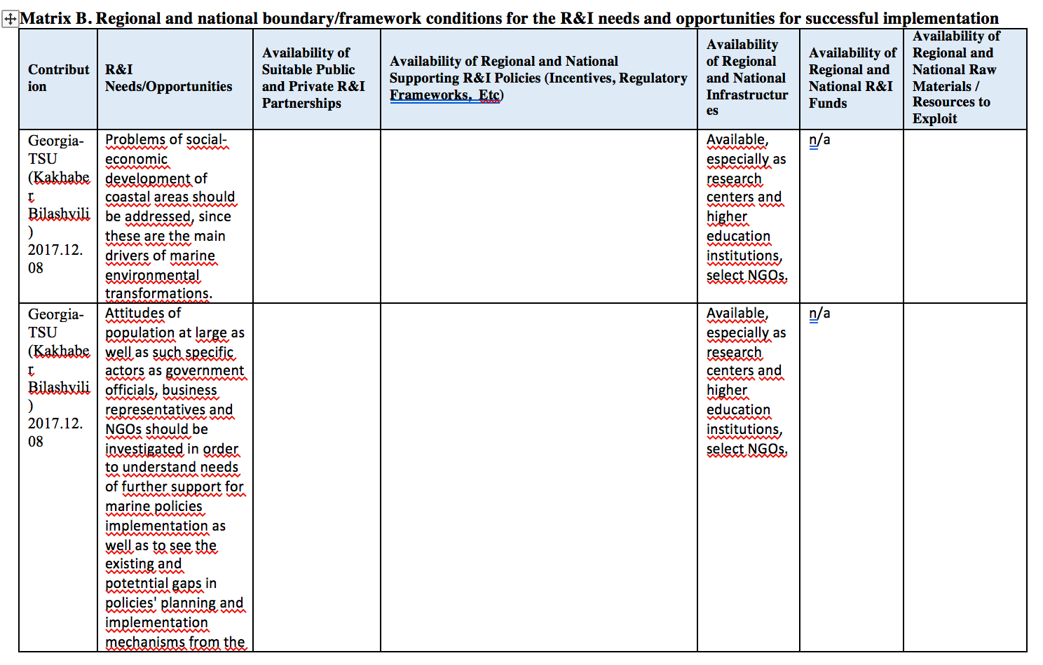

Slide 54
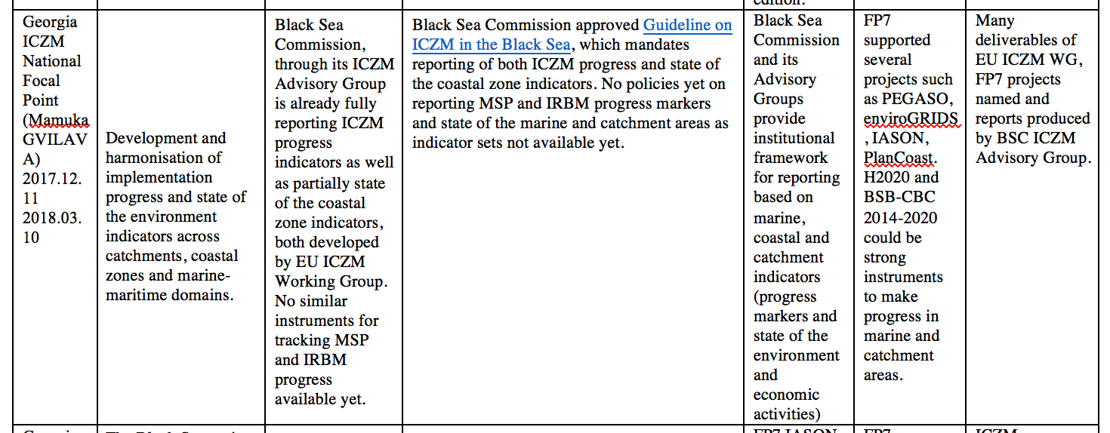

Slide 55
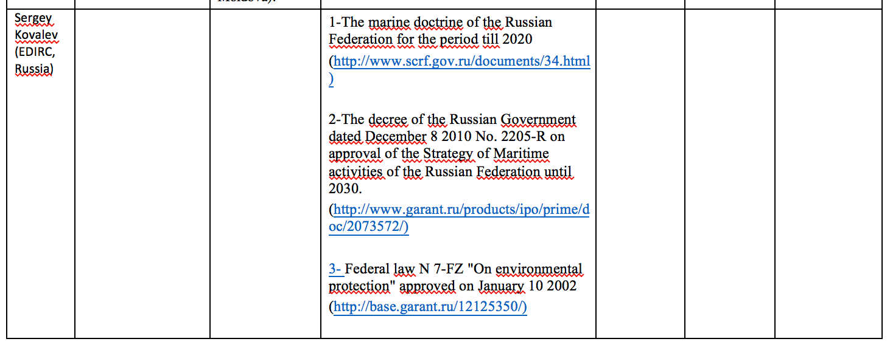

Slide 56
Other Country / Organization Contribution
France:
The French research community is mainly involved in the following fields:
Geosciences and sea floor observatories
Danubius Research Infrastructure
Physical and spatial oceanography
Aquaculture
Archeology
sedimentary system and the structuring of the Black Sea margins in a partnership with GeoEcoMar (Romania) European project ("DANCERS")
DANUBIUS-RI led by GeoEcoMar and the National Institute for Biological Sciences (INSB) has entered on the ESFRI roadmap.
European Multidisciplinary Seafloor and water-column Observatories EMSO - which has been labelled at European level as an ERIC – has a site located in the Black Sea.
Cooperation with Turkish institutions since the Izmit and Duzce earthquakes in 1999. 8 cruises were conducted with Ifremer blue ocean Research Vessels in order to understand seismicity and assess geohazards along the North Anatolian fault in the Marmara Sea
Cooperation is also well developed in the area of physical and spatial oceanography especially with Russian and Ukrainian institutes.
Archeology and history in the Black Sea region, particularly on antique sites and on the Danube area.

Slide 57
Major Trends in Research Needs and Opportunities (in no particular order and not exhaustive) Matrix A & B combined
More integrated, frequent and multi-parameter observation
Use of high tech novel tools (genomics, sensors etc.) in established ‘areas’ such as living resources, operational oceanography
Planning – MSP,ICZM and other framework
Catchment-sea interactions
Researcher-industry-stakeholder partnership
Socio-economics
Capacity building, of both blue professionals and public sector
Sustainable utilization of non-living resources, i.e. gas hydrates and renewable energy resources
Coastal communitty resilience against climate change, extreme events
Share of mature and emerging blue growth sectors in the overall Blue Economy – numbers and economic analyses are missing, to the extent that this gap hinders setting up priorities and sub-strategies

Slide 58
Major Trends in Research Needs and Opportunities (in no particular order and not exhaustive) Matrix A & B combined
More integrated, frequent and multi-parameter observation
Use of high tech novel tools (genomics, sensors etc.) in established ‘areas’ such as living resources, operational oceanography
Planning – MSP,ICZM and other framework
Catchment-sea interactions
Researcher-industry-stakeholder partnership
Socio-economics
Capacity building, of both blue professionals and public sector
Sustainable utilization of non-living resources, i.e. gas hydrates and renewable energy resources
Coastal communitty resilience against climate change, extreme events
Share of mature and emerging blue growth sectors in the overall Blue Economy – numbers and economic analyses are missing, to the extent that this gap hinders setting up priorities and sub-strategies

