Slide 1
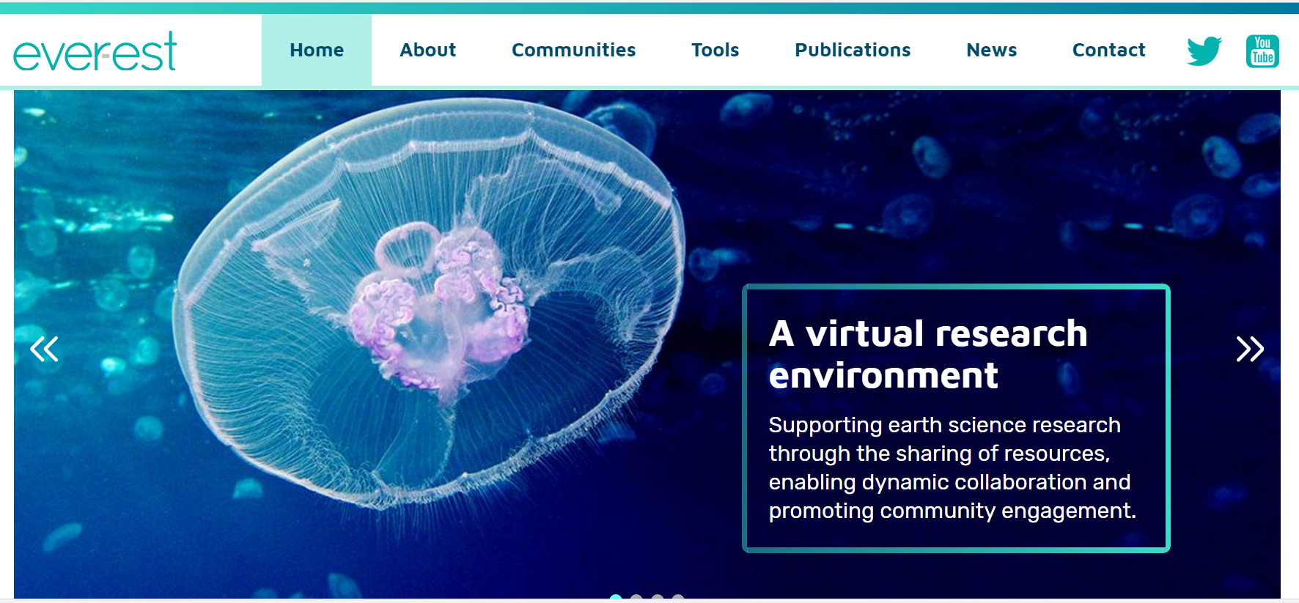
EVER-EST Sea Monitoring VRC
building a Virtual Resarch Enviroment
Federica Foglini¹ and Rosmarie Leone²
¹ CNR-ISMAR
² ESA
http://ever-est.eu/

Slide 2
EVER-EST - A VRE for Earth Science validated by VRC

Slide 3
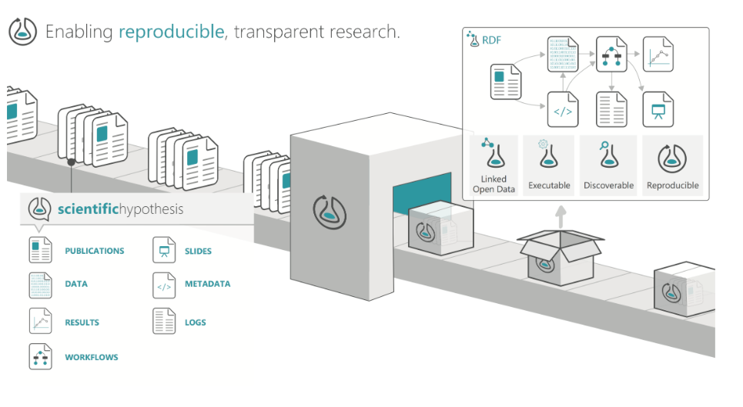
EVER-EST – Research Objects in Earth Science
The EVER-EST project will define, implement and validate the use of “Research Objects” concepts and technologies in the Earth Science domain as a mean to establish more effective collaboration.

Slide 4
Ever-est toward the European Open Science Cloud
Reinforce the interdisciplinary research in various community in earth science, removing the barriers to domain specific research.
re-use and re-purposing and sharing data within an integrated cloud platform (processing services, visualization services, workflow services).
Implementing fair data principles through the adoption of Research Object able to encapsulate, share and reproduce the entire research cycle.
Foster the application of long term preservation best practices and data stewardship using the Research Objects.
Notes:
Reinforcing the interdisciplinary research in various community in earth science, removing the barriers to domain specific research.
Provide to a variety of stakeholders and endusers with a "handy" access to complex and trans-disciplinary data clouds thereby improving awareness in decision making;
Give accessibility to different multidisciplinary marine data repositories and the possibility of re-use and re-purposing and sharing data within an integrated cloud platform (processing services, visualization services, workflow services).
Implementing fair data principles through the adoption of Research Object able to encapsulate, share and reproduce the entire research cycle.
Foster the application of long term preservation best practices and data stewardship using the Research Objects.
Strengehting the capacity building of next generation using the VRE e-learing services.

Slide 5
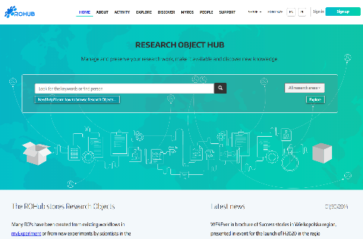
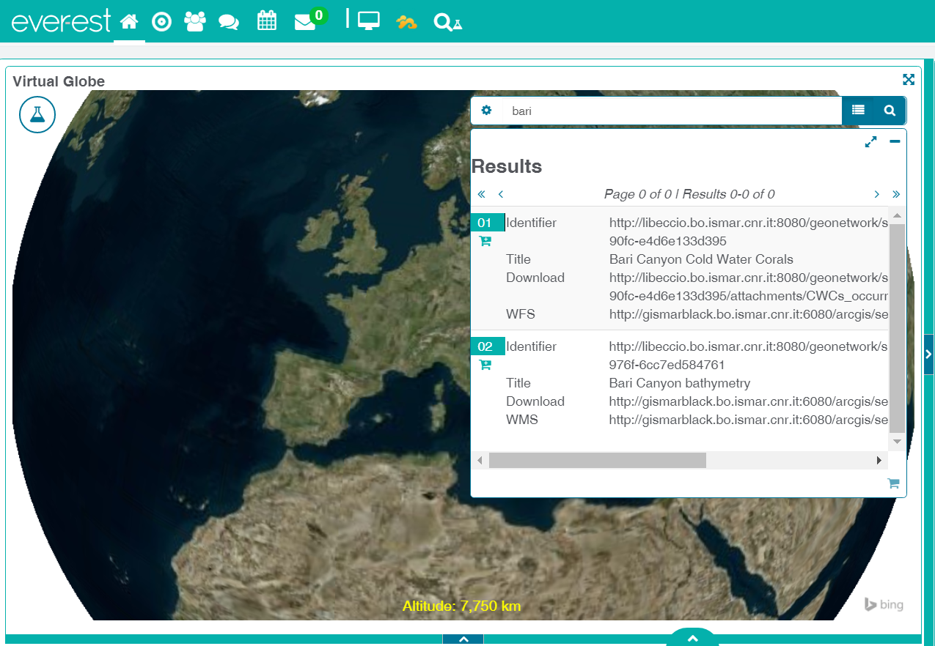
Ever-est in the in the direction of the Pilot Blue Cloud
Strengthening discoverability and re-use of exiting multidisciplinary marine platform (SEA MONITORING VRE Portal)
Reduce the gap between ICT technologies and marine scientist real need.
Promoting collaborative intelligence in the next generation of marine researchers and earth science disciplines (ROHUB Portal)

Slide 6
EVER-EST Training opportunities for a new generation of Blue Cloud experts.
Educational path for marine data scientists
Dedicated stages on multidisciplinary oceanographic cruises.
Train in post processing, data assimilation and data fusion.
Train in the field of assessing data quality.
E-Learning Services Jupyter notebooks

