Slide 1
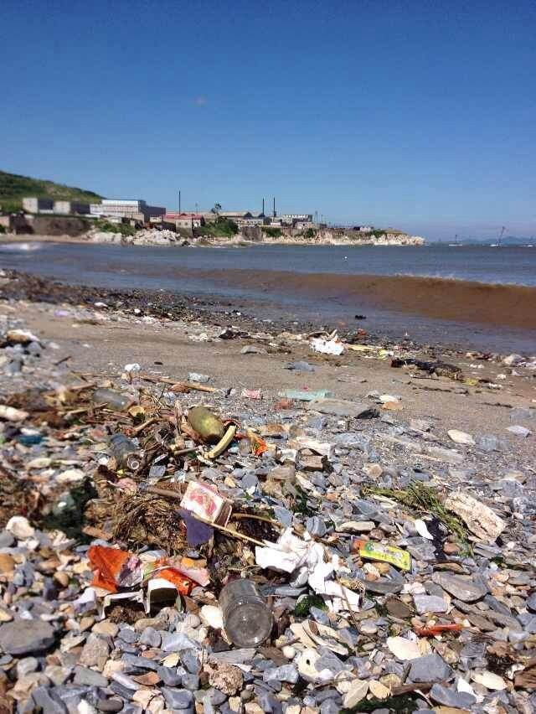
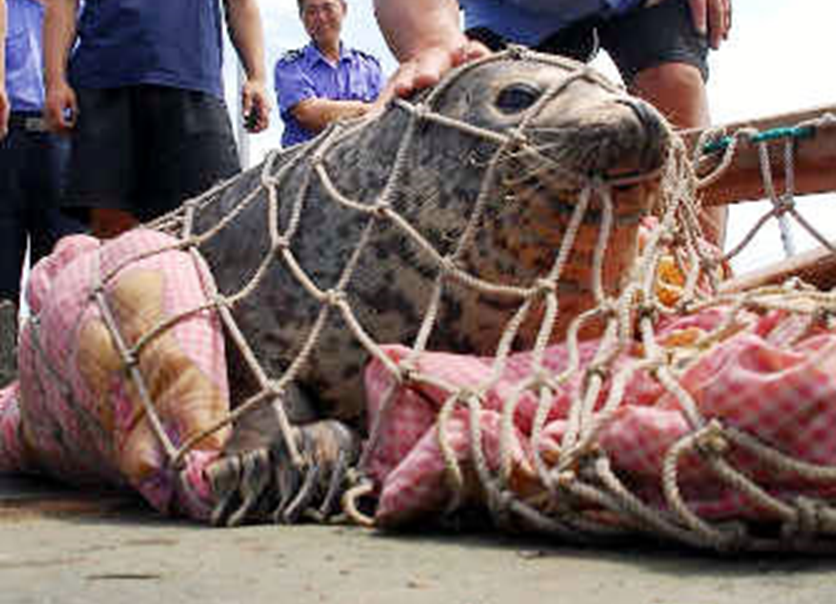
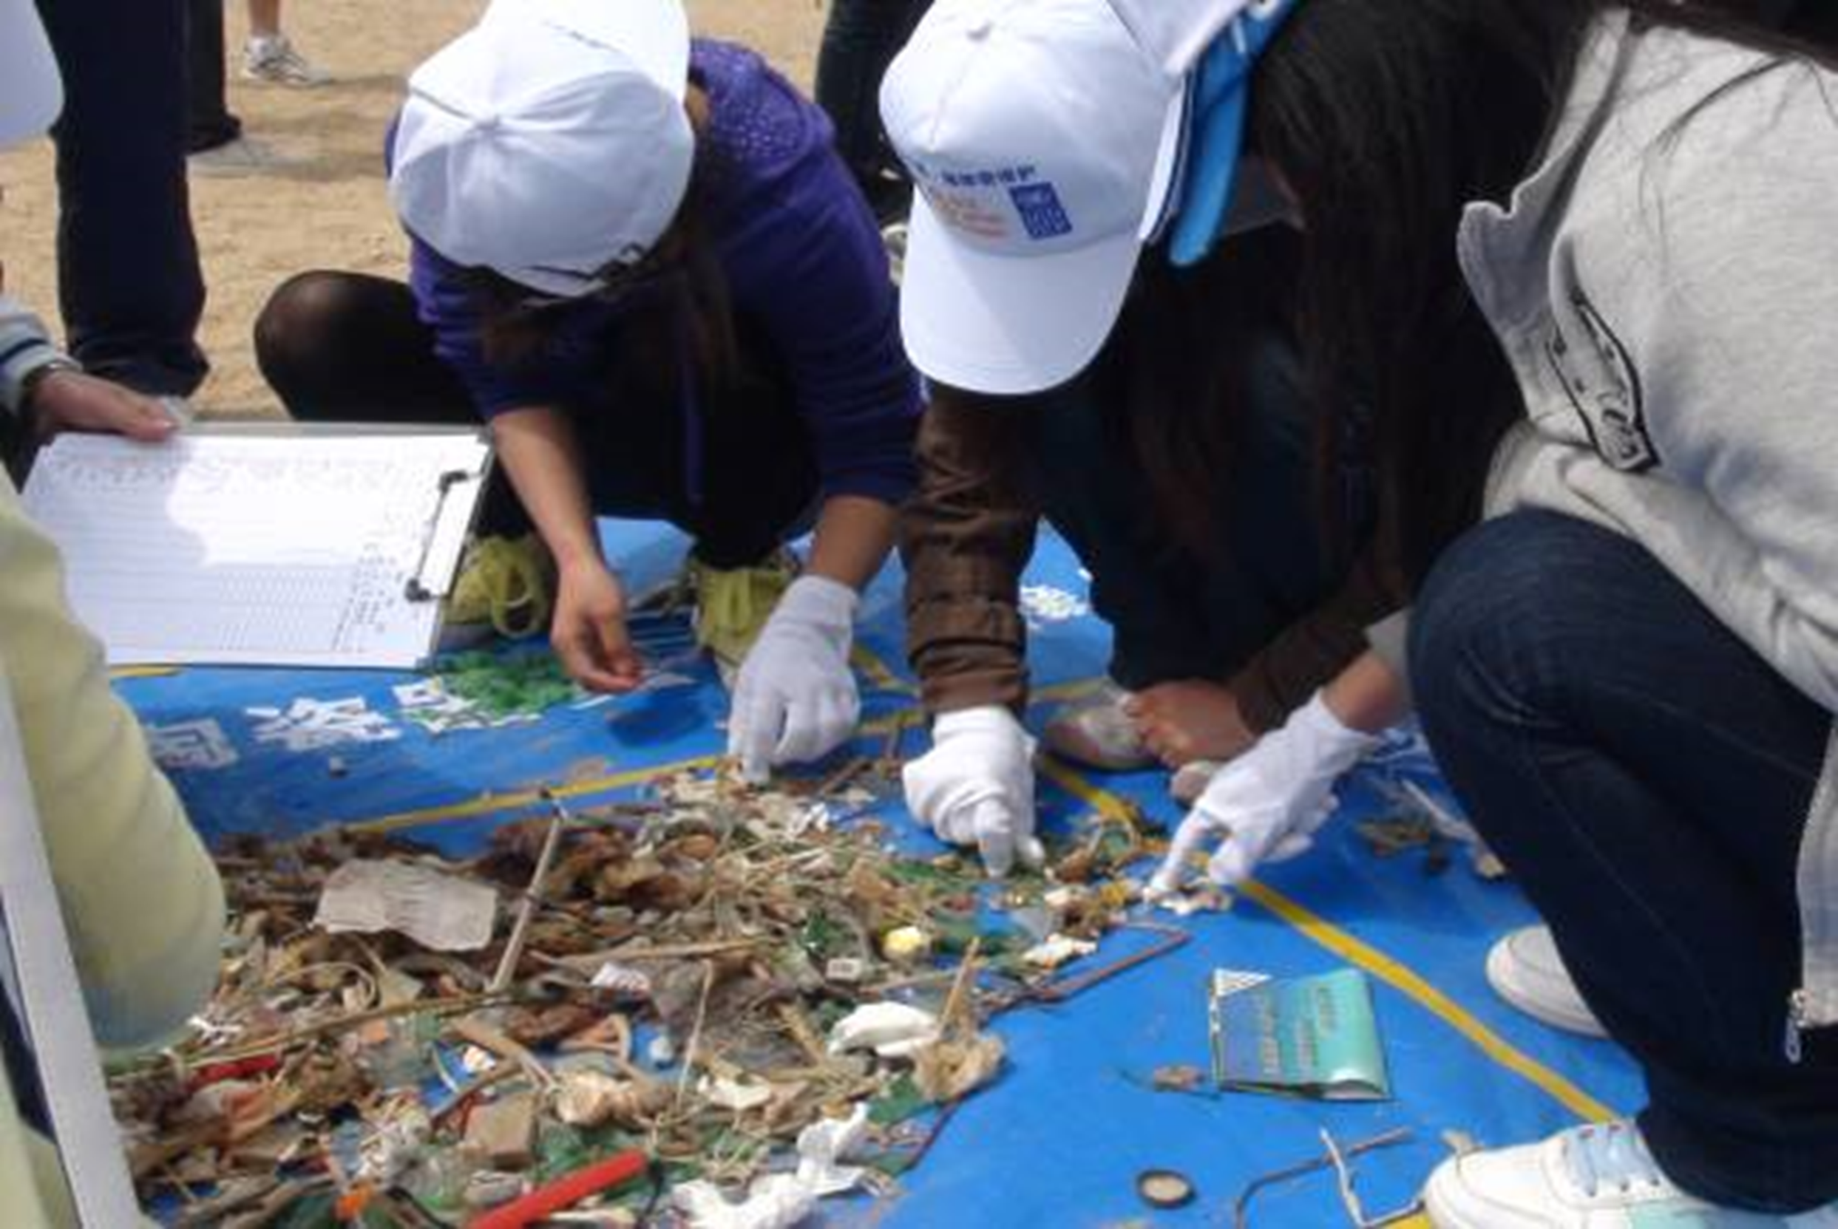
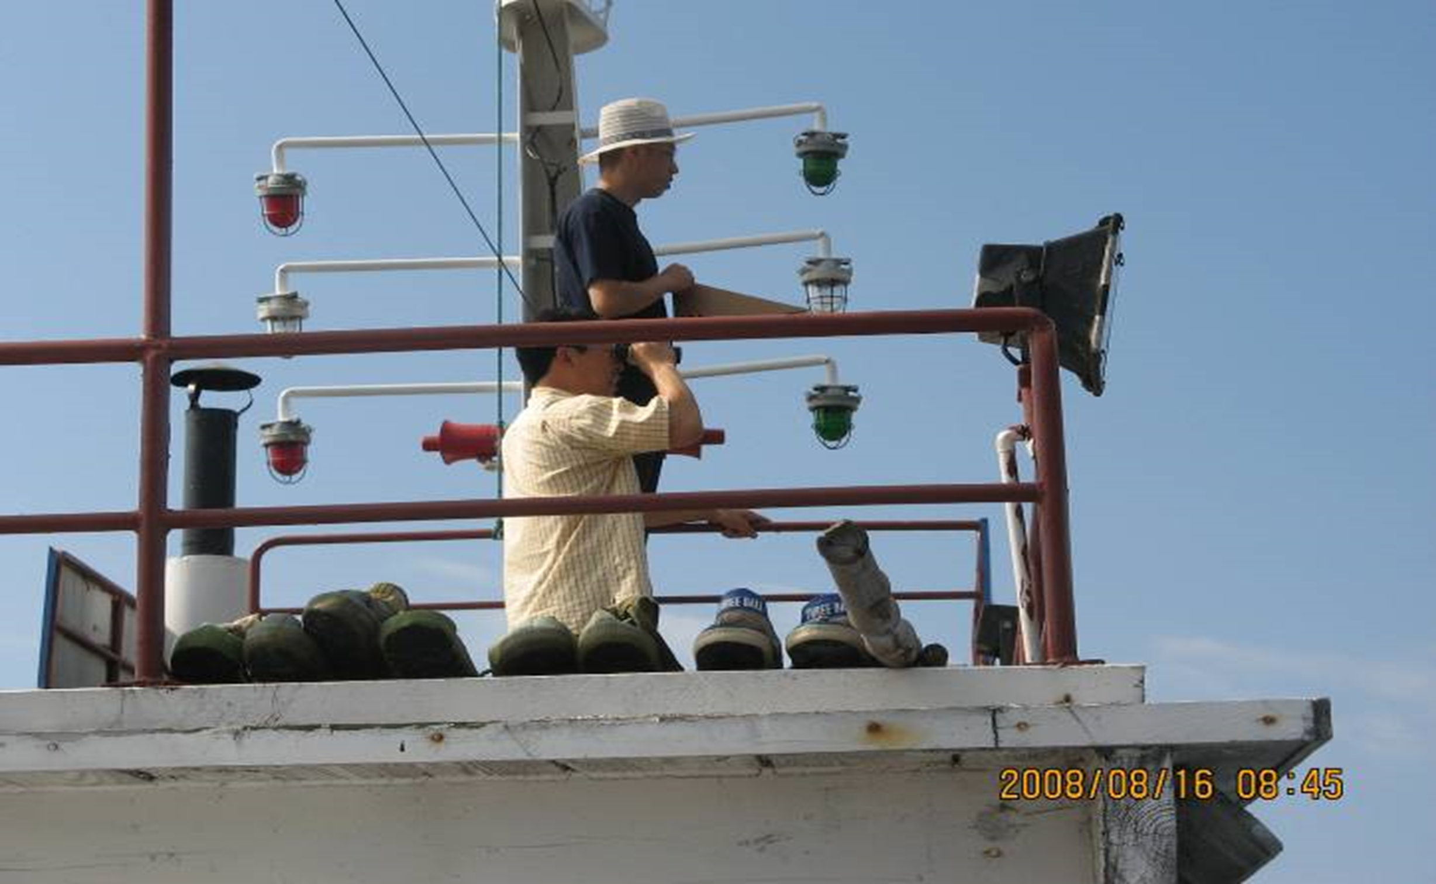
Marine Debris (micro- & macro-) Monitoring and Research in China
Juying Wang, Weiwei Zhang, Jingli Mu
Brussels, Belgium June 02, 2017

Slide 2
Contents
1
Governance to Marine Debris
2
MD Monitoring Program in China
3
MPs Research in China
4
Conclusions

Slide 3
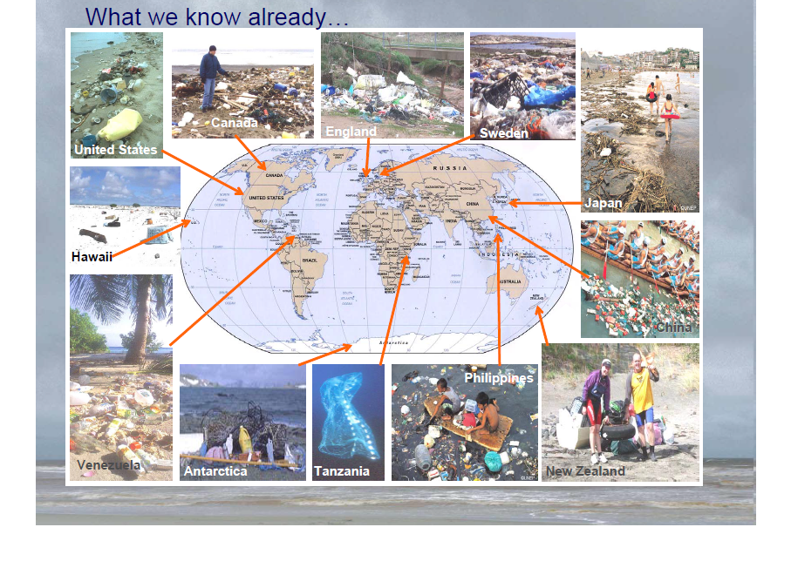
Marine debris is present in all marine habitats, from densely populated regions to remote points far from human activities.
Notes:
Marine litter accumulating in the marine environment may be one of the greatest threats facing our planet.

Slide 4
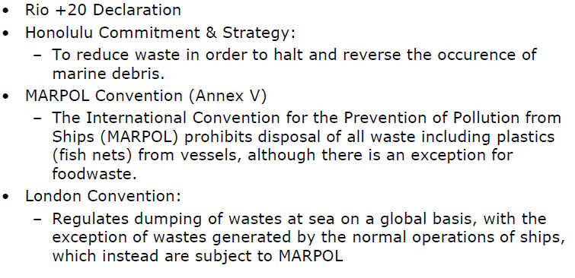
Global Governance
UNCLOS, Basel Convention on the Control of Transboundary Movements of Hazardous Wastes and Their Disposal
UNEP: Global Partnership of Marine Litter (GPML)
SDG 14
Notes:
Global, serious problem;
There is a large gap in international hard law specifically addressing land-based debris marine pollution.
Generally speaking, soft law dominates global efforts to address marine debris and is an essential part of the existing regime.
As the contracting state for Marpol, London, Basel convention and Unclos, China effectively execute the Convention, and actively participates in activities and initiatives of the management of marine debris.
作为上述公约缔约国，我国切实履行公约，积极参与海洋垃圾管理的国际实践。
我国参与的其他国际协议、倡议及相关国际组织，也十分重视海洋塑料垃圾的管理，包括保护海洋免受陆源活动危害的全球行动计划(GPA)海洋垃圾议题、联合国第60和65届大会决议、联合国环境署(UNEP)设立的海洋垃圾全球倡议、联合国粮农组织渔业委员会(COFI)渔业垃圾议题等。
Rio+20 (para 163): Collectively commit to take action；Achieve significant reductions by 2025；Prevent harm to the coastal and marine environment；Recognises plastic problem

Slide 5
EU Marine Strategy Framework Directive
Came into force in 2008, Aimed at achieving a good ecological status of marine water in 2020
Biological diversity
Non-indigenous species introduced by human activities
Pressure by fisheries
Productivity of marine food web
Eutrophication
Sea floor integritity
Hydrographic alterations
Contaminant concentrations in water and sediment
Contaminant concentrations in seafood for human consumption
Marine litter
Introduction of energy (thermal energy, EMF and light) and noise
http://ec.europa.eu/environment/marine/eu-coast-and-marine-policy/marine-strategy-framework-directive/index_en.htm
Notes:
MSFD the is one of the most important legal framework in EU, for implementation of measures on Marine Litter.

Slide 6
National Policy Framework in China
Environmental Protection Law of the People’s Republic of China
Marine Environmental Protection Law of the People’s Republic of China
Law of the People's Republic of China on Prevention and Control of Water Pollution
Law of the People's Republic of China on Prevention and Control of Environmental Pollution by Solid Wastes
Regulations Concerning the Prevention and Cure of Pollution Damage of Marine Environment by Pollutants from Land
Regulations Concerning the Management of Marine Dumping
Regulations Concerning the Prevention and Cure of Pollution Damage of Marine Environment by Seashore Construction Project
Regulations on Prevention of Environment Pollution by Marine Oil Exploitation and Development
Regulations Concerning the Prevention of Pollution of Sea Areas by Vessels
Regulations on Prevention of Environment Pollution by Ship Scraping
……
To strictly manage solid wastes, control marine debris input from both the land and sea based activities
Notes:
严格固体废弃物管理，控制海洋垃圾陆域输入、减少海上来源

Slide 7
Recent National Action Plan
Integrated Reform Plan for Promoting Ecological Progress;
Water Pollution Prevention and Control Action Plan;
Air Pollution Prevention and Control Action Plan;
Soil Pollution Prevention and Control Action Plan;
Coast Pollution Prevention and Control Plan
Plan on Prevention and Control of Pollution from Ship and Ports (2015-2020)
……
Notes:
In the context of ecological conservation,
Market-Based approach, green product, circular economy, extended producer responsibility, sustainable waste management

Slide 8
Marine debris Institutional Arrangements
Monitoring &
Assessment
Research
Land Source Control
University &
Institute
Ministry of Environ. Protection
SOA
Local monitoring agency
NMEMC

Slide 9
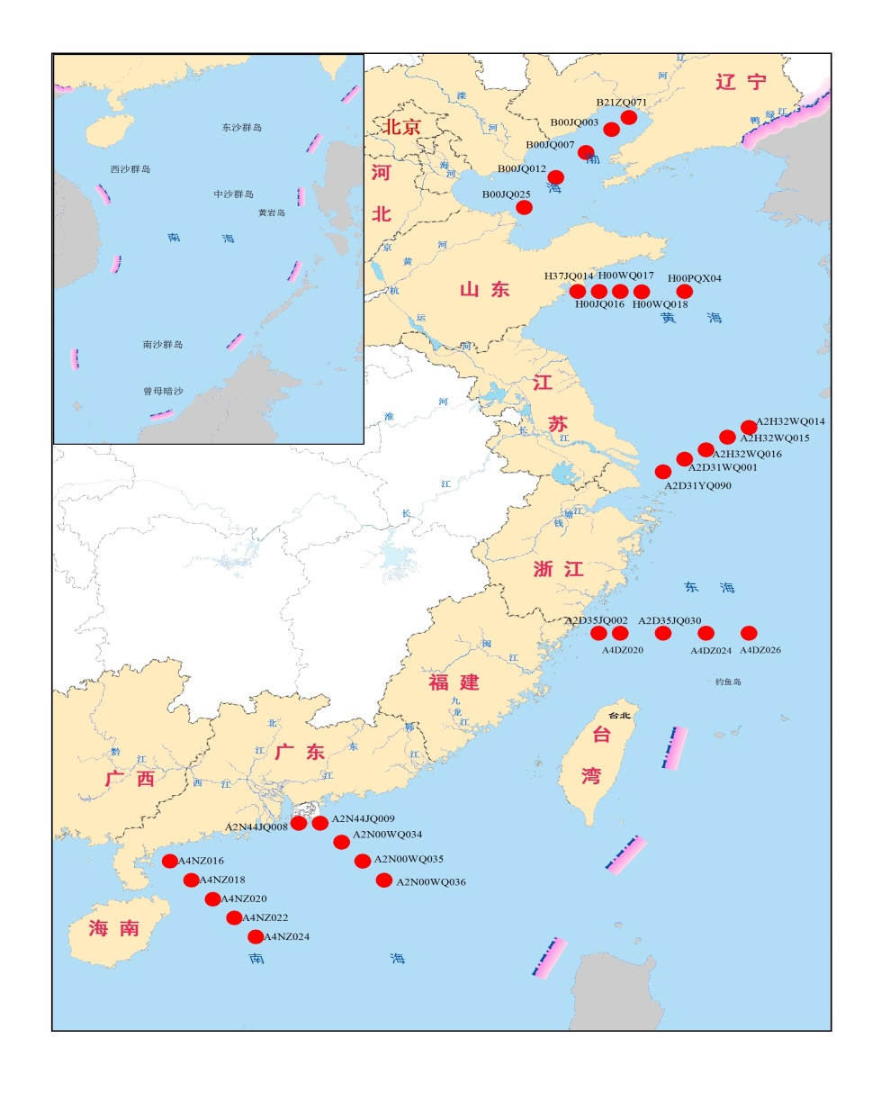
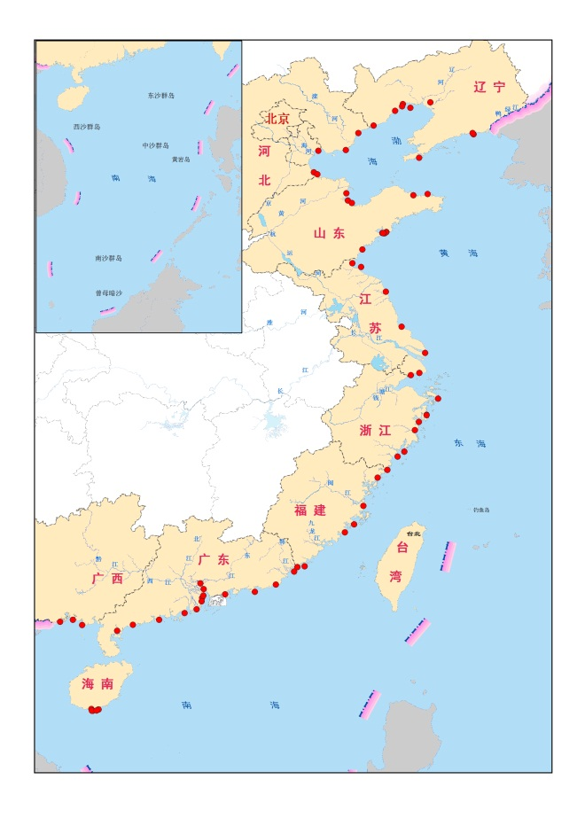
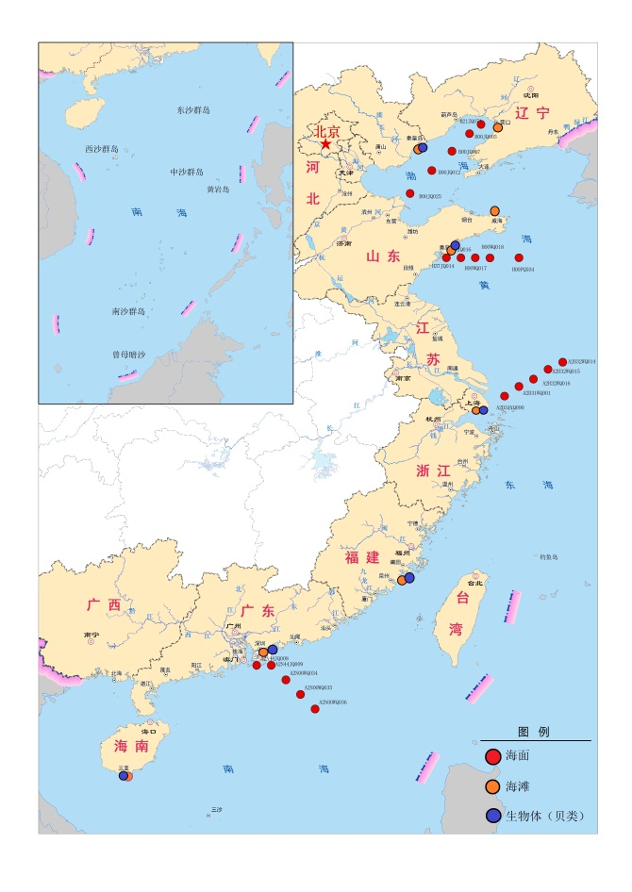
2. SOA’s Marine Debris Monitoring Program
2017
Macro-debris: being commenced since 2007.
Micro-debris: being commenced since 2016

Slide 10
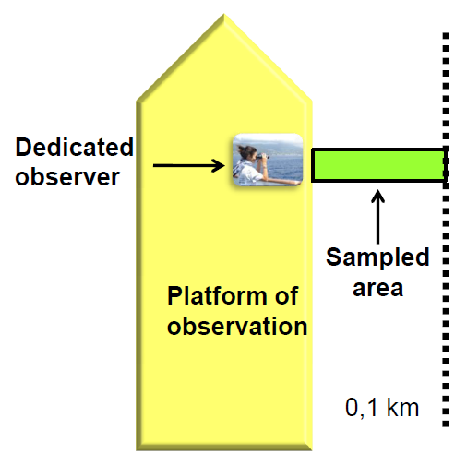
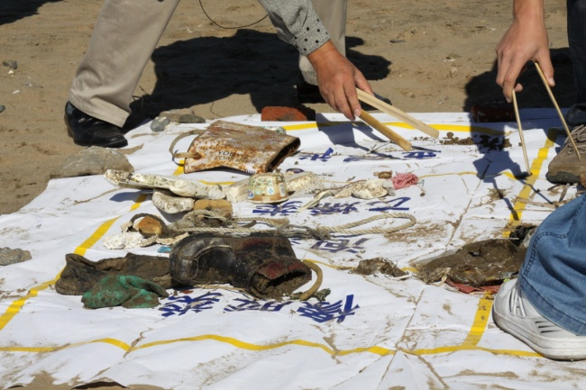
Macro-Debris Monitoring Program
▶ Main focus areas
  Coastal recreational waters
  Harbors and ports
  Mariculture zones
  Marine protection areas
Once/year , in wet season
▶ Frequency
▶ Monitoring items
 | Observing Methods
Beach Debris | Sighting survey
Floating Debris | Sighting/Trawling survey
Benthic Debris | Diving survey/Trawling survey

Slide 11
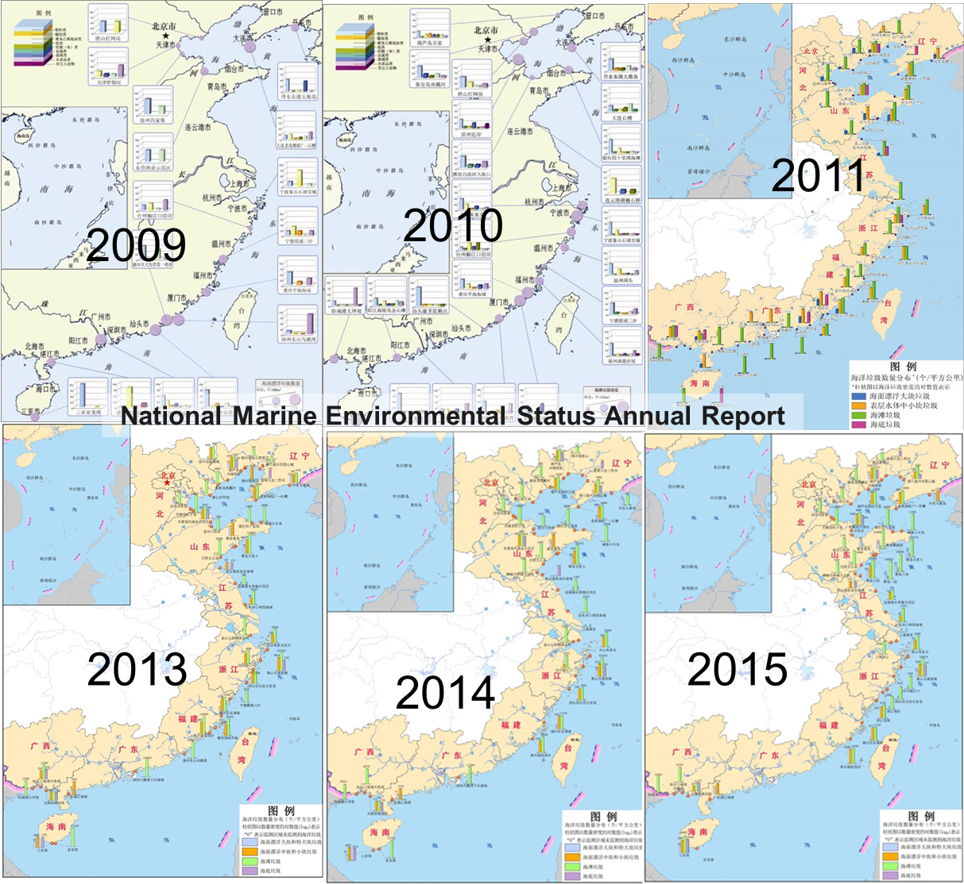
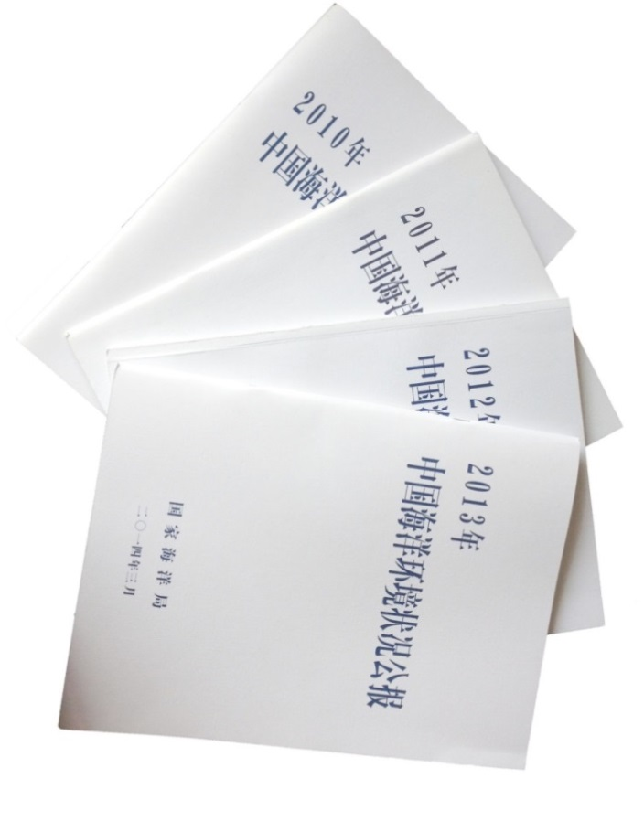
Distribution of marine debris

Slide 12
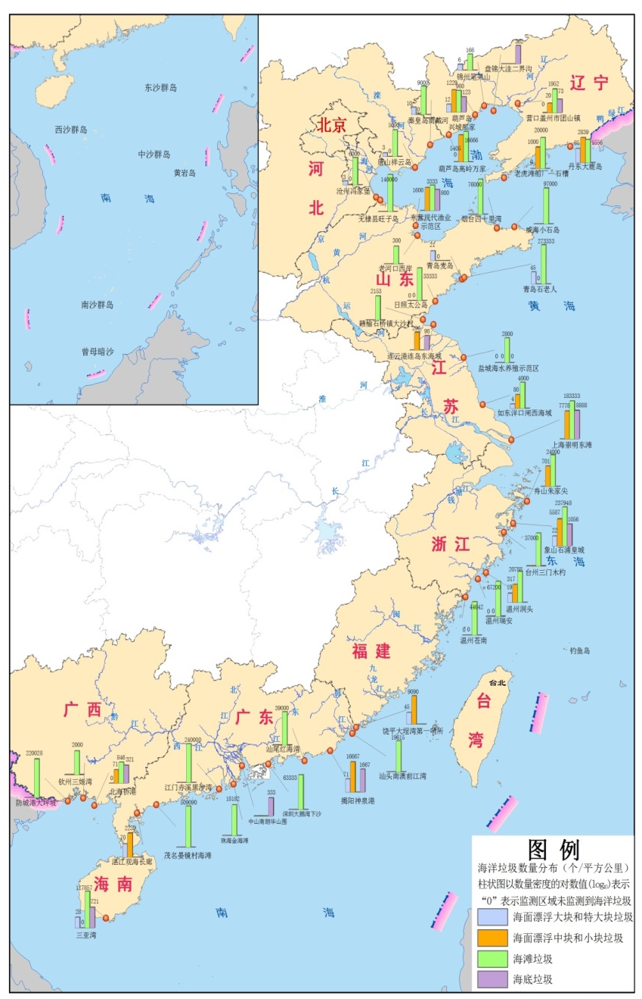
Macro-Debris In 2016
Floating: 2 284 items/km², 62 kg /km²;
Beach: 69 203 items/km² , 1 105 kg /km²;
Seafloor: 1 325 items/km², 34 kg/km²;

Slide 13
Mega Floating Debris
Macro Floating Debris
Beach Debris
Sea Floor Debris
Debris Abundance from 2007 to 2016 in China

Slide 14
Floating Debris (items/km²)
NE. Pacific
China coast
Caribbean Sea
Australia coast
Gulf of Maine
Coastal N. Atlantic Ocean
N. Pacific central gyre
N. Atlantic subtropical gyre
S. Pacific subtropical gyre
N. Pacific / Kuroshio Current
N. Pacific/Bering/Japanese Sea
data of WOA I was cited
Notes:
Order of magnitude
与北大西洋沿岸、加勒比海、缅因湾、澳大利亚沿海等处于同一水平

Slide 15
Beach Debris (items/100 m²)
Persian Gulf
Mumbai, India
China coast
Sea of Japan, Russian
NOWPAP region
Chile
Monterey Bay, USA
Cliffwood Beach, USA
Sea of Japan, Japan
Gulf of Aqaba, Red Sea
Ensenada, Mexico
Rio de Janeiro, Brazil

Slide 16
Benthic Debris (items/km²)
Greek Gulfs
Belgium
European Coast
US West Coast
Gulf of Mexico
China coast
West coast of Portugal
Gulf of Aqaba, red Sea
eastern Fram Strait west of Svalbard
Antalya Bay, Mediterranean

Slide 17
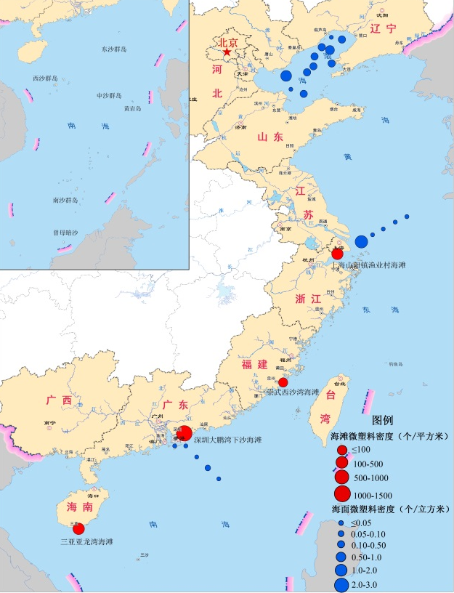
SOA’s Marine Micro-Debris Monitoring Program
MPs in surface waters
Density：0.29 (0.001-2.35) particles/m³
Component: PE, PP and PS;
Color: white, blue;
Shape：line, film, fragment, foam spherules.
MPs on beaches
Density：100 - 1208 particles/m²
Component: PE, PP, PS, PET, PVC.
Shape：fragment, film, fiber.
MPs in shellfish: 0.26 particle/g（WW）
Sinonovacula constricta:0.16 particle/g
Ruditapes philippinarum:0.49 particle/g
Perna viridis:0.12 particle/g
MPs distribution in 2016
Notes:
highest 2.35 items/m³ near Yangtze Estuary.

Slide 18
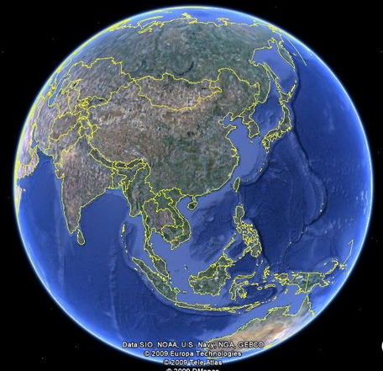
Bohai Sea
Low water exchange capacity
The Bohai Sea (BHS) is a shallow semi-enclosed marginal sea of the NW Pacific, with an area of about 77×10³ km², average depth of 18m, and coastal line length of nearly 3800 km (Sun, 2006).

Slide 19
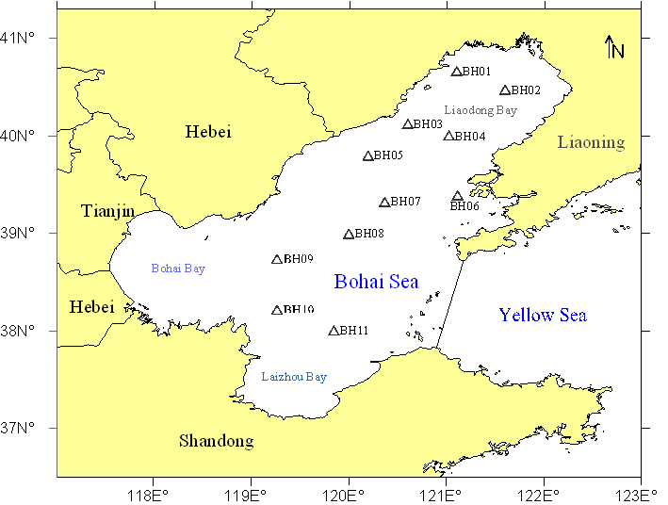
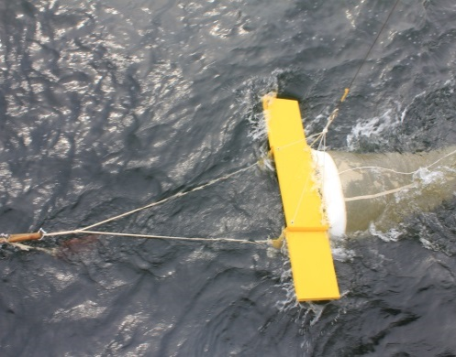
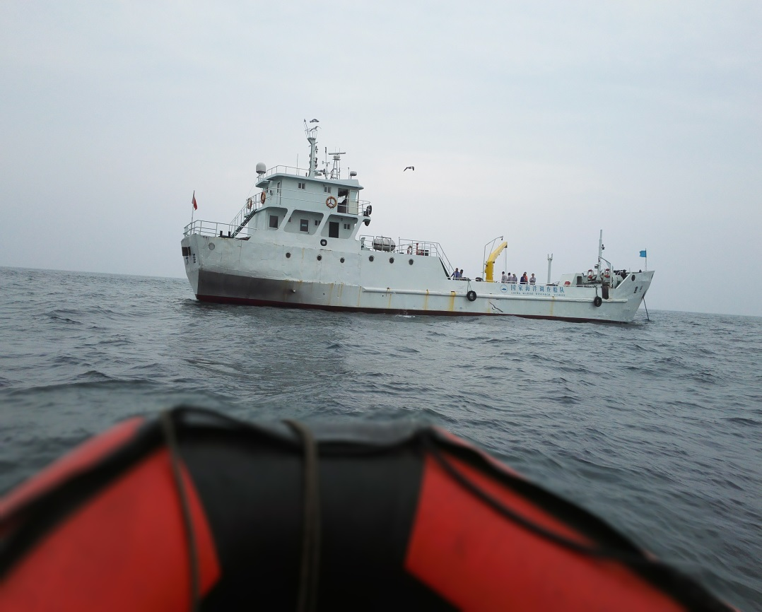
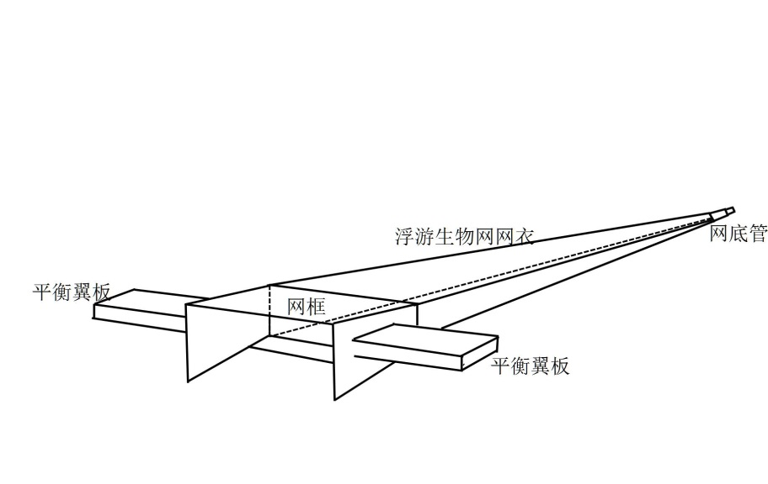
Floating MPs samples were collected at 11 stations during August 17 to 22, 2016.
15 minutes at ～1.5-2.0 knots
3 m
Bottom
tube
0.333 mm mesh
0.45 m
0.95 m
Flow-meter
balance plate

Slide 20
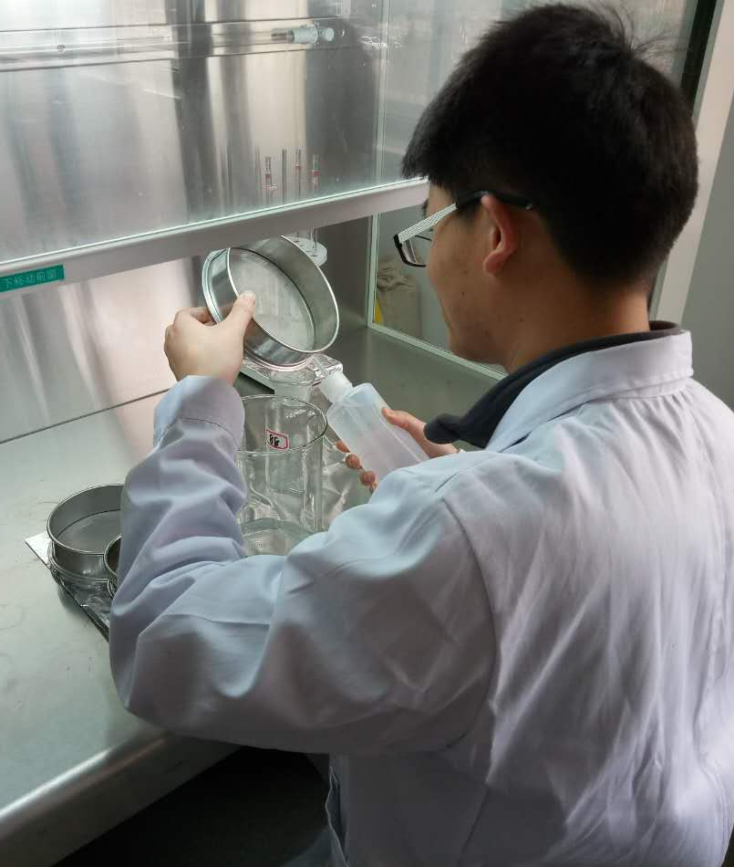
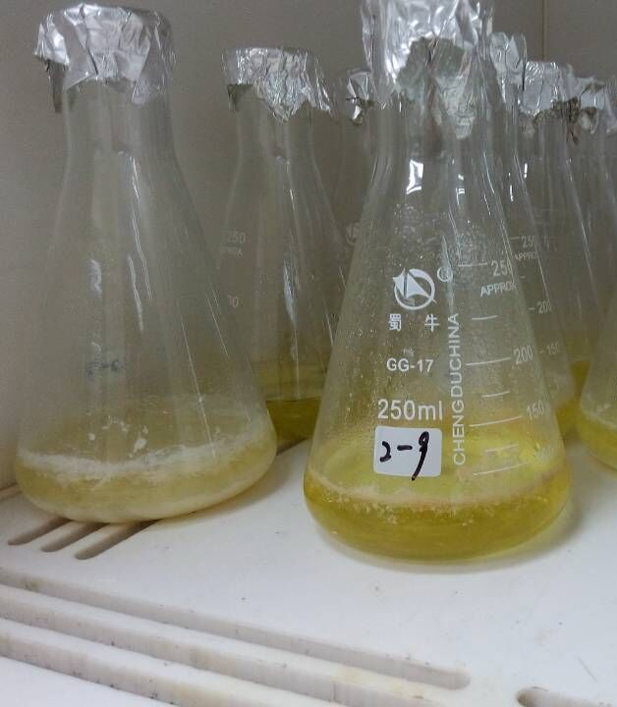
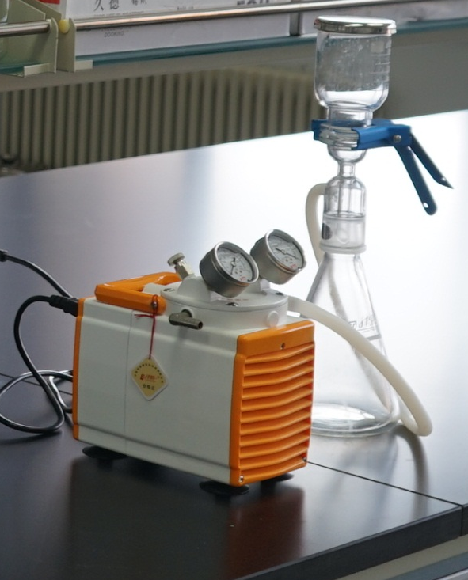
Laboratory Analysis of MPs
Wet sieve
Wet peroxide oxidation
Filtering
Pour the sample through stacked 5.0 mm and 0.3 mm stainless steel mesh sieves..
Add aqueous 0.05 M Fe(II) + 20 mL of 30% H₂O₂. Heat at 75℃ for 30 min to removal natural organic.
Solid float on surface of the mixed solution were filtrated with glass fiber filter (0.7μm).

Slide 21
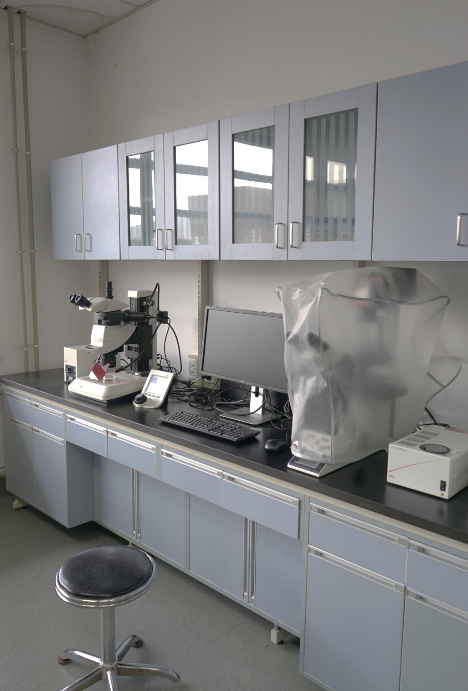
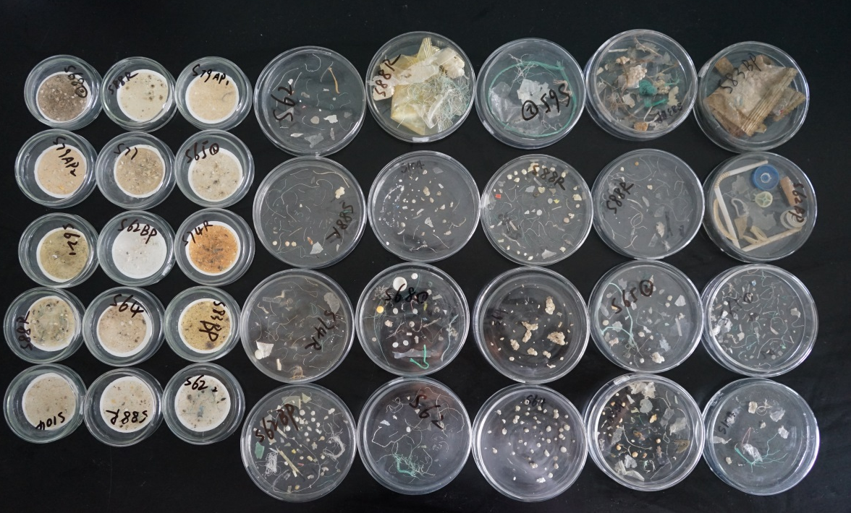
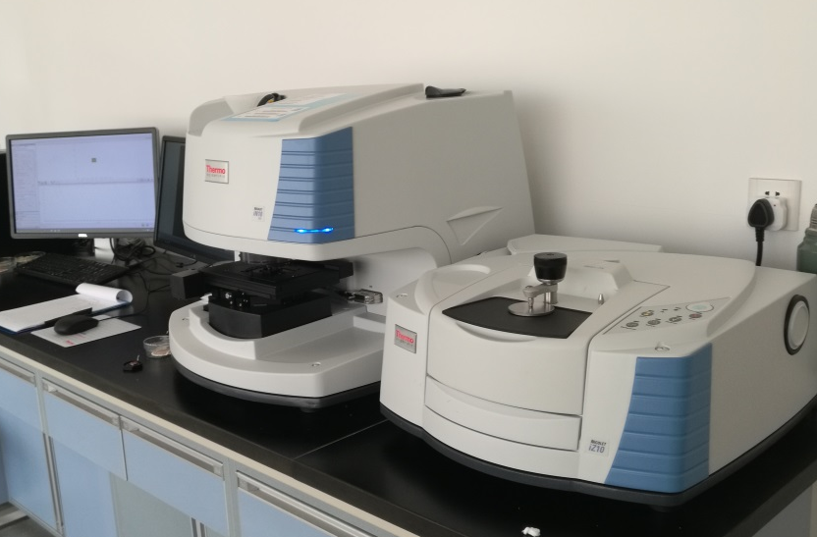
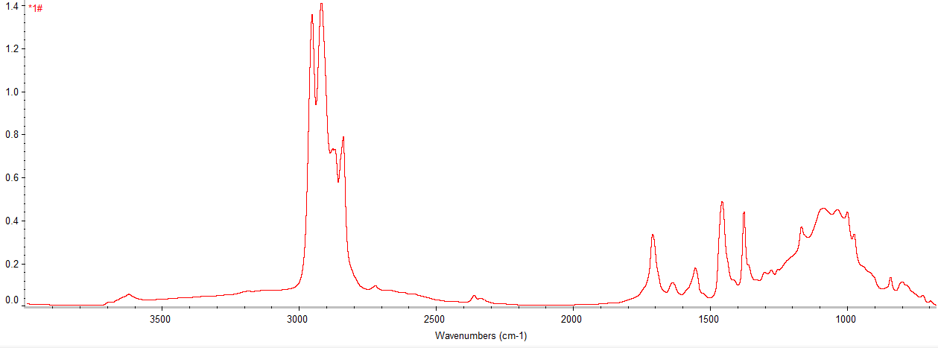
Microscope Exam and FTIR Analysis
Stereoscopic microscope
Fourier Transform Infrared Spectroscopy

Slide 22
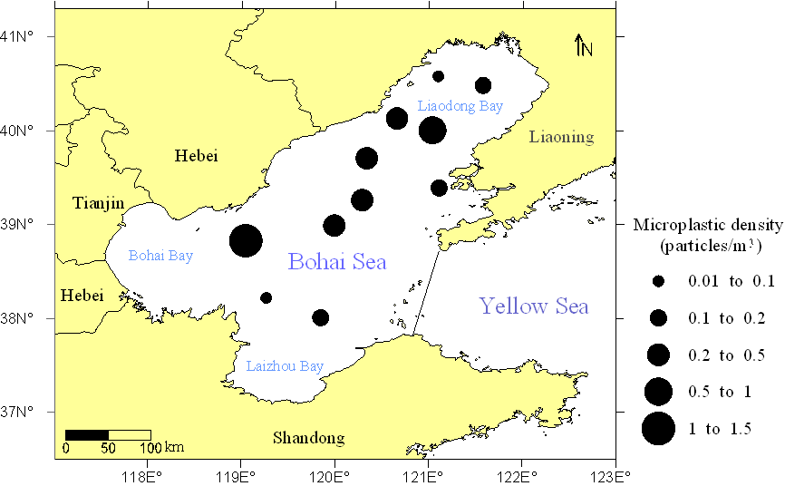
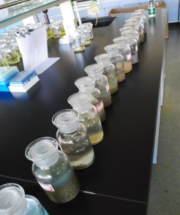
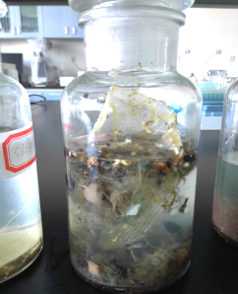
Microplastics abundance
Plastics were collected at all stations, with a total count of 2,925 fragments
MPs was about 1600, accounted for 55%
Average abundance of all plastic samples: 0.60 ± 0.71 particle/m³.
MPs: 0.33 ± 0.36 (ranged 0.01–1.23) particle/m³
Under review

Slide 23
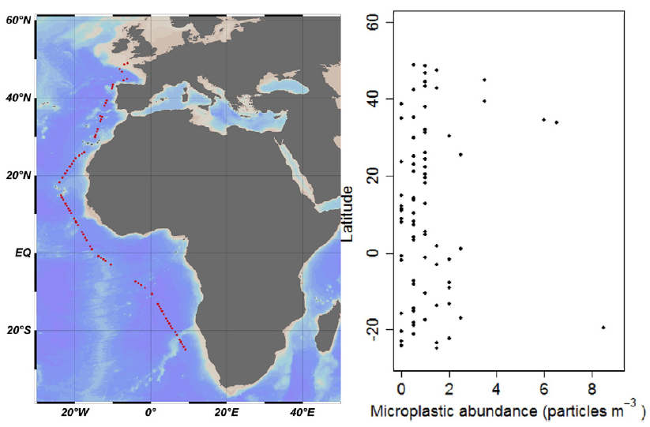
ranged from 0 to 8.5 particles m⁻³, average 1.15 ± 1.45 particles m⁻³
Kanhai et al., 2017
Map of sampling locations and microplastic abundance along the north/south transect in the Atlantic Ocean.

Slide 24
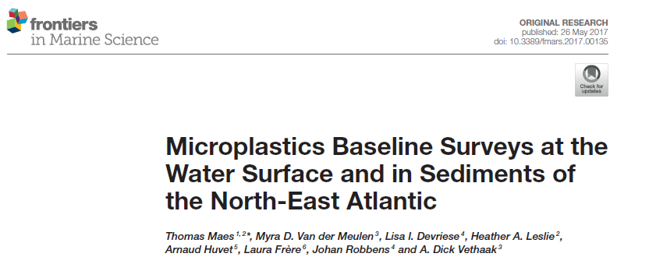
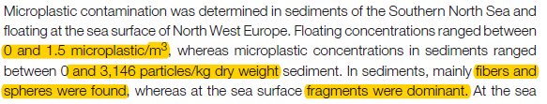
Maes et al., 2017
Bohai:MPs density ranged 0.01–1.23 particle/m³.

Slide 25
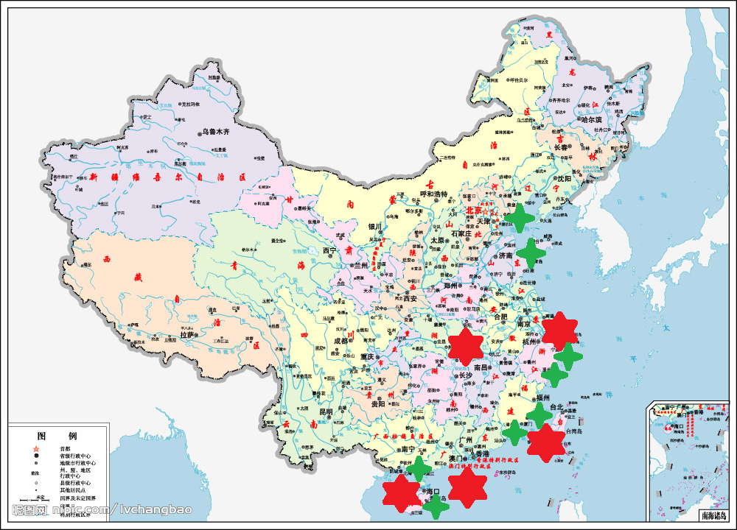
3. MPs research in China
河北曹妃甸
山东半岛
三峡大坝下游
（ Fok et al. 2015 ）
长江河口及东海海域
（Zhao et al. 2014）
长江口、闽江口
瓯江口、椒江口
南海底泥和香港
（Qiu et al. 2015 ； Zhang et al. 2015）
广西北部湾
南部海岸
（Zhao et al 2015a,b）
海南岛
Notes:
lakes in Tibet plateau, three Gorges Dam

Slide 26
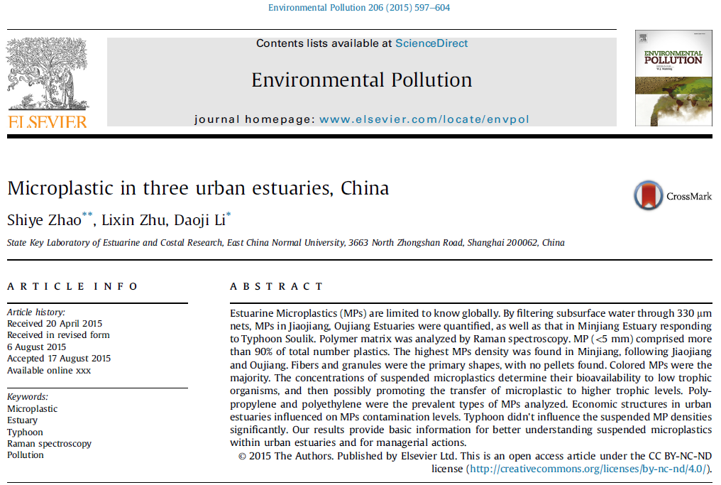
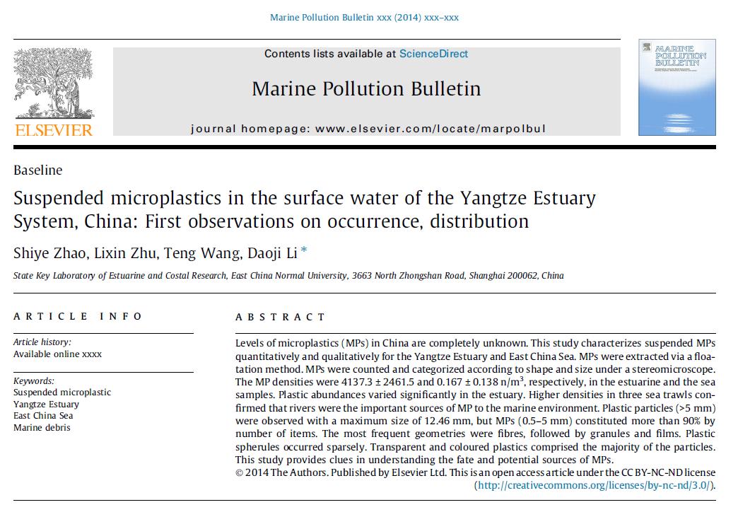
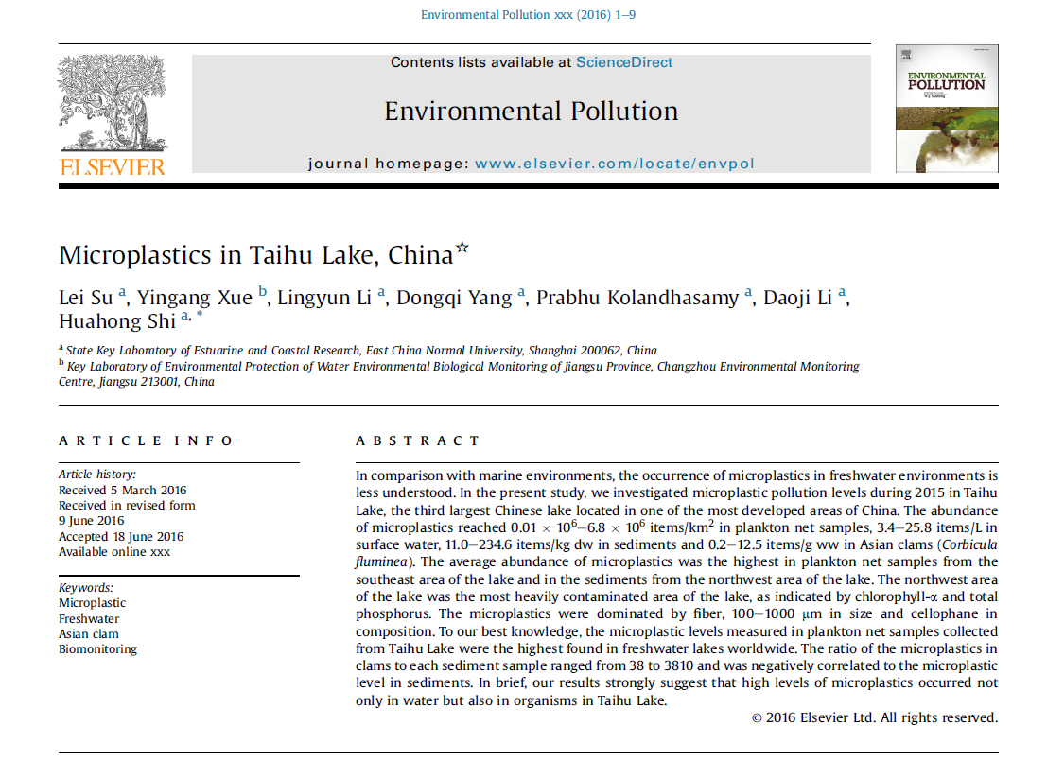
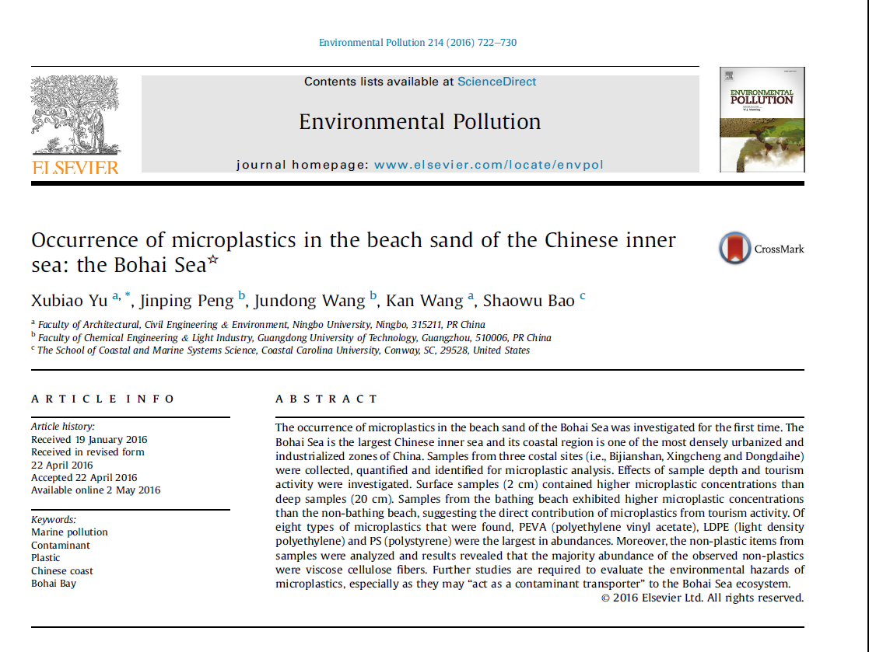
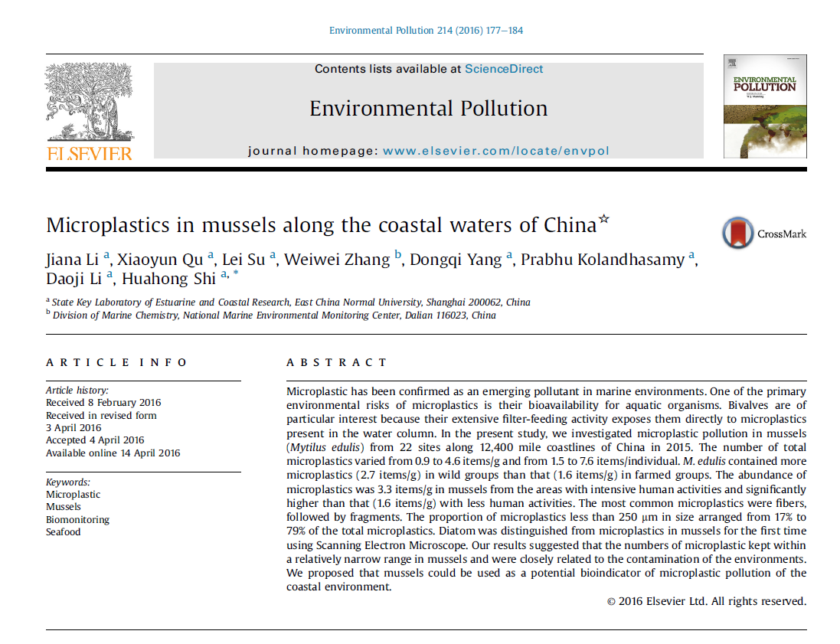
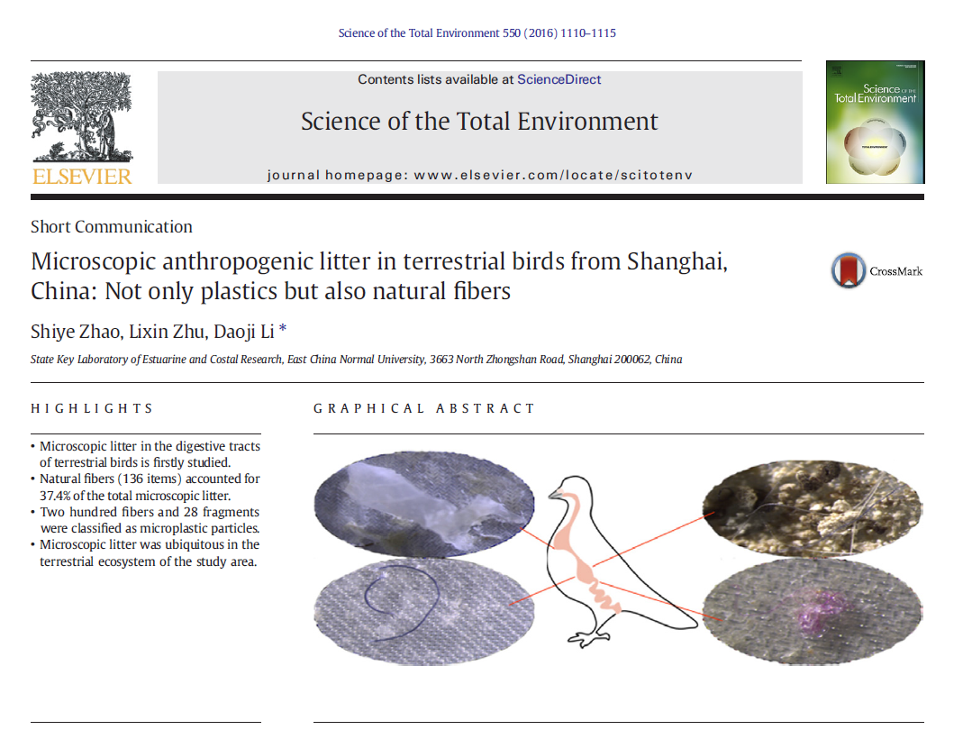
Notes:
In China, although distributions of MPs in beach sediment, estuaries, lakes, shellfish, birds, table salt etc., have been reported.

Slide 27
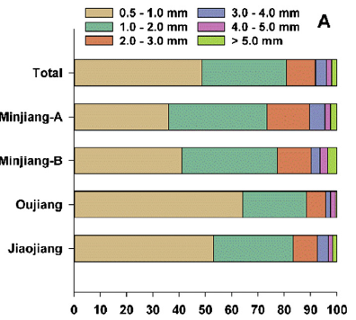
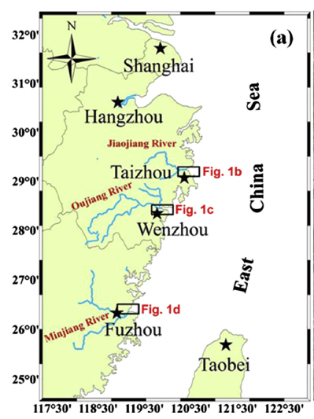
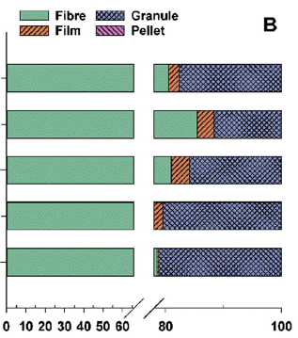
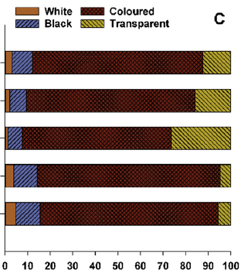
MP in Surface Water
MP abundance:
4137.3 ± 2461.5 n/m³
0.167±0.138 n/m³
955.6 ± 848.7 n/m³
680.0 ± 284.6 nm³
1245.8 ± 531.5 n/m³
Zhao et al.,2014; 2015

Slide 28
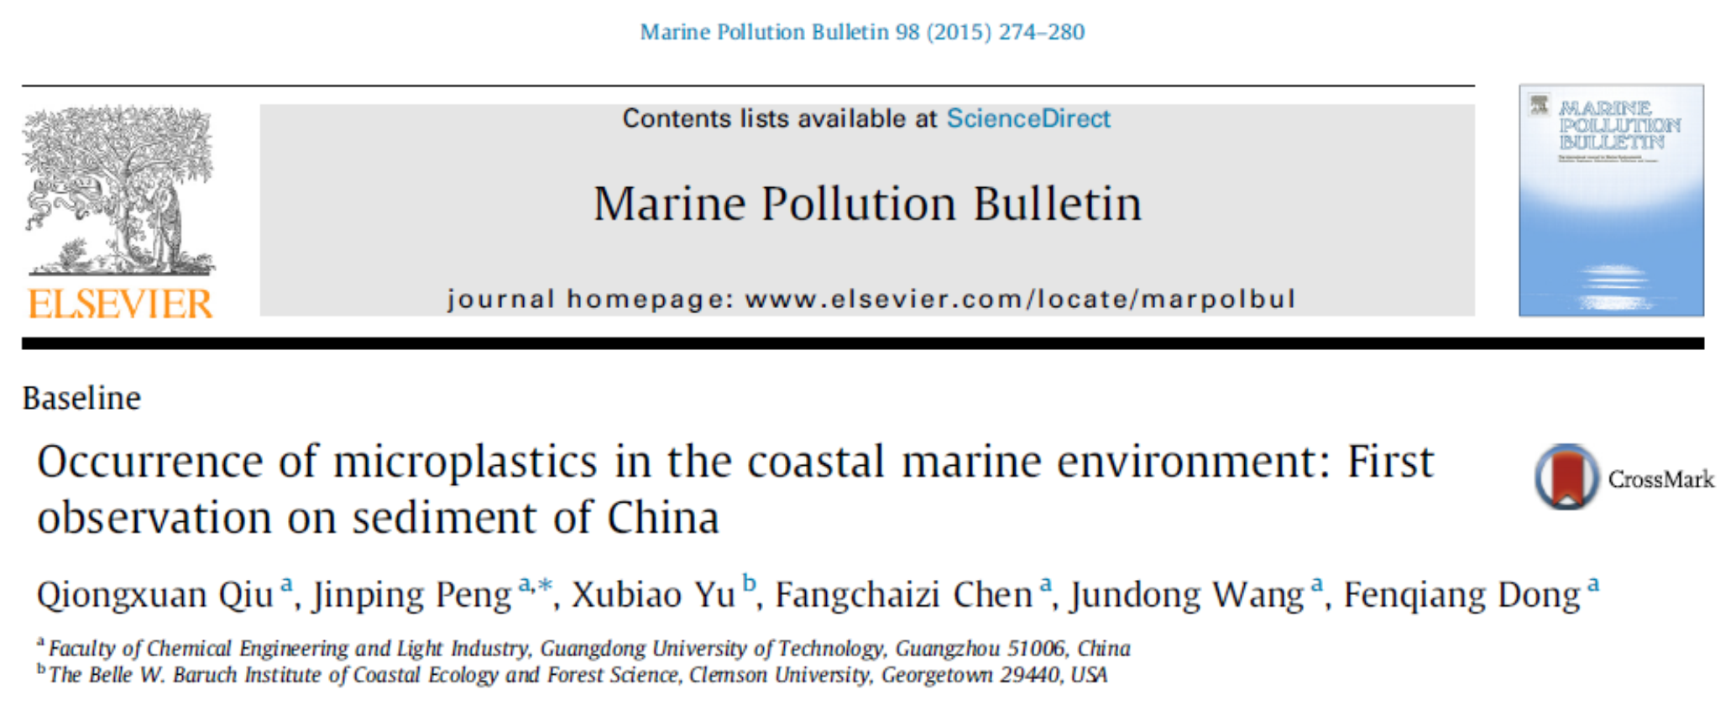
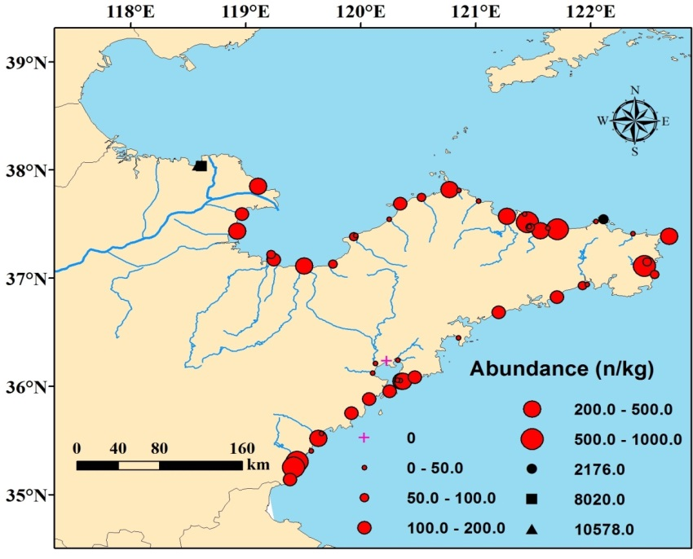
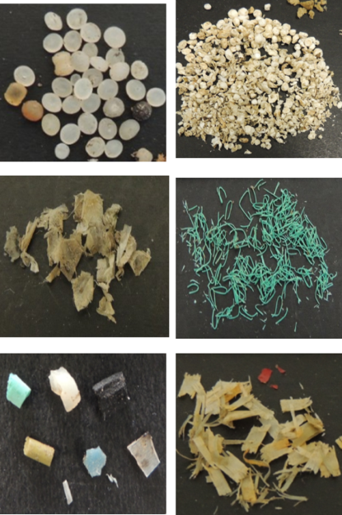
MPs on Beach
Qiu et al., 2015
Zhang et al., 2016

Slide 29
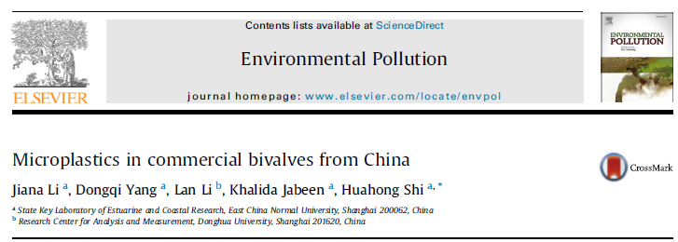
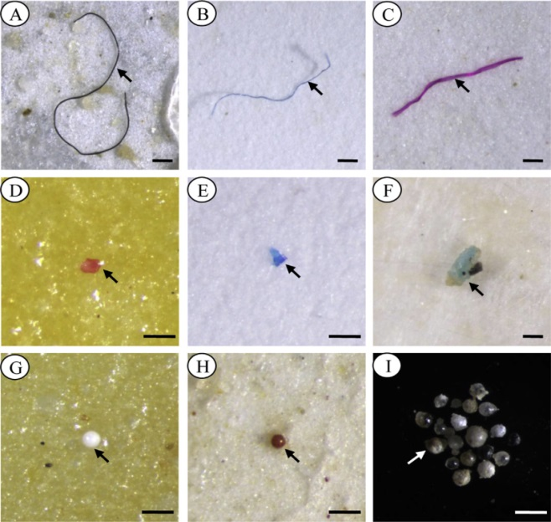
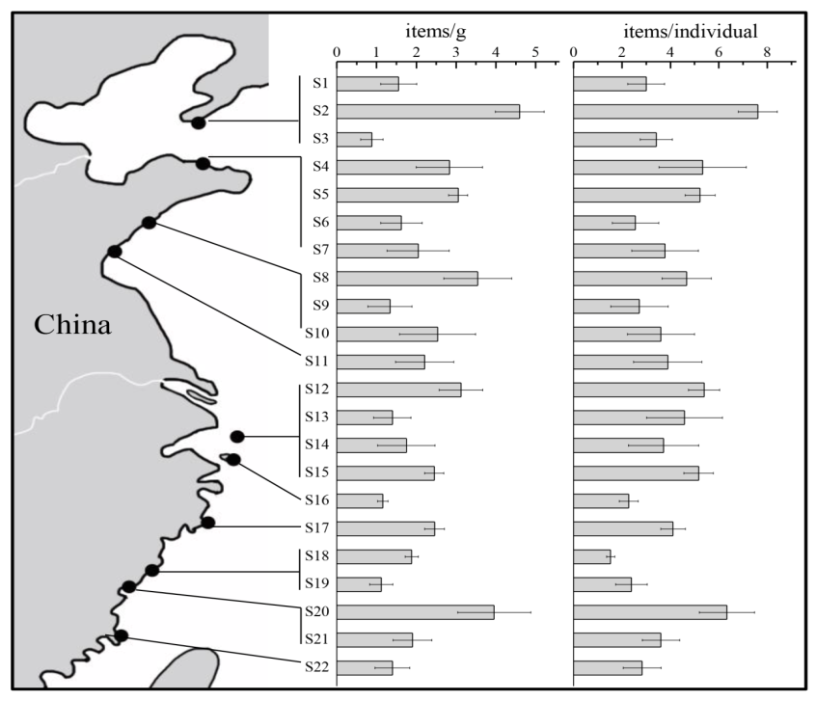


Fibers
MP in Shellfish
Li et al., Environ. Pollut. (2016)
fragments
MP Varied 2.1 - 10.5 items/g
and 4.3 - 57.2 items/individual
pellets
Variation Range:
0.9 - 4.6 items/g;
1.5 - 7.6 items /individual
Average Density:
2.2 items/g;
4.0 items/individual
Mytilus edulis

Slide 30



POPs carried on MP
The collected pellets were analyzed for PAHs, PCBs, HCHs, DDTs, chlordane, heptachlor, endosulfan, aldrin, dieldrin and endrin.
“International Pellet Watch” (Takada, 2015）
PCBs concentrations in pellets from East Asia
Microplastic collected from beaches

Slide 31


Biologicall effects of MPs
MPs Ingestion of microplastics on copepod Tigriopus japonicus
Photographs of accumulation and egestion of fluorescent polystyrene microspheres in marine medaka
Unpublished data

Slide 32
MP in Table salt
MPs: 550−681 particles/kg in sea salts;

Slide 33
The presence of MP in commercial salts from different countries
Extracted MP-like particles larger than 149 μm from 17 salt brands originating from 8 different countries;
MP were absent in one brand while others contained between 1 to 10 MPs/Kg of salt.
Particle size (mean ± SD) was 515 ± 171 μm.
The low level of anthropogenic particles intake from the salts (maximum 37 particles per individual per annum) warrants negligible health impacts.
149 μm pore size to filter
Karami et al., 2017
https://www.nature.com/srep/
Notes:
In 2010, the global daily sodium consumption was 3.95 g/day (equivalent to 9.88–10.2 g salt/day) corresponding to 3.6 to 3.7 Kg salt per annum. The number of anthropogenic particles (MPs and pigments) detected in the salt samples ranged from 0 (sample # France-F) to 10 (sample # Portugal-N) MPs/Kg. Based on this data, humans could ingest a maximum of 37 plastic particles annually.

Slide 34

MPs in Table Salts from China
Yang et al., 2015
MPs content was 550−681 particles/kg in sea salts;
fragments and fibers were the prevalent types of particles compared with pellets and sheets.
MPs measuring less than 200 μm represented the majority of the particles, accounting for 55% of the total MPs
most common MPs were polyethylene terephthalate, followed by polyethylene and cellophane in sea salts.
5 μm pore size, 47 mm cellulose nitrate filter paper using a vacuum system.
PET
PE
PB
PP
PES
CP
CHD
BT

Slide 35
4. Conclusions
Governance at local, regional, national, and global scales;
Rationalization of monitoring
  Develop comparable and coherent monitoring standards and baselines, harmonized protocols
  Indicators for monitoring
  Intercalibrations between regional and overlapping indicators species
  New approaches for monitoring: automated

Slide 36
4. Conclusions
Research priority
  Develop model for MD transportation: Accumulation areas, source/fate
  Rish assessment:
  Better understand the environmental consequences of marco- and micro- MD on wildlife, ecosystem and the food chain.
  Evaluate effects/enable definition of threshold levels.

Slide 37
Thanks for your attention!

Slide 38
Location | item/m³ | Reference
N. Pacific SG | 32.76 | Goldstein et al., 2012
N. Pacific G | 2.23 | Moore et al., 2001
N. Pacific offshore | 0.43-2.23 | Moore et al., 2005
N. Pacific inshore | 5-7.25 | Moore et al., 2005
Southern Californian | 3.92 | Lattin et al., 2004
East Asian Seas | 3.7 | Isobe et al., 2015
NE Atlantic | 2.46 | Lusher et al., 2014
N. Atlantic (accumulation area) | 1.7 | Reisser et al., 2015
Italian Coast | 0.62 | Fossi et al., 2012
Plymouth, UK | <0.04 | Thompson et al., 2004
Seto Inland sea | 0.39 | Isobe et al., 2014
Bohai Sea | 0.33 | Our study
Arctic polar waters | 0.34 | Lusher et al., 2015
East China Sea | 0.167 | Zhao et al., 2014
Mediterranean Sea | 0.15 | De Lucia et al., 2014
N. Pacific | 0.12 | Goldstein et al., 2012
Southern Oceans | 0.099 | Isobe et al., 2016
MP in Surface Water
Area | References | Analysis /Concentration
Taihu Lake, China | Su et al., 2016 | Plankton net samples: 0.01×10⁶ ~ 6.8×10⁶ n/km² Surface water： 3.4 ~ 25.8 items/L
Three Gorges Dam, China | Zhang et al., 2015 | Main stream: 3407.7 ×10³ to 13,617.5 ×10³ n/km² Tributary: 192.5 ×10³ to 11,889.7 ×10³ n/km²
Yangtze Estuary, | Zhao et al., 2014 | 4137.3 ± 2461.5 n/m³
Estuaries, China | Zhao et al., 2015 | Jiaojiang： 955.6 ± 848.7 n/m³ Oujiang： 680.0 ± 284.6 n/m³ Minjiang： 1245.8 ± 531.5 n/m³

Slide 39
Location | Microplastic abundance (particles per m³) | Method for surface waters (unless otherwise indicated) | Study
Arctic Ocean
Svalbard, Norway | 0.34 ± 0.31; 0–1.31 (mean, range) 2.68 ± 2.95; 0–11.5 (mean, range) | Manta trawl (333 μm) Underway system (250 μm)ª | Lusher et al. (2015)¹
Pacific Ocean
Southern California, USA | 7.25 (mean) | Manta trawl (333 μm) | Moore et al. (2002)
Santa Monica Bay, USA | 3.92 (mean) | Manta net (333 μm) | Lattin et al. (2004)
South Californian current | 0–3.141 | Manta net (505 μm) | Gilfillan et al. (2009)
Southeast Bering Sea | 0.004–0.19 | Sameoto neuston/manta net (505 μm) | Doyle et al. (2011)
NP Subtropical Gyre | 0.425 (median) | Manta net (333 μm) | Goldstein et al. (2012)
North eastern Pacific Ocean | 279 ± 178 (mean) | Underway system (62.5–250 μm)a | Desforges et al. (2014)²
Geoje Island, South Korea | 0.4–54 | Manta trawl (330 μm) | Song et al. (2014)
East China Sea | 0.167 ± 0.138 (mean) | Neuston net (333 μm) | Zhao et al. (2014)
Southern Sea of Korea | 1.92–5.51; 2.3–38.77 (2012) 582–924; 10–375 (2013) | Manta trawl (330 μm) Hand Net (50 μm) | Kang et al. (2015a)
Geoje and Jinhae Bays, Korea | 1.92 ± 1.84; 5.51 ± 11.2 (2012) 1.68 ± 0.81; 1.07 ± 0.34 (2013) | Manta Trawl (330 μm) | Kang et al. (2015b)
East Asian Sea | 3.7 ± 10.4; 0.03–491 (mean, range) | Neuston net (350 μm) | Isobe et al. (2015)
Indian Ocean
Southeast South Africa | 257.9–1215 | WP-2 type net (80 μm) | Nel and Froneman (2015)
Atlantic Ocean
Bristol Channel, UK | 0–100 | Lowestoft plankton sampler (270 μm) | Morris & Hamilton (1974)
Offshore Ireland | 2.46 ± 2.43; 0–22.5 (mean, range) | Underway system (250 μm)^{b} | Lusher et al. (2014)³
Western English Channel | 0.27 | Plankton nets (200, 500 μm) | Cole et al. (2014)
Portuguese coastal waters | 0.002–0.036 | WP2 (180 μm), Neuston (280 μm), LH Plankton Recorder (335 μm) | Frias et al. (2014)
St. Peter/St. Paul Archipelago, Brazil | 0.01 | Plankton net (300 μm) | Ivar do Sul et al. (2013)
Western Tropical Atlantic Ocean | 0.015–0.04 | Manta trawl (300 μm) | Ivar do Sul et al. (2014)
North Atlantic Ocean | 13–501 | Underway system (10, 300 μm)^{b} | Enders et al. (2015)⁴
Atlantic Ocean | 1.15 ± 1.45; 0–8.5 (mean, range) | Underway system (250 μm)^{b} | Kanhai et al.(2017)⁵
Mediterranean and European Seas
West Coast, Sweden | 167–2400 72–141 | Plankton net (80 μm) Zooplankton net (450 μm) | Noren (2007)
West Sardinian Coast | 0.15 | Manta trawl (500 μm) | de Lucia et al. (2014)
Southwest Finland | 0–0.74 | Manta trawl (333 μm) | Magnusson (2014)
Baltic Sea | 102–104 | WP2 net (90 μm mesh) | Gorokhova (2015)

Slide 40

Plastics in the surface waters of Bohai Sea
Size
Component
Color
Shape
Under review

Slide 41

Plastics are estimated to make up as much as 95 % of the marine litter found on coastlines, sea surface, and the ocean floor (Galgani et al., 2015.)
why care about
PLASTIC

Slide 42


Slide 43

Flow chart describing inputs of plastics into marine environ.
Law, 2017
Notes:
Beginning with the manufacture of common plastic resins in the form of industrial pellets

Slide 44


The exact quantity of plastic in the ocean and volumes entering the ocean from waste generated on land is unknown.
4.8-12.7
million Tons
322

Slide 45





Slide 46

Macro
Micro

Slide 47


Microplastic marine debris
2004，Thompson

Slide 48

E-business

Slide 49
EU: Regional Convention
OSPAR – Convention for the Protection of the Marine Environment of the North-East Atlantic:
  Regional Action Plan in 2014: reduction measures and targets, taking into consideration an ambitious target resulting in a reduction in 2020.
7th EAP and other EU Acquis (e.g. Waste, Port Reception Facilities Directive)
EU/MSFD- Marine Strategy Framework Directive:
  Properties and quantities of marine litter do not cause harm to the coastal and marine environment.
MSFD is most important legal framework for implementation of measures on Marine Litter.

Slide 50

Response To Marine Debris in China
Strengthening the management to eliminate the use of plastics products.
  National: Required to limit the use the plastic bags since Jan. 8, 2008 ;
  Local - Jilin Province, forbid to produce and sale non-degradable plastics bag and cutlery since Jan. 1st, 2015
Pushing the recycling and reusing of plastic products.
Organizing cleaning event to raise awareness.
Monitoring Marine Debris (Macro- and Micoro-) .
Notes:
Market-Based approach, green product, circular economy, extended producer responsibility, sustainable waste management
我国各级政府、社会公众及NGO组织等多年来均采取积极行动措施，加强对塑料制品使用的管控，定期开展对重点海域垃圾的清除，并加强海滩清洁和环境保护公众教育，取得了良好效果
—“限塑令”：2008年6月1日起，在全国范围内禁止生产销售使用超薄塑料袋（厚度小于0.025mm），并实行塑料袋有偿使用制度。
—吉林： 2015年1月1号开始，吉林省正式施行“禁塑令”，规定全省范围内禁止生产、销售不可降解塑料购物袋、塑料餐具。这也成为中国施行“限塑令”6年以来，首个全面“禁塑”的省份。

