Slide 1

WestMED Assistance Mechanism
Matteo Bocci
7 July 2022

Slide 2
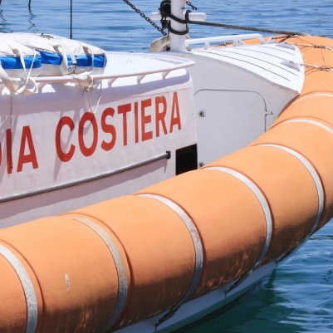


WestMED Strategic Initiative
Goals
A Safer and more Secure Maritime Space
A Smart and Resilient
Blue Economy
A better Governance
of the Sea

Slide 3

WestMED Strategic Initiative
Framework for Action & Roadmap
Six Priorities
Maritime safety and the fight against marine pollution
Maritime cluster development
Skills development and circulation
Sustainable consumption and production
Biodiversity and marine habitat conservation and restoration
Development of coastal communities and sustainable fisheries and aquaculture

Slide 4
WestMED Strategic Initiative
Revision of the Framework for Action
Instrumental in keeping the ‘policy agenda’ up-to-date
Allowing for inclusive and participatory dialogue
Towards the end of 2022: Malta + Libya Co-Presidency

Slide 5











WestMED Strategic Initiative
Steering Committee and governance
Steering Committee
Assistance Mechanism
Rotating co-presidency (currently Malta-Libya)
Providing overall steer and key decisions
Approving work and priorities for the Assistance Mechanism

Slide 6
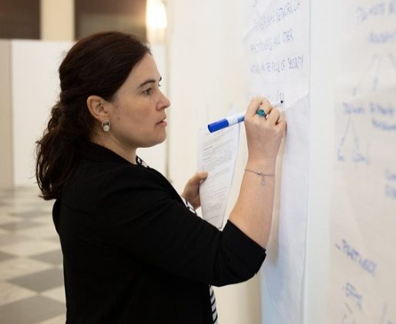

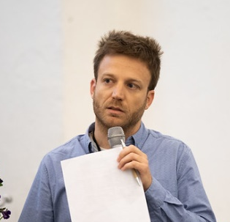
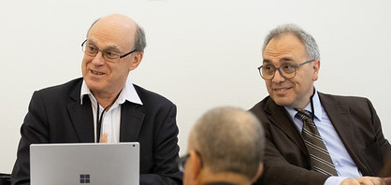
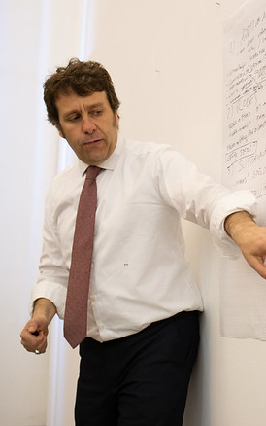
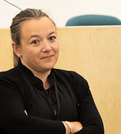
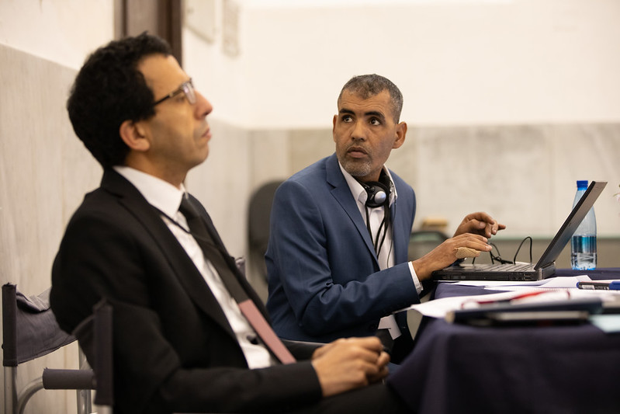
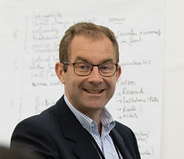
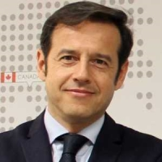
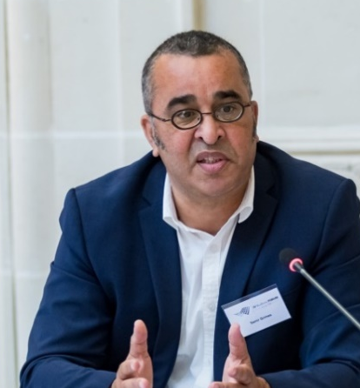
Assistance Mechanism
Central
Team
National
Hubs
Expert
Pools
29+ Experts

Slide 7
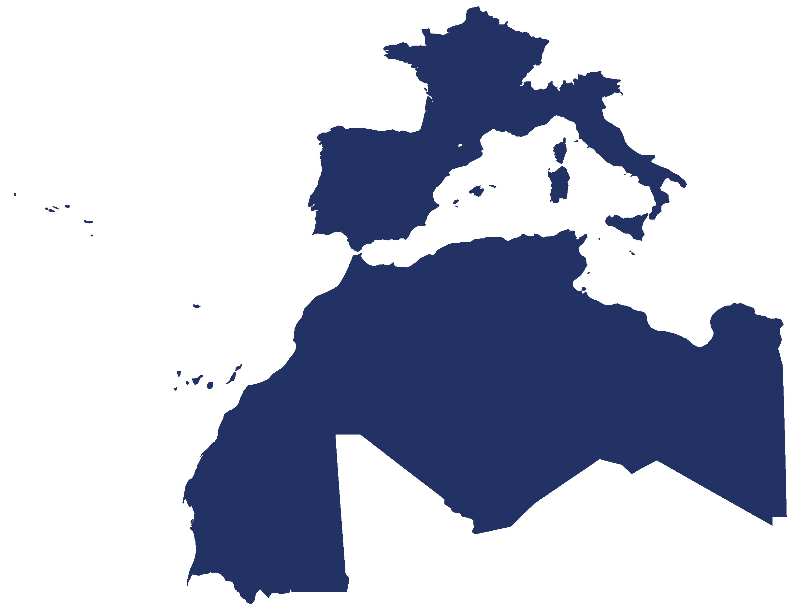


Network of National Hubs (NHs)
ALGERIA
FRANCE
ITALY
LIBYA
MALTA
MAURITANIA
MOROCCO
PORTUGAL
SPAIN
TUNISIA

Slide 8
ASSISTANCE SERVICES
Support partnership and dialogue
Partner Matchmaking
Funding Opportunities
Project Proposals
Partnership
support
Aquaculture
Coastal &
Maritime Tourism
Engagement
platform
Maritime Clusters
Blue Skills
Green Shipping
& Smart Ports

Slide 9
WestMED Assistance Meachanism
Funding and financing opportunities
GRANTS
Theme
Specific
(EU)
Cosme
Erasmus +
EU Invest
FINANCE
EU
focus
EMFAF
EMFAF Sea basin calls
ITERREG EU MED
INTERREG NEXT
Horizon Europe
EU Missions/ Lighthouse
GRANTS
Sea Basin
(EU + partners/ neighbours)
FINANCE
EU +
neighbour
focus
EU Invest
BlueInvest
ERRD
EFSD+

Slide 10
WestMED Assistance Mechanism
Working to achieve ‘synergies’ in project support
‘Level 1’ synergies: amongst projects (capitalisation)
‘Level 2’ synergies: areas of strategic relevance (Technical Groups)
‘Level 3’ synergies: amongst programmes (e.g. INTERREG)

Slide 11
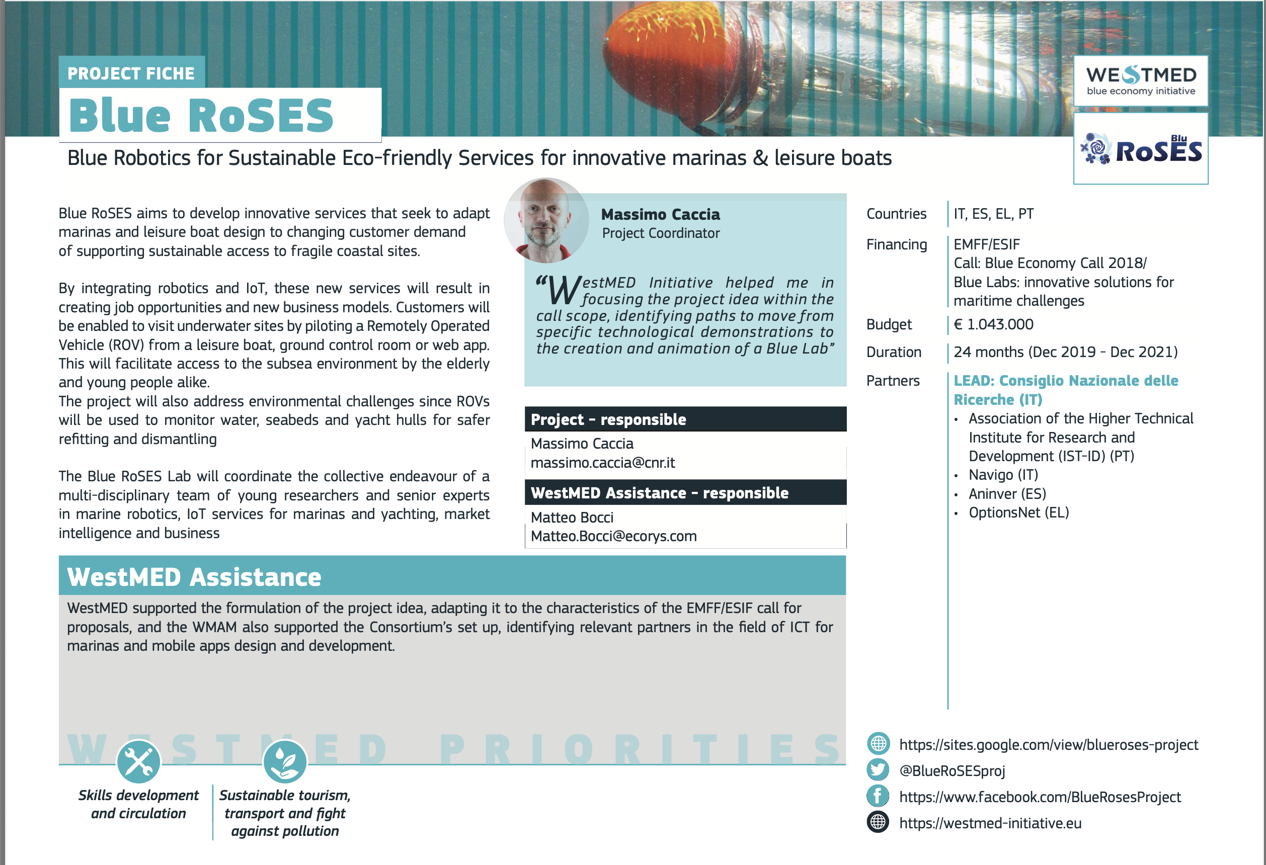
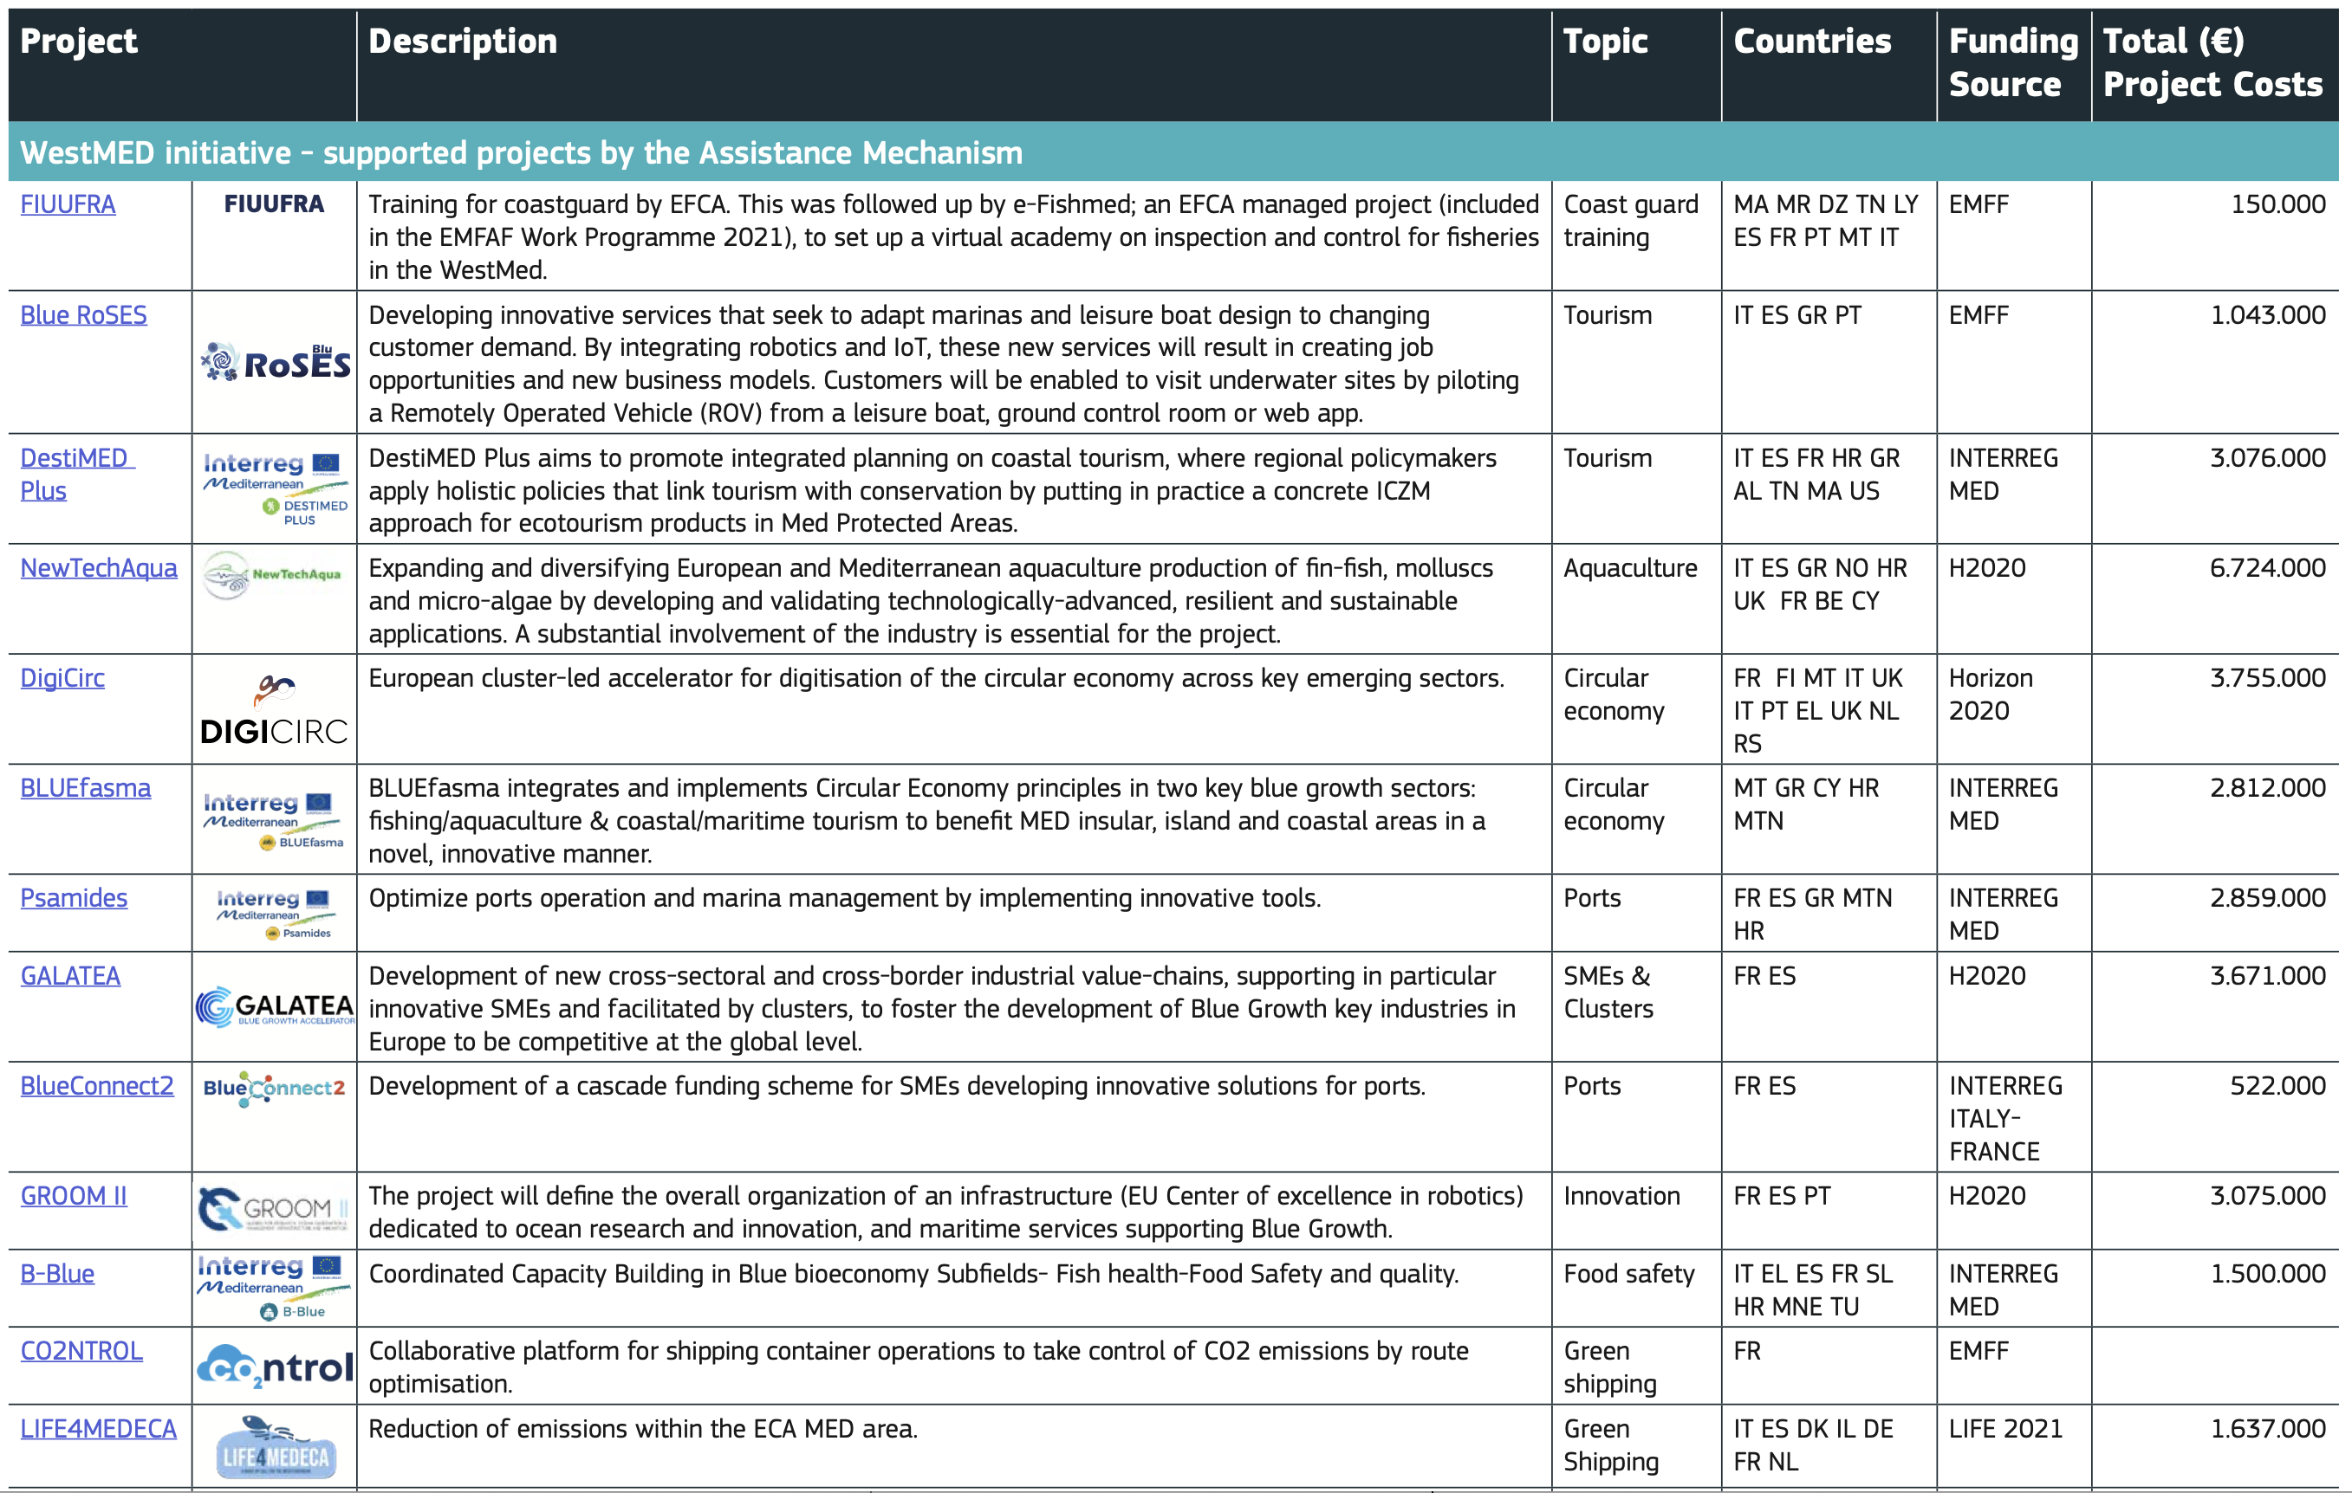
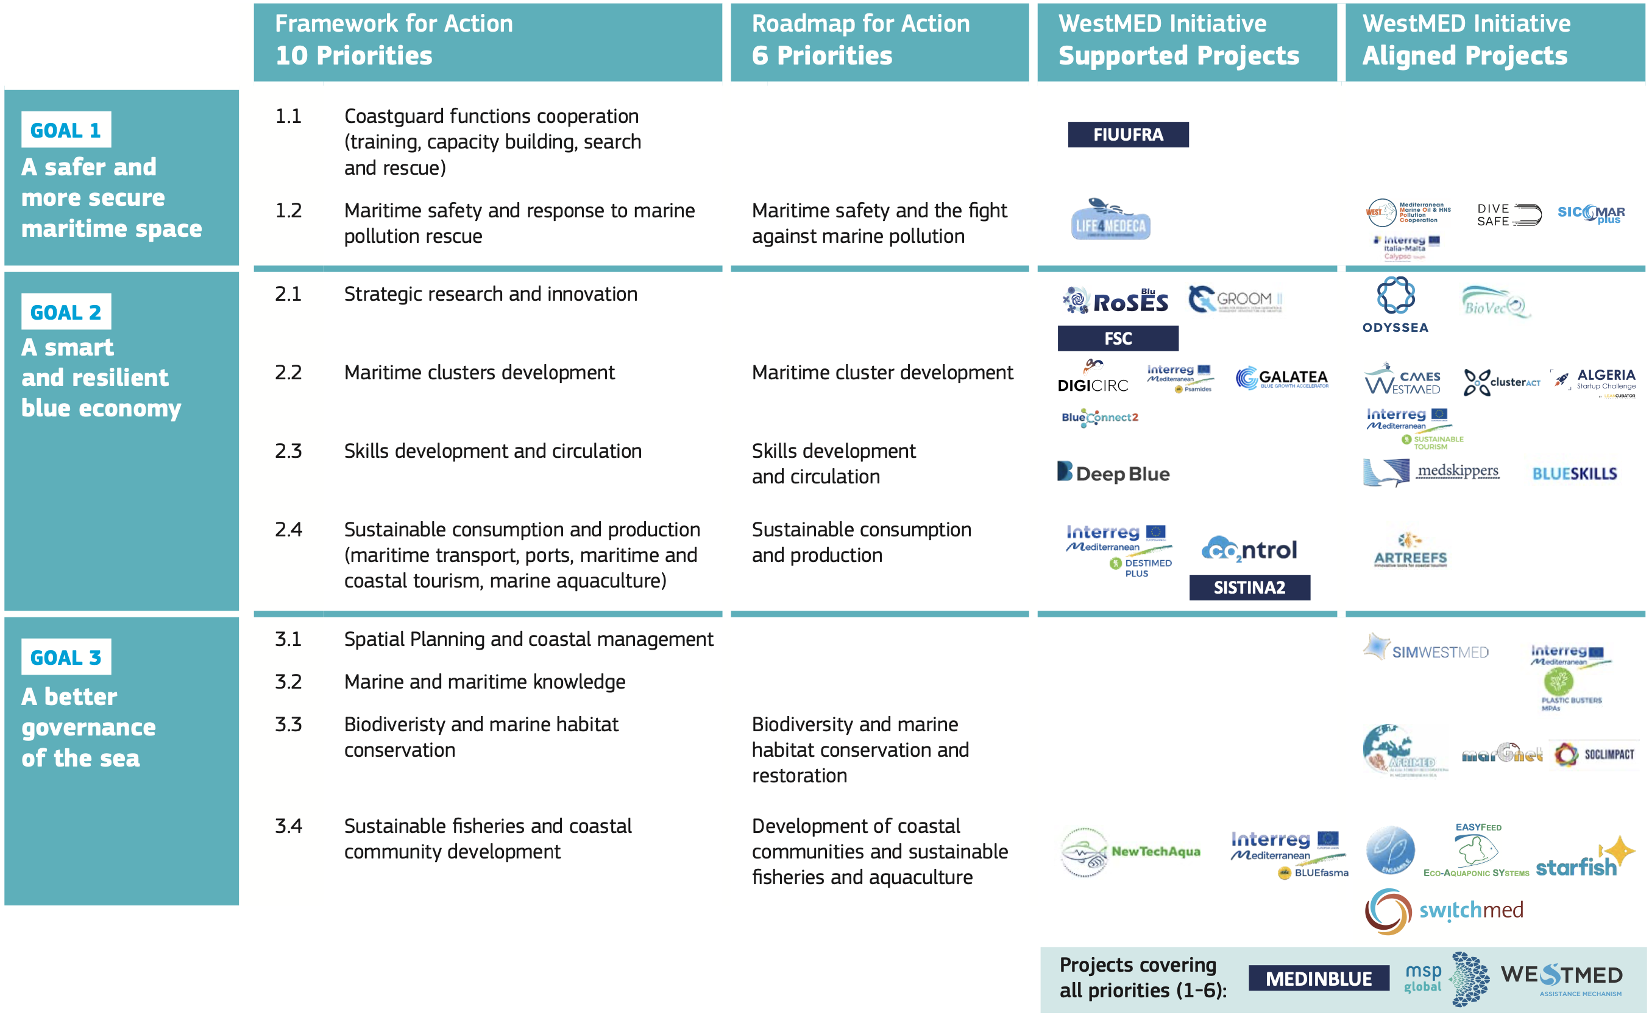
WestMED Assistance Mechanism
‘Level 1’ synergies: amongst projects

Slide 12
WestMED Assistance Mechanism
‘Level 2’ synergies: areas of strategic relevance
WestMED Technical Groups and similar initiatives
Green Shipping | AquaWest | Clusters Alliance
WestMED: Technical Groups for project identification
A group of carefully selected stakeholders officially endorsed by each country
With clear objectives and mandate reflected into its tender specifications
Key Performance Indicators (results) with guidelines and deliverables
They are time-bound (1 year with possible renewal) in achieving their objective
Primarily aimed at identifying and specifying strategic project ideas

Slide 13
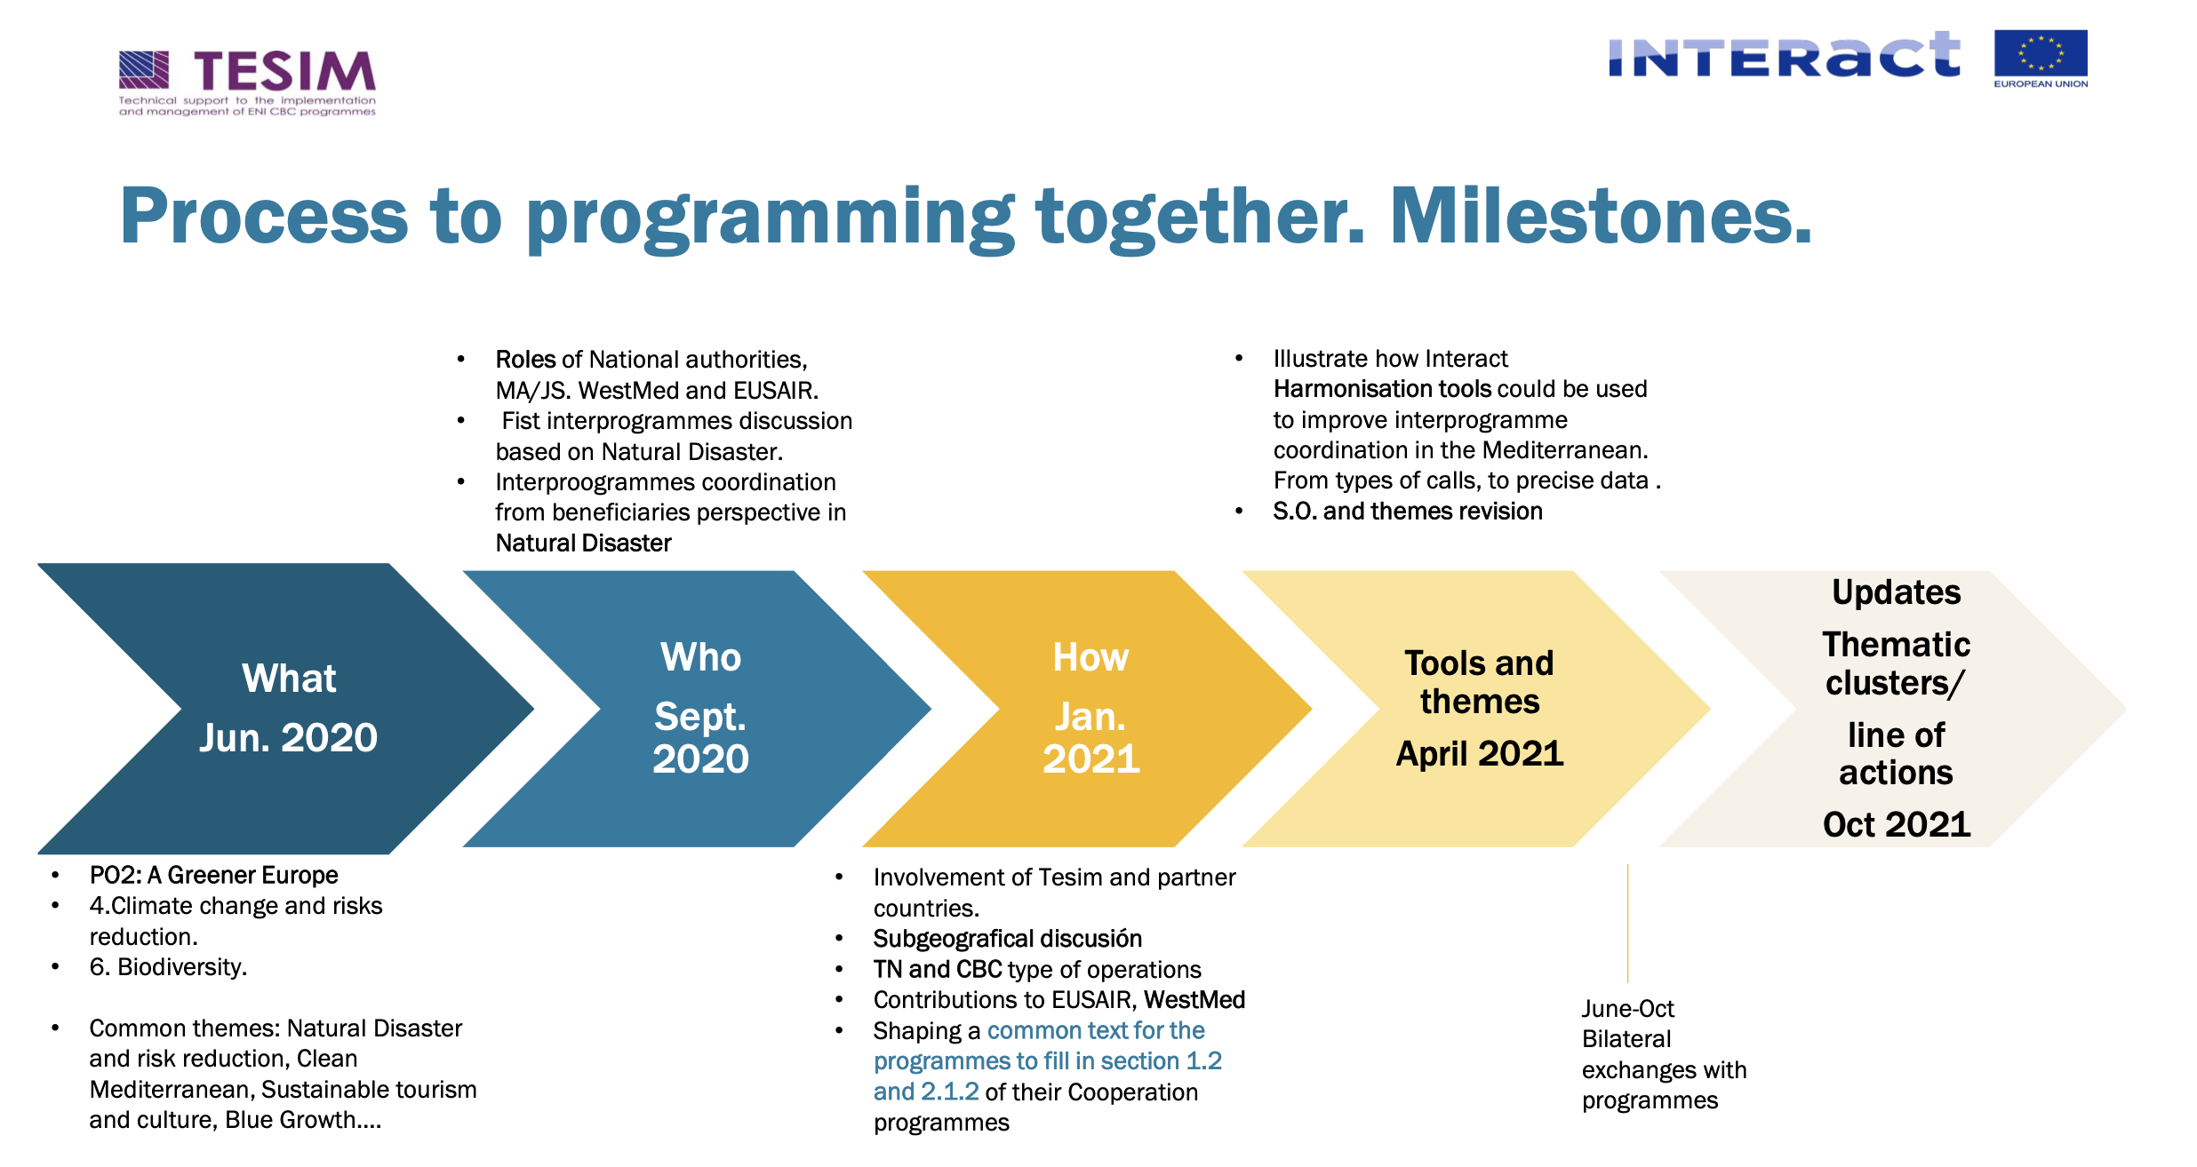
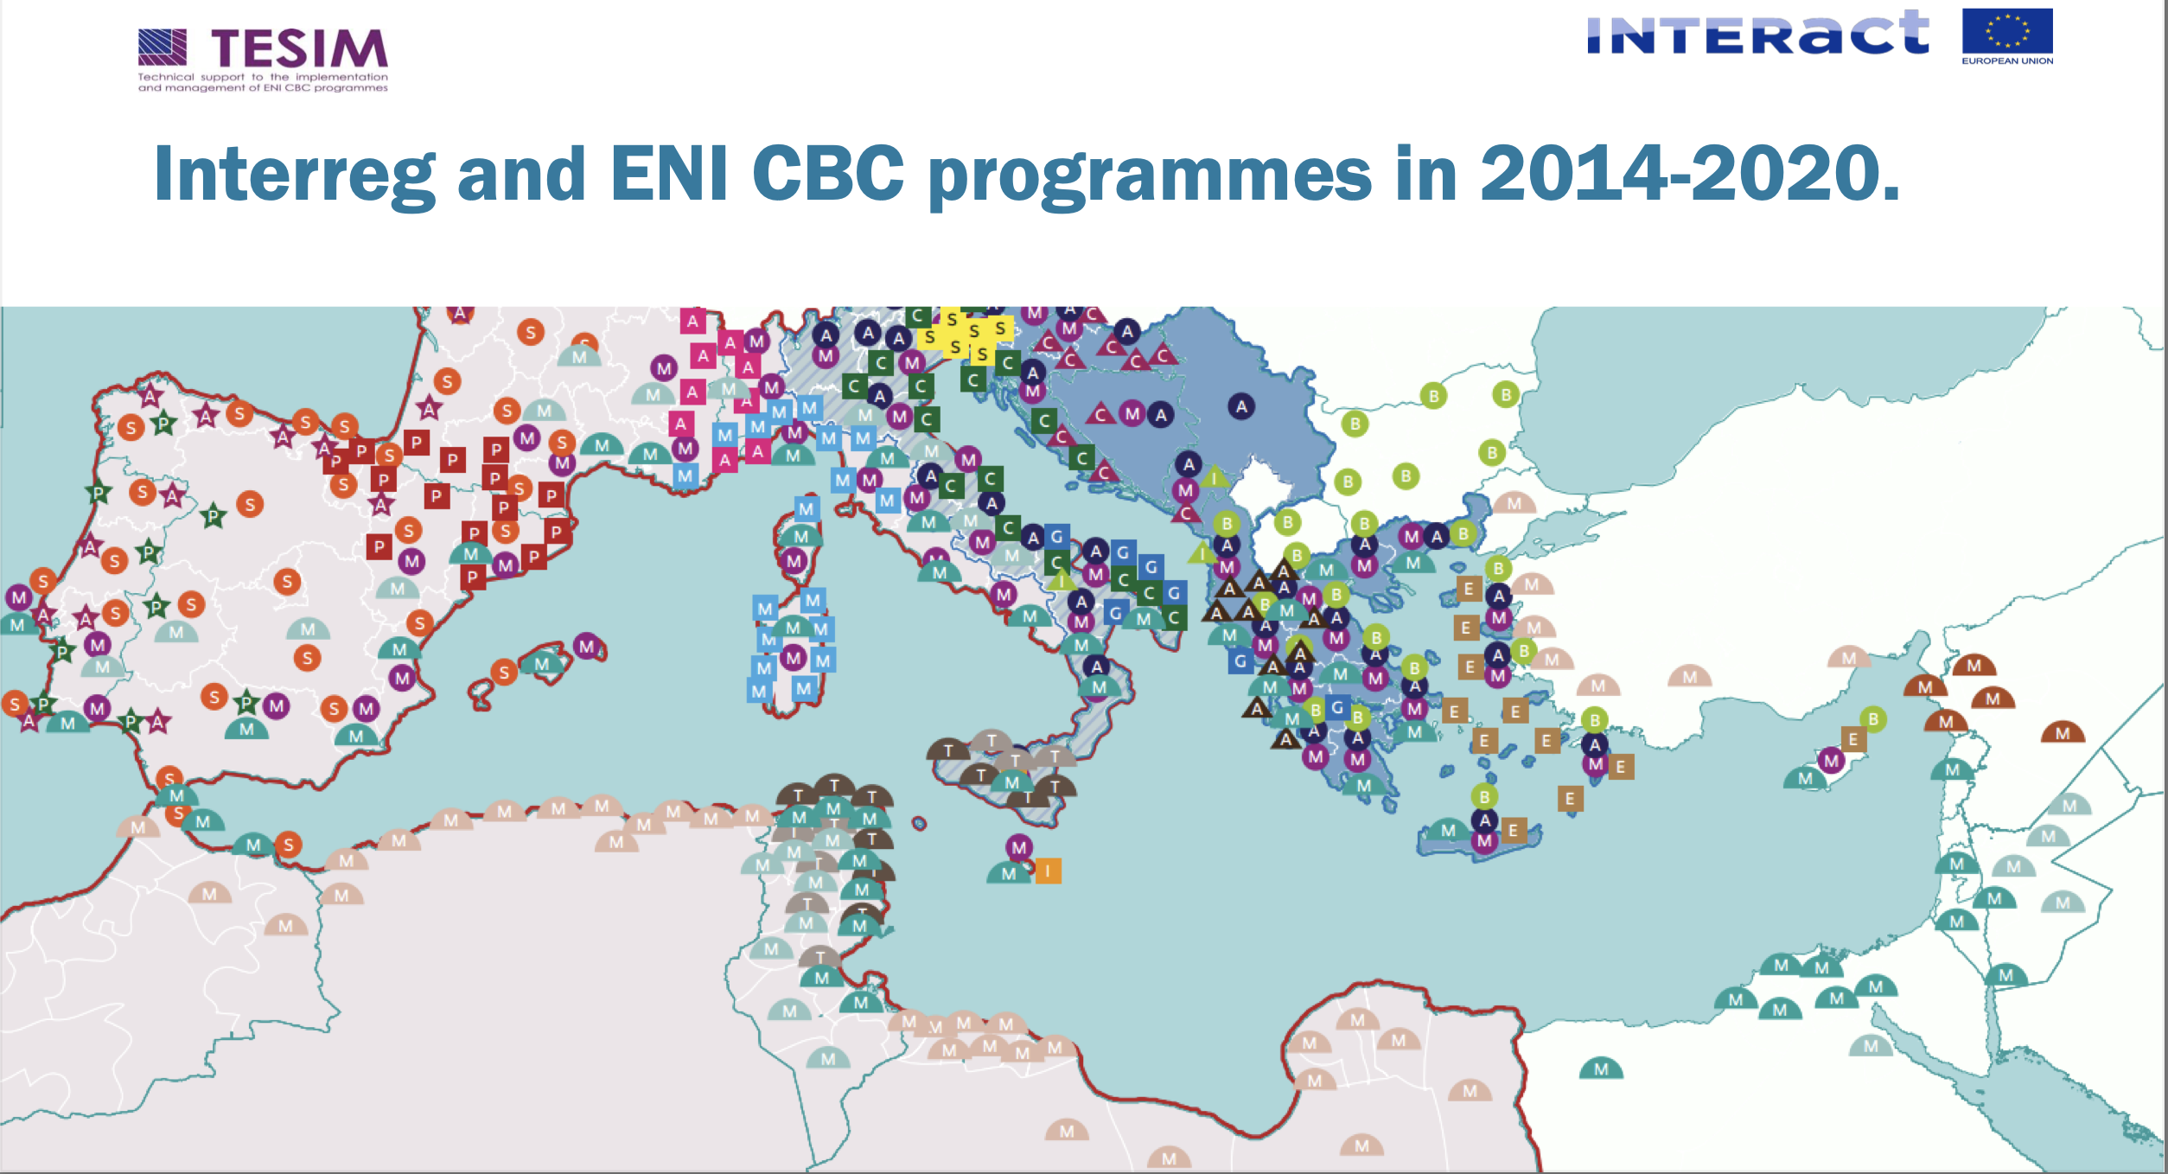
WestMED Assistance Mechanism
‘Level 3’ synergies: amongst programmes

Slide 14
WESTMED and the INTERREG ‘family’
Euro-MED
Joint Roadmap for collaboration
Upcoming calls (e.g. Governance)
Ongoing exchanges for concrete cooperation (i.e. ‘put the Roadmap into action’)
INTERREG Next MED
Exchanges with the INTERREG Next ‘antenna’ for western Mediterranean
Build on the Euro-MED Roadmap as a frame for cooperation
Identify most adequate next-steps given programming status
Bi-laterals (IT, FR, MT, TU)
Cooperation with Italian Bi-lateral Programmes
Build on the WestMED Sustainable Tourism Accelerator ‘concept note’
Follow-up actions to be discussed with the responsible for the Programmes
EUSAIR (to be confirmed)
Exchanges in the past with potentials for future cooperation

Slide 15
Some elements for discussion
In the context of supporting synergies
We should also reflect on …
How to involve ‘outliers' more (i.e. new stakeholders)?
How to make best use of the Maritime Datahub?
How to move to 'cross-seabasin' synergies?
How to support valuable projects not being awarded?

