Slide 1
Institut Français de Recherche pour l'Exploitation de la Mer French Research Institute for Exploitation of the Sea
Nan-Chin Chu
European & International Affairs

Slide 2
…An integrated research institute covering all marine sciences and technology disciplines: -living and mineral resources, -environment, -geosciences, -oceanography, -marine economy, -observation technologies

Slide 3
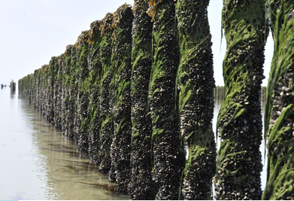
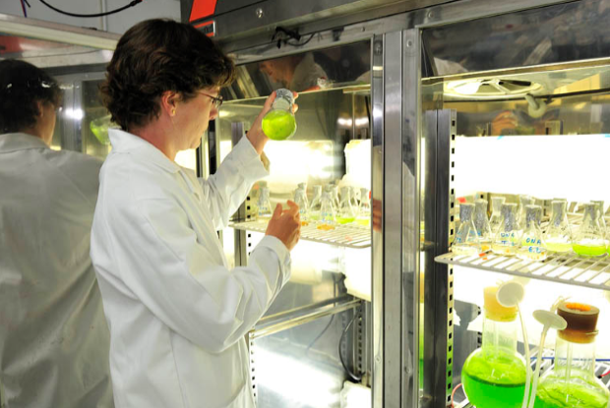
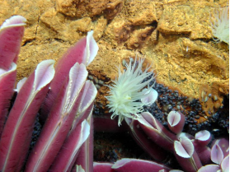
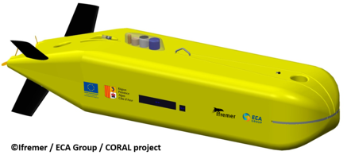
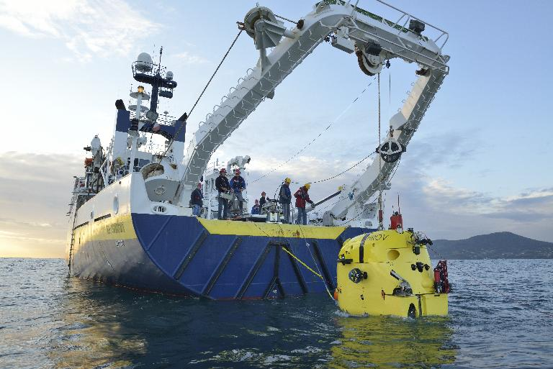
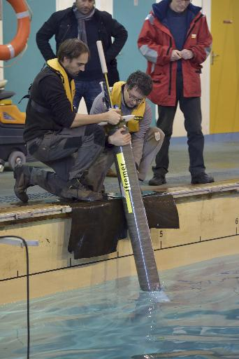
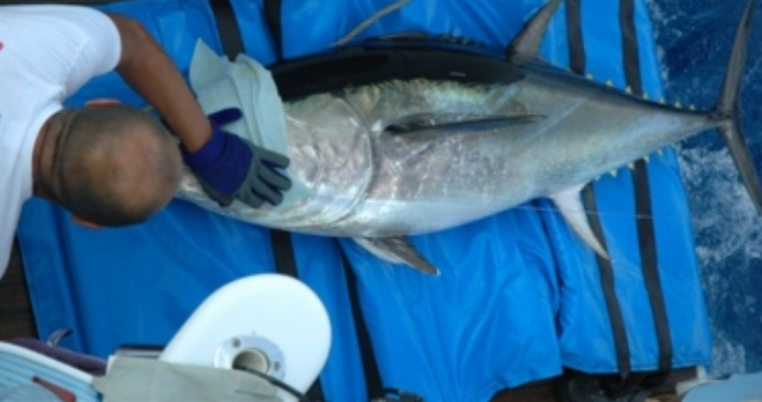
Missions
Develop marine research to better understand (preserve and exploit) marine ecosystems
Technology: development and transfer

Slide 4
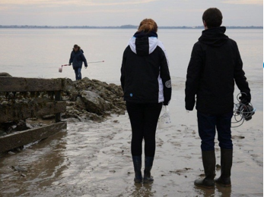
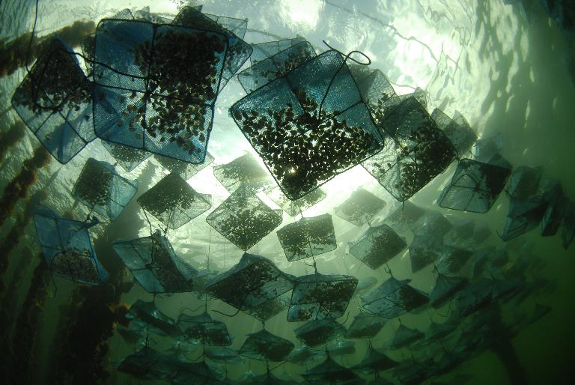
Missions
Perform environmental assessment and monitoring missions, support to public policies
Conceive and operate large-scale Research Infrastructures (French oceanographic fleet)

Slide 5
SOA & Ifremer
Germany & Italy
Marine Renewable Energies
Wave energy capture
Ocean Governance
Marine litter
Deep-sea ecosystem functioning
CFOSAT Ocean surface wind/wave
Dragon 4
GODAE/ OO
Marine economy
Gas hydrate, seismology
Arctic Issues
Arctic ROOS
Horizon2020/ INTAROS
Arctic sea ice concetration of 23/02 Ifremer/CERSAT

