Slide 1
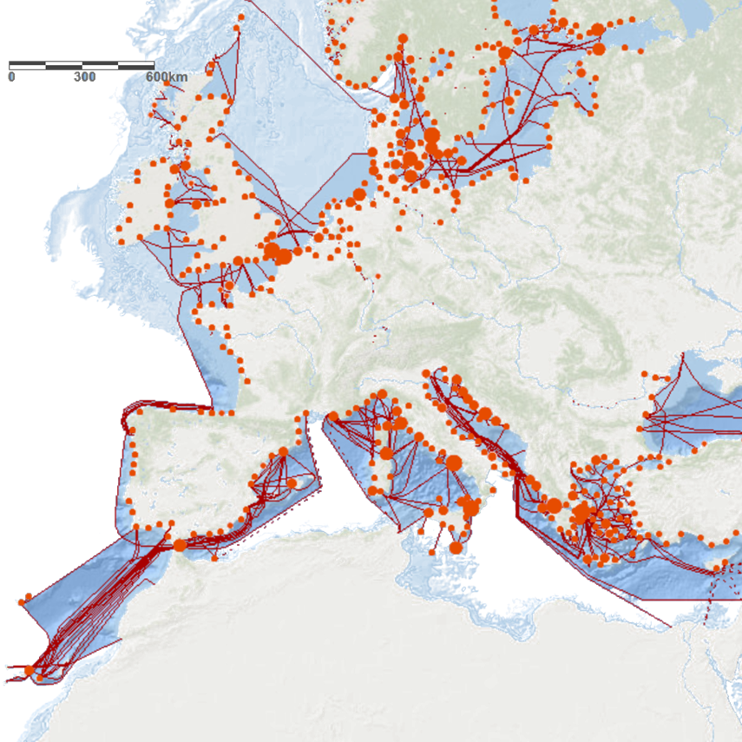
European Atlas of the Seas
Workshop:
Hamburg Climate Week
Tim Collart
EMODnet Secretariat

Slide 2
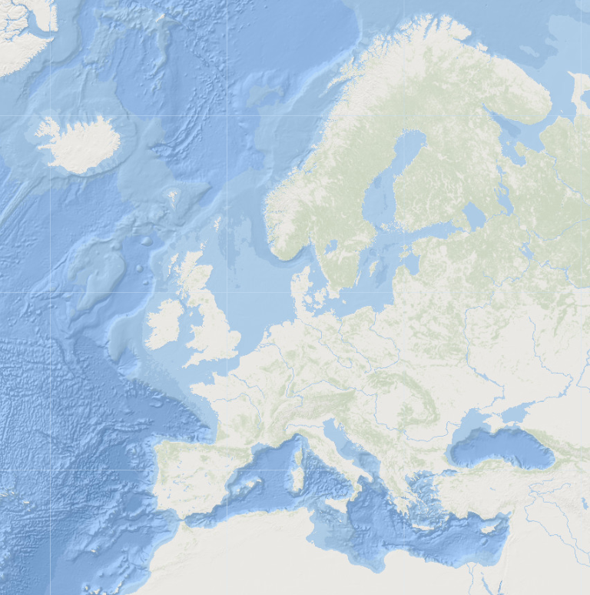
What is the European Atlas of the Seas?
European
Atlas
Seas

Slide 3
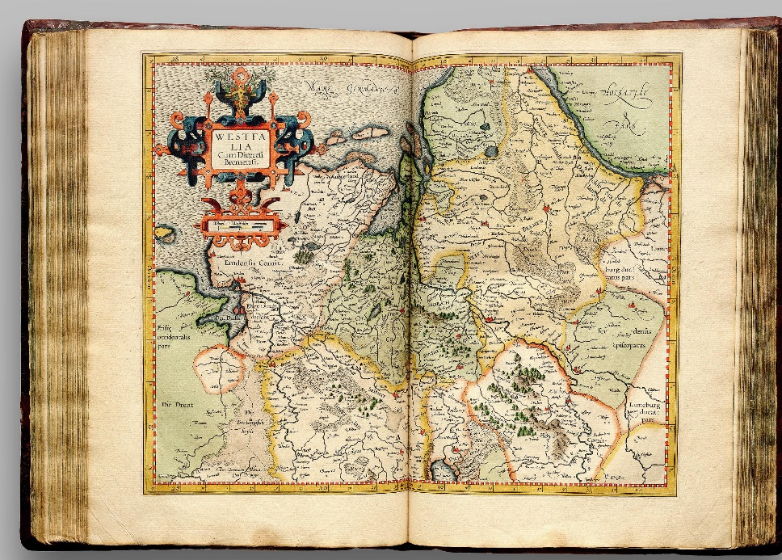
What is the European Atlas of the Seas?
European
Atlas
Seas

Slide 4

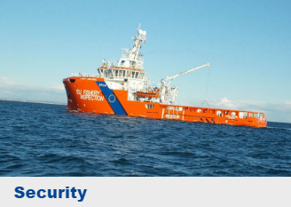
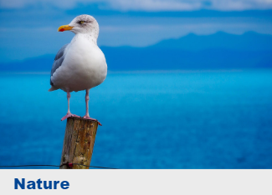
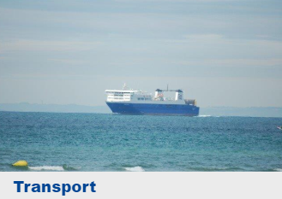
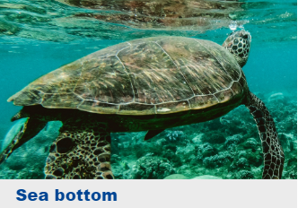
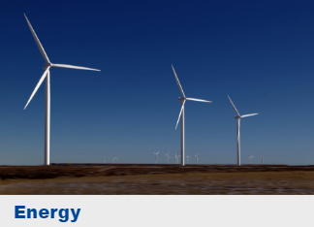
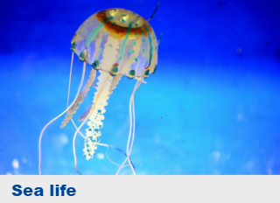
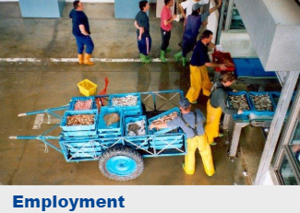
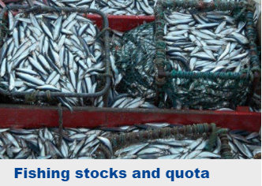
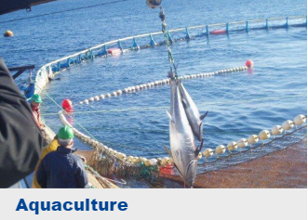
What is the European Atlas of the Seas?
European
Atlas
Seas

Slide 5
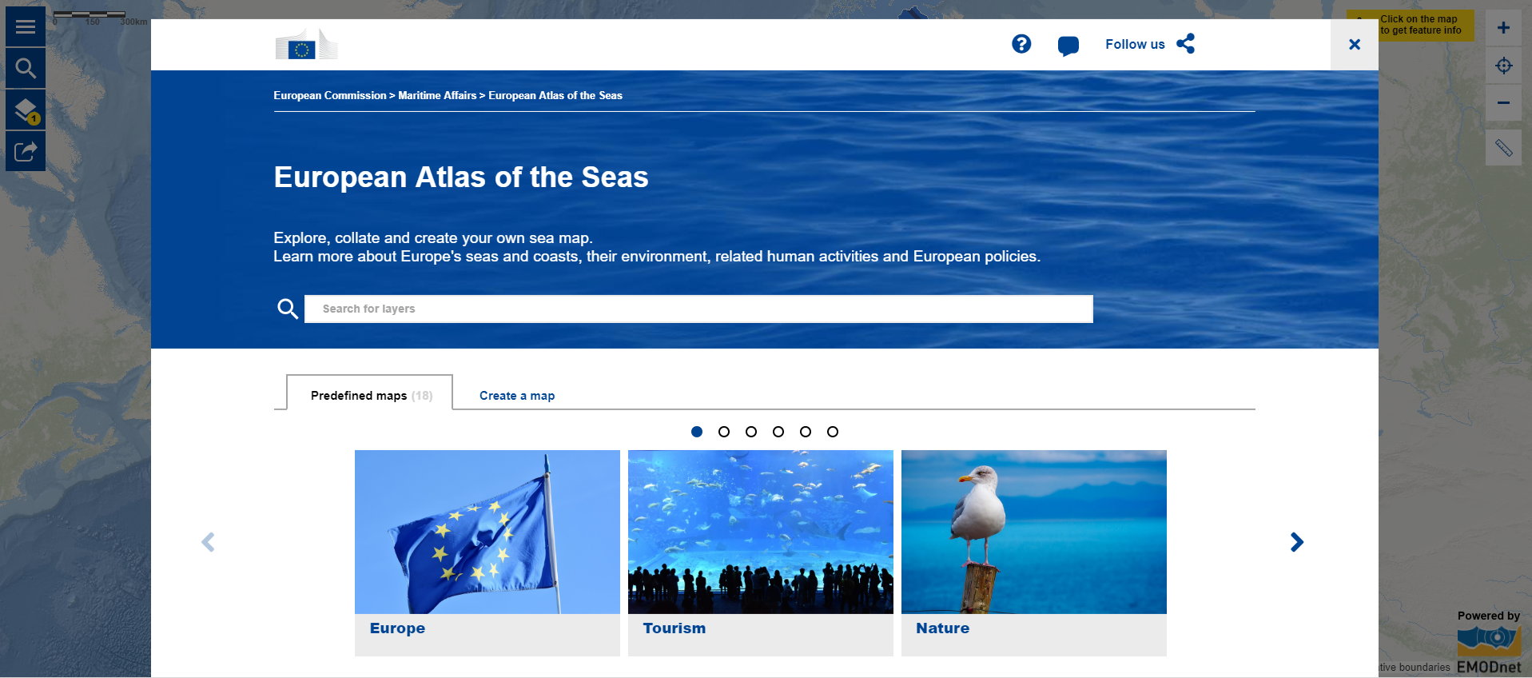
www.european-atlas-of-the-seas.eu
ONLINE DEMONSTRATION
Notes:
Landing page

Slide 6
Exercises:
Use the Atlas to learn about the changes and threats to the seas and oceans

Slide 7

Climate Change - Temperature anomalies
Using the map Sea surface temperature anomalies, answer the following questions:
In which sea or ocean has temperature increased the most?
Why do you think this area is warming more than the rest of the ocean?
In which sea or ocean has the temperature decreased the most?
Why do you think this area is becoming colder?
Notes:
Temperature anomalies are calculated as the difference of the average temperature between 2005 and 2015.

Slide 8
Climate Change - Temperature anomalies
In which sea or ocean has the temperature increased the most?

Slide 9
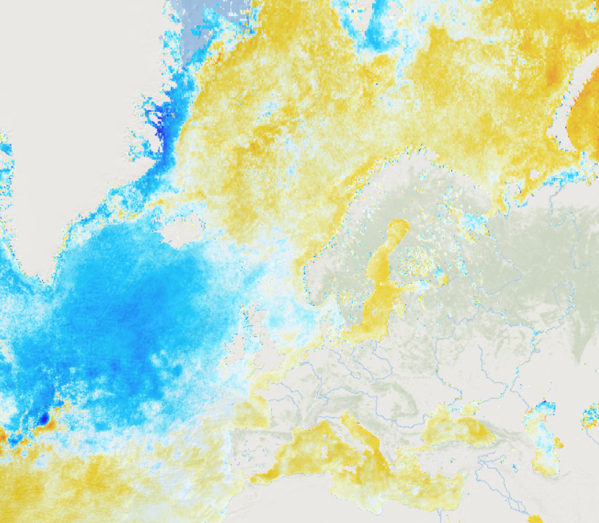
Climate Change - Temperature anomalies
In which sea or ocean has the temperature increased the most?

Slide 10
Climate Change - Temperature anomalies
Why do you think this area is warming more than the rest of the ocean?

Slide 11
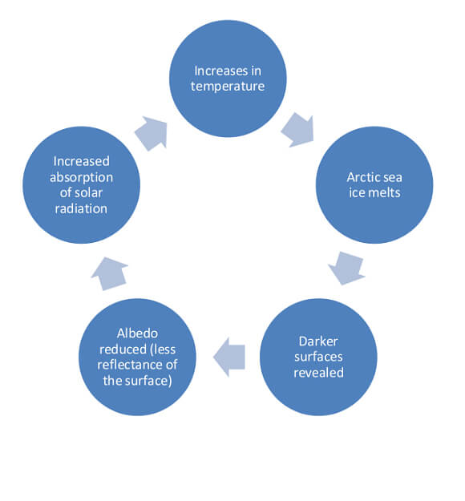
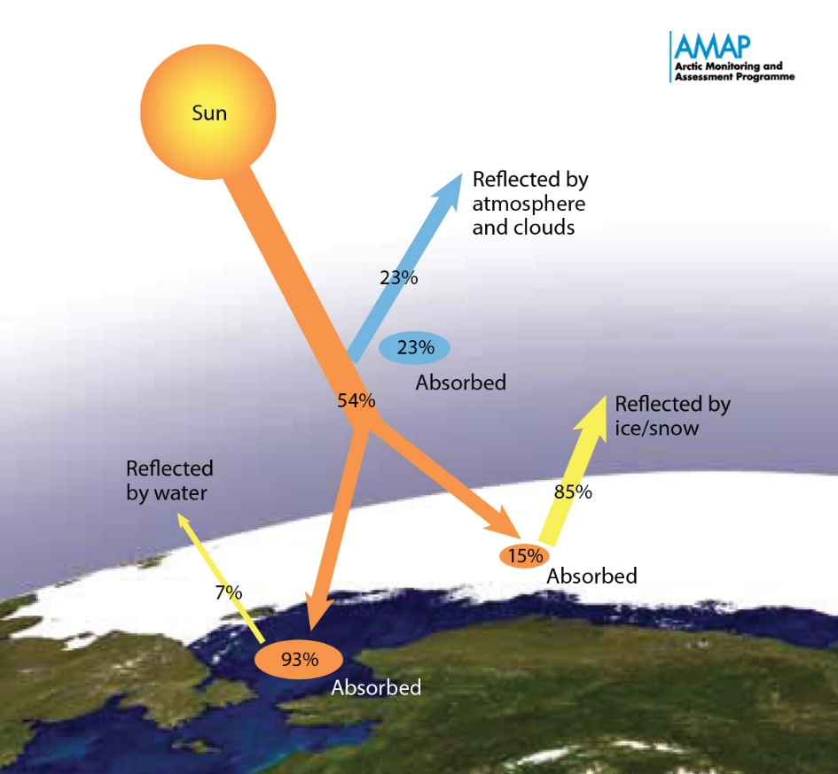
Climate Change - Temperature anomalies
Why do you think this area is warming more than the rest of the ocean?
ice-albedo feedback cycle
Notes:
The Arctic used to be covered in sea ice. The white sea ice is very reflective and hence a lot of the energy from the sun gets reflected. However, as the planet warms the sea ice has been decreasing and the ocean below absorbs much more sunlight causing it to heat up more. This is a cycle that strengthens itself. The warmer the water becomes, the less sea ice can form and the warmer the water becomes.

Slide 12
Climate Change - Temperature anomalies
In which sea or ocean has the temperature decreased the most?

Slide 13
Climate Change - Temperature anomalies
In which sea or ocean has the temperature decreased the most?

Slide 14
Climate Change - Temperature anomalies
Why do you think this area is becoming colder?

Slide 15
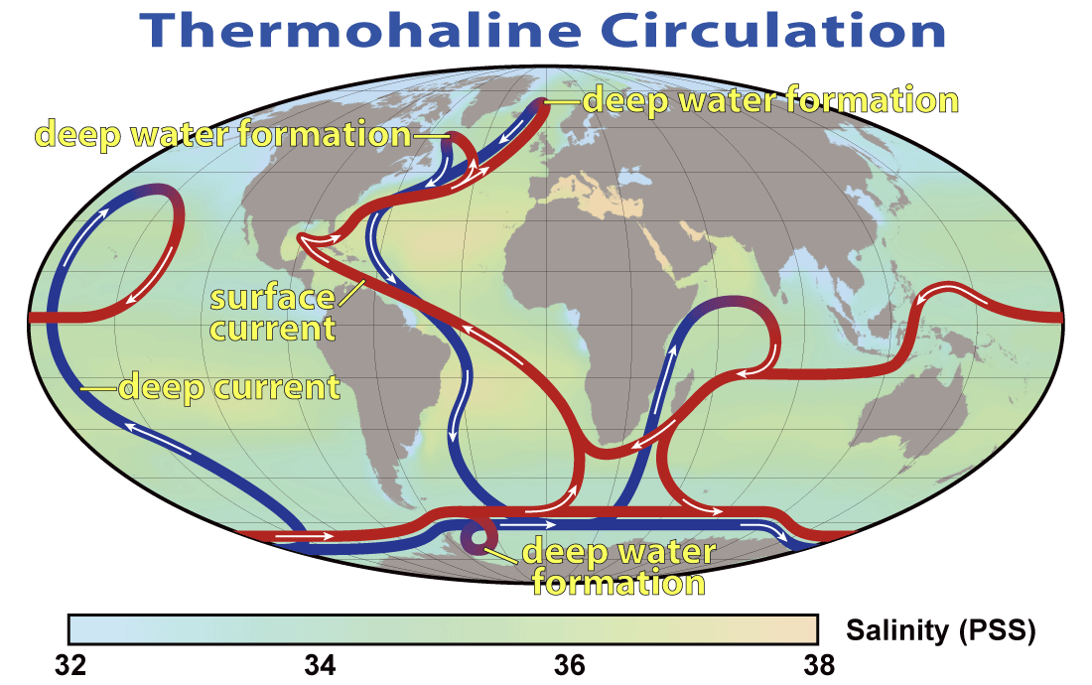
Climate Change - Temperature anomalies
Why do you think this area is becoming colder?
slowdown of the thermohaline circulation

Slide 16
Climate Change – Sea level rise & coastal erosion
Using the map on Relative sea level trends, answer the following questions:
By how many millimeter (on average) per year is the relative sea level rising along German coasts? What do you think will happen in the future?
Are there places where the relative sea level is falling? What do you think is the reason for this?
Using the map on Coastline erosion, answer the following questions:
What has happened to the German coastline along the North Sea and Baltic Sea in the last 10 years? What do you think will happen in the future?
Around which European sea is the coastline expanding (coastline accretion)? What do you think is happening here?

Slide 17
Climate Change – Sea level rise & coastal erosion
By how many millimeter (on average) per year is the relative sea level rising along German coasts? What do you think will happen in the future?

Slide 18
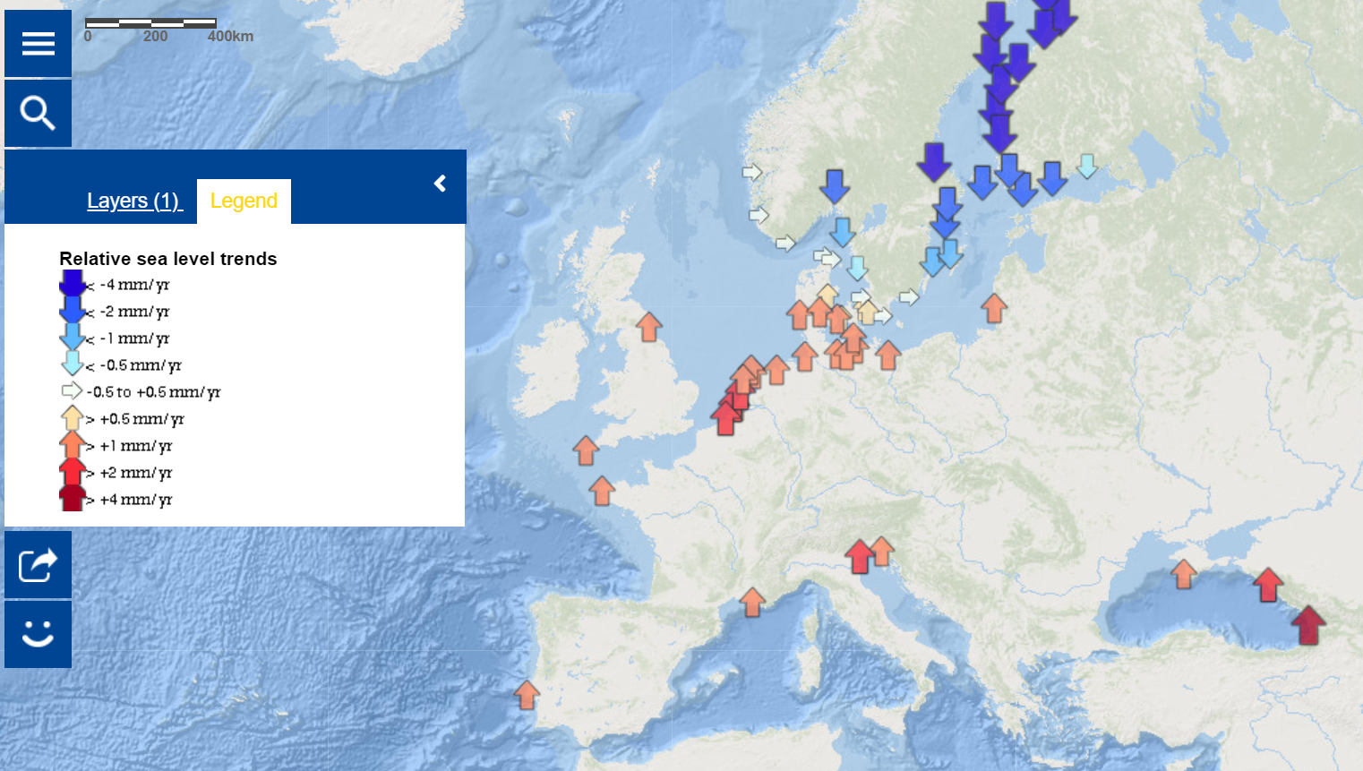
Climate Change – Sea level rise & coastal erosion
By how many millimeter (on average) per year is the relative sea level rising along German coasts? What do you think will happen in the future?

Slide 19
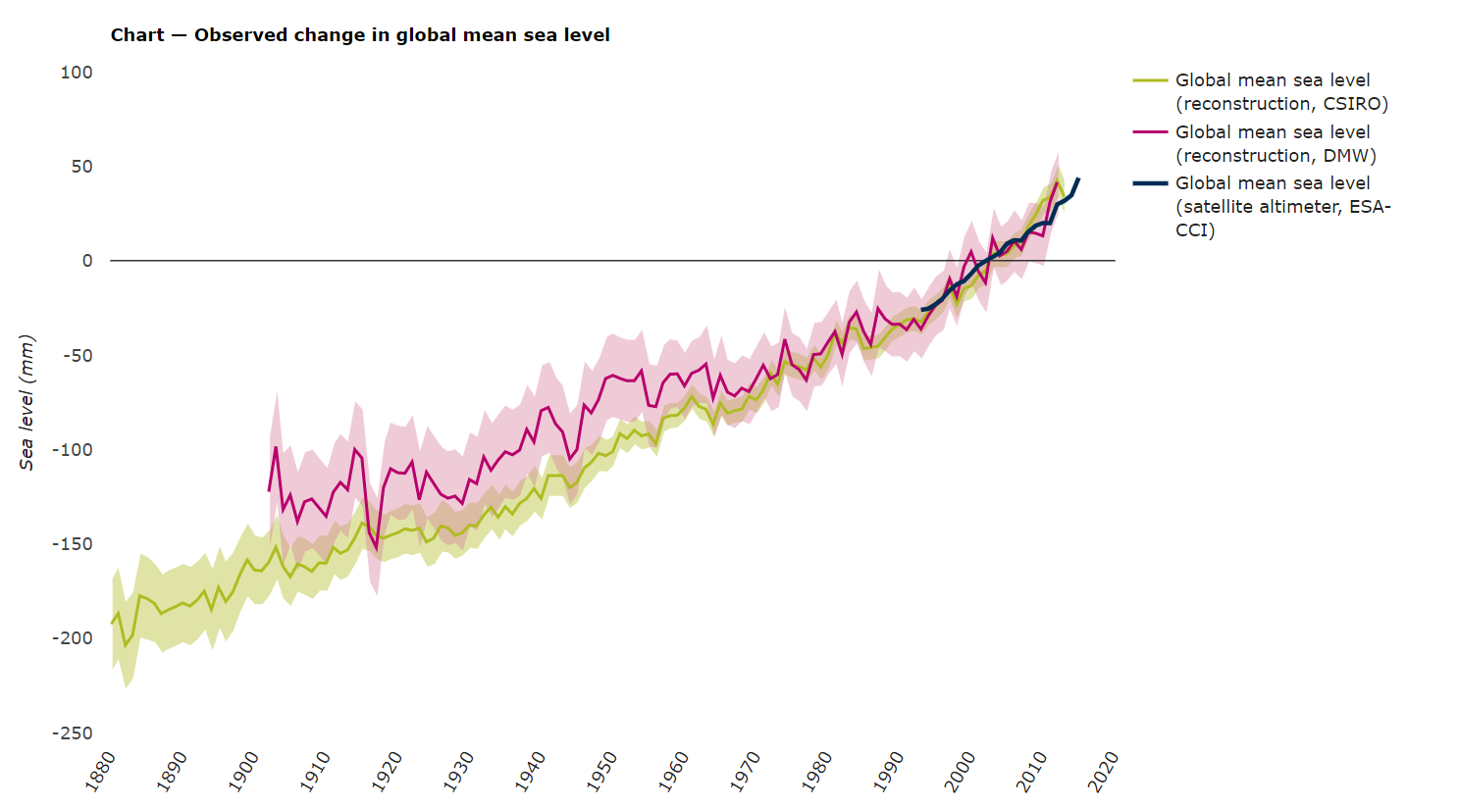
Climate Change – Sea level rise & coastal erosion
By how many millimeter (on average) per year is the relative sea level rising along German coasts? What do you think will happen in the future?
Source: https://www.eea.europa.eu/data-and-maps/indicators/sea-level-rise-5/assessment

Slide 20
Climate Change – Sea level rise & coastal erosion
Are there places where the relative sea level is falling? What do you think is the reason for this?

Slide 21
Climate Change – Sea level rise & coastal erosion
Are there places where the relative sea level is falling? What do you think is the reason for this?

Slide 22
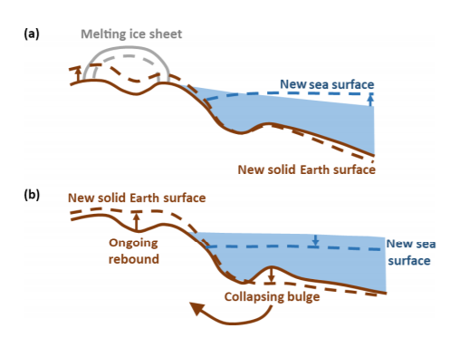
Climate Change – Sea level rise & coastal erosion
Are there places where the relative sea level is falling? What do you think is the reason for this?
Post-glacial rebound
Source: doi.org/10.5194/esurf-6-401-2018

Slide 23
Climate Change – Sea level rise & coastal erosion
What has happened to the German coastline along the North Sea and Baltic Sea in the last 10 years? What do you think will happen in the future?

Slide 24
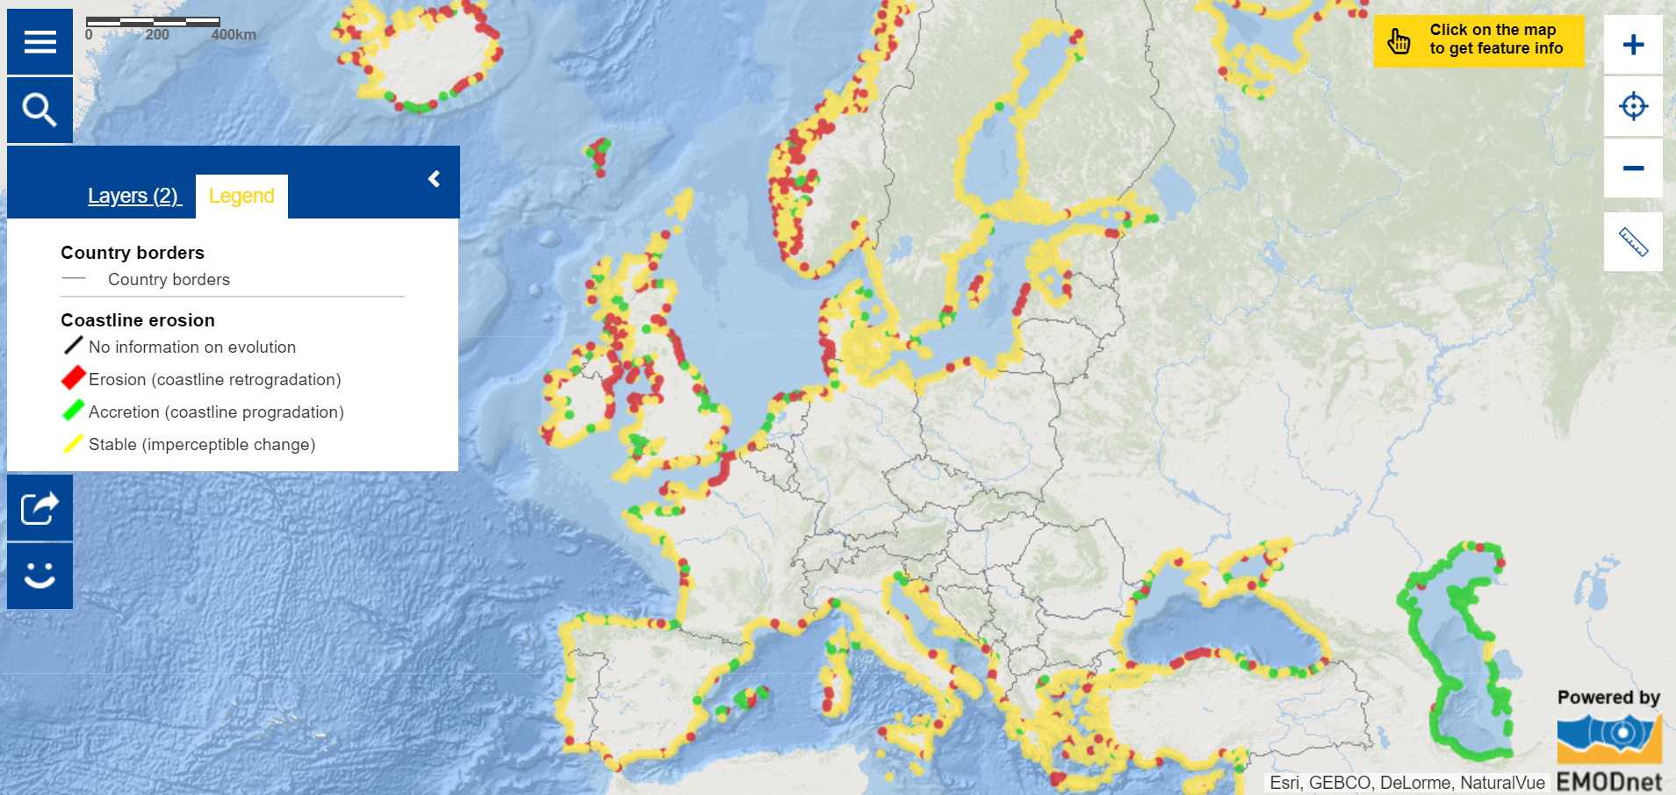
Climate Change – Sea level rise & coastal erosion
What has happened to the German coastline along the North Sea and Baltic Sea in the last 10 years? What do you think will happen in the future?

Slide 25
Climate Change – Sea level rise & coastal erosion
Around which European sea is the coastline expanding (coastline accretion)? What do you think is happening here?

Slide 26
Climate Change – Sea level rise & coastal erosion
Around which European sea is the coastline expanding (coastline accretion)? What do you think is happening here?

Slide 27
Climate Change – Sea level rise & coastal erosion
Around which European sea is the coastline expanding (coastline accretion)? What do you think is happening here?
Source: doi.org/10.1002/2017GL073958

Slide 28
Overfishing
Using the map Catches by country, answer the following questions:
Which 3 European countries catch the most fish? How many tonnes of fish do they catch in a year?
How many tonnes of fish does Germany catch in a year?
Using the map Stocks by fishing zone, answer the following questions:
In which sea or ocean is the majority of the fish populations (stocks) overfished?
Are they close to the countries that catch a lot of fish?
Using the map Quotas by species, answer the following question:
How many tonnes of the following fish species is Germany legally allowed to catch?:
  Cod?
  Haddock?
  Atlantic Salmon?
Do you think these quotas are sufficient to restore fish stocks?

Slide 29

Overfishing
Which 3 European countries catch the most fish? How many tonnes of fish do they catch in a year?

Slide 30

Overfishing
Which 3 European countries catch the most fish? How many tonnes of fish do they catch in a year?
859,700
tonnes

Slide 31

Overfishing
Which 3 European countries catch the most fish? How many tonnes of fish do they catch in a year?
859,700
tonnes
1,069,400
tonnes

Slide 32

Overfishing
Which 3 European countries catch the most fish? How many tonnes of fish do they catch in a year?
1,872,600
tonnes
859,700
tonnes
1,069,400
tonnes

Slide 33
Overfishing
Which 3 European countries catch the most fish? How many tonnes of fish do they catch in a year?
How many tonnes of fish does Germany catch in a year?
1,872,600
tonnes
859,700
tonnes
1,069,400
tonnes

Slide 34
Overfishing
Which 3 European countries catch the most fish? How many tonnes of fish do they catch in a year?
How many tonnes of fish does Germany catch in a year?
240,500 tonnes
1,872,600
tonnes
859,700
tonnes
1,069,400
tonnes

Slide 35
Overfishing
In which sea or ocean is the majority of the fish populations (stocks) overfished? Are they close to the countries that catch a lot of fish?

Slide 36
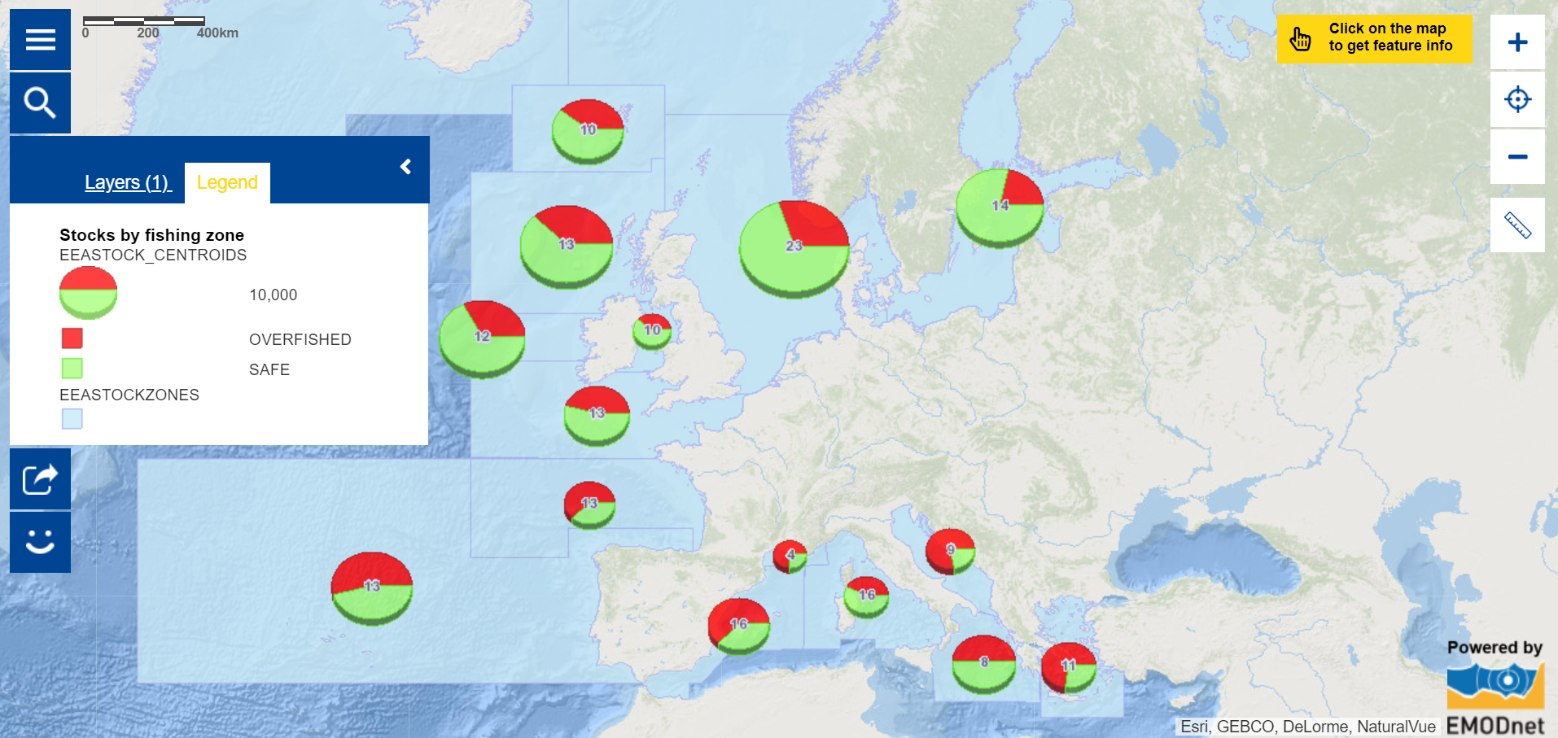
Overfishing
In which sea or ocean is the majority of the fish populations (stocks) overfished? Are they close to the countries that catch a lot of fish?

Slide 37
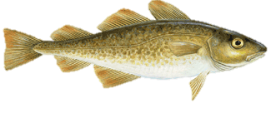
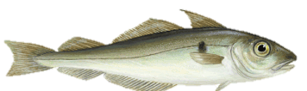
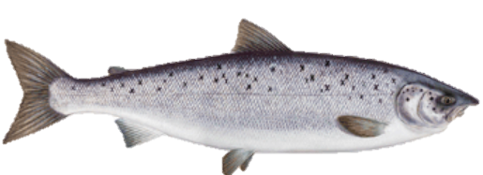
Overfishing
How many tonnes of the following fish species is Germany legally allowed to catch?:
Cod | Haddock | Atlantic Salmon

Slide 38
Overfishing
How many tonnes of the following fish species is Germany legally allowed to catch?:
Cod | Haddock | Atlantic Salmon
22,754 tonnes

Slide 39
Overfishing
How many tonnes of the following fish species is Germany legally allowed to catch?:
Cod | Haddock | Atlantic Salmon
22,754 tonnes | 1,501 tonnes

Slide 40
Overfishing
How many tonnes of the following fish species is Germany legally allowed to catch?:
Cod | Haddock | Atlantic Salmon
22,754 tonnes | 1,501 tonnes | 2,212 tonnes

Slide 41
Overfishing
Do you think these quotas are sufficient to restore fish stocks?

Slide 42
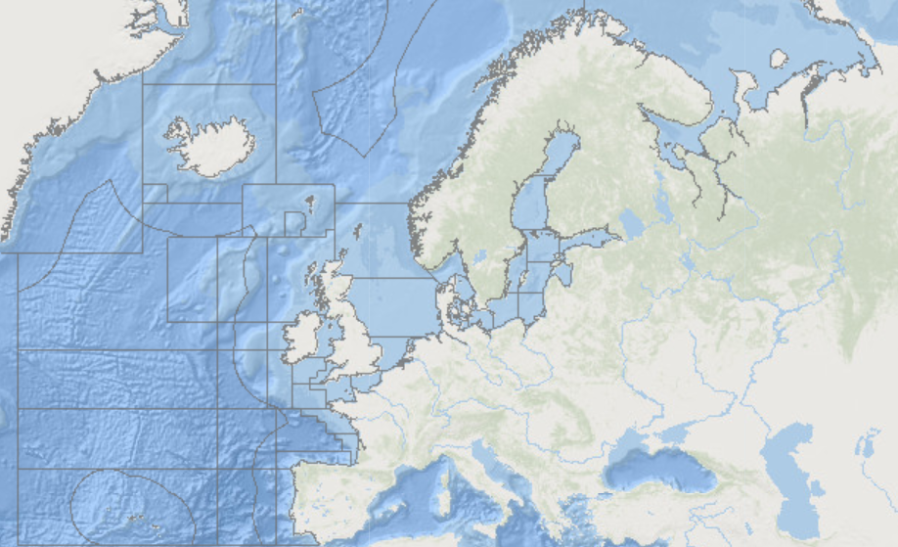

Overfishing
Do you think these quotas are sufficient to restore fish stocks?
Catch limits of each country are set for different area’s of the seas and ocean based on scientific studies of the fish populations (stocks). They limit the number of catches so that the population can restore itself

Slide 43
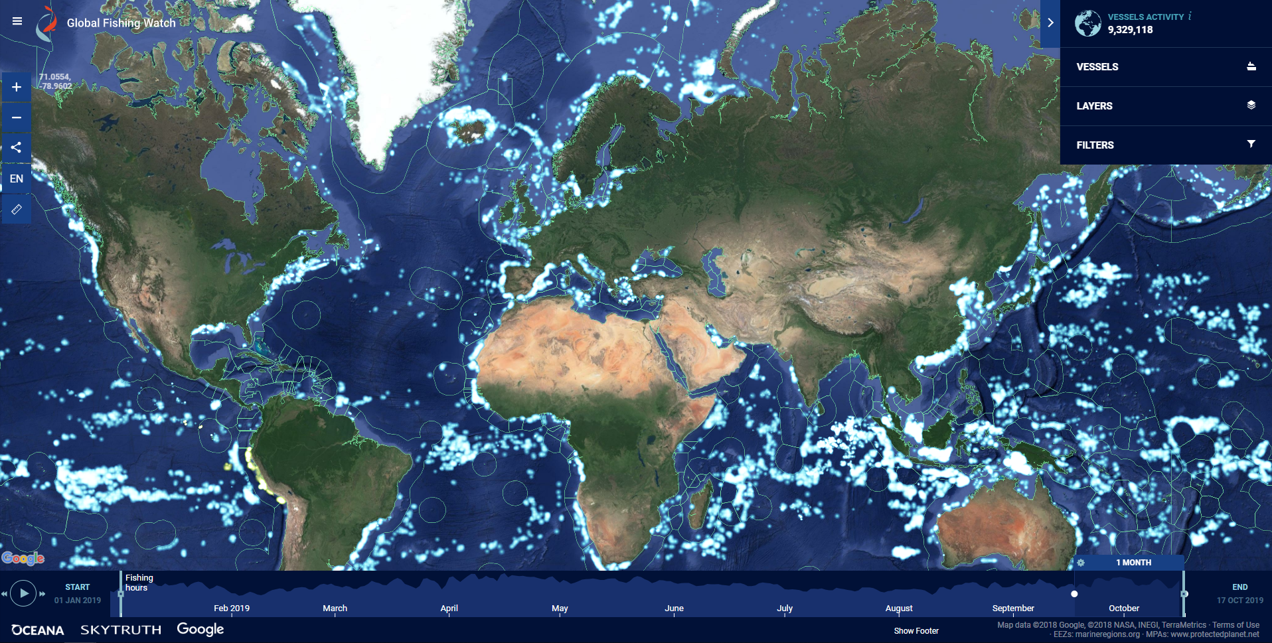

Overfishing
Do you think these quotas are sufficient to restore fish stocks?
Illegal fishing: Hard to track!?

Slide 44
Beach litter
Using the map Beach Litter - Composition of litter according to material categories, answer the following questions:
Which is the most abundant type of litter? What do you think are the reasons for this?
Which monitored beach is closest to Hamburg:
  In the North Sea?
  In the Baltic Sea?
What are the differences in litter composition between these two beaches?

Slide 45
Beach litter
Which is the most abundant type of litter?

Slide 46
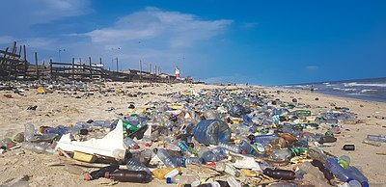
Beach litter
Which is the most abundant type of litter?

Slide 47
Beach litter
What do you think are the reasons for this?
Zephyrschord - Own work

Slide 48
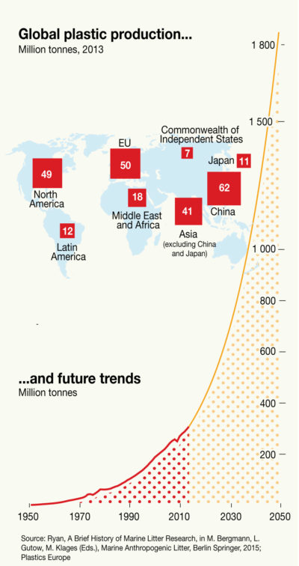
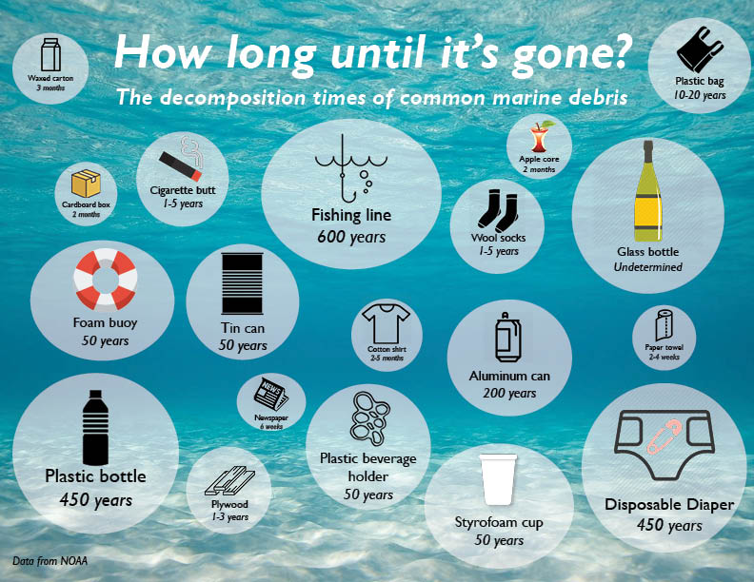
Beach litter
What do you think are the reasons for this?
Zephyrschord - Own work

Slide 49
Beach litter
Which monitored beach is closest to Hamburg?

Slide 50
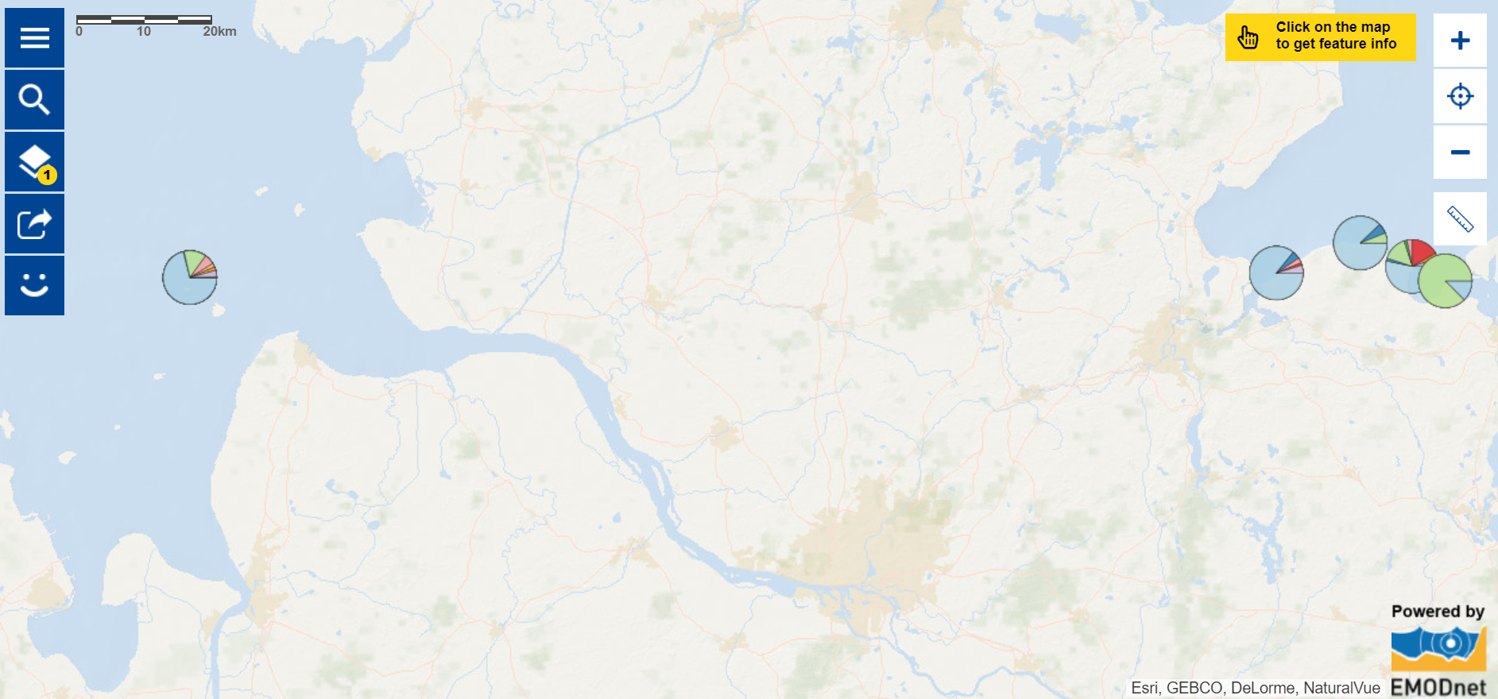
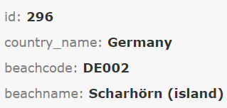
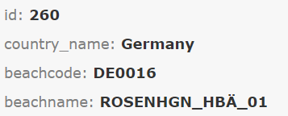
Beach litter
Which monitored beach is closest to Hamburg?

Slide 51
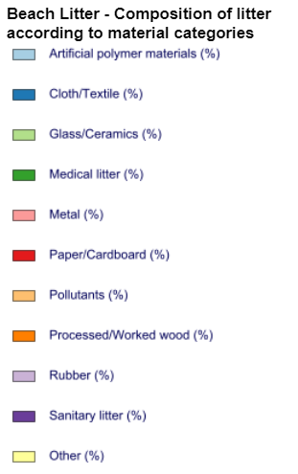
Beach litter
What are the differences in litter composition between these two beaches?

Slide 52
Beach litter
Using the dataset on beach litter composition available at bit.ly/2kx4dQb, answer the following questions:
What are the different survey types during which the data was collected?
What are the advantages and disadvantages of the different survey types?

Slide 53
Beach litter
What are the different survey types during which the data was collected?
.

Slide 54
Beach litter
What are the different survey types during which the data was collected?
Cleaning – Monitoring - Research

Slide 55
Beach litter
What are the different survey types during which the data was collected?
Cleaning – Monitoring - Research
What are the advantages and disadvantages of the different survey types?

Slide 56
Beach litter
What are the different survey types during which the data was collected?
Cleaning – Monitoring - Research
What are the advantages and disadvantages of the different survey types?
Monitoring may be quicker to collect data but beach clean-ups have the advantage they remove more litter from the beaches.

Slide 57
Beach litter
Investigate the evolution of European beach litter composition through time and answer the following questions:
In what year(s) do you see the largest changes in litter composition along the European beaches?
What types of litter are increasing or decreasing?
What are the possible causes for these changes?

Slide 58
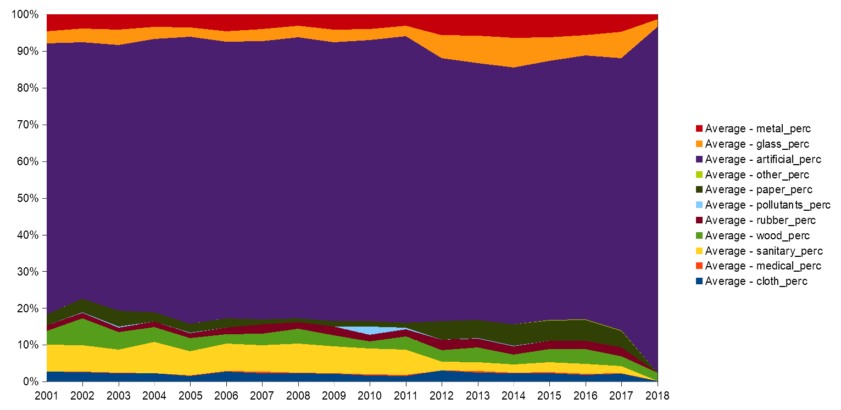
Beach litter
In what year(s) do you see the largest changes in litter composition along the European beaches?
What types of litter are increasing or decreasing?
What are the possible causes for these changes?

Slide 59
Beach litter
Investigate changes in data collection through time and answer the following questions:
How many beaches from each country were surveyed in 2018?
So are the changes in 2018 representative for Europe?
Are there any changes in data collection in 2012?

Slide 60
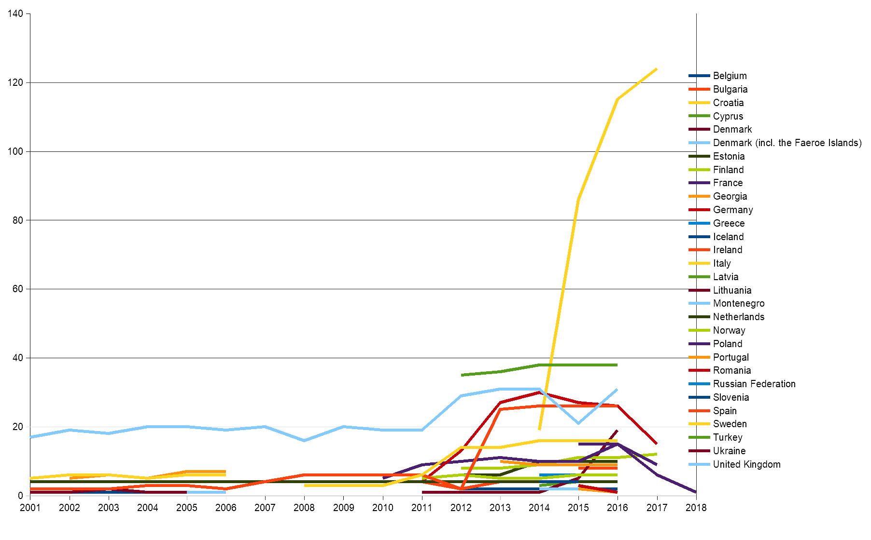
Beach litter
How many beaches from each country were surveyed in 2018?
So are the changes in 2018 representative for Europe?
Are there any changes in data collection in 2012?

Slide 61
Beach litter
Using the map Beach Litter - Composition of litter according to material categories and your previous findings, answer the following questions:
Which country has a lot of paper litter?
Did this country change the number of sampled beaches in 2012?
Which countries have a lot of glass litter?
Are there significant changes in the number of sampled beaches in these countries?
What can you conclude on the causes of the observed changes in the litter composition along European beaches?

Slide 62
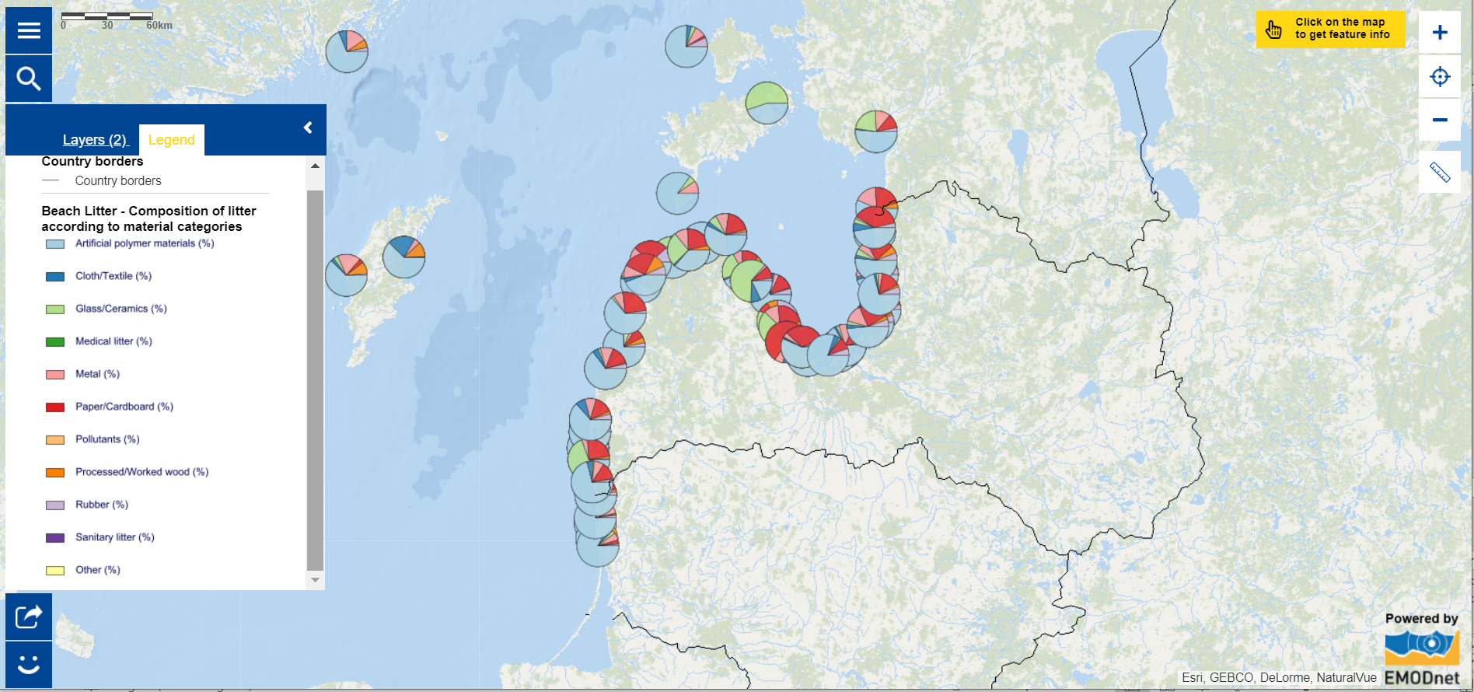
Beach litter
Which country has a lot of paper litter?

Slide 63
Beach litter
Did this country change the number of sampled beaches in 2012?

Slide 64
Beach litter
Which countries have a lot of glass litter? Are there significant changes in the number of sampled beaches in these countries?

Slide 65
Beach litter
What can you conclude on the causes of the observed changes in the litter composition along European beaches?

Slide 66
Beach litter
Extra exercises using the map Beach Litter - Composition of litter according to material categories and the dataset available at bit.ly/2kx4dQb:
Per group, pick a European country and investigate how the composition of beach litter has changed over time.
Per group, pick a beach where the survey type is “cleaning” and investigate how beach clean-ups change the litter composition.

