Slide 1
OPPORTUNITIES START HERE.

Slide 2
01
ABOUT BLUEINVEST

Slide 3
About us
BlueInvest was launched in 2019 with the aim to facilitate access to finance and support investment readiness for early stage businesses, SMEs and scale ups in the blue economy. The platform …
Supports investment readiness and access to finance for innovative start-ups, SMEs, and scale-ups in the blue economy.
Provides a market path through technical assistance, visibility, matchmaking and network- and opportunity-building for investors and companies.
Guides investors to specialize their investment strategies into blue economy related areas and to maximize their related investments.
Fosters a community and investment ecosystem to help finance the go-to-market and scale-up and to fuel the transition to more sustainable finance and impact investment.

Slide 4
Sectors
BlueInvest programme targets ten sectors having a high potential to support the transition to a Sustainable Blue Economy.
Aquaculture
Farming of aquatic organisms while minimising its externalities on the air, water, and soils, and prioritising the use of clean energy.
Shipping & Ports
Use of cleaner fuels and optimising routes in maritime transport and transforming the activities that ports carry out to lessen their environmental and climate impact.
Blue Biotechnology
Application of science and technology to living aquatic organisms to produce knowledge, goods, and services, while following processes that minimise the negative environmental impact.
Coastal & Maritime Tourism
Beach-based and recreation activities in the coastal area & water-based activities and recreational activities in the maritime area, with a focus on building a more regenerative and resilient industry
Fisheries
All kinds of harvesting of naturally occurring living resources in both marine and freshwater environments, while ensuring enough fish is left in the ocean for the regeneration of the species and habitats and threatened species are protected.
Environmental Protection & Regeneration
Prevention and response to coastal erosion and preservation/ regeneration of marine and freshwater ecosystems, including the activities that the support ocean pollution control.
Blue Renewable Energy
Offshore generation of clean and renewable power which comes from natural sources that are constantly replenished, covering both offshore wind energy and ocean energy.
Water Management
Water supply (collection, purification, desalination and distribution of water), sewage, treatment and disposal of waste, as well as decontamination and remediation activities.
Shipbuilding & Refit
Green ship and green shipyard aiming at causing the least harmful effect on the environment during the building and maintenance phases, by reducing the consumption of materials and energy and the release of emissions
Blue Tech & Ocean Observation
Measurement, observation and forecasting of the ocean and human activity on the ocean for all purposes including defence

Slide 5
BlueInvest Features
BLUEINVEST COMMUNITY
BLUEINVEST EVENTS
BLUEINVEST
READINESS ASSISTANCE
BLUEINVEST
FUNDRAISING ASSISTANCE
BLUEINVEST INVESTOR CAPACITY BUILDING
BLUEINVEST PROJECT PIPELINE
BLUEINVEST FUND
BLUEINVEST KNOWLEDGE CENTER

Slide 6
BLUEINVEST COMMUNITY
Join the community to meet potential partners and investors, gain access to exclusive events, market intelligence and learning opportunities.
The community is open to entrepreneurs, investors, corporates and innovation stakeholders interested in the Blue Economy. Our content and activities are designed to help start-ups and SMEs with investment and growth prospects.
BLUEINVEST EVENTS
BlueInvest events are aimed at business impact. Opportunities for investment, knowledge exchange and networking, in formats designed to transform business.
Save the date:
BlueInvest Day | 09 March, Brussels
BlueInvest Thematic Workshop @ WindEurope | 26 April, Copenhagen
BlueInvest Investors Workshop @ Sustainable Investor Summit 6 | 16 May, Frankfurt

Slide 7
BlueInvest Events
6 e-Pitch sessions
5 innovative start-ups and SMEs will pitch to a dedicated audience of interested investors.
Upcoming:
E-pitch with the European Boating Industry (EBI)
23 Mar 2023, online
2 investors matchmaking events
2 matchmaking events fully dedicated to our fund managers and financial profiles.
Upcoming:
Investor Capacity Building II: Impact Investing Masterclass
08 Mar 2023, Brussels
6 thematic workshops
6 thematic workshops to bring together entrepreneurs, corporates, investors and stakeholders from a key sector.
Upcoming:
Thematic Workshop @WindEurope
26 Apr 2023, Copenhagen
2 BlueInvest Days
Annual event that features the BlueInvest Awards
Upcoming:
BlueInvest Day 2023
09 Mar 2023, Brussels

Slide 8
BLUEINVEST READINESS ASSISTANCE – APPLY BEFORE 7 APRIL 2023
Exclusive coaching programme for high potential start-ups and SMEs with innovative and sustainable products and solutions for the Blue Economy.
Businesses and projects selected for Investment Readiness Assistance will receive coaching packages tailored specifically to their readiness levels and business objectives. The programme is impact-driven, providing business support to help startups and SMEs build capacities for growth and attract investment.
BLUEINVEST FUNDRAISING ASSISTANCE
– APPLY BEFORE 7 APRIL 2023
New feature of the second edition of BlueInvest that aims to support equity rounds closures for 20 high potential EU start-ups with innovative blue economy solutions. Selected companies will receive a tailored set of up to 20 days of 1:1 advisory services.

Slide 9
Readiness Assistance Packages
AP #1: Pre-assistance discovery workshop:
Get to know the company, discuss the assessment results and provide a first diagnostic of company’s business dimensions
Fine-tune coaching needs and draft the coaching plan with an emphasis on measurable objectives
AP #4: Operational excellence:
NEW!
Verify the company’s value chain from sourcing, to production and distribution
Identify and support the development of strategic commercial partnerships
Assess the current team structure and skillset.
AP #2: Sustainability business case for investors:
Equip the company with knowledge and tools to showcase the positive environmental impact of their solutions, products and technologies to investors in a credible way.
Convey the environmental benefits of the solution to investors in a credible and quantifiable manner.
Key value proposition for investors - development of a sustainability business case for impact investors.
AP #5: Market readiness, product & innovation:
Support the company in refining and validating its product fit versus the market needs
Review the product’s business model
Support identification and targeting reference customers
Provide technical and IP mentorship, if applicable
Mainly for early-stage start-ups
AP #3: Corporate strategy:
Refine the strategy, vision, and mission
Challenge the value proposition and support the definition of the Unique Selling Point
Verify the business model, help the company define and fine-tune company’s goals and KPIs

Slide 10
Readiness Assistance Packages
AP #6: Marketing & growth strategy:
AP #8: Access to finance:
Define fundraising strategy (equity, debt)
Identify a list of potential investors and other financing sources – recommended KPI: 5 potential investors
Review guidelines for development of documentation for investors
Define approach for short-listing of key leads, meeting preparation and deal analysis
Negotiations and pitch presentation
Refine the communication strategy of company’s value proposition
Support the analysis of key marketing and sales channels
Reinforce lead generation strategy and market segmentation
Guide identification of potential investors, partners and resellers
Obtain an overview of sales cycle
Challenge user experience journey
Support the mastering of investor feedback
AP #9: Pitch doctor:
Development of pitching presentation
Communicating with impact: rehearsals and live feedback.
Physical and virtual pitching preparation
AP #7: Improving investment readiness and reaching bankability:
Essentials of business case with a focus on profitability and revenue-generation potential
Challenge key financial indicators for investors’ due diligence (e.g. cash-flows, NPV, ROI, IRR)
Support development or fine-tuning of the business plan
Review and align financial strategy with the market plan
Identify company’s financing needs
AP #10: Path to Net Zero
Verify the company's carbon footprint and outline the action plan for the emissions reduction.
Develop an action following the measurement of GHG emissions via a calculator: a net zero roadmap outlining next steps to reduce the company's carbon footprint by 2030.
Improve efficiency at the level of the company's premises, logistics and travel.
Revise production cycle and supply chain.

Slide 11
BLUEINVEST PROJECT PIPELINE
A showcase of innovative projects and entrepreneurs who are shaping the Blue Economy.
Projects will consist of innovative and scalable business ventures from traditional and emerging sectors of the maritime economy.
BLUEINVEST KNOWLEDGE CENTER
Open to members of the BlueInvest Community, the knowledge center offers capacity-building courses, training events and exclusive webinars to accelerate your business for investment, market access and international expansion in the blue economy.

Slide 12
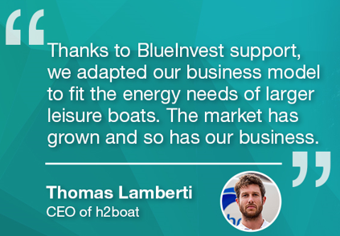
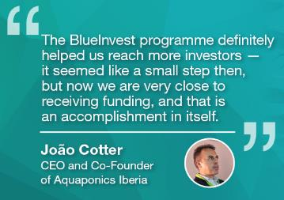
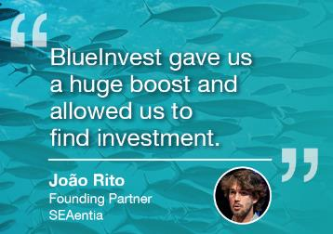
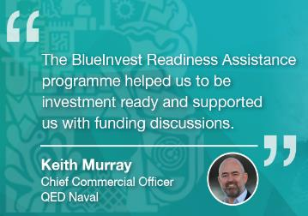
BlueInvest Success Stories
1600+ Community members
226 Investment Readiness Assistance beneficiaries
80+ beneficiaries had qualified introductions to investors
29 beneficiaries secured investment
96.5% satisfaction rate
Discover more success stories! Follow us here:
EU Business Support
EU_MARE
EU Maritime & Fish

Slide 13
02
BLUEINVEST INVESTORS

Slide 14
BlueInvest Investors
INVESTORS
1240
Investors informed on blue economy opportunities
440
Investors engaged with the BlueInvest features
120
Investors registered to the new BlueInvest Community platform
Investor type
Proactive
Open to share
Blue economy sectors of interest

Slide 15
BlueInvest Club of Investors
Proactive
Cooperative
Open to share

Slide 16
Open fundraising & investment rounds
Country of Origin: Portugal
Target fundraising amount: 50 million EUR
Investment capacity in the blue economy: 50 million EUR
Target ticket size: 200k to 5 million EUR
Target TRL: 6 - 9
Investment types: Pre-seed to Series B
Proactive
Country of Origin: Netherlands
Target fundraising amount: 1-10 million EUR
Investment capacity in the blue economy: 500 million EUR
Target ticket size: 1 million EUR to >10 million EUR
Target TRL: 6 - 9
Investment types: Seed to Series B
Open to share
Country of Origin: United Kingdom
Target fundraising amount: 200 million EUR
Investment capacity in the blue economy: 125 million EUR
Target ticket size: 1 million EUR to >10 million EUR
Target TRL: 8 - 9
Investment types: Series A to Series B

Slide 17
Open fundraising & investment rounds
Country of Origin: France
Target fundraising amount: 50 million EUR
Investment capacity in the blue economy: 10 million EUR
Target ticket size: 200k to 2 million EUR
Target TRL: 5 - 9
Investment types: Pre-seed to Series A
Proactive
Country of Origin: France
Target fundraising amount: 130-150 million EUR
Investment capacity in the blue economy: 130 million EUR
Target ticket size: 200k EUR to 10M EUR
Target TRL: 5 - 9
Investment types: Seed to Series A
Open to share
Country of Origin: Germany
Target fundraising amount: 40 million EUR
Investment capacity in the blue economy: 40 million EUR
Target ticket size: 200k to 500k EUR
Target TRL: 2 - 9
Investment types: Pre-seed to Series A

Slide 18
03
Q&A
Thank you!

Slide 19
04
DEVELOP YOUR VALUE
PROPOSITION

Slide 20
Definition
The Value Proposition describes the benefits an investor can expect from your products and services in a persuasive manner. It helps us to influence the investor’s perceived value
WHAT
What problem do you solve for your investors
What unresolved pains your investor has
What your investor gains from using your solutions
HOW
How you solve the pain points
How your investors get their gains
Explain how you differ from existing solutions
WHY
Why should your investors buy your solution
Why do your investors prefer you over competitors: use data
Have you worked out a value proposition for your core solutions?
Do you systematically develop a value proposition for everything you are trying to bring to market?
Perceived value is the investor’s evaluation of the merits of a product or service, and its ability to meet their needs and expectations, in comparison with its peers
How does the investor see you? Try to include relationships/unique elements

Slide 21
Value Proposition Cheat Sheet
Are embedded in great business models
Outperform competition substantially
in at least one dimension
Focus on unsatisfied needs:
jobs, gains, unresolved needs
Focus on jobs, pains and
gains that matter to investors
Great value propositions…
Address also social and
emotional jobs
Differentiate from
competition
Are difficult to copy
Align with how investors
measure success
Focus on jobs, gains and pains that a lot
of people have or will pay a lot of money
for
Target few jobs, pains and gains
but solve them extremely well

Slide 22
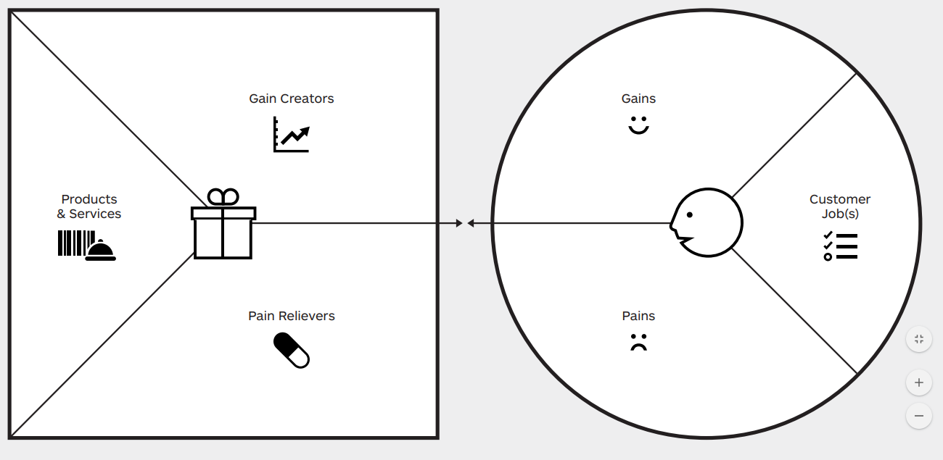
The Value Proposition Canvas
B. VALUE MAP
A. investor PROFILE
C. FIT
Source: Ostewalder, Pigneur, Smith, Bernarda, Papadakos, Value Proposition Design, Wiley ,2014
Notes:
Products and services: List of all products and services the VP is built around
Gain creators: How your products and services create customer gains
Pain relievers: How your products and services alleviate customer pains
investor PROFILE
Gains: Outcomes customers want to achieve or benefits they are seeking
Pains: Bad outcomes, risks and obstacles related to customer jobs
Customer jobs: What customers are trying to get done with their work and lives
FIT: when value map meets the customer profile

Slide 23
Applying the Canvas
Gain Creators:
You should describe here how your product creates investors gain, how it offers an added value to your investors .
investor Gains:
All the investors ’s benefits and desires, and may span personal, functional, or economical etc.
Example: positive emotions, functional requirements, or specific cost savings
Product & Services:
You list all the products and services which your value proposition is built upon. This includes for example the services that you offer or the help the investors receives either functional, social, or emotional.
investor Jobs:
All the investors needs, the problems that they are trying to solve and the tasks they are trying to perform or complete
Pain Relievers:
Here you describe how your products addresses the challenges, needs and the pains of the investors , how you eliminate negative emotions, undesired costs or avoidable situations.
investors Pains:
All the negative emotions and undesired costs, situations and risk which the investors could experience before, during and after getting the job is done
Notes:
Persuation with power words: YOU, EASY, SAVE, RESULTS, GUARANTEE

Slide 24
The Value Proposition Canvas – Investor profile
Investor Jobs
Investor Pains
Investor Gains
Tasks they are trying to complete
Problems they are trying to solve
Needs they are trying to satisfy
Functional jobs - Social Jobs - Personal/Emotional jobs
Undesired outcomes, problems & characteristics
Obstacles
Risks
TIP: Make concrete – think of trigger questions to map potential pains
Required gains
Desired gains (exceeding expectations)
Unexpected gains (unknown)
TIP: Make concrete - think of trigger questions to map potential gains
Important
Insignificant
Extreme pain
Moderate pain
Essential
Nice to have
Notes:
PwC offering tends to focus on the first two:
Functional jobs: focused on trying to complete a specific task, e.g get license for a fund, define amount of tax to pay
Social jobs: focused on how investor is going to be perceived by others, e.g efficient, competent, reliable
Personal /emotional jobs: related to emotional state, e.g feeling of job security at one’s workplace
The jobs are context dependent. e.g working with teams is different of working with investors, so the jobs below have a different profile
For the rankings, one can use post-it notes and place them on the scale

Slide 25
Applying the Canvas – Investor profile
Investor profile – Visualise what matters to your target investors using the framework
1. Select a segment (end users, influencers, detractors, etc.)
2. Identify jobs
3. Identify pains
4. Identify gains
5. Prioritise jobs, pains and gains

Slide 26
The Value Proposition Canvas – Value map
Solutions
Pain relievers
Gain creators
List of products
List of solutions
List of features
List of services
In relation to your customer pains and for your specific customer segment
How exactly you relieve pains
Focus on pains that matter to investors, and only a few pains that we can solve extremely well
Think of trigger questions to map ways the pain is solved. It is not about products yet
How exactly you create gains
Focus on the gains you can really make a difference, not all features
Think of trigger questions to map gain creators
Essential
Nice to have
Essential
Nice to have
Essential
Nice to have
Notes:
Products and services: focus on your specific suite of products. List of all products and services that your value proposition builds on to target a specific customer segment. FOCUS on SEGMENT
Pain relievers: only focus on a few. Outline exactly how you kill customer pains. Each reliever has to address at least one or more pains and gains. Do not add products and services, go to the points. E.g the tool creates tax reports in 3 days when that would take the investor 30 days to develop
Gain creators: have to be linked to the pains listed, and explain how they help customers to achieve the gains
Solutions should include services – tech enabled services
The pains and gains here are not the same as in the investor profiling. The difference is what you address is something you control when designing products, whilst the customer pains are not controllable

Slide 27
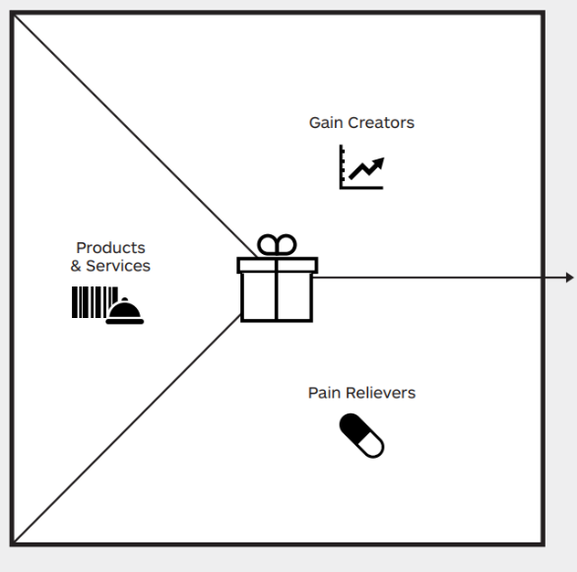
Applying the Canvas – Value Map
Value Map – Visualise the value map of one of your existing solutions for the investor profile mapped
1. List solution, including products & services, or features
2. Outline pain relievers
3. Outline gain creators
4. Rank by order of importance pains and gains

Slide 28
Applying the Canvas – FIT
FIT– Position the value map on the investor map
1. Do you √ or X most of them?
FIT

Slide 29
Pitfalls
Do Not
Lose sight of the investor profile – push approach needs to be careful
Ignore the FIT
Employ buzzwords and too much jargon
Present with long preambles
Focus on detailed technical features (this is product description)
Provide long explanation on how to buy and sell (this is business model)

Slide 30
The core of your VP - Tag line
KEEP IT SIMPLE
Our (products and services) helps (customer segment) who want to (jobs to be done) by (add own verb for pain reduction) and (add own verb for gain generation).
Credibility – Productivity – Efficiency – Simplicity - Cost savings – Compliance – Overview – Control - Managed risks – Easy – Pleasant - Integrated

Slide 31
05
NOW IT’S
YOUR TURN!

Slide 32
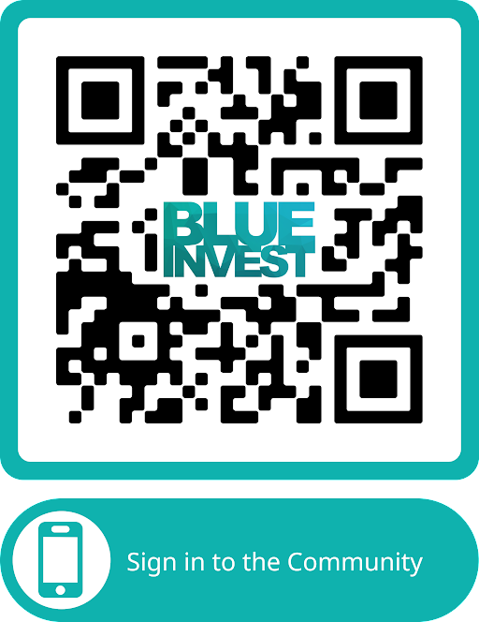
THANK YOU!
www.blue-invest.eu
lu_blueinvest@pwc.com

