Slide 1
EUCISE 2020 TAG Meeting
EUCISE2020 TAG Meeting
Bruxelles, 10/02/2017
EUCISE2020 received funding from the European Union’s seventh framework programme under grant agreement no: 608385

Slide 2
EUCISE 2020 TAG Meeting
EUCISE2020 Status Report
Current activities
Principles
Basic elements
Technical architecture
EUCISE2020 received funding from the European Union’s seventh framework programme under grant agreement no: 608385

Slide 3
EUCISE 2020 TAG Meeting
EUCISE2020 Principles
Military/civilian cooperation; management of EU RESTRICTED information through a special channel
Complete decentralization according to CISE Hybrid Architecture: no central system, no central database
Independence from any system and sensor
Independence from any national or European architecture
Firm adherence to standards and open source software
Adherence to the CISE data and service models
EUCISE2020 will promote standardizations groups inside the EU bodies
Open to new partners and to European agencies
IPR management and sharing
Common technical architecture
EUCISE2020 received funding from the European Union’s seventh framework programme under grant agreement no: 608385

Slide 4
EUCISE 2020 TAG Meeting
IPR sharing with DG MARE for interoperability call
In the next interoperability call, DG MARE will make reference to EUCISE2020.
EUCISE2020 was requested to make available documents and software:
Documents are made available under the same Creative Common License used for the tender, and under some requirement
Software will be available in September 2017 and the Consortium will decide its sharing policy; in March WP10 will activates a specific sub-group on the subject to analyse the issue and define a draft policy.
The same conditions apply to any new partner interested in joining the Consortium or taking part in the information exchange.
EUCISE2020 received funding from the European Union’s seventh framework programme under grant agreement no: 608385

Slide 5
EUCISE 2020 TAG Meeting
EUCISE2020 Status Report
Basic elements
Partners
Operational concept
Status
Technical architecture
EUCISE2020 received funding from the European Union’s seventh framework programme under grant agreement no: 608385

Slide 6
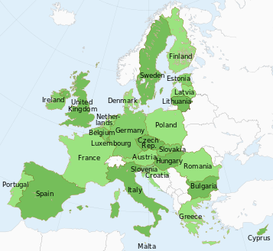
EUCISE 2020 EUCISE2020 Coverage
EUCISE2020 Partners
37 (39) Partners
15 EU/EEA maritime Countries
Open to new partners and to collaborations with EU Agencies
Maritime Authorities
Experts
Research Institutions
Two new partners:
SGMER – France
Ministry of Fishery - Spain
EUCISE2020 received funding from the European Union’s seventh framework programme under grant agreement no: 608385

Slide 7
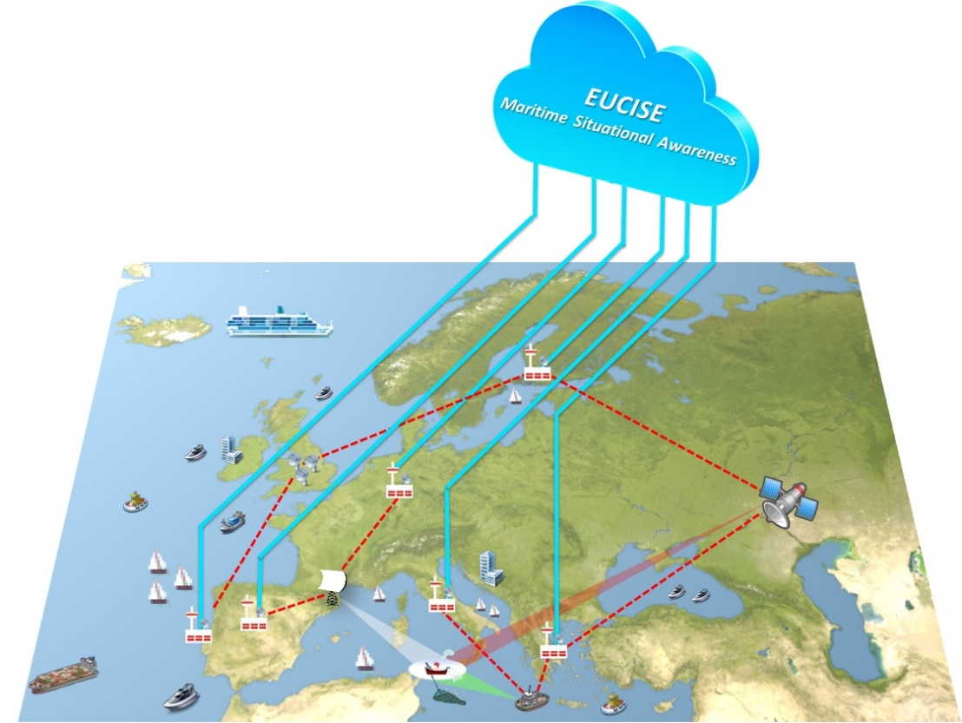
EUCISE 2020 Operational Concept
Operational Concept
Primary mission of EUCISE2020 is to support the EU Maritime Situational Awareness capability by means of an Information Sharing Environment capable to implement adequate security measures and protocols ensuring the confidentiality, integrity and availability of the data required and transmitted in the CISE community.
EUCISE2020 will not affect the functionalities of the operational information systems belonging to the participating Public Authorities or of the European existing sectorial information systems.
Blue lines depict flows of information within the CISE community, while the red dashed lines depict flows of information within the legacy systems belonging to single Public Authorities.
EUCISE2020 received funding from the European Union’s seventh framework programme under grant agreement no: 608385

Slide 8
EUCISE 2020 User Functions
User Functions
User functions analysed with reference to 9 different operational scenarios studied in the Cooperation projects and enhanced in the first phase of the project:
Use Case 13b: Inquiry on a specific suspicious vessel (cargo related).
Use Case 13c: Inquiry on a specific suspicious vessel (crew and ownership related).
Use Case 25b: Investigation of antipollution situation (law enforcement).
Use Case 37: Monitoring of all events at sea in order to create conditions for decision making on interventions.
Use Case 44: Request for any information confirming the identification, position and activity of a vessel of interest.
EUCISE2020 received funding from the European Union’s seventh framework programme under grant agreement no: 608385

Slide 9
EUCISE 2020 User Functions
User Functions
Use Case 57: Knowledge of surveillance capacities of partner authorities in a given sea area to plan basic tactical surveillance (Baseline and Targeted operations).
Use Case 70: Suspect Fishing vessel/ small boat is cooperating with other type of vessels (m/v, Container vessel etc.).
Use Case 85: Anti-Piracy Maritime Surveillance and free navigation control: Merchant vessels at sea (outside Territorial waters) sends an alert that it is under Piracy attack.
Use Case 93: Detection and behaviour monitoring of IUU listed vessels.
For each of the above mentioned scenario a full set of operational views for operational node connectivity and operational activity model are defined.
EUCISE2020 received funding from the European Union’s seventh framework programme under grant agreement no: 608385

Slide 10
EUCISE2020 deliverables and review processes
Document | Planner | Developer | Reviewer | Acceptor | Distributor
D1.1 – Joint POV call for tender | WP1 | WP1/PB | DG HOME, IVV, SECB, EAB | PB | PC
D1.2 – Periodic project progress reports and financial cost reports | WP1 | WP1 | PC, APRE, ADMIN POC | PC, DG HOME | PC, CDM
D2.1 – Communication and dissemination plan | WP2 | WP2 | EMG, IVV, | PC, DG HOME | PC, CDM
D3.1 – Partners cooperative plan | WP3 | WP3 | EMG, IVV, SECB, EAB | PC, DG HOME | PC, CDM
D4.1 – Needs analysis document | WP4 | WP4 | EMG, IVV, SECB, EAB | PC, DG HOME | PC, CDM
D4.2 – Validation strategy | WP4 | WP4 | EMG, IVV, SECB, EAB | PC, DG HOME | PC, CDM
D4.3 – Technical specifications | WP4 | WP4 | EMG, IVV, SECB, EAB | PC, DG HOME | PC, CDM
D4.4 – Validation strategy (classified annex) | WP4 | WP4 | EMG, SECB, EAB | PC, DG HOME | PC
D4.5 – System security requirements statement (classified annex) | WP4 | WP4 | EMG, SECB, EAB | PC, DG HOME | PC
D5.1 – Governance of the standardization process | WP5 | WP5 | EMG, IVV, SECB | PC, DG HOME | PC, CDM
D6.1 – Detailed design of prototype of CISE | WP6 | WP6 | EMG, IVV, SECB, EAB | PC, DG HOME | PC, CDM
D6.3 – Integration and validation procedures and reports | WP6 | WP6 | EMG, IVV, SECB, EAB | PC, DG HOME | PC, CDM
D8.1 – Ex-post assessment report | WP8 | WP8 | EMG, IVV, SECB, EAB | PC, DG HOME | PC, CDM
D8.2 – Final report on validation of services (classified annex) | WP8 | WP8 | EMG, IVV, SECB, EAB | PC, DG HOME | PC, CDM
D8.3 – Dissemination plan | WP8 | WP8 | EMG, IVV | PC, DG HOME | PC, CDM
D9.1 – Preliminary design of CISE test bed | WP9 | WP9 | EMG, IVV, SECB, EAB | PC, DG HOME | PC, CDM
D10.1 – IPR strategy for the exploitation | WP10 | WP10 | EMG, IVV | PC, DG HOME | PC, CDM

Slide 11
EUCISE 2020 TAG Meeting
European contract to develop the EUCISE2020 platform
During Phase 2, the Consortium procured through a European tender the research services needed to develop the European network and to manage the demonstration at national and European levels
Contractual Milestone | Contractual date | Effective milestone acceptance date | Delivery of draft documents (15 days before the milestone)
MS1 - CD - Concept Design | T0 + 1 | 09/02/2017 | 25/01/2017
MS2 - CDR - Critical Design Review | T0 + 3 | 30/03/2017 | 15/03/2017
MS3 - FAT Factory Acceptance Review | T0 + 8 | 30/08/2017 | 16/08/2017
MS4 - SAT - Site Acceptance Review | T0 + 10 | 30/10/2017 | 16/10/2017
MS5 - INT - Integration Test | T0 + 11 | 30/11/2017 | 15/11/2017
MS6 - FAR - Final Acceptance Review | T0 + 16 | 30/04/2018 | 16/04/2018
T0 = 30/12/2016
EUCISE2020 received funding from the European Union’s seventh framework programme under grant agreement no: 608385

Slide 12
EUCISE 2020 Contractual Milestones
CD: Concept Design concerns the preliminary design - CD @ T0+1 month
CDR : Critical Design Review concerns the final design - CDR @ T0+3 months
FAT: Factory Acceptance Test concerns the accomplishment of Tests in Laboratories conducted following the selected uses cases - FAT @ T0+8 months
SAT: the Site Acceptance Test concerns the deployment of EUCISE2020 testbed in corresponding environment and the testing that the EUCISE2020 Network is correctly working - SAT @ T0+10 months
INT: the Integration Test concerns the accomplishment of Integration of Legacy Systems of at least 3 Public Authorities. INT @ T0+11 months
FAR: the Final Acceptance Review concerns the accomplishment that all the Legacy Systems have been integrated, the certification process has been completed and that validation tests have been correctly performed in the real operational environment - FAR @ T0+16 months
EUCISE2020 received funding from the European Union’s seventh framework programme under grant agreement no: 608385

Slide 13
EUCISE 2020 Phases 2 and 3
During Phase 2, partners participating in the demonstration, will procure nationally the research services needed to develop the national interfaces to the CISE common platform, in time for the planned demonstrations.
EUCISE2020 will demonstrate the CISE capabilities both at the different basins level, and a global European scale, through a series of demonstrations planned in the last six months of Phase 2. Operational testing of the developed network environment should last at least 6 months.
Statistical data on the costs and benefits of the developed solution and of the information exchanged will be collected and made available for the subsequent assessment work.
In the final evaluation phase (Phase 3 - Ex-Post Assessment (CSA)), the EUCISE2020 Consortium will conduct a thorough assessment of the solution performances, and of the cost-benefit ratio of the alternative architectures tested in Phase 2. EUCISE2020 will issues a set of recommendations concerning the management of the EUCISE2020 infrastructure and the future governance of the joint enterprise.
EUCISE2020 received funding from the European Union’s seventh framework programme under grant agreement no: 608385

Slide 14
EUCISE 2020 TAG Meeting
Technical Architecture
EUCISE2020 received funding from the European Union’s seventh framework programme under grant agreement no: 608385

Slide 15
EUCISE 2020 TAG Meeting
Network Topology
The network topology of EUCISE2020 is based on the CISE hybrid vision concept. Each Member State and Community can adopt one of the following paradigms:
Single-way approach: All Public Authorities of a Member State are connected to the EUCISE2020 Network through a single access point
Multiple-way approach: Public Authorities of a Member State are connected to the EUCISE2020 Network through different access points
EUCISE2020 received funding from the European Union’s seventh framework programme under grant agreement no: 608385

Slide 16
EUCISE 2020 Common architecture
The three different CISE configurations of the network architecture will be implemented:
Configuration A: single Public Authority belonging to a single Member State will connect to EUCISE2020 contributing with a single Legacy System
Configuration B: Public Authorities belonging to the same Member State connect their own Legacy Systems to the EUCISE2020 Gateway through a dedicated Adaptor
Configuration C: Public Authorities belonging to the same Member State connect their Legacy Systems to the EUCISE2020 Network through a single EUCISE2020 Node type C
EUCISE2020 received funding from the European Union’s seventh framework programme under grant agreement no: 608385

Slide 17
EUCISE 2020 TAG Meeting
Multiple way approach: CISE B and C architectural visions
B | Multiple Providers of CISE Services Coordinated by Member States (+ EU initiatives) This vision proposes a governance model where each Member State appoints an authority to manage which CISE services are delivered. Unlike vision C, each Member State has one or more service providers of CISE services. CISE services are also be provided by EU led initiatives. As in the Vision A, several integrated maritime awareness pictures coexist, but they are no longer divided in User Communities.
C | Single National Providers of CISE Services (+ EU initiatives) This vision proposes a governance model where each Member State appoints an authority to manage which CISE services are delivered. Unlike vision B, each Member State has a single service provider of CISE services. CISE services can also be provided by EU led initiatives. Unlike visions A and B, a single integrated maritime awareness picture can be offered per Member State. Sea basin authorities can also be set up to provide sea basin level services (variant of vision C).
EUCISE2020 received funding from the European Union’s seventh framework programme under grant agreement no: 608385

Slide 18
EUCISE 2020 Common architecture
Common EUCISE2020 system configurations will include the following components:
CISE Adaptor allows a Legacy System (LS) to connect to a CISE Gateway. It translates the LS data into the common CISE Data Model
CISE Gateway (GW) implements the common CISE specifications and implements the CISE messaging protocol to exchange with the CISE adaptor or with the other CISE Gateways
CISE Node (NODE) is an enhanced gateway, capable of performing advanced business related activities like fusion and storing of information (EUCISE Advanced Services).
CISE Adaptor and CISE Gateway will be implemented in all configurations, while CISE Node will be included only in configuration C, to deliver the EUCISE2020 advanced services.
EUCISE2020 received funding from the European Union’s seventh framework programme under grant agreement no: 608385

Slide 19
EUCISE 2020 EUCISE2020 services
The EUCISE2020 Services are organized in four classes:
Core Services: according to the CISE Hybrid Vision architecture, core services implement the CISE gateways which are the component that will ensure the connection of each partner, or group of them, to the EUCISE2020 network.
Common Services: devoted to the exploitation of entities within the CISE network following the EUCISE2020 business rules.
Advanced Services: consisting of added value services proposed by each EUCISE2020 community of interest. Member States decide the implementation of advanced services or not.
Innovative Services are optional R&D application services, with TRL (Technology Readiness Level) between 6 and 8 according the HORIZON 2020 scale, and with different IPRs; the Innovative Services are expected to deliver new added value in the maritime surveillance business processes.
EUCISE2020 received funding from the European Union’s seventh framework programme under grant agreement no: 608385

Slide 20
EUCISE 2020 CISE components
The CISE components are able to:
translate the request of information coming from PAs in a common vocabulary;
ensure the exchange of messages within the EUCISE2020 Community based on a Service Oriented Architecture paradigm;
manage access rights to information exchange based on a roles/rules based approach;
handle classified information up to EU restricted level;
implement a collaborative environment;
optionally, implement advanced functions to enhance the information available at PAs level.
EUCISE2020 received funding from the European Union’s seventh framework programme under grant agreement no: 608385

Slide 21
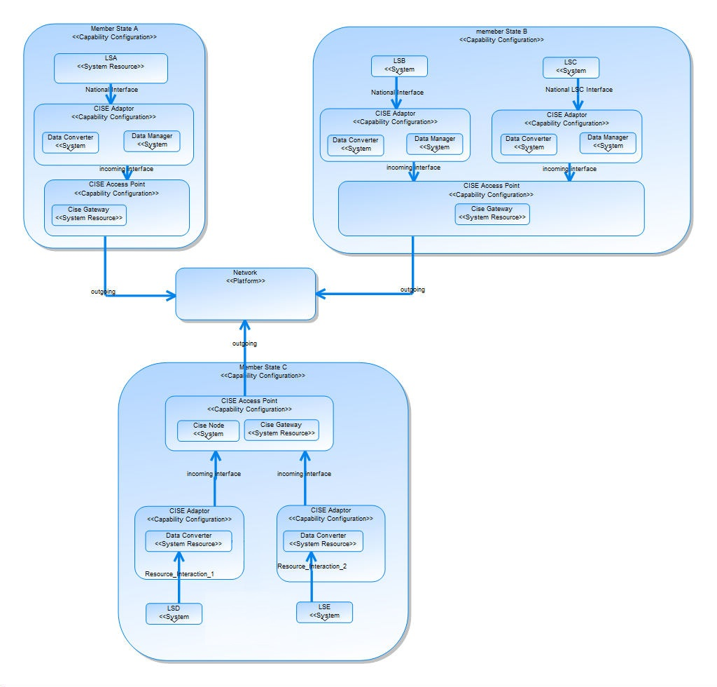
EUCISE 2020 Common architecture
Logical Architecture of EUCISE2020 Configurations A, B and C:
Inside the red line components developed through the European tender
Outside the red line interfaces developed through the national procurements
EUCISE2020 received funding from the European Union’s seventh framework programme under grant agreement no: 608385

Slide 22
EUCISE 2020 Demonstration
Demonstration
Eleven European countries will take part in the demonstration.
Regarding the configurations chosen:
six countries with configuration C
one country with configuration A
one country with configuration B
one country expressed an option for a kind of "Hybrid Vision configuration - A merge of Visions A, B and C"
one country still under decision.
Few partners have not decided the configuration model with which they will take part; possibly, they will connect through a "Light Client".
Each country will connect one or more Legacy Systems to its chosen configuration; so far, the ten participating countries indicated at least twelve Legacy Systems to connect to the EUCISE2020 network.
EUCISE2020 received funding from the European Union’s seventh framework programme under grant agreement no: 608385

