Slide 1
EMFAF portfolio of projects on algae and blue bioeconomy
Synergies and clustering workshop, Rome 12th December
Charlotte JAGOT, CINEA

Slide 2
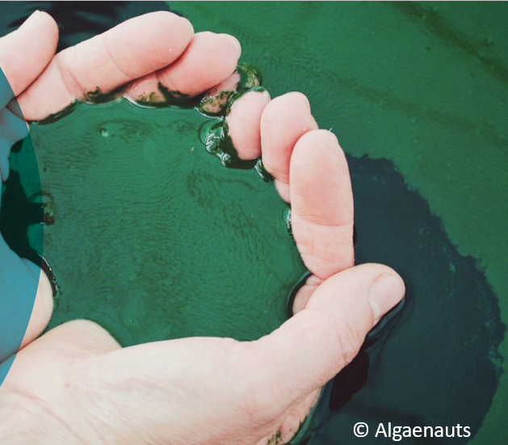
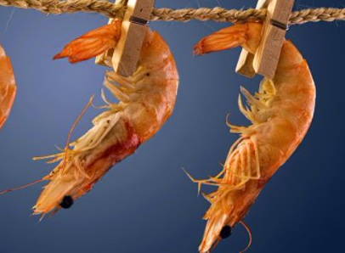
Portfolio of EMFF projects
Microalgae:
New alternative and sustainable sources of food
Eco-friendly Biopesticides based on microalgae and circular approach
Seaweed
Seaweed cultivation
High value products from Invasive seaweed
Restoration of macro-algal forests
Circular biobased projects :
Bioactive fish packaging from shrimp waste
Biobased ropes for mussel aqauculture and algae farming in an IMTA approach
,
Notes:
9 projects
Blue labs, demo projects and BLUEINVEST grants
Consortia vs. Monobneficiary
Research, demonstration activities, access to market

Slide 3
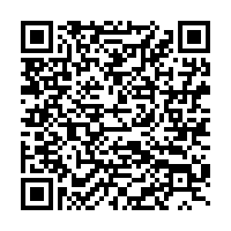

Slide 4
EMFAF-2022-PIA-FLAGSHIP-6-BALTIC
OBJECTIVE: Reorienting fishers to ocean regeneration activities
SCOPE
Knowledge creation and sharing, and identification of skills and training for regenerative ocean farming;
Access to space and water, (marine protected areas);
Permitting and authorisation processes (installation of regenerative ocean farms);
Demonstration activities for setting and operating regenerative ocean farming.
Baltic Sea (Topic 6): EUR 600 000
Co-funding: 80%
Partners: Min 3 - from 2 EU MSs

Slide 5
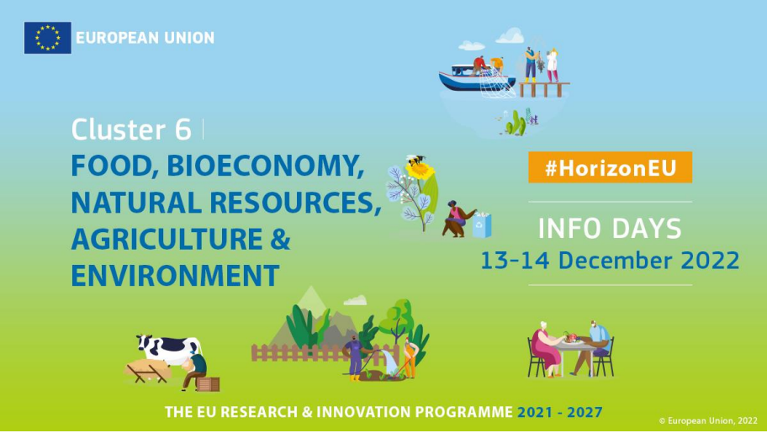
Horizon Europe
WP 2023-2024 : here
several topics on algae
Join the infoday: https://rea.ec.europa.eu/funding-and-grants/horizon-europe-cluster-6-food-bioeconomy-natural-resources-agriculture-and-environment_en
☺
Notes:
HORIZON-CL6-2024-FARM2FORK-01-7: Impact of the development of novel foods based on alternative sources of proteins
HORIZON-CL6-2023-CircBio-01-8: Eco-friendly consumer products – low-toxicity/zero pollution construction bio-based materials
HORIZON-CL6-2023-CircBio-01-11: Novel culturing of aquatic organisms for blue biotechnology applications

Slide 6
CBE JU
WP to be adopted before the end of the year https://www.cbe.europa.eu/
« SAVE THE DATE » INFODAY : 20/04/2023

Slide 7
Thank you! #BeGreenGoBlue

