Slide 1
Innovations for the Oceans of Tomorrow
Jay Pearlman
OoT Workshop, Oceans17
Aberdeen
June 22 2017

Slide 2
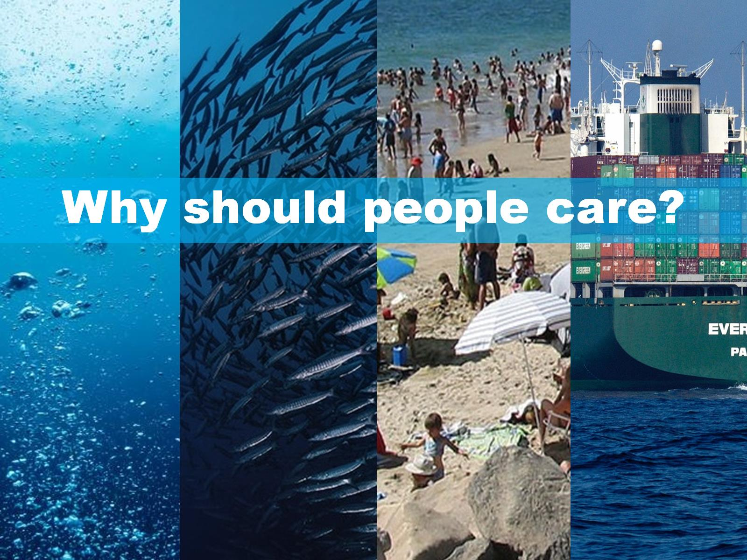
Why should people care?

Slide 3
“Seas and oceans have a huge impact on our daily lives, providing an essential part of our wealth and well-being. “
“They are not only a critical source of food, energy and resources, but also provide the majority of Europe's trade routes.”

Slide 4
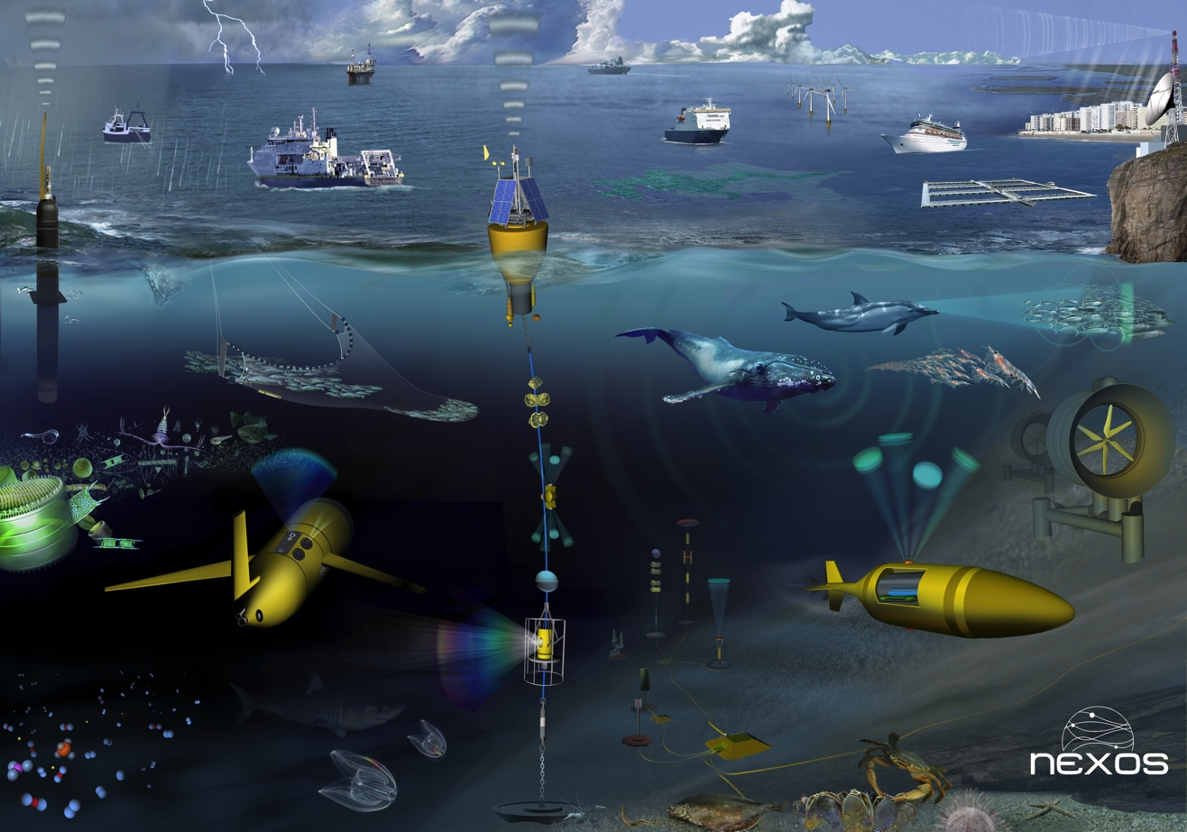

Slide 5
"The Ocean of Tomorrow (OoT) 2013" - a cross-thematic program focused on fostering research and innovation in marine technologies.

Slide 6
Phase 2 Projects | Common Sense | NeXOS | SCHeMA | Sense Ocean
Temp, Pressure | X |  | X
Oxygen |  |  | X | X
CDOM |  | X |  | X
Nutrients/carbonates | X |  | X | X
Phytoplankton |  | X |  | X
Hydrocarbons |  | X |  | X
Carbon Cycle |  | X |  | X
Fisheries |  | X
Underwater noise | X | X
Microplastics | X
Heavy/trace metals | X |  | X

Slide 7
OoT Workshop – Session 1
Presenter | Project | Organization | Title
Jay Pearlman | Introduc-tion | IEEE | Innovation in Sensors and Observations
Matt Mowlem | SENSEOCEAN | NOC | SenseOCEAN: Development of biogeochemical sensors for autonomous platforms and observatories
Jan van der Meer | BRAVOO | University of Lausanne | BRAAVOO: Biosensors for Near Real-Time Marine Toxicant Monitoring
Luca Sanfilippo | SMS | SYSTEA | SMS: Innovations in emerging pollutants ocean monitoring using biosensing technology
Antonio Novellino | SCHeMA | ETT | SCHeMA - Integrated In situ CHemical MApping probes: objectives and main achievements

Slide 8
OoT Workshop – Session 2
Presenter | Project | Organization | Title
Eric Delory | NeXOS | PLOCAN | NeXOS: Development and end-to-end integration of compact, low-power, multifunctional ocean sensors.
Dennis Gowland | EnviGuard | Northbay Shellfish Ltd. | ENVIGUARD: a real-time multi-sensor in a small package with a big future
Matteo Bonasso | MariaBox | KONTOR 46 | MariaBox: first prototype of a novel instrument to observe natural and chemical pollutants in seawater
Sergio Martinez | COMMON SENSE | LEITAT | COMMON SENSE: Cost-effective sensors, interoperable with international existing ocean observing systems

Slide 9
Thank you

