Slide 1





WFO Belgium
Flemish Fishermen for a Better Marine Environment
13/9/2011

Slide 2
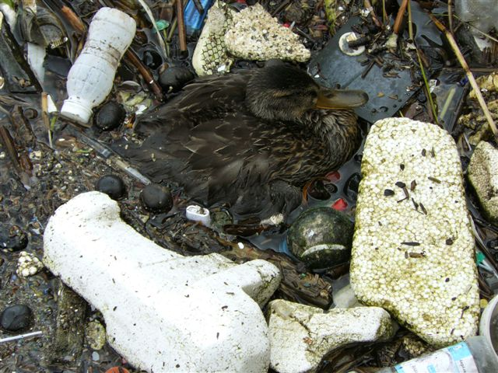

Marine litter: where does it come from?
Geographically
  Waste at the sea floor: probably from local origin
  Floating debris: origin difficult to assess, circulates within (and between ?) all oceans and seas.
Marine litter originates from
  Fishing gear
  Shipping waste
  Littering at beaches
  Plastic granules
  (from industry and logistics)
  Uncontrolled landfill in coastal areas and along rivers
  Land based litter ending up in rivers and in sewage drains

Slide 3
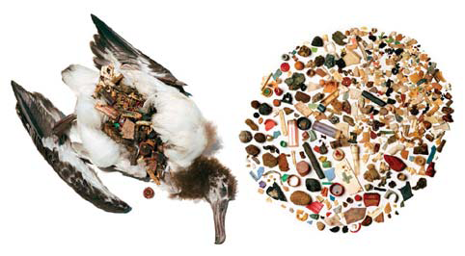
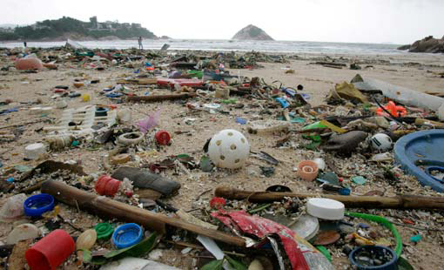
Marine litter: which problems?
Macroplastics
  Physical threat to marine life :
  suffocating, injuries, blocked digestion
  Visual pollution:
    Negative impact on the valuation
    of the marine environment
    Restoration costs
  Disintegrates by UV radiation and physical degradation into microplastics
Microplastics
  Insufficient knowledge about impact on marine environment and food chain: physical influences, adsorption of pollutants
  Impact on the image of marine food products

Slide 4
Marine litter: which solutions?
Prevention
  “Clean Sweep” program: guidelines for a sustainable manipulation of plastic granules in industry and in logistics
  Product policy: reuse/ degradability/ composition
  Selective recovery & recycling of waste
  e.g. Green Dot recovery systems, Marpol convention, …
  Anti litter campaigns & repression
  Worldwide issue:
    Northwest-Europe and Northern America are less problematic as southern and eastern regions
    Flanders and Europe should put the example about sustainable chain management of plastics
    Awareness in Africa and Asia is increasing

Slide 5
Marine litter: which solutions?
Restoration of the marine environment
  Cleaning of beaches
  Fishing of waste from sea floor: “Fishing For Litter” projects
  Fishing of floating debris before it disintegrates into microplastics: WFO “Waste Free Oceans” projects
  Development of captive systems for floating debris

Slide 6
WFO Belgium
Flemish Fishermen for a Better Marine Environment
Objectives
Fishing of floating debris before the Belgian coast
Reorientation of the Flemish fishermen from exploitation towards sustainable management of the marine environment
Belgian & Flemish participation with European and international developments in this field: eventually new economic opportunities in the long term

Slide 7
WFO Belgium
Flemish Fishermen for a Better Marine Environment
Promotor
SDVO (Flemish Foundation for Sustainable Fishery)
  Coordination
  Logistics: use of existing Fishing For Litter infrastructure
  Knowledge of the fishery sector – contacts with fishermen
  Permits – consultation with authorities
Co-promotor: Federplast.be (Belgian Plastics Industry)
  Knowledge of plastics issues: materials, uses, …
  Expertise of plastics chain management, with e.g. Fost Plus, Febem (Belgian recycling industry, EuPR, Ekol …
  WFO network – EU wide practical experiences and expertise
  Communications, in collaboration with Kustbeheer, Vliz, Environment Ministry, EuPC, PlasticsEurope, essenscia …

Slide 8
WFO Belgium
Flemish Fishermen for a Better Marine Environment
Programme
5 principal activities:
  Monitoring of the presence of floating debris
  Fishing of floating debris
  Generating data according to the Ospar/FFL protocol
  Sorting and routing of plastics waste for recycling, with use of existing Fishing For Litter infrastructure
  Communication activities
Additional activity:
  WFO Belgium acting as an intervention team for accidental spills of floating marine debris

Slide 9
WFO Belgium
Flemish Fishermen for a Better Marine Environment
Where to monitor and to fish for drifting debris ?
Before the Belgian coast
At sea (EEZ zone)
In the 4 harbours at the Belgian coast:
  Ostend
  Nieuwpoort
  Blankenberge
  Zeebrugge
In the mouth of the Yzer river:
  Nieuwpoort (Ganzenpoot)

Slide 10
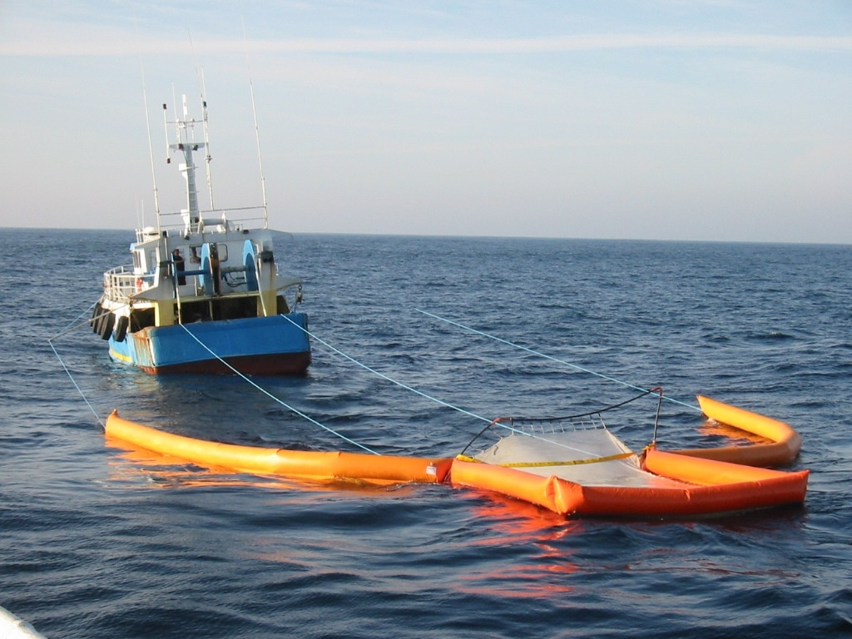
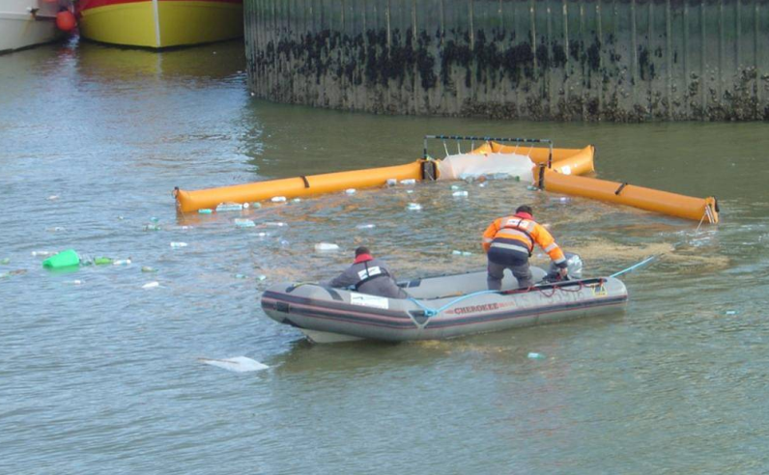
WFO Belgium
Flemish Fishermen for a Better Marine Environment
Technical concept for the fishing of drifting debris
3 fishing boats
3 Thomsea nets or equivalent fishing gear:
  2 smaller nets to be used at sea and in the harbours
  1 bigger net to be used in the mouth of the Yzer river (Ganzenpoot – Nieuwpoort)

Slide 11
WFO Belgium
Flemish Fishermen for a Better Marine Environment
Practical concept
24x going out per year – maximum use to be made of the currents to reduce fuel consumption
The collected waste is transported to the Ostend harbour (Fishing For Litter site)
Sorting and registering of the collected waste by using the FFL infrastructure & the OSPAR protocol
Sorted out plastics waste to be transported to a mixed plastics recycling company
Other waste fractions taken care of by the existing FFL operations

Slide 12
WFO Belgium
Flemish Fishermen for a Better Marine Environment
Timing
Project proposal – call for EU fishery funds subsidies: January 2012
Start up : May 1st, 2012
End of project: April 30th, 2014

Slide 13
WFO Belgium
Flemish Fishermen for a Better Marine Environment
Strengths
Integration in the European WFO project:
  Support from European institutions (European Parliament, DG Mare, DG Environment)
  Support from the European plastics industry (EuPC, EuPR)
  Network of 20 projects in Europe: exchange of knowledge
Complementarily to the Fishing For Litter initiative: maximum use to be made of existing infrastructure
Experience of SDVO in coordinating fishery projects
Experience and international network of Federplast.be on sustainable chain management of plastics

Slide 14
WFO Belgium
Flemish Fishermen for a Better Marine Environment
Weaknesses
Limited knowledge on the presence of drifting waste in Belgian coastal waters: there are probably no important concentrations due to the strong currents
No experience with using Thomsea nets or other fishing gear for catching drifting litter
Need for a pilot project to study the practical feasibility of the project and to allow efficient programming of future waste fishing activities.

Slide 15
WFO Belgium
Flemish Fishermen for a Better Marine Environment
Long term perspectives
Fishing of macroplastics avoids the formation in time of a multitude of microplastics
Preoccupation about ‘marine litter’ goes crescendo, the problem is increasing, so will be the need for expertise
Competence gained by fishermen increases their competitiveness for being involved in international programmes to clean up marine litter hotspots
Acquired competence and infrastructure also to be used for intervention at accidental spills
The tendency of European policies to reorient the fishery sector from exploitation towards sustainable management of marine resources (cfr agricultural policy) offers good prospects for long term continuity

Slide 16
WFO Belgium
Pilot project
Concept
Monitoring of floating debris in the 4 Belgian coastal ports
(4 days with a small boat)
5 days going out into the sea with a fishing boat:
  1 day testing of different nets and fishing techniques
  4 days monitoring and fishing of floating debris at sea
Sorting and analysis of the waste according to OSPAR protocol
Recycling of the plastics fraction
Costs
15000 euro : 50% SDVO / 50% Federplast.be + partners

Slide 17
WFO Belgium
Pilot project
Project management:
SDVO & Federplast.be
Partners:
EuPC / WFO Foundation OK
essenscia OK
SPF Environment –Marine Environment Department OK
EKOL (plastics recycler) OK
Febem (BE Federation of the Waste Management Industries) ?
Ovam (Flemish Waste Management Administration) ?
Fost Plus (Belgian Green Dot organisation) ?
Flemish fishery administration ?

