Slide 1

EUSeaMap 2 (EMODnet Habitats)
A physical habitat map for European Seas
19th meeting of Marine Observation and Data Expert Group
4-5 July 2013, European Environment Agency, Copenhagen
Mickaël Vasquez ⁽¹⁾
Jacques Populus - Coordinator ⁽¹⁾
On behalf of EUSeaMap 2 Consortium
(1) Ifremer – DYNECO / AG

Slide 2
Outline
Methodology developed for broadscale habitat mapping
Past projects
  EUSeaMap (ur-EMODnet)
  MeshAtlantic
  Lessons learned
EUSeaMap 2
  Objectives
  Tasks
  Interactions with other EMODnet lots
  2014 deliveries

Slide 3
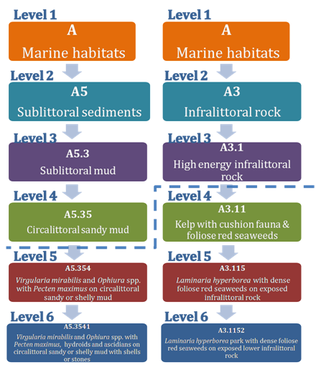
Methodology : a Eunis driven top-down approach
Eunis Classification provides a common language for seabed habitats
Methodology
Past Projects
EUSeaMap 2

Slide 4
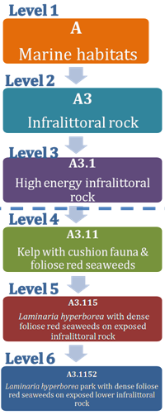
Methodology : a Eunis driven top-down approach
Biological zone : Infralittoral
Energy level at seabed : High
Substrate : Rock
Methodology
Past Projects
EUSeaMap 2
Notes:
4

Slide 5

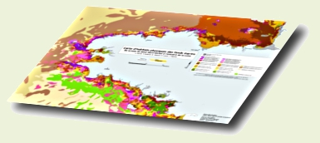
Methodology : a Eunis driven top-down approach
Biological zones full coverage layer
Energy at the seabed full coverage layer
Seabed substrate full coverage layer
Broad-scale habitats full coverage layer
Methodology
Past Projects
EUSeaMap 2

Slide 6
Methodology : a Eunis driven top-down approach
Biological Zones layer : each biological zone has to be modelised via
  depth or derivative (slope change)
  other physical parameters, for which a proxy has to be used
Biological Zone | Upper Limit | Lower Limit
Infralittoral |  | Depth at which there’s no longer enough light for kelp or seagrass growth
Circalittoral | Depth at which there’s no longer enough light for kelp or seagrass growth | Stable exposure to waves
Deep Circalittoral | Stable exposure to waves | Shelf break (slope change)
Upper Slope | Shelf break (slope change) | Depth -750m
Upper Bathyal | Depth -750m | Depth -1100m
Mid Bathyal | Depth -1100m | Depth -1800m
Lower bathyal | Depth -1800m | Continental Slope foot (slope change)
Abyssal | Continental Slope foot (slope change)

Slide 7
Methodology : a Eunis driven top-down approach
Energy at the seabed layer : combined action of wave-induced and current-induced energy
3 levels are considered in EUNIS
  High
  Moderate
  Low
Methodology
Past Projects
EUSeaMap 2

Slide 8
Methodology : a Eunis driven top-down approach
Seabed substrate layer : has to be standardised in the 6 classes classification used by EUNIS
  Rock
  Coarse sediment
  Mixed sediment
  Sand
  Muddy sand
  Sandy mud
  Mud
Methodology
Past Projects
EUSeaMap 2

Slide 9
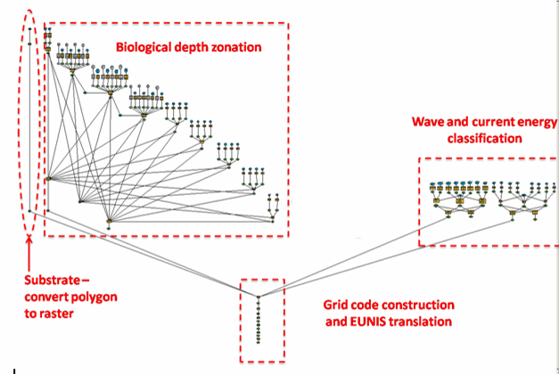
Methodology : a Eunis driven top-down approach
ArcGIS Model Structure
Pixel size: 250 m
Methodology
Past Projects
EUSeaMap 2

Slide 10
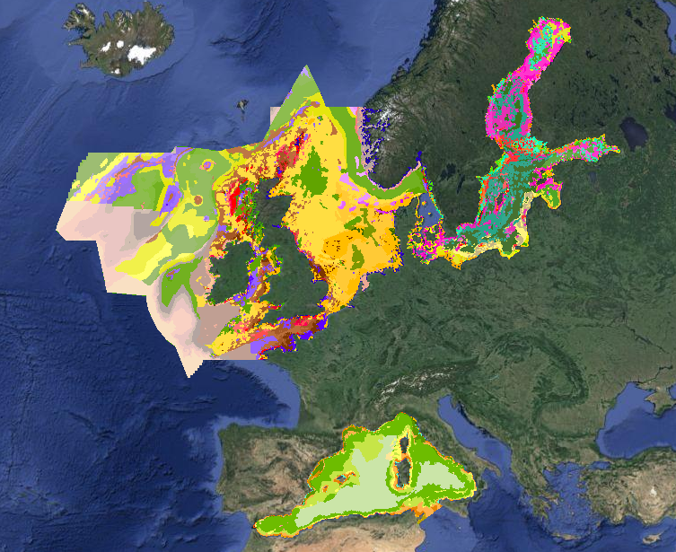
EUSeaMap (ur-Emodnet, JNCC coordination)
Aim : to provide broad-scale maps of seabed habitats
  for 4 basins
  using common functional mapping methods
Methodology
Past Projects
EUSeaMap 2

Slide 11
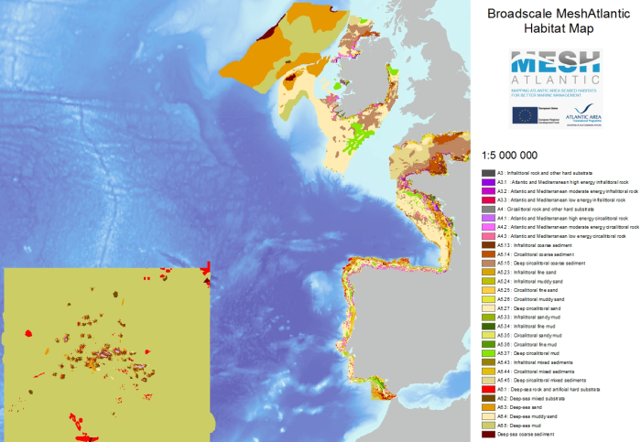
MeshAtlantic : Interreg IV project, Ifremer coordination
Atlantic broadscale map created according to the methodology developed by EUSeaMap
Methodology
Past Projects
EUSeaMap 2

Slide 12
Lessons learned from past projects
MeshAtlantic successfully used EUSeaMap’s methodology  it is robust
Eunis classification is not available in some areas (e.g. Baltic Sea, deep seas) EUNIS can’t be used everywhere, hence need for improvement
Oceanographic data is the most difficult to get  some specialists must be part of the team
Thresholds for EUNIS classes must be improved to reflect the communities that live inside the habitat  they have to be calibrated by as many as possible samples of habitats (grountruthing)
There is a huge lack of groundtruth data  we need to find some
Methodology
Past Projects
EUSeaMap 2

Slide 13
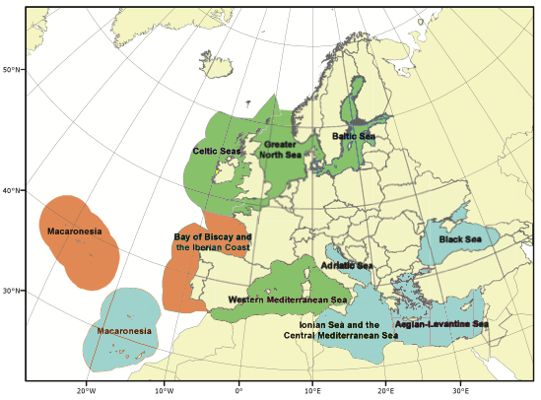
EUSeaMap 2 – Main objectives
To fill in the gaps (blue areas on the map)
To improve the maps created so far, thanks to inputs improvements (hydrodynamics models, seabed substrate layers, …)
Refine down to 100m pixel size in pilot areas
Methodology
Past Projects
EUSeaMap 2

Slide 14
EUSeaMap 2 – Main tasks
WP1 - Classification review - ISPRA (I)
WP2 - Data preparation - HCMR (GR)
WP3 - Habitat samples data - Geoecom(RO)
WP4 - Thresholds - Ifremer (F)
WP5 - Modelling and confidence - JNCC (UK)
WP6 - Web portal - JNCC (UK)
WP7 - Applications of physical habitat products - DCE (DK)
WP8 - Coordination and Communication - Ifremer (F)
Methodology
Past Projects
EUSeaMap 2

Slide 15
EUSeaMap 2 – Interactions with other lots
Bathymetry and Geology lots provide direct inputs to EUSeaMap 2
Biology lot could provide sample data that we missed in past projects
These data should be available for us by the end of year 1
We are keen on sharing with these lots our requirements at their kick-off
Methodology
Past Projects
EUSeaMap 2

Slide 16
EUSeaMap 2 – 2014 deliveries
Maps will be made available for the empty areas
  Adriatic
  Ionian
  Aegan
But at low resolution, using IBCM geology map (Scale 1 / 10,000,000)
Methodology
Past Projects
EUSeaMap 2

Slide 17





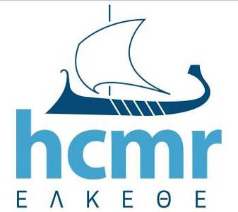



Thank you for your attention …

