Slide 1
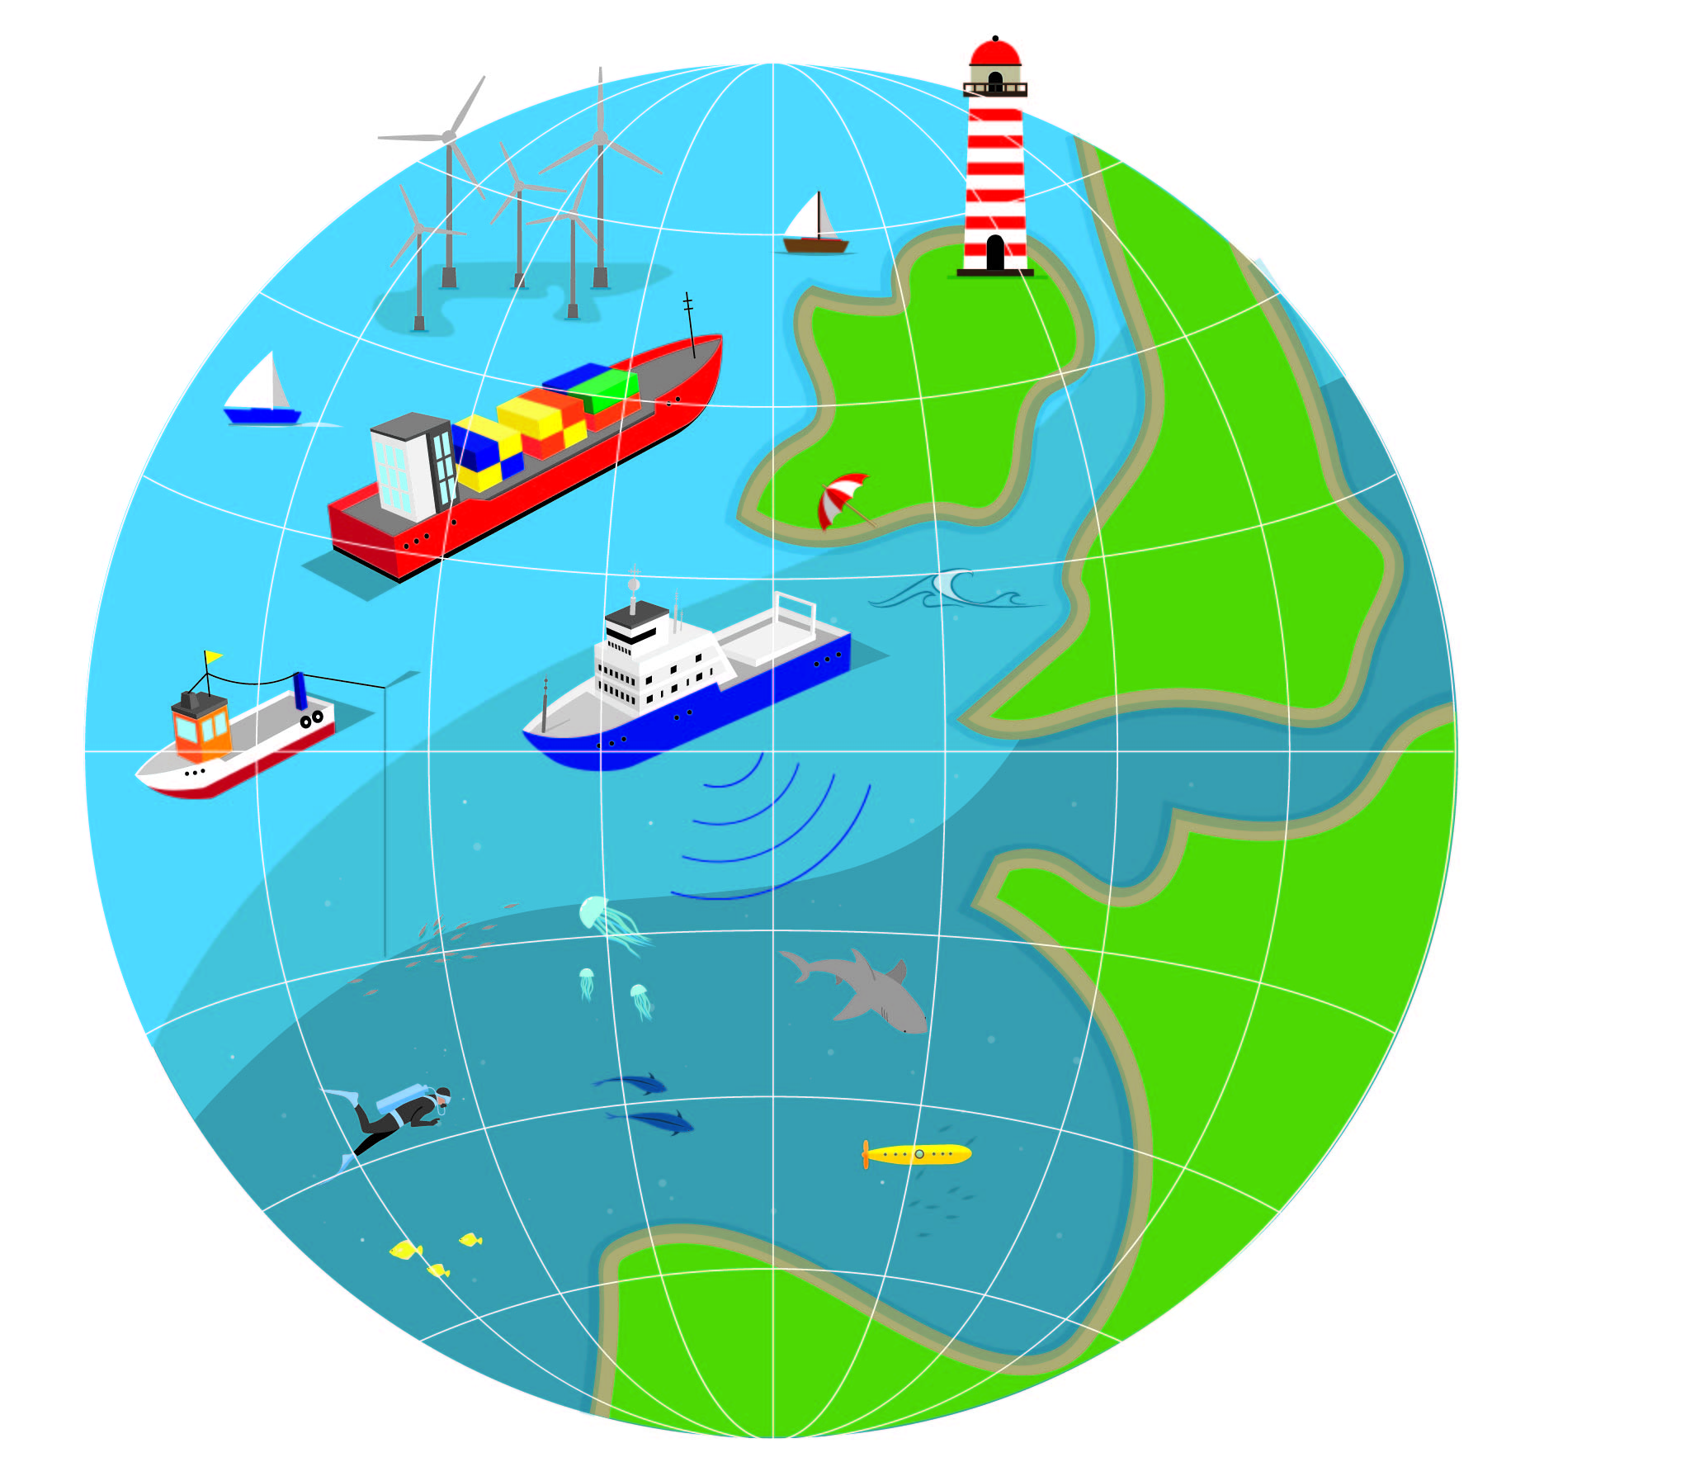
European Atlas of the Seas
www.european-atlas-of-the-seas.eu
Open presentation mode
Answer the question.
Did you get it right?
No
Yes
Click on
the text and
try again
Look at the map and move to the next slide

Slide 2
Climate
Sea level is rising as a result of ocean heating and land ice mass loss.
By how much does the sea level rise per year (1993 -2019 trend)?
3,3 mm
50 mm
30 cm

Slide 3
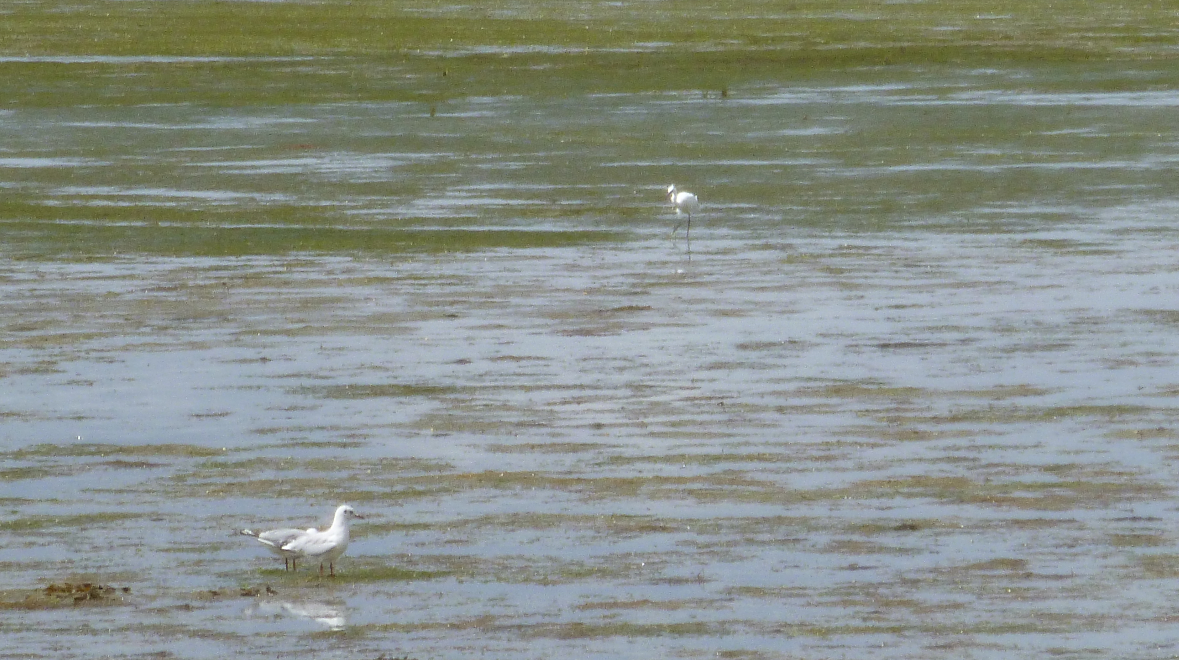
That is not the answer... Let’s try again!
www.european-atlas-of-the-seas.eu

Slide 4
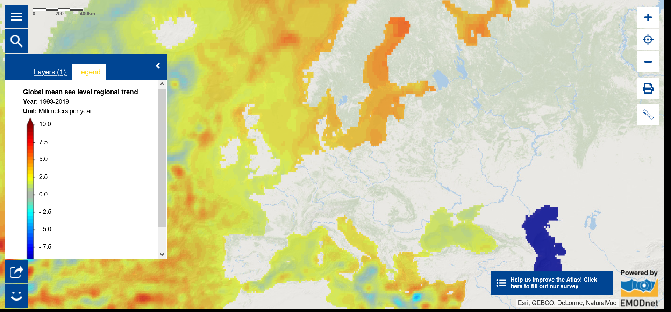
Climate: 3,3 mm per year

Slide 5
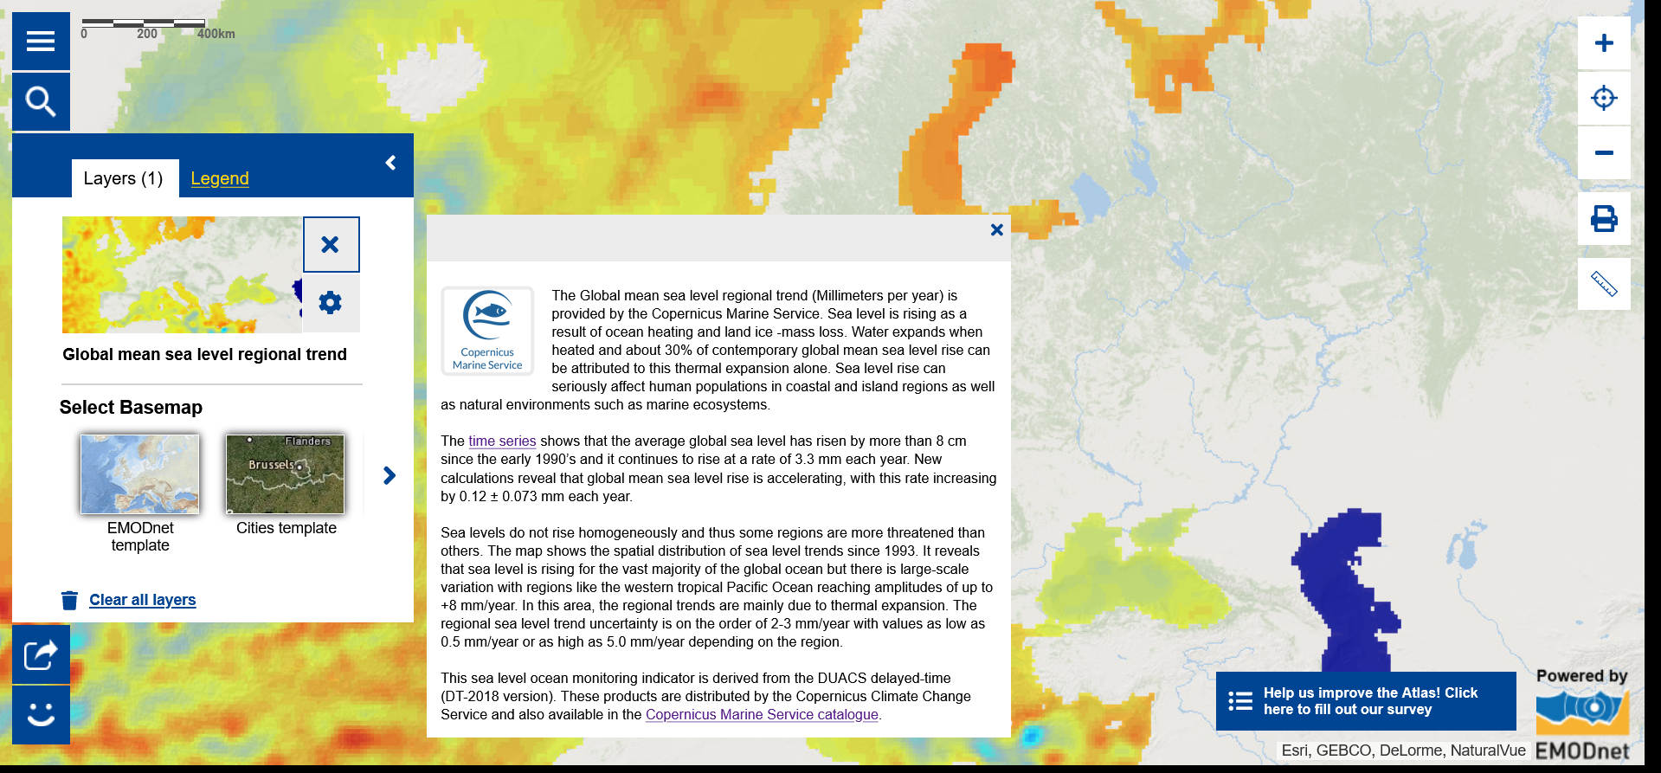
Climate: 3,3 mm per year

Slide 6
Mean underwater depth
What is the greatest depth on the European map showing mean underwater depth?
1,000 m
6,000 m
11,000 m

Slide 7
That is not the answer... Let’s try again!
www.european-atlas-of-the-seas.eu

Slide 8
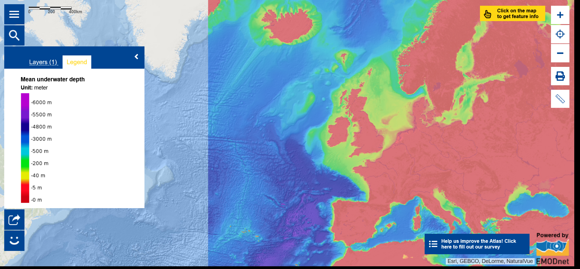
Underwater depth: 6,000 m

Slide 9
Underwater depth in the world...
The estimate of the average depth of the ocean basins is 3,682 m.
The deepest known spot on the planet is Challenger Deep in the Mariana Trench, east of the Philippines, at 11,034 m.
(Bron: https://oceanliteracy.unesco.org/how-deep-is-the-ocean/)

Slide 10
Marine litter
In 2019, a beach cleaning event was organised in Blankenberge (Belgium). How much waste was collected?
300 kg
5,000 kg
9,000 kg

Slide 11
That is not the answer... Let’s try again!
www.european-atlas-of-the-seas.eu

Slide 12
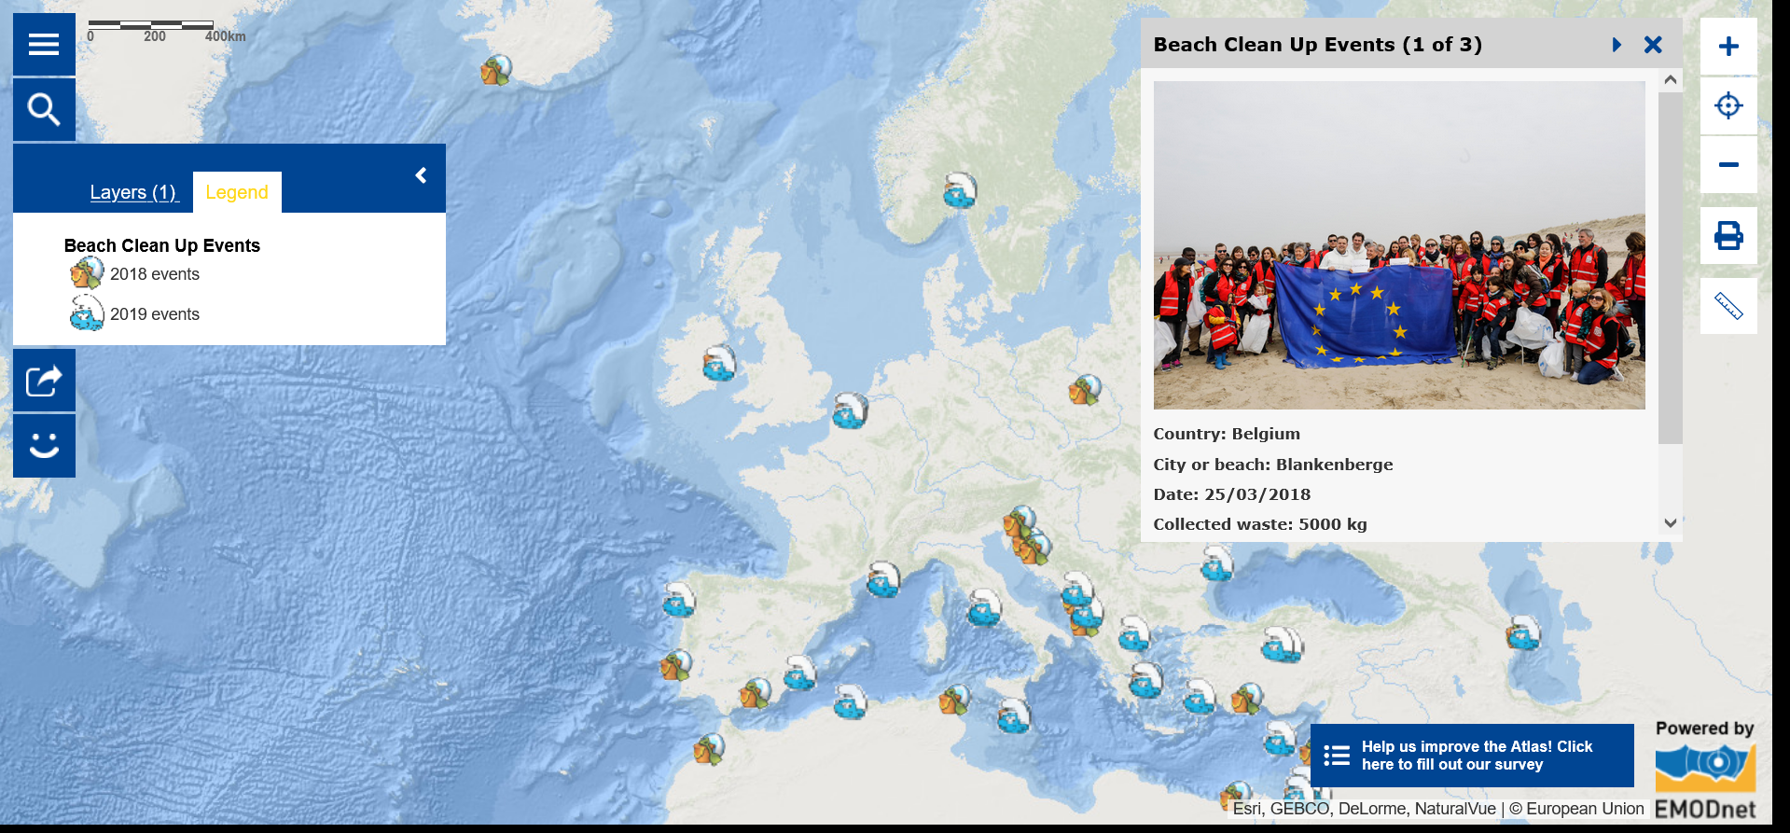
Marine litter: 5,000 kg

Slide 13
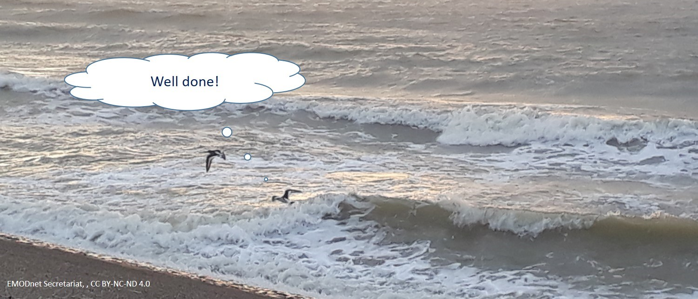
EMODnet Secretariat, , CC BY-NC-ND 4.0

