Slide 1
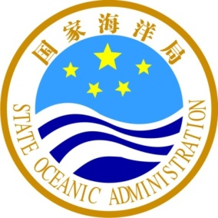
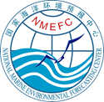
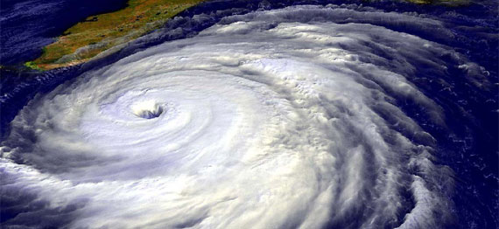
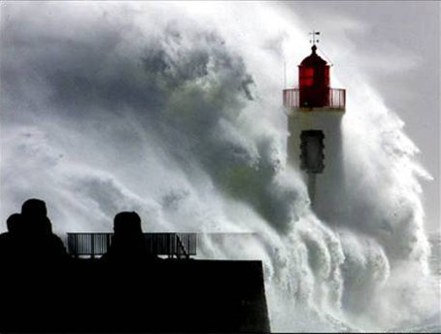

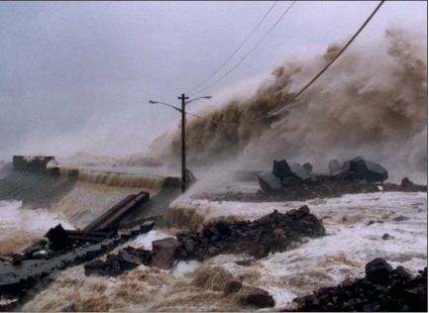

Operational ocean observation and forecasting services in China
Hui WANG
National Marine Environmental Forecasting Center (NMEFC), Beijing, China
1st June, 2017

Slide 2
Outlines
1. Marine Observing System in China
2. Marine Environment Forecasting and
Disaster Warning Service
3. Perspective of China-EU collaboration
Page

Slide 3
GOOS
GOOS Work Plan
•Improve the Strategic Mapping as vision for implementation of GOOS
•Framework for Ocean Observing processes
–Scientific oversight, network implementation and coordination, data management, evaluation
•Improving the capacity of GOOS Regional Alliances
•Energize and modernize GOOS through Projects
•Develop communications
SAON
Euro-GOOS
Black
Ses
GOOS
NEAR-GOOS
US-GOOS
MONGOOS
IOCARIBE-GOOS
SEAGOOS
PI-GOOS
GOOS-Africa
OCEATLAN
GRASP
IMOS
SOOS

Slide 4
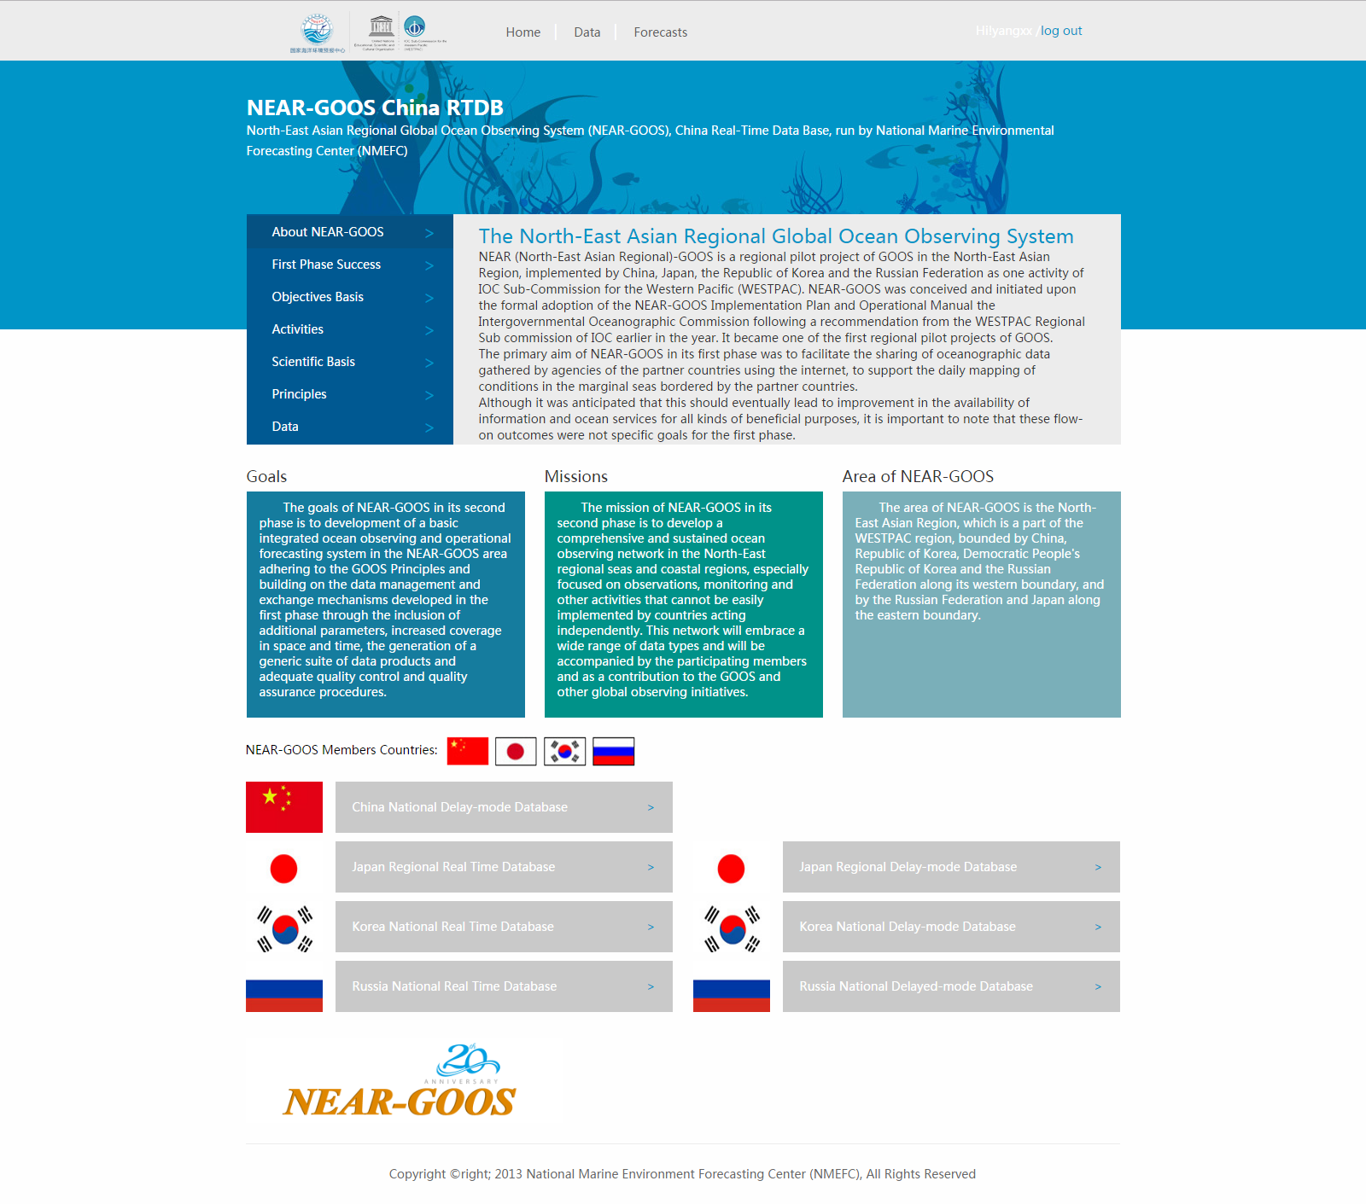
General Status of China RTDB for NEAR-GOOS
China Real Time Data Base (RTDB) is operated by National Marine Environmental Forecasting Center (NMEFC).
Start Time
Number of Visits
Data in RTDB available since September, 2013.
More than 1,600,000(PV)
Forecasting products
Time-window
Region: East China Sea and Northwest Pacific Ocean;
Products: numeric forecasts including wave, sea surface current, sea surface temperature and sea ice.
Recent 30 days
Authorised users
More than 50

Slide 5
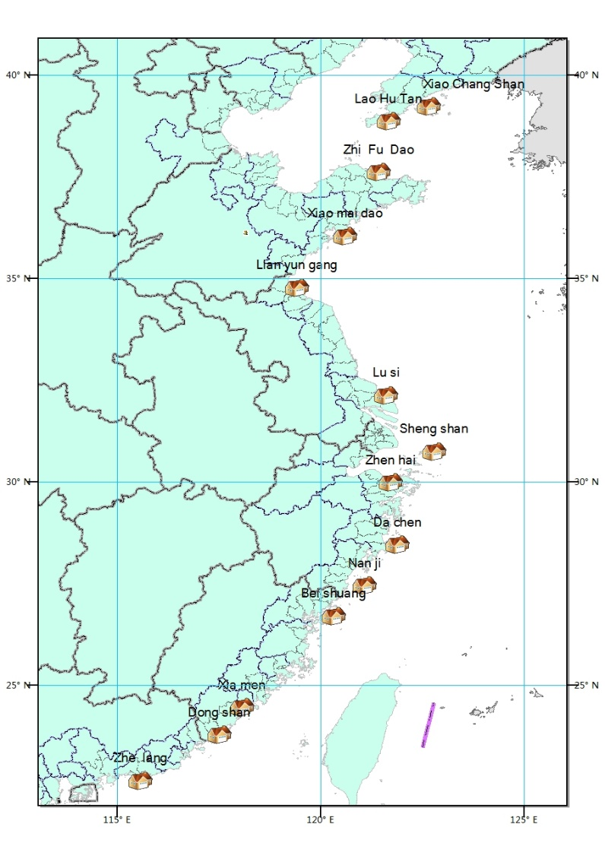
General Status of China RTDB for NEAR-GOOS
Station Distribution
Station database
Station Data
14 stations of SOA
Buoy Data
1 buoy of SOA
VOS Data
Regional voluntary observation ship

Slide 6
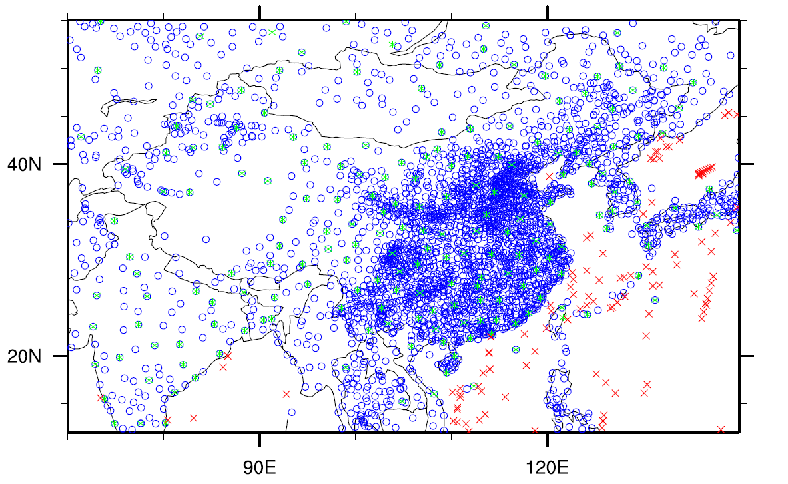
GTS
“GTS” is acquired in real time through fiber networks that is established by National Marine Environment Forecasting Center and National Meteorological Information Center . The NMEFC broadcasts information via VSAT
  Countries (including China) international exchange of observation data of upper air and surface
  Countries (including China) international exchange of Surface Meteorological Monthly Bulletin Data
  Countries (including China) international exchange of aviation observation data
  Countries (excluding China) international exchange of marine meteorological observation data ，
  Marine meteorological data of ship (buoy):the meteorological elements including temperature, air pressure, wind speed etc, and the marine elements include including SST, wave, section temperature, salinity and current etc.
  Facsimile chart and various alerts （ Cyclone, typhoon, tsunami ）
Distribution of GTS data in China
o：Surface weather observation
*：Radiosonde observation
x：Volunteer ship and buoy observation

Slide 7
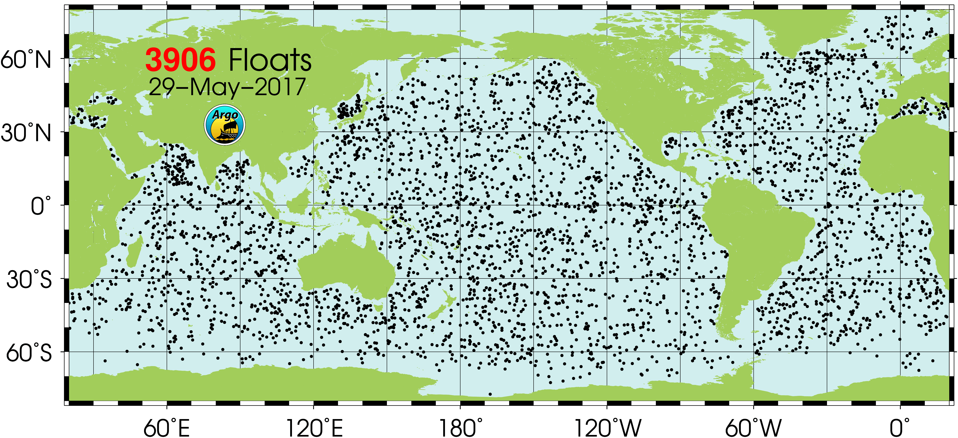
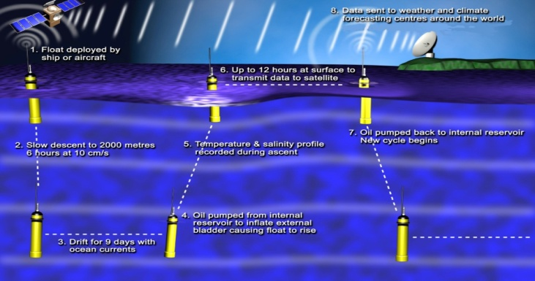
Global ：ARGO
Since 1998 more than 3000 Argo buoys have been deployed in the world oceans, measuring temperature and salinity profile more than 2000 meters deep.
China has participated in the Argo program, so far 376 profiling floats have been laid （ According to The China Argo Center ）

Slide 8
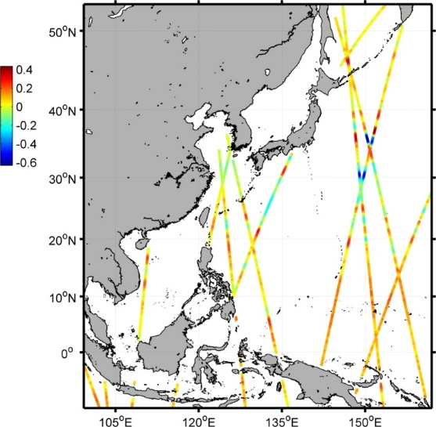
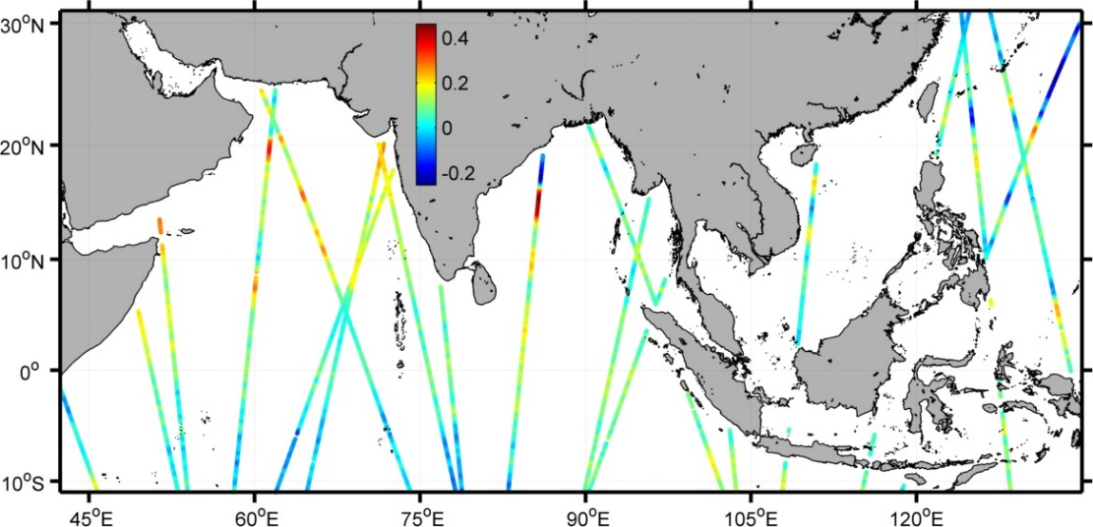
Satellite remote sensing data
Our forecasting Center has obtained CLS satellite data since 2010, covering the Pacific northwest and the India ocean, with a resolution of 7 km
Pacific northwest 99°-161°E
10°S-53°N
The Indian Ocean
42.5°-135°E
10°S -31°N
Date in Figure ：May 22, 2017
Sea level anomaly data along the rail
Notes:
Cls那张ppt改成卫星遥感数据，
我中心自2010年起，获取CLS卫星数据，区域覆盖西北太平洋和印度洋，分辨率7公里。

Slide 9
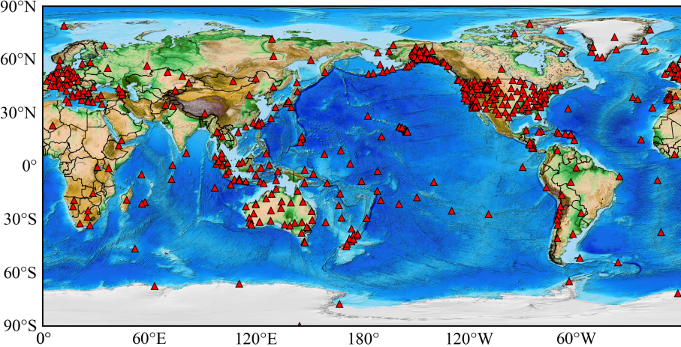
Global ： Global Seismic Networks （GSN）
Obtain 540 global seismic network data in real time through the Internet

Slide 10
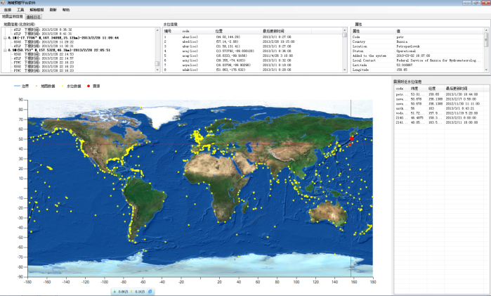
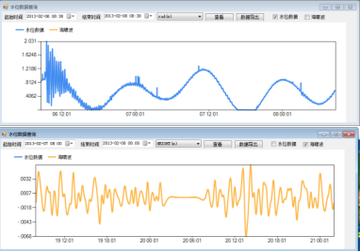
Global ：IOC-GLOSS Global Sea Level Observing System
Tidal stations ：853
Tsunami buoy ：59

Slide 11
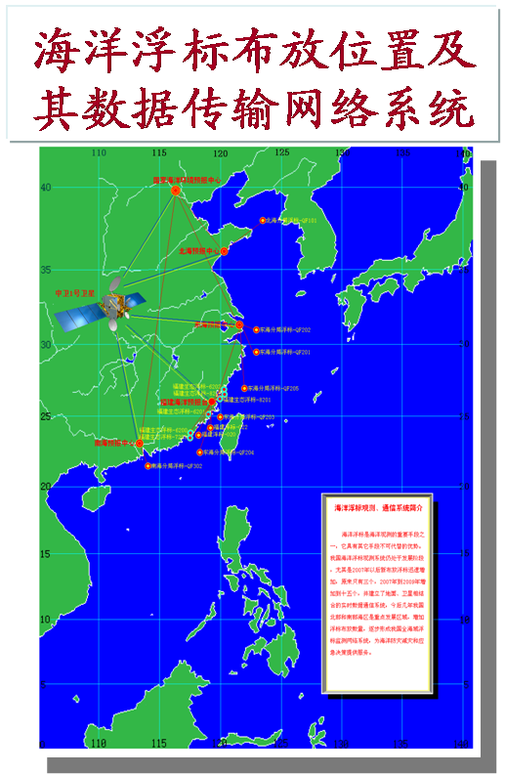
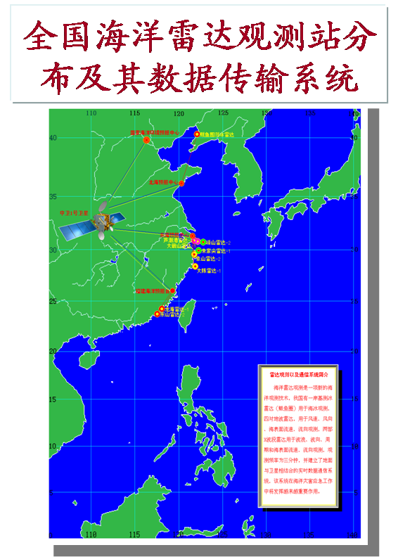
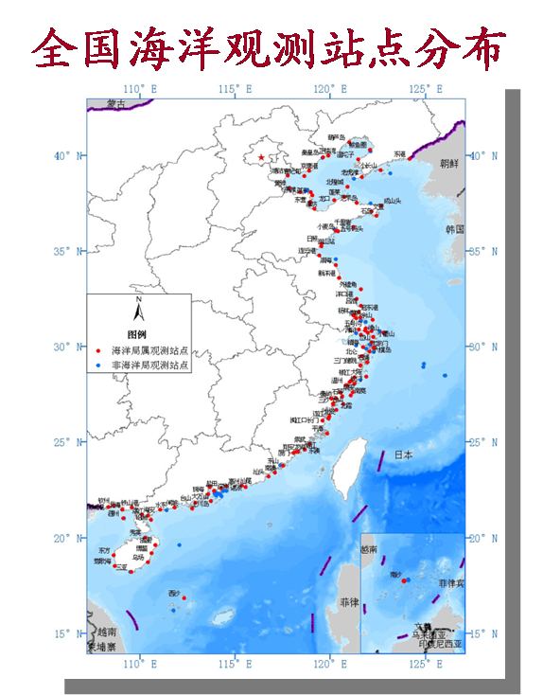
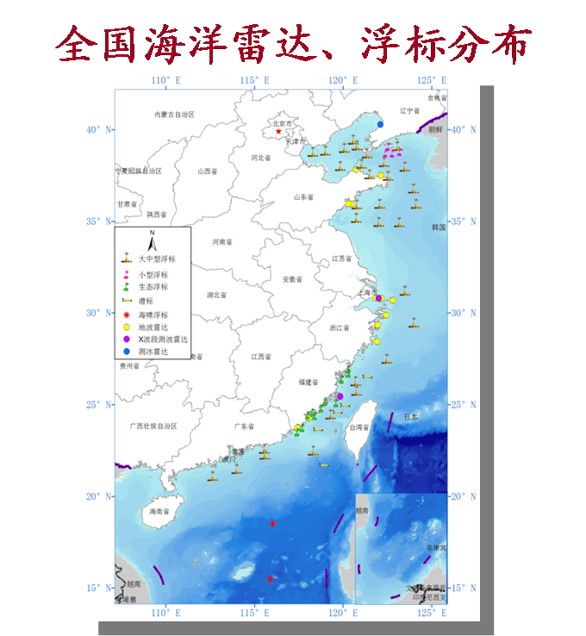
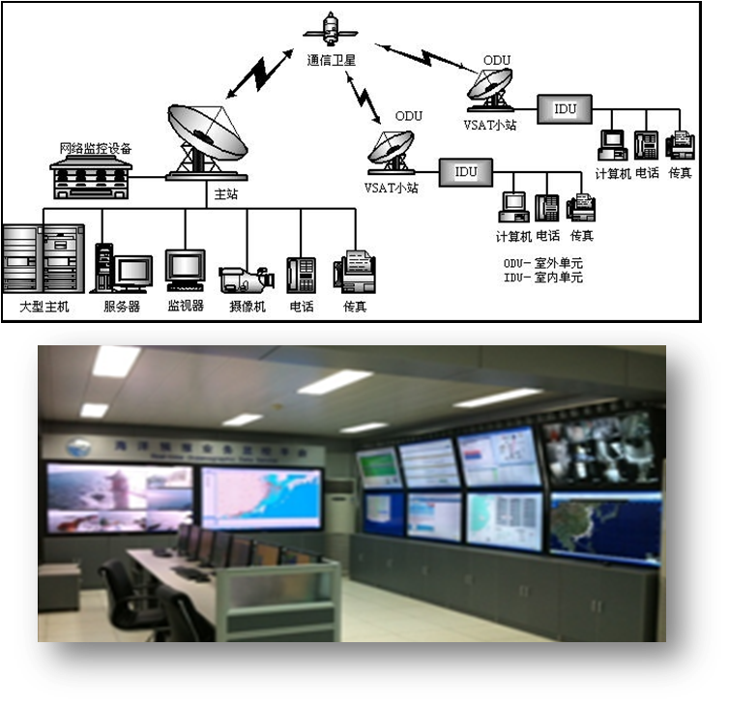
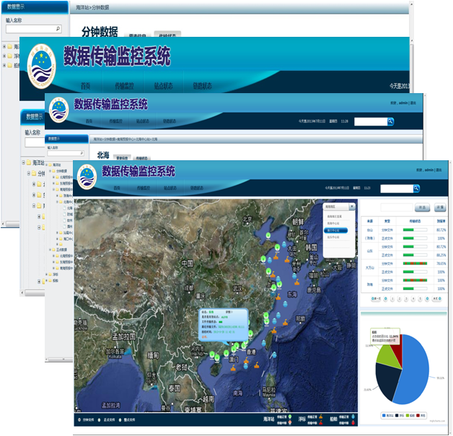
Marine environment observation of SOA
Real-time observation
Real-time transmission
Real-time monitoring
At present：
Ocean Station ：155
Buoy +3m buoy ：69
Ground wave radar ：7 groups
X-band Rada ：25
Hydrological data ：57sites
Seismic Station ：79， 25 of the Seismic Stations belong to SOA,the others sharing with Seismological Burea
Shared real-time data with Chinese Academy of Sciences, Ministry of Water Resources, Seismological Burea etc.
The onshore data is real-time transmission Mainly through the line and VSAT
The offshore data via satellite implement real-time transmission
The onshore data basically actualize real-time transmission and monitoring in minute timescal

Slide 12
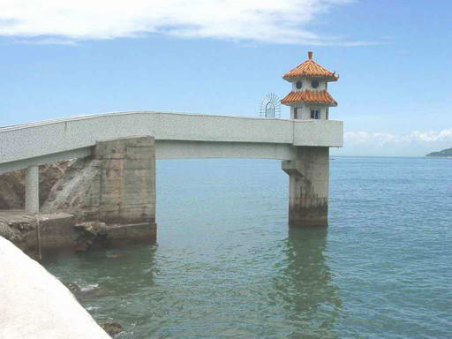
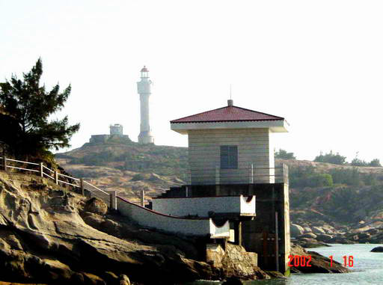
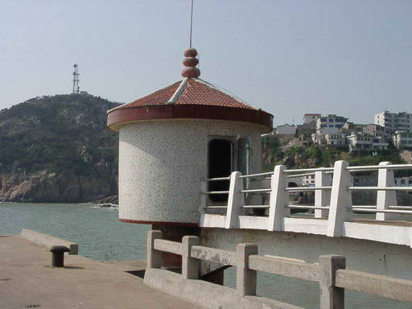
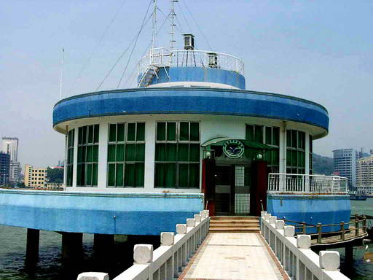
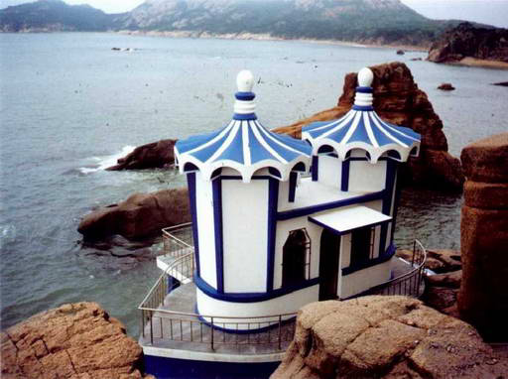
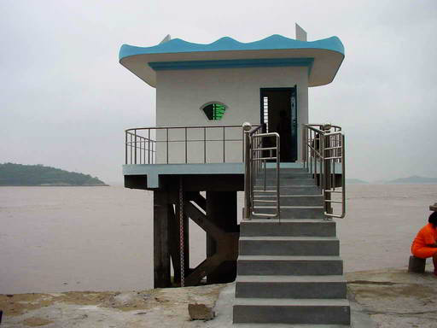
Marine Observation: Coastal observing stations
Real-time monitoring of seawater temperature, salinity, tide, wave, GPS, meteorology, marine chemistry, etc
Yun’ao
Zhelang
Shengshan
Xiamen
Chengshantou
Daishan
Page
Page

Slide 13
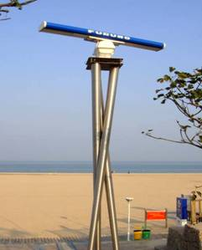
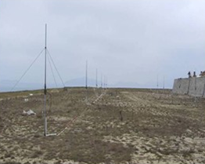
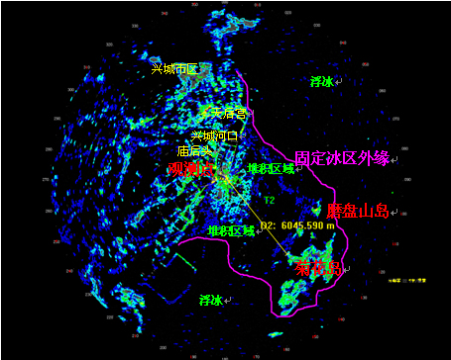
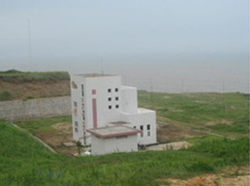
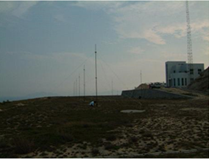
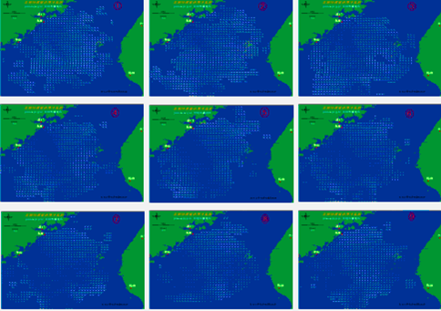
Marine Observation: Radars
Variety of radars for sea ice monitoring, wave observation, ocean surface current, etc..
Wave radar
HF ground wave radar
Ice regime
Longhai radar station
Dongshan radar station
Application
Page

Slide 14
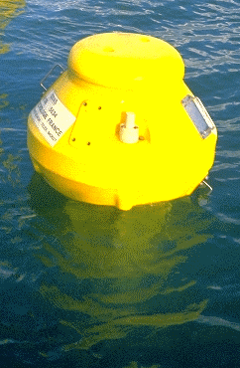
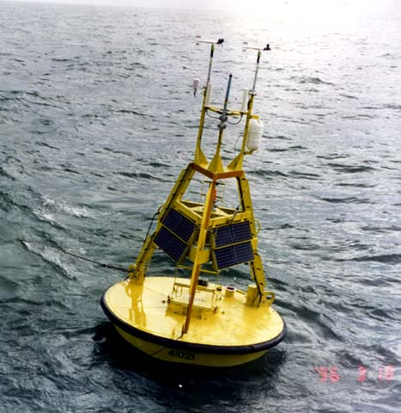
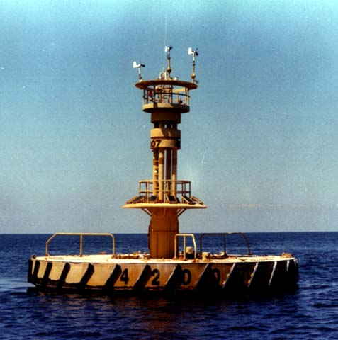
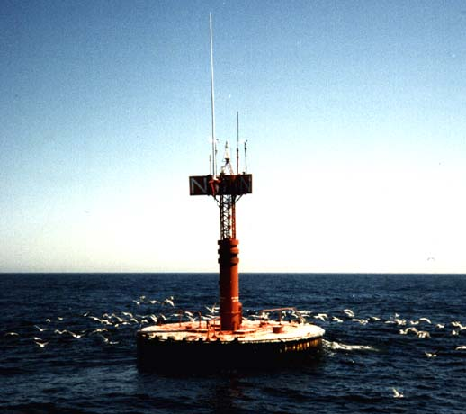
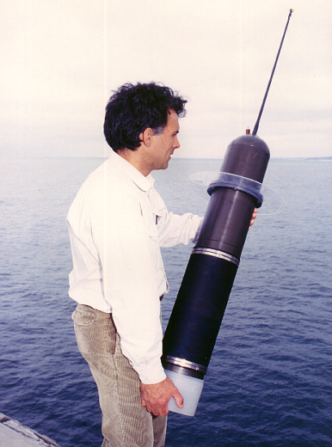
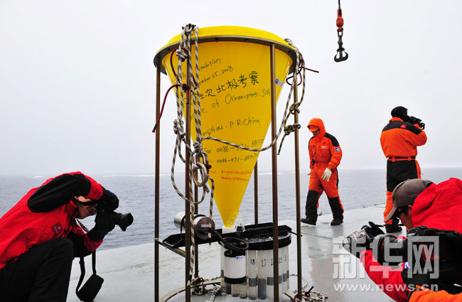
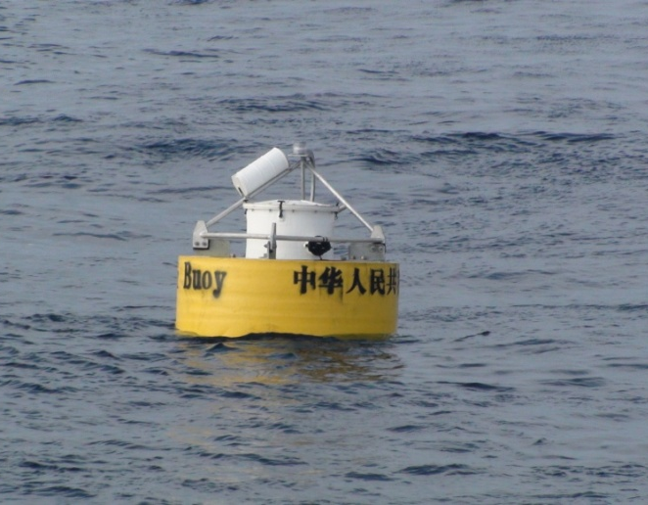
Marine Observation: Buoys
Variety of buoys for meteorological parameter, current, wave, temp., tsunami monitoring, etc..
Argo
Tsunami buoy
Page

Slide 15
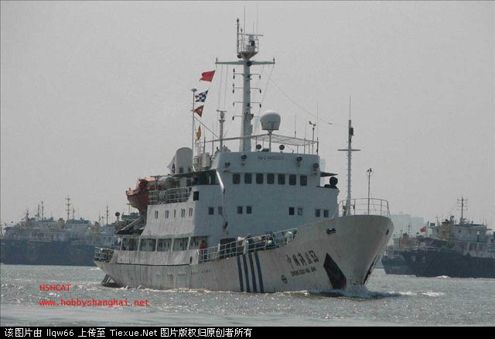
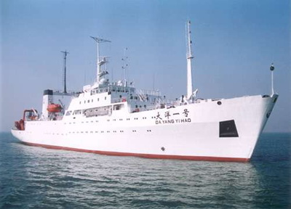
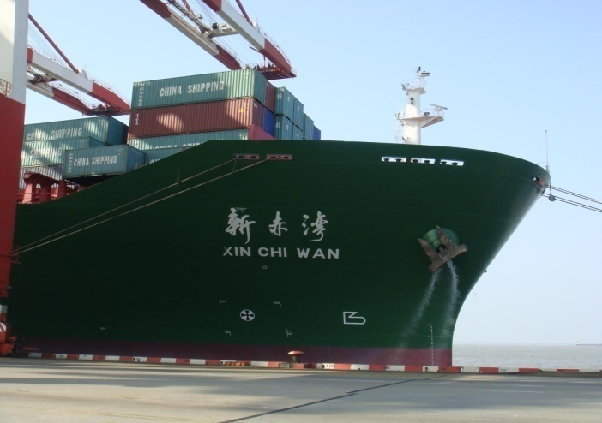
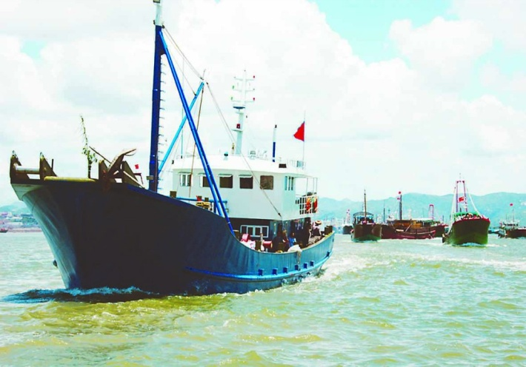
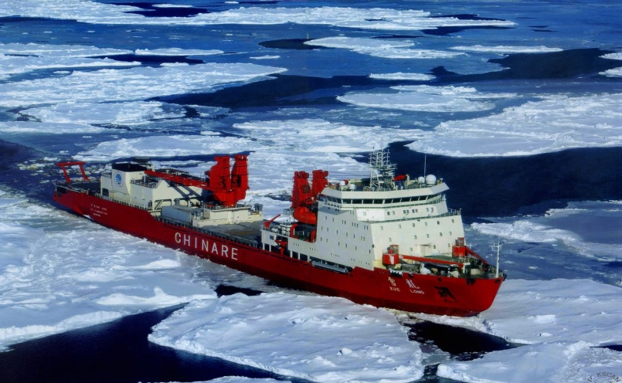
Marine Observation: Ship Observations
  SOA Official Research Vessel
Operational ship observations
  Voluntary Observation Ships
  - Commercial ships, fishing vessels
  Marine Section Observations
  - Official research vessels of SOA
Scientific expedition ships
  Antarctic and Arctic exploration: Xuelong
  World wide ocean expedition:
  Ocean No. 1
  ……
Ocean No. 1
Commercial Ship
Fishing Vessel
  Xuelong
国 家 海 洋 局
State Oceanic Administration
Page
SOT-VI, 11 - 15 April 2011, Hobart, Australia
November 2011, Beijing

Slide 16


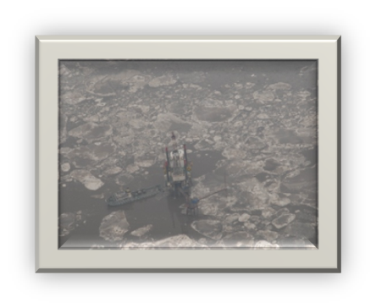

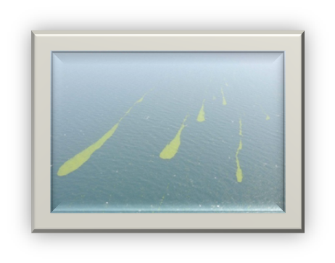
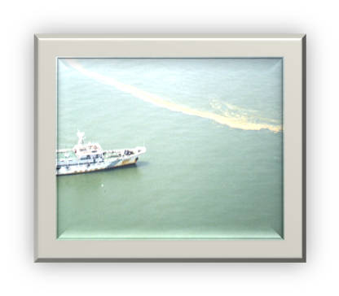
Marine Observation: Remote Sensing
CMS areoplanes are used for sea ice, red tide, oil spill monitoring, and emergency surveillance.
……
Sea ice
Harmful bloom
Green tide
Oil spill
Page

Slide 17
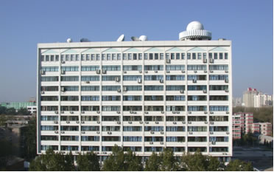
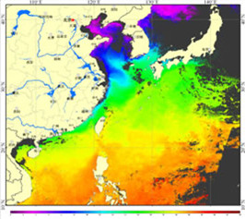







Marine Observation: Satellite
HY-1
Data
Analysis
HY-2
Satellite
Ground station
Application
Page

Slide 18






Global Integrated Observation System Program in China
Notes:
尚属于规划布局阶段，观测系统尚未建设完成

Slide 19
Outlines
1. Marine Observing System in China
2. Marine Environment Forecasting and
Disaster Warning Service
3. Perspective of China-EU collaboration
Page

Slide 20
Marine Forecasting System: Organizational structure
National Marine Environmental Forecasting Center (NMEFC, SOA)
1 National Forecasting Centers
The North China Sea
Forecasting Center
The East China Sea
Forecasting Center
The South China Sea
Forecasting Center
3 Regional Forecasting Centers
Jiangsu Province
Zhejiang Provincer
Liaoning Provice
Shanghai City
Guangdong Province
Hainan Province
Tianjin City
Guangxi Province
Fujian Province
Shangdong Province
Hebei Province
11 City-level Forecasting Centers
Page

Slide 21





Marine forecasting services
Ocean wave
Storm surge
Tsunami
Sea ice
Temperature and currents
Forecasts for Search and Rescue
Public forecasts
For Fishery
ENSO prediction & climate prediction
Sea route forecasting for polar exploration
Page

Slide 22




Refined Forecasts in China Coastal Zone
Storm Surge
  Resolution ~ 50 m, dam resolved
  Waves offshore and flood considered
  Application in Fujian, zhejiang ….

Slide 23



Refined Forecasts in China Coastal Zone
Data assimilation on Waves
  Combine radar altimeter(wave) and microwave scatter (wind) = narrow wave band + validated wide wave band derived from wind.
  Application in Northwest Pacific

Slide 24




Refined Forecasts in China Coastal Zone
Tsunami Warning
  High resolution operational system.
  High performance parallel tsunami model.
    More than 20 times faster than previous version.
    Release Warning within 2~5min all over Pacific and SCS
100KM
2KM

Slide 25

Marine forecasting services: Sea ice
Page
November 2011, Beijing

Slide 26

Chinese Global operational Oceanography Forecasting
System(CGOFS v1.0) and extended forecast system
Global Oceanography Forecasts:
  Level 1: Global Ocean
  Level 2:
    Northwest Pacific and
    Indian Ocean
  Level 3:
    Bo-Yellow-East China Sea and South China Sea
  Level 4: Polar Region
Refined forecasts:
  China Coastal Zone
Ecological Forecasts:
  Level 1: Northwest Pacific
  Level 2: East and South China sea
Climate Prediction:
  Level 1: Global
  Level 2: Asia & Northwest Pacific

Slide 27







Global Forecast Products of CGOFS
Surface Wind
Temperature
Polar ice
Wave
Tide
Current

Slide 28




Developing Progress
(1) Global 1/12°High Resolution Forecasting System
Code
-- NEMO v3.6
Grid
-- ORCA tri-polar grid, 1/12°at equator
-- cyclic east-west and north fold with T-point pivot
Bathymetry and coordinate
-- from Mercator Ocean bathymetry_ORCA12_V3.5，provided by Romain Bourdalle Badie
Horizontal resolution
– 4322 x 3059 horizontal grid points
– Grid spacing from 10 km at equator down to 3 km at high latitudes
Vertical grid
– 75 levels, with a resolution of 1m near the surface and 200m in the deep ocean，0-5900m
Notes:
将全面提升海洋上层混合、内部混合等主要海洋混合过程的理论创新水平；建立我国自主的、新一代全球业务化海洋学预报系统，水平分辨率由原来的25km 左右，提升到10km，实现对海洋中尺度过程的稳定识别，

Slide 29




Developing Progress
(1) Global 1/12°High Resolution Forecasting System
Global Oceanography Forecast System v2.0
  Develop ocean mixing parameter schemes on internal oscillation, diurnal process and so on.
  10km global currents (LiCOM, FIO-COM,PCOM), wave (WWIII, UMWM), tide (Hohai, FVCOM) multi-model forecast system.

Slide 30




Developing Progress
(2) Polar forecasting service
Arctic Antarctic
  Polar WRF model (30-10-3km)
d03
d02
  MITgcm ice-ocean model (4km)
  EnKF ice-ocean data assimilation (in research)
Notes:
Based on our numerical forecasts and available satellite images, we offer Arctic and Antarctic forecasting service for the Chinese Arctic and Antarctic scientific expeditions, and the Chinese Arctic commercial cruises. In particular, in summer 2016, there are 6 Chinese commercial Arctic cruises passing through the Arctic Passage, NMEFC provided successful sea ice, weather and ocean wave services for all the ships.
We run the Arctic and Antarctic numerical weather and sea ice forecasts. For the weather forecasts, we use the Polar WRF model and the Nudging data assimilation. For the sea ice-ocean operational forecasts, we use the MITgcm ice-ocean model and the nudging scheme to assimilate the sea ice concentration. A new EnKF based ice-ocean data assimilation scheme is under development, and the preliminary results show large improvement in the sea ice concentration and thickness forecasts.

Slide 31






Developing Progress
(2) Polar forecasting service
YONG SHENG- General Cargo Ship
2013, 1st experiment voyage cross Arctic.
2015, two-way navigating
2016, 5 merchant ships cross Arctic
Notes:
Based on our numerical forecasts and available satellite images, we offer Arctic and Antarctic forecasting service for the Chinese Arctic and Antarctic scientific expeditions, and the Chinese Arctic commercial cruises. In particular, in summer 2016, there are 6 Chinese commercial Arctic cruises passing through the Arctic Passage, NMEFC provided successful sea ice, weather and ocean wave services for all the ships.
We run the Arctic and Antarctic numerical weather and sea ice forecasts. For the weather forecasts, we use the Polar WRF model and the Nudging data assimilation. For the sea ice-ocean operational forecasts, we use the MITgcm ice-ocean model and the nudging scheme to assimilate the sea ice concentration. A new EnKF based ice-ocean data assimilation scheme is under development, and the preliminary results show large improvement in the sea ice concentration and thickness forecasts.

Slide 32



Developing Progress
(3) Climate Prediction
CESM coupled model
forecast time：12 months
forecast range：global
time resolution：monthly
spatial resolution：0.9×1.25_gx1v6
Notes:
A coupled global climate model CESM was used to predict the precipitation and temperature over China, as well as the SST in China offshore and in the east-central Pacific Ocean. The model configurations were displayed here. And these four pictures showed our model prediction results.

Slide 33



Developing Progress
(3) Climate Prediction
Ensemble Prediction
Couple Models:
  IAP-FGOALs
  IAP-ICM
  FIO-ESM
  NUIST Model
Notes:
A coupled global climate model CESM was used to predict the precipitation and temperature over China, as well as the SST in China offshore and in the east-central Pacific Ocean. The model configurations were displayed here. And these four pictures showed our model prediction results.

Slide 34


Release media for marine forecasts and warnings
Forecasting products are produced and disseminated to the public by:
TV programs covering the national and regional TV channels (CCTV, et al.)
Broadcasting programs (CCBS)
Website
Micro blog
Newspaper
LCD in the fishery ports or beach
Forecasts and Warnings are disseminated to the governments and relative departments by:
Digital fax using parallel tech.
Short messages
Telephone
Page

Slide 35


National Marine Forecasting Video Consultation System
National marine forecasting center
3 regional forecasting centers
11 provincial marine forecasting centers
Several city-level forecasting centers
are inter-connected to establish the National Marine Forecasting Video Consultation System
Page

Slide 36
Future development prospect of marine forecasting work
Target oriented comprehensive forecast & support
Service mode
Single factor forecasting
Global, deep-sea and important marine passages
Service scope
Nearshore
Environmental oceanography and ecological oceanography
Service field
Physical oceanography
Page

Slide 37
Outlines
1. Marine Observing System in China
2. Marine Environment Forecasting and
Disaster Warning Service
3. Perspective of China-EU collaboration
Page

Slide 38



China-Italy cooperation
2nd Scientific Workshop
Shanghai
4th China-Italy Collaboration Workshop
Memorandum of Agreement
Guangzhou
6th China-Italy Collaboration Workshop
Hangzhou
2017
2009
2010
2012
2013
2014
2015
Memorandum of Agreement
1st China-Italy Collaboration Workshop
Bologna
3rd China-Italy Collaboration Workshop
Venice
5th China-Italy Collaboration Workshop
Lecce
7th China-Italy Collaboration Workshop
Rome
Notes:
We should promote cooperation in the connectivity of energy infrastructure, work in concert to ensure the security of oil and gas pipelines and other transport routes, build cross-border power supply networks and power-transmission routes, and cooperate in regional power grid upgrading and transformation. ➢ We should increase cooperation in the exploration and development of coal, oil, gas, and other conventional energy sources; advance cooperation in hydropower, nuclear power, wind power, solar power and other clean, renewable energy sources; and promote cooperation in the processing and conversion of energy and resources at or near places where they are exploited, so as to create an integrated industrial chain of energy and resource cooperation. We should enhance cooperation in deep-processing technology, equipment and engineering services in the fields of energy and resources.

Slide 39


China-FMI/Finland Cooperation
Joint research on sea ice since 1990s;
Sea ice/weather observation and numerical modelling;
Signed MoU on 2012, and will renew in June 2017;
Two scientists are visiting in FMI;
Chinese-Finnish joint polar prediction workshop (2012, 2014, 2017)

Slide 40


China-AWI/Germany Cooperation
Joint research on sea ice-ocean data assimilation and forecast;
Also cooperation in the framework of WMO Polar Prediction Project (PPP);
Signed MoU on 2014;
Regular bi-visiting between AWI and NMEFC;
BMBF-SOA Project: A high resolution Arctic sea ice-ocean coupled modeling and forecasting system (2014-2017);
DFG-NSFC 2017 Proposal: Ensemble based sea ice-ocean multivariate data assimilation: Towards a better Arctic sea ice prediction (IODAPP)

Slide 41


China-Norway Cooperation
Joint research on sea ice-ocean numerical modelling and observations;
Official Partner of EU project INTAROS – Integrated Arctic Observation System (2016-2021; Lead by NERSC Norway) ;
Will sign MoU on polar prediction with Met Norway in November 2017;

Slide 42


China-France cooperation
Signing Ceremony For Memorandum of Understanding between NMEFC and Mercator Océan in October 2014. This opened the normalization of our bilateral international cooperation and talent exchange on operational oceanography for the South China Sea and global ocean.
“The 1st French-China joint workshop on operational oceanography” is held in Toulouse in November 2015, mainly focusing on the development and application of ROMS-based high resolution numerical forecasting system in the South China Sea and a NEMO-based high resolution forecasting system in the global domain to discuss.
The 2nd China-France Joint Workshop on Operational Oceanography for the South China Sea will be held in Hangzhou China in June, 2017. It aims to improve the forecast service capacity and the quality of the numerical analysis and prediction for the regional sea and global ocean.

Slide 43

Future perspective of China-EU collaboration
National policy -- One Belt, One Road Initiative
“One Belt One Road” (OBOR) is an initiative, which was launched by President Xi Jinping in 2013, to focus on improving and creating new trading routes, links and business opportunities with China, passing through over 60 countries along the way, across Asia, Europe, the Middle East and Africa.
• One Belt: The Silk Road Economic Belt
Enhancing and developing land routes:
• Building a “Eurasian land ridge”
• Developing a number of economic corridors
• One Road: The 21st Century Maritime Silk Road
o Coastal China—South China Sea—Indian Ocean—Europe
o Coastal China—South China Sea—South Pacific
▬▬ Silk Road Economic Belt
▬▬ 21st Century Maritime Silk Road
Source: A role for UK companies in developing China’s new initiative
Notes:
One Belt, One Road ：development strategy and framework, proposed by Chinese paramount leader Xi Jinping that focuses on connectivity and cooperation among countries primarily between the People's Republic of China and the rest of Eurasia
It has two main elements:
Together, the countries along the Belt and Road will create an “economic cooperation area” that stretches from the Western Pacific to the Baltic Sea.
: The 21st Century Maritime Silk Road is a sea route rather than a road (a
reference to the old maritime Silk Road)
which runs west from China’s east coast
to Europe through the South China Sea
and the Indian Ocean.

Slide 44

21st Century Maritime Silk Road
The 21st-Century Maritime Silk Road – a sea route rather than a road
runs west from China’s east coast to Europe through the South China Sea and the Indian Ocean, and east into the South Pacific.
The aim of the sea route is to build efficient transport routes between major ports in various countries, including the development of an economic corridor through the Indian Ocean, better connecting China with South Asia, the Middle East, Africa and the Mediterranean.

Slide 45
Challenges and Prospects for Marine Forecasting
Enhanced economic dynamism
Geo-economics construct : trade and energy flows
Dependence on sea lanes
Economic prosperity intertwined with maritime affairs
Geostrategic construct : region characterized by continental and maritime powers
Regional waterways : strategic for merchant and naval shipping

Slide 46



User requirements
Fundamental Marine environmental and disaster pre-warning and forecasting system in China coastal area, Indian Ocean and Pacific Ocean and the Mediterranean
Special warning system and platform construction for Marine transport, Shipping routes, oil and gas and fisheries

Slide 47


User requirements
Marine environmental and marine weather forecasts for stakeholders , important strait and channels
The Straits of Malacca which connects the Pacific Ocean and the Indian Ocean is an important oceanic energy channel. It increases the importance to enhance our ability to protect the ocean, and to maintain the safety of important maritime energy transport corridors
Study on monsoon climate and environmental change
The monsoon system directly control China's drought and floods
Notes:
The Straits of Malacca which connects the Pacific Ocean and the Indian Ocean is an important oceanic energy channel. It increases the importance to enhance our ability to protect the ocean, and to maintain the safety of important maritime energy transport corridors
The South Asian monsoon, the Australian monsoon, the South China Sea monsoon, the northwest Pacific monsoon, and the subtropical monsoon in East Asia comes together

Slide 48


“One Road” ocean forecasting capability
Maritime Silk Road Environmental Service System
covers 28 offshore routes and 40 important ports
Special service website is on-line trial operation in early January 2017
realization of the domestic port, coastal route comprehensive forecast
forecast variables : wind, wind direction, wave height, wave direction and tide.
Forecast time: 24,48,72 hours
Notes:
专题服务网页于17年1月上旬上线试运行，基本实现了国内港口、近海航线综合预报产品在专题服务网页上的叠加显示：
预报要素包括风力、风向、浪高、浪向及潮汐水位，时效包含24、48、72小时，产品覆盖国内近海28条近海航线和26个重要港口。

Slide 49



Functions of the Service System
Real-time position dynamic overlay display function
Plan route setting function
Dynamic simulation of route trajectory function
Generate the wind / wave element time evolution curve on the route
C-map Electronic chart background map
Wind, wave, current forecast field dynamic display function
Wind and waves, tropical cyclone warning function
Notes:
实时船位的动态叠加显示功能
计划航线设置功能
动态模拟航线轨迹功能
一键生成航线上的风/浪要素时间演变曲线
C-map电子海图背景底图
风、浪、流预报场动态显示功能
大风大浪区、热带气旋警示功能

Slide 50
Promote cooperation in the 21st century Maritime Silk Road
Promote cooperation in providing marine environmental forecasting and marine disaster prevention and mitigation decision-making services for the countries along the 21st century Maritime Silk Road and provide technical support for national strategies.
Carry out research on monsoon climate and environmental change.
Develop marine emergency warning systems and products for important sea lanes, ports and stake areas.

Slide 51
Conclusion
Future research and cooperation priorities
1.Jointly develop the Marine Observation Network and Operational Oceanography Capability
. development of global/coastal ocean forecast systems
. intercomparison and validation；observing system
. climate change and prediction
2. Provide services for the countries along the 21st century Maritime Silk Road

Slide 52

Thank You!
国家海洋环境预报中心
NMEFC，SOA，CHINA
Page

