Slide 1
JERICO
A
Joint
European
Research
Infrastructure network
for Coastal
Observatories

Slide 2
  Towards a long-term and sustained European
  network of coastal observatories
EC umbrella (directives, policies, communications)
Marine Core Services (DG ENT / GMES)
Oceanic modelling
Coastal modelling
Coastal and shelf seas continuous in situ measurements
MY OCEAN
National/regional activities/projects
Rivers discharges
EURO ARGO (ESFRI)
Fisheries data
Social/commercial activities
EMSO (ESFRI)
EUROFLEETS (I3)
MY OCEAN
Marine data thematic centers
SEADATANET (I3) standards and web portal
WISE-Marine (DG ENV)
EMODNET (DG MARE)

Slide 3
MAIN OBJECTIVES
Enhance the coordination between existing coastal observatories
Propose common procedures from the sensor to the data quality assessment
Enlarge the network with new partners
Prepare for the future European Network of operational coastal observatories (OCO)

Slide 4
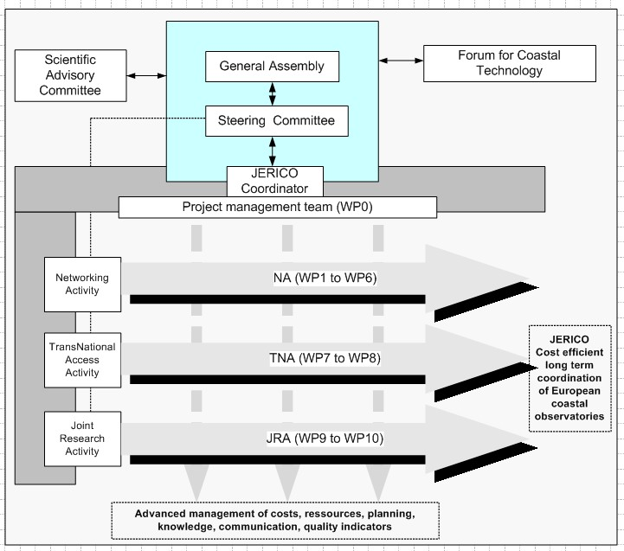
How the project is structured ?

Slide 5
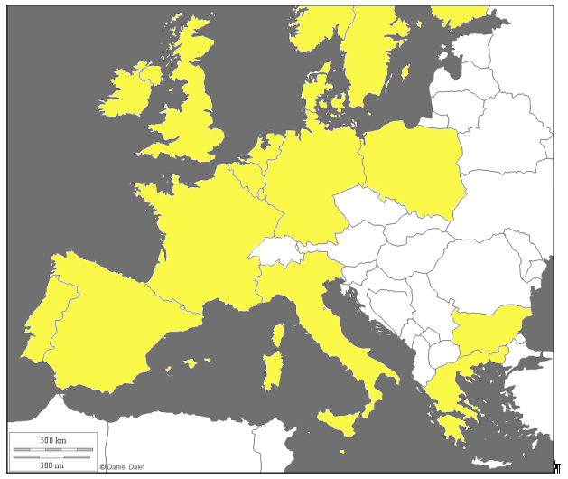
NIVA
IMR
SYKE
SMHI
MI
DMI
P
A
R
T
N
E
R
S
NERC
CEFAS
BL
DELTARES
NIOZ
IBWPAN
MUMM
HZG
INSU
IFREMER
OGS
INGV
CNR
CMCC
IH
AZTI
CSIC PdE
IO-BAS
UOM
HCMR

Slide 6
JERICO Context : A Vision
Prepare for the future European Network of operational coastal observatories both for research and societal expectations with:
  Better pan-European coordination
  Increased harmonisation of existing infrastructures
  Exchange of know-how and definition of Best Practices
  Promotion European OCO through TNA
  Agreed deployment strategy

Slide 7
WP1: Scientific coordination
  Patrick Farcy, Ifremer
    Coordinator of Jerico
  Pascal Morin, CNRS
    UPMC & IUEM – Roscoff
    Coordinator of the French coastal fleet committee
  Dominique Durand, NIVA
    Head of Dept. Oceanography and Remote Sensing
  Ingrid Puillat, Ifremer
    PhD in Oceanography
    Former deputy coordinator of ESONET/NOE

Slide 8
WP1: JERICO objectives
Define the rules for a better coordination at European level
Identify gaps in existing OCOs
Launching a European strategic view on OCO
Creating a JERICO label
Organizing a Forum for Coastal technology
Promote open access to JERICO network
Provide cross-regional integration and demonstration
Suggest a roadmap for a deployment strategy
Coordinating networking actions for optimal integration of knowledge and consensus

Slide 9
JERICO Networking activities (NA)
WP1 : A common strategy, including definition and implementation aspects
  WP coordinator INSU + Ifremer & NIVA
WP2 : Strengthening regional aspects
  ROOS aspects and inter regional interfaces
WP3 : Harmonizing technological aspects
  Observing systems : fixed station, ferrybox, gliders
WP4 : Harmonization operation and maintenance methods
  Fouling, calibration, quality control, maintenance and costs
WP5 : Data distribution (Seadatanet and MyOcean)
WP6 : Public outreach and education

Slide 10
JERICO TNA & JRA
WP7 : Service Access (SA) to the data
WP8 : Trans National Access
WP9 : OBSERVING SYSTEM DESIGN
  How to optimize the network : OSE, OSSE
WP10 : IMPROVE THE SYSTEM COMPONENTS
    monitoring of key biological compartments and processes .
    Developments and implementation on new platforms of physico-chemical sensors
    Emerging technology : profiler, ship of opportunity (Recopesca, CANOE)

Slide 11
SA OBJECTIVES
Provision of useful data coming from most of the Jerico partners
Compliant with SeaDataNet and MyOcean standards and requirements
+ 3 TOPs (Targeted Operation Periods)
  Multi parameters maps on monthly basis
  Data & demonstrative products from fishing vessel probes
  Collocated data from buoys and ferryboxes

Slide 12
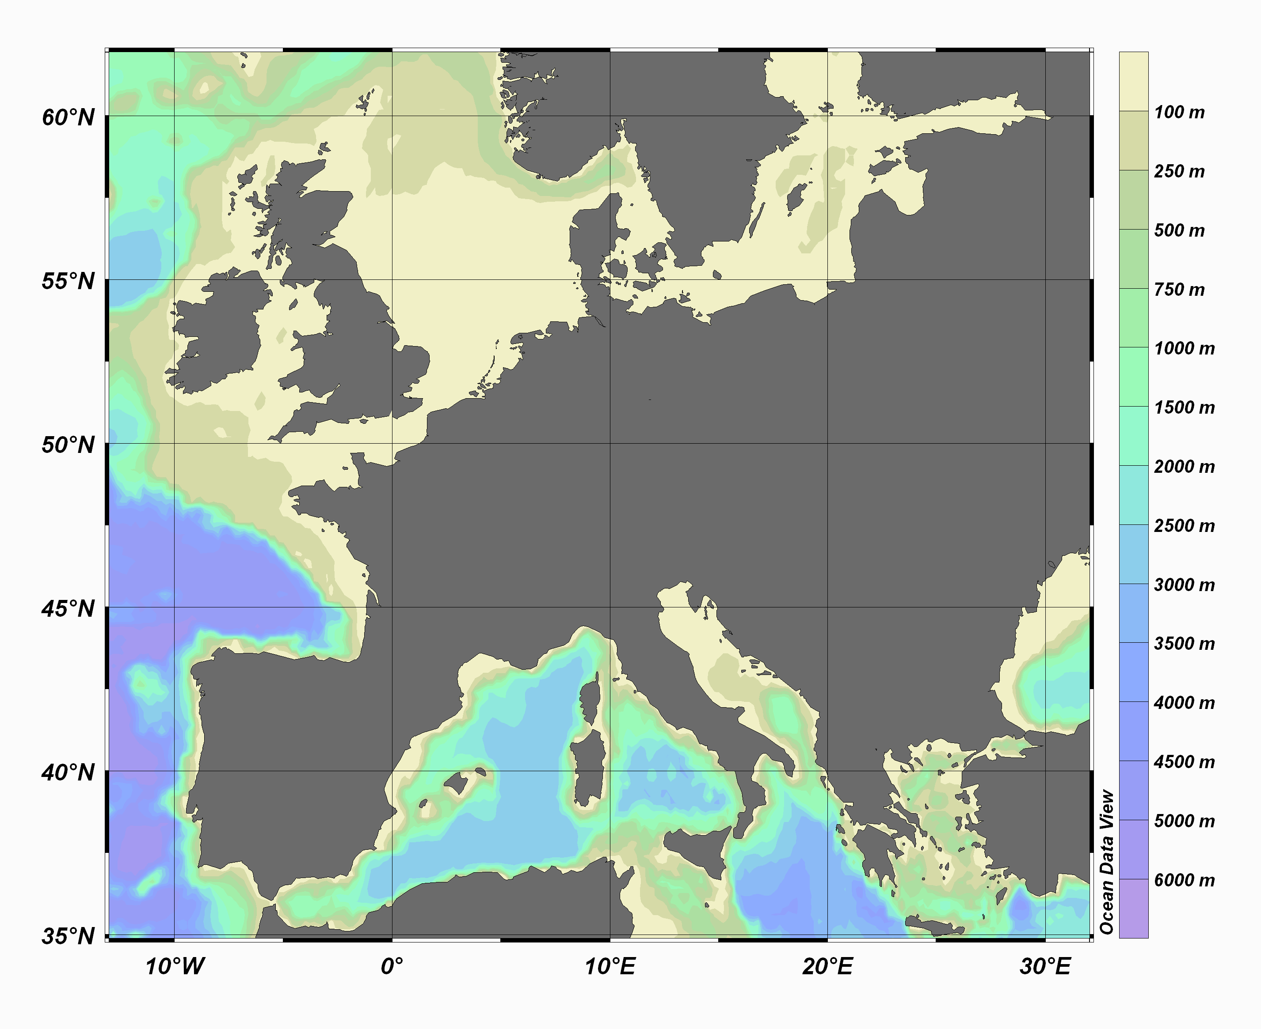
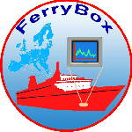

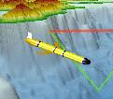

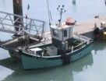
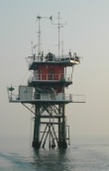

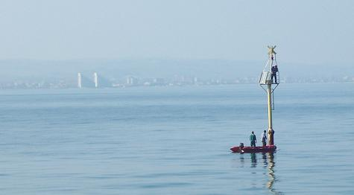
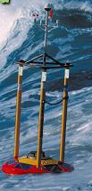
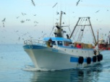
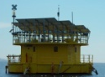
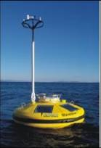

The Trans National Infrastructure Network
Fixed platforms
Ferrybox
Fishing vessels
Gliders

Slide 13
CONCLUSION :JERICO Ultimate goal
Roadmap for future implementation and deployment of OCOs in Europe
Through
  Harmonisation of strategies, technologies and methodologies
  Identification of gaps and plan for filling in gaps
  Accounting for new environmental, research and service requirements
  Accounting for new technologies

Slide 14
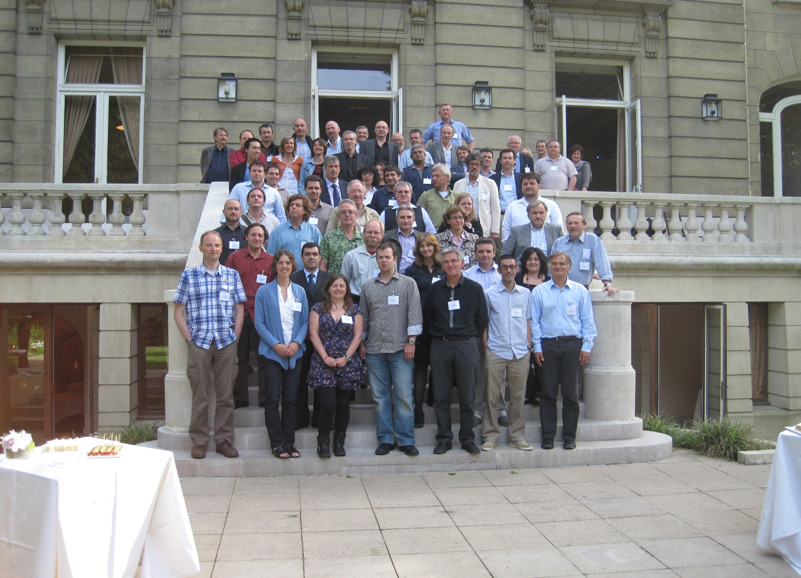
Thank You for your attention

