Slide 1


National Pilot Monitoring Study - Ukraine
EMBLAS II
Stakeholder Conference on Blue Economy in the Black Sea
15 September 2017
Batumi, Georgia
V. Komorin

Slide 2


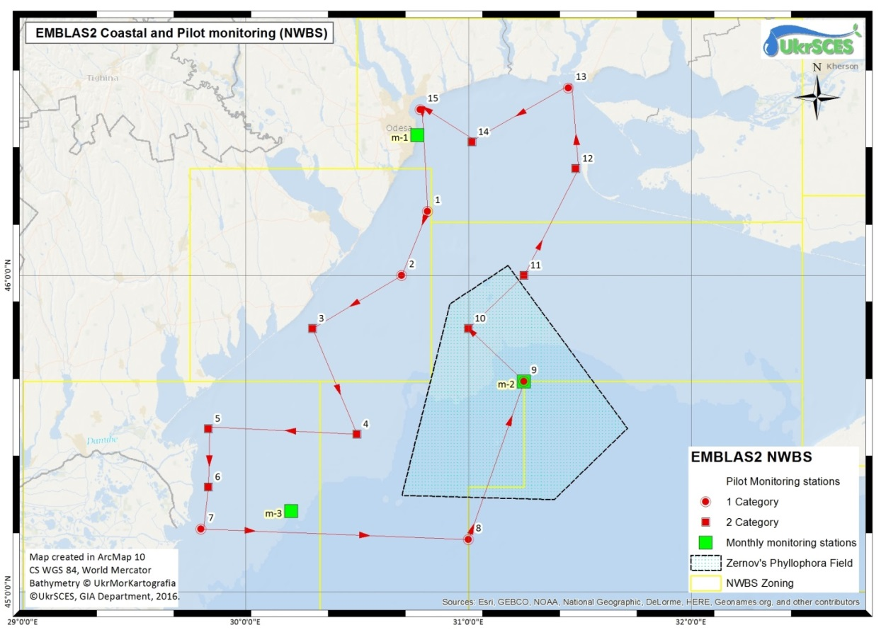
Environmental Monitoring in the Black Sea
The main objectives of the NPMS - UA
To develop methodological framework for marine monitoring in accordance with the MFSD and WFD;
To assess the current state of marine ecosystem in North-western Black Sea (NWBS) to making the initial assessment
To assess the seasonal dynamic of marine ecosystem on the ZPF to making the initial assessment
To build the Black Sea WQDB
To prepare a set of recommendations for GES of Black Sea

Slide 3
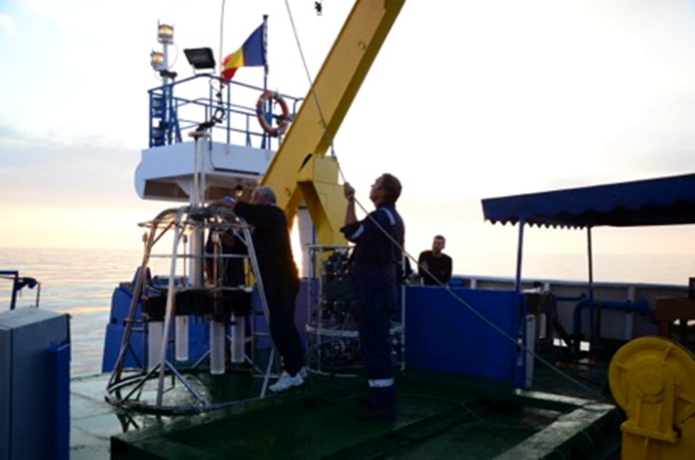
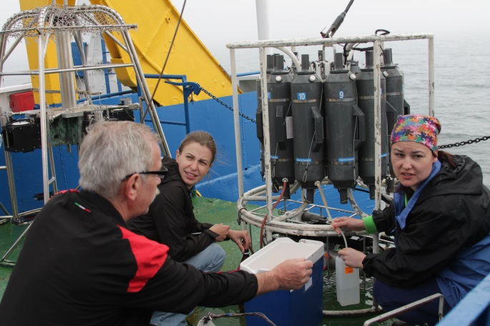
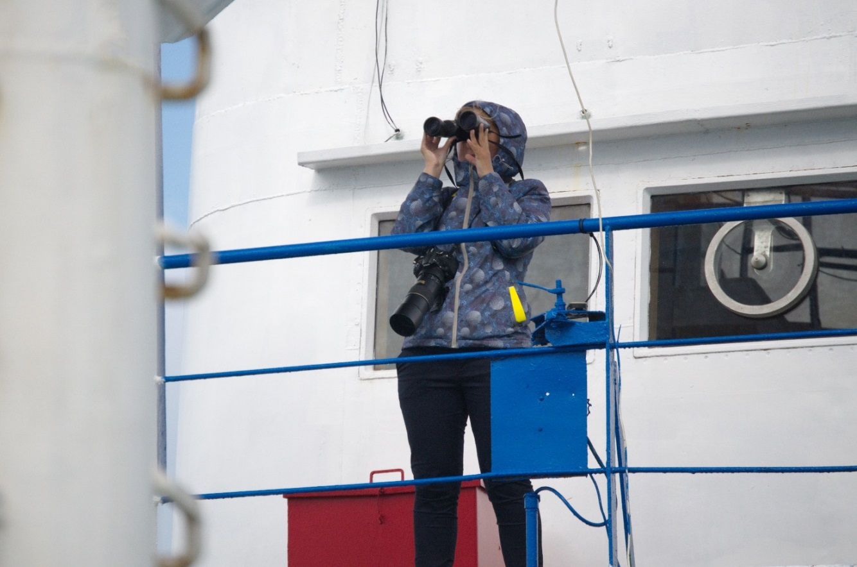
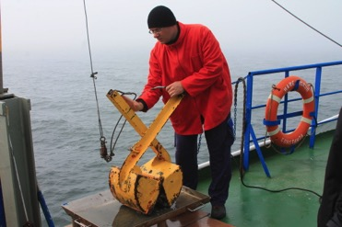
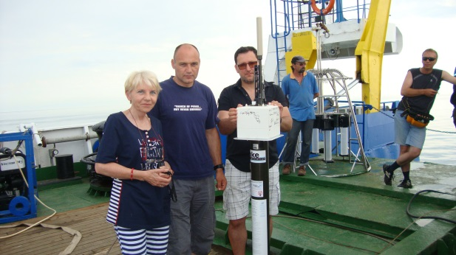
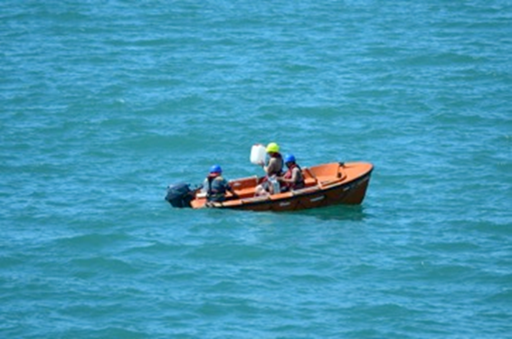
Environmental Monitoring in the Black Sea
Observations and Sampling

Slide 4
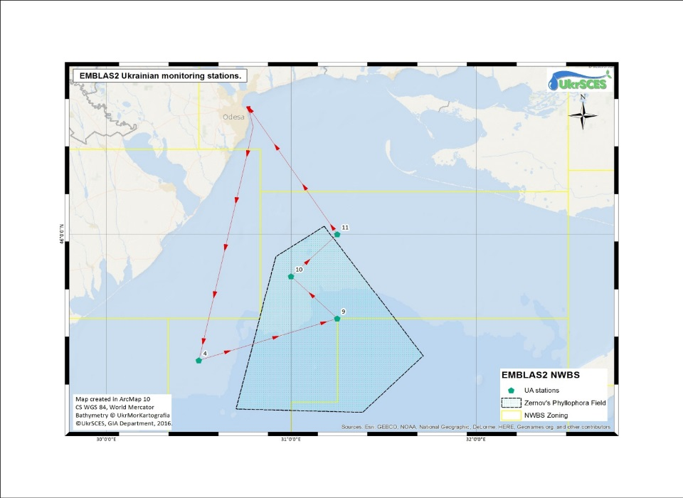
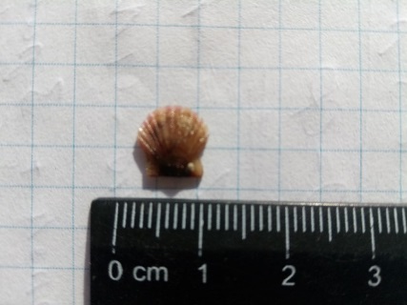
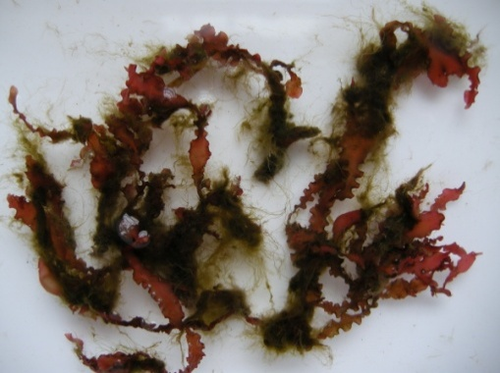
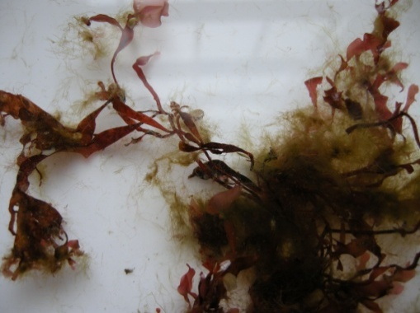
Phyllophora field
Alive Pectinidaes were found on the depth 20-30 m in survey on the Zernov’s phyllophora field in framework NPMS UA 2017
It wasn’t found during last 20 years
The sensitive macrophytes from genus Phyllophora: a - Coccotylus truncatus; b - Ph. crispa, fouling by the tolerant, small, filamentous species

Slide 5
Data collection templates
№ | File name | Template type | Comments
1 | DCT_target_meteo_hydro_UA_v1 | Hydrology / Hydrochemistry | Developed and discussed with V. Komorin
2 | DCT_target_sea_sediment_biota_UA_v5 | Sediment / Biota Pollutant | Developed and discussed with Peter Oswald
3 | DCT_target_sea_water_UA_v5 | Water | Developed and discussed with Peter Oswald
4 | DCT_macrophytes_UA_v1 | Macrophytobentos | Developed and discussed with G. Minicheva
5 | DCT_macrozooplankton_UA_v1 | Macrozooplankton | Developed and discussed with T. Shiganova
6 | DCT_phytoplankton_v5 | Phytoplankton | Developed and discussed with S. Kovalishina, M. Grandova and A. Zotov
7 | Macrozoobenthos_Template_v4 | Macrozoobenthos | Developed and discussed with S. Kovalishina, O. Kachalov
8 | Mesozooplankton_Template_v16 | Mesozooplankton | Developed and discussed with A. Korshenko

Slide 6
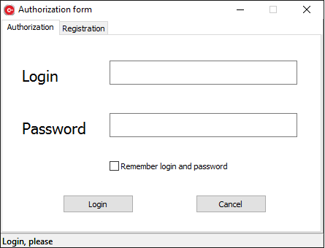
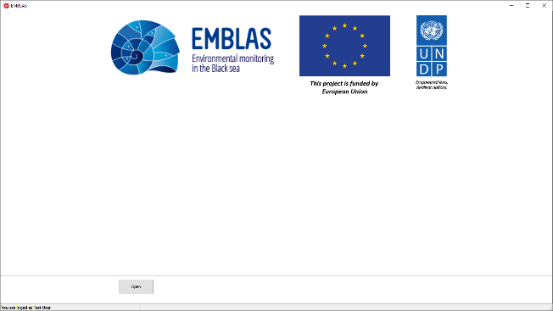
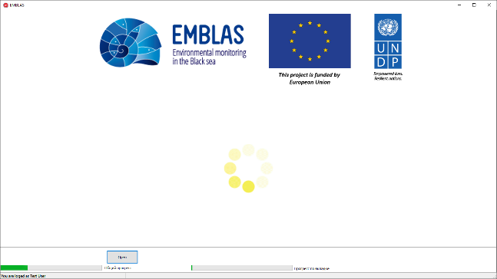
Environmental Monitoring in the Black Sea
Software for BS WQ data input (Login, Home screen and Open file process)

Slide 7
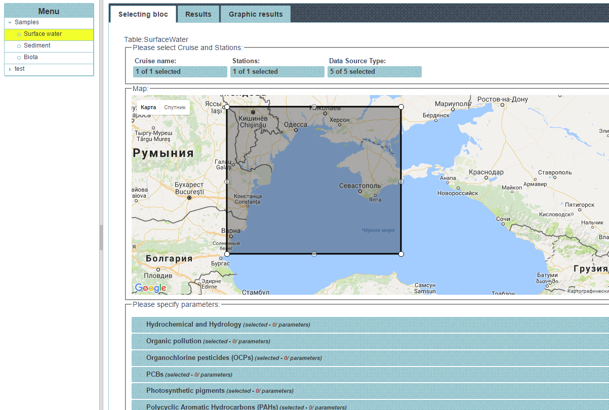
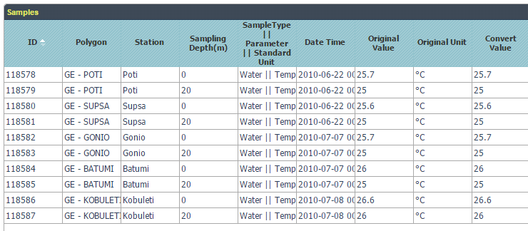
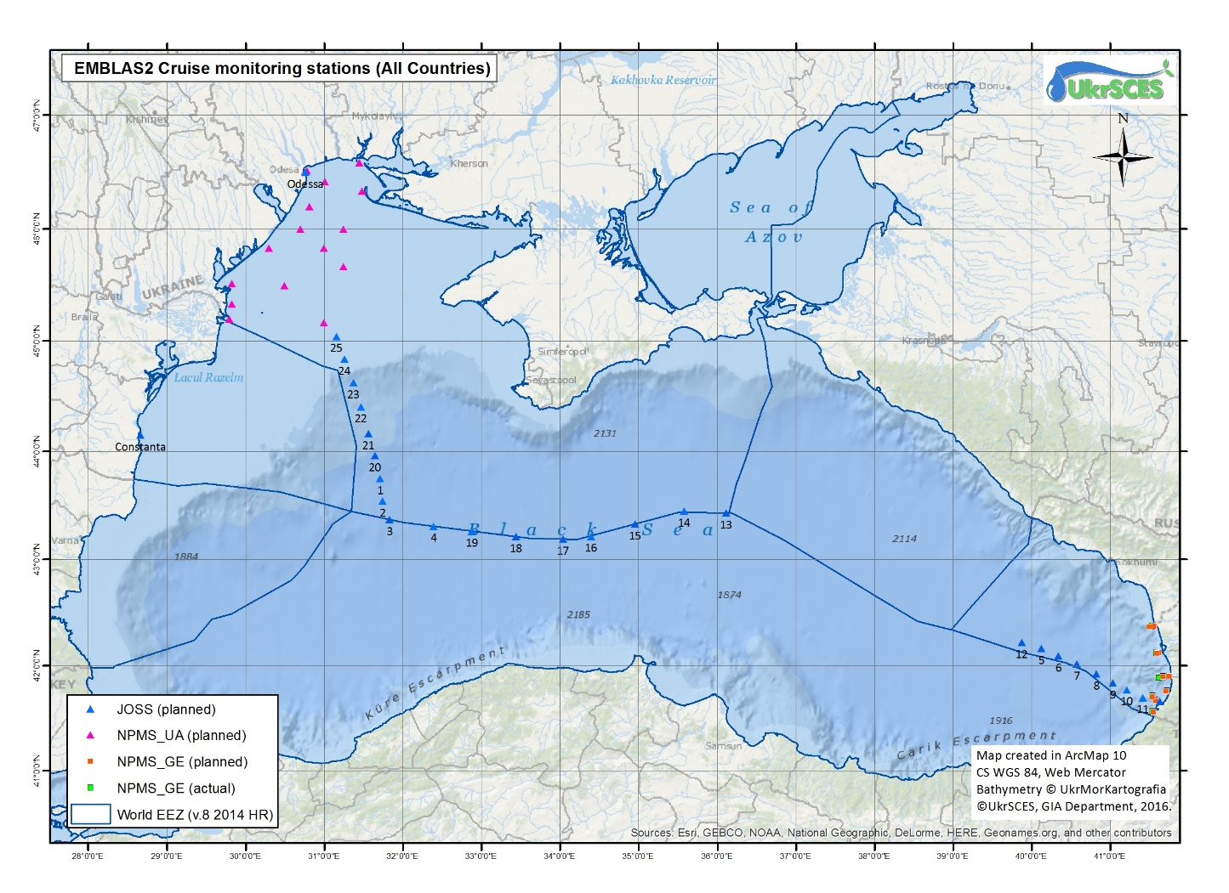
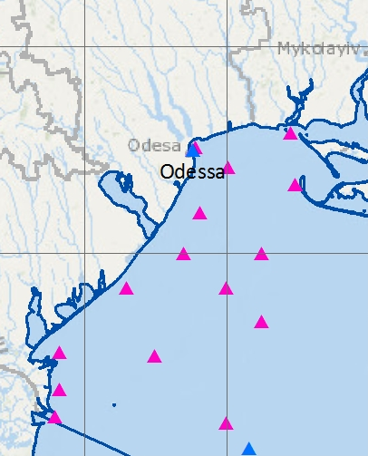
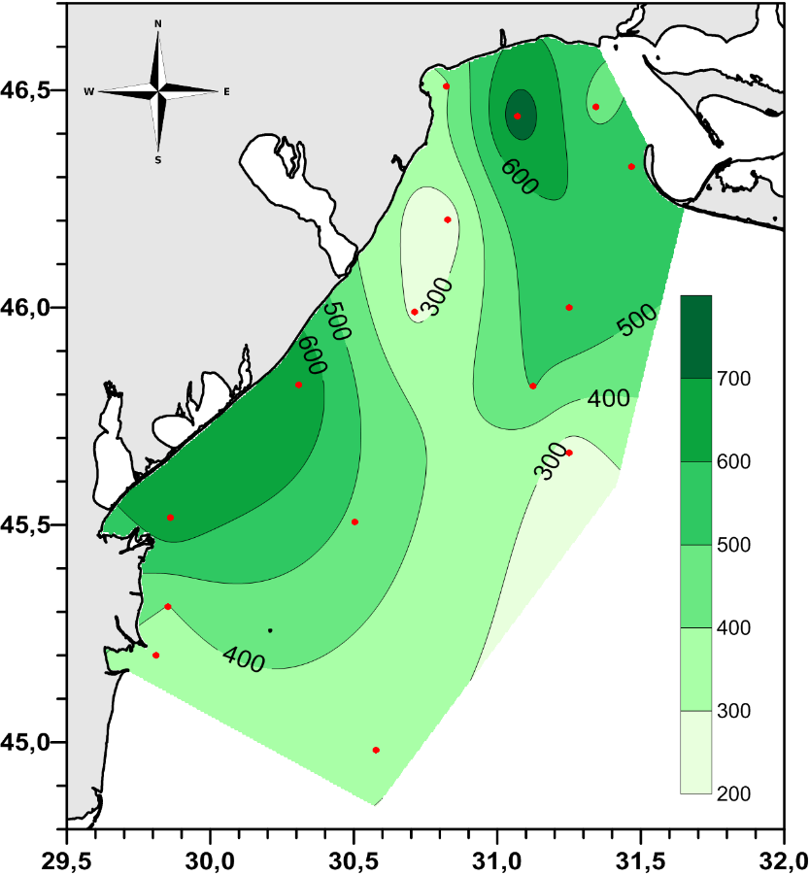
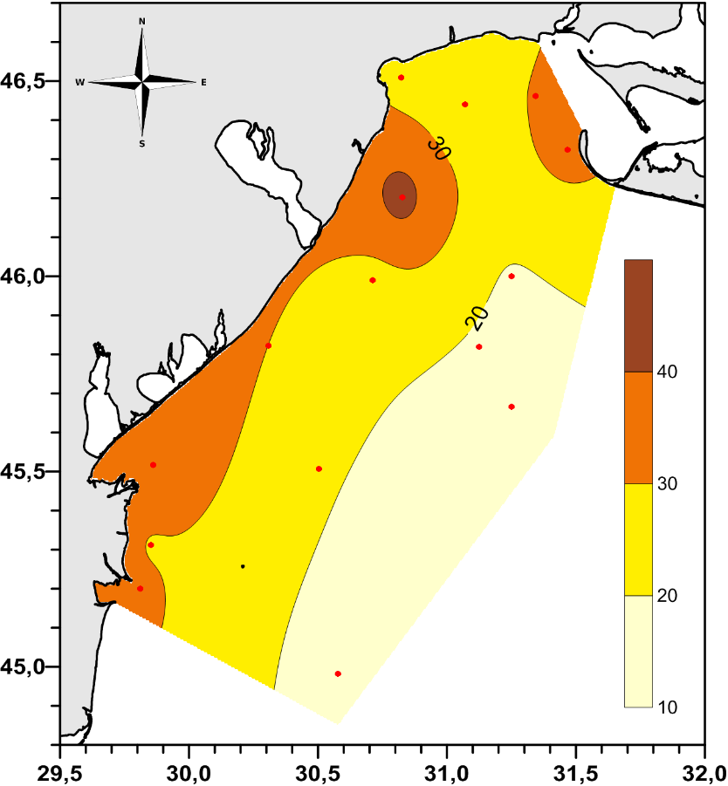
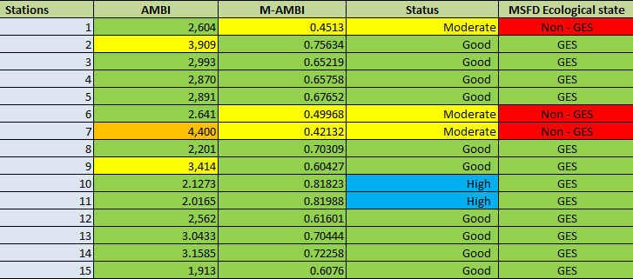
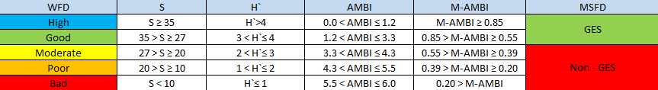
Environmental Monitoring in the Black Sea
BS WQDB web-interface (draft pages templates)
N total (0m, mkg/dm3)
P total (0m, mkg/dm3)

Slide 8
Environmental Monitoring in the Black Sea
Interaction between the BS WQDB and other Black Sea regional data management infrastructures
MONINFO
ICPDR
MISIS
BS WQ Data (xls, csv) - ?
BS WQ Data (xls, csv)
GIS mapping layers (geotiff)
BS WQ Data (xls, csv)
MSFD Implementation - ?
BS WQ Data (xls, csv) - ?
EMBLAS BS WQDB
BS WQ Data (xls, csv) - ?
SEIS
WISE
BS WQ Data (xls, csv)
CDI Metadata files
BS WQ Data (xls, csv)
CDI Metadata files
Metadata (ISO 19115)
GIS mapping layers (shp, geotiff, etc.)
EMODNET
SeaDataNet
CoCoNET

Slide 9
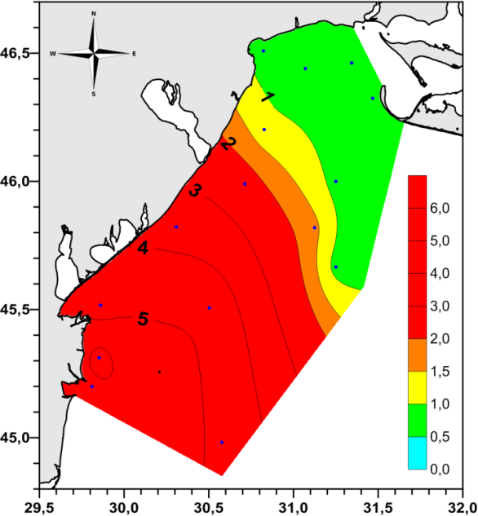
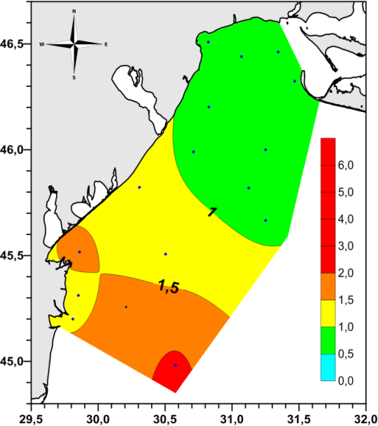
Black Sea eutrophication assessment
in surface and bottom water by BEAST

Slide 10
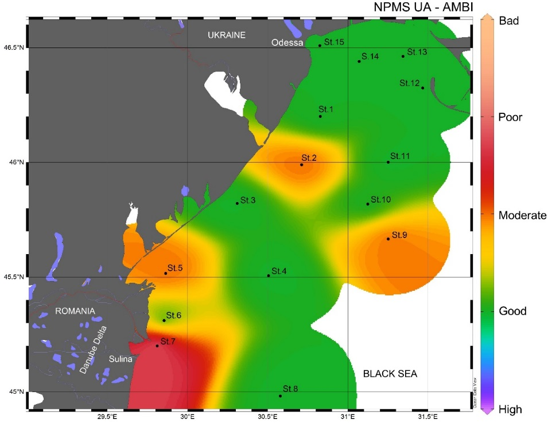
AMBI values and ecological status of habitats

Slide 11
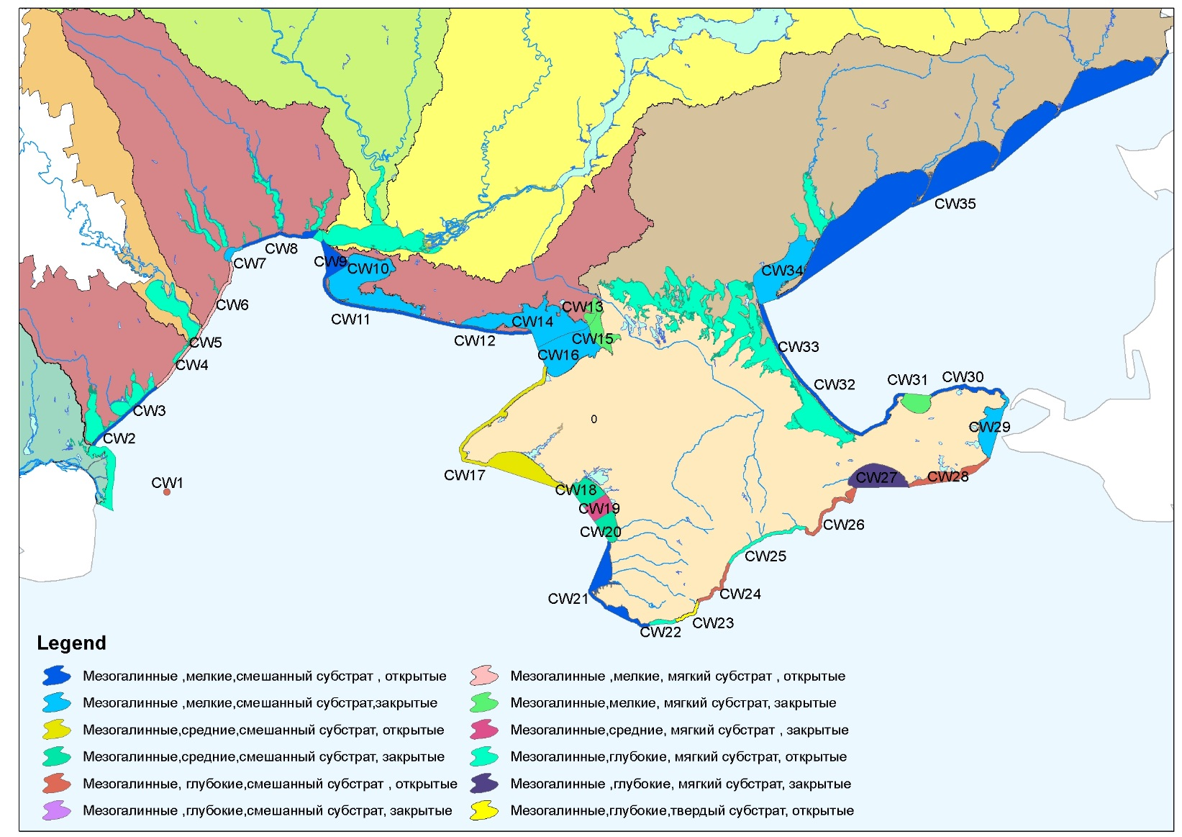
Water bodies of Black Sea and Marine environmental monitoring
according to WFD and MSFD

Slide 12
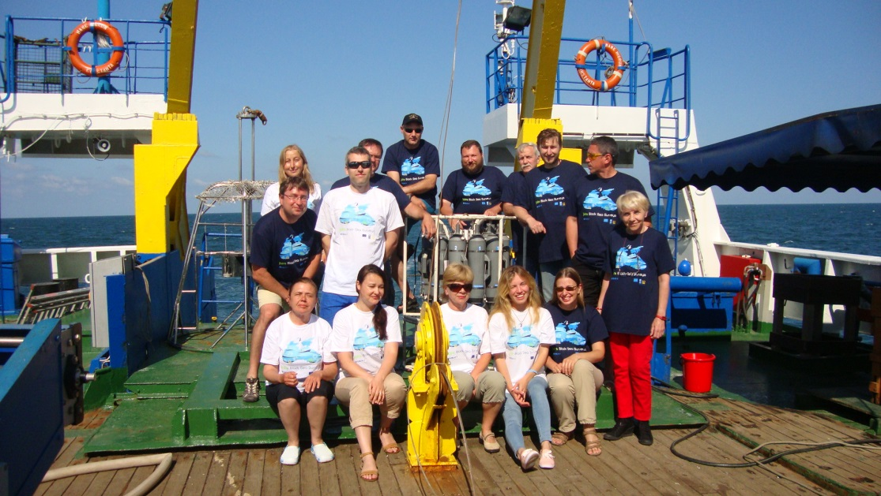

Environmental Monitoring in the Black Sea
Any questions?

