Slide 1
Maritime opportunities – Blue Growth for a Green Future
Grete Pettersen, Deputy Director
Maritime Policy Member State Expert Group, Brussels, 25 June 2015

Slide 2
”The government’s main goals for the maritime industry are sustainable growth and value creation.The maritime strategy presents the Government’s policy to realise the maritime potential of the ocean industries”.

Slide 3
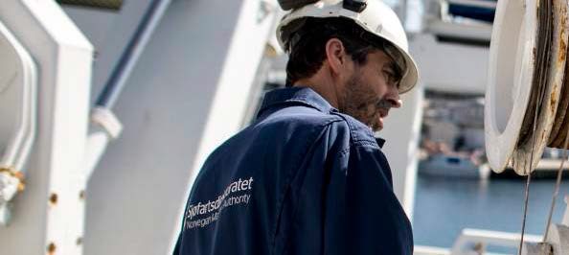
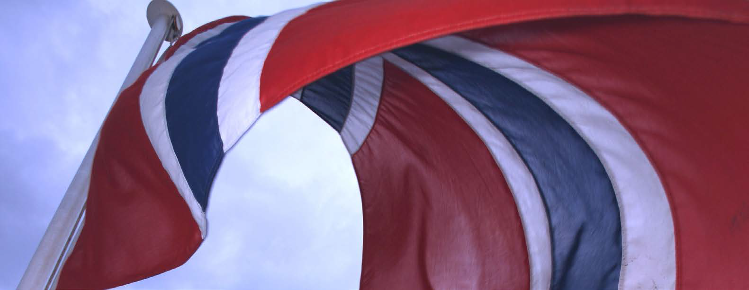
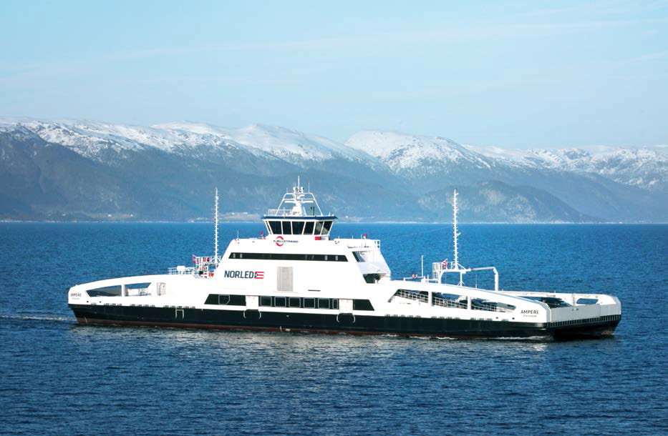
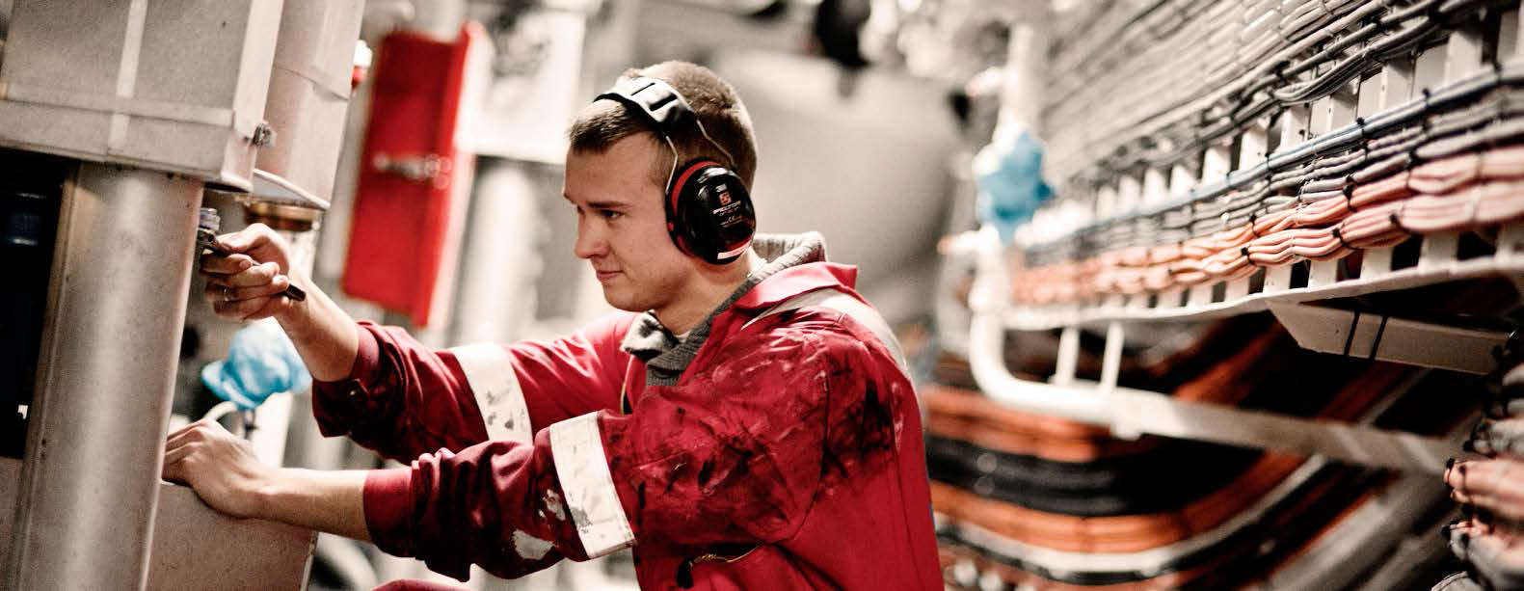
Central areas
Trading areas for Norwegian flagged vessels
Environment
Maritime Administration and Simplification
Competence and Education

Slide 4
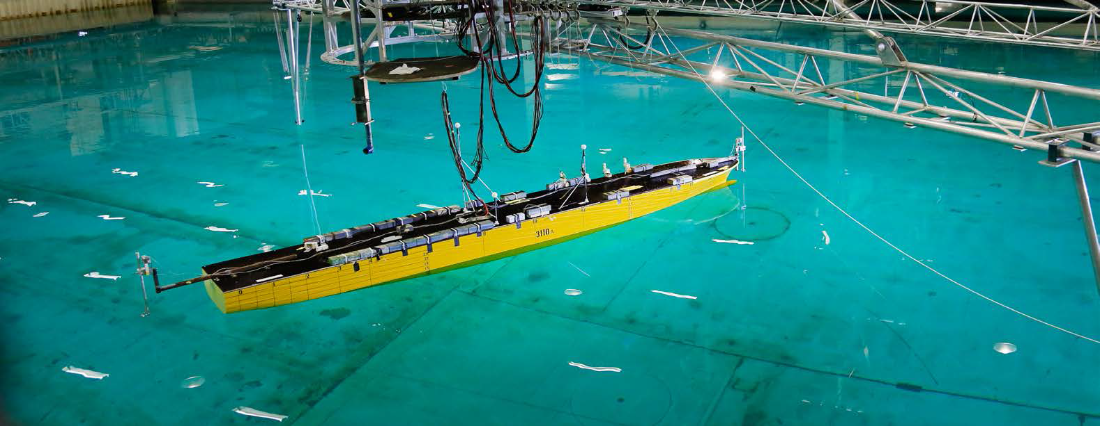
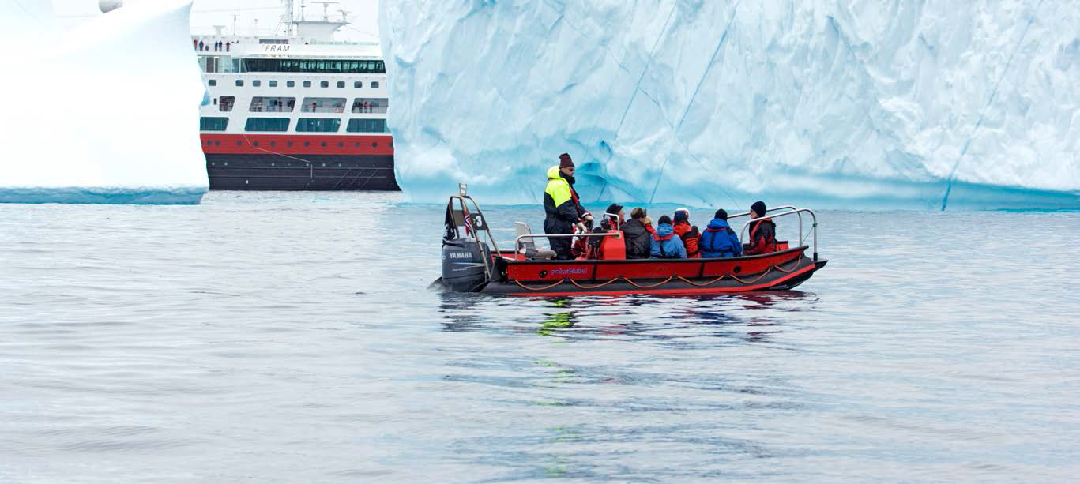
Central areas cont.
Research, Development and Innovation
International Regulatory Frameworks
Blue Growth
High North

Slide 5
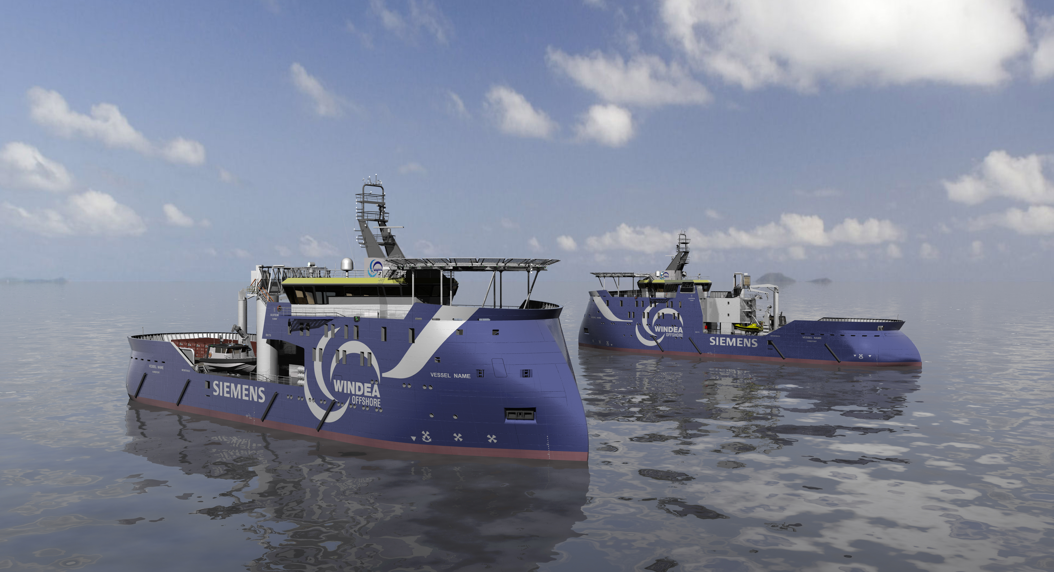

Slide 6
Thank you for your attention!

