Slide 1
MENTOR
Blue Career Centre of Eastern Mediterranean and Black Sea (BCC)
Zacharias Siokouros
Mar.In.E.M.
Blue Careers
Call for Proposals EASME/EMFF/2016/1.2.1.2:
"Blue Careers in Europe“
Proposal N° EASME/EMFF/2016/1.2.1.2/002
“Blue Economy call 2018: Blue Careers, Blue Labs and Grants for the Blue Economy “organized by DG MARE , Brussels, 22/11/2018
Notes:
Mentor partners:
1.University of Cyprus (UCY) Cyprus
2. Maritime Institute of Easter Mediterranean (Mar.In.EM) Cyprus
3. Cyprus Chamber of Commerce and Industry (CCCI) Cyprus
4. Agricultural University of Athens (AUA) Greece
5. National Technical University of Athens (NTUA) Greece
6. Marine Cluster Bulgaria (MCB) Bulgaria
7. Constanta Maritime University (CMU) Romania
Mentor observers:
1.Arab Academy for Science, Technology and Maritime Transport (Egypt)
2. Jordan Academy for Maritime Studies (Jordan)
3. Al-Manar University of Tripoli (Lebanon)
4. Istanbul Technical University (Turkey)
The Lebanon and Jordan observers have already signed an MoU with the BCC and the rest of the observes are also expected to sign it soon.
Aspiration of Mentor: Creation of a Network of BCCs in the East Med (EM) & Black Sea (BS) Region for raising awareness & promoting synergies on Blue careers, skills and training of young people & professionals

Slide 2
Mentor Mission & Objectives
Mission
Supporting businesses in finding qualified staff
Providing career guidance to young jobseekers
Attract higher education graduates and/or persons with vocational/technical qualifications to Blue professions through targeted and innovative education and/or training initiatives
Offer mentoring and career guidance to students (age 15-18) for key Blue sectors of the region
Re-train and up-skill workers employed in other sectors and/or unemployed people for a job in the Blue Economy
Expand the skills of people currently employed in the Blue Economy to advance their careers and/or to facilitate their mobility to other maritime jobs
OBJECTIVES
Notes:
Mentor has 4 Focus Areas, the so called Marine and Maritime Economic Activities areas or MEAs:
Maritime Transport
Cruise Tourism
Offshore Oil & Gas
Marine Aquaculture

Slide 3
MENTOR best practices & lessons learned
1. Visits to Schools
2. Organization of Blue Career Fairs
Inform on required academic, technical & behavioral skills & competences for Blue Professions
Major challenge & prerequisite for the success of the project
Great interest from students (secondary & tertiary education), teachers, professors & parents, as well as companies
Increased cooperation with & support from public and private organizations (ministries of education, universities, academies and maritime companies)
Notes:
Mentor’s main achievements can be summarized as follows:
1.Production of an important volume of data & tools on maritime education & training in the East Med and Black Sea region
2. Promoting networking & cooperation on Blue careers & skills development in the region
3. Promoting synergies between the industry, the public sector & the society

Slide 4
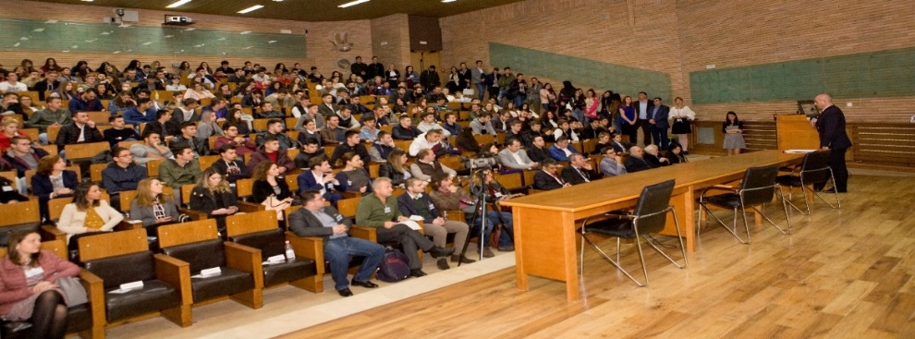
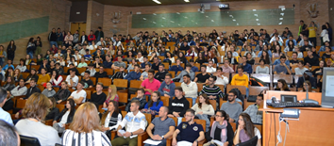
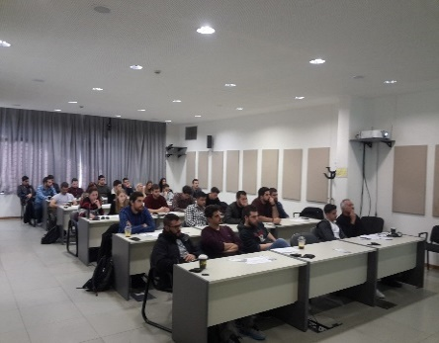
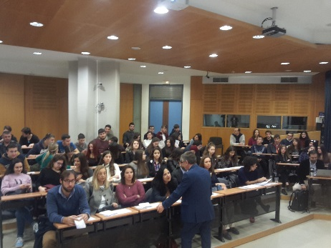
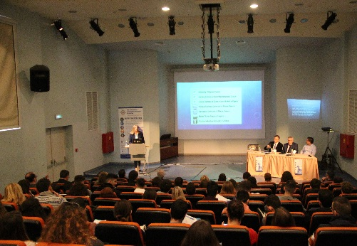
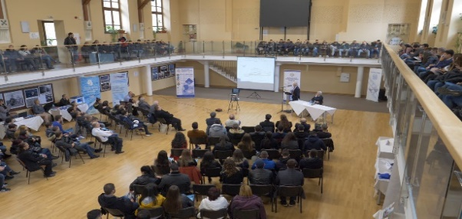
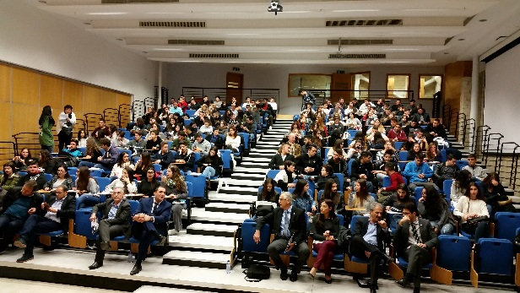
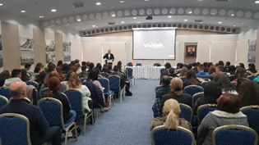
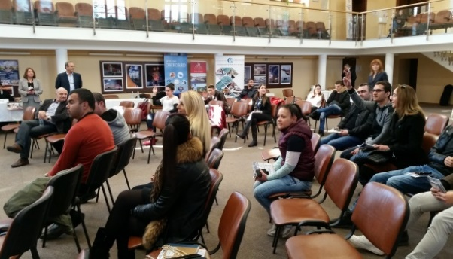
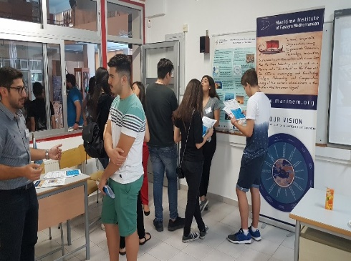
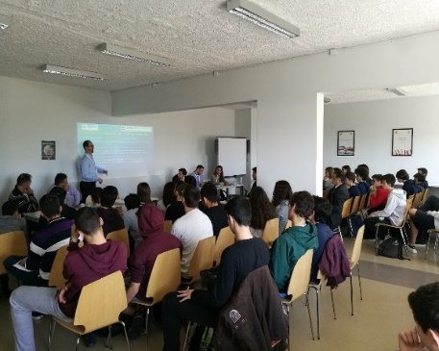
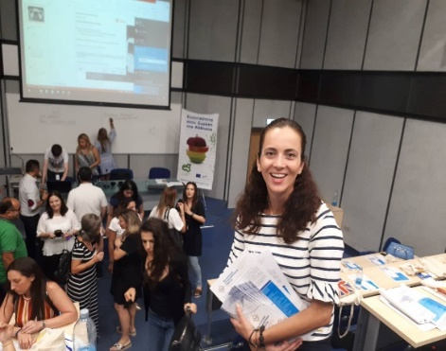
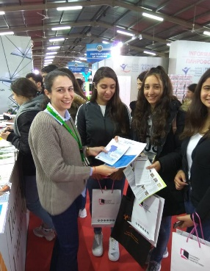
Blue Career Fairs, Constanta, 27.10.2017 & 19.10.2018
Blue Career Fair, Athens, 27.10.2017 & 30.11.2018
Blue Career Fairs, Varna, 31.1-1.2.2018 & 15.11.2018
Blue Career Fair, Limassol, 8.12.2017 & 14.12.2018
Visits to Schools & Career Fairs

Slide 5
MENTOR best practices & lessons learned
Generates several career paths by matching the needs of a candidate looking for employment (in the 4 selected MEAs) with the present or future needs of the selected industry, while considering the occupational status of the candidate
Created by mapping the needs of the 4 MEAs through questionnaires distributed to representatives of the 4 MEAs in all Mentor partner countries and the use of relevant literature
3. Career Mentoring Framework
Aims at facilitating students to access Blue courses from various, different training centres in the region that have curricula related to the 4 MEAs
Development of a platform for each MEA, including:
institutions of the 4 Mentor countries that have inter-institutional agreements and similar “Blue” study programmes
Blue undergraduate courses offered in English for motivating mobility
Contact persons related to these courses
4. Cooperative network of training
institutions
Notes:
Career Mentoring Framework:. The procedure is the following:
The mentor identifies the current status of the student, then presents to him/her the Blue Sectors. The student selects the Blue sector that is of interest to him/her e.g cruise tourism. Then the mentor presents to him/her the professions in this sector and the student identifies the one that he/she believes is suitable for him/her (e.g chief engineer). After that, the mentor informs the student on the necessary academic qualifications, technical skills & behavioral competences needed for the selected profession.
The aim is to help the student enter an academic institution that will deliver the required degree for the selected Blue profession.
Cooperative Network of training Institutions: 30 training institutions in total were identified in the 4 project countries, including 32 inter–institutional agreements that fall within the 4 MEAs

Slide 6
MENTOR best practices & lessons learned
Identifies the necessary career skills for professionals in the blue economy and provides pathways for facilitating career advancement and job mobility in the 4 MEAs
Created by identifying 1) National Agencies and Institutions of higher education that participate in Erasmus+ programme, deliver “blue” courses and have Inter-institutional Agreements between the 4 project countries 2) National Authorities for the Certification of Qualifications in the 4 project countries 3) professions with positive prospects in the blue sectors & required skills & competencies for them
5. Framework for promoting mobility for Blue Sector courses
E-mobility tool
Aims at facilitating the mobility of students and staff between the four Mentor countries by providing guidance on the selection of the appropriate blue courses
Includes ERASMUS projects for under graduates and MSc courses for post-graduates and professionals that fall within the 4 MEAs, in the four Mentor countries
6. Framework for promoting mobility of students and staff within the region
Notes:
The E-Mobility tool basically consists of the following steps:
The candidate selects the personal educational level (graduate or postgraduate)
Then he/she selects the desired field of studies and the University of Origin
He/she views results (list of educational & training institutions) for the selected fields
After that, the candidate selects the institution that is of interest to him/her and views the available details for this Institution
Finally, he/she can also see the available “Blue” courses of that Institution

Slide 7
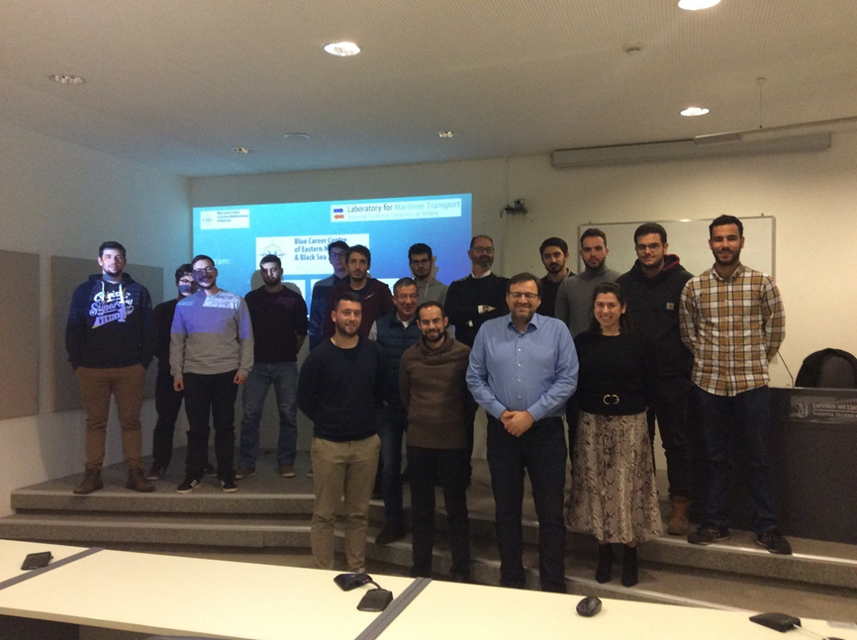
MENTOR best practices & lessons learned
Identify specific categories of maritime professionals
Catalogue the needs & requirements for upscaling and further advancing their career (conduct of survey)
Provide harmonized requirements for maritime professionals training focusing on practice
Perform a pilot training course
7. Harmonized requirements for maritime professional training focusing on
practice
Case study
Seafarers with seagoing experience who wish to shift their careers to shore based positions
Training on the non-technical skills and behavioral competences needed in order to upskill and further develop their professional profile
Notes:
The picture shows the organizers and participants in the pilot training seminar that was organized on January 17th, 2019 in Athens. In total, 15 persons participated. There was a mix of students (under and post-graduates) along with young professionals. The participant number was limited to 15 persons in order to make the training course as efficient as possible. A certificate of attendance has been also given to participants.

Slide 8
More info and Updates
http://www.bluecareers.org
https://www.facebook.com/Blue-Career-Centre-of-Eastern-Mediterranean-Black-Sea-1101721573291460/
https://twitter.com/Blue_Career
https://www.linkedin.com/company/26998900/
admin@marinem.org
Thank you very much for your attention!
MENTOR is co-funded by the European Maritime and Fisheries Fund under grant agreement EASME/EMFF/2016/1.2.1.2/06/SI2.749365-MENTOR

