Slide 1
Work Package 3- Use of algae for wastewater and water treatment and use of resulting algae biomass in fertilisation

Slide 2
Outputs
Objective: Assess the use of algae for wastewater and water treatment and use of resulting algae biomass in fertilisers
Legal requirements for acceptance of algae as fertilizer or biostimulant
Potential of algae for wastewater treatment (industrial symbiosis, TEA, and LCA)
Recommendation of 6 most promising species for wastewater treatment

Slide 3
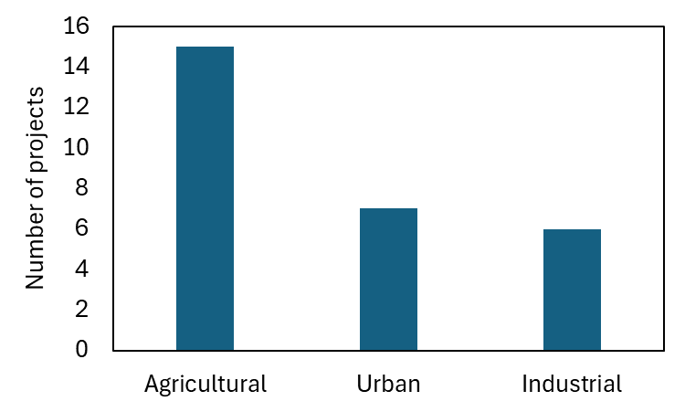
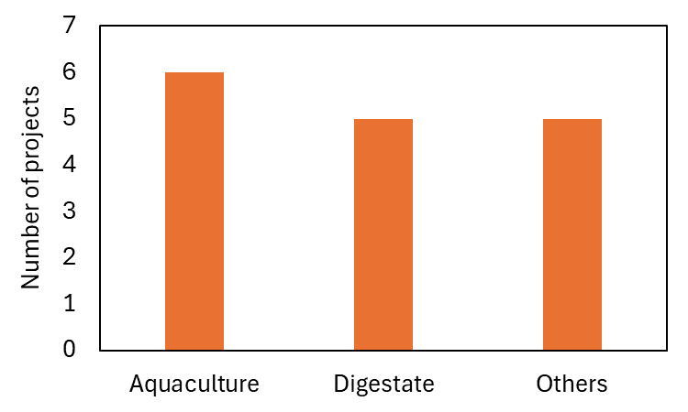
Wastewater selection

Slide 4
Wastewater selection
Urban WW
Manure
digestate
Aquaculture effluent
Horticulture effluent

Slide 5
FPR
Fertilizing Product Regulation
CMC2: Plants, plant parts or plant extracts
Includes algae
Excludes cyanobacteria
CMC1: chemical extraction
CMC3: anaerobic digestion
CMC13: pyrolysis/ gasification

Slide 6
Legal status of algae grown on WW
Algae
Sewage Sludge
Unclear
End-point for digestate?

Slide 7
Insights into legal implications? Examples of practices?

Slide 8
Thank you!
ROHELINE VIHMAVARI OÜ

