Slide 1
Nawal ALLAOUI
CEO-Founder
allaouinawal93@gmail.com
 +212 681 011 265

Slide 2
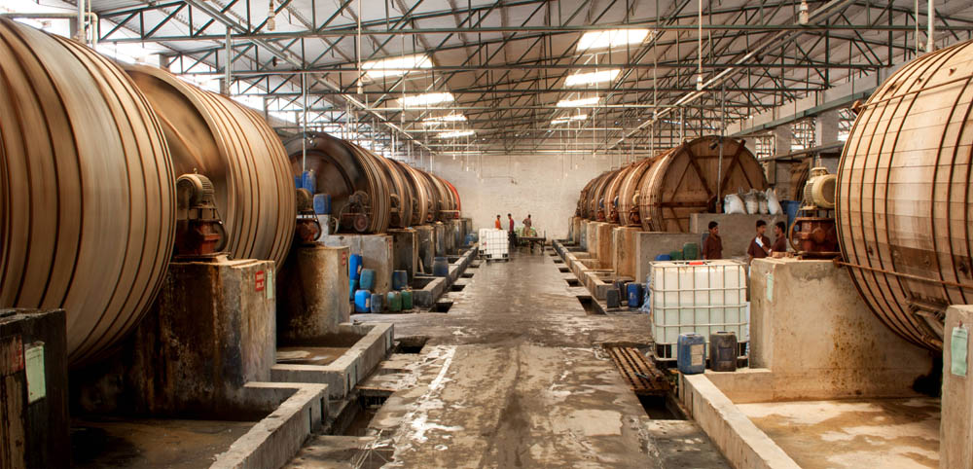
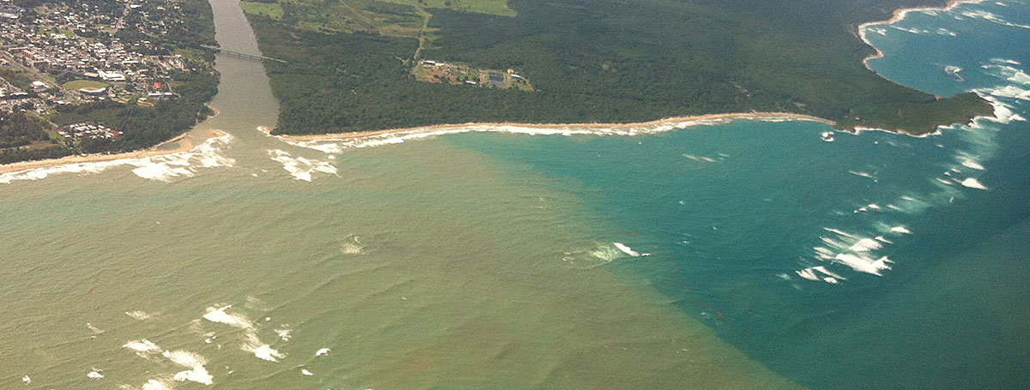
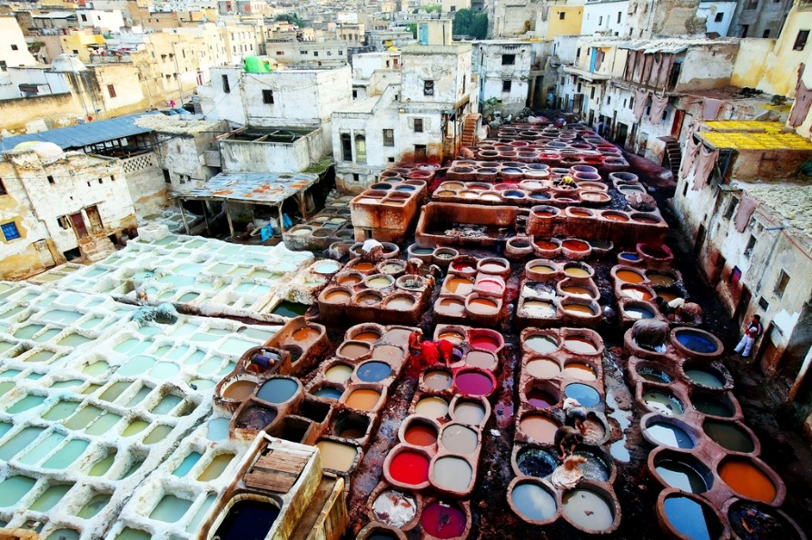
1300 L/TON

Slide 3
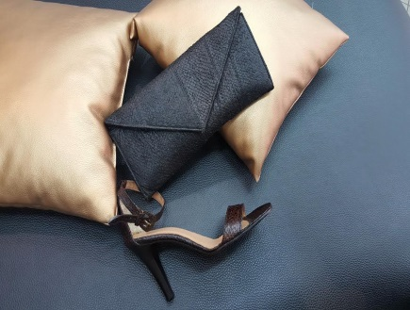
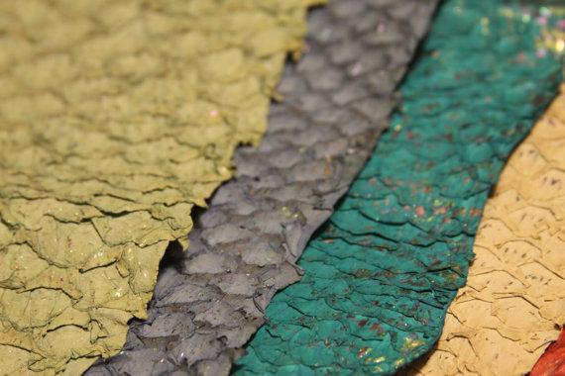
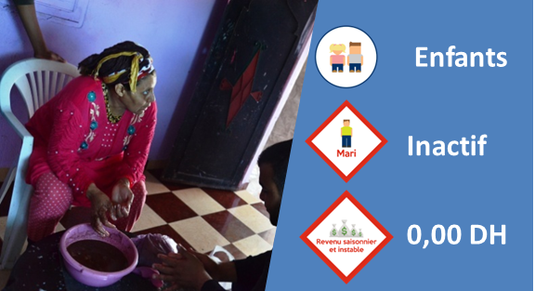
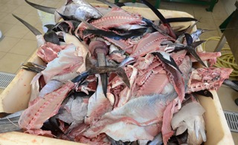
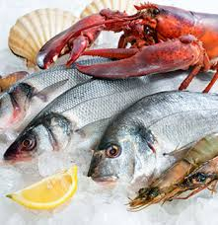
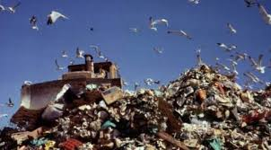
EXOTIC
Dry Tanning
WATERPROOF
RÉSISTANT

Slide 4
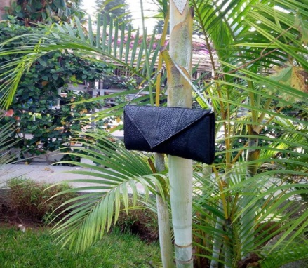
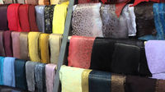
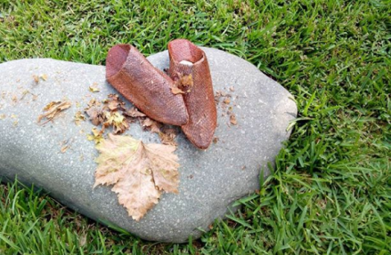
BUSINESS MODEL
Finish product
Leather (premiry material)

Slide 5
Market size
4.47%

Slide 6
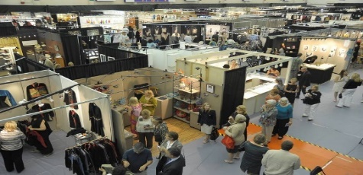
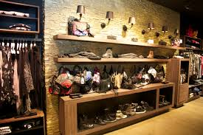
Marketing & Sells
Penetration strategy
Social media
Direct connections
Expositions
distribution cannels
resellers
Show Room
E-commerce

Slide 7
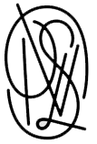
COMPETITION
Eco-friendly brand
Brand image

Slide 8
TEAM
CEO- Founder
Industrial engenner branch product manager and phd student
Production manager
10 year of experience in production
Brand manager
Experience of 3 year on dropshipping
Designer (part time job )
Laureate of traditional art academy branch leather
❶
❷
❸
❹

Slide 9
Financial projection
Profitability indicators | A1 | A2 | A3 | A4 | A5
Gross margin rate | 30% | 49% | 63% | 72% | 78%
net margin rate | 33% | 54% | 69% | 79% | 86%

Slide 10
Accomplissement
Funding : 10 000 $
Turnover 2018 : 32 000 $
Visibility :
Clients :
WE NEED : 100 000 Euro & Network To attend the Next Level
Redefining the Fashion

Slide 11
Thank you for your attention
Nawal ALLAOUI
Allaouinawal93@gmail.com
+212 681 011 65

