Slide 1
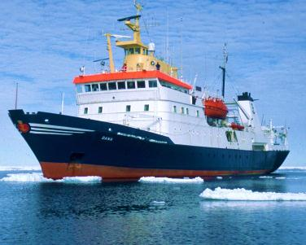
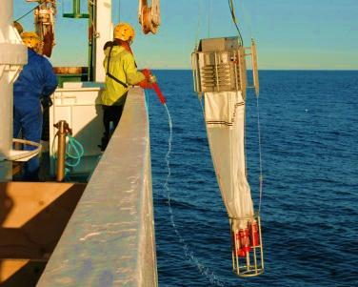
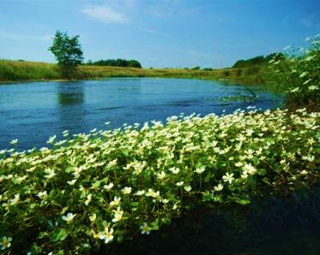
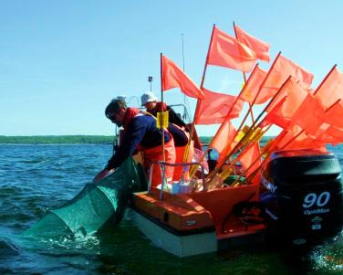
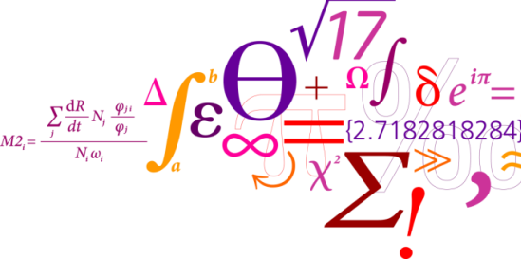
Integrated End-to-End and Fisheries Bio-Economic Modeling for Evaluating Ecosystem-Wide Effects of Human Pressures in the Baltic Sea
J. Rasmus Nielsen, Artur Palacz, Sieme Bossier,
Francois Bastardie, Asbjørn Christensen, Kerstin Geitner
and Elisabeth A. Fulton.

Slide 2
Key Biological Data and Monitoring: Marine Higher Trophic Levels - Fish and Fisheries
ICES (International Council for Exploration of the Sea) Biological Data:
Sampling from Member National Institutes
Dataset | Measurements | No of years
Biological community | 832 193 | 35
Contaminants and biological effects | ​11 666 819 | 38
​Eggs and Larvae | ​1 010 599 | ​93
Fish predation (stomach contents) | 1 149 608 | 12
Fish trawl surveys | 6 565 612 | 51
ICES Historical Plankton | 318 319 | 11
Oceanographic | 285 608 302 | 127

Slide 3
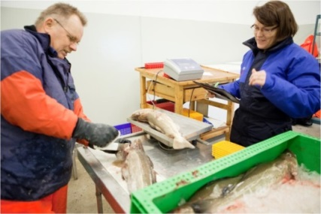
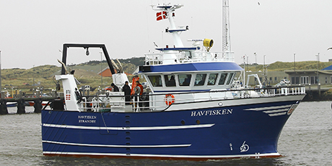
Key Fish, Shellfish & Fisheries Monitoring and Data: EU DCF & ICES
At Sea Observer Sampling Commercial Fishery
Harbor Sampling Commercial Fishery
VMS Data by vessel, trip & haul (fishing+steaming)
Self Sampling Commercial Fishery
Catch, Effort, Biological & Economic Data by species, fleet, vessel, trip & haul
BALTICDISPLACEOM
Fisheries Economic Data by vessel & trip
Fish & Shellfish Trawl + Dredge + Gillnet Surveys by haul or set
Fish Acoustic + Video Surveys (cont. transects)
Fish Plankton + Hydrographic Surveys

Slide 4
The problem and challenge
Human-induced changes in the heavy-populated Baltic Sea catchment area.
To evaluate biological and economic effects of single and multiple pressures:
Nutrient loads / Eutrophication
Climate change
Fishery
on the semi-enclosed Baltic Sea ecosystem in relation to existing and anticipated
management plans (EU Directives) under Ecosystem Based Management.
The Approach
To modify and use a holistic modeling tools capable of simulating the likely structural and functional ecosystem responses to pressures as well as the consequences for ecosystem goods and services, e.g. fisheries impacts and responses.

Slide 5
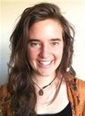
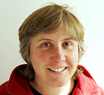
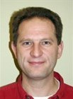
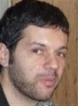
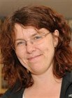
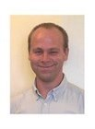
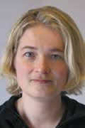
Sieme
Bossier
Beth
Fulton
J. Rasmus
Nielsen
Artur
Palacz
François
Bastardie
Kerstin
Geitner
From: HELCOM 2010
Asbjørn Christensen
Marie Maar
Notes:
If our goal is to provide long-term evaluations of ecosystem changes, we can use the Baltic ATLANTIS model. The past few years within EU Vectors and IMAGE projects a large group of people put lots of effort to implement this model in the Baltic. So far we have calibrated the model on the levels of physics, biogeochemistry and biological interactions but not in the socio-economic or management levels.
What is special to Atlantis is its flexible structure based on multiple modules, which are optional and replacable.
The Baltic model is already an interdisciplinary effort that has many resources to extend it towards a model hybrid. e.g. there is linking with HBM/ERGOM and FishRent, and we have experts from IBM fleet models, physical and biogeochemical models and stochastic models.

Slide 6
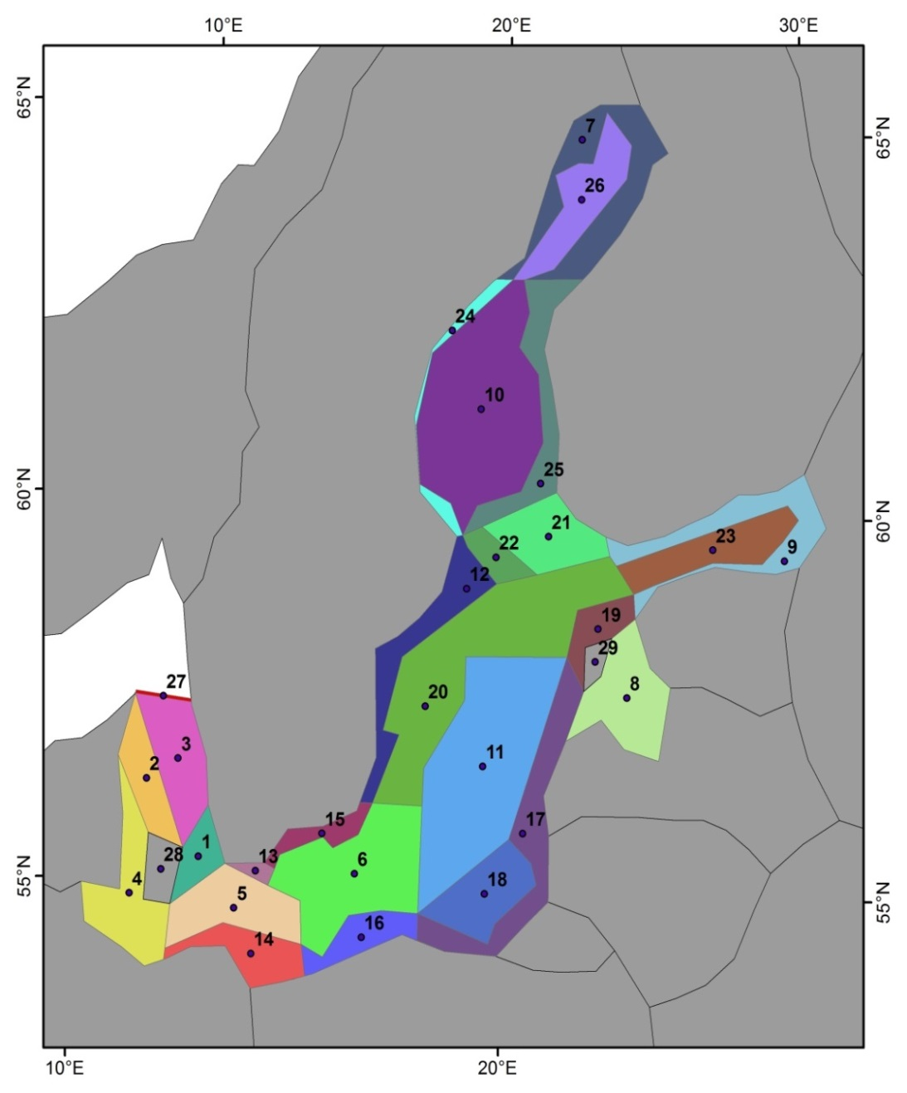
Baltic Atlantis Implementation: geometry & forcing
Geometric structure:
29 polygons
26 dynamic boxes, 3 boundary boxes
9 vertical layers
Forcing & initial conditions:
HBM-ERGOM (or RCO-SCOBI) -> Each ATLANTIS Polygon
Initial conditions 2005 with
new hindcasting
Temperature, salinity, nutrients, volume exchange
Point source inputs of Nitrogen (box uniform) (by country data from HELCOM PLC-5.5: 5th Baltic Sea Pollution Load Compilation)
Time resolution:
Year & Quarter & Month & Age

Slide 7
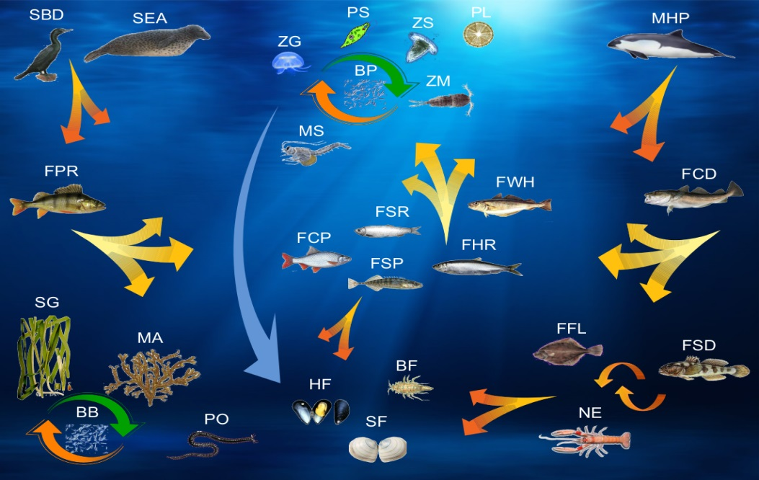
ATLANTIS implementation: Biological model input groups & habitats
33 Biological functional groups
Marine mammals (2)
Seabirds (2)
Fish (9): cod, sprat, herring,
whiting, flatfish, cyprinids,
mall demersals, small
pelagics, perch-like fish.
Benthic invertebrates (7)
Benthic flora (3)
Zooplankton (4)
Phytoplankton (3)
Detritus (3)
Data sources: Nutrients, Sediments, Habitats, Plankton, Benthos, Fish, etc.
(including invertebrate and vertebrate life history parameters)
HBM-ERGOM: physics & nutrients & plankton
HELCOM Pollution Load Compilation 5.5: point sources - N point sources)
HELCOM: Habitat distribution based on HELCOM sediment classes (EUNIS, EMODNET data)
ICES Fish Stock Assessments: fish stock biomass by age, age-length keys
ICES BITS & Acoustic Surveys: fish relative spatial distríbution and abundance by age
HELCOM: Abundance indices for Freshwater Species (by age)
ICES, DMU, SMHI, HERTTA* databases: invertebrate abundance/biomass
Literature: biological & chemical rates, diets, life history traits etc.
Vertebrates age
structured &
mature /
juvenile
Invertebrates:
1 biomass pool, except Nephrops structured to mature/juvenile

Slide 8
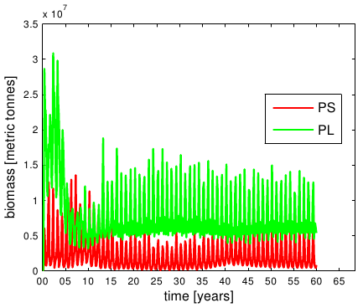
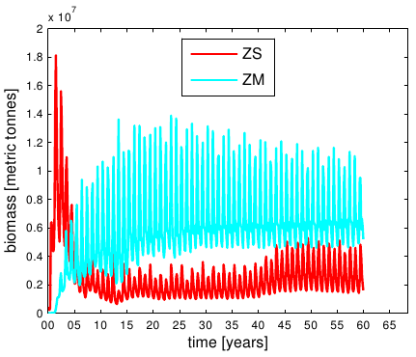
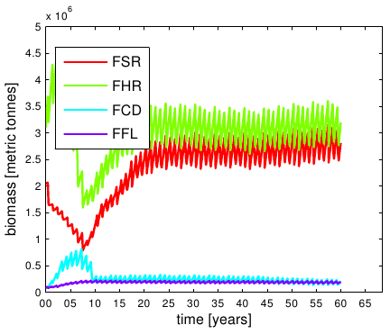
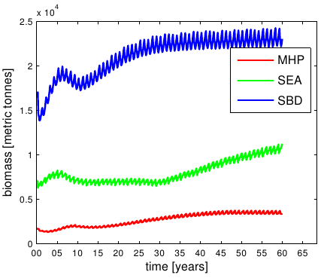
Model is calibrated to simulate a balanced ecosystem
in ~equilibrium state under the 2005 initial conditions
Phytoplankton:
PS – small phytoplankton
PL – large phytoplankton
Zooplankton:
ZS – microzooplankton
ZM – mesozooplankton
Fish:
FSR – sprat
FHR – herring
FCD – cod
FFL – flat fish
Higher Trophic Levels:
MHP – harbour porpoise
SEA – seals
SBD – pursuit-diving
seabirds
Figure 1: Selected time series of area-integrated biomass in metric tonnes from a 60-year
model spin-up run. (Phytoplankton, zooplankton, fish and higher trophic levels groups).
Notes:
8

Slide 9
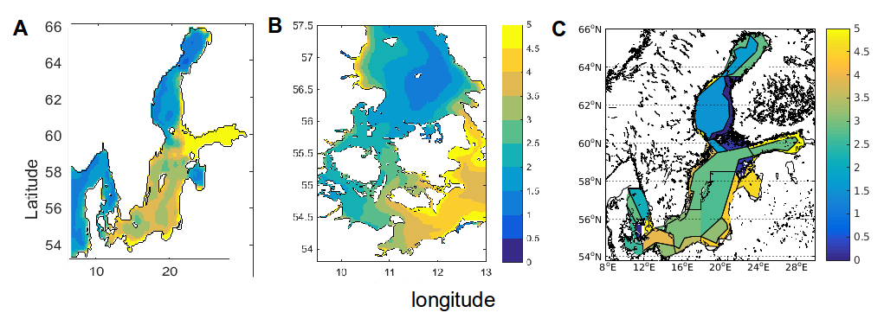
Model verification
Figure 2: Spatial distribution of annual average surface chl-a as simulated by
HBM-ERGOM (A-B) and Baltic Atlantis (C).
Notes:
9

Slide 10
Integrated eutrophication scenario evaluation:
In Baltic Atlantis 3 nutrient load reduction scenarios are applied with the same new forcing repeated for 20 years forecast to bring the system to new near-equilibrium:
Scenario 1: Reduction of single country nutrient loads: 33% reduction of Danish contribution to N river load in Kattegat, the Sound and Western Baltic areas.
Scenario 2: Reduction of single countries nutrient loads: 33% reduction on DK+SWE+GER N river loads in those areas.
Scenario 3: Nutrient reductions in all Baltic states: Projected Baltic-wide point source reductions to match BSAP2 (Baltic Sea Action Plan 2) demands.
Notes:
10

Slide 11
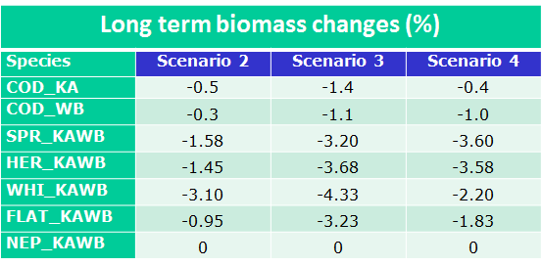
Integrated eutrophication scenario evaluation:
the Baltic Atlantis
Results:
Fish biomass decreasing consistently in all scenarios but within model error (< 3% change);
Hypothesis behind the preliminary results:
Fish biomass changes co-incident with observed changes in plankton community composition, but difficult to disentangle from any error due to internal model variability;
Notes:
11

Slide 12
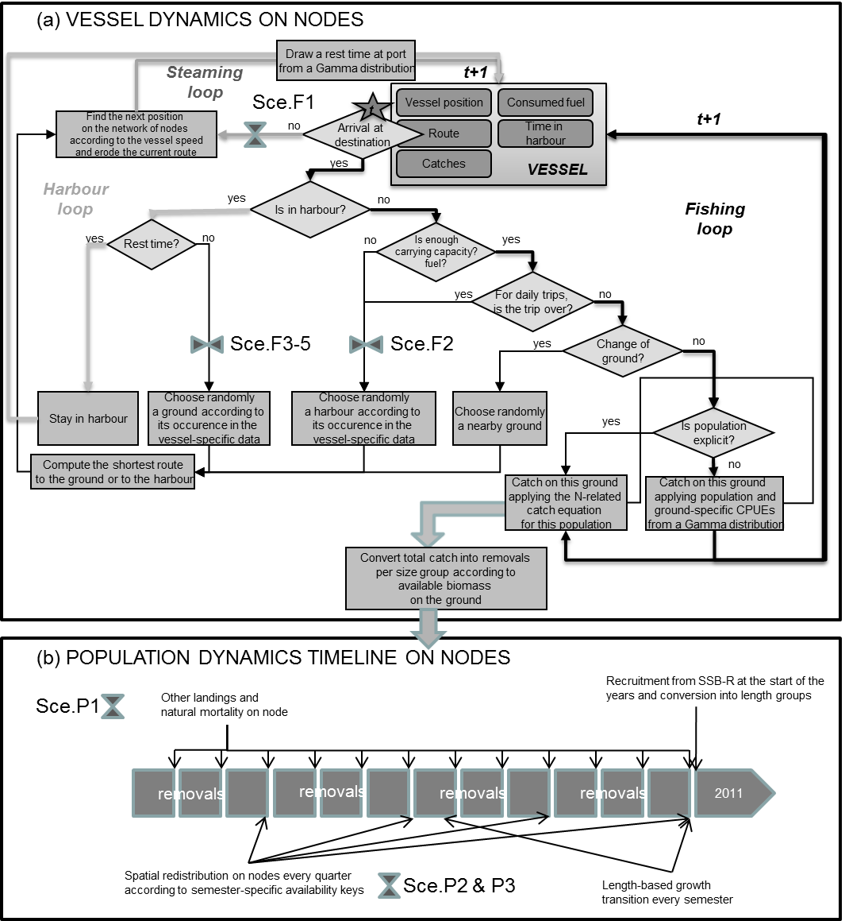
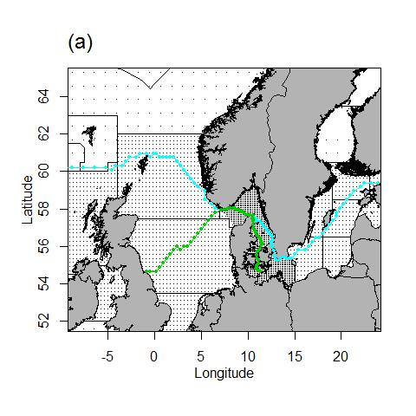
Bio-Economic
IBM DISPLACE
Model
Designing an Individual Vessel based & Bio-economic Simulation Model for Integrated Stock and Fleet Management Strategy Evaluation useful for Maritime Spatial Planning

Slide 13
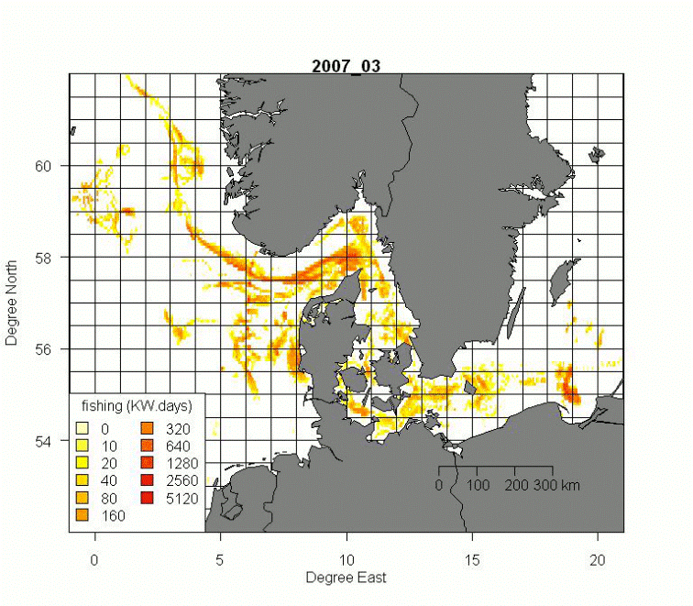
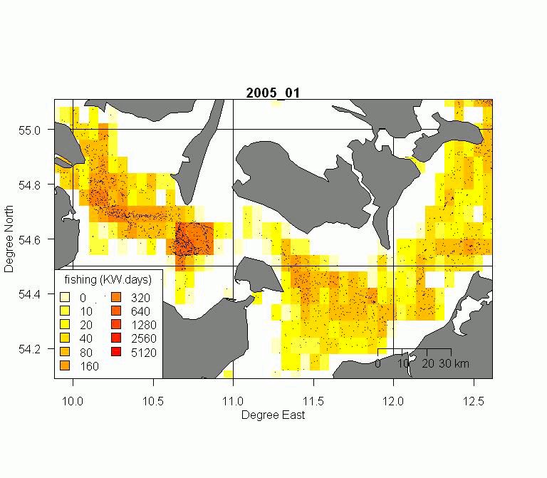
Coupling VMS positions with logbooks
Analysing VMS tracks: Mapping Catch & Effort
Fine retrospective pattern of
spatial and temporal effort
and catch allocation build from satellite vessel monitoring system (VMS) tracking data on haul to haul basis within a fishing trip (trip basis) coupled to logbook and sales slips declarations

Slide 14
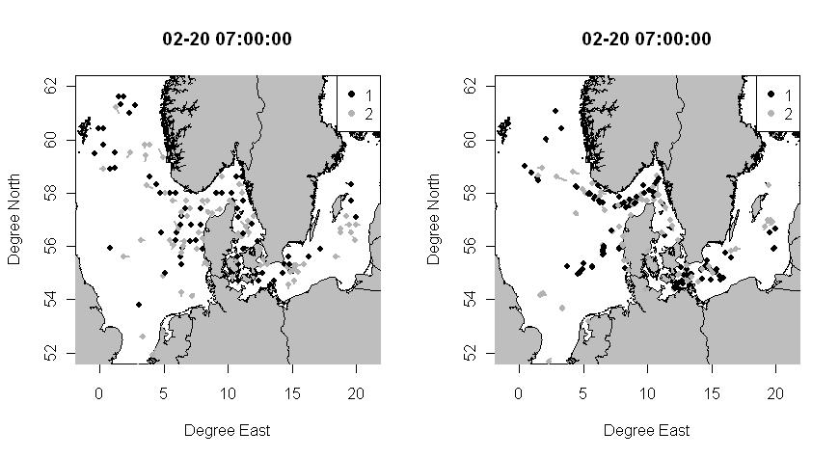
Bio-economic IBM DISPLACE Model
- An example IBM run: Effort and resulting catch / harvest scenario
- A stochastic (IBM) simulation model = forward projection with uncertainties)

Slide 15
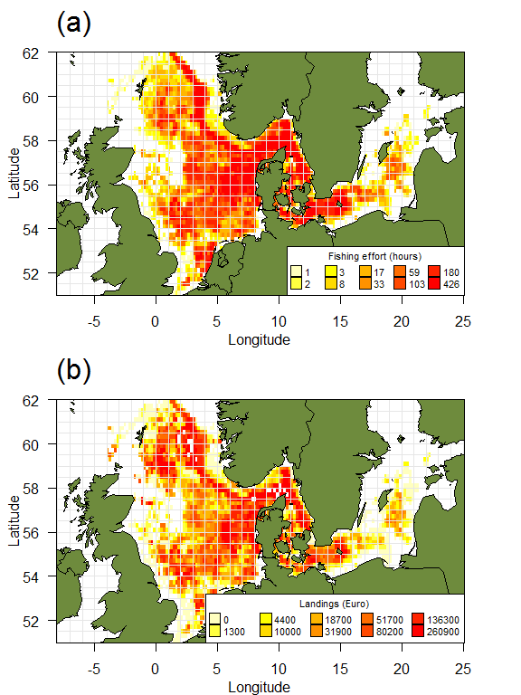
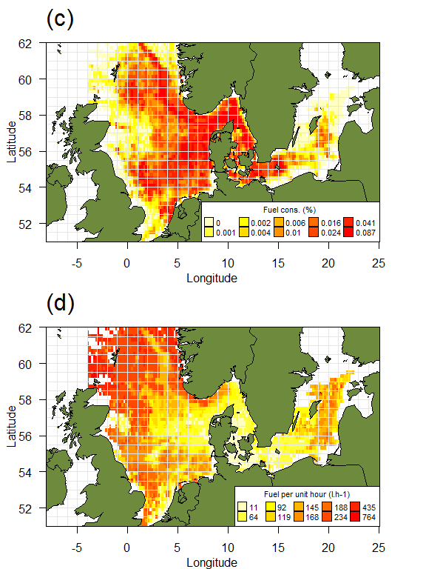
Type of Integrated Output (DISPLACE)
(a) Danish fishing effort (>15m) (b) origin
of landings in value (c) % fuel consump-tion (d) fuel per hour

Slide 16
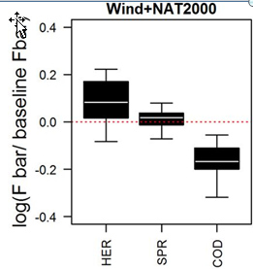
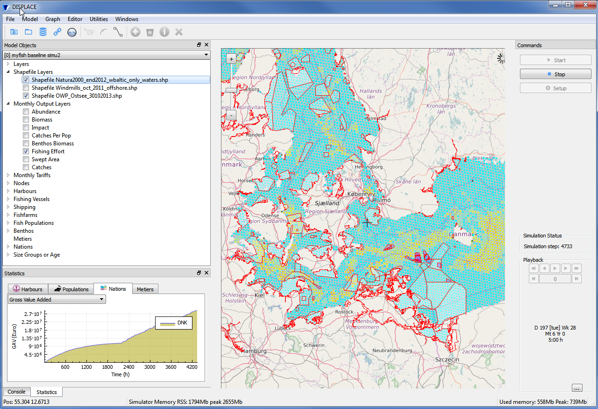
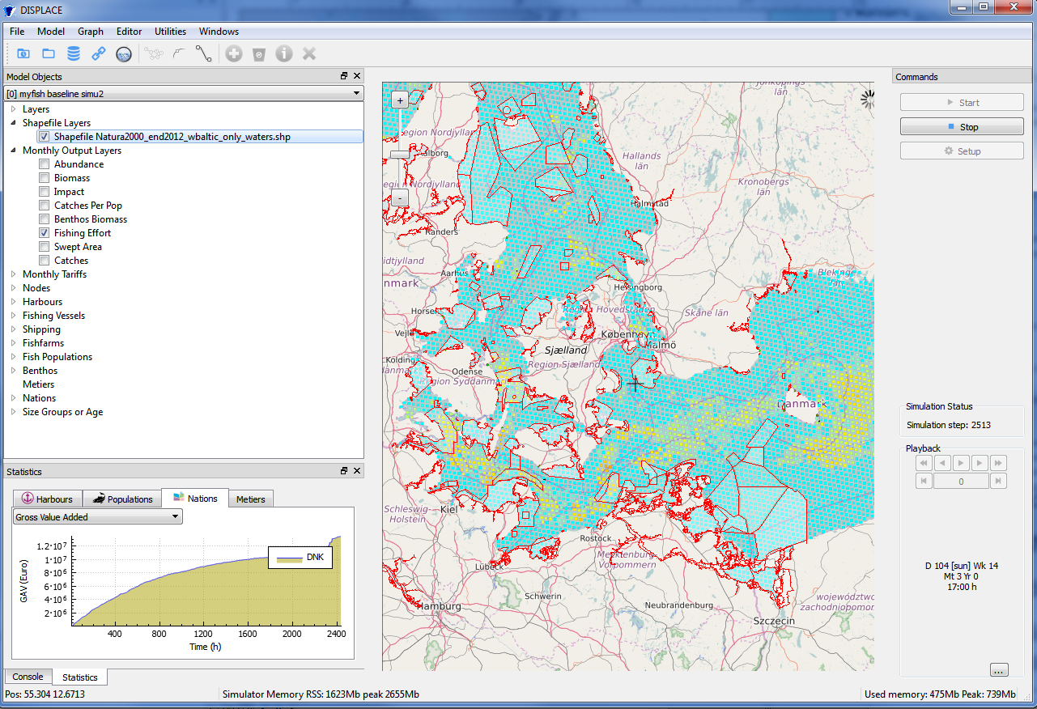
Bio-economic IBM DISPLACE Model: Example of Output (www.displace-project.org) from Run of Spatial Fisheries
Scenarios - BALTIC
Notes:
DISPLACE ex3 – incorporating the impact assessment of various MSP plans i.e. wind mills farms and conservation areas – the plan

Slide 17
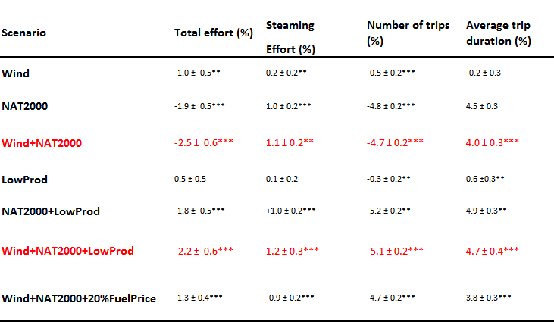
Consequences on fisheries of alternative scenarios – effort and trip patterns

Slide 18
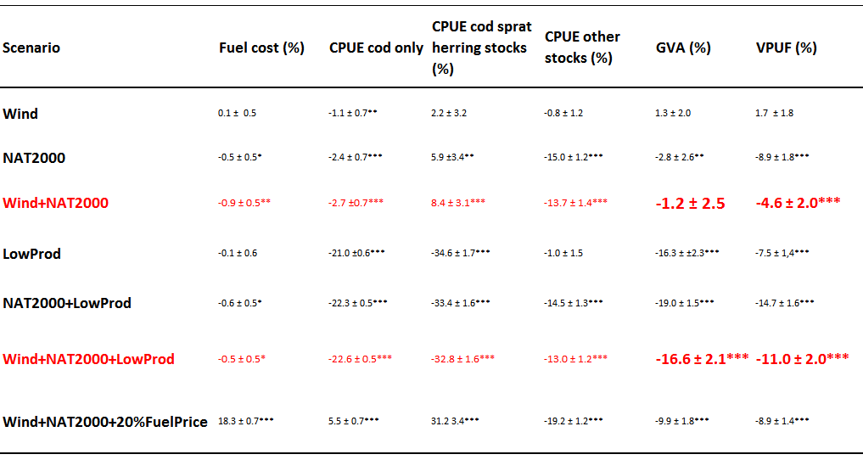
Consequences on fisheries of alternative scenarios – revenue, cost & energy efficiency

Slide 19
Consequences on stocks of alternative scenarios – biological sustainability, SSB (and similar for F)

Slide 20
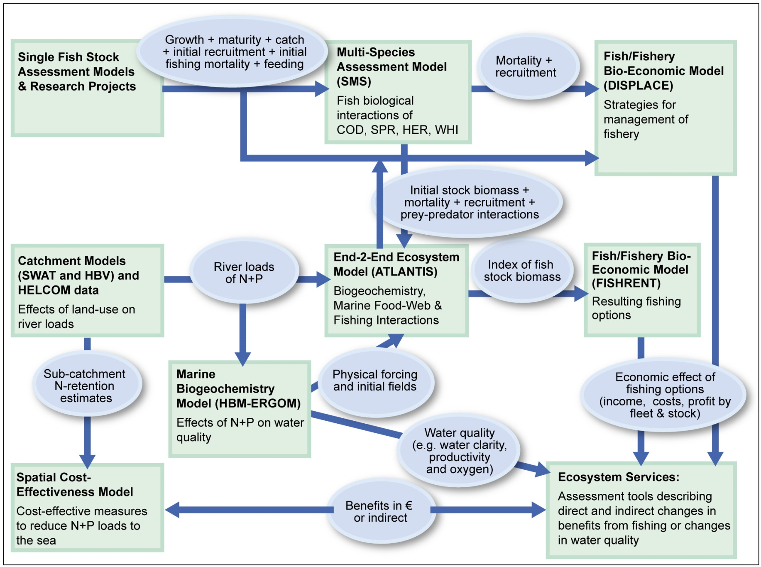
Current Baltic ATLANTIS Conceptual Framework
Illustrating currently operation and envisaged linking within the integrated modeling framework for investigating ecosystem-wide effects of human-induced pressures in Kattegat and the Western BalticATIO
Model linking to bio-geo-chemical and physi-cal models a coope-ration with Marine Living Resources
Further coopera-tion with Ecosystem Based Manage-ment
& Population and Ecosystem Dynamics.

