Slide 1



SenseOCEAN: Development of biogeochemical sensors for autonomous platforms and observatories
Professor Matt Mowlem
National Oceanography Centre
Southampton
U.K

Slide 2

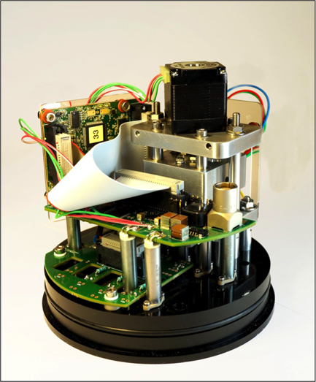
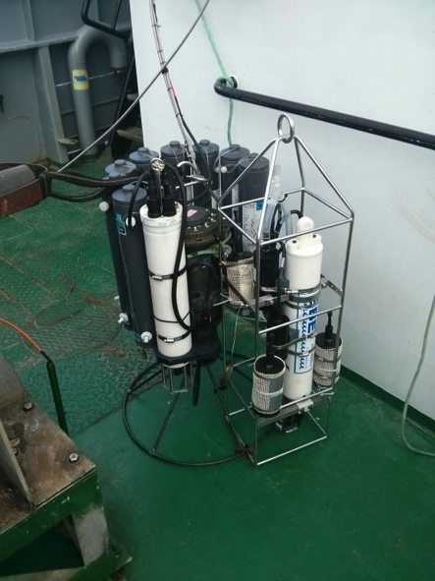
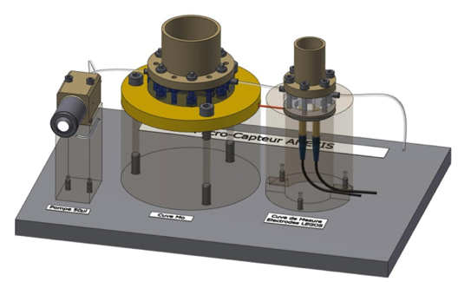
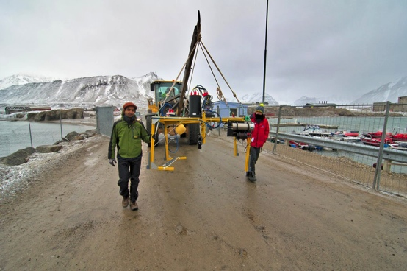

www.senseocean.eu
In situ sensors to measure crucial biogeochemical parameters.
Deployable on many platforms.
Low cost & mass producible.
Using a variety of sensor technologies.
Lab on chip sensor (image courtesy OTE Group, NOC)
Optode sensors mounted on CTD frame ready for deployment (image courtesy E. Fritzsche
Deploying sensors on an observatory system (Hypersub) in Helgoland (image courtesy A. Chennu)
Silicate sensor prototype developed by CNRS (image courtesy CNRS)

Slide 3
Project Outline
12 Partners: 7 Academic and 5 SME
Total budget €5.92 Million
48 months
43 Deliverables
SenseOCEAN: Marine sensors for the 21st century

Slide 4
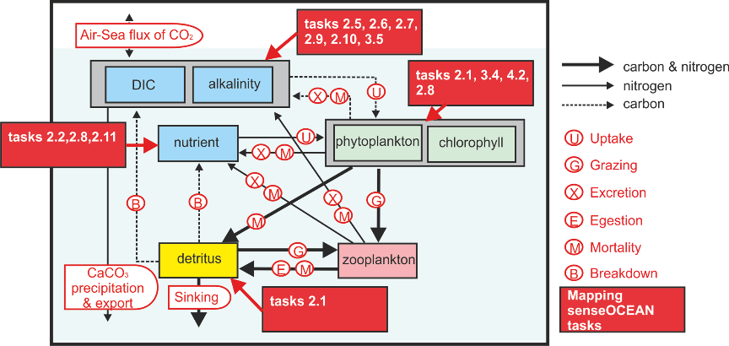
SenseOCEAN: Marine sensors for the 21st century

Slide 5
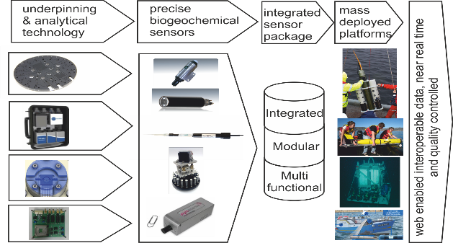
SenseOCEAN Concept
SenseOCEAN: Marine sensors for the 21st century

Slide 6
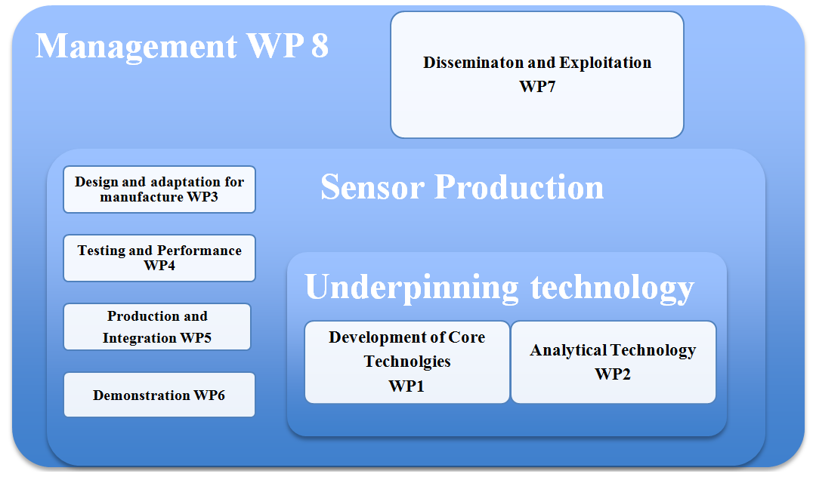
Project Structure
SenseOCEAN: Marine sensors for the 21st century

Slide 7
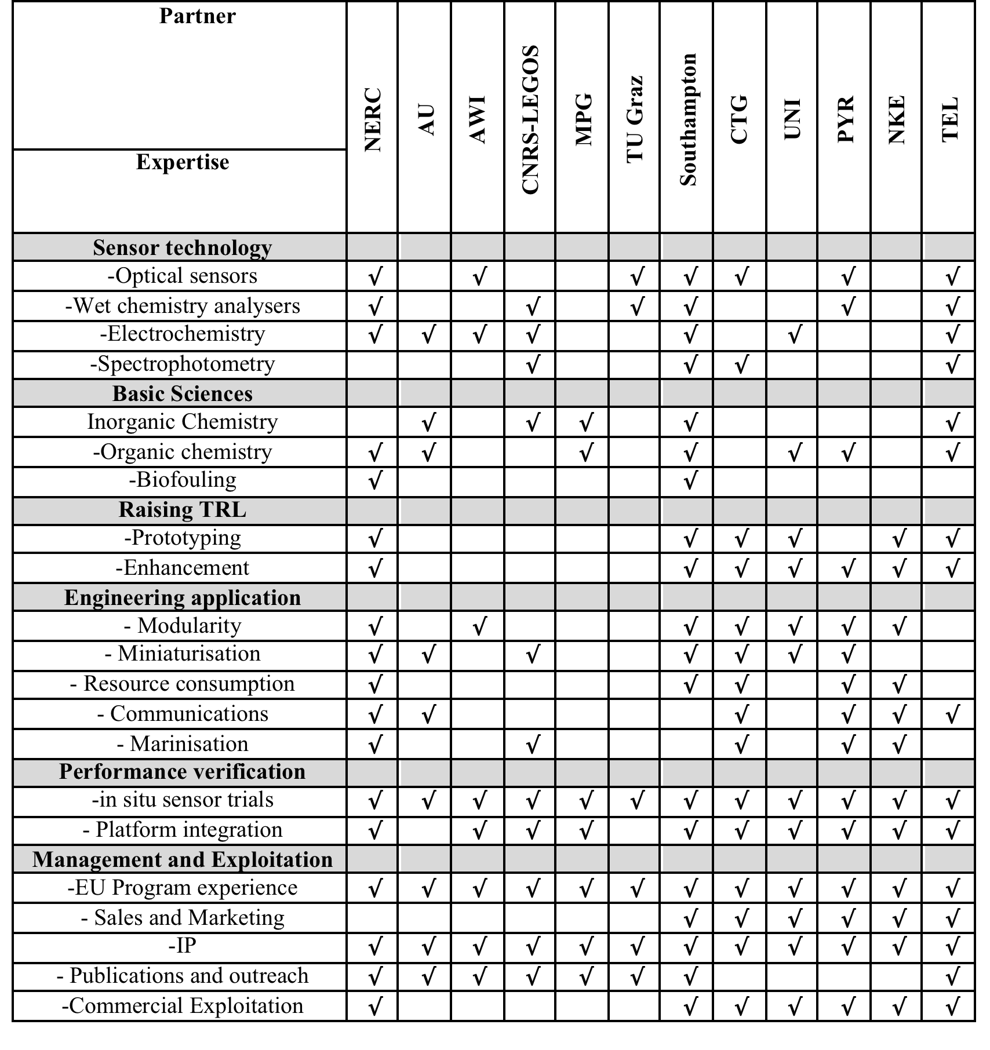
SenseOCEAN: Marine sensors for the 21st century

Slide 8
Underpinning Technologies
Electronic Control And Measurement Processing System
  New embedded system
Communication systems
  Using existing in situ systems (e.g. Iridium implemented on PROVOR)
Data Management
  Conforming to existing standards (e.g. Global Telecommunications System (GTS))
Connectors, interfaces and mechanical systems
  New low cost solutions, modular
Resources and their management
  Batteries, Reagent Stores, On-board Standards
Shared analytical systems
  Common elements (e.g. optical detection)
Biofouling protection – requires collaboration (Oceans 2013.2 and 2013.3
SenseOCEAN: Marine sensors for the 21st century

Slide 9




Proposed approach
Sensor passes UUID through to base station
Platform
Satellite
Base station/
Data centre
Data delivery by SOS server and linked ocean data server
NERC
Linked data
(RDF, SPARQL)
server
UUID
SensorML
SSN (OWL)
JSON LD
Reference for netCDF Link Data conventions:
Yu J. et al. Towards Linked Data Conventions for Delivery of Environmental Data Using netCDF: pages 102-112; Springer., ISBN: 978-3-319-15993-5
netCDF EGO 1.1, CF1.6, LD
Notes:
How it will work

Slide 10
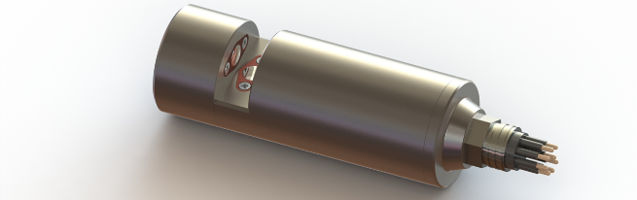
T3.4/D3.3/MS11:
Updated sensor variants
 |  | UV (BTEX) | UV (PAH) | UV (Tryptophan) | Algae
Fluorescence Channel 1 | λex: λem: | 255 685/30 | 255 685/30 | 280 685/30 | 450, 470, 530 & 620 685
Fluorescence Channel 2 | λex: λem: | 255 310/15 | 255 365/50 | 280 365/50
Fluorescence Channel 3 | λex: λem: | 255 450/55 | 255 450/55 | 280 450/55
Absorbance | λex: | 255 | 255 | 280 | 450, 470, 530 & 620
Turbidity | λex: | 860 | 860 | 860 | 860

Slide 11
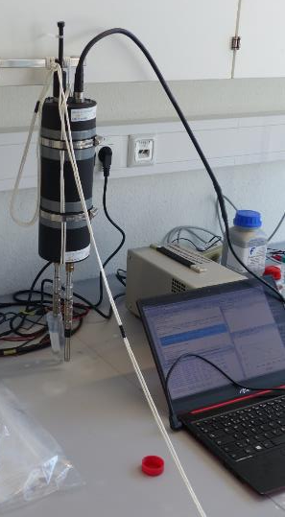
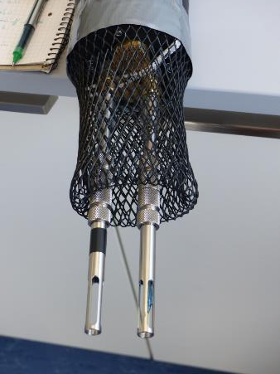
SenseOcean Equipment/sensors test in Kiel
Emilio Garcia-Robledo; Niels Peter Revsbech (Aarhus University)
STOX based sensors for O2 and N20
Electrochem CO2
O₂-STOX
N₂O-STOX

Slide 12
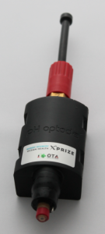
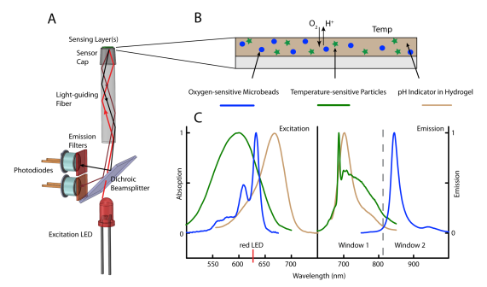
Optodes
Led by TUG/ Pyroscience
Principle: Fluorescence
Parameters:
  O₂,
  pH,
  CO₂,
Objectives
  Accuracy of pCO2: ±1 µatm
  Accuracy of pH: ±0.001 pH
  Accuracy of O₂: <3µmol/l
Notes:
Pour Patrice: les performances ne sont pas mentionnées dans le rapport DOW de SenseOCEAN.

Slide 13
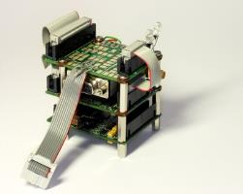

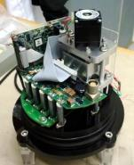
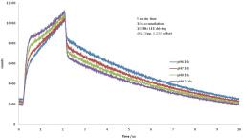
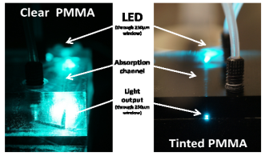
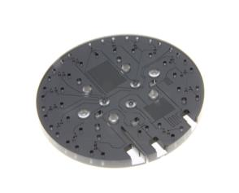
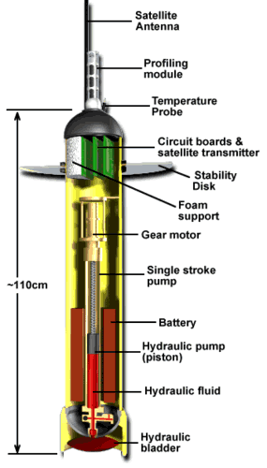
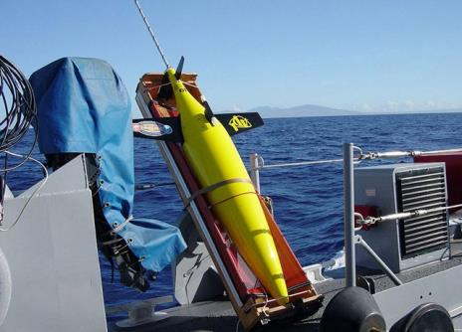
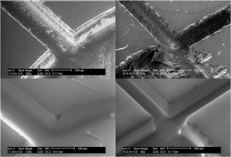

Microfluidic / Lab on Chip
Microfluidics
electronics
Integrated
systems
Assay optimisation
optics
Platforms & comms
Lab on a chip
manufacturing
Biofouling
mitigation
Notes:
We have built the group to develop all aspects of environmental observation systems including: analytical assays (reagent systems); microfluidics theory and design; design and fabrication of lab on chip (including with low-cost manufacture), electronics, optics, integrated systems, integration with platforms development of platforms and communication systems, developing and implementing standards for data quality and flow . This technology is optimised for each application, be that oceanography, river or coastal monitoring, industrial or defence applications.

Slide 14
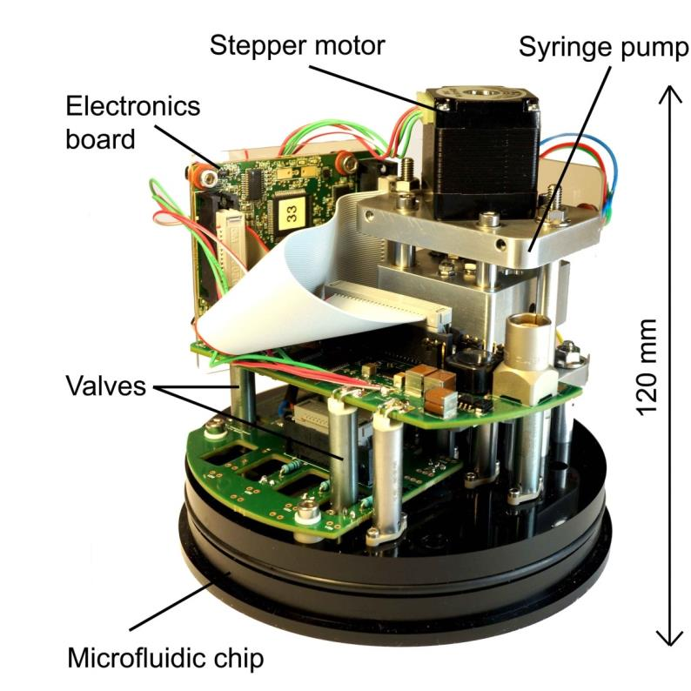
NOC chemical sensor platform
Now operational for several parameters
Platform technology - easy to adapt to other absorbance-based assays
Works at pressure (deepest deployment to date 4800 m)
Small enough for glider/AUV deployment
Low power (year long deployment on batteries achieved)

Slide 15
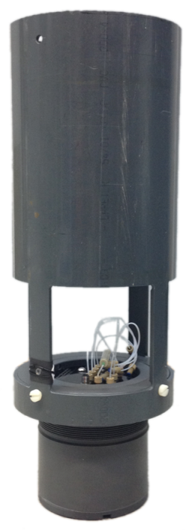
NOC chemical sensor platform
20 cm
Now operational for several parameters
Platform technology - easy to adapt to other absorbance-based assays
Works at pressure (deepest deployment to date 4800 m)
Small enough for glider/AUV deployment
Low power (year long deployment on batteries achieved)
Reagent housing
56 cm
LOC sensor housing

Slide 16
LOC Sensor | Analytical method | Measurement type | LOD/precision*
Nitrate + nitrite | Griess assay (with Cd reduction) | Colourimetry (absorbance) | 20 nM
pH | Thymol blue | Dual wavelength absorbance | 0.001 pH units*
Phosphate | Molybdenum blue (modified) | Colourimetry (absorbance) | 30 nM
Iron (II), Iron (III) | Ferrozine (with ascorbic acid reduction for Fe (III)) | Colourimetry (absorbance) | 20 nM
Silicate |  Silicomolybdic acid | Colourimetry (absorbance) | 20 nM
Ammonium |  OPA + membrane | Fluorescence | 1 nM
Total alkalinity | BCG with TMT or single step  | Dual wavelength absorbance | (2 µM)*
DIC | Membrane+ C of NaOH | Conductivity | (2 µM)*
Organic N and P |  UV digester + inorganic system | Colourimetry (absorbance) | (20 nM)
Notes:
Manganese, arsnic, copper, H2S, other abs-based assays

Slide 17
Nutrient sensing and measurement
Optodes: Ammonia, nitrate/nitrite
Lab on chip: Nitrate/nitrite, phosphate
Electrochemistry: Silicate, Phosphate

Slide 18
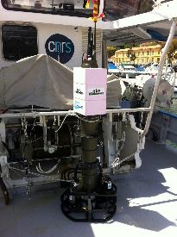
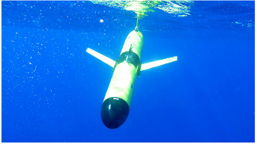
Deployments
Observatories
Gliders
AUV’s
Floats
Optode sensors mounted on CTD frame ready for deployment (image courtesy E. Fritzsche
Deploying sensors on an observatory system (Hypersub) in Helgoland (image courtesy A. Chennu)
Notes:
Gliders undulating path, long term deployments weeks-months

Slide 19
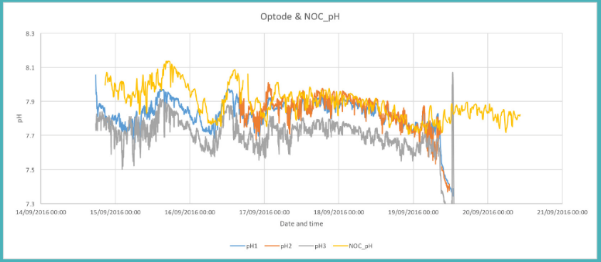
Carbon system parameters
pCO2 – existing off the shelf for underway. Lacking in true in situ systems. Contros, Aanderaa
pH SAMI system, Aanderaa new optodes

Slide 20
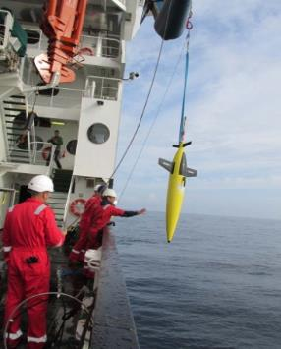
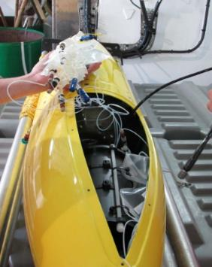
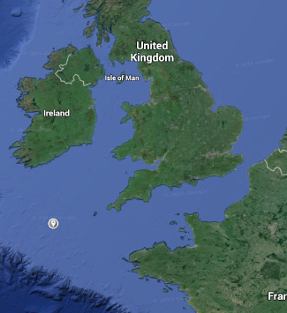
Nitrate deployment on gliders
Celtic Sea, April 2015
Alex Vincent & Maeve Lohan, NOC / SOES (U. Soton)
Notes:
Southwest approaches / Celtic Sea

Slide 21
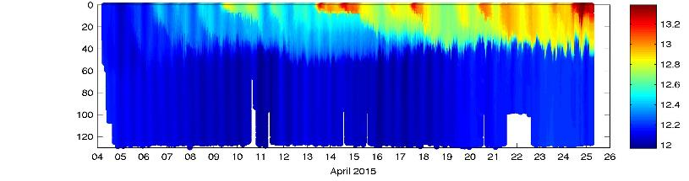
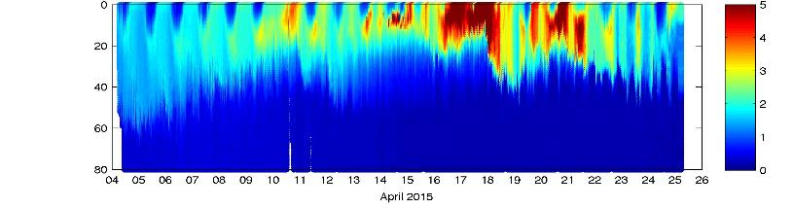
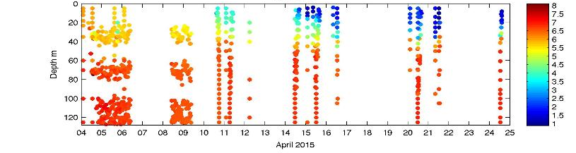
Temperature
(°C)
Chlorophyll
(mg/m³)
Nitrate
(µM)
Notes:
Onset of stratification coincides with start of the spring bloom
Results in large drawdown of Nitrate in surface waters from 6 µM to ~ 1.5 µM
All of this is captured by the nitrate sensor on the glider

Slide 22
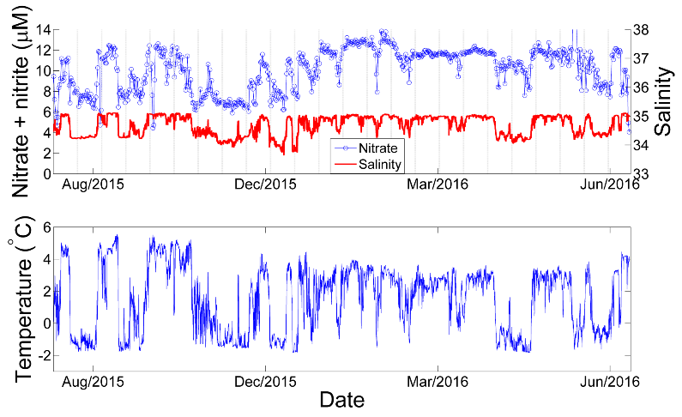
FixO3 TNA: Year-long unattended in the Arctic

Slide 23
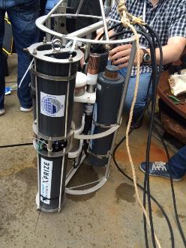
NOC pH sensor field tests
Precision 0.0003 pH (0.3 mpH)
Accuracy limited by CRM (3 mpH)
Gullmar fjord, Sweden June 2015

Slide 24


Slide 25
Project highlights
All sensors have moved from TRL 1-5 to >6 some to 7-8
New generation of optodes
Cost reduced for all sensors by up to €1000 per unit
3 patents pending
Honorable mention in the ACT nutrient challenge
Lab on chip sensor made it to finals of the X-Prize
Full field deployments on multiple platforms
The first deployment of a truly multiparameter marine system
Standardized approach to data management being rolled out to
other projects.
Notes:
150 days for fluorimetr in Arctic
2 years nutrients in UK harbour
Chile, Med, Baltic, Pacific

