Slide 1
MATES Maritime Alliance for fostering the European Blue economy through a Marine Technology Skilling Strategy
Increasing the impact of Marine Training initiatives
Dr. Tim Deprez
Dr. Thibaud Mascart
Brussels, 16 Jan 2018

Slide 2
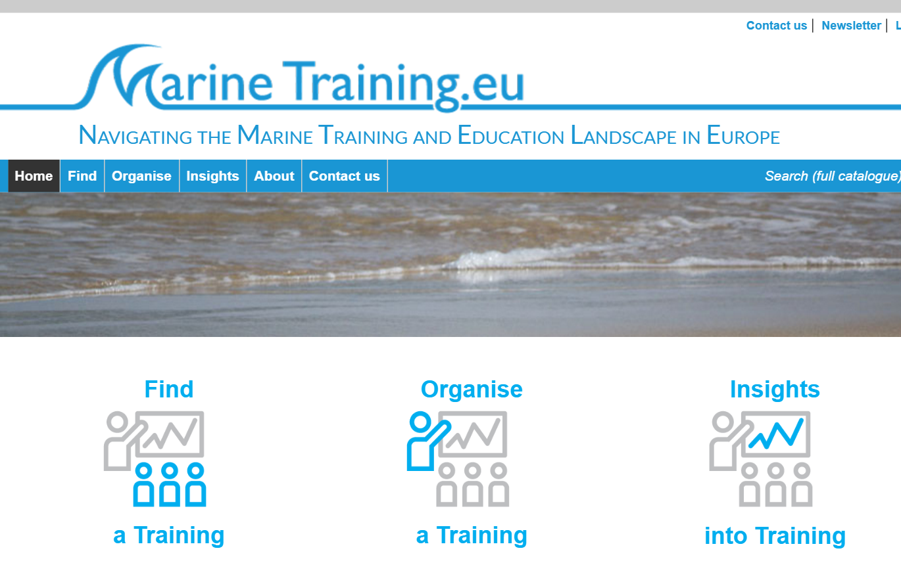
The Marine Training e-Platform
Multiple service provider for European Marine and Maritime training initiatives
A one-stop-shop for
trainees in search of a training
trainers in search of assistance
stakeholders in search of insights

Slide 3
The Marine Training e-Platform
MSc
PhD
CPD
E –learning Platform
Advertisement & dissemination
600+ Programmes
32 thematic fields
400+ Short Courses
16 Languages
50+ Countries
400+ unique visitors/
day

Slide 4
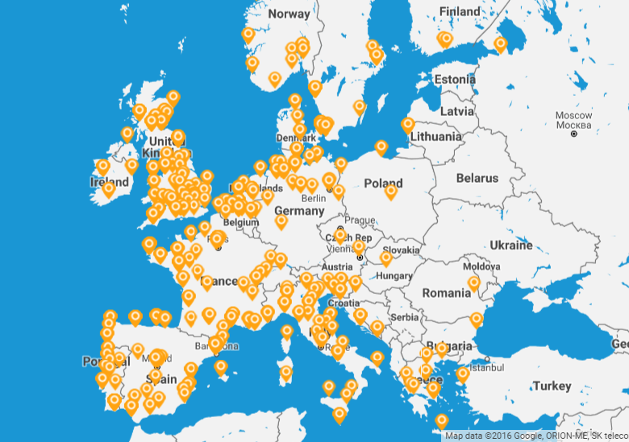
Distribution map of MSc programmes 2016-2017

Slide 5
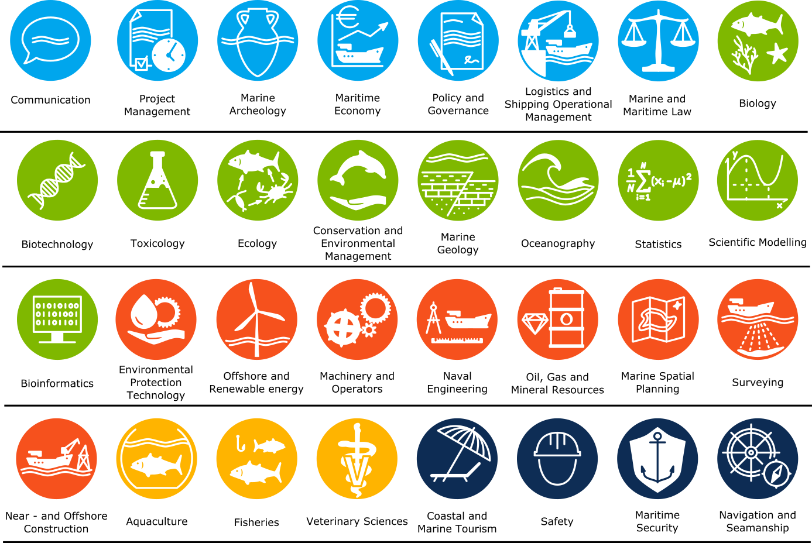
UNESCO Thematic fields of education (ISCED)
Standardised
Comparable
Qualification based
32 “marine” fields

Slide 6
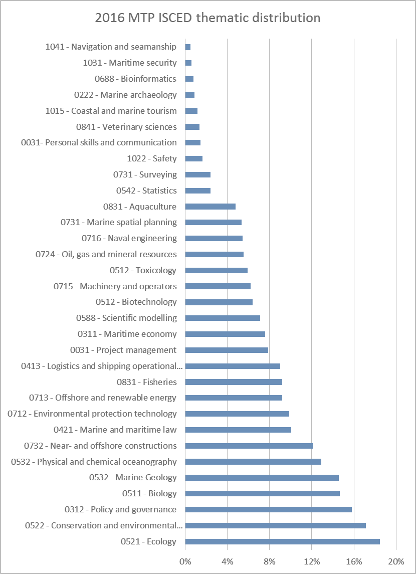
Current EU HE content
Ecology = 18.5%
Conservation & environmental management = 17.1%
Near- and offshore constructions = 12.1%
Maritime security and navigation & seamanship = 0.5%

Slide 7
How to bring MATES to the industry
Work in close cooperation with local Industry Clusters and build on existing networks

Slide 8
Our involvement in MATES
In order to enhance competitiveness and innovation capacity:
Co-host a regional workshop (Belgium-Netherlands) (WP2)
Transversal support for pilot experience outreach (WP4)
Creation of an integrated MATES training information portal made available through the project website (WP6)
Draw final conclusions for decision makers and relevant stakeholders for their use in the future (WP5)

Slide 9
Seas do not have boundaries…education shouldn’t either !
Tim.Deprez@UGent.be

