Slide 1
EMODnet Bathymetry - High Resolution Seabed Mapping – part I
EMODnet Project Web Conference 20 March 2020
Dick M.A. Schaap
MARIS (NL)

Slide 2
Main aims and consortium
To produce the best harmonised, and higher resolution Digital Terrain Model (DTM) of all European seas on the market
To gather as input, bathymetric datasets, collected by European organisations
To make the European DTM available for users by means of viewing and downloading services and OGC machine to machine services, and with metadata links to used data sets
Consortium of national hydrographic services, marine research institutes, survey companies, and bathymetry and IT experts.

Slide 3
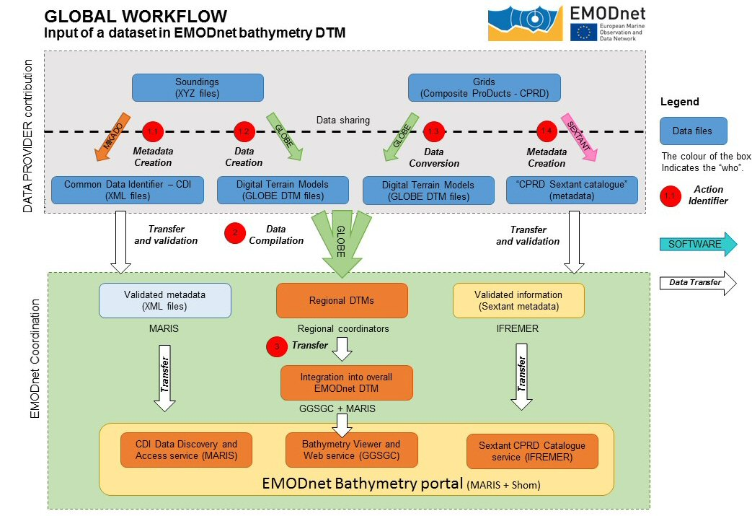
Methodology

Slide 4
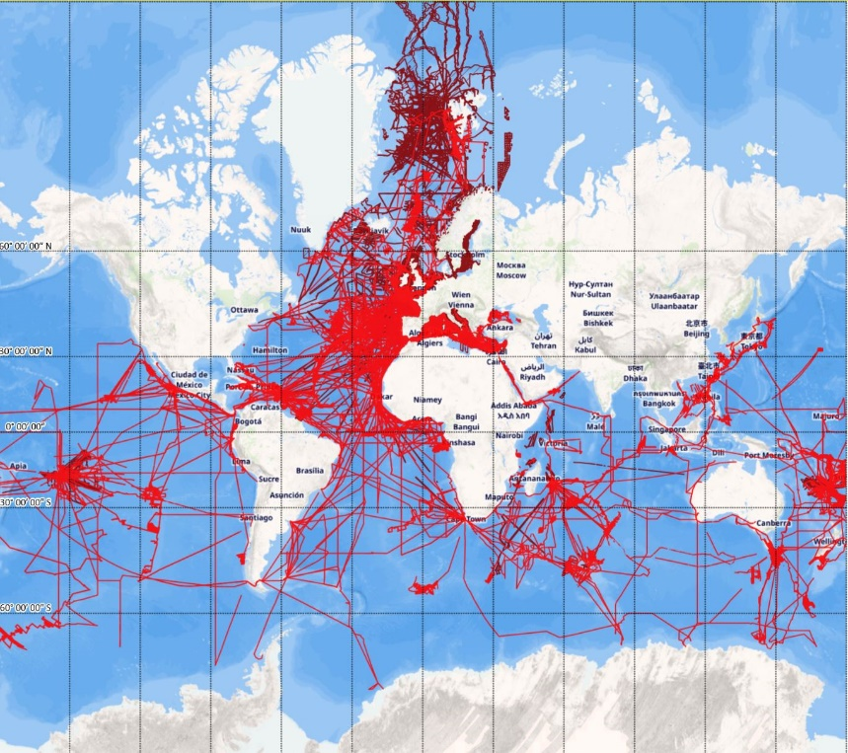
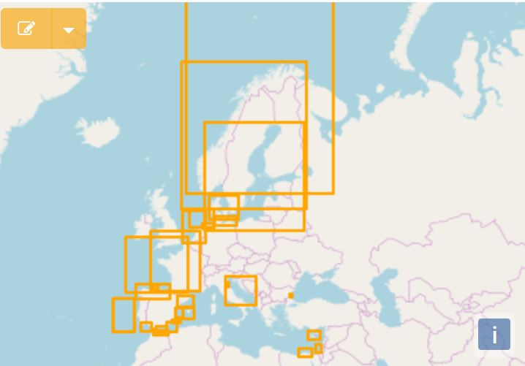
Data gathering results
Circa 27500 survey CDI metadata records from 42 data centres from 21 countries and 278 data originators from 1816 to 2019
Circa 180 composite DTM Sextant metadata records from 36 data centres from 18 countries

Slide 5
DTM latest release
September 2018: eighth release of EMODnet DTM with 1/16 * 1/16 arc minutes, including coastal zones, with 3D visualisation, and hot spots with higher resolution. Approx. 12.3 billion grid nodes versus GEBCO 933 million grid nodes. Based upon 9369 unique CDI references and 87 DTM references

Slide 6
Users
2019: EMODnet portal and services are very popular among researchers and industry users. Circa 52.000 viewing portal visitors and 44.000 web portal visitors.
38.000 DTM tiles were downloaded by 4.000 unique users from 2100 unique organisations and more than 115 countries during more than 11.000 transactions: 20% industry, 20% research, and 40% universities
OGC web services (machine-to-machine) also are very popular with more than 20 million WMS views in the reporting period by circa 170.000 visitors.
Google Scholar: more than 150 references to EMODnet Bathymetry in accepted papers and edited books during the reporting period.
60 feedback forms received and answered, all positive
Since 2008, more than 200.000 DTM tiles downloaded

