Slide 1
Overview of Shirshov Institute of Oceanology Russian Academy of Sciences research in framework national, transnational and international activities in the Black Sea
Tamara Shiganova,
P.P.Shirshov Institute of oceanology Russian Academy of Sciences

Slide 2
National research in the Black Sea was conducted with support :
Ministry of economical development 1998-2013
Ministry of Education and Sciences
Russian Academy of Sciences
Russian Federal agency since 2014

Slide 3
National research programs in the Black Sea which support research :
Long –term all-Russian Program “ The World Ocean” of Ministry of economical developments 1998-2013
Ministry of Education and Sciences. Research projects. One of the relevant project “Invasive species in the Black and Caspian Sea with creation website ” Head Shiganova T.A.
Russian Federal agency support expeditions since 2014 –present time
Program of fundamental investigations of Presidium RAS :
Fundamental investigations of oceanology: physics, geology, biology and ecology 2001-2014
«The World Ocean” Multyphases, multyscales, multycomponents 2015 -2017. Support expedition projects,
project “Biodiversity, Living researches, Invasive species”.(IPEE-head)
Invasive species Head Shiganova T.A.

Slide 4
International programs and projects
COMSBlack 1991-1993
NATO-Tu Black Sea in1992-1993; 1993-1995 (METU).
NATO ARW Baku, 2002 (Shiganova T.,Dumont H)
Black Sea Environmental program (UNEP) (1993-1996)
EROS 1995-1997 (EC Black Sea, Danube area )
EU FW-5 SEA SEARCH (Efremer, France), EU FW-6: SEADATANET(Efremer, France), Black Sea Scene (Maris, Netherlands) , Black Sea Scene1 (Maris, Netherlands) ,
IASON, SESAME (Hellenic National centre of Marine research) (Greece)
ENCORA 2007-2009
Network of excellence EUROOCEAN 2002-2006 (Villefranche sur Mer, France)

Slide 5
EC projects RW-7
FW-7 CASPINFO (Maris, Netherlands) , BLACK SEA SCENE2 (Maris, Netherlands) , SEADATANET 2,3 (Efremer, France) PERSEUS ((Hellenic National centre of Marine research) (Greece) ,
COCONET (Universita' del Salento. Lecce )
EMODNET I II, III (OGS Istituto Nazionale di Oceanografia)
EMBLAS I, EMBLAS-2, project EC and UNDP
Sea basin check point NoMARE 2014/09
SeaDataCloud H2020-INFRAIA-2016-2022GA 730960 (Maris, Netherlands)

Slide 6
SIO RAS bilateral interacademic cooperation
with Hellenic National centre of Marine research (Greece) 2001-2006,
Biological lab in Piran of University of Ljubljana (Slovenia) 2003-2015,
Lab Oceanography in Villefranche sur Mer. (France) 2005-20013;
Head from Russia Shiganova T.A.
Russian basic foundation projects for group of scientists.

Slide 7
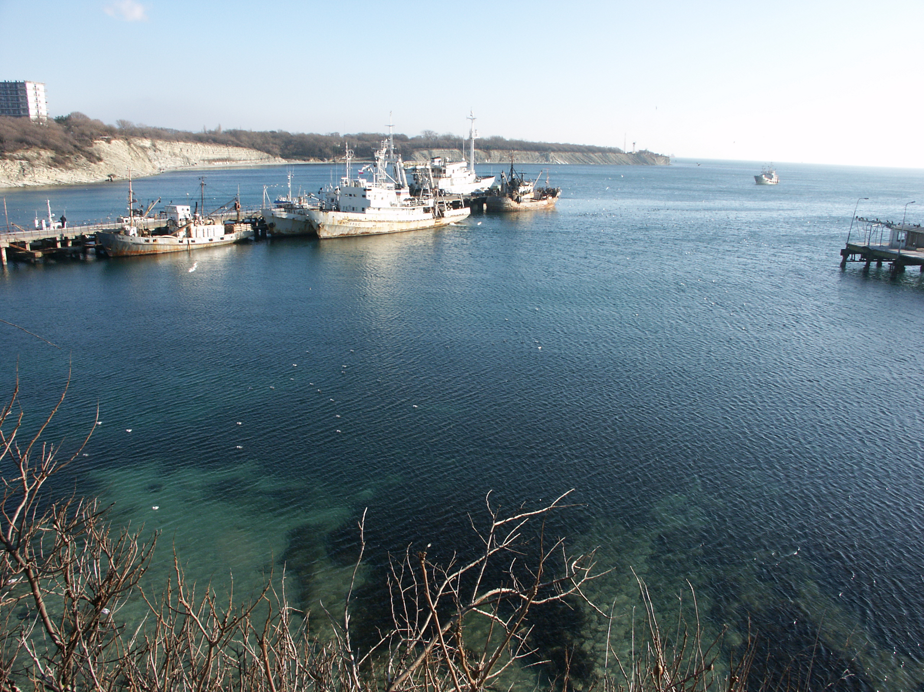
Southern branch of SIO RAS has pier and some research ships.

Slide 8
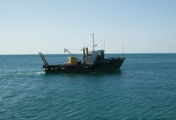
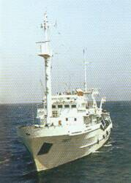
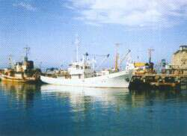
Research boat “Ashamba”
Research vessel “Rift”
Research vessel “Akvanavt”

Slide 9
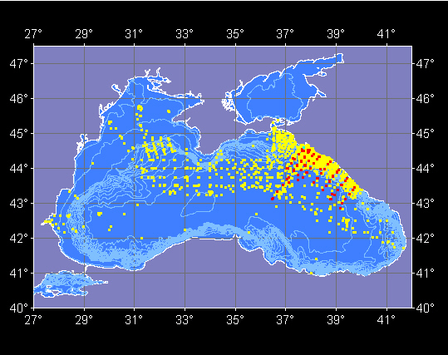
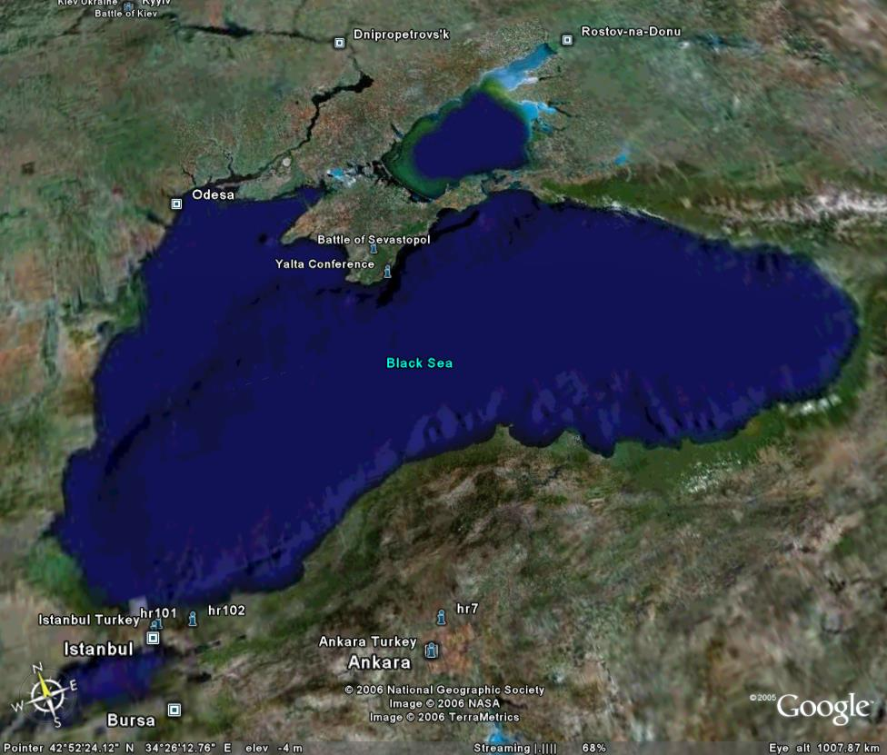
Gelendzhik

Slide 10
Joss Russian Federation in June 2016 (EMBLAS-2)

Slide 11
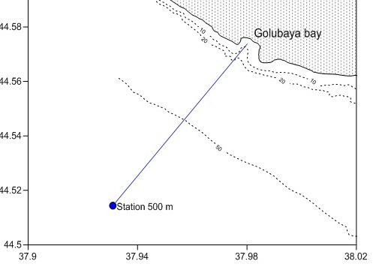
Sampling area along transect

Slide 12
Studied parameters
Microplankton (bacteria)
Phytoplankton
Mesozooplankton
Macrozooplankton, including gelatinous
Ichtyoplankton
Invasive species
Hydrophysical parameters
Hydrochemical parameters
Litter in the sea and at the shore
Benthos

Slide 13
Data quality control of biological parameters
Methods of sampling was standardized with all the Black Sea countries
Procedure of inter-calibration sampling was provided during international cruises
Net catchabilities was compared and coefficients of differences were estimated,
Quality of samplings is always accurate repeated hauls.
Proceedings of samples and estimations abundance and biomass were standardized during participating in international programs

Slide 14
The main focus of research

Slide 15
Invasive species Chronology of species invasions into the Black Sea
Ballast tanks constraction
T⁰ rising
Start of disturbance
11

Slide 16
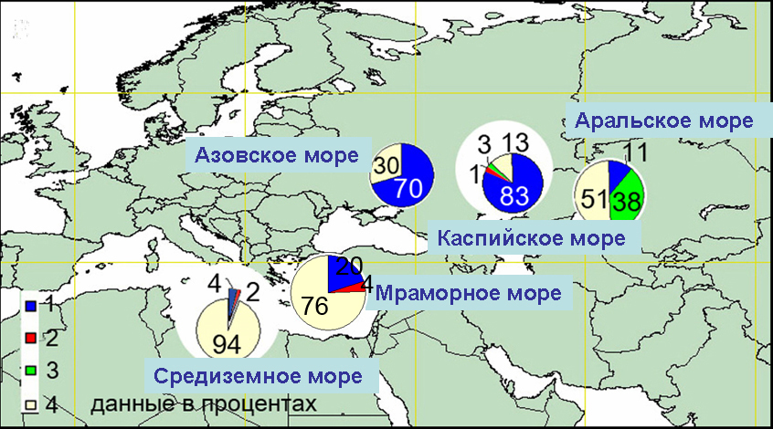
Proportion (%) of species, penetrated from the Black Sea (1), probably from the Black Sea (2), Sea of Azov (3) other areas (4)
Aral Sea
Sea of Azov
Caspian Sea
Sea of Marmara
Mediterranean Sea
Data in percents
Shiganova,2010, Annual review on ecology and evolution

Slide 17
Interannual development M.leidyi and B.ovata
Invasive ctenophores

Slide 18
Long term zooplankton variability under effect of M.leidyi and B.ovata

Slide 19
Ichthyoplankton
Occurrence fish eggs in May-November 2016 according to all data

Slide 20
Occurrence fish larvae in May-November 2016 according to all data

Slide 21
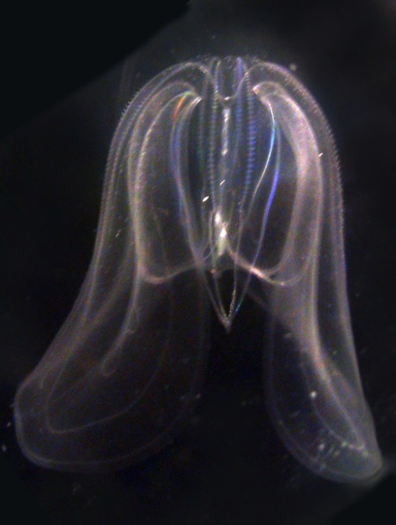
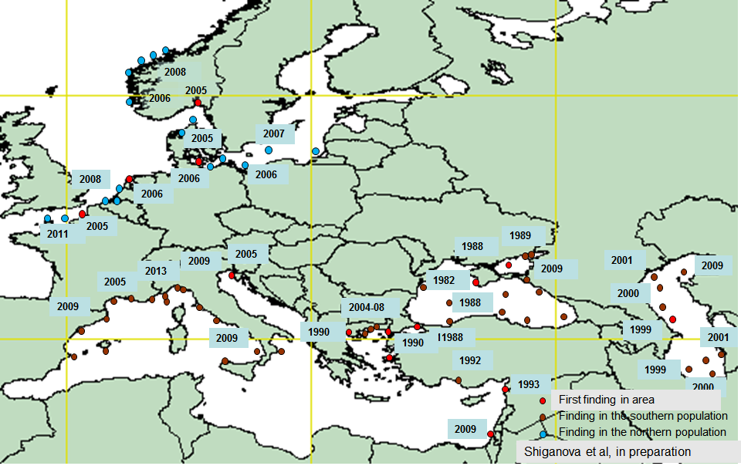
Chronology of Mnemiopsis leidyi invasion and dispersal in the seas of Eurasia
Mnemiopsis leidyi
Shiganova et al., 2017

Slide 22
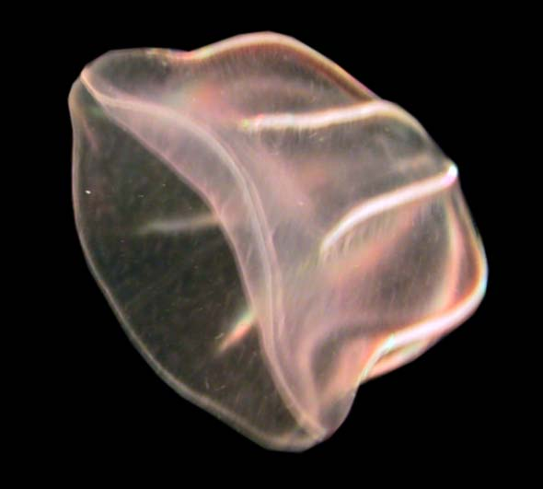
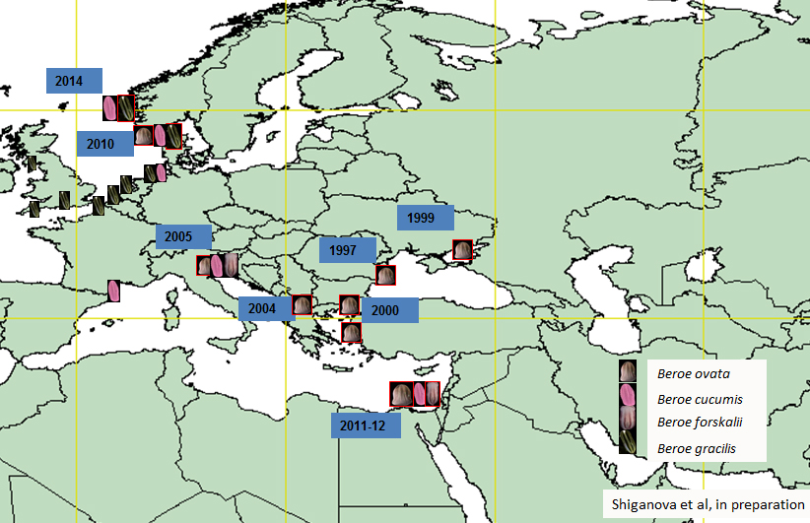
Chronology of Beroe ovata dispersal in new basins, expansion of Beroe cucumis, Beroe forskalii in the Mediterranean Sea and Beroe gracilis in the Baltic Sea from the North Sea Red frame showed that species invaded in area
Beroe ovata
Shiganova et al.sub

Slide 23
Haplotype distribution and frequency map for Mnemiopsis leidyi. Allele (inner circle for ITS) and haplotype (outer donut for COI) distribution. Each color indicates a different allele/haplotype. Private alleles/haplotypes are highlighted in grey).
Population genetic analyses supported its invasion from the Gulf of Mexico (e.g., Tampa Bay) into the Black Sea, then secondary into the Azov, Caspian seas and the eastern and western Mediterranean (Ghaboolii,Shiganova et al., 2011; Ghaboolii, Shiganova et al,2013 PLOS ONE)

Slide 25
Ecological status of marine environment (GES), in the northeastern Black Sea on the base macro- and mesozooplankton state indicators in 2016.

Slide 26
Our results according to Water Framework Directive
Biomass of copepods (%) - contribution of copepods biomass to total mesozooplankton biomass comprised 13-26% at the depth 500 m and only 0,5-5% of biomass in coastal waters and shelf. Particularly low percent of Copepoda is recorded during peak of M.leidyi development in July and early August 1,2-4% in shelf waters, which is not corresponded to GES in coastal and deep waters areas although at the depth 500 m percent of Copepoda is higher 26,6% before and 13% during and after peak of M.ledyi. The GES boundary was estimated to be 42%.
Shannon-Weaver index (bit·ind-1) – reflects the number of species in a dataset, taking into account how evenly the basic entities (such as individuals) are distributed among species. So this index reflected total biodiversity of mesozooplankton. The boundary for good status was accepted 3 bit·ind⁻¹ for coastal and shelf habitats, while 2.5 bit·ind-1 was for open sea. The index was low 1,2 in the open sea and 0,3 in shelf.

Slide 27
Biodiversity: changes in taxonomic composition of phytoplankton
Share (%) of different phytoplankton groups in the total phytoplankton biomass (May-October)

Slide 28
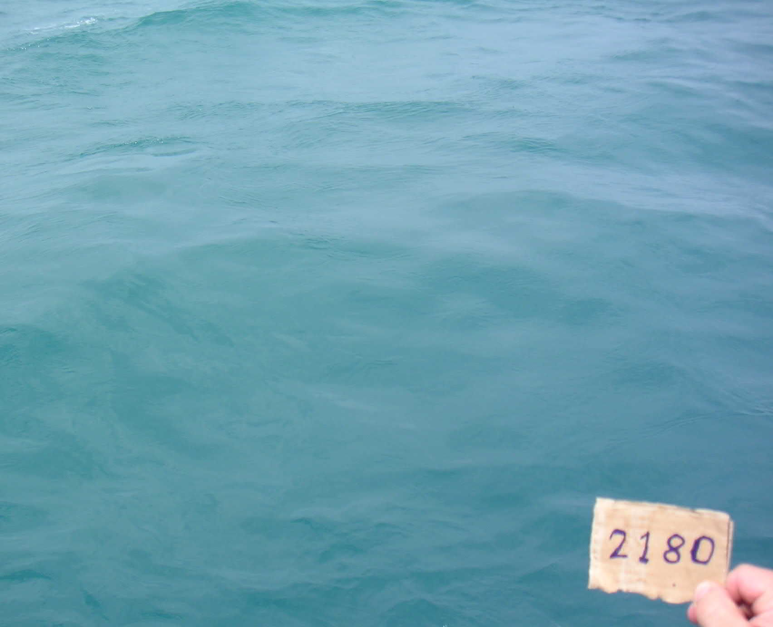
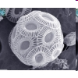
Phytoplankton Coccolithophore blooms
Changes in biomass, scan photo of the coccolithophore cell (6 microns) and typical color of water during the bloom

Slide 29
Data base
Phytoplankton
Mesozooplankton
Gelatinous plankton
Site: invasive species in the Black and Caspian Sea : http://inviders.ocean.ru/

Slide 31
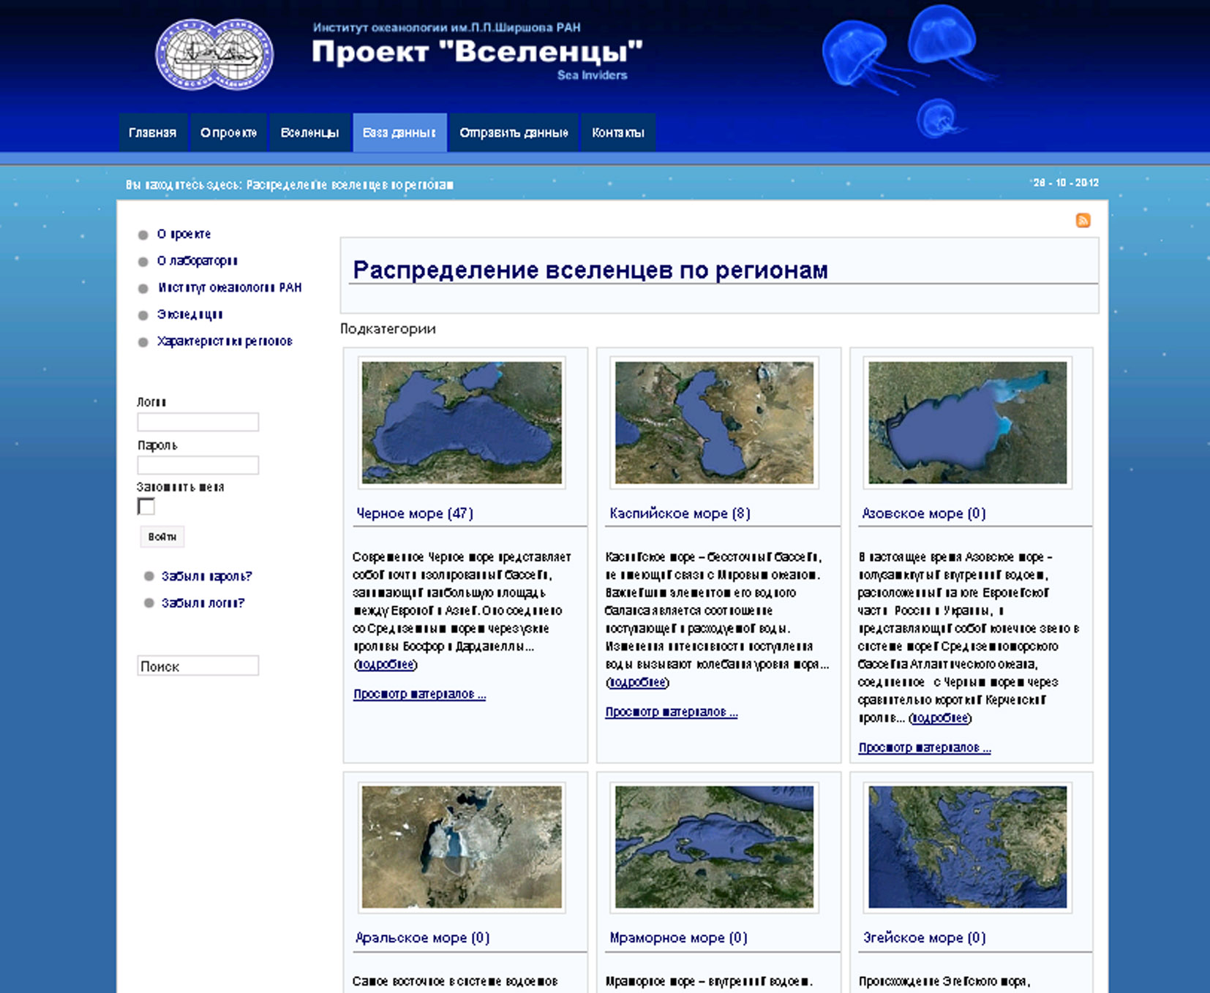

Slide 32
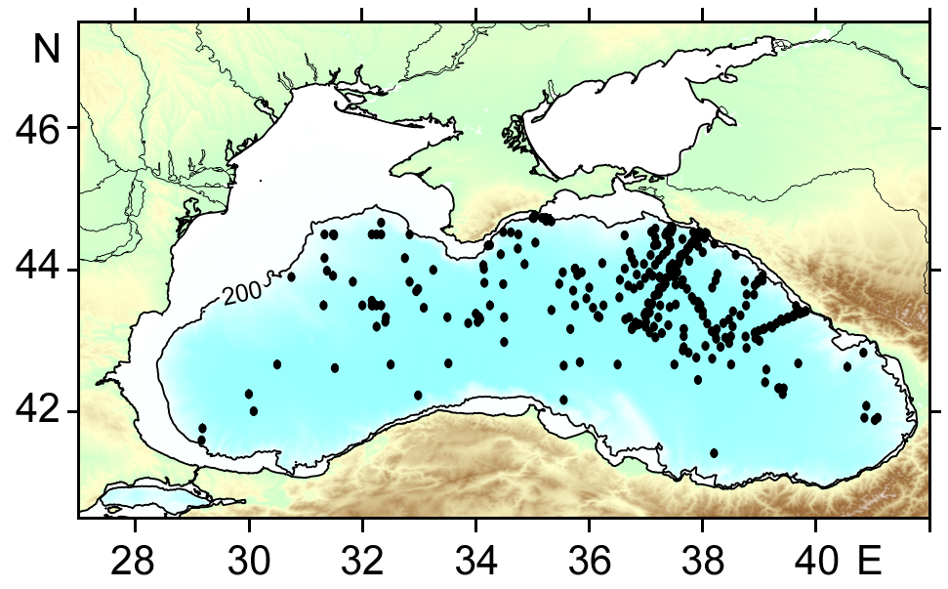
Database on phytoplankton of the deep Black Sea with the species level entries (Mikaelyan,SIO RAS)
Locations of sampling sites deeper 200 m.
Mikaelyan et al., 2006

