Slide 1
Strategy 2018-2022
Overview of working draft v. 29 January 2018
8 February, 2018
Notes:
EOOS Steering Group : Tasked with developing the Strategy and Implementation Plan (led by co-Chairs)

Slide 2
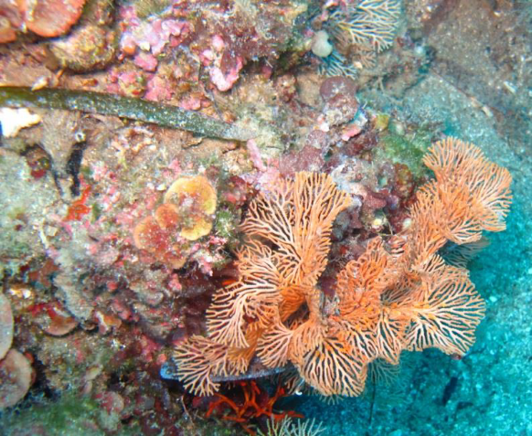
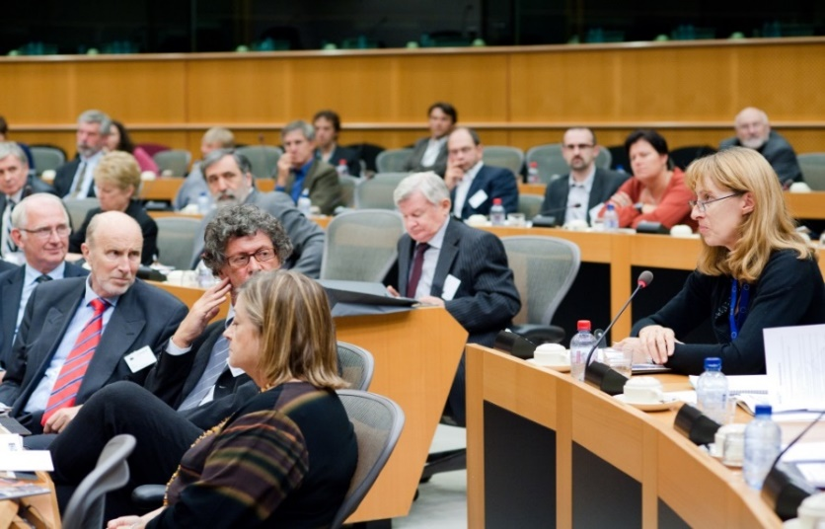
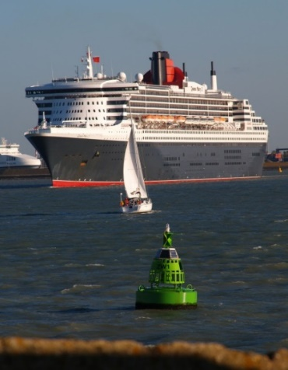
“Recognizing the fundamental role of stakeholders in driving and implementing EOOS, this strategy is prepared by the EOOS Steering Group based on an open stakeholder consultation on EOOS.”
draft EOOS Strategy v.29 January 2018
Notes:
The working draft will be available for open stakeholder consultation by the EOOS Forum on 8 March 2018, for finalization by the EOOS Conference on 21-23 November 2018.
Stakeholders are a central component of EOOS, driving its development, informing on the latest innovations and implementing actions. The EOOS Consultation Document specifies “EOOS is intrinsically a bottom-up process, elements of which are already taking place at various geographical scales.”

Slide 3
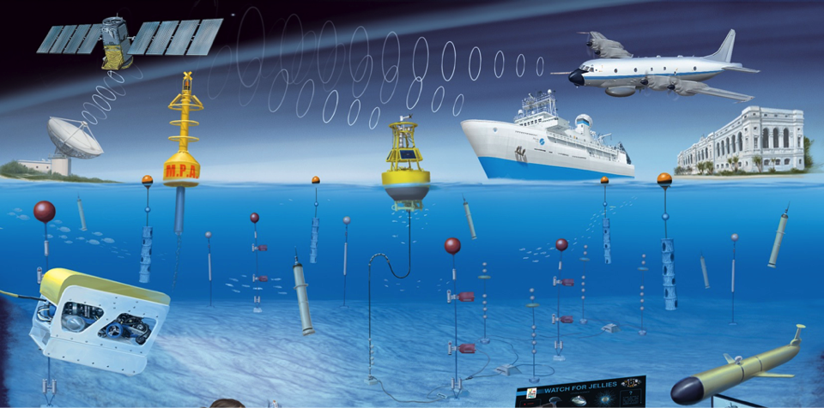
“There exist many European ocean observation and wider marine networks. However, there is currently no single framework representing the full diversity of European ocean observation and monitoring, its stakeholders, capabilities, and services.”
draft EOOS Strategy v.29 January 2018
Notes:
Why is this end-to-end coordination needed?

Slide 4
A more coordinated community would enable:
- Sustainability and cost-effectiveness
Fitness-for-purpose and adaptability
Societal value – information and services on ocean, climate
“Europe must use the enormous potential of its infrastructure capacities, knowledge and resources to take a leading role in the development of the world’s ocean observing.”
Vladimir Ryabinin, IOC, UNESCO, EOOS European Parliament Event, September 2016 [quote tbc]
draft EOOS Strategy v.29 January 2018
Notes:
Bottom line: Cost-effectiveness and societal value
“In the EU, 50% national budgets for marine science on operating and replacing marine infrastructure assets” (GOSR, 2017; EMB, 2007)

Slide 5
draft EOOS Strategy v.29 January 2018
Notes:
In front of you a hard copy of the draft Strategy
Brief: high level document

Slide 6
Definition
The European Ocean Observing System, EOOS, is a coordinating framework designed to align and integrate Europe’s ocean observing capacity in the long-term; to promote a systematic and collaborative approach to collecting sustained information on the state and variability of our seas; and to underpin sustainable management of the marine environment and its resources EOOS Consultation Document, September 2016
Scope: European capability in ocean observation across the global ocean.
draft EOOS Strategy v.29 January 2018
Notes:
EOOS concerns all ocean observation activities led by European stakeholders, both within the European Exclusive Economic Zone (EEZ) and beyond.

Slide 7
Vision
By 2030, EOOS aims to achieve a coordinated and connected end-to-end European ocean observation community promoting European leadership, innovation and sustainability, driven by stakeholders, serving the needs of science, society, and innovation. To achieve this vision, EOOS will be multi-sectoral and cross-discipline, connecting the diverse stakeholder communities actively working in the area of ocean observation across Europe.
draft EOOS Strategy v.29 January 2018

Slide 8
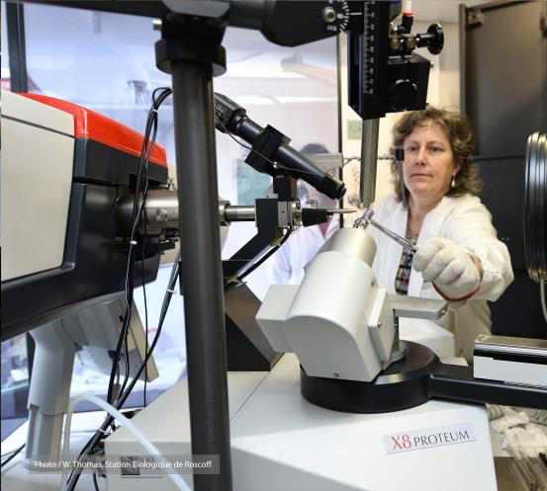
By and for the communities
“EOOS is intrinsically a bottom-up process, elements of which are already taking place at various geographical scales.”
draft EOOS Strategy v.29 January 2018

Slide 9
By and for the communities
Specifically, EOOS will:
Align and integrate existing initiatives to ensure efficiency and value for money and to eliminate duplication of effort;
Identify gaps in our observing capacity and foster initiatives to fill those gaps;
Promote standardization of the end-to-end system from observation collection to data management and products;
Drive capacity building and provide leadership for ocean observation;
Promote the ocean observing services for multiple sectors including research, policy, management and industry; and
Promote a common European voice and integration at the international level.
draft EOOS Strategy v.29 January 2018
Notes:
Heard about the EOOS process and the progress to date.
\The working draft will be available for open stakeholder consultation by the EOOS Forum on 8 March 2018, for finalization by the EOOS Conference on 21-23 November 2018.
Stakeholders are a central component of EOOS, driving its development, informing on the latest innovations and implementing actions. The EOOS Consultation Document specifies “EOOS is intrinsically a bottom-up process, elements of which are already taking place at various geographical scales.”

Slide 10
By and for the communities
EOOS will be a framework and focal point to:
Discuss and implement the Essential Ocean Variables (EOVs) for Europe;
Bring together wider time-series of oceanic measurements (e.g. regular hydrographical, biological data sets);
Share innovations and latest developments in ocean observation technology and best practice.
draft EOOS Strategy v.29 January 2018
Notes:
EOOS will also create a framework for wider time series where regular measurements are taken of ocean variables (e.g. biological time-series stations) that have a societal relevance for understanding the ocean system, specific monitoring or assessment needs at local, national or other levels, or that serve a particular stakeholder need e.g. data for industry activities. EOOS will provide a framework for an innovative, adaptable ocean observing system that can respond to new needs, apply emerging technology and invest in observations that may currently have a low feasibility (low Technology Readiness Level, TRL) but would have a high societal impact.

Slide 11
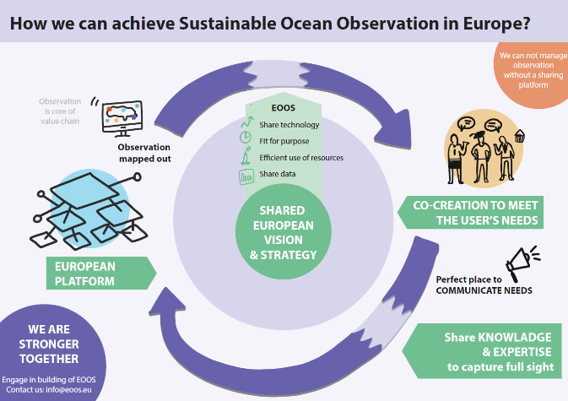
By and for the communities
+ Foresight
draft EOOS Strategy v.29 January 2018
Notes:
Regular process for stakeholder input, co-creation of implementation actions

Slide 12
Governance
“EOOS will have a light governance structure that is flexible and adaptable, placing stakeholder dialogue and input at its core.”
draft EOOS Strategy v.29 January 2018
Notes:
EOOS is a framework not a member organization aiming to help coordinate, advance and innovate European capability. In its initial stages, EOOS coordination has been promoted and taken forward by EuroGOOS and European Marine Board through the establishment of the EOOS steering group.
The EOOS stakeholder consultation included further feedback on potential governance models for EOOS. The majority of the respondents indicated a preference for a bottom-up governance model with light strategic coordination and strong member state and stakeholder involvement.

Slide 13
Governance
Steering Group: Strategic and coordination planning, including implementation of coordination and community actions.
(EuroGOOS, EMB, EC (3 DGs), JPI-Oceans, national experts)
Coordination team: jointly led by EuroGOOS and the European Marine Board. Coordination includes structured dialogue and contributions from other European networks and initiatives.
Stakeholder Engagement: Fora and conferences bringing together all EOOS stakeholders for an interactive dialogue and agreeing the main directions. An Advisory Committee for the EOOS events has been set up (KoM 8 February 2018)
draft EOOS Strategy v.29 January 2018
Notes:
EOOS is a framework not a member organization aiming to help coordinate, advance and innovate European capability. In its initial stages, EOOS coordination has been promoted and taken forward by EuroGOOS and European Marine Board through the establishment of the EOOS steering group.
The EOOS stakeholder consultation included further feedback on potential governance models for EOOS. The majority of the respondents indicated a preference for a bottom-up governance model with light strategic coordination and strong member state and stakeholder involvement.

Slide 14
Community Implementation
“The EOOS implementation plan is being prepared by the EOOS steering group in parallel with this strategy for an open discussion at the EOOS Forum in March 2018, with a view to launch the implementation at the EOOS Conference in November 2018.”
draft EOOS Strategy v.29 January 2018
Notes:
EOOS is a framework not a member organization aiming to help coordinate, advance and innovate European capability. In its initial stages, EOOS coordination has been promoted and taken forward by EuroGOOS and European Marine Board through the establishment of the EOOS steering group.
The EOOS stakeholder consultation included further feedback on potential governance models for EOOS. The majority of the respondents indicated a preference for a bottom-up governance model with light strategic coordination and strong member state and stakeholder involvement.

Slide 15
http://www.eoos-ocean.eu/

