Slide 1
Save the sea The Black Sea : A climate paleo-archive Gilles Lericolais – Ifremer Director of European and International Affairs

Slide 2
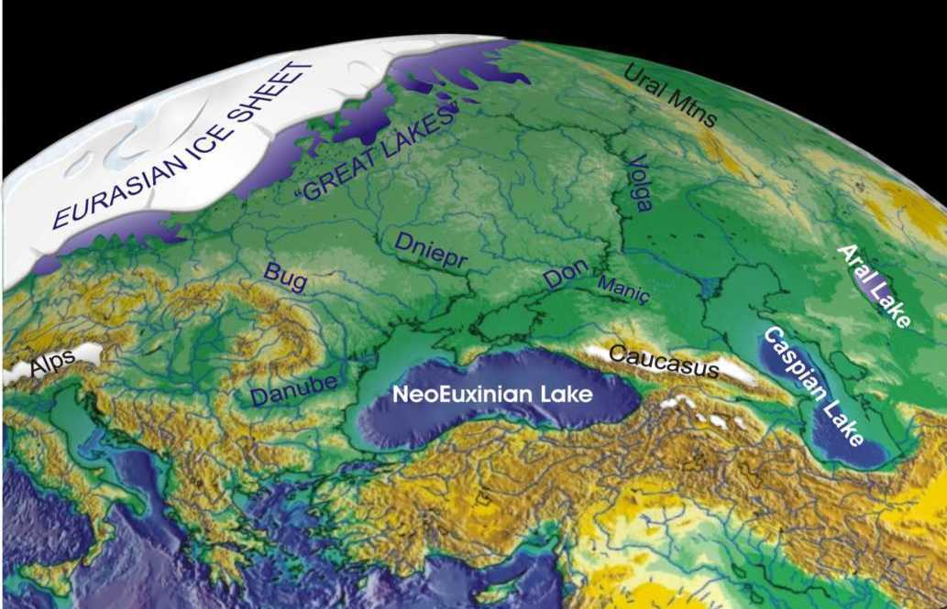
The Black Sea recorded the Climate Change
Gilles Lericolais
IGCP 464 - Gdansk 7-11 May 2003
May 9, 2003

Slide 3
Save the Sea : Avoid Geohazards

Slide 4
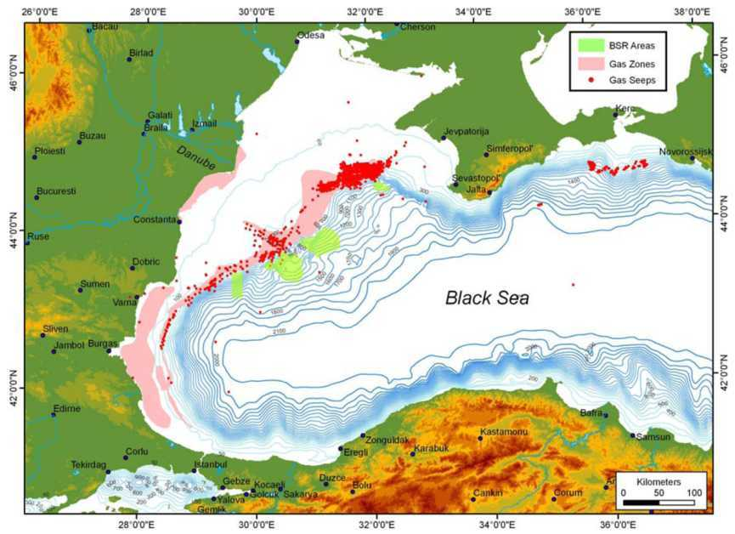
Gas Hydrates

Slide 5
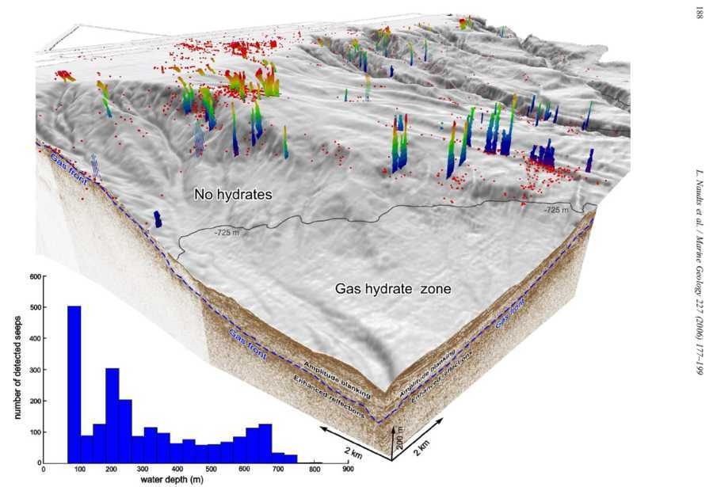
Gaz Hydrates

Slide 6
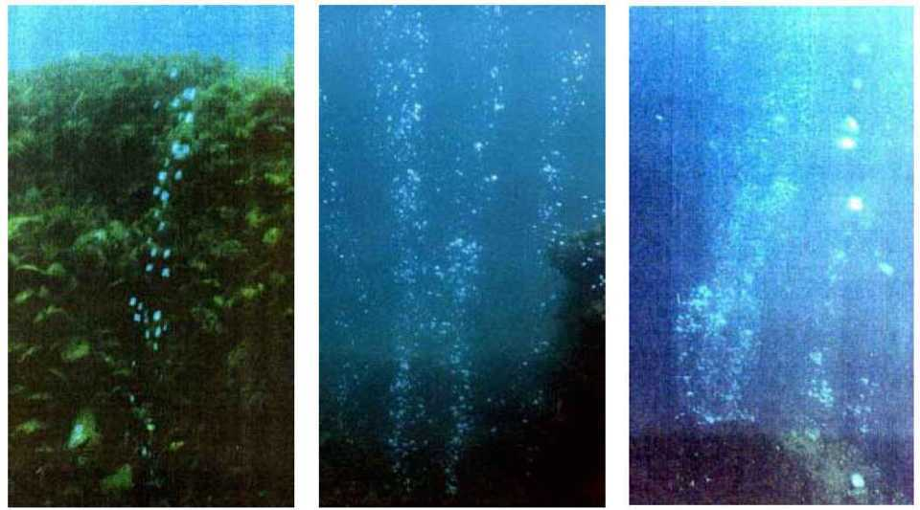
What next ?

Slide 7
How to study the Sea bed

