Slide 1
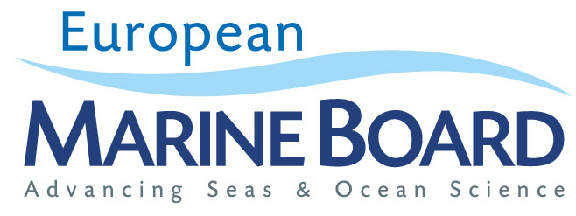
Major marine & maritime research challenges
Niall McDonough

Slide 3
Outline of presentation
Food Security
Climate change
The Deep Sea
Oceans & Human Health
EOOS
Concluding remarks

Slide 4
Food from the sea
Global Food Security
EU Blue Growth
Different Research Needs?
Balanced Harvest?
Sustainable mariculture

Slide 5
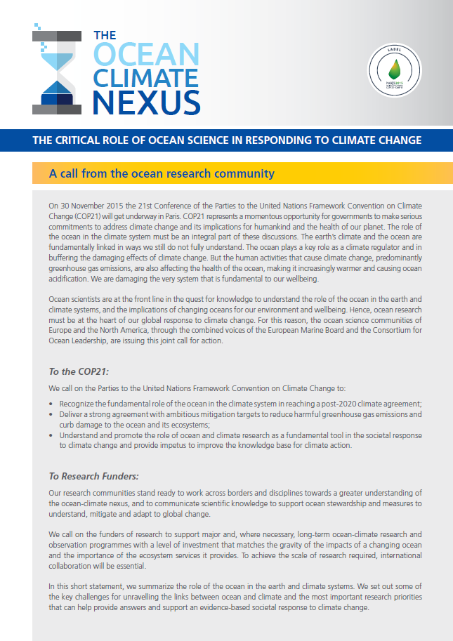
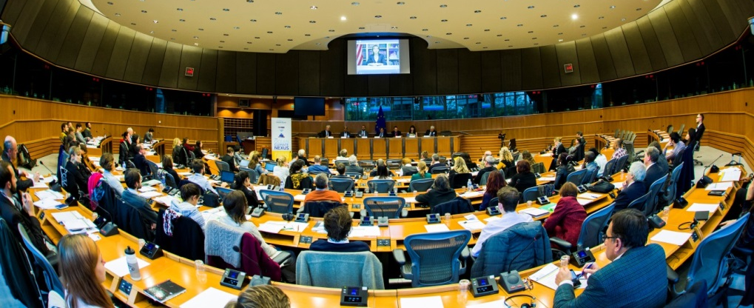
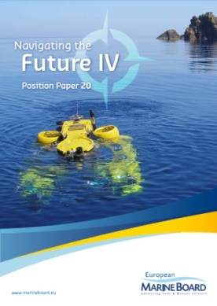
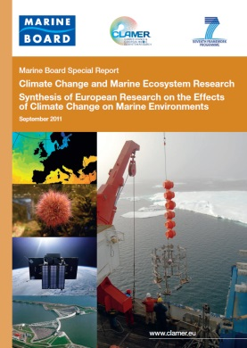
Ocean and Climate
Reduce uncertainty of predictions
Multiple scales (temporal & spatial)
Advanced ocean observing
Adaptation and mitigation
EMB 5th Forum – The Ocean-Climate Nexus
EU Parliament, Brussels, 21 October 2015

Slide 6
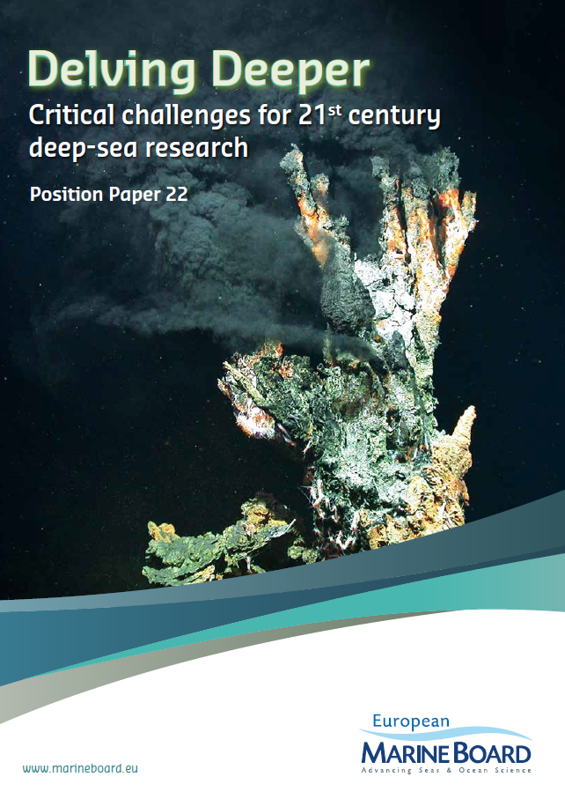
Exploring the deep
“..to support Blue Growth, European public research funding should target fundamental scientific research on all components of the deep sea environment and the establishment of environmental baselines.”
EMB Position paper 22:
Delving Deeper: Critical challenges for 21st century deep-sea research
December 2013

Slide 7
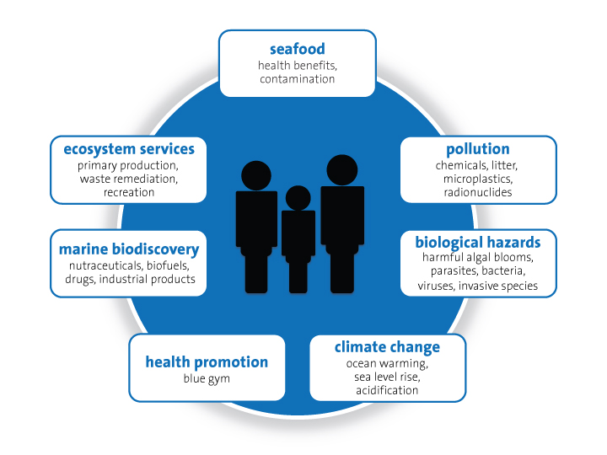
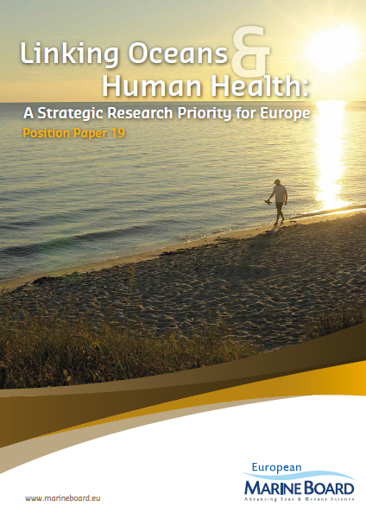
Oceans & Human Health
“…human health and wellbeing is intrinsically connected to, and impacted by, the seas and oceans which surround our continental landmass.”
EMB Position paper 19:
Linking Oceans & Human Health: A Strategic Research Priority for Europe
December 2013

Slide 8
A flagship ocean infrastructure for Europe…
European Ocean Observing System

Slide 9
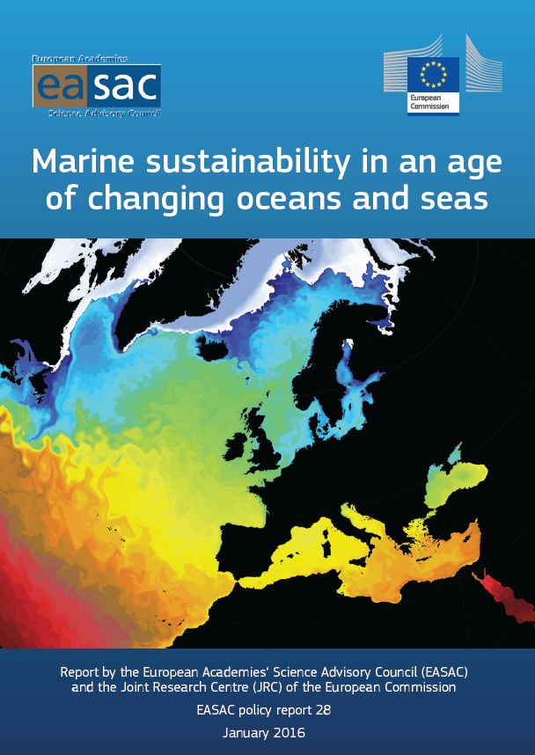
Navigating the Future IV
“…the EASAC Marine Sustainability Working Group agreed that, as a basis for its own work, it should endorse the European Marine Board position paper ‘Navigating the Future IV’ (2013). ‘Navigating the Future IV’ provided a compendium of marine science policy briefings that together set out a blueprint for the next phase of seas and oceans research in Europe.”
(Page 17 of EASAC / JRC Report)

Slide 10
To address complex societal challenges, research cannot deliver solutions in isolation or using reductionist approaches. Multi-disciplinary research involving cooperation within and across a range of natural and social sciences and humanities. Engage multiple sectors and end-users at all stages of the research cycle to maximize uptake and use of new knowledge
Research delivering maximum societal benefit

Slide 11
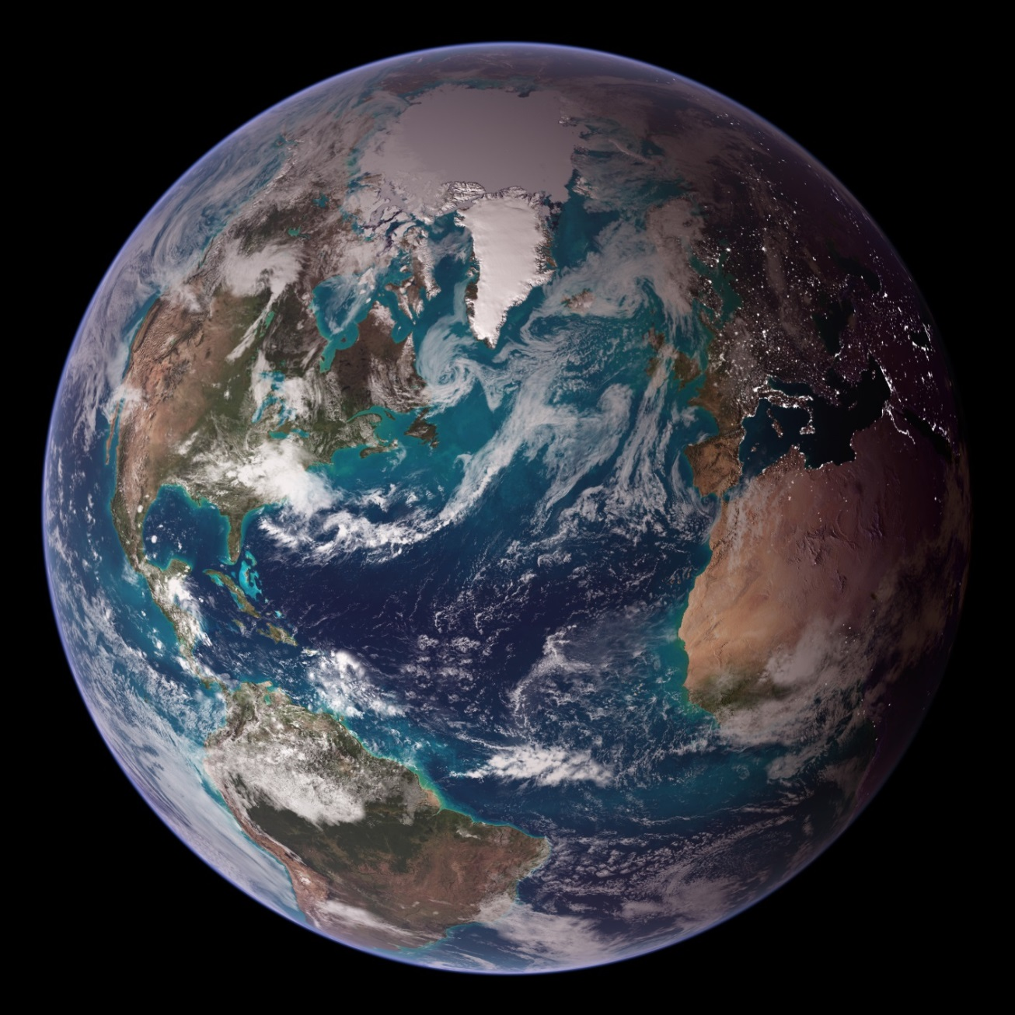
Thank you
www.marineboard.eu

