Slide 1
D3.1.7 EUCISE2020 Governance Model for CISE
EUCISE 2020
Technical Advisory Group 18 - 19 Nov 2015 | Brussels, Belgium
Mr. Alkis Astyakopoulos (alastiak@iit.demokritos.gr)
Mr. Charalampos Mavrikas (cmavrikas@iit.demokritos.gr)
Dr. Sotirios Kanellopoulos (skanellopoulos@iit.demokritos.gr)
Dr. Stelios C.A. Thomopoulos (scat@iit.demokritos.gr )
Integrated Systems Laboratory, Institute of Informatics and Telecommunications
National Center for Scientific Research "Demokritos"
EUCISE2020 has received funding from the European Union’s seventh framework programme under grant agreement no: 608385

Slide 2
Summary
Summary
Introduction
Governance Principles
Approach to define the governance model
References
Methodological Framework
Overview
Domains of Governance
Interoperability Levels
CISE Governance process Table
What is a CISE Governance Process?
Roadmap for the definition of governance
Overview and what we have achieved
CISE Governance Process matrix
CISE Governance Processes definition
Top-down study
Next Steps
Extra slides: Working Groups, Legal interoperability layer, Technical interoperability layer, Semantic interoperability layer, Organizational interoperability

Slide 3
Summary
Summary
Introduction
Governance Principles
Approach to define the governance model
References
Methodological Framework
Overview
Domains of Governance
Interoperability Levels
CISE Governance process Table
What is a CISE Governance Process?
Roadmap for the definition of governance
Overview and what we have achieved
CISE Governance Process matrix
CISE Governance Processes definition
Top-down study
Next Steps
Extra slides: Working Groups, Legal interoperability layer, Technical interoperability layer, Semantic interoperability layer, Organizational interoperability

Slide 4
Governance Principles
Governance Principles
The governance structure to be successful it needs to
Be “realistic” and “dynamic”.
“Realistic” accommodate all the complex administration/governance requirements (what needs to be governed
“Dynamic” (i) accommodate new requirements that will emerge in the future and are not feasible to foresee in advance (ii) embrace the different views from all participating competent authorities.
Respect the principles of subsidiarity/ decentralization
Fit the environment of a “Federation of Systems” with voluntary participation
support both day-to-day function, decision making and mid and short-term planning.

Slide 5
Approach
Approach (as presented by D3.1.7)
Outcome 1: Methodological Framework
Outcome 2: Roadmap
Outcome 3: First instantiation of the Governance model
Outcome 1: A Methodological Framework regarding the development of a governance model for CISE.
Outcome 2: A Roadmap, namely a sequence of steps that we need to follow to deliver the model.
Outcome 3: A First instantiation of the Governance Model.

Slide 6
References
References
COM(2010) 584, “on a Draft Roadmap towards establishing the Common Information Sharing Environment for the surveillance of the EU maritime domain”
Governance Recommendations Draft Report by DIGIT
European Interoperability Framework (EIF) for European public services by Interoperability Solutions for Public Administrations (ISA)
CISE Network Topology v.1 building blocks and requirements
CISE Architecture Visions Document by TAG v3.0 (and previous versions)
EUCISE2020 DoW
CISE Incubator Report v1.2

Slide 7
Summary
Summary
Introduction
Governance Principles
Approach to define the governance model
References
Methodological Framework
Overview
Domains of Governance
Interoperability Levels
CISE Governance process Table
What is a CISE Governance Process?
Roadmap for the definition of governance
Overview and what we have achieved
CISE Governance Process matrix
CISE Governance Processes definition
Top-down study
Next Steps
Extra slides: Working Groups, Legal interoperability layer, Technical interoperability layer, Semantic interoperability layer, Organizational interoperability

Slide 8
Methodological Framework (Overview)
Methodological Framework (Overview)
Dimension 1: The domains of governance (what needs to be governed).
CISE vision
CISE operation
Membership management
Procurement management
Communication management
?
Dimension 2: The 5 levels of interoperability as defined by EIF
Political context
Legal interoperability
Organizational interoperability
Semantic interoperability
Technical interoperability

Slide 9
Domains of Governance
Domains of Governance
CISE vision and planning: Plans and visualizes the policies, the high level objectives and the high level system capabilities that will meet these objectives.
CISE operation: Executes all necessary day-to-day activities to ensure seamless function of CISE at all participation levels.
“Operation, Configuration, verification & Maintenance of CISE components”
“Management of Security Policies”
“Manage changes and configure CISE information model”
“Management of Service Level Agreements”
Membership management: Membership management could have been part of CISE operation but it is kept as a separate domain because of its importance.
“Audit Interface Readiness level”,
“Semantic Interoperability level”,
“ management of legal baseline regarding CISE membership” (code of conduct)

Slide 10
Domains of Governance
Domains of Governance
Procurement management: Carries-out all necessary activities related to the procurement life-cycle: prepare, develop, publish a tender and then evaluate and award contracts to the successful bidder.
Procurement Technical specifications and evaluation criteria
Procurement technical verification and validation
Legal issues: procurement scheme (eligibility with EU national laws), IPRs,
Integrated Procurement management
Communication management: Plans, facilitates and executes all activities related to communications. The audience addressed are competent maritime authorities participating in CISE, CISE stakeholders and the public opinion.
CISE components s/w release of versions and documentation
CISE communication management tools (including twitter, Facebook, LinkedIn, forum, Instagram etc.)
Communicate Semantic Interoperability processes outcomes
?

Slide 11
Methodological Framework (Overview)
Methodological Framework (Overview)
Dimension 1: The domains of governance (what needs to be governed).
CISE vision
CISE operation
Membership management
Procurement management
Communication management
?
Dimension 2: The 5 levels of interoperability as defined by EIF
Political context
Legal interoperability
Organizational interoperability
Semantic interoperability
Technical interoperability

Slide 12
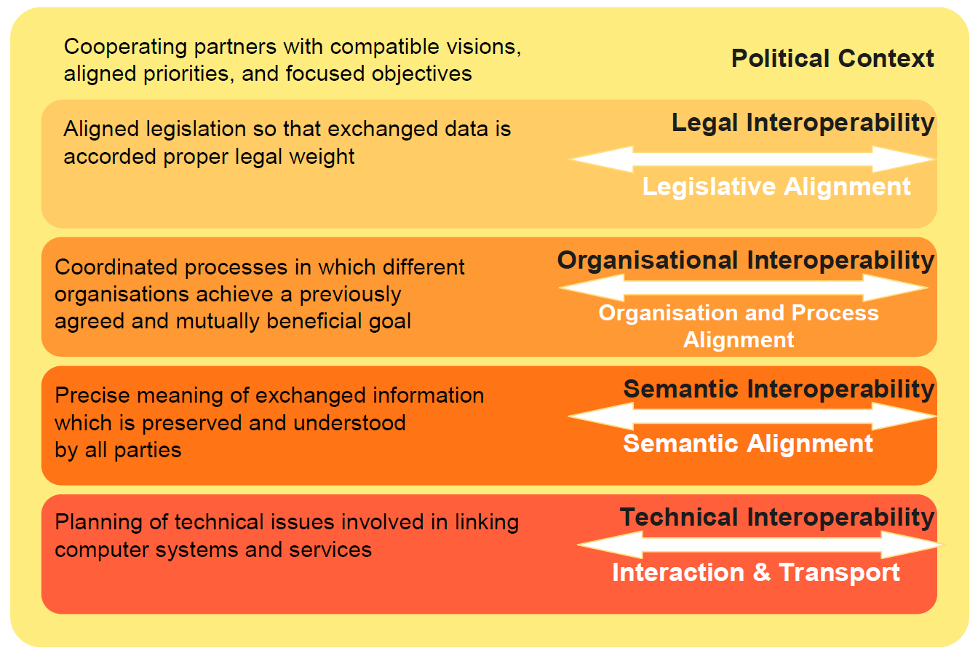
Interoperability Levels
Interoperability levels

Slide 13
Methodological Framework (CISE Governance Process Table)
Methodological Framework (CISE Governance process table)
Interoperability Levels
This approach leads us to a Table as the one illustrated below:
Governance Domains

Slide 14
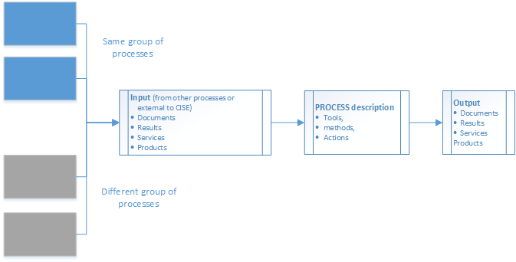
Methodological Framework (What is CISE Governance process?)
Methodological Framework (What is CISE Governance process?)
At its most basic level, a process is simply a way of transforming an input into an output using proven tools and techniques.
Description of the process: includes the elementary actions that constitute a process plus the methods and the tools used to carry-out the actions.
Input/ output: Inputs might come internally from CISE governance processes (of the same or different group) or externally from the European Commission, relevant initiatives, national governance bodies or other. Input Outputs can be services, documents or other results.

Slide 15
Methodological Framework (benefits)
Methodological Framework (benefits)
It is sustainable
Can add, remove Governance domains. Interoperability layers are most unlikely to change
Each process is managed individually (by an experts group) so the governance definition is manageable . A facilitator should have ownership and good understanding of the masterplan to coordinate the different expert groups
It is modular, so that changes in one process do not affect significantly other processes.
Can embrace future endeavors, best practices and lessons learnt acquired during EUCISE2020
As noted during the EUCISE2020 meeting in Rome (July 2015):
“there might be other methods as well (to define a governance model), and this method in question is definitely a one of appropriate ones”
“not so frequent to attempt to define governance in the bottom-up approach”

Slide 16
Summary
Summary
Introduction
Governance Principles
Approach to define the governance model
References
Methodological Framework
Overview
Domains of Governance
Interoperability Levels
CISE Governance process Table
What is a CISE Governance Process?
Roadmap for the definition of governance
Overview and what we have achieved
CISE Governance Process matrix
CISE Governance Processes definition
Top-down study
Next Steps
Extra slides: Working Groups, Legal interoperability layer, Technical interoperability layer, Semantic interoperability layer, Organizational interoperability

Slide 17
Roadmap (Overview of What has been Achieved)
Roadmap (Overview of what has been achieved)
15.07.2015
We were here in Rome meeting
30.10.2015
A full set of processes is finalized
30.10.2015
Governance models survey
2. CISE Governance Methodological Framework
3. CISE Governance Processes definition
4. CISE Governance structure, roles and responsibilities
1. CISE Strategy
6. Possible Governance Models for CISE
5. Survey of the existing Governance Models of International & European maritime structures
Bottom-up approach
Top-down approach

Slide 18
ROADMAP (CISE Governance Process Matrix)
Roadmap (CISE Governance Process Matrix)
)
 | Political Context | Legal Interoperability | Organizational Interoperability | Semantic Interoperability | Technical Interoperability
CISE Vision & planning | CISE strategy CISE Governance model CISE action plan | Legal Baseline 1: Legal Impact Assessment at EU level Legal Baseline 2: Legal Impact Assessment at National Level | Information exchange and joint operations requirements Memorandums of Understanding |  | CISE Architecture and system design specification
CISE Operation | Security policies | CISE Audit against legal baselines | Management of Service Level Agreements CISE operational reporting | Manage changes and configure CISE information model | Operation, Configuration, verification & Maintenance of CISE components Management of Security Policies
Membership management | CISE growth strategy along the seven CISE communities | Management of legal baseline regarding CISE membership: rights and responsibilities | Audit of Trustworthiness as data producer and consumer | Assessment of the CISE participants Semantic Interoperability Level (SIL) Plan and execute the upgrade of CISE participants Semantic Interoperability Level (SIL) | Compatibility verification and Acceptance of new legacy systems and their adaptors (Audit Interfacing Readiness Level)
Procurement management | CISE portfolio definition and management | Legal Advice on the procurement process including Intellectual Property Rights | Procurement Integrated Management |  | Procurement Technical specifications and evaluation criteria Procurement technical verification and validation
Communication management | CISE dissemination plan (public) CISE communication plan (restricted to EC and CISE community) |  |  | Communicate Semantic Interoperability processes outcomes | CISE components s/w release of versions and documentation CISE communication management tools (including twitter, Facebook, LinkedIn, forum, Instagram etc.)
Financial management | Funding and subsidies management |  | Cost Benefit Analysis from the Use of CISE

Slide 19
ROADMAP (Working Groups & Teleconferences)
Roadmap (Working Groups & Teleconferences)
)
Legal Working Group | Technical Working Group
Finish Boarder Guard (FBK) | Italian Navy (IN)
Swedish Coast Guard (SCG) | Direção-Geral de Política do Mar (DGPM)
Marine Technology Center (MTC) | Romanian Border Police (IGPF)
Hellenic Ministry of Defense (HMOD) | Joint Research Center (JRC) – advisor/reviewer
Date | Teleconference
29.07.2015 | 1st teleconference conducted with the Legal Group for reviewing the document and proposing new governance processes under the legal interoperability layer
20.08.2015 | 2nd teleconference conducted with the Legal Group for further reviewing the document and finalizing the governance processes under the legal interoperability layer and assigning the description of processes
20.08.2015 | 1st teleconference conducted with the Technical Group for reviewing the document and finalizing the governance processes under the technical interoperability layer and assigning the description of processes
17.09.2015 | Teleconference organized to discuss the revised Governance processes matrix prepared by DGPM and decide which of them should be kept and which ones should be merged with the existing processes

Slide 20
ROADMAP (CISE Governance Process Definition)
Roadmap (CISE Governance Process Definition)
)
PARTNERS Tasks:
Why we need this Governance processes
In what way does it serve governance and practical needs that we can foresee or met during the implementation of the project?
Does it link to the outcomes of any other governance process? Under the same or different interoperability layer?
What this process will do
Which are the methods and the tools that this process will use. Can be based on international best practices e.g. Integration Readiness Level as defined by NASA or similar or from effective practices employed during the first phase of the project (legal impact assessment)
What are the outputs.

Slide 21
Top Down Approach
Top Down Approach

Slide 22
Next Steps
Next Steps
Finalize the descriptions for the processes.
At the moment, description focus on the “why we need this process” plus a general description of the activities it carries-out. We need to exemplify:
the exact tools and methods to be used taking into consideration best practices and lessons learnt from Phase 1 and Phase 2: e.g the legal impact assessment, collection of requirements process, semantic interoperability etc
The inputs/ outputs of the processes and how they are relevant to other processes (in turn as new input and output)
All this will lead to a complex pertt diagram
Based on the outcome, and the survey of governance models, visualize a Governance Structure (of roles and groups)
deliver a Responsibility Assessment Matrix (RAM) of roles & groups vs processes

Slide 23
Summary
Summary
Introduction
Governance Principles
Approach to define the governance model
References
Methodological Framework
Overview
Domains of Governance
Interoperability Levels
CISE Governance process Table
What is a CISE Governance Process?
Roadmap for the definition of governance
Overview and what we have achieved
CISE Governance Process matrix
CISE Governance Processes definition
Top-down study
Next Steps
Extra slides: Working Groups, Legal interoperability layer, Technical interoperability layer, Semantic interoperability layer, Organizational interoperability

Slide 24
Thank you!
EUCISE 2020
Technical Advisory Group 18 - 19 Nov 2015 | Brussels, Belgium
Mr. Alkis Astyakopoulos (alastiak@iit.demokritos.gr)
Mr. Charalampos Mavrikas (cmavrikas@iit.demokritos.gr)
Dr. Sotirios Kanellopoulos (skanellopoulos@iit.demokritos.gr)
Dr. Stelios C.A. Thomopoulos (scat@iit.demokritos.gr )
Integrated Systems Laboratory, Institute of Informatics and Telecommunications
National Center for Scientific Research "Demokritos"
EUCISE2020 has received funding from the European Union’s seventh framework programme under grant agreement no: 608385

