Slide 1
EUCISE 2020 Project Presentation
EUCISE2020 TAG Presentation
C. Matarazzi, ASI, Project Coordinator
Bruxelles, 17/06/2016
EUCISE2020 received funding from the European Union’s seventh framework programme under grant agreement no: 608385

Slide 2
EUCISE 2020 Project Presentation
EUCISE2020 Presentation
CISE Framework
Project basic information
EUCISE2020 status and procurements
Network Architecture and Functions
EUCISE2020 received funding from the European Union’s seventh framework programme under grant agreement no: 608385

Slide 3
EUCISE 2020 CISE Roadmap
CISE: Common Information Sharing Environment
Cross – Sectorial interoperability for better “Maritime Governance”
CISE
MS action
Joint Undertaking ?
Test-CISE ('FP7')
2020
EC action
CISE Handbook
2016
EUMSS and Action Plan
2015
Cooperation project
2014
Expected Added Value:
-Effectiveness
-Cost efficiency
-Safer, more secure
& cleaner seas
-EU digital society
-Sustainable growth
-Coordination
-Knowledge based IMP
CISE Communication
Impact Assessment
2013
CISE Roadmap roll-out
Sectoral developments
2012
MARSUNO BlueMassMed
2011
CISE Roadmap
2010
CISE Principles
2009

Slide 4
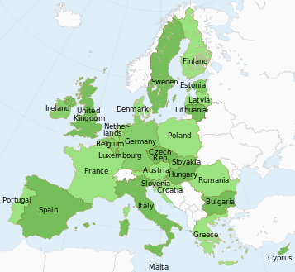
EUCISE 2020 EUCISE2020 Coverage
EUCISE2020 Partners
37 Partners
15 EU/EEA maritime Countries
Open to new partners and to collaborations with EU Agencies
Maritime Authorities
Experts
Research Institutions
Two new partners as External Entities:
EFCA - European Fisheries Control Agency; e/SENS
MARSAFENET – Network of experts on the legal aspects of maritime safety and security; more than 70 legal experts from 22 countries
EUCISE2020 received funding from the European Union’s seventh framework programme under grant agreement no: 608385

Slide 5
EUCISE 2020 Partners List
Partner | website | Partner | website
ASI | www.asi.it | DMI DK | www.dmi.dk
MMI | www.marina.difesa.it | NERSC | www.nersc.no
MEF GDF | www.gdf.gov.it | AEAT ES | www.agenciatributaria.es
MIT GC | www.guardiacostiera.gov.it | CIT | www.cit.ie
MDE ES | www.defensa.gob.es | DGPM | www.dgpm.mam.gov.pt
GUCI | www.guardiacivil.es | MARAD | www.marad.bg
SASEMAR | www.salvamentomaritimo.es | DEMOKRITOS | www.demokritos.gr
EUSC | www.satcen.europa.eu | RBP | www.politiadefrontiera.ro
SWED CG | www.kustbevakningen.se/sv/the-swedish-coast-guard | FINNAVY | www.puolustusvoimat.fi/en/Navy
MIN INT FBG | www.raja.fi | FGMSSC | www.bmvi.de
FTA | www.liikennevirasto.fi | HMOD | www.mod.mil.gr
TRAFI | www.trafi.fi | HCR | www.hcg.gr
BG PORT | www.mtitc.government.bg | MERCATOR | www.mercator-ocean.fr
MTC | www.regjeringen.no | MISE | www.sviluppoeconomico.gov.it
LAUREA | www.laurea.fi | GLT | www.studiotosato.it
OC UCI | www.ucy.ac.cy | DFT | www.gov.uk/government/organisations/department-for-transport
APRE | www.apre.it | LCU | www.unilink.it
INGV | www.ingv.it | WPI | www.wisepens.com
CMCC | www.cmcc.it
EUCISE2020 received funding from the European Union’s seventh framework programme under grant agreement no: 608385

Slide 6
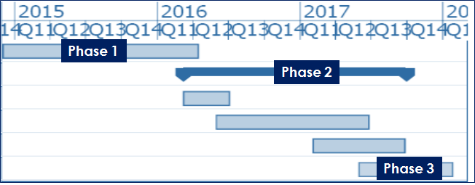
EUCISE 2020 Project Phases
Phase 1 - Initial Definition Phase (CSA)
Phase 2 - Preparatory and Execution Phase (CP/RTD)
Phase 3 - Ex-Post Assessment (CSA)
Total duration: 38 months
Starting date: December, 1°, 2014
EUCISE2020 received funding from the European Union’s seventh framework programme under grant agreement no: 608385

Slide 7
EUCISE 2020 Project Costs and EU Grant
Activity | Cost in € | EU Grant in €
Total Project | € 17.053.931 | €13.000.000
In Phase 2 Commonly European Procured R&D Services Nationally Procured R&D Services | € 4.500.000 | € 3.375.000
 | € 1.200.000 | € 900.000
In February 2016, the EUCISE2020 Consortium launched a European tender to develop the reference implementation of CISE.
Partners participating in the demonstration will manage national tenders to develop the national interfaces to the interoperability platform.
EUCISE2020 received funding from the European Union’s seventh framework programme under grant agreement no: 608385

Slide 8
EUCISE 2020 Project Status
EUCISE2020 Status
Closing Phase 1 - Initial Definition Phase (CSA)
Completed and approved deliverables
Managing Procurement process
EUCISE2020 received funding from the European Union’s seventh framework programme under grant agreement no: 608385

Slide 9
EUCISE 2020 Deliverables: Phase 1
Phase | Specific Objectives | Deliverables
Phase 1 Initial Definition Phase (CSA) | Identification of elements requiring new R&D that should be tested and validated in cooperation Definition of an action plan, setting scenarios and issues for concrete implementation of activities Establishment of modalities and procedures for POV evaluation and monitoring (common evaluation criteria and implementation methods) Drafting a preliminary CISE IPR strategy for the (expected) outcome of the Call for Tender Allocation and training of additional resources for implementation (if appropriate) Building cooperation with other stakeholders | Needs Analysis and Requirements Document Partners Cooperative plan Validation Strategy Document, (including a practical Exercise Plan and the proposed set of key performance indicators) IPR concept strategy Technical Specifications Joint POV Call for Tender Common REQs for national CISE procurements
EUCISE2020 received funding from the European Union’s seventh framework programme under grant agreement no: 608385

Slide 10
EUCISE 2020 Phases 2 and 3
During Phase 2, partners participating in the demonstration, will procure nationally the research services needed to develop the national interfaces to the CISE common platform, in time for the planned demonstrations.
EUCISE2020 will demonstrate the CISE capabilities both at the different basins level, and a global European scale, through a series of demonstrations planned in the last six months of Phase 2. Operational testing of the developed network environment should last at least 6 months.
Statistical data on the costs and benefits of the developed solution and of the information exchanged will be collected and made available for the subsequent assessment work.
In the final evaluation phase (Phase 3 - Ex-Post Assessment (CSA)), the EUCISE2020 Consortium will conduct a thorough assessment of the solution performances, and of the cost-benefit ratio of the alternative architectures tested in Phase 2. EUCISE2020 will issues a set of recommendations concerning the management of the EUCISE2020 infrastructure and the future governance of the joint enterprise.
EUCISE2020 received funding from the European Union’s seventh framework programme under grant agreement no: 608385

Slide 11
EUCISE 2020 Common EU Tender
Procurement Process articulated in different steps:
Procurement Strategy and Plan
Preparing the Procurement
Launching the Tender Procedure
Tenderers Selection
Contracts Award
Contracts execution management
We are here
From the point of view of the tenderers, selection in two phases:
Phase 1: submission of candidatures
Publication on the OJ
Prequalification criteria based on administrative, financial and technical capabilities
Phase 2: submission of offers
EUCISE2020 received funding from the European Union’s seventh framework programme under grant agreement no: 608385

Slide 12
EUCISE 2020 Common EU Tender
Procurement Process articulated in different steps:
Invitation to tender
Conclusion
EUCISE2020 received funding from the European Union’s seventh framework programme under grant agreement no: 608385

Slide 13
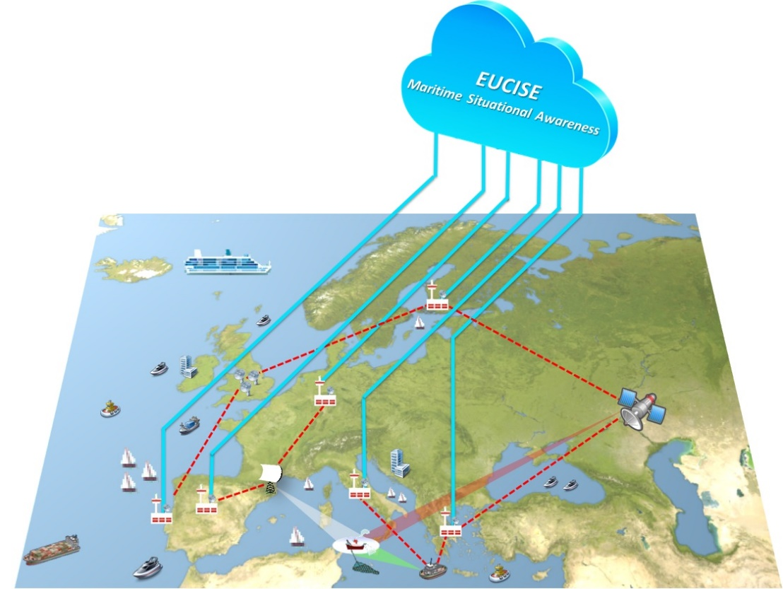
EUCISE 2020 Operational Concept
Operational Concept
Primary mission of EUCISE2020 is to support the EU Maritime Situational Awareness capability by means of an Information Sharing Environment capable to implement adequate security measures and protocols ensuring the confidentiality, integrity and availability of the data required and transmitted in the CISE community.
EUCISE2020 will not affect the functionalities of the operational information systems belonging to the participating Public Authorities or of the European existing sectorial information systems.
Blue lines depict flows of information within the CISE community, while the red dashed lines depict flows of information within the legacy systems belonging to single Public Authorities.
EUCISE2020 received funding from the European Union’s seventh framework programme under grant agreement no: 608385

Slide 14
EUCISE 2020 User Functions
User Functions
User functions analysed with reference to 9 different operational scenarios studied in the Cooperation projects and enhanced in the first phase of the project:
Use Case 13b: Inquiry on a specific suspicious vessel (cargo related).
Use Case 13c: Inquiry on a specific suspicious vessel (crew and ownership related).
Use Case 25b: Investigation of antipollution situation (law enforcement).
Use Case 37: Monitoring of all events at sea in order to create conditions for decision making on interventions.
Use Case 44: Request for any information confirming the identification, position and activity of a vessel of interest.
EUCISE2020 received funding from the European Union’s seventh framework programme under grant agreement no: 608385

Slide 15
EUCISE 2020 User Functions
User Functions
Use Case 57: Knowledge of surveillance capacities of partner authorities in a given sea area to plan basic tactical surveillance (Baseline and Targeted operations).
Use Case 70: Suspect Fishing vessel/ small boat is cooperating with other type of vessels (m/v, Container vessel etc.).
Use Case 85: Anti-Piracy Maritime Surveillance and free navigation control: Merchant vessels at sea (outside Territorial waters) sends an alert that it is under Piracy attack.
Use Case 93: Detection and behaviour monitoring of IUU listed vessels.
For each of the above mentioned scenario a full set of operational views for operational node connectivity and operational activity model are defined.
EUCISE2020 received funding from the European Union’s seventh framework programme under grant agreement no: 608385

Slide 16
EUCISE 2020 Common EU Tender
Network Topology
The network topology of EUCISE2020 is based on the CISE hybrid vision concept. Each Member State and Community can adopt one of the following paradigms:
Single-way approach: All Public Authorities of a Member State are connected to the EUCISE2020 Network through a single access point
Multiple-way approach: Public Authorities of a Member State are connected to the EUCISE2020 Network through different access points
EUCISE2020 received funding from the European Union’s seventh framework programme under grant agreement no: 608385

Slide 17
EUCISE 2020 CISE components
The CISE components are able to:
translate the request of information coming from PAs in a common vocabulary;
ensure the exchange of messages within the EUCISE2020 Community based on a Service Oriented Architecture paradigm;
manage access rights to information exchange based on a roles/rules based approach;
handle classified information up to EU restricted level;
implement a collaborative environment;
optionally, implement advanced functions to enhance the information available at PAs level.
EUCISE2020 received funding from the European Union’s seventh framework programme under grant agreement no: 608385

Slide 18
EUCISE 2020 EUCISE2020 services
The EUCISE2020 Services are organized in four classes:
Core Services: infrastructure services devoted to enable the connection of the EU CISE 2020 Participants. According to the CISE Hybrid Vision architecture, core services implement the CISE gateways, i.e. the component that ensure the connection of each partner, or group of them, to the EUCISE2020 network.
Common Services: application services devoted to the implementation of EUCISE2020 service and data models; they exploit entities within the CISE network following the EUCISE2020 business rules.
Advanced Services: consisting of added value services proposed by each EUCISE2020 community of interest. Member States decide the implementation of advanced services or not.
Innovative Services are optional R&D application services, with TRL (Technology Readiness Level) between 6 and 8 according the HORIZON 2020 scale, and with different IPR; the Innovative Services are expected to deliver new added value in the maritime surveillance business processes.
EUCISE2020 received funding from the European Union’s seventh framework programme under grant agreement no: 608385

Slide 19
EUCISE 2020 EUCISE2020 services
The EUCISE2020 Services are implemented under different procurement frameworks:
Core, Common and Advanced Services will be developed, tested, integrated and validated under the contractual framework of LOT1
Innovative Services will be integrated in the EUCISE2020 platform and validated in the pre-operational environment under the contractual framework of LOT2.
EUCISE2020 received funding from the European Union’s seventh framework programme under grant agreement no: 608385

Slide 20
EUCISE 2020 EUCISE2020 services
LOT1 concerns R&D Services for the Implementation and the pre-operational validation of EUCISE2020 cross-sector and cross-border inter-regional wide network (core, common and advanced services).
The scope of work shall include:
Final design of R&D Core, Common and Advanced Services;
Development of R&D Core, Common and Advanced Services;
Verification of R&D Core, Common and Advanced Services in test-bed environment;
Integration and Verification of R&D Core, Common and Advanced Services in the EUCISE2020 participants’ environment;
Pre-operational Validation of R&D Core, Common, Advanced (Lot 1) and Innovative (Lot 2) Services in the real operational environment of the EUCISE2020 project partners participating in the demonstration.
EUCISE2020 received funding from the European Union’s seventh framework programme under grant agreement no: 608385

Slide 21
EUCISE 2020 EUCISE2020 services
LOT 2 concerns Innovative R&D services for the pre-operational validation of added value services for the maritime surveillance in the EUCISE2020 inter-regional wide network; the services relate to the following domains:
Big data Analytics
Entity Fusion
Mission Planning
Satellites services for maritime surveillance and communications.
EUCISE2020 received funding from the European Union’s seventh framework programme under grant agreement no: 608385

Slide 22
EUCISE 2020 LOT 2
The scope of the Lot 2 contract/s will be the execution of service trials for the integration and the pre-operational validation of innovative R&D services under the property of the contractor(s) into the EUCISE2020 platform.
The services of LOT2 do not include the development of applications, but only their integration and pre-operational validation in the EUCISE2020 environment. The interested tenderers are required to give evidence of the existence of their innovative service/s in one or more of the application domains listed above; each R&D proposed service shall have a TRL (Technology Readiness Level) between 6 and 8 in the TRL scale of H2020.
EUCISE2020 received funding from the European Union’s seventh framework programme under grant agreement no: 608385

Slide 23
EUCISE 2020 Common architecture
Common EUCISE2020 system configurations will include the following components:
CISE Adaptor allows a Legacy System (LS) to connect to a CISE Gateway. It translates the LS data into the common CISE Data Model
CISE Gateway (GW) implements the common CISE specifications and implements the CISE messaging protocol to exchange with the CISE adaptor or with the other CISE Gateways
CISE Node (NODE) is an enhanced gateway, capable of performing advanced business related activities like fusion and storing of information (EUCISE Advanced Services).
CISE Adaptor and CISE Gateway will be implemented in all configurations; CISE Node will be included only in configuration C, to deliver the EUCISE2020 advanced services.
EUCISE2020 received funding from the European Union’s seventh framework programme under grant agreement no: 608385

Slide 24
EUCISE 2020 Common architecture
Three different configurations of the EUCISE2020 network architecture will be implemented:
Configuration A: single Public Authority belonging to a single Member State will connect to EUCISE2020 contributing with a single Legacy System
Configuration B: each Public Authority of the same Member State taking part in the EUCISE2020 information exchange connects its own Legacy System to a dedicated Adaptor; several Adaptors connect to a EUCISE2020 Gateway type B that will access the EUCISE2020 Network.
Configuration C: Public Authorities belonging to the same Member State connect their Legacy Systems to the EUCISE2020 Network through a single EUCISE2020 Node type C
EUCISE2020 received funding from the European Union’s seventh framework programme under grant agreement no: 608385

Slide 25
EUCISE 2020 Common architecture
EUCISE2020 Services allocation in configurations A, B and C
 | Configuration A |  |  | Configuration B |  |  | Configuration C
Services | GATEWAY | ADAPTOR | NODE | GATEWAY | ADAPTOR | NODE | GATEWAY | ADAPTOR | NODE
CORE | X |  |  | X |  |  |  |  | X
COMMON |  | X |  |  | X |  |  |  | X
ADVANCED |  |  |  |  |  |  |  |  | X
INNOVATIVE |  |  |  |  |  |  |  |  | X
EUCISE2020 received funding from the European Union’s seventh framework programme under grant agreement no: 608385

Slide 26
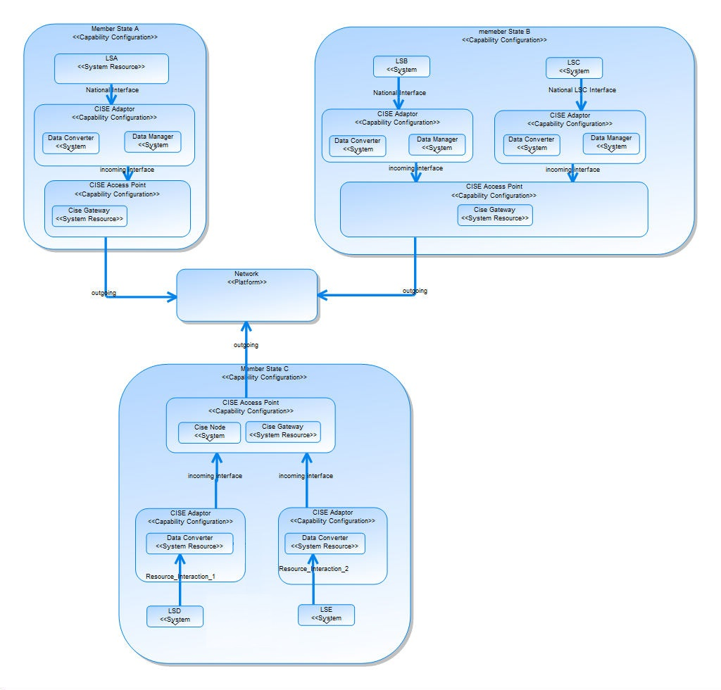
EUCISE 2020 Common architecture
Logical Architecture of EUCISE2020 Configurations A, B and C:
Inside the red line components developed through the European tender
Outside the red line interfaces developed through the national procurements
EUCISE2020 received funding from the European Union’s seventh framework programme under grant agreement no: 608385

Slide 27
EUCISE 2020 Demonstration
At least ten European countries and two European agencies, EFCA and SATCEN will take part in the demonstration.
Two participating European countries have yet to take the decision about their participation in the demonstration.
Regarding the configurations chosen:
six countries with configuration C
one country with configuration A
one country with configuration B
one country expressed an option for a kind of "Hybrid Vision configuration - A merge of Visions A, B and C"
one country still under decision.
EFCA and SATCEN have not decided the configuration model with which they will take part; possibly, they will connect through a "Light Client".
Each country will connect one or more Legacy Systems to its chosen configuration; so far, the ten participating countries indicated at least twelve Legacy Systems to connect to the EUCISE2020 network.
EUCISE2020 received funding from the European Union’s seventh framework programme under grant agreement no: 608385

Slide 28
EUCISE 2020 Contractual Milestones
CD: Concept Design concerning the preliminary design - CD @ T0+1 month
CDR : Critical Design Review concerning the final design - CDR @ T0+3 months
FAT: Factory Acceptance Test concerns the accomplishment of Tests in Laboratories conducted following the selected uses cases - FAT @ T0+8 months
SAT: the Site Acceptance Test concerns the deployment of EUCISE2020 testbed in corresponding environment and the testing that the EUCISE2020 Network is correctly working - SAT @ T0+10 months
INT: the Integration Test concerns the accomplishment of Integration of Legacy Systems of at least 3 Public Authorities. INT @ T0+11 months
FAR: the Final Acceptance Review concerns the accomplishment that all the Legacy Systems have been integrated, the certification process has been completed and that validation tests have been correctly performed in the real operational environment - FAR @ T0+16 months
EUCISE2020 received funding from the European Union’s seventh framework programme under grant agreement no: 608385

