Slide 1
Coastal Mapping
Final meeting
SHOM
gael.morvan@shom.fr

Slide 2
Genesis
Memorandum of Understanding (MoU) – 23 April 2012
Framework for interaction between the EC and the IHO
Creation of the IHO-EU Network WG (June 2013)
Decided at the 5th IHO IRCC meeting
Developed and chaired by France
Development of a Joint European Coastal Mapping Programme (JECMaP) within this WG
Concurrently, CPMR work on data knowledge for the management of coastal areas
On-going EMODnet projects

Slide 3
Service contract
Signed by SHOM on 29 May 2015
Signed by EASME on 26 June 2015
3-year duration with 2 periods of 18 months:
Production period from 26 June 2015 to 26 Dec. 2016
Maintenance period from 26 Dec. 2016 to 26 June 2018

Slide 4
Objectives
Assess the current availability of digital coastal maps in the EU
Disseminate this information by EMODnet
Share experience of coastal mapping in the EU
Develop standards for best practices
Propose how a future JECMAP could operate

Slide 5
Deliverables
Every 2 months: progress report
26 Dec. 2015: first version of portal on-line
26 March 2016: interim report
26 Dec. 2016:
final version of portal on-line
final report
executive summary of final report
Around Feb. 2017 : stakeholder workshop
26 June 2018 : maintenance report

Slide 6
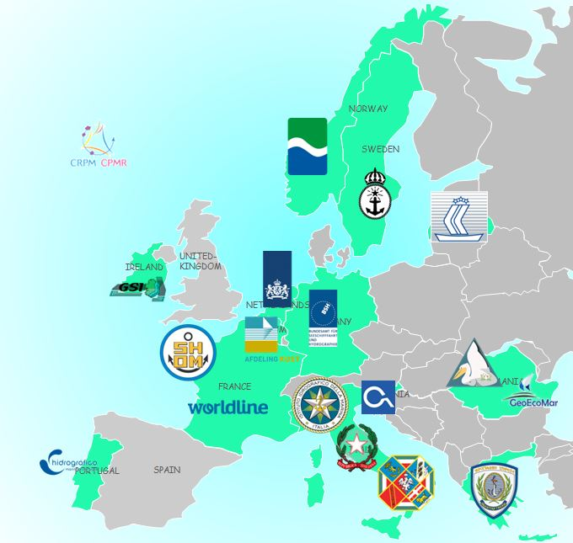
Consortium
Hydrographic offices :
FRANCE – BELGIUM – GERMANY – GREECE – IRELAND – ITALY – LATVIA – NORWAY – PORTUGAL – SLOVENIA – SWEDEN
Regions :
CPMR – Regione Lazio
Public Bodies :
ISPRA – RWS - GeoEcomar – DDNI
IT company :
Worldline

Slide 7
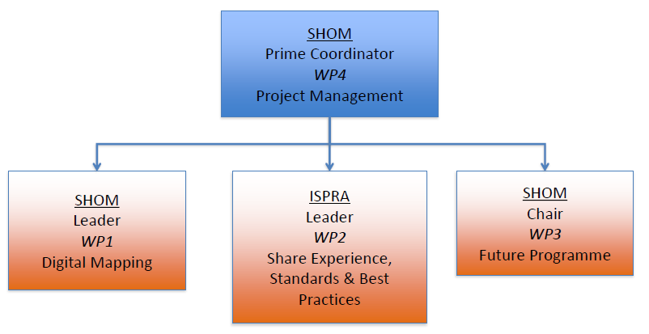
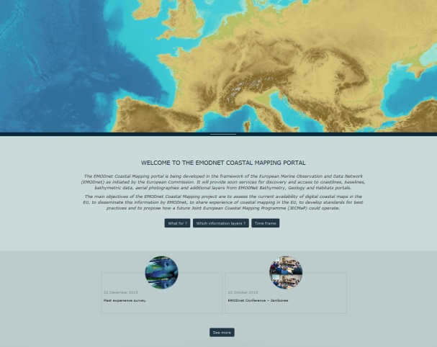
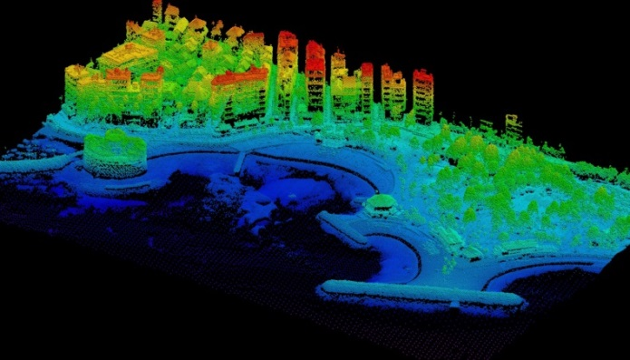
Organisation

Slide 8
Project group meetings
WP1 & KO meetings (23-24/06/2015, St Mandé)
Specification meeting (21-22/10/2015, Ostend)
Portal meeting (1-2/12/2015, Bezons)
Algorithm meeting (2-3-4/03/2016, Roma)
Interim meeting (7-8/06/2016, Stockholm)
Progress meeting (14-15/09/2016, Dublin)
Final meeting (8/12/2016, Brussels)
Stakeholder meeting (Feb. 2017, Brussels)

Slide 9
Side meetings
EMODnet steering committees
EMODnet-INSPIRE workshops
EMODnet Technical WG meetings
Seminar at JRC
(Last) MODEG meeting
EMODnet Bathymetry progress meetings
EMODnet-MSFD coordination meetings
IENWG meetings
MPMSEG meeting
Bologna Charter Coordination Board
EUREF 2016 symposium
Italian National Table on Coastal Erosion
…

Slide 10
Thank you!

