Slide 2
WP1: Lithosphere-biosphere interaction & resources (W. Roest, IFREMER, G. Früh-Green, ETH Zurich)
WP2: Sedimentary sea floor and sub-seafloor ecosystems: past, present and future links (T. Ferdelman, MPI, J. McKenzie, ETH Zurich)
WP3: Deep biosphere (B. B. Jørgensen, Aarhus, J. Parkes, Cardiff)
WP4: Sediment Dynamics and geohazards (M. Canals, Barcelona, V. Lykousis, HCMR Athens)
WP5: Geofluids & gas hydrates (J. Meinert, Tromso, A. Camerlenghi, Barcelona)
WP6: Climate change & response of deep-sea biota (H. Pälike, Southampton, R Schneider, Keil)
WP7: Mission-specific sub-seafloor sampling (C Mével, IPG Paris,, M Ask, Lulea)
WP8: Infrastructure & synergies (A. De Santis , INGV, P. Weaver, Southampton)
WP9: Management & science –policy interface (A. Kopf, Bremen, A. Boetius, Alfred-Wegener Inst, Bremerhaven)

Slide 3
WP1: Lithosphere-Biosphere interactions and resources
The World’s largest aquifer
What is the flux of heat, chemicals?
What are the deep water mineral resources?

Slide 4
WP2: Sedimentary sea floor and subsea floor ecosystems: past present and future links

Slide 5
WP 3 The Deep Biosphere
What dictates the magnitude and extent of the deep biosphere?
Are there novel microbial biodiversity and processes in deep biosphere hotspots?
What is the influence of the deep biosphere on fossil fuel formation and exploitation?
What is the impact of the deep biosphere on global climate change feedbacks, particularly methane flux?

Slide 8
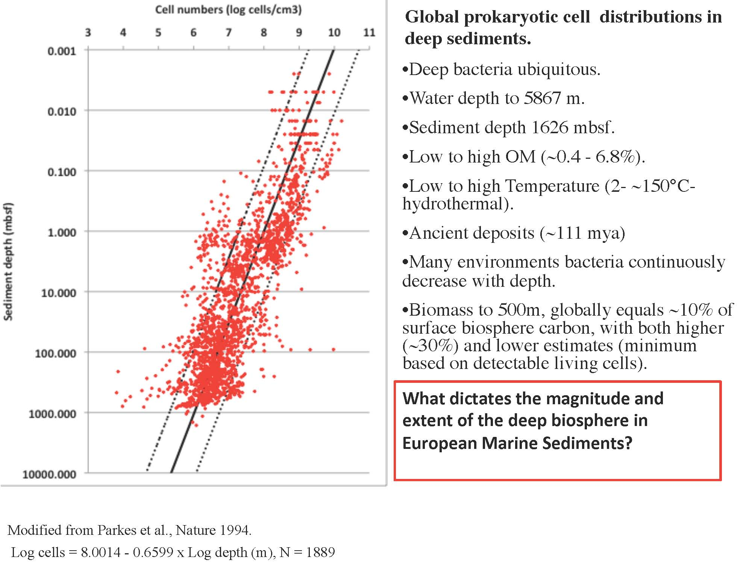

Slide 9
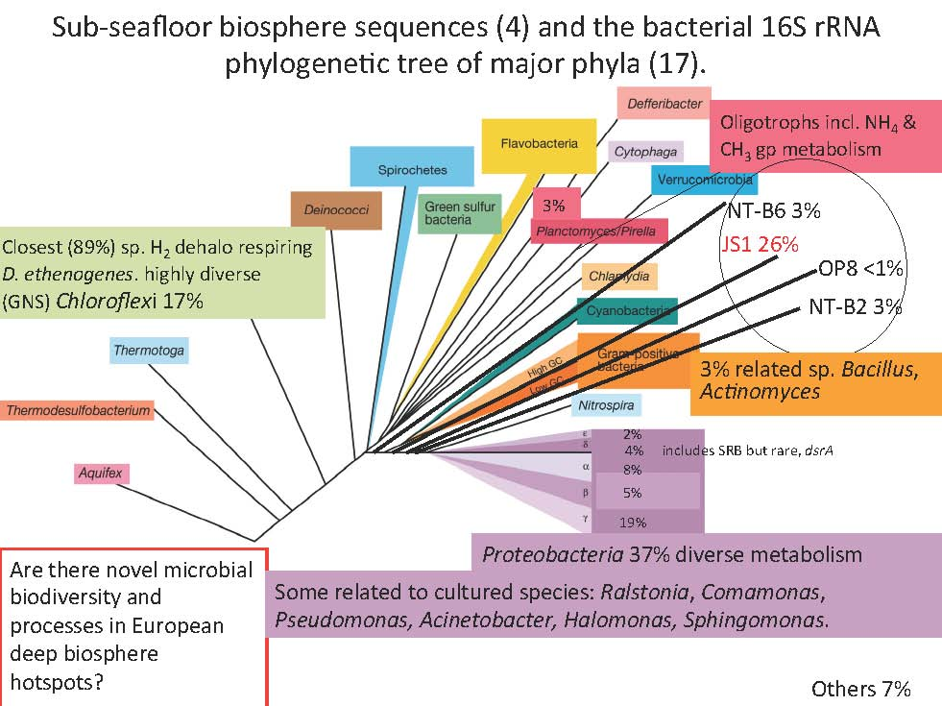

Slide 10
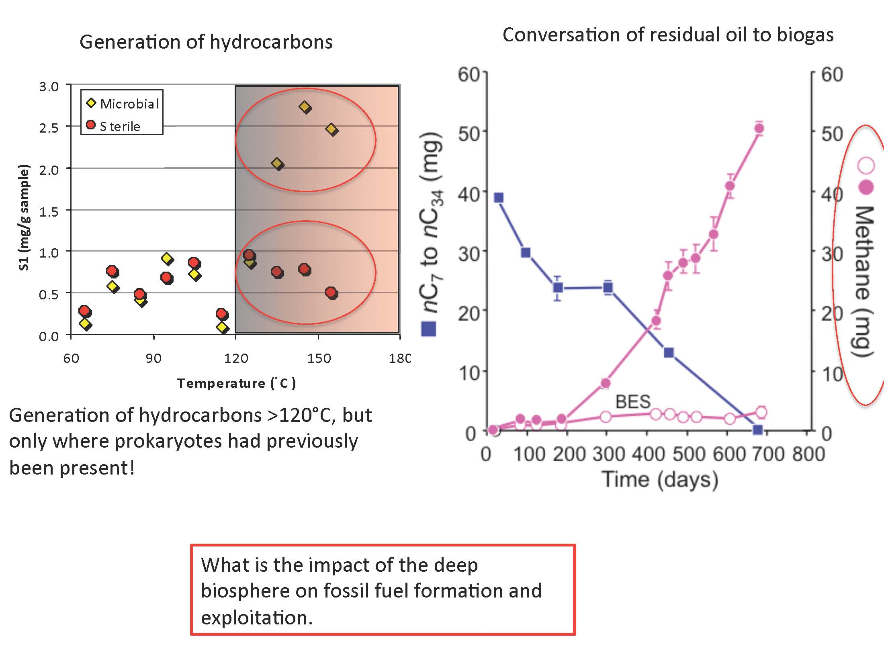

Slide 12
WP 4 Sediment dynamics and geohazards
Shelf water cascades and turbidity currents
The role of contour currents on sediment redistribution
Missing deep water sediments at the mouths of canyons
Palaeotsunamis and risk analysis
Dynamics of submarine landslides

Slide 13
DSWC: Dense Shelf Water Cascading (climate-related)

Slide 14
The mystery of the missing deep-sea deposits off large submarine canyons: dispersal, Flushing?
Deep- sea (abyssal and bathyal plains; sandy deposits off large submarine canyon systems. Role and persistence of deep sea channels

Slide 17
WP 5 Geofluids and Gas Hydrates Energy and Environment
Origin of hydrates:
Pathways of methane movement
Storage capacity and rates of release
Distribution of hydrate; quantities; potential resource,
Abrupt methane releases; assessing palaeochanges; CH4 flux in the oceans; ocean acidification
Impacts: geohazards: ecosystems; ocean chemistry

Slide 25
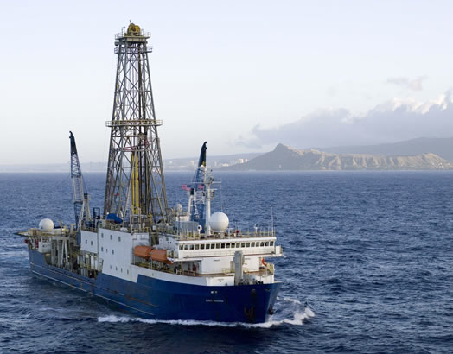
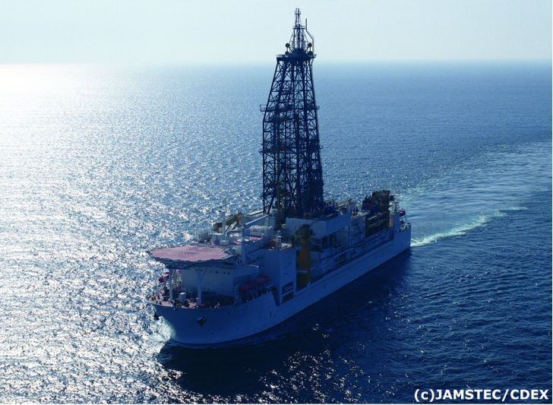
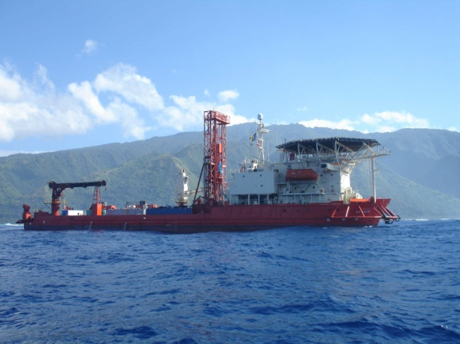
WP7: Mission-specific subseafloor sampling
The challenge: Provide the technology to answer the scientific questions
Expand the use of new and cost effective technologies such as sea floor drills, in-hole observatories and pressure sampling
Strengthen the distributed facilities and partnership and seek ESFRI status
Maintain data management and distribution – open access
Continue to provide exceptional training facilities for young scientists
Seek new funding sources through collaboration with industry and the EU
Provide access to the scientific community
JOIDES Resolution
Non-riser vessel
funded and operated
by USA
Chikyu
Riser vessel
built, funded and operated by Japan
Mission Specific Platforms (MSPs)
funded and operated by ECORD

Slide 26
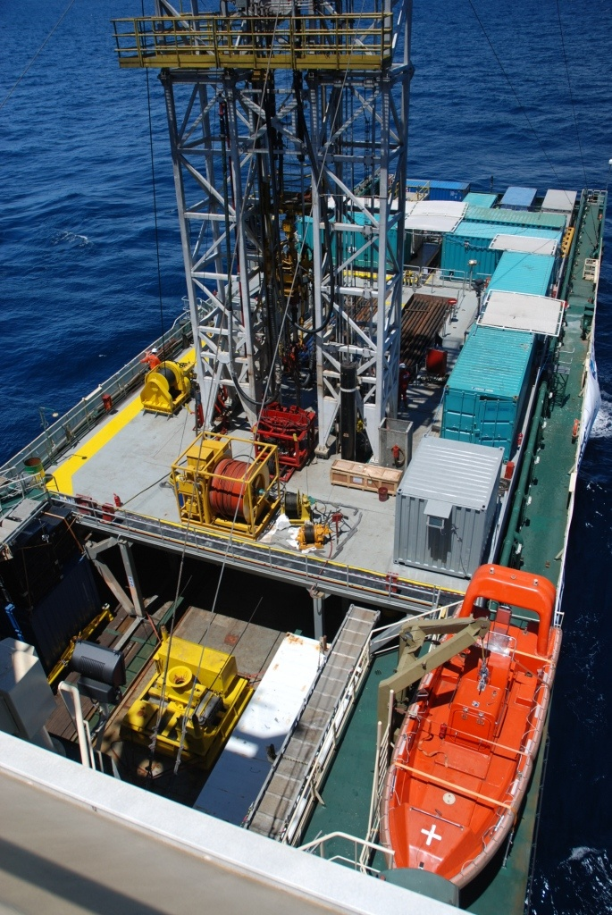
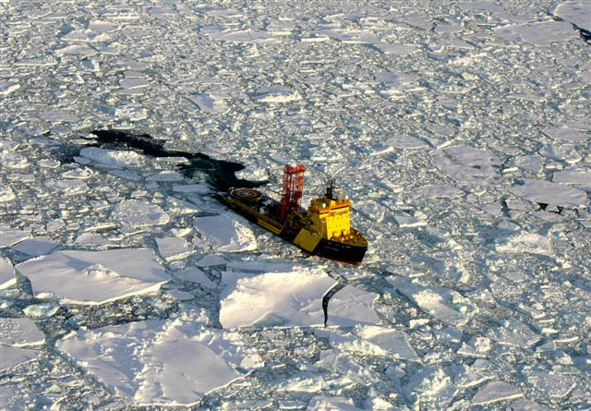
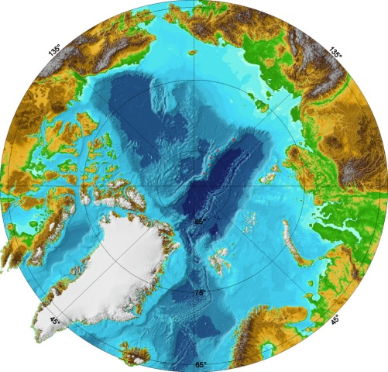
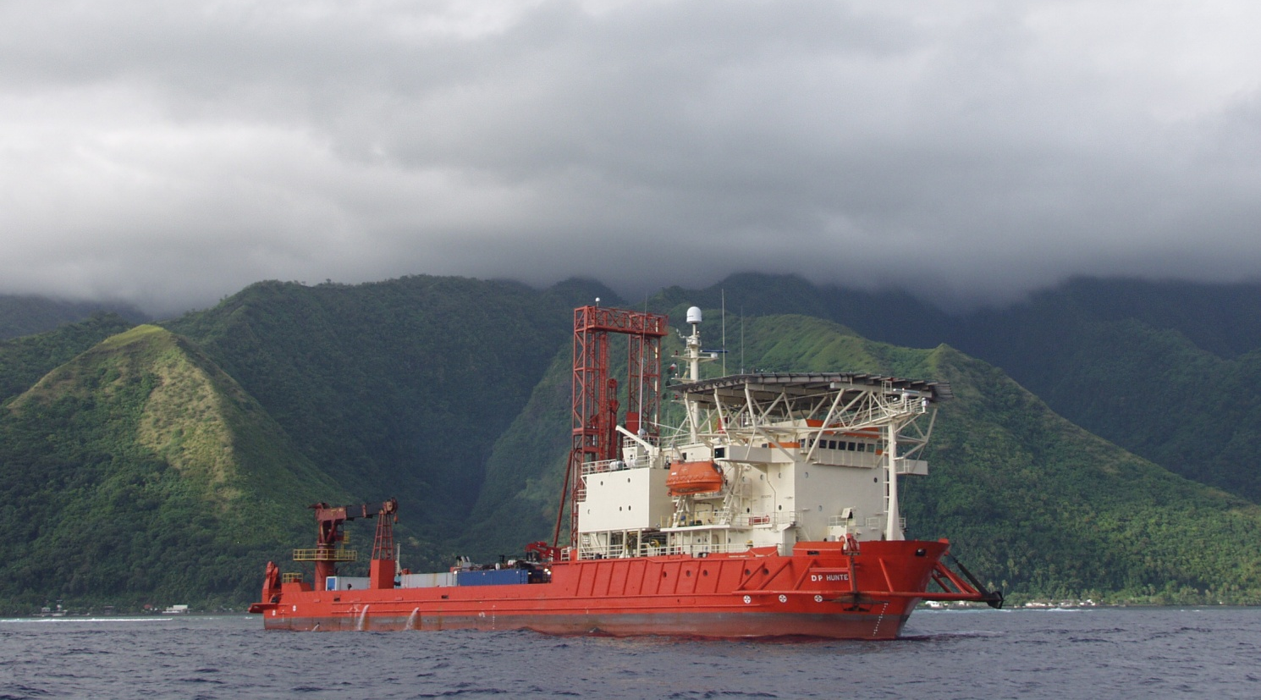
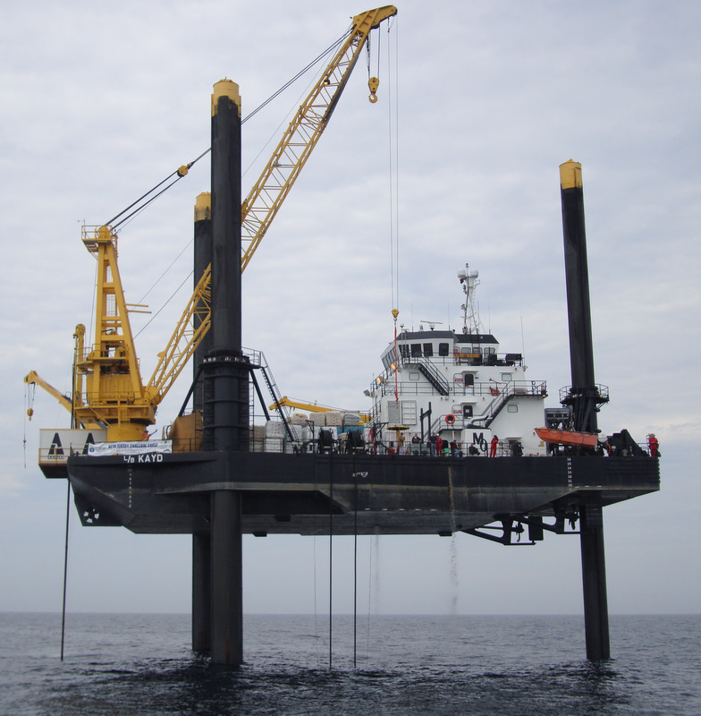
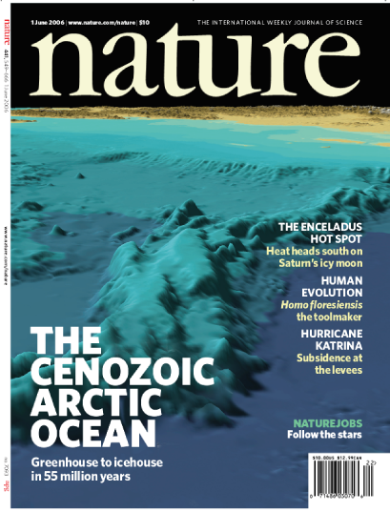
IODP Mission Specific Platforms
ACEX
GREAT BARRIER REEF
NEW JERSEY
TAHITI
Pictures © ECORD/IODP

Slide 27
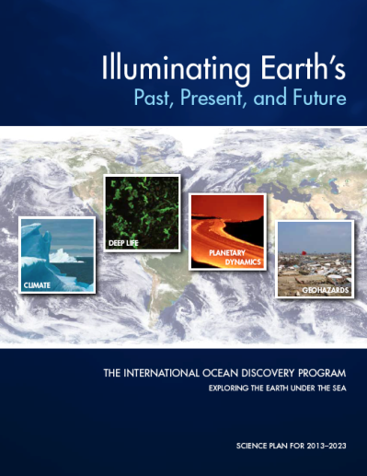
The next phase in Europe
2013-2023
The new science plan
Develop new technologies
Cost-effective operations
18 European countries provide support
Support from industry
Support from the EU
Maintain scientific leadership in Europe
A distributed European infrastructure for ocean drilling and subsea observatories

Slide 28
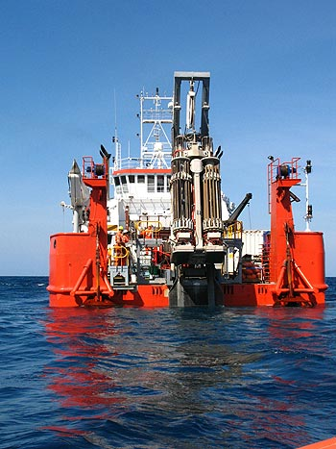
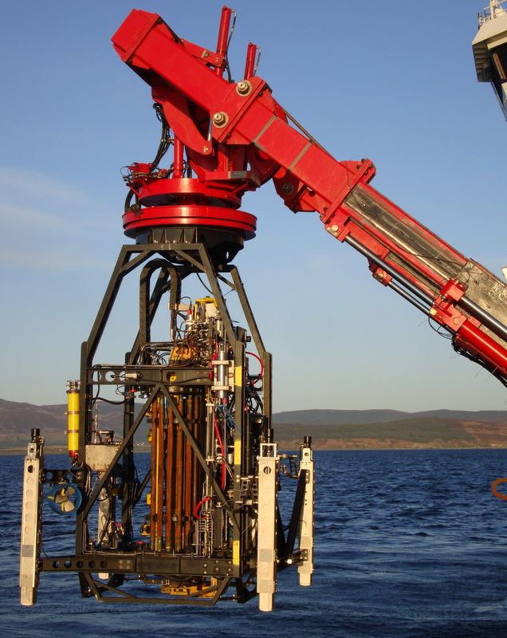
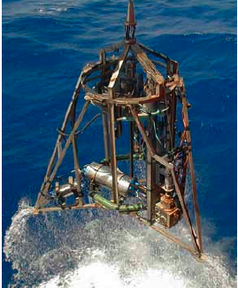
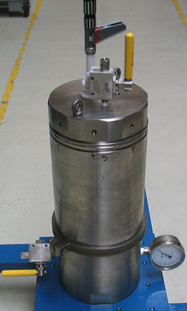
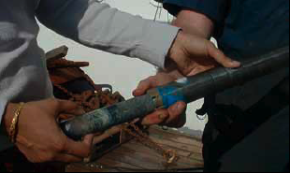
Sea Floor Drills
deployed from conventional R/V
BGS
50m rockdrill oriented drill
MARUM
MEBO (75 m)
Future developments
Greater drilling depth (MEBO is planning to expand to 200m)
Wireline coring to minimise drilling time
- improve core recovery and quality
Development of in situ measurements (logging)
Observatories for long-term measurement
-pressure sampling
Courtesy of T. Freudenthal

Slide 29
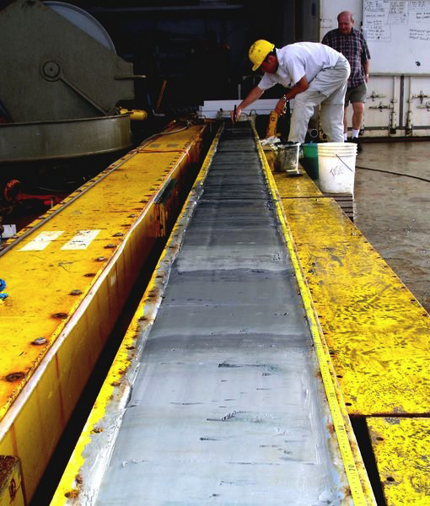
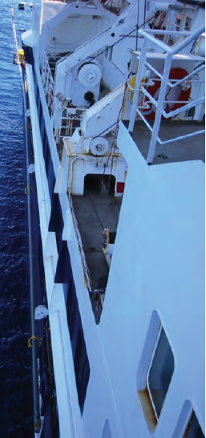
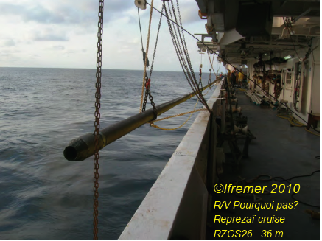
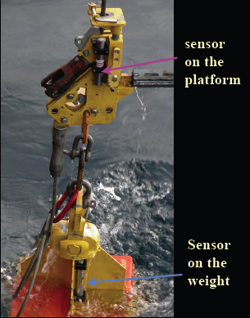
Long piston coring
IPEV (Brest) developed the giant Calypso corer operated from the Marion Dufresne
Currently working with IFREMER to improve piston coring techniques (distortion, oversampling, etc…)
Other tools….

Slide 30
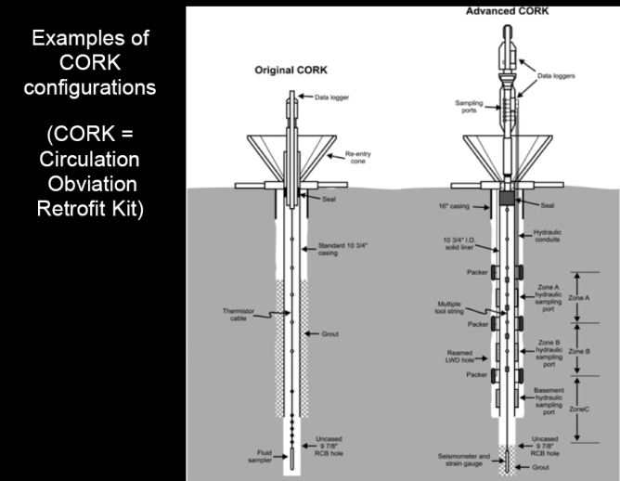
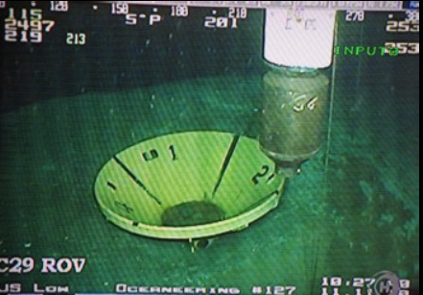
Borehole observatories
“CORKs” concept developed within IODP
equipped with sensors, plugged
Into borehole
Provide the third dimension to seafloor observatories
P, T ,fluid flows, seismicity, geochemical and
microbiological sampling
Tools developed in Europe
Genius plus
Geochemical and microbiological sampling/cultivation
MARUM, courtesy of A. Kopf
Deployed in the Nankai seismogenic zone

Slide 31
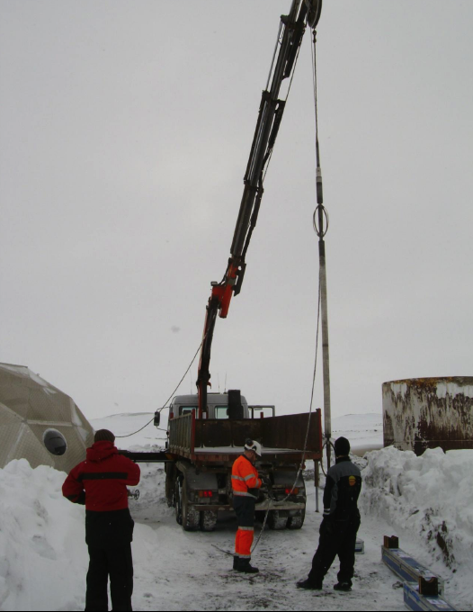
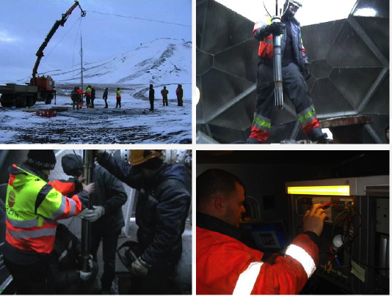
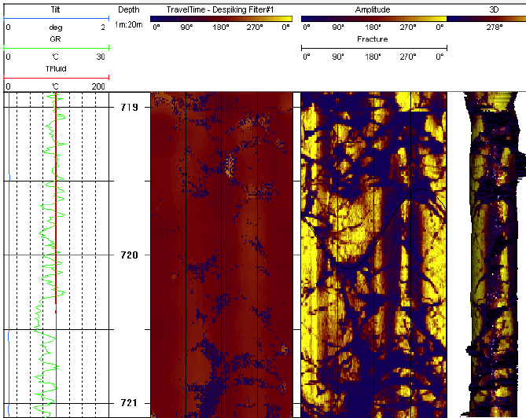
High temperature tools
Strong expertise in Iceland, associated with geothermal industry
ISOR (Iceland GeoSurvey)
has participated in a number of technological developments in essential to research in hydrothermal systems
High Temperature logging tools
300°C natural gamma ray
360° borehole televiewer

Slide 32
8 Infrastructure and Synergies
Existing Infrastructures Industries and organisations

Slide 34
Project Conclusion
White papers for each work package

