Slide 1
EMODnet Bathymetry Technical Infrastructure and methodology

Slide 4
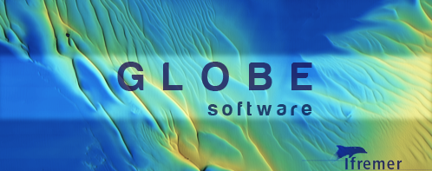
Compilation of Regional DTMs
Based on Globe software from Ifremer
Tasks performed using Globe
Quality control
Data modeling (EMODnet Bathymetry data model and structure)
Meta data link
Deconfliction
Void filling
Anomaly detection and possible repair
Export to NetCDF

Slide 5
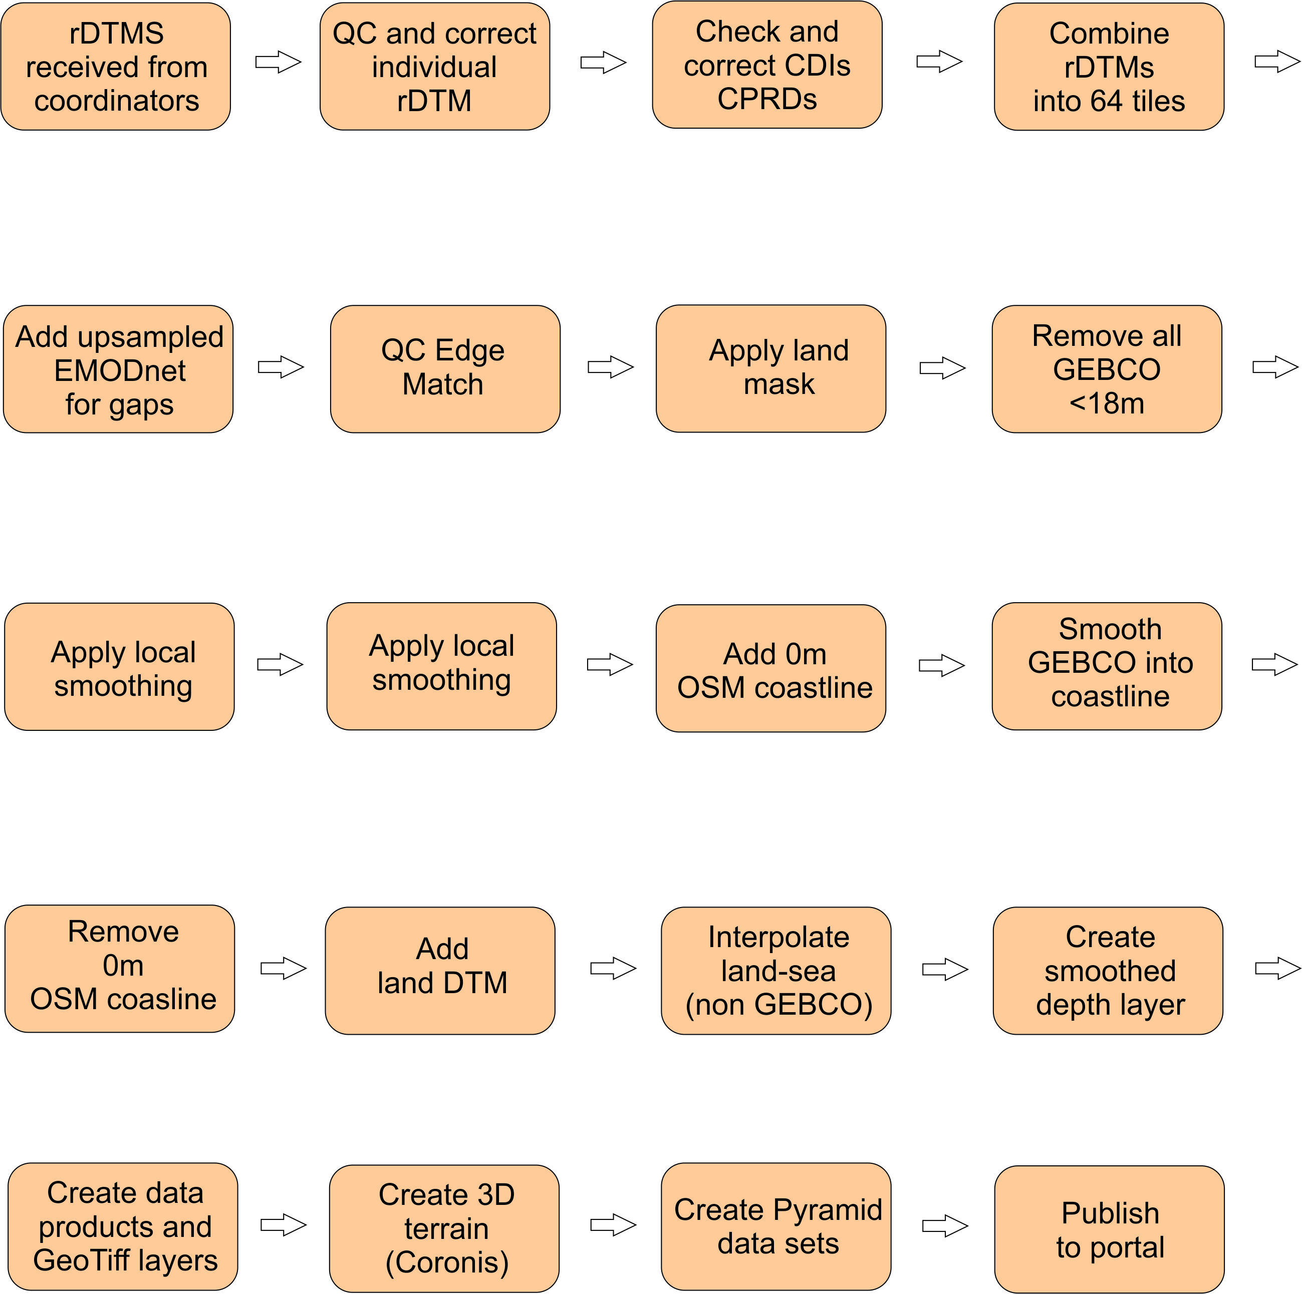
EMODnet DTM integration (overview)

Slide 6
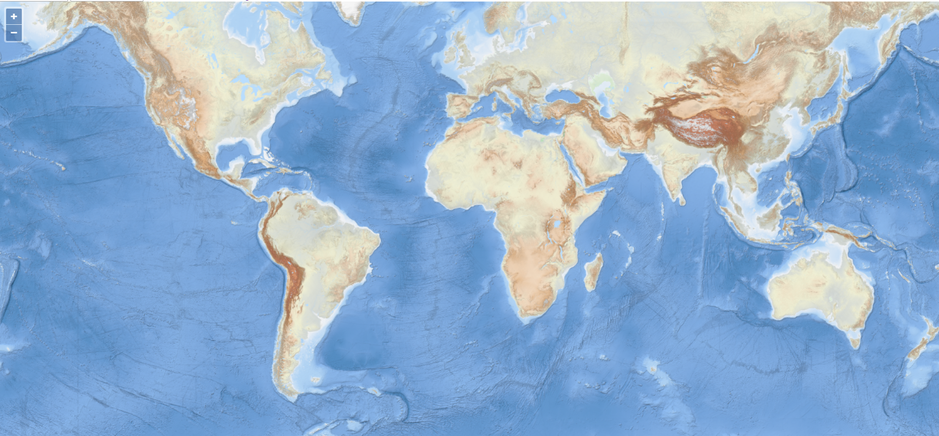
World baselayer is latest addition to EMODnet Bathymetry product
Next slides provide overview of integration process

Slide 7
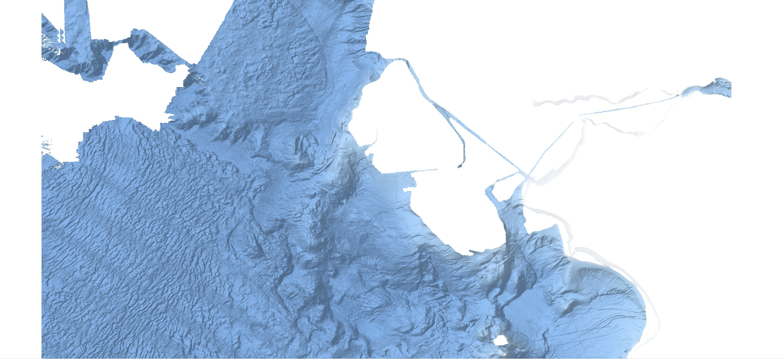
rDTM as received from regional coordinators

Slide 8
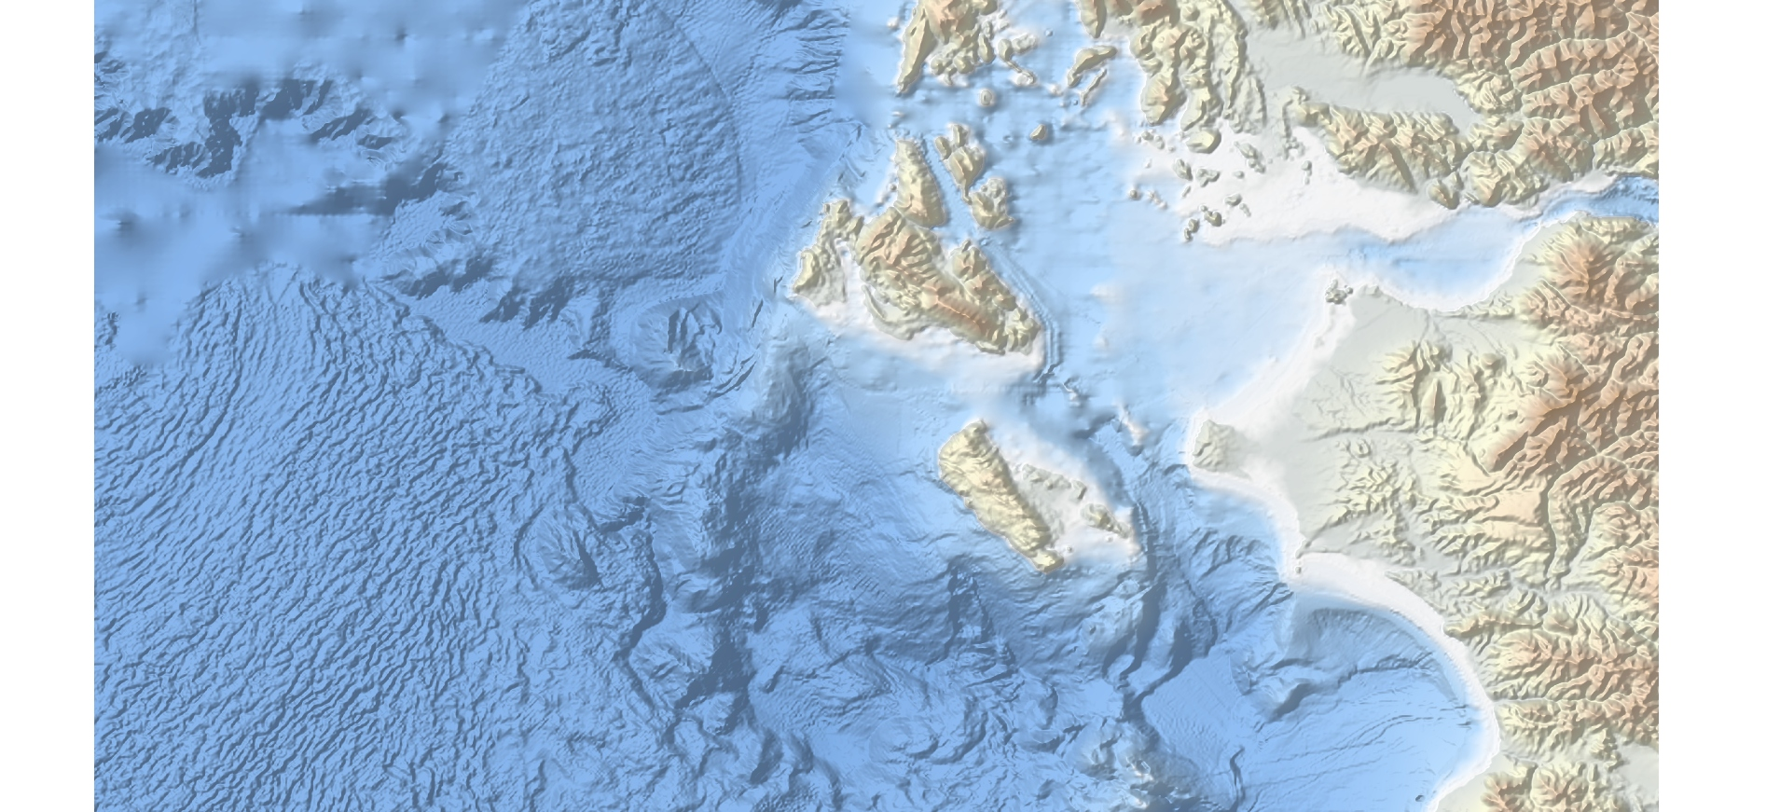
Low resolution GEBCO 2019 data set to fill the gaps

Slide 9
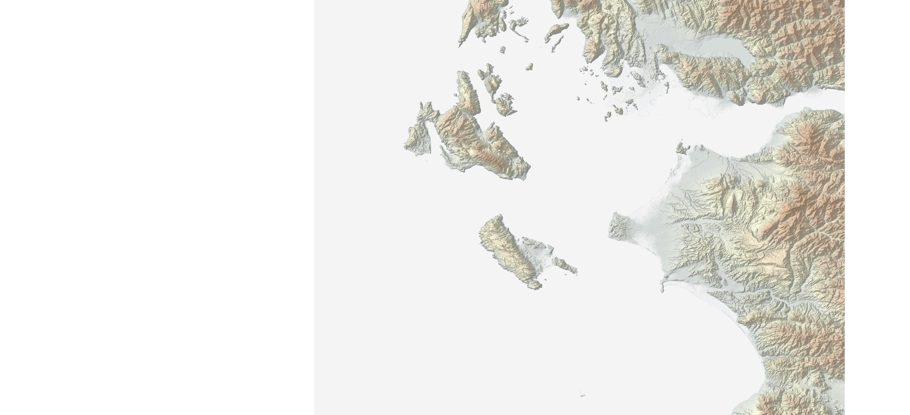
High resolution land data

Slide 10
Land mask based on OSM

Slide 11
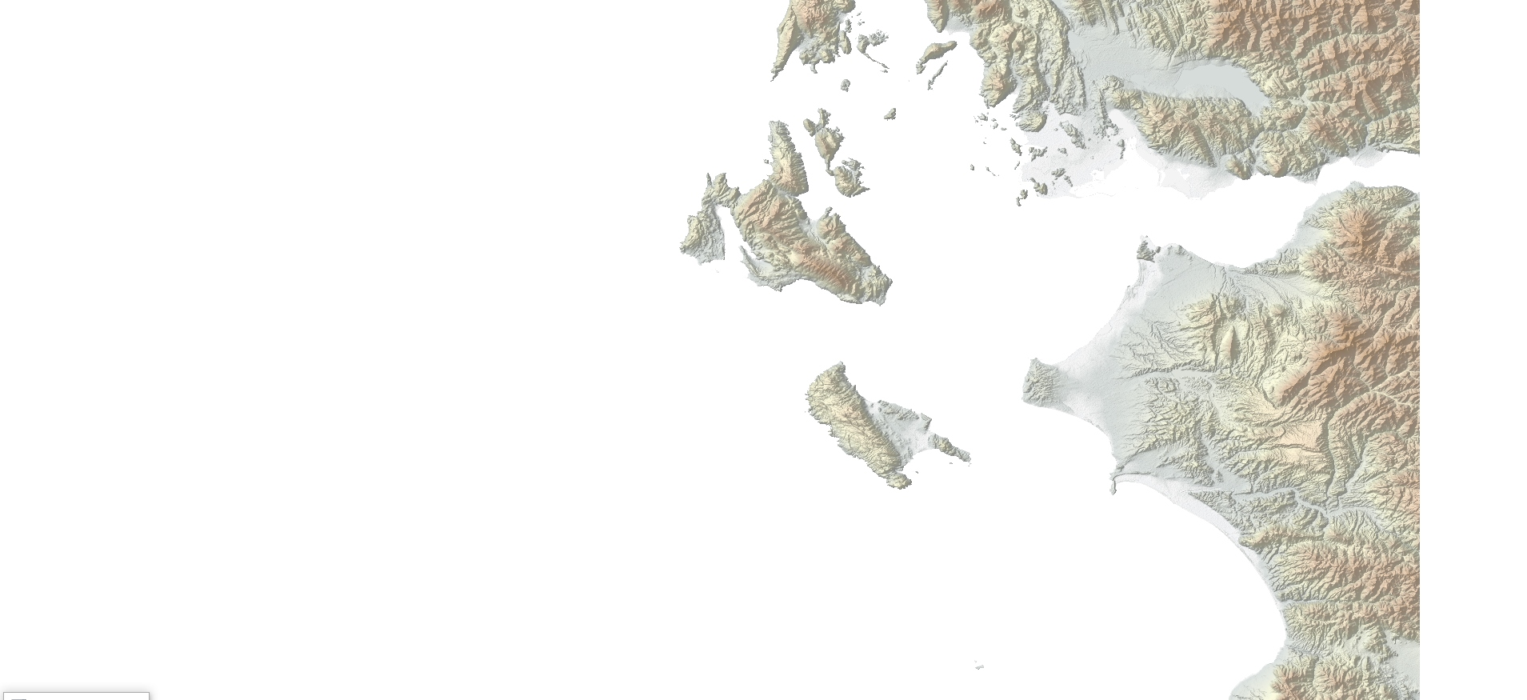
Land with negative mask applied

Slide 12
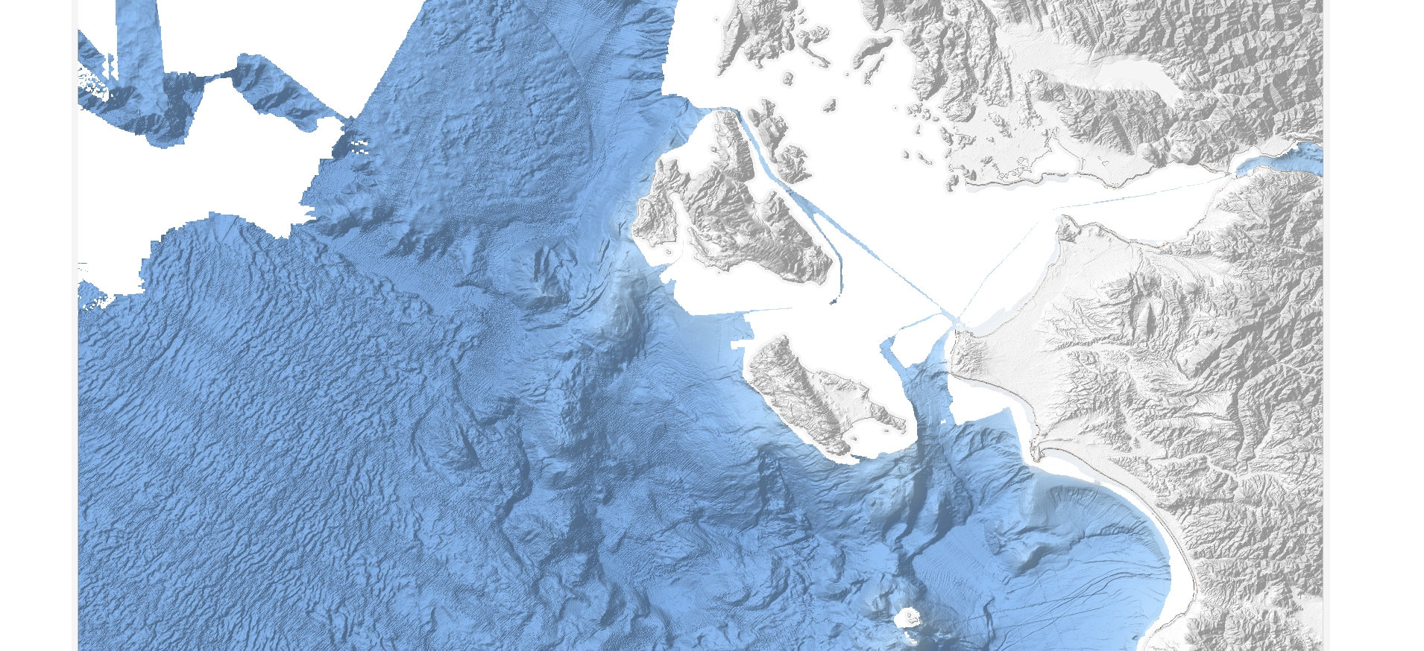
Land and EMODnet rDTM combined

Slide 13
Coastline set to 0 meters and combined with land

Slide 14
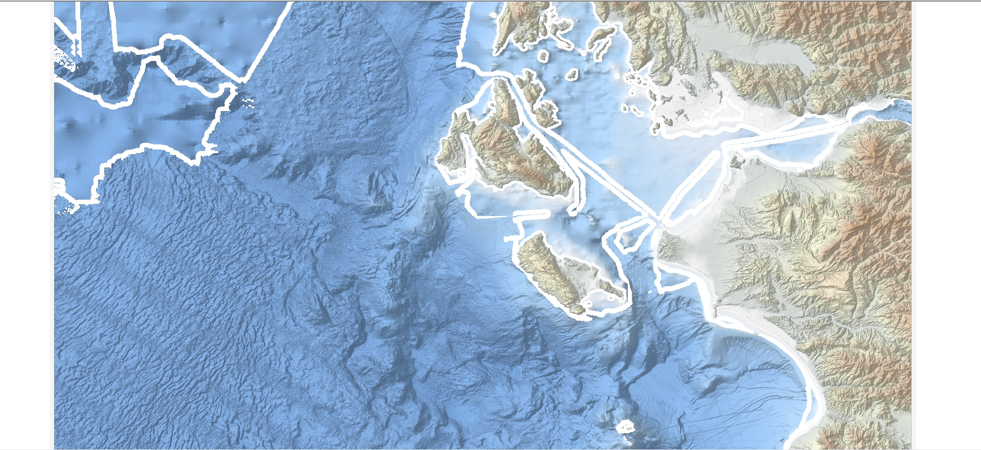
Low resolution GEBCO added and buffered

Slide 15
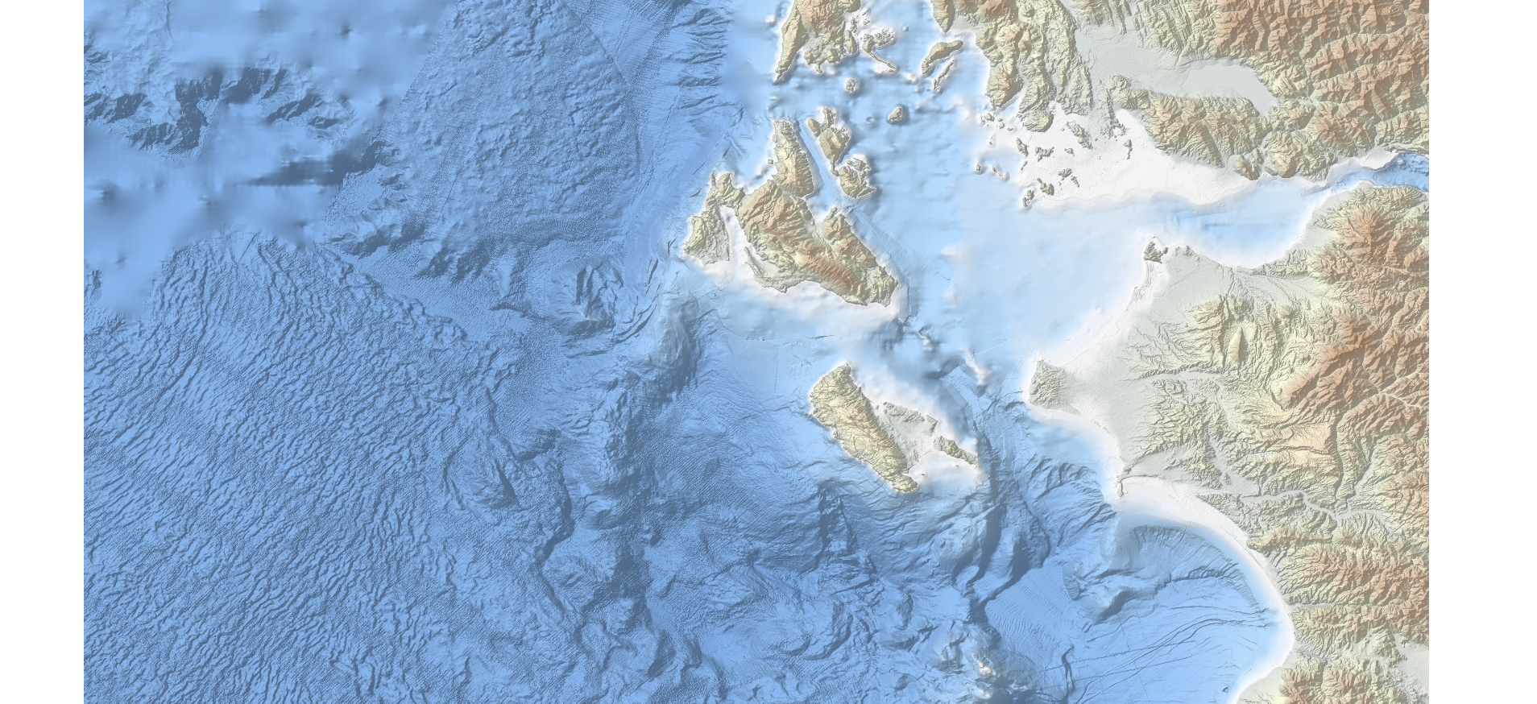
Buffer interpolated

Slide 16
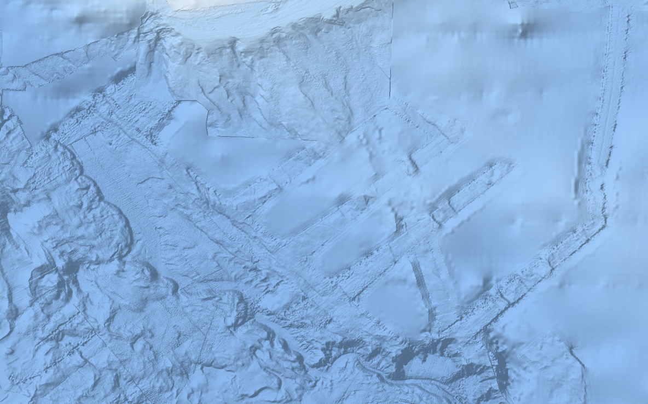
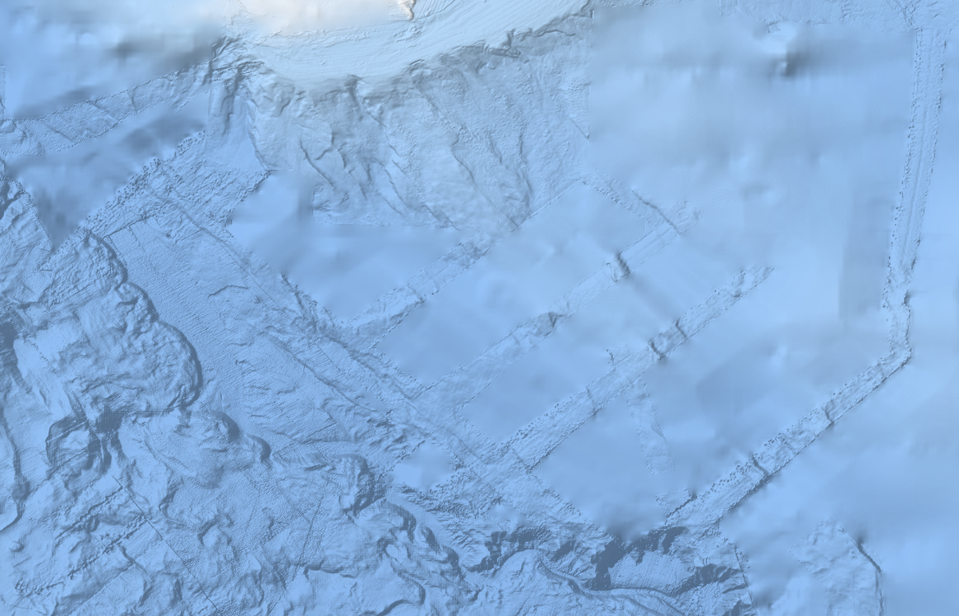
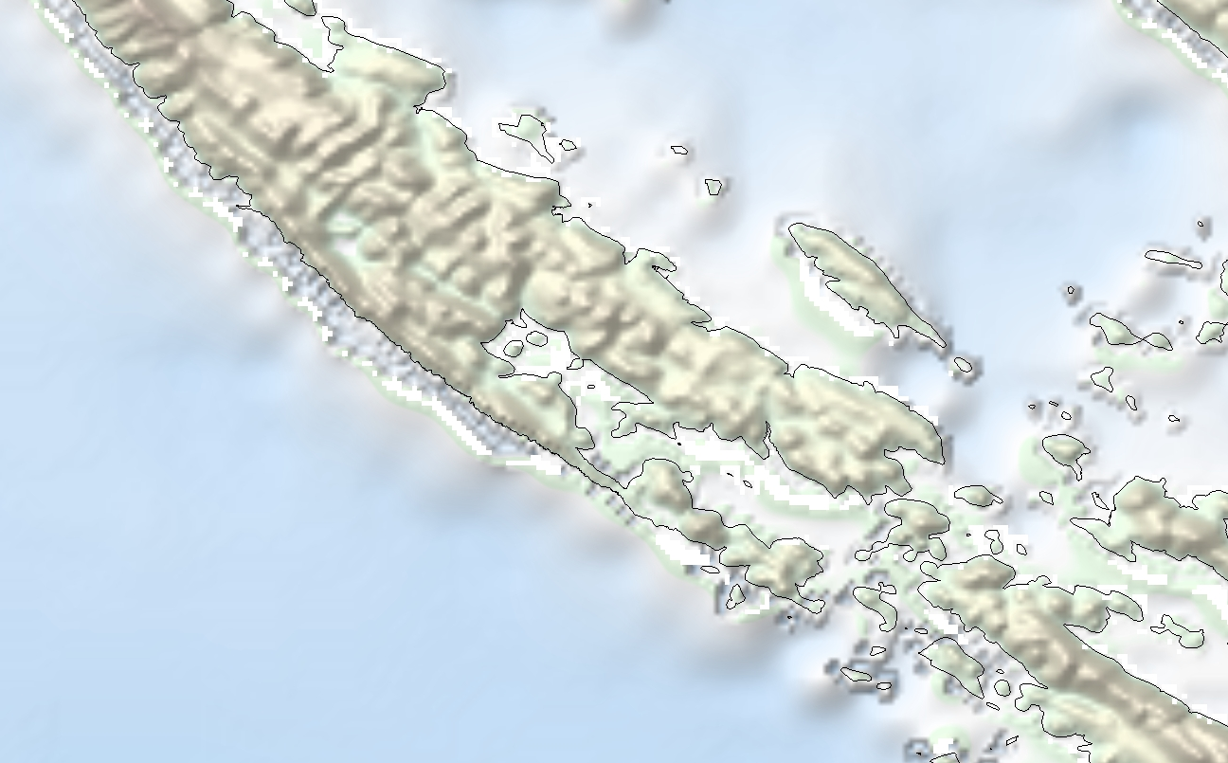
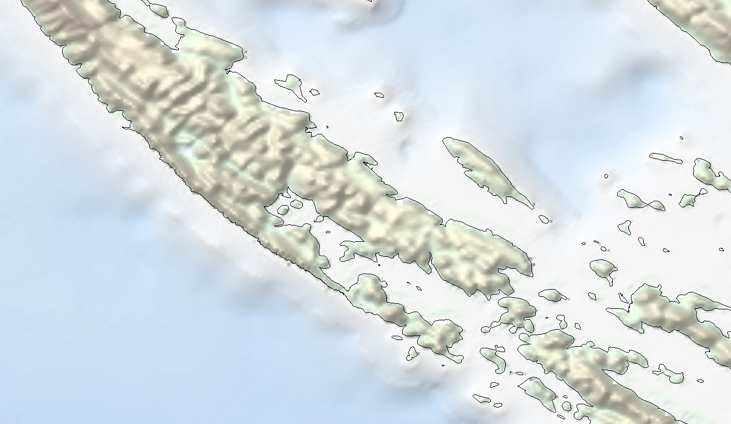
Difference without and with buffering

Slide 17
In numbers:
GEBCO 2019 global grid
15 arc second resolution
2.7 Billion grid cells
EMODnet 2018 release (Europe DTM)
3.75 arc seconds (1/16 arc minute)
5.4 Billion grid cells with 10 data bands each
EMODnet World Base Layer release 1 (EBWB1)
3 arc seconds (with upsampled EMODnet Europe DTM)
90 Billion grid cells

Slide 18
Product generation
All processing steps so far are performed on the data itself. At this stage, no other products have been created
Products (created by GGSgc and Deltares) include:
Source reference polygons
Depth contours
3 RGB tile sets in different colour schemes at 0.00069 arc degree (appr 1/24 arc minute) with hillshading
High resolution data sets (resolution < 1/16 arc minute) including an polygon index map and RGB images at native resolution
64 data tiles in 8 different formats
3 sets of coastlines for different tidal levels based on satellite imagery
World baselayer RGB tiles rendered in 4 map projections at 0.00069 arc degree resolution with hillshading

Slide 19
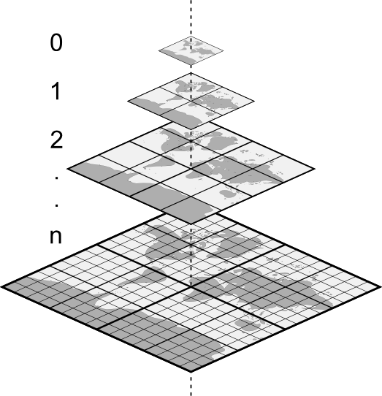
Preparation for visualization
32 bit geotiffs
Post-Processing / Tiling data
Indexing data
PostGIS
Processing of depth data
Highly optimized schema
SSD Storage
RGBA GeoTiffs
Tileset
Processing and converting affected images
Generating WMTS pyramid
Processing of image data

Slide 20
Services and API
https://portal.emodnet-bathymetry.eu/services/services.html
REST – depth info
WMS - WFS
WCS
WMTS
rest.emodnet-bathymetry.eu
ows.emodnet-bathymetry.eu
tiles.emodnet-bathymetry.eu
PostGIS
PostGIS
SSD Storage
SSD Storage
Raster data
Vector data
Raster data
Pre rendered raster imagerydata

Slide 21
Depth retrieval services
WMS GetFeatureInfo
Bathymetry REST API
{
"min": 105,
"max": 105,
"avg": 105,
"elementarySurfaces": 1,
"smoothed": 104.46,
"smoothedOffset": 0.5400000000000063,
"reference": {
"organisation_id": 540,
"identifier": "S201108200-5",
"type": "CDI"
}
}
{
"type": "FeatureCollection",
"features": [
{ "type": "Feature",
"id": "",
"geometry": null,
"properties": {
"GRAY_INDEX": 543.7899780273438
}
} ],
"totalFeatures": "unknown",
"numberReturned": 1,
"timeStamp": "2020-03-19T10:20:36.836Z", "crs": null
}
- Single depth attribute (mean)
Multiple depth attributes (mean, avg, min, max)
Links grid cell with source metadata (source references)

Slide 22
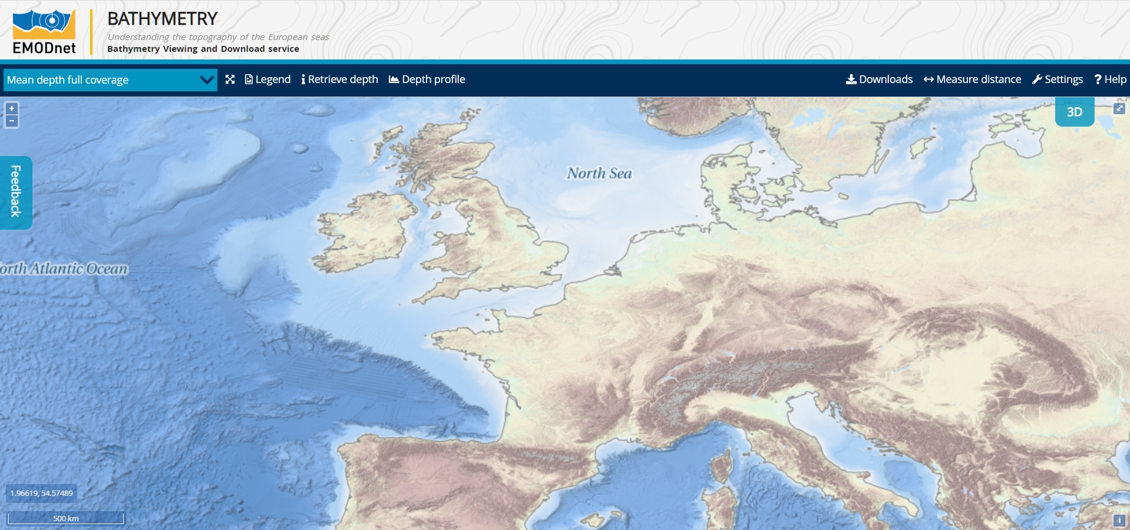
Viewing service

Slide 23
Hosting
Distributed server infrastructure for production environment
REST service with depths
OWS service providing WMS/WCS/WFS
OWS requests requires processing source data
Bottleneck: CPU and Disk performance
WMTS tile service providing static WMTS imagery
Static, pre-rendered image data
Bottleneck: Disk performance
Frequently accessed tiles cached in memory
Backup infrastructure (mirror also used for test purposes)
Use of Amazon AWS services when needed
Physically hosted on Amsterdam Internet exchange

Slide 24
Thanks Questions?

