Slide 1
EuropeWave Update
EMFF Workshop on Offshore Renewable Energy 2022
October 4 2022
Notes:
Little background to the project
A little on the ambition for the project
A little on what’s happening now
A glimpse of the concepts

Slide 2

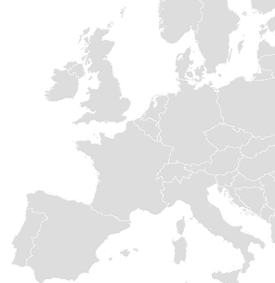




Bridging the gap to commercialisation of wave energy technology using pre-commercial procurement
Wave Energy Scotland (WES)
www.europewave.eu
Duration: 65 months (01/01/2021 to 31/05/2026)
PCP Budget: €19,600,000
Total Budget: €22,702,112
Programme: H2020-EU.3.3.2.
[Low-cost, low-carbon energy supply]
Topic: LC-SC3-JA-3-2019
[European Pre-Commercial Procurement Programme for Wave Energy Research & Development]
Ocean Energy Europe (OEE)
Ente Vasco
de la Energía (EVE)
Buyers Group
This project has received funding from the European Union’s Horizon 2020 research and innovation programme under grant agreement No 883751.
Consortium Partner

Slide 3

Overarching Challenge
[LC-SC3-JA-3-2019]
The design, development,
and demonstration of cost-effective wave energy converter systems for electrical power production that can survive in the harsh and unpredictable ocean environment

Slide 4

EuropeWave PCP Challenge
To advance promising
wave energy converter systems
to a point from which
they can be developed to commercial exploitation
through other
national/regional programmes and/or private sector investment.

Slide 5
EuropeWave PCP: Objectives
Phase 3
Open-sea deployment &
testing programme
Phase 1
Concept Development
Phase 2
Design / modelling
Optimise the concept engineering design for the EuropeWave requirements
Benchmark performance
Estimate the Phase 3 power performance capability
Evidence that the WEC system is on track to provide an attractive commercial offering
Complete FEED of
the Phase 3 prototype
Pass Critical Design Review (CDR) to begin meaningful engagement with fabrication providers
Improve fidelity of simulation
and financial modelling
Develop and evidence appropriate planning for
Phase 3 deployment
Completion of Stage 2 of
the IEA Framework
Validate power capture and conversion capability through operational data recorded during sustained periods of operation in the energy producing sea-states
Demonstrate the effectiveness
of survival strategies
Demonstrate achievable
levels of availability
Completion of Stage 3 of
the IEA Framework

Slide 6
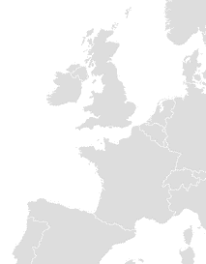


EuropeWave PCP: Phase 3 deployment locations

Slide 7
May 18 - May 29
0%
0%
0%
0%
0%
2021
EuropeWave PCP: Timeline
24.6 w
Jul 2021
Procurement
Dec 2021
16 w
18 w
Jun 2022
PG
Sep 2022
May 2023
PG
Sep 2023
Mar 10 - May 30
30 w
40 w
142 w
0%
0%
0%
0%
0%
Phase 1
Phase 2
Phase 3
Jan 2022 - Jul 2022
Sep 2022 - Jun 2023
Sep 2023 - May 2026
26 w
52 w
12 w
50 w
2 w
Design
Fabrication
Operations
Sep 2023 - Mar 2024
Mar 2024 - Mar 2025
Jun 2025 - May 2026
Commissioning & installation
Demobilisation
2021
2022
2023
2024
2025
2026
Q3
Q1
Q3
Q1
Q3
Q1
Q3
Q1
Q3
Q1
2026
Today

Slide 8






Phase 1 Contractors
Lead Contractors | AMOG Consulting | UK (England)
 | Arrecife Energy Systems * | Spain
 | Bombora Wave Power Europe * | UK (Wales)
 | CETO Wave Energy Ireland * | Ireland
 | IDOM Consulting, Engineering, Architecture | Spain
 | Mocean Energy | UK (Scotland)
 | Waveram * | Ireland
* consortium project

Slide 9
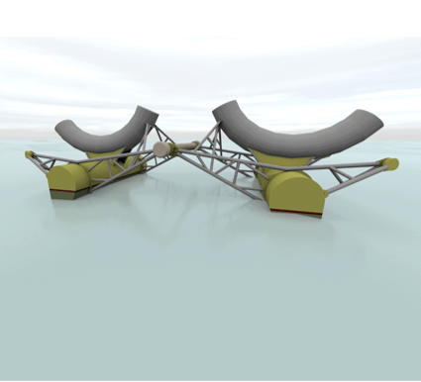




AMOG Consulting: Sea-Saw WEC
Consortium
Subcontractors (Phase 1)
Ocean Energy Systems Ltd
www.europewave.eu/phase-1-awards/project-amog-sea-saw-wec

Slide 10
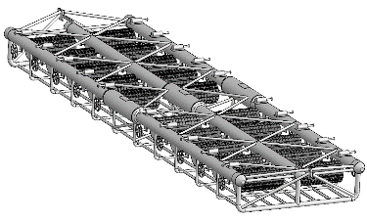



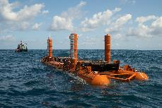

Arrecife Energy Systems: Trimaran
Consortium
Subcontractors (Phase 1)
www.europewave.eu/phase-1-awards/project-arrecife-trimaran

Slide 11






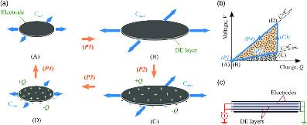

Bombora Wave Power Europe: emWave
Consortium
DEG Cell module
Subcontractors (Phase 1)
Floating DEG mWave
DEG Membrane &
Control System
www.europewave.eu/phase-1-awards/project-bombora-emwave

Slide 12
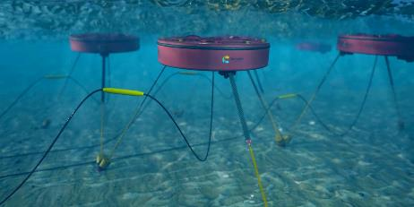





CETO Wave Energy Ireland: ACHIEVE
Consortium
Subcontractors (Phase 1)
www.europewave.eu/phase-1-awards/project-ceto-achieve

Slide 13

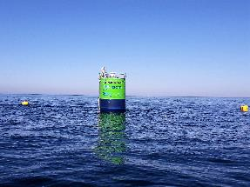

IDOM Consulting, Engineering, Architecture SAU: MARMOK Atlantic
Consortium
Subcontractors (Phase 1)
www.europewave.eu/phase-1-awards/project-idom-marmok

Slide 14







Mocean Energy: Blue Horizon 250
Consortium
Subcontractors (Phase 1)
www.europewave.eu/phase-1-awards/project-mocean-blue-horizon-250

Slide 15
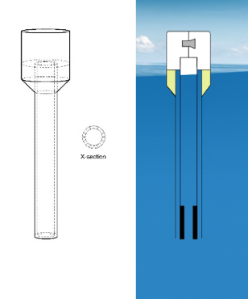



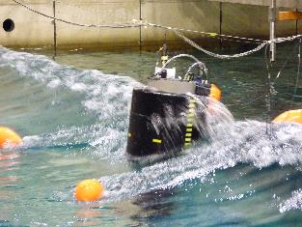

Waveram: The Waveram
Consortium
Subcontractors (Phase 1)
www.europewave.eu/phase-1-awards/project-waveram

Slide 16

Keep in touch
Social networks:
Twitter: @EuropeWave_EU
LinkedIn: EuropeWave Project
Project newsletters:
Sign-up at the EuropeWave website
Project website:
www.europewave.eu
Email:
info@europewave.eu

Slide 17
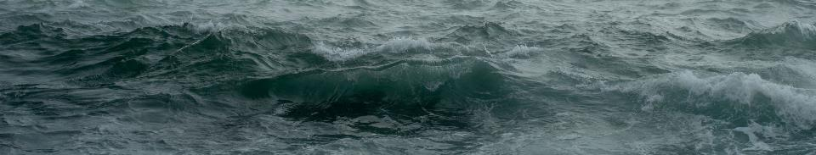
Thank you!

