Slide 1
EMBRC -
European Marine Biological Resource Center K. Deneudt, I. Nardello
Pilot Blue Cloud Workshop
March 28th, 2017
Brussels

Slide 2
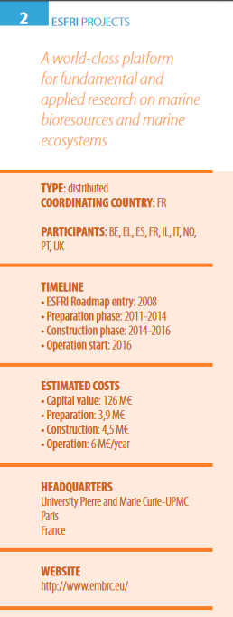
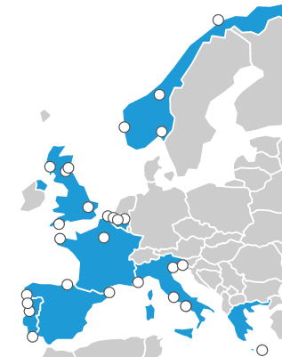
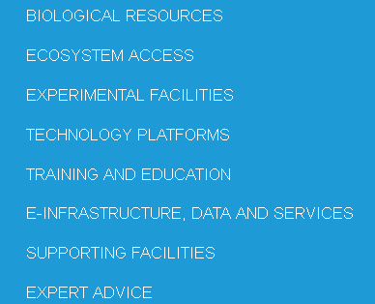
EMBRC ESFRI Project

Slide 3
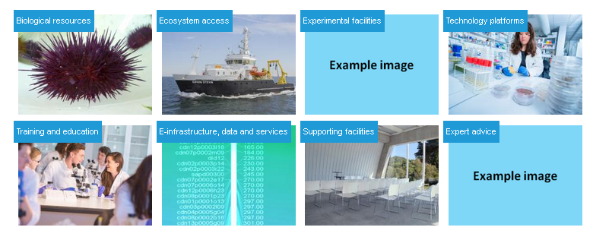
EMBRC Service offer
User
On-site access
Remote access
Virtual access
To
Service catalogue & request system

Slide 4
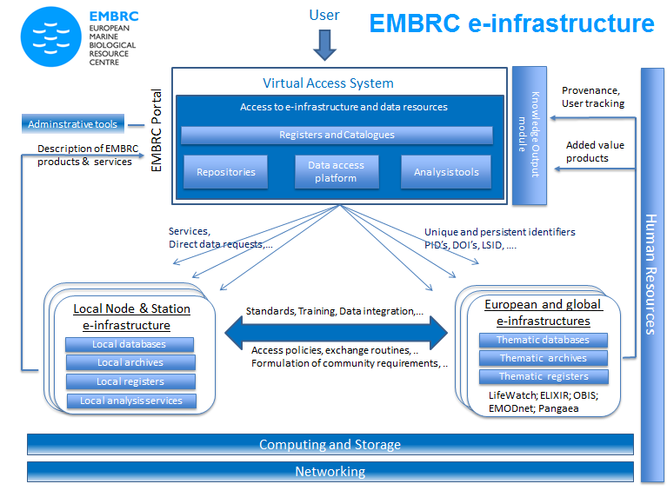
EMBRC e-infrastructure
Working group
Listing initial requirements
Data storage and Computing capacity; Networking and connectivity; Repositories; Integrated thematic databases; Analysis tools; Registers and catalogues; Administrative tools; IT & Data management capacity; Training & standards
Preferred approach based on co-development and interoperability
Defining architecture model
Defining Priorities for implementation
Data policy and DMP for EMBRC
Notes:
Based on use cases and consultation
Data life cycle

Slide 5
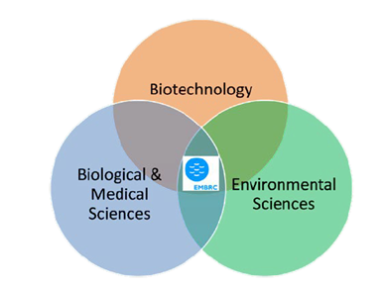
EMBRC – Blue Pilot Cloud
How the project can contribute to the European Open Science Cloud
Formulating EMBRC community requirements for Blue Cloud
Connecting marine biological stations to Bleu Pilot Cloud
Connecting EMBRC users to Blue Pilot Cloud
Connecting with industry and maritime regions stakeholders
Implications of Nagoya Protocol for Blue Pilot Cloud
Link key catalogues and repositories for marine biological resources
Collection and knowledge of broad array of research data types
Species data
Experiment data
Marine imaging data
Omics data
Coastal environmental sensor data
Link key analytical tools in bioinformatics and ecology
Standardisation and training
Terrabytes

Slide 6
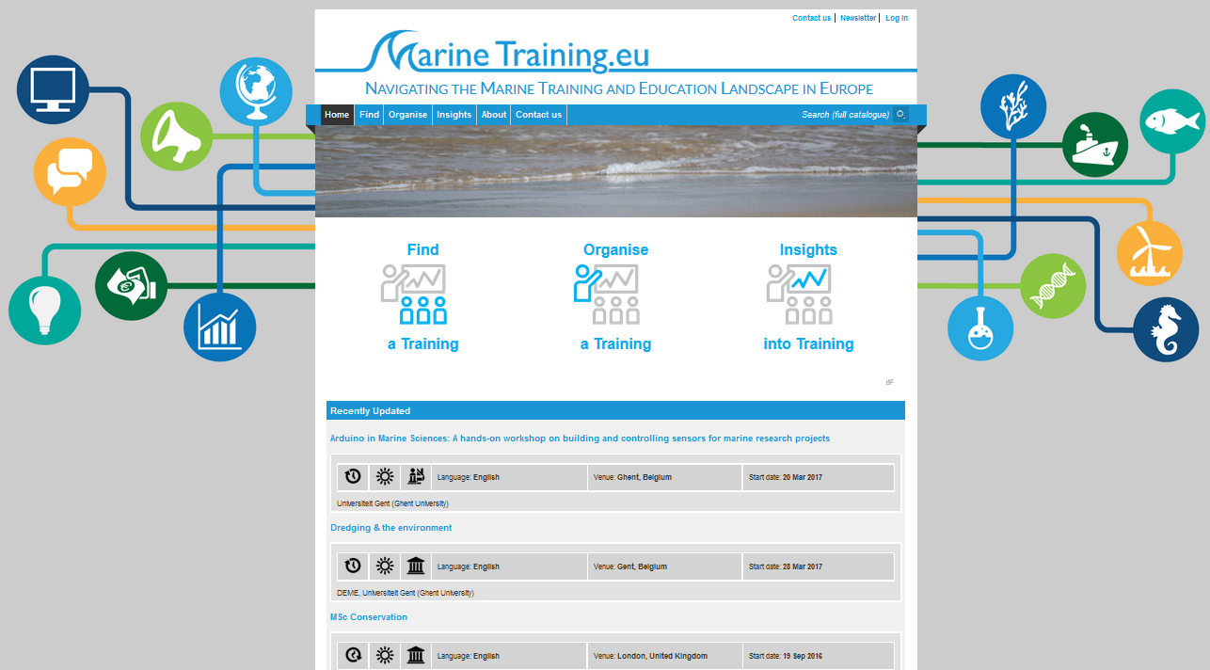
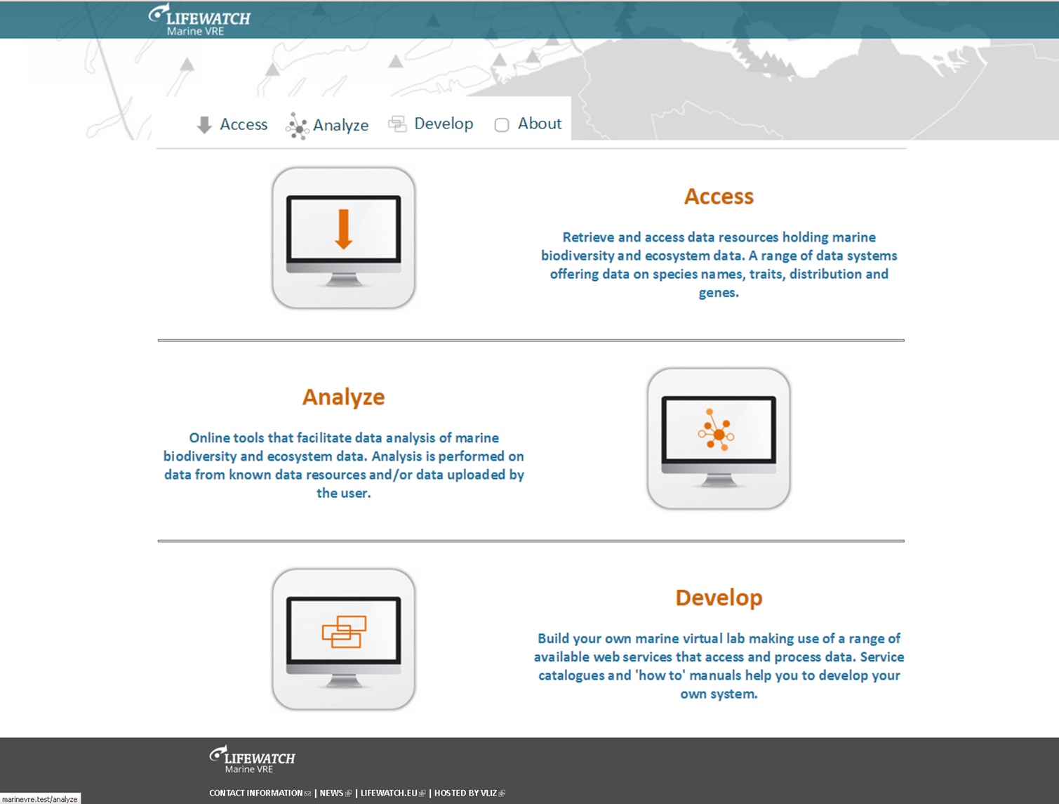
EMBRC – Blue Pilot Cloud
- Additional priorities and possible actions at short and medium term in the direction of the Pilot Blue Cloud
Expert
register
Knowledge output
module
EMBRC DMP
2017
2018
Service
catalogue
Dataset
Catalogue
Virtual data
Access
Virtual analysis
platform
- Training opportunities to train a new generation of Blue Cloud experts
MarineTraining.EU
LifeWatch Marine VRE

