Slide 1
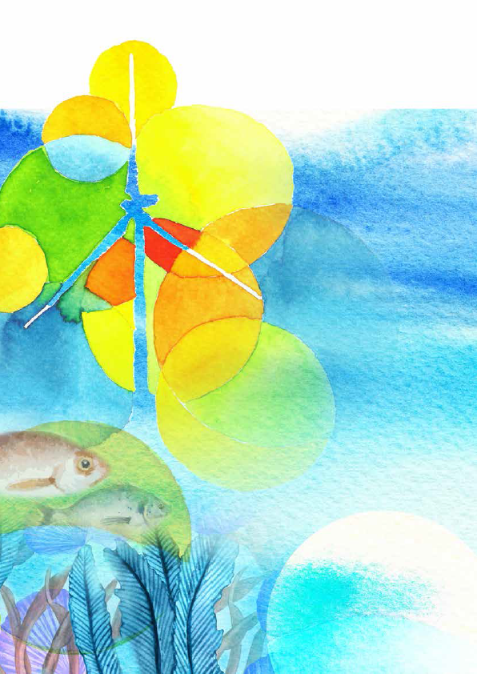
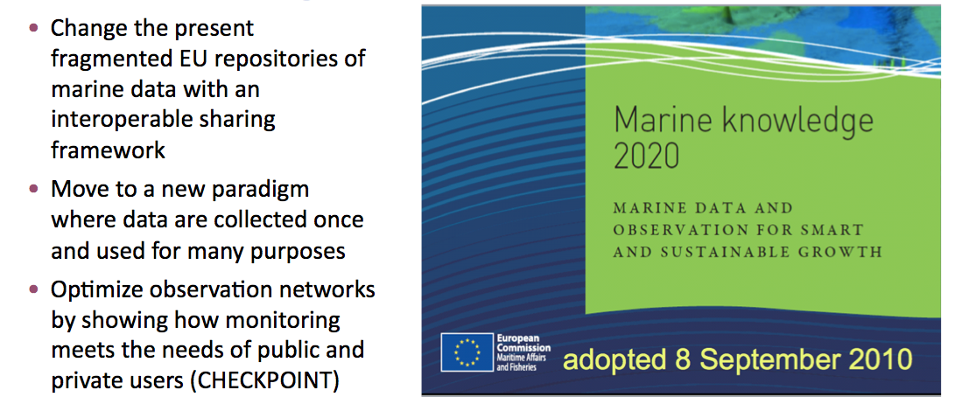
The European Marine Observation and Data Network
EU-China Blue Year Event
1 June, 2017
secretariat@emodnet.eu
info@emodnet.eu
Notes:
Good afternoon Minister, Commissioner and distinguished guests and experts
It is a great pleasure and honour to speak at this event about the European efforts we are doing to assemble and make European marine data and observations more easily available for use by a growing user community via the European Marine Data and Observation network.

Slide 2
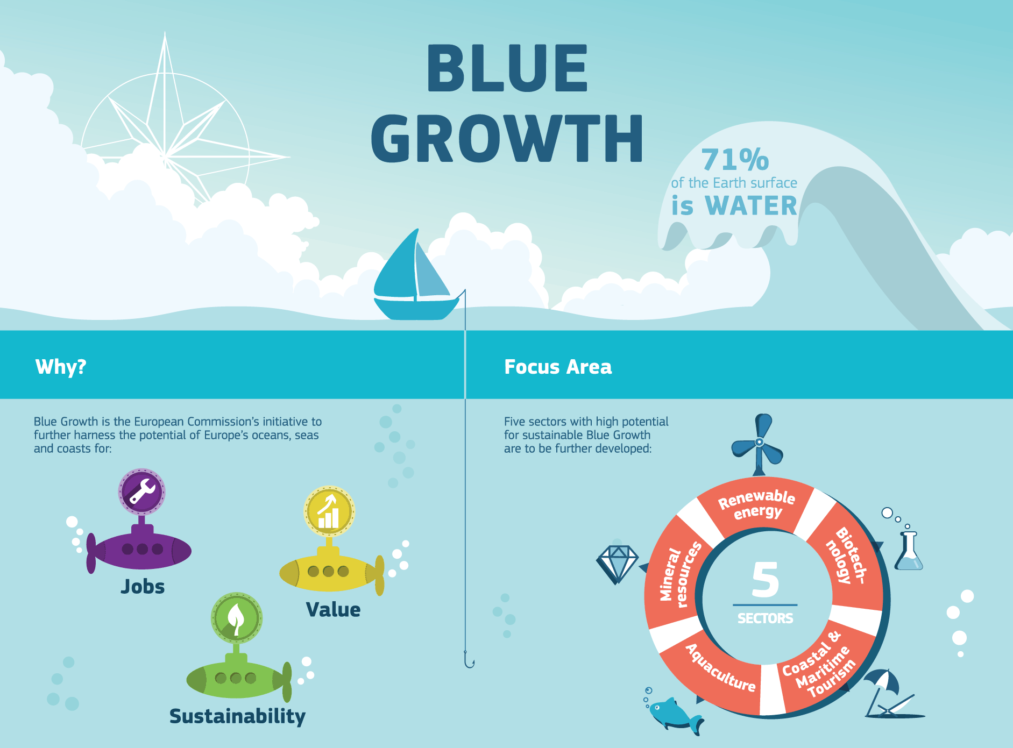
Notes:
Before speaking about EMODnet, I would like to take a step back and look at the wider European policy framework where EMODnet fits in.
Blue Growth is Europe’s policy response aiming to make use of the vaste opportunties presented by the seas and oceans to create jobs, value and ensure sustainability. It is one of the core cross-cutting policies under the Integrated Maritime Policy supporting Europe’s 2020 strategy for smart, sustainable and inclusive growth.

Slide 3
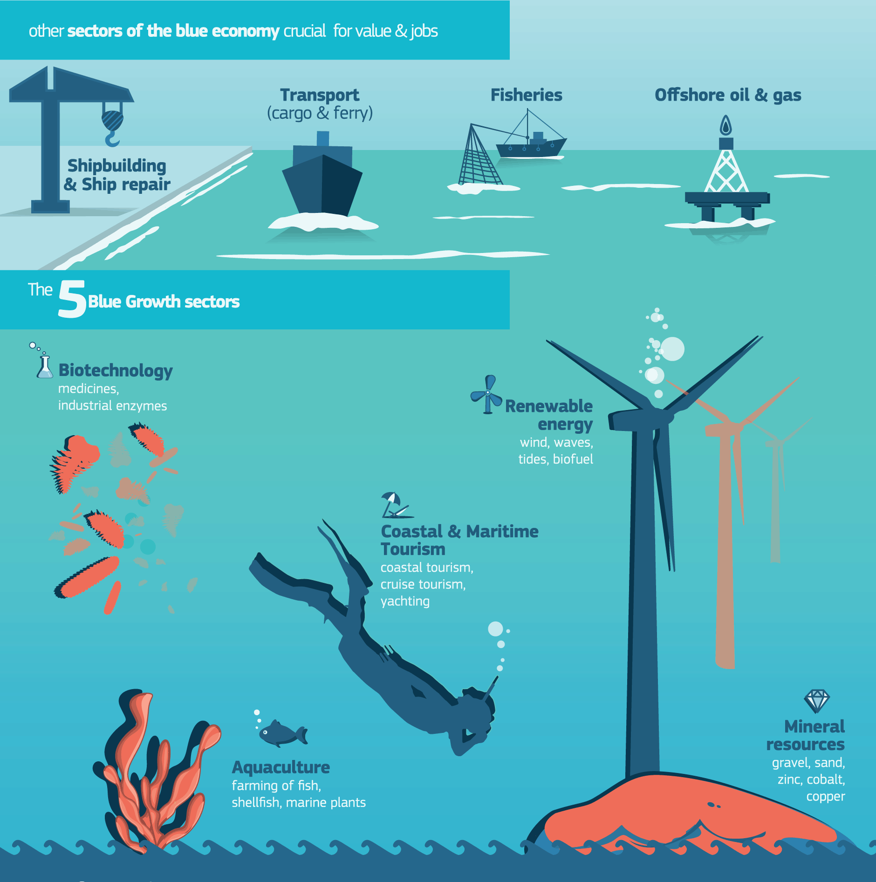
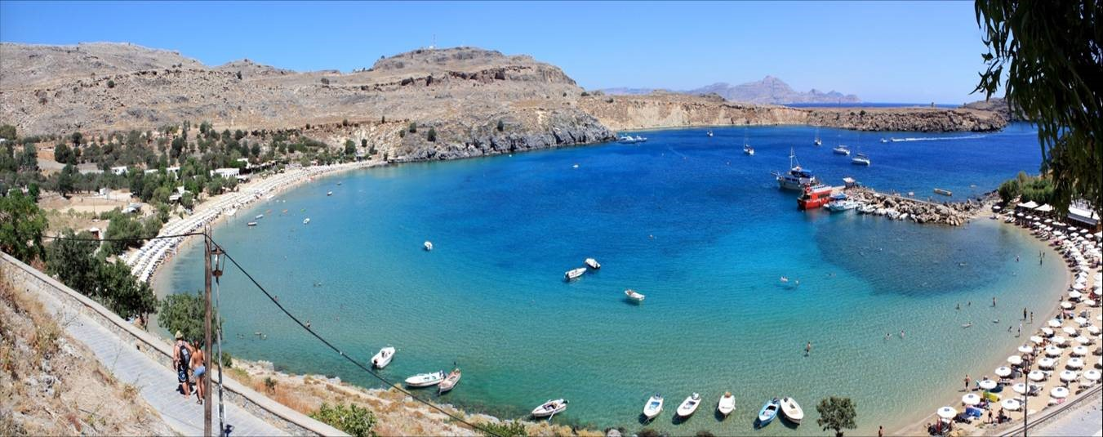
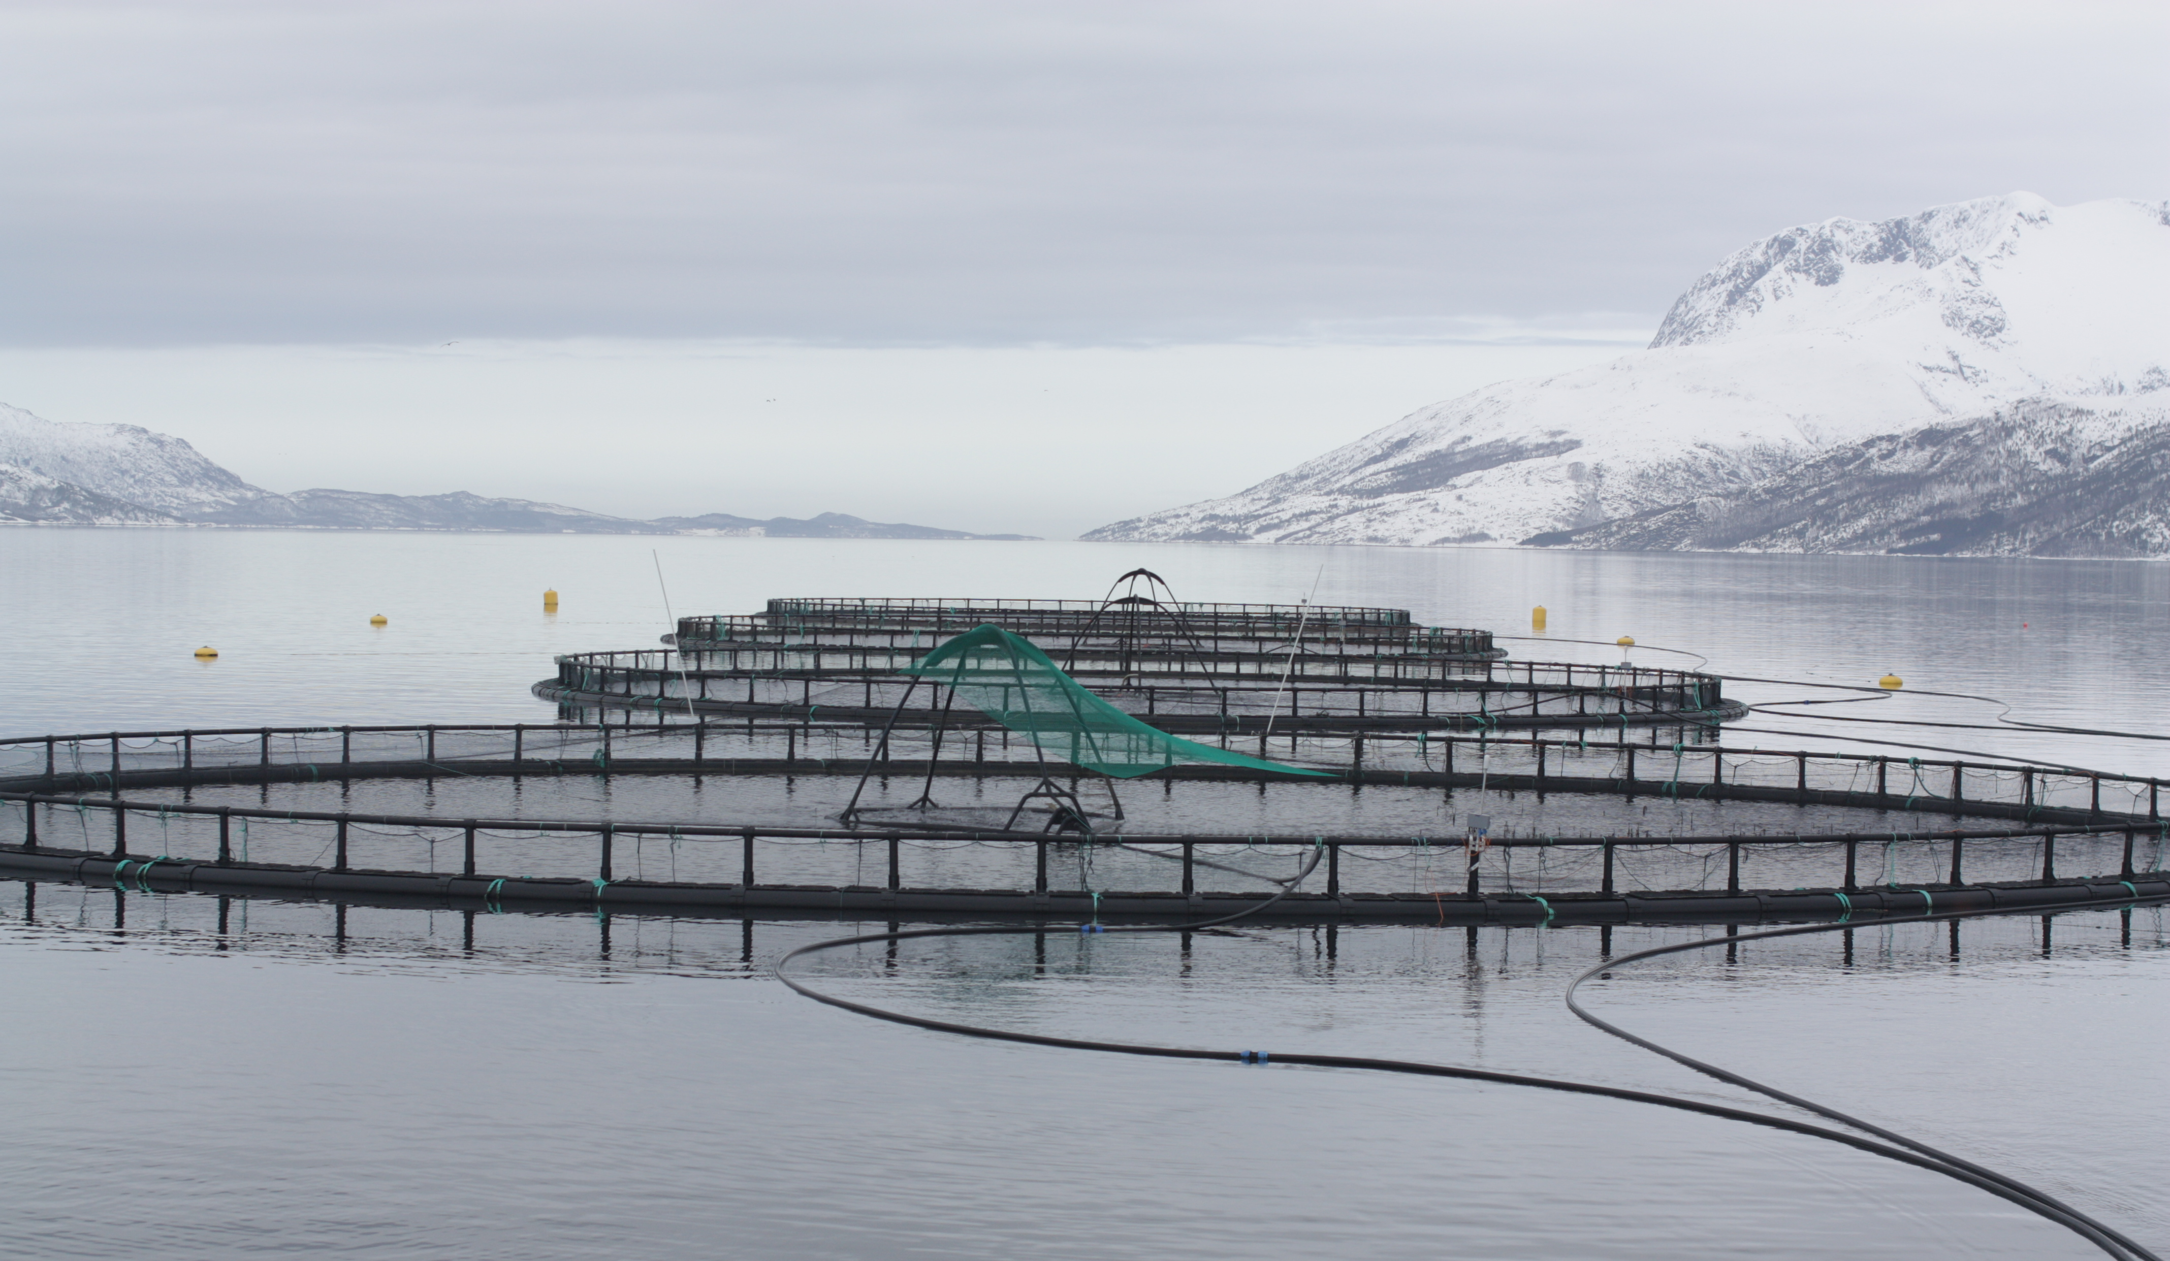
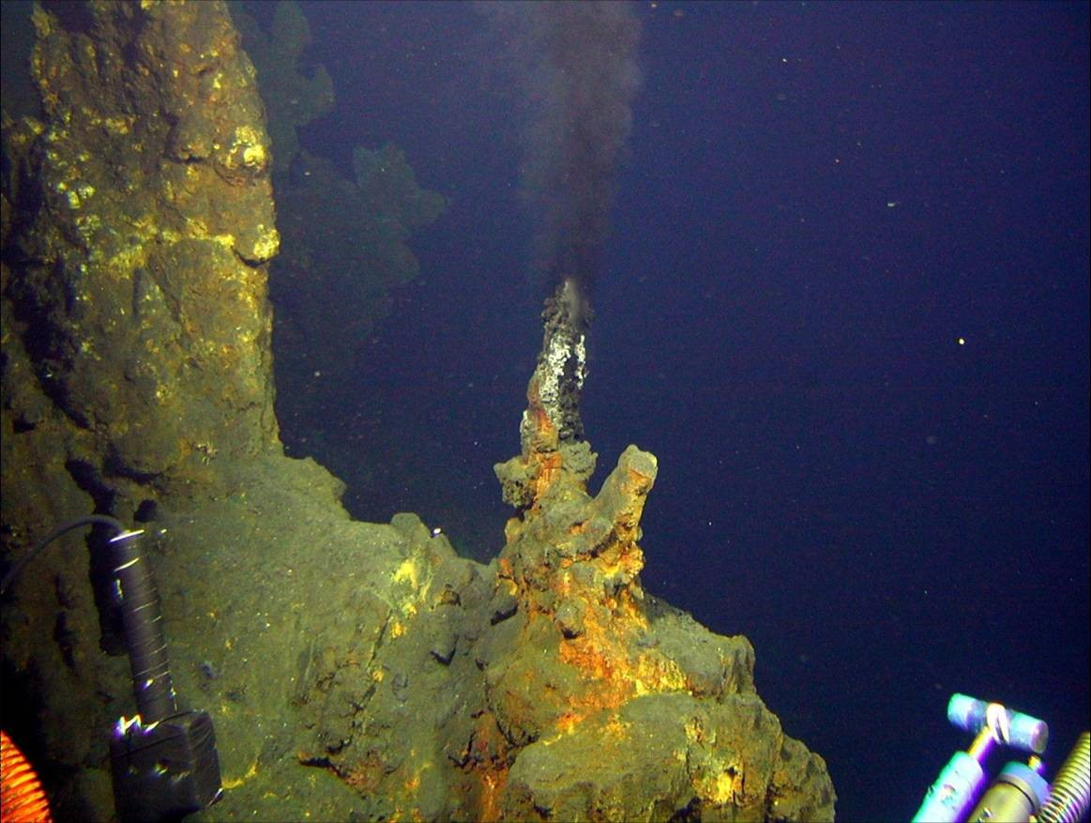
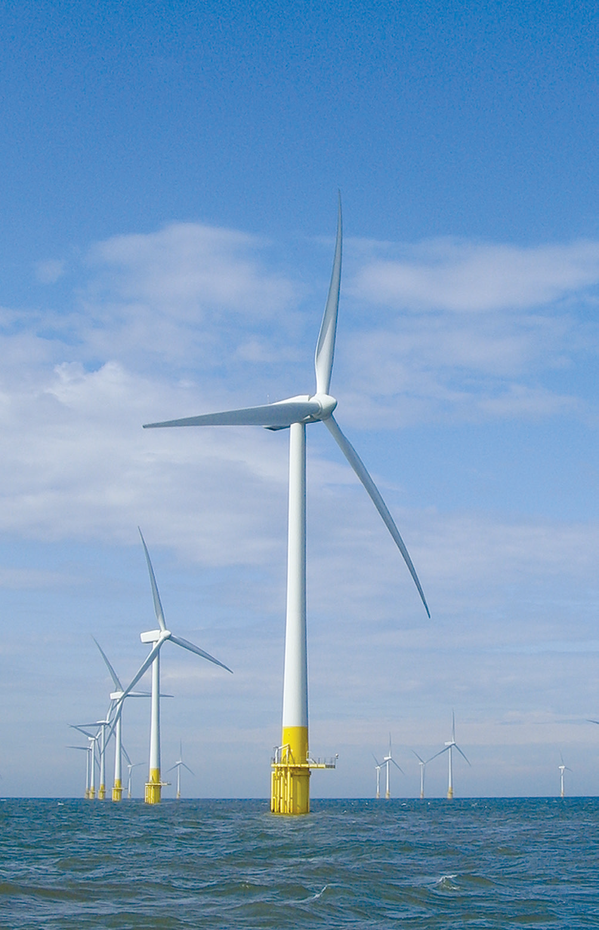
Notes:
The work of DG MARE to stimulate blue growth has identified 5 areas with high potential for further growth (with proper attention and sufficient support):
Blue tourism
blue energy
Aquaculture
Blue biotechnology:
Marine mineral resources:
Both traditional and identified growth sectors heavily rely upon marine data, information and knowledge for various stages of their work from exploration and planning to operation.

Slide 4
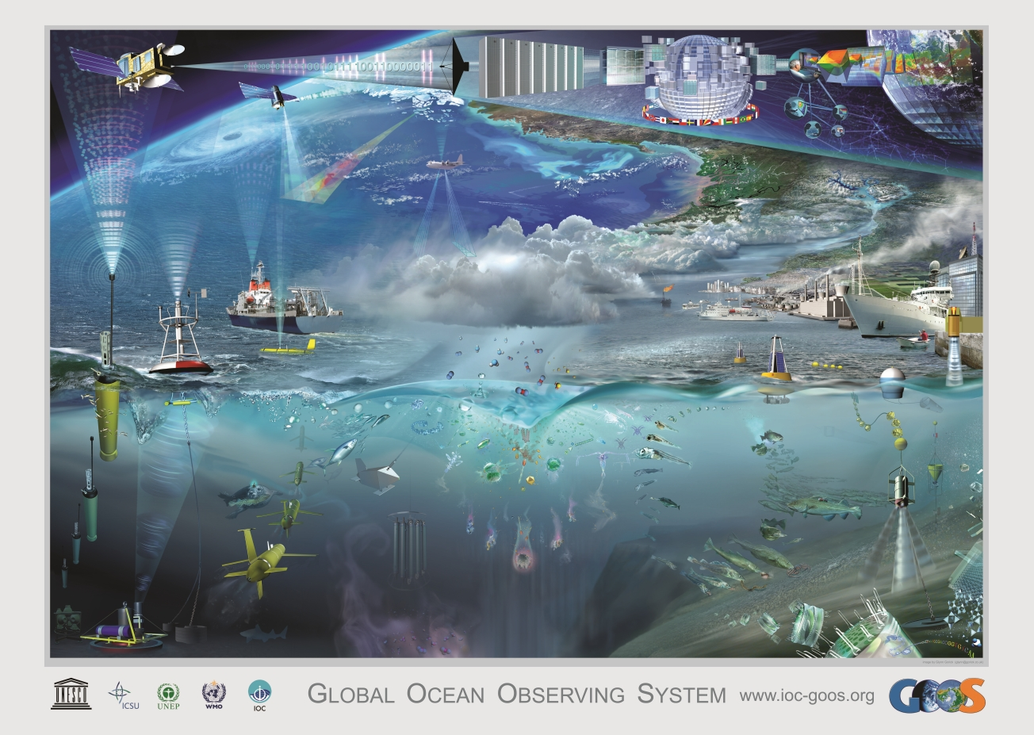
There is only one Earth, with only one history, and we get only one chance to record it. Ideas not followed through can be taken up again later. A record not made is gone for good. Editorial - Nature 450, 761 (6 December 2007)
Cost of Ocean Observation in EU
Space data: € 400 M per year
In-situ data: > €1 billion per year
Notes:
However there is no marine knowledge without first collecting and observing our seas and oceans.
At great cost and largely covered by members states, but also some regional and EU efforts… complex and fragmented picture…

Slide 5
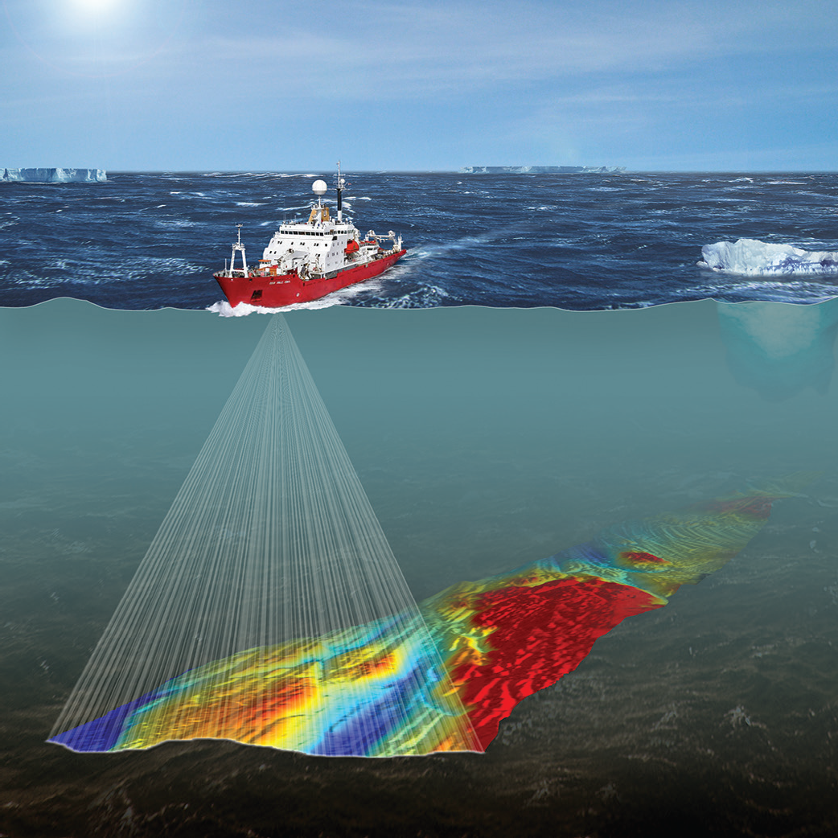
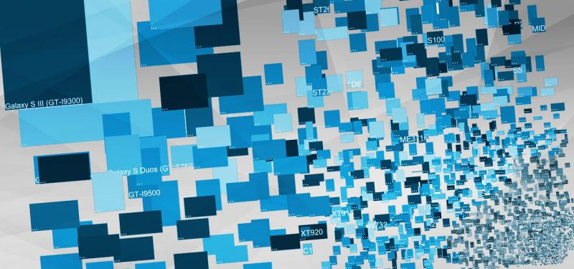
Data Acquisition (Observations)
Data management & access
EMODnet
Notes:
Observations: lack of coordination and continuity + no integrated assessment as to the needs, gaps, duplications etc. → not an efficient ‘system’ at European level
Data management and assessment – fragmentation and lack of coordination → difficult and time consuming to obtain existing data for larger areas (e.g. seabasin level)

Slide 6
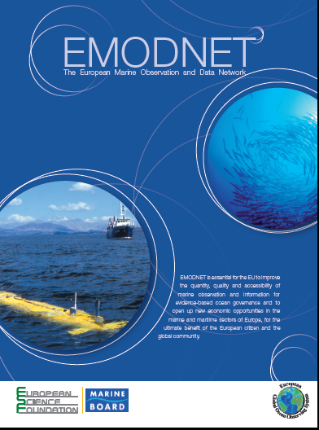
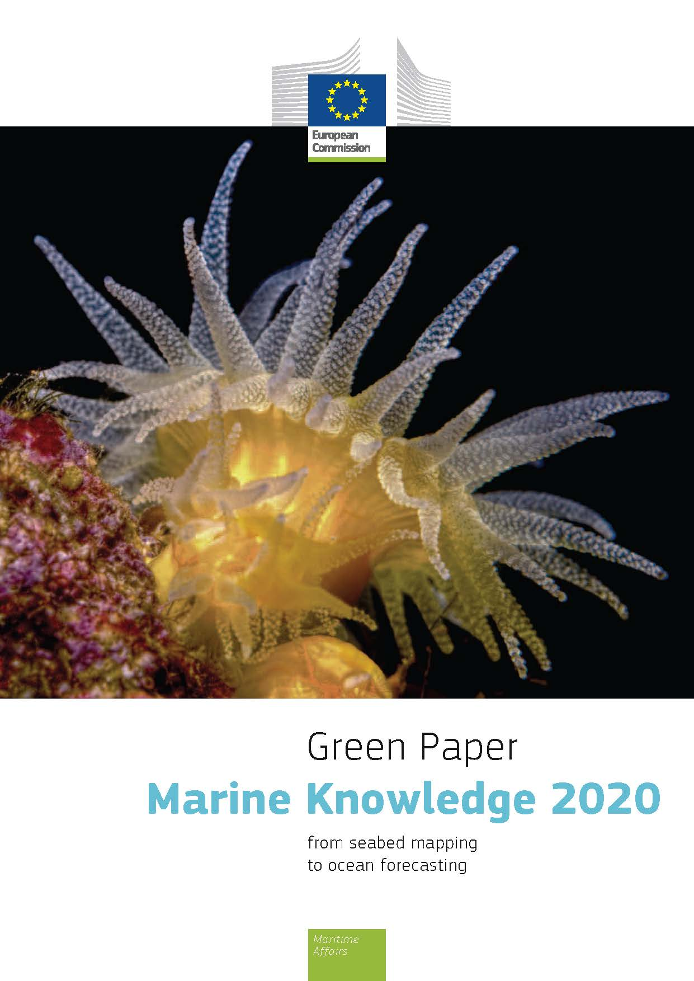
What can EU do?
A vision for an end-to-end, integrated, inter-operable and user-oriented network of European marine observation and data systems
Notes:
To do something about this, EC launched Marine Knowledge 2020 Strategy, which is Europe’s strategy to unlock the economic and societal potential of Europe’s wealth of marine observations.
Change to interoperable sharing framework
Collect once use many times by many users

Slide 7
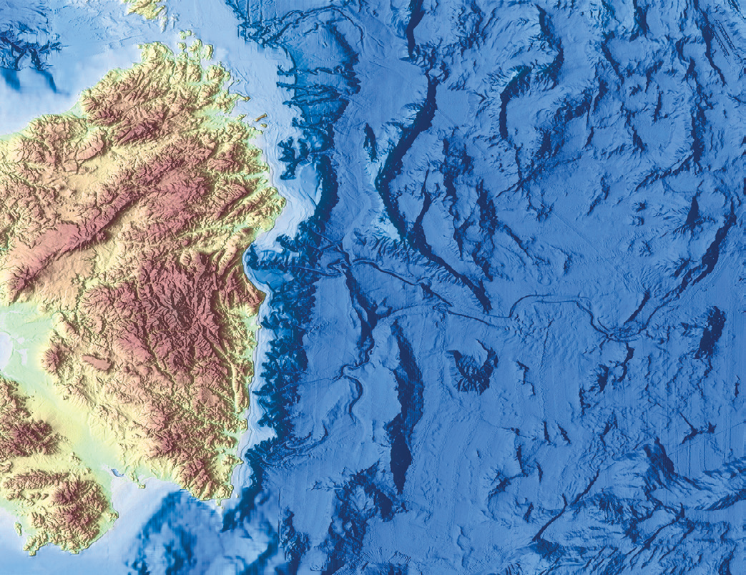
Vision Target for 2020
Seamless multi-resolution digital seabed map of European waters by 2020
Topography, geology, habitats and ecosystems;
Highest resolution possible in areas that have been surveyed;
Accompanied by timely information on
Physical, chemical and biological state of the overlying water column
Oceanographic forecasts;
Easily accessible, interoperable and free of restrictions on use;
Notes:
Objectives
Reduce costs of those requiring marine data e..g. offshore operators
Stimulate competition and innovation – more data allows new hypothesis testing and development of new products and services
Reduce uncertainty about the behavior of the seas

Slide 8
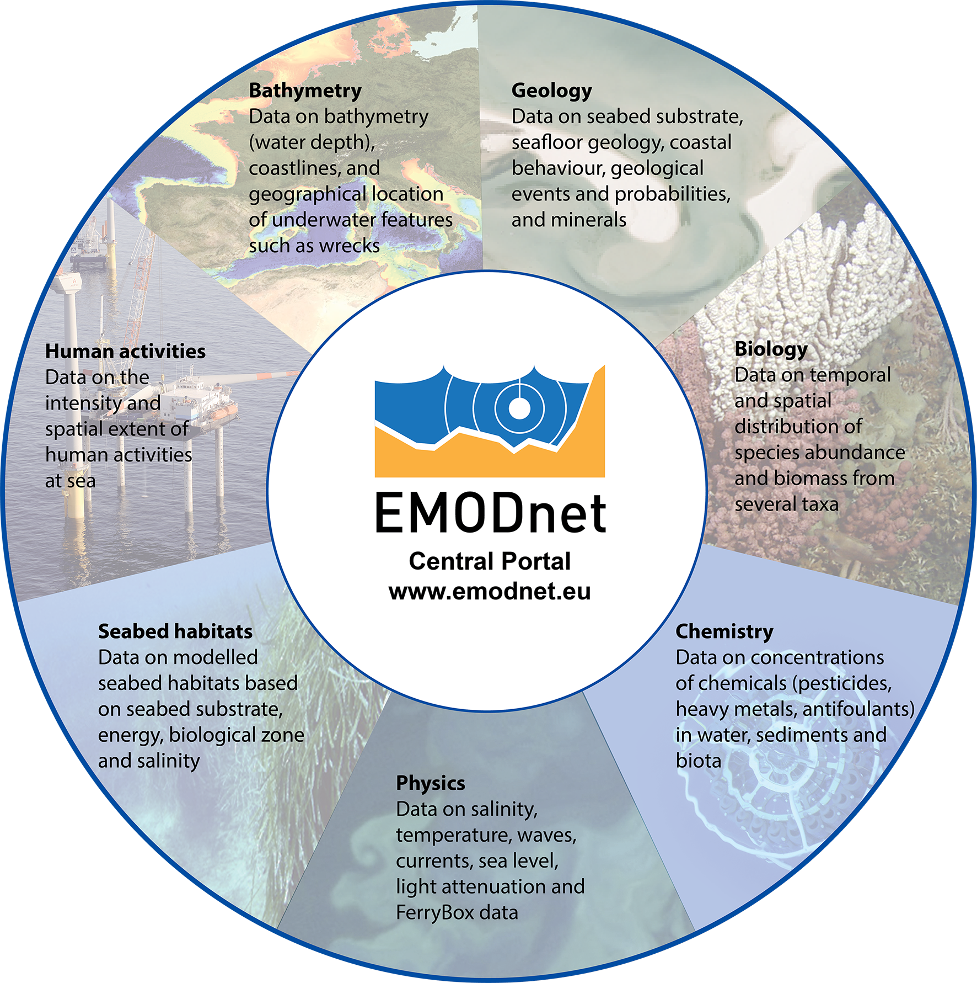
Data
Metadata
Data Products
Data Services
Notes:
How do we get there?
Network of people and organisations – now more than 150 partner organisations
Provide access to marine data, metadata and products + tools/services (ingest, search, visualization, manipulation, e.g. Query Tool, …)
Provides services – e.g. Data Ingestion helpdesk – training – visualization and manipulation/query functionalities / EMODnet products catalogue
EU Multimillion investment
Collect marine data once, use it many times

Slide 9
More than just access to data & products
Reducing fragmented marine data landscape
Platform for collaboration: bringing together key European providers, integrators, networks & infrastructures (e.g. EuroGOOS, CMEMS, SDNet, OBIS, ICES, PANGAEA, RSCs, HOs, GeoSurveys…)
Stimulate adoption of standards and develop joint solutions for common problems
Facilitate down- and up-stream integration & interoperability (WMS, WFS, Web Service, etc.)
Raising visibility of Europe’s wealth of marine observations & data resources → attracting more users and more providers
Changing culture towards open data sharing practices & increased collaboration
Multi-disciplinary and increasingly global
Long term infrastructure & service supported by DG MARE
Notes:
Furthermore EMODnet is much more than data collection, harmonization & access as it covers the full data knowledge process. All the data products/services that EMODnet is building should contribute to the full set of services for professionals
Long term data initiative: funding till 2020 but strong political commitment to establish emodnet as a permanent service – however this will require that ambitions are raised and new areas are explored – EMODnet needs to remain dynamic and must evolve to address new needs and new policy requirements to stay relevant

Slide 10
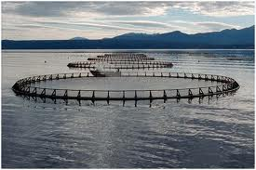
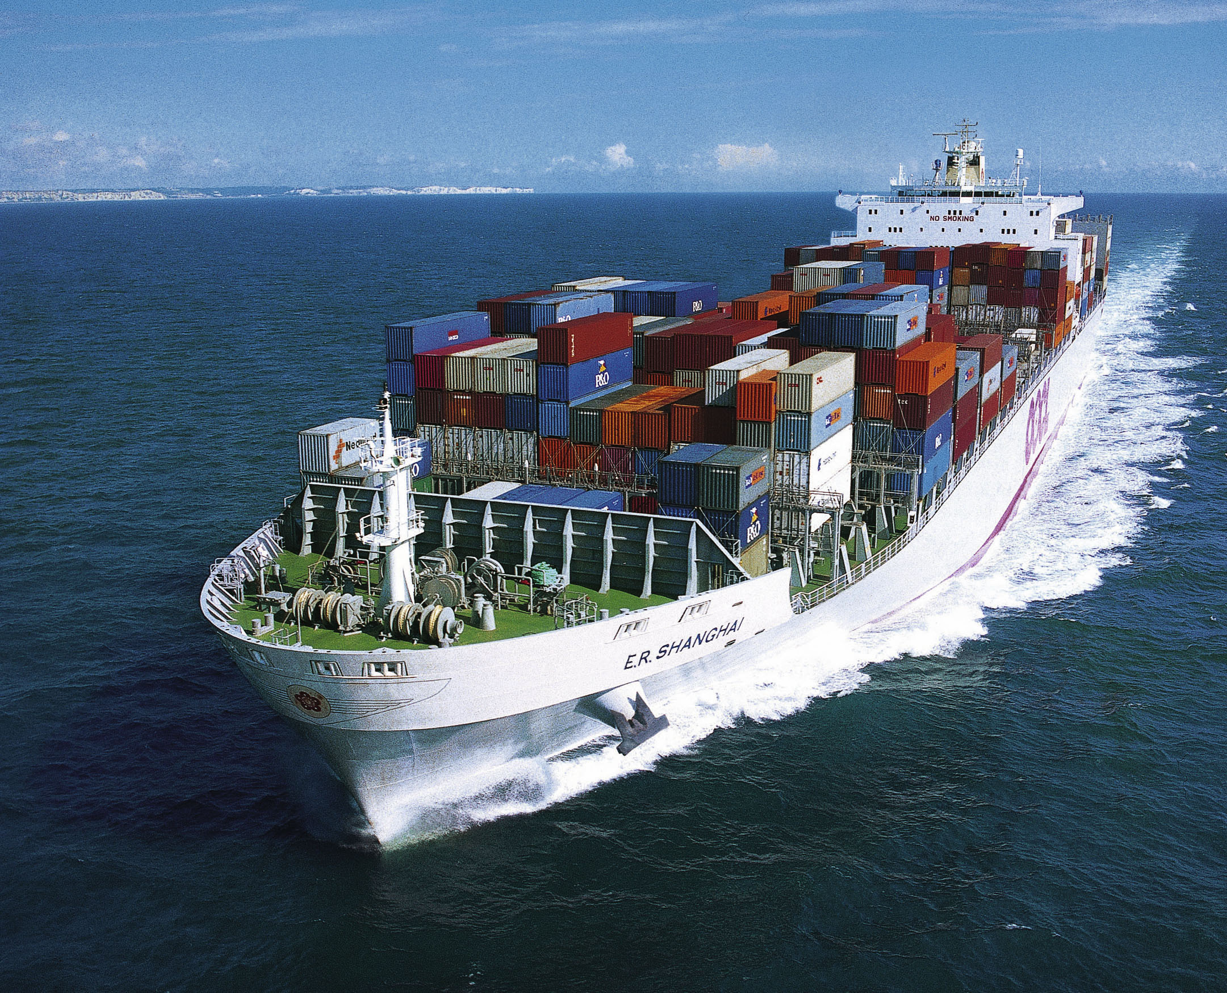
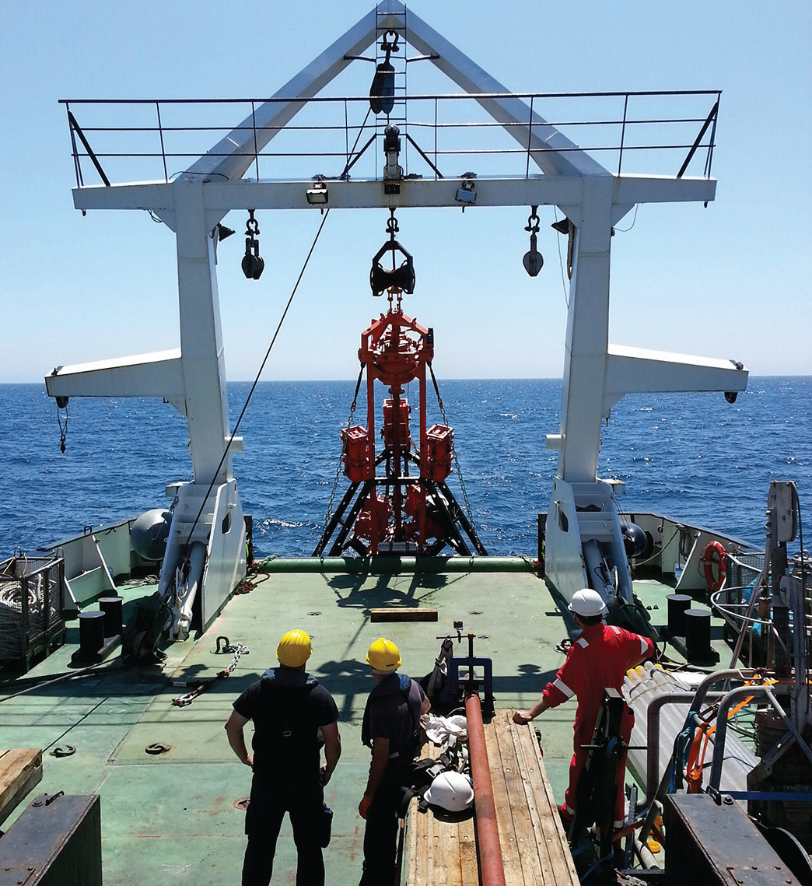
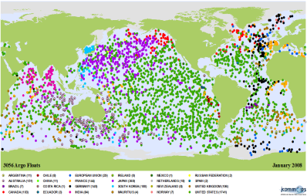
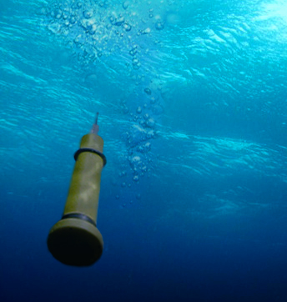
Why is this important?
Benefits for data users
Reduced costs for offshore activities
no need to repeat measurement that made by others
costs less to assemble data from different sources
Stimulation of innovation and competition
Reduced uncertainty in knowledge
Better policies & management
Benefits for data providers
Increase number/kinds of users - help justify investments
Contribute to data products - increase visibility
Make better use of own data via access to others’ data
May help data providers comply with their obligations

Slide 11
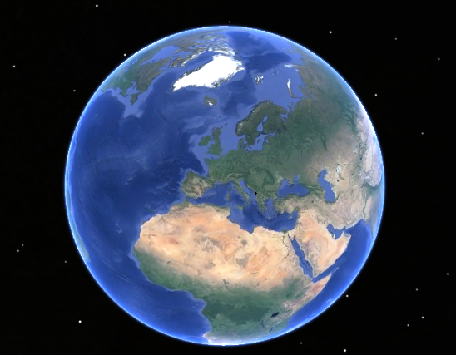
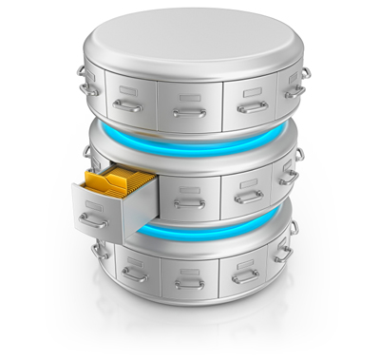
How does it work?
Secretariat – DG MARE - EASME
Are data fit for use?
EMODnet Sea-Basin Checkpoints
As surrogate users
users
Expert User
Group
service providers
services to customers
access to data and data products from more than one theme
Central Portal www.EMODnet.eu
EMODnet THEMATIC GROUPS provide access to data and create data products
Steering Committee
Bathymetry
Chemistry
Habitats
Physics
Geology
Biology
Human activity
HOs
SDC
RSCs
EuroGOOS
CMEMS
SDC
GSs
PANGAEA
OBIS
ICES
RSCs
Data repositories in Member States
www.EMODnet-ingestion.eu
Notes:
Data needs to be harmonised
We want a single access points for marine data where professionals from public sector, industry, civil society and science communities can obtain high quality harmonised datasets and products (e.g. maps) that are stored in different systems around Europe
We want this to be quick and provided in formats and ways that allows us to easily use and combine the data and products.
With EMODnet we are developing such a ‘distributed data system’ consisting of a central gateway underpinned by 7 thematic data subportals

Slide 12
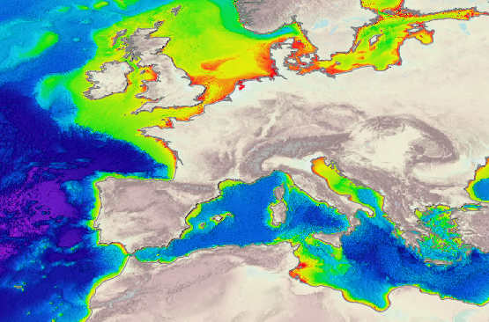
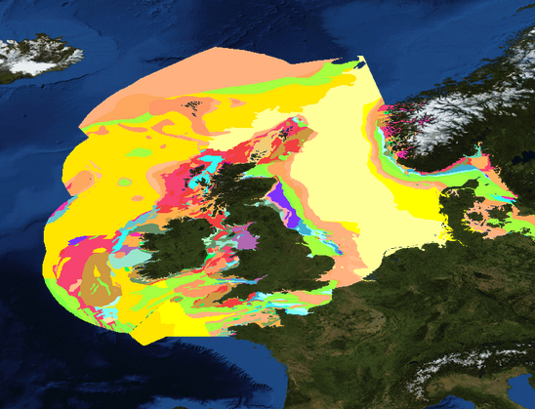
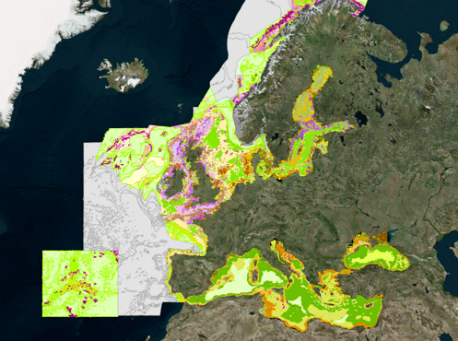
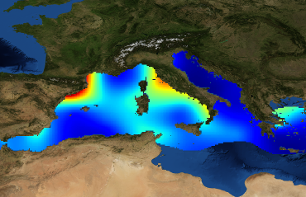
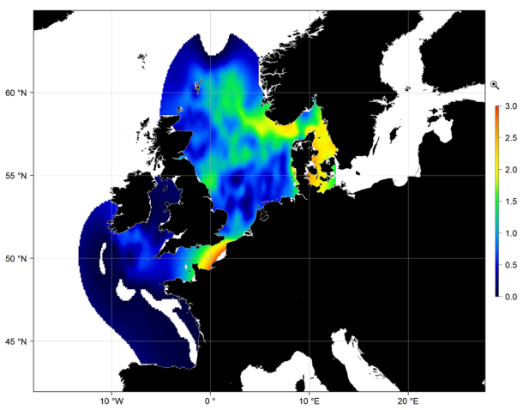
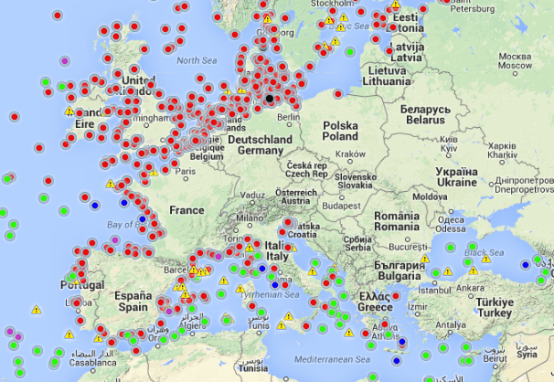
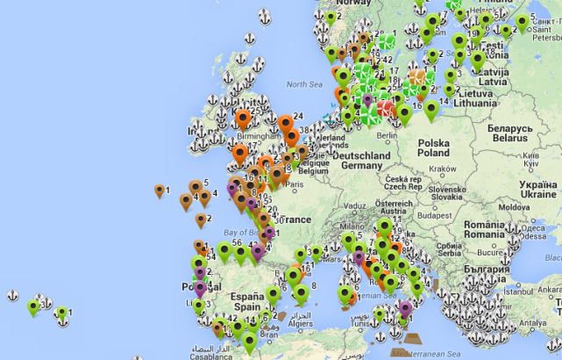
Thematic data coverage
Bathymetry Geology Seabed habitats Chemistry Biology Physics Human activities
HOW?
Bathymetric Data and metadata from surveys
Bathymetry layers:
average, minimum, maximum water depths
Higher resolution data layers in coastal areas
Underwater features
Shipwrecks
Coastal behaviour (migration)
Geological events and probabilities
(volcanoes, landslides)
Minerals
(gas hdyrate deposits, shulphides, phosporite, cobalt)
Seabed substrate
(gravel, sand, mud)
Seafloor geology
Seismology
Depth
Seabed substrate
Energy at seabed (waves & current)
Salinity
Temperature
Light at seabed
Oxygen at seabed
DDT
PCB
TBT
TPT
Oxytetracycline
Mercury
Cadium
Lead
Anthracene
Fluoroanthene
Cs137
Pu239
Nitrogen (Din, TN)
Phosphorus (DIP, TP)
pH,pCO2,alkalinity
O2,CO2
Polyethylene
Polypropylene
Chlorophyll
Silicates
Organic Matter
10-y running averages
Biomass
Abundance
Gridded Abundance (DIVA)
species groups
phytoplankton
zooplankton
angiosperms
macro-algae
invertebrate bottom fauna
birds
mammals
reptiles
Fish
Temporal evolutionin species distribution and abundance
Waves
Water temperature
Water salinity/conductivity/density
Currents
Light attenuation/ fluorescence
Sea level
Wind
Underwater noise
River
Ice
Aggregate Extraction
Dredging
Fisheries
Hydrocarbon Extraction
Main Ports
Mariculture
Ocean Energy Facilities
Pipelines and Cables
Protected Areas
Waste Disposal
Wind Farms
Other Forms of Area Management / Designation
Notes:
Well, indeed with data. EMODnet is the entry point to marine data in Europe, there are 150 institutions working together to assemble data and make them available through thematic portals, representing communities which were already used to collaborating. But EMODnet has been working for almost 8 years now, and there are efforts underway to make everything more homogeneous.
New datasets
Underwater noise
Marine litter
And products
European Atlas of marine life
AIS/VMS data to develop ship traffic density maps

Slide 13
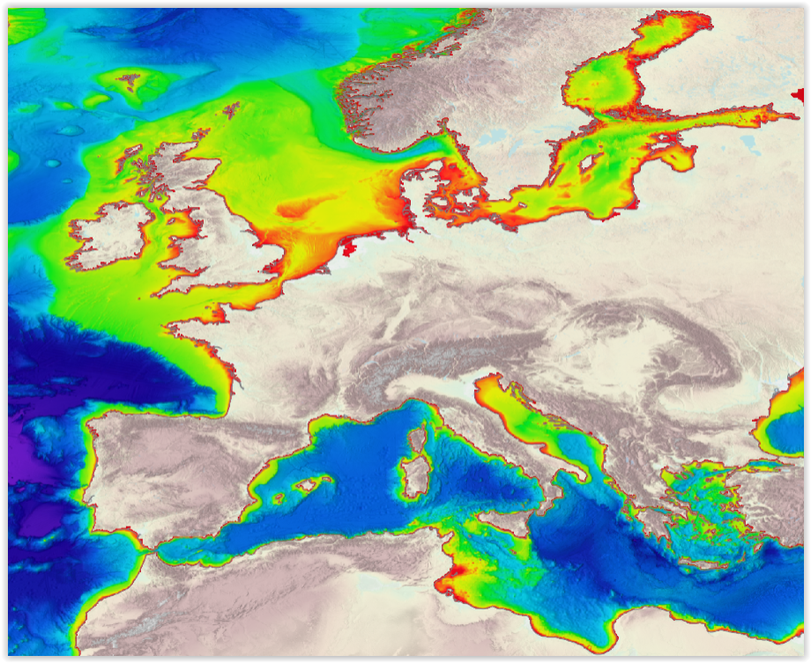
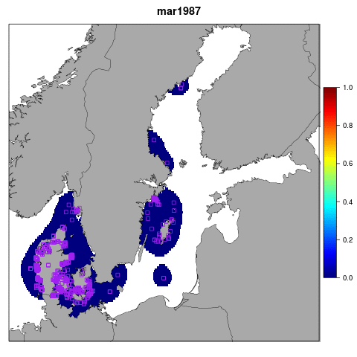
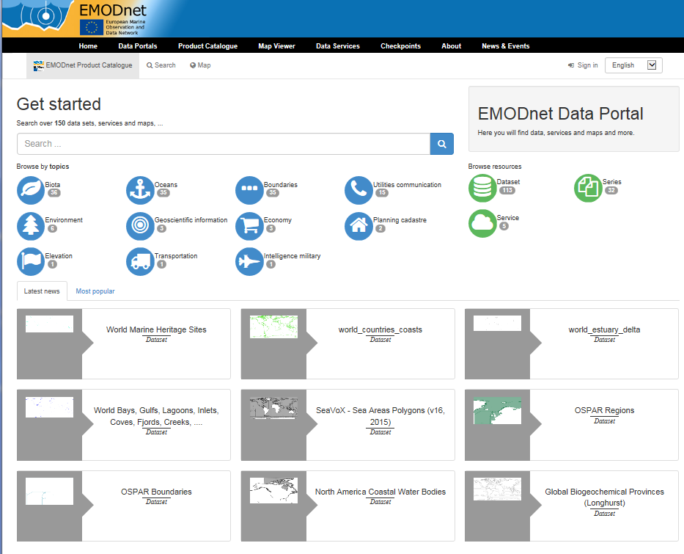
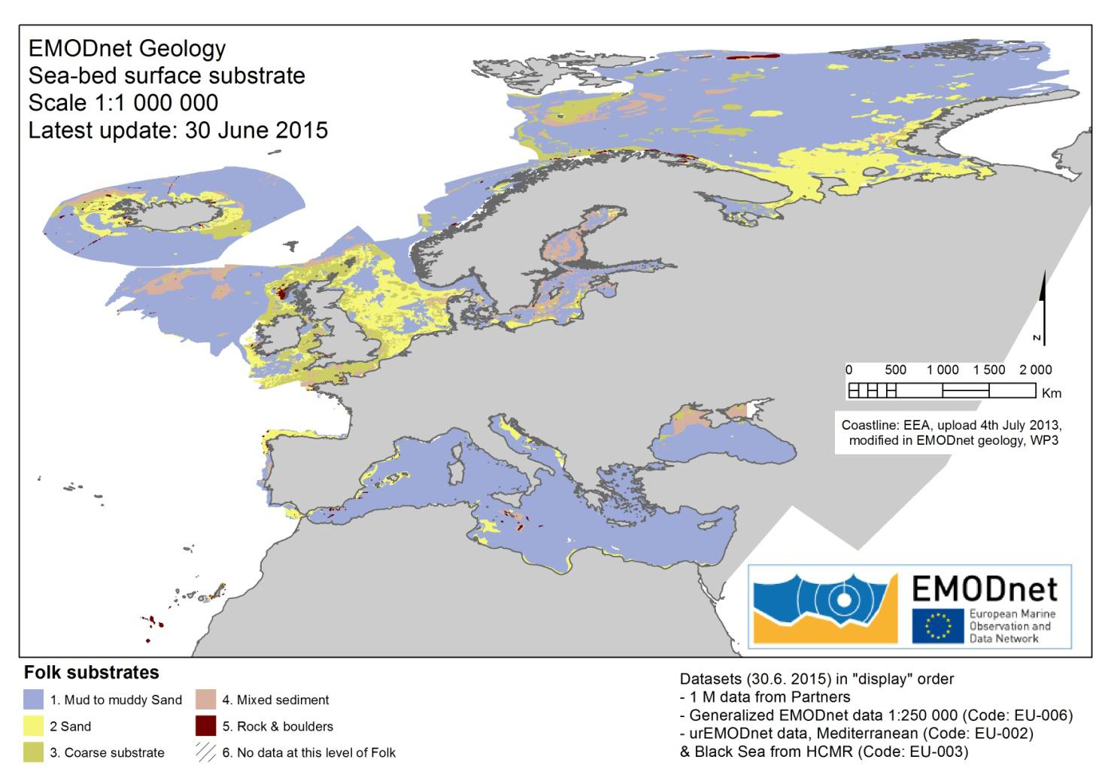
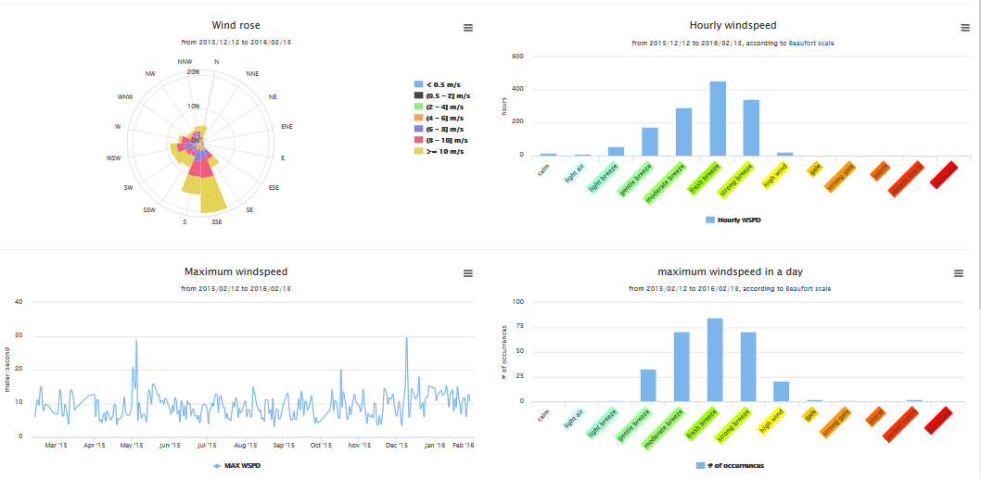
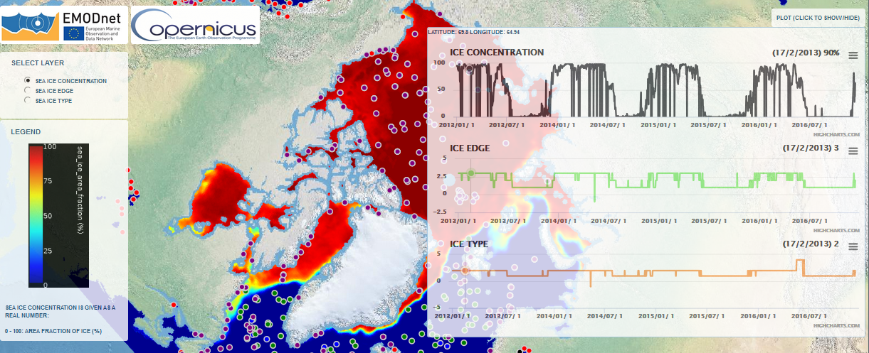
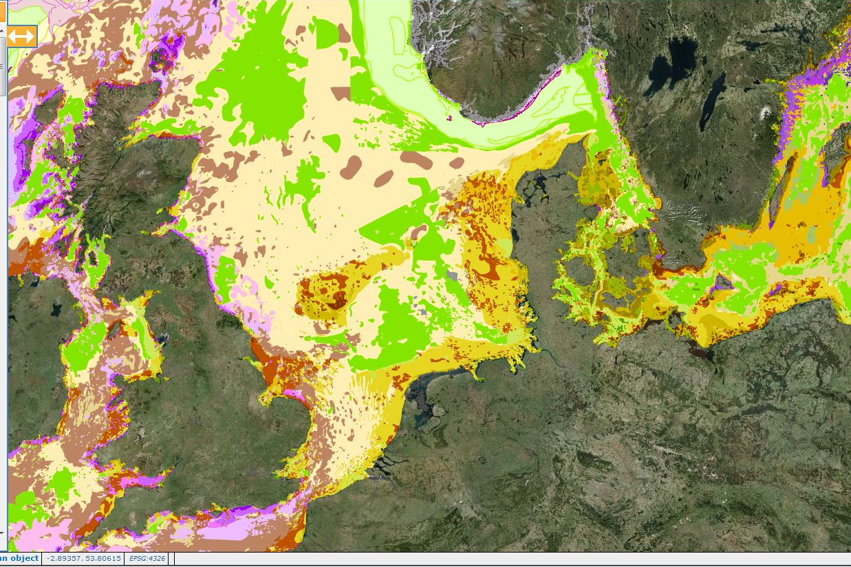
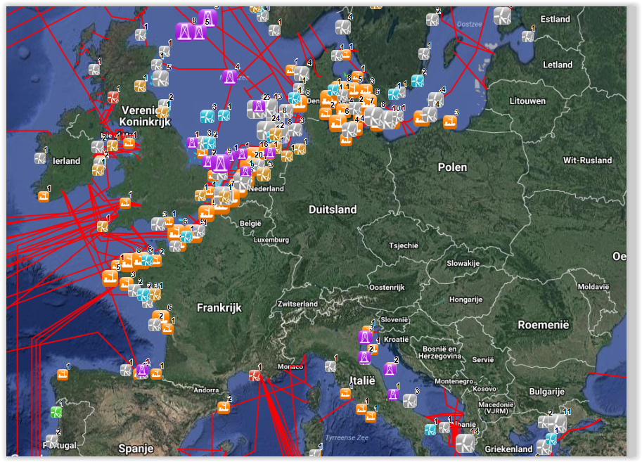
Layers & products
EMODnet Central Portal Products Catalogue
Marenzelleria abundance showing multiple invasions in Baltic Sea
http://www.emodnet-bathymetry.eu
http://www.emodnet-biology.eu
www.emodnet-geology.eu
www.emodnet-physics.eu
www.emodnet-humanactivities.eu
www.emodnet-seabedhabitats.eu
www.emodnet-chemistry.eu
Notes:
Examples of data products

Slide 14
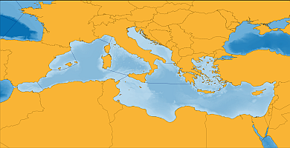
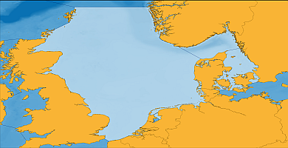
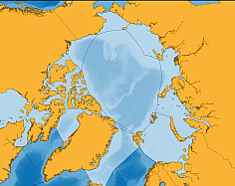
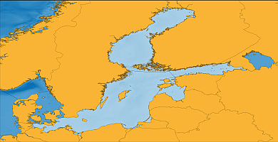
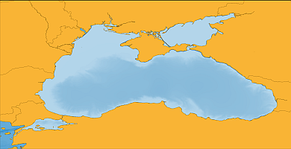
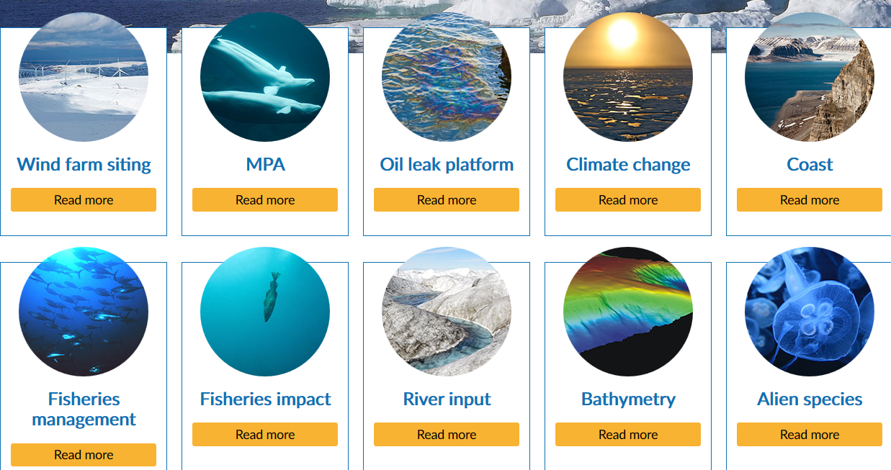
EMODnet Checkpoints
MedSea North Sea Arctic Baltic Atlantic Black Sea
2013
2013
2015
2015
2015
2015
Notes:
As EMODnet evolved, the realization that it was not only how many data we made available but also how useful those data were became more and more important. And within this notion: the usefulness of the data, came a new set of projects, which are the checkpoints. And, to make it simple, this is what Checkpoints do. They evaluate the current status of the monitoring systems in place at a sea-basin scale. But, in addition to making a let’s say, an “inventory” of the data available, they also check (hence their name) how adequate for users those data are (that is why I was talking of usefulness of data. And within this perspective, a MSP practicioner could be a user.

Slide 15
Who is it for?
Targeted at professionals, well-informed experts, policy advisors from 4 main communities:
Public sector organisations and authorities
Civil society (NGOs, ...)
SME’s and large companies from private sector
Research Community

Slide 16
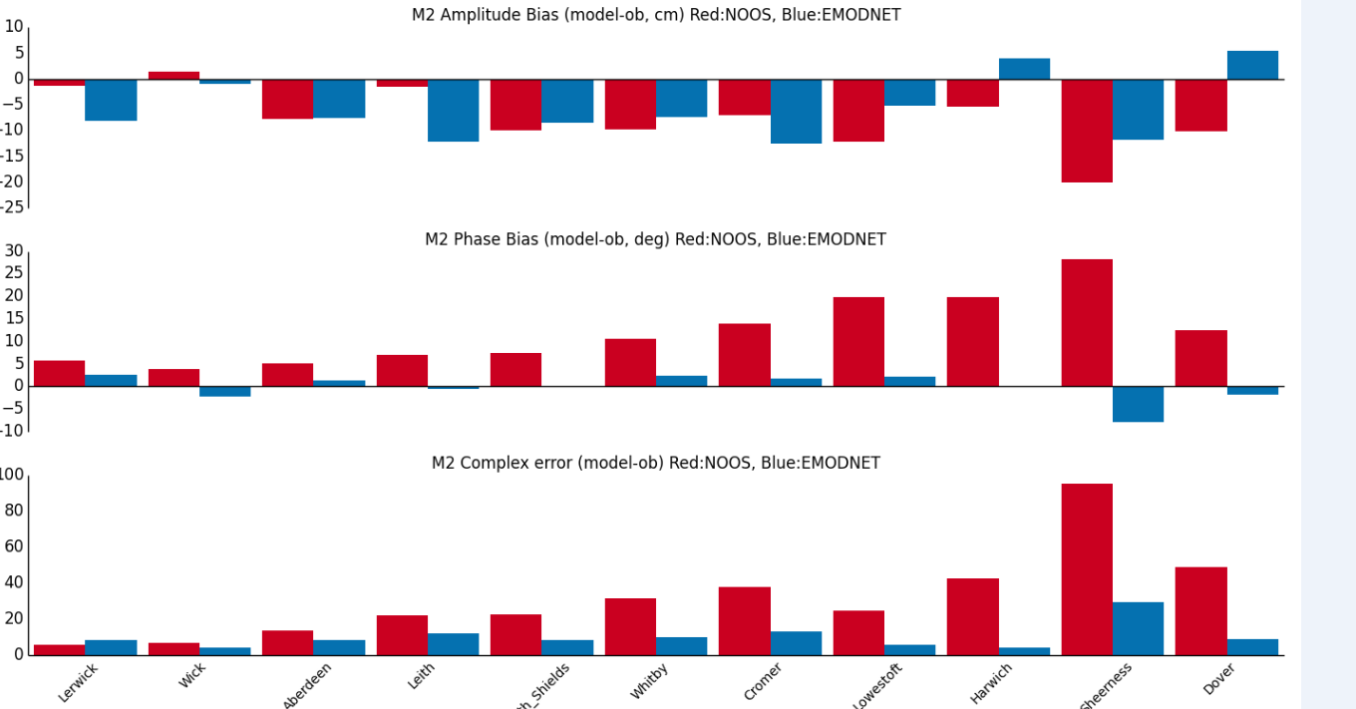
EMODnet bathymetry
UK Met Office & NOC new storm surge forecast model
Requires tidal solution is accurate which in turn requires an accurate bathymetry.
Using a bathymetry based on the EMODnet dataset led to an overall improvement in the model tide significant improvements using EMODnet.
www.emodnet-bathymetry.eu
Notes:
The Met Office and National Oceanography Centre (NOC) are jointly developing a new storm surge forecast model for the UK. The new system uses NEMO as the underlying ocean model. In order to correctly forecast storm surge it is vital that the model’s tidal solution is accurate, which in turn requires an accurate bathymetry. As part of the setup a number of different bathymetry products have been tested, and the results compared against observations from tide gauges around the UK.
Using a bathymetry based on the EMODnet dataset led to an overall improvement in the model tide solution compared with the previously used NOOS bathymetry. Systematic biases in particular have been reduced. The figure shows errors in the M2 constituent (the most dominant in the UK region) for ports on the east coast, where there are significant improvements using EMODnet.
As a result, EMODnet has been selected as the bathymetry to be used by the new system.
Dr Clare O'Neill Ocean Modelling Scientist Met Office Fitzroy Road Exeter Devon EX1 3PB United Kingdom Tel: +44(0)1392 886241 Email: clare.oneill@metoffice.gov.uk Website: http://www.metoffice.gov.uk

Slide 17
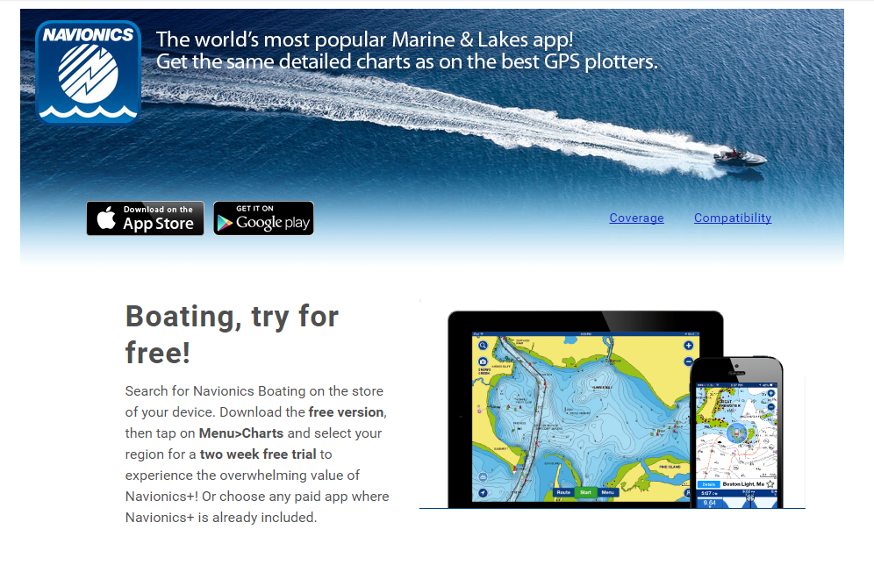
Promote innovation
www.emodnet-bathymetry.eu

Slide 18
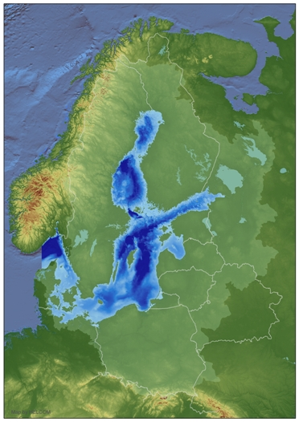
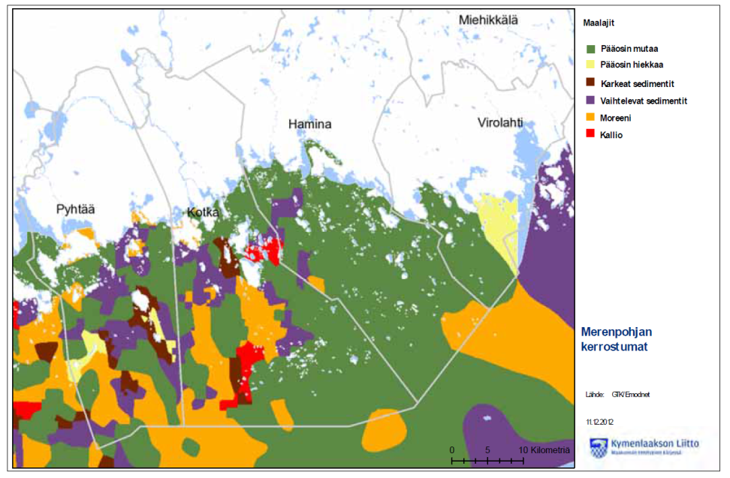
EMODnet Geology
Gulf of Finland Regional Plan for Trade and the Sea Area
EMODnet-Geology seabed substrate data provided to planners.
Marine geologists (and biologists) interacted with planners to evaluate what is available for marine spatial planning.
Information can be understood by decision-makers
www.emodnet-geology.eu

Slide 19
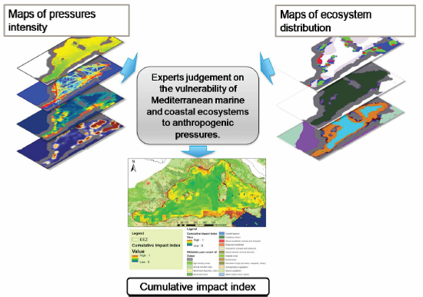
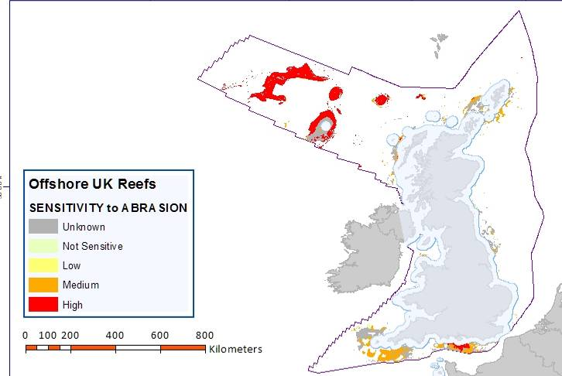
EMODnet Seabed Habitats
Enables a good many uses
Joint land use - seabed habitats map for cumulative impact index (FP7 Pegaso)
Sensitivity maps for assessing
Seabed Integrity
www.emodnet-seabedhabitats.eu
Notes:
Another example is the use of Seabed habitat maps in an FP7 project to calculate a cumulative impact index or the development of sensitivity maps for assessing seabed integrity.

Slide 20
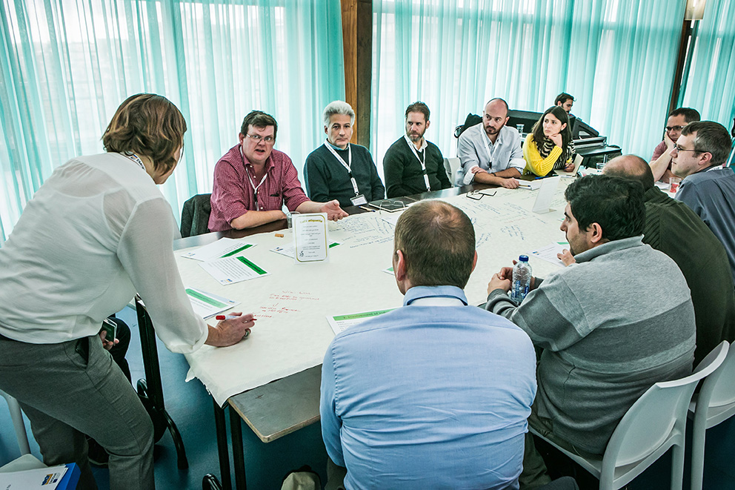
Thank you!
It is all about sharing & bringing people and ideas together
http://www.emodnet.eu/video
Notes:
I would like to conclude that the main keyword characterizing all of our efforts is synergy and interoperability – between initiatives, systems, databases, networks and above all… between people.

