Slide 1

National Ocean Strategy 2013-2020 (NOS)
Strategic monitoring framework in Portugal
Conceição Santos
Head of Strategy Department
conceicao.santos@dgpm.mam.gov.pt
29th September 2015
Notes:
My presentation is about the monitoring framework adopted in Portugal to follow the performance of the blue economy and also other indicators related with dynamics of the economic sectors included in blue economy and also social and environmental issues. Almost all decisions we made about indicators selection are interconnected, and is why we prefer to show the global picture.

Slide 2


NOS 2013-2020: Development model
National Ocean Strategy 2014-2020 and its Action Plan Mar-Portugal
The NOS 2013-2020 proposes a sustainable development model that is based on the Ocean, in articulation with the coastal zone, grounded on knowledge, which guarantee that Portugal faces the challenges that promotion, growth and competitiveness of the ocean economy imposes
This model is in parallel with:
The green growth discussed in Rio + 20 (August 2012) and expressed in the respective Declaration The Future We Want. Aligned with the Sustainable Development Goals of the UN Pós-2015 Development Agenda
The Blue Growth model in the context of the Integrated Maritime Policy of the EU, maritime contribution to European Strategy 2020, and the EU Martime Atlantic Strategy/Atlântic Action Plan
And is beeing articulated with several finantial instruments available (ESIF, Horizon 200, LIFE, COSME, EEA Grants, EIB funds, …)
Notes:
The Portuguese monitoring framework is much rooted in the development model proposed by the National Ocean Strategy .
But it is important to bearing in mind that this is a sustainable development model aligned with the blue growth model of the Integrated Maritime Policy and also with the green growth model as signed in UN Conference Rio plus 20.

Slide 3
NOS 2013-2020: Strategic Monitoring and Prospective Framework
Work domains
Projects
Partners
Satellite Account for the Sea and Input-output Analysis
Sectorial representatives
Monitoring
Battery of Sustainable Development Indicators for the SEA /SEAMind
CIAM/ Their Technical Teams/Statistics Portugal
Coastal and Marine Ecosystem Services – PT TEEB
Academia
Feedback
Foresight
Foresight analysis to action support
Senior Sectorial Experts
Scenarios
CIAM /Sectorial representatives/ others
Notes:
The strategic monitoring framework of NOS is much interconnected with the foresight analysis that supports the ocean strategy.
The strategic monitoring includes 3 areas of work:
A battery of macroeconomic indicators for what we are developing a satellite account for the sea. And an input output project to determine the indirect impacts.
A battery of sectorial indicators considering also environmental and social indicators. This is the SEAMind project. Includes indicators related with its dynamics of the sectors and also it includes some economic indicators mainly coming from Structural Business Statistics. National Accounts, considering the desegregation we need, comes with final numbers with a time lag of twenty month. And Structural Business Statistics comes first. So why we don’t use just Structural Business Statistics? The SBS is mainly based on data sources from the business activity. The main problem with this source of information is that other important institutional sectors are neglected, such as the public administration or non-profit institutions, namely public research centres and universities that highly contribute to the blue growth and to its present and future nature and dynamics. If we use the Structural Business Statistics we are much underestimate the blue economy.
We also include in the strategic monitoring a project dedicated to assess the economic value of ecosystem services reminding what is written about this issue in the European Biodiversity Strategy and also in the EU Atlantic Action Plan:
(Assessing the social and economic value and functioning of the Atlantic's ecosystems and biodiversity in order to support decision-making).
I will talk more deeply about these projects later in my presentation.
A battery of macroeconomic indicators which analysis is under the National Accounts methodologies. We are developing a Satellite Account for the Ocean Economy to estimate the contribution of the blue economy to GDP
A battery of sectorial indicators related with its dynamics and also it includes some economic indicators mainly coming from Structural Business Statistics. National Accounts, considering the desegregation we need, comes with final numbers with a time lag of twenty month. And Structural Business Statistics comes first. So why we don’t use just Structural Business Statistics? The SBS is mainly based on data sources from the business activity. The main problem with this source of information is that other important institutional sectors are neglected, such as the public administration or non-profit institutions, namely public research centres and universities that highly contribute to the blue growth and to its present and future nature and dynamics. If we use the Structural Business Statistics we are much underestimate the blue economy.
That is one of the reasons because we would prefer to follow a Satellite Account for the Sea approach, within the National Accounts system framework, or any other approach that relies on the National Accounts; that would allow comparability between countries and also a more coherent and reliable approach; it would allow to evaluate the direct contribution of the blue economy to GDP as well as the direct GVA, Production and Employment (Full-Time Employment) for each group of activities of the blue economy. And the consequent supply and use tables for the sea would allow to establish the indirect GVA and Employment from blue economy.
CIAM – Inter-Ministerial for Maritime Affairs

Slide 4
NOS 2013-2020: Strategic Monitoring Framework
Strategic Monitoring of the NOS 2013-2020
Maritime Spatial Planning legislation, socioeconomic impacts
MSFD, socioeconomic analysis of marine waters use in PT
Integrated System to Support Decision Making
Articulation with EU Action Plan for Atlantic Area
NOS monitoring and appraisal
Strategic comunication
Public sectorial policies
Articulation with
ITI MAR
Articulation with Ocean UN SDG Post2015 Process
Notes:
With the strategic monitoring our intention is to stablish an Integrated System to Support Decision Making.
In other words, we are working to support different areas like MSFD implementation, in what concerns socioeconomic us of marine waters, and marine spatial planning in what concerns socioeconomic impacts, and utilization of European Structural and Investment Funds in ocean projects.

Slide 5

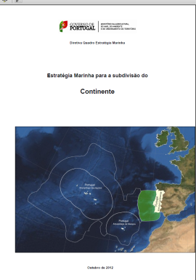
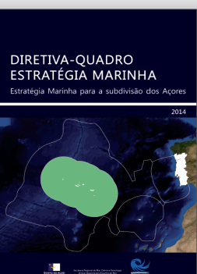
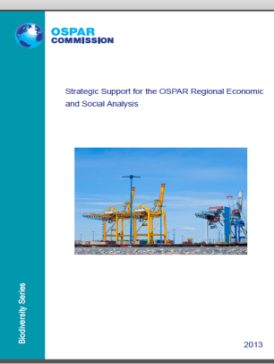

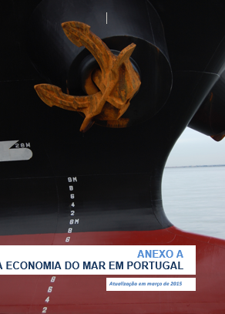
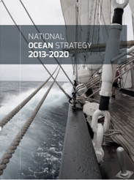
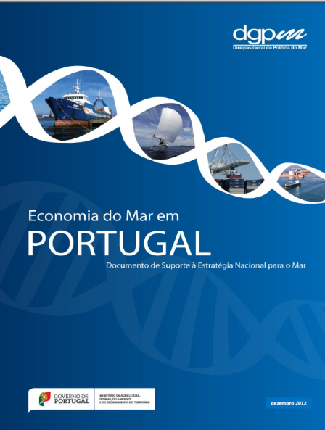

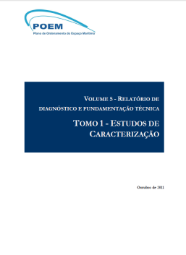
NOS 2013-2020: socio-economic analysis
Socio-economic analysis
- THE WORK DONE -
October 2012 e 2014 (AR)
2012-2013
OSPAR
Strategic Support for the OSPAR Regional Economic and Social Analysis
December 2012/March 2015
MSFD – Initial reports
Chapter – Socioeconomic analysis
October 2011
MSP Exercise
Chapter 3 – Activities, Uses and Functions Caracterization
Chapter 4 – Economy
NOS 2013 - 2020
Report “Ocean Economy in Portugal” (Dec 2012)
Annex A of NOS (Nov 2013) and update (March 2015)
Notes:
We start working in blue economy assessment in 2011 in the context of Maritime Spatial Planning.
In 2012 we improved the work already done, estimating the blue economy in the context of National Accounts. That work supported the MSFD PT report and also the revision of National Ocean Strategy.

Slide 6

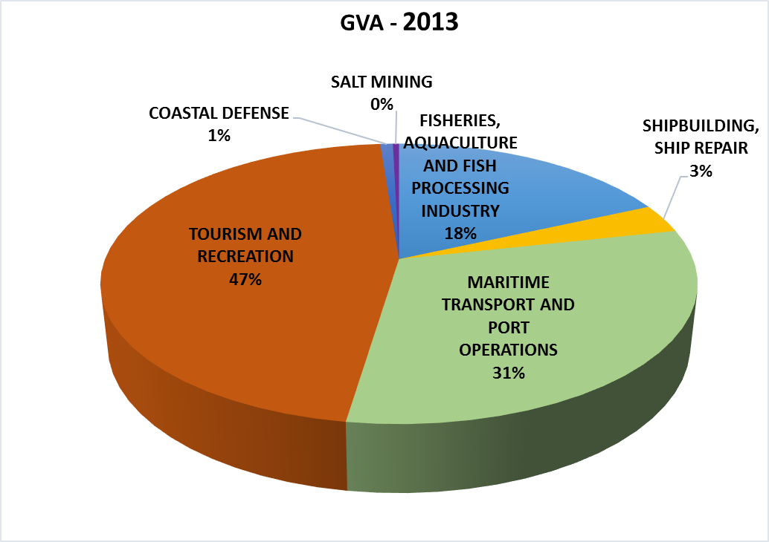
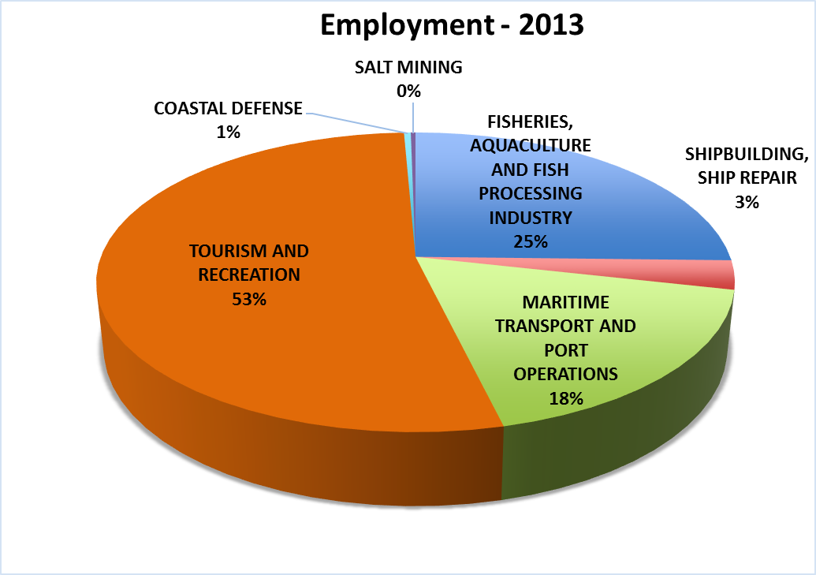
NOS 2013-2020: socio-economic analysis
Characterisation of the Blue Economy in Portugal
Structure of GVA and of the Employment, 2013
Source: DGPM 2015 (based on Statistics Portugal, National Accounts)
Notes:
Here you have an overview of the structure of Portuguese Blue economy considering GVA and employment. It is an update made in the beginning of this year.
GVA (2010) preços correntes com base nas CN (Anexo A da ENM)= 3 730 000 000 €
GVA (2013) preços correntes com base nas estatisticas das empresas e apenas setores com as CAES completamente mar= 503 036 621€

Slide 7



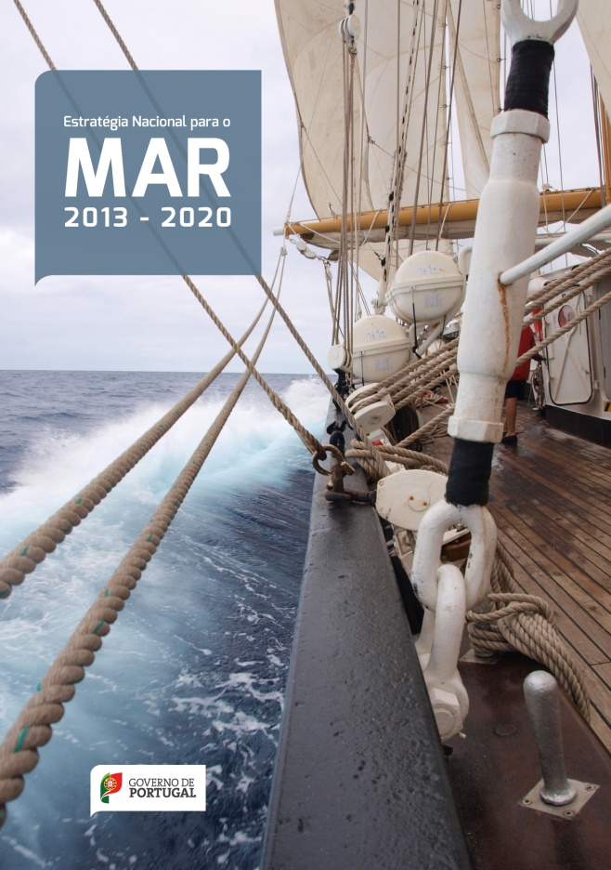
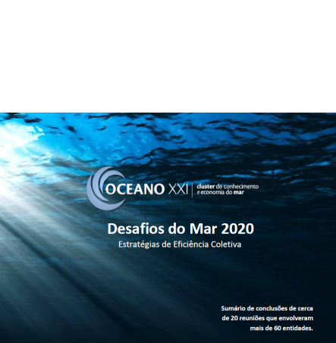
NOS 2013-2020: Satelitte Account for the Sea (SAS)
The Project:
DGPM and Statistics Portugal (INE) signed a Protocol in June 2013, for the elaboration of a Satellite Account for the Sea (SAS).
A Satellite Account is an extension of the central system of accounts, with additional information, being the National Accounts (NA) the economic overview statistics, par excellence.
The drawing up of a SAS is considered the most appropriate instrument to estimate the dimension and the importance of the Ocean Economy in the whole economy, as well as to provide information on the production structure of the economic activities related to the sea.
The Purpose:
to measure the relevance of the Ocean Economy;
to support decision making regarding the coordination of public policies for the ocean;
to monitor the National Ocean Strategy 2013-2020 (NOS) in its economic component, giving support to the Inter-Ministerial Commission for Maritime Affairs (ICMA).
to provide reliable and adequate information for Portugal in the context of the Integrated Maritime Policy (IMP) and other processes where data for the Ocean Economy is decisive.
Notes:
So about the Satellite account for the Sea it is important to point out that it is an extension of the central system of accounts of Portugal and is being developed by DGPM and Statistics of Portugal, the public institute that represents Portugal in Eurostat.
The purpose is …

Slide 8
NOS 2013-2020: Satelitte Account for the Sea (SAS)
First draft concept of “Ocean Economy”
Ocean Economy
“Set of economic activities carried out in the sea and others, dependent upon the sea, including non tradable marine ecosystem services”
SAS – Satellite Account for the Sea
Non tradable marine ecosystem services
National Accounts
Notes:
This definition accommodates the blue commercial economy but also the valuation of ecosystem services, those that are not traded in the market. And this could be relevant, even if we consider that now at European level the Commissioner is the same for the environment and IMP policy.
Karmenu Vella – Envirinment, Maritime Affairs and Fisheries

Slide 9
NOS 2013-2020: Satelitte Account for the Sea (SAS)
Expected results:
  Country Portugal (Mainland and Islands)
  Output
  Intermediate Consumption
  Gross Value Added
  Gross Operating Surplus
  Employment
  Compensation of Employees
  Other Subsidies on Production
  Other Taxes on Production
  Gross Fixed Capital Formation
  Imports and Exports of Goods and Services.
Direct contribution of the Sea Economy to the whole Economy (% GVA)
Advantages:
  Coherent approach to compare all sectors
  Consistent with National Accounts and GDP
  Support long-term, macroeconomic and structural analysis
  Produce a supply and use table for the ocean economy
Limitations:
  Time lag - Results with 21 months lag
  Geographic disagreggation - May be NUT II, but not NUT III
  It doesn’t include environment dimension
Notes:
We expected to have results for this bakery of indicators.

Slide 10
NOS 2013-2020: SEAMind Indicators and Monitoring
OBJECTIVE
To implement a restricted number of relevant indicators to check the NOS 2013-2020 results, considering a sustainable development perspective.
Connection with NIPIM@R/enhanced CISE
Partner in the NIPIM@R Project Model for information sharing/visualisation on Sustainable Development Pillars – Governance, Economy, Social and Environment
Information sharing
Information visualisation in specific context
Notes:
To overcome the limitations of the Satellite Account for the Sea we are running the SEAmind project
SEAMind is the project that implements the National Ocean Strategy monitoring considering the economic, social and environmental pillars.
As I already anticipated the main objective is to implement a restricted number of relevant indicators to check the NOS 2013-2020 results, considering a sustainable development perspective.

Slide 11
NOS 2013-2020: SEAMind Indicators and Monitoring
Levels of policy coordination
National Ocean Strategy
Partnership Agreement (European Funds)
Operational Programs (National)
Research and Innovation Strategy (RIS)
National Strategy for SD
Sectorial Strategies
Rio +20 – UN SDG Ocean
Europe2020
IMP EU – Atlântic Strategy
MSFD
European Strategy for SD
Horizon 2020, COSME, LIFE
National
Regional
Regional Operational Programs
Regional Research and Innovation
Strategy (RIS)
Ocean in Regional Strategies
Vertical integration
…
Local
…
Ocean in local strategies (e.g. cities strategies)
National Level
International level
Intersectoral apprach
Horizontal integration
Notes:
It is of main concern in SEAMind project to guarantee horizontal integration, in other words, to guarantee indicators that permit to compare different sectors of ocean economy, and vertical integration, that is the same to say we can compare indicators between different geographic disaggregation.
We consider also the necessary international articulation that is very important for example in the context of Integrated Maritime Policy.

Slide 12
NOS 2013-2020: SEAMind Indicators and Monitoring
Data Desagregation and Geographic Scale Analysis
Marine waters
Terresterial area
NOS 2013-2020
Ocean Economy Chain value
MSFD in PT
Human and economic activities that occur in marine waters and terresterial area
Economic data by:
NACE
NUT
Ports
Others
MSP in PT
Extended Continental Platform
Territorial
waters
EEZ
Notes:
One of the first points we need to think about is the geographic implementation of the different instruments. As you can see MSFD, maritime spatial planning and National Ocean Strategy have coincident areas of implementation despite National Ocean Strategy consider also the ocean economy chain value.

Slide 13
NOS 2013-2020: SEAMind Indicators and Monitoring
Calendar of monitoring reports
Notes:
And also it is very important to align the calendar of monitoring reports.
To support NOS we have to produce an annual report. We are already producing an annual assessment that includes the Action Plan monitoring and also some indicators related to ocean economy.
To Marine Strategic Framework Directive we are preparing the second cycle.
Marine Spatial Planning have to be submitted to regular assessment and each 3 years the Government should present a report in the National Assembly.
Also very important for us it is the cooperation within the monitoring process of Atlantic Action Plan and also to align with the UN Sustainable Development Goals approved this month.

Slide 14
NOS 2013-2020: SEAMind Indicators and Monitoring
Project cycle
International commitments (goals, objectives)
Pilot test – Fishing, aquaculture and fishing industry
Indicators demand
Concepts
Methodology
Methodology test
Sectorial Plans/ National Plans and policies
Conceptual matrix
Indicators
New clientes, Interests
Indicators supply
Broad strategic framework
Who, which statistics/ surveys/ oceanographic capaigns
Discussion of the indicators listed
Improvement
Tableau de Bord
Oriented discussion
Pre-selection
Implementation
Indicators selection
Auscultation of stakeholders
Radar
Other important areas of interest of the stakeholders
Notes:
What I would like to point out in this meeting about the cycle project is that we rely on sustainable and reliable existing sources of data. We are very rigorous with metadata.
And we are very careful about the sectorial needs and perspectives. What are the perspective of the public institution responsible for each sectorial policy? And what about the maritime clusters?
And for some dimension if we have already a national or international compromise we will se the some indicator as the sectorial institution.

Slide 15

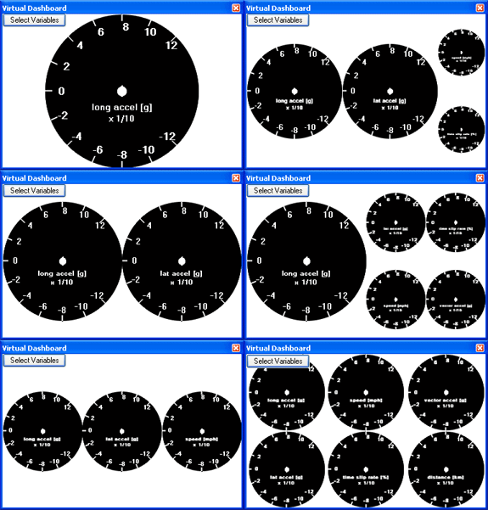
NOS 2013-2020: SEAMind Indicators and Monitoring
Deliverables
Strategic objectives
Objectives of Programatic Areas
Dash Board
Radar
Radar
Control Panel
Periodic reports
Notes:
We foresee to obtain at the end of the project a dash board with two elements:
The Radar will include long term indicators, related with strategic objectives,
and
a Control Panel, with medium term indicators, splitted by sectors or aggregations for specific areas, like maritime spatial planning.

Slide 16
NOS 2013-2020: SEAMind Indicators and Monitoring
Control Panel
ECONOMY
Fully maritime sectors:
Common indicators
Turnover, GVA, Labour (Structural Business Statistics/SBS)
Sectorial specific indicators
Other maritime activities, including emergente activities:
Sectorial specific indicators
Best examples
Complement of NA analysis:
Trends analysis and support to projections
Narrower time lag (n-1)
NUT III and other sub-regional level
NACE Codes - fully maritime sectors:
Living resources
Fishing
Aquaculture
Processing and preserving of fish, crustaceans and molluscs
Retail sale of fish, crustaceans and molluscs
Ship and boat building
Building of ships, floating structures and pleasure and sporting boats
Repair and maintenance of ships and boats
Transport
Sea and coastal passenger water transport
Sea and coastal freight water tranport
Inland passenger water transport
Inland freight water transport
Renting and leasing of water transport equipment
Notes:
As I said before SEAMind contain a battery of medium term economic indicators, mainly coming from Structural Business Statistics. For those economic sectors that are fully maritime sectors and correspond to a Nace Code we are considering has common indicators Turnover, GVA and Labor.
For the rest of the maritime sectors we use sectorial specific indicators and best examples, when there is no other way to have a better characterization.
In what concerns the medium term economic analysis included in SEAMind it complements the NA analysis.

Slide 17
NOS 2013-2020: SEAMind Indicators and Monitoring
Fishing and aquaculture: Example of tendencies analysis
GVA (NA) (current prices) vs GVA (SBS)
Production (NA) (current prices) vs Turnover (SBS)
The GVA (SBS) could be a proxy to make the projections of GVA (NA) in current prices.
The Turnover (SBS) could be a proxy to make the projections of Production (NA) in current prices
Notes:
As just an example in this picture you can compare for fishing plus aquaculture the results if we use National accounts or Structural Business Statistics.
Both sources present the same trend but indicators from business statistics is always lower. But we can use trends and also make projections using final results of National Accounts.
In this example GVA from Structural Business Statistics is a proxy of GVA in National Accounts and Turnover from Structural Business Statistics is a proxy of Production in National Accounts.
Attention because for Labor things could be different because the dynamics of labor in number of people could be different from the one in terms of FTE.

Slide 18
NOS 2013-2020: SEAMind Indicators and Monitoring
Ports and logistics:
Port Administration is a fully maritime activitie but… it is included in NACE Class 52.22 - Service activities incidental to water transportation, that includes non maritime activities
Port Commmunity? Includes also service companies such as pilotage, tows, concessionaires, navigation agents, brokers, shipowners, other suppliers, road and railway transporters and also public administration companies (customs, emigration services, sanitary and veterinarian services).
NACE Codes (all partially) Class 4291, Group 521, Class 5222, Class 5224, Class 5229, Class 7490, Subclasse 77340
Sectorial specific indicators (proxys of economic activities in the ports):
Analyzes of the seaborne traffic of the ports by calculating the volume of the cargo/passengers that is handled over a period of time.
Notes:
Here you have an example of an important sector that are a fully maritime sector but It does not correspond to any NACE code. This is an example of sectorial specific indicator as a proxy of the positive or negative dynamics of the all port community.

Slide 19
NOS 2013-2020: SEAMind Indicators and Monitoring
Deliverables
Strategic objectives
Dimensions (domains identification and indicators available ongoing )
Geography
Macroeconomics and trade
Employment
Market labour
Innovation
International cooperation
Marine ecosystems and biodiversity
Marine resources/fishing resources
Carbon and energy
Marine waste
Radar
Notes:
Within the Radar we expect to include indicators for long term and structural analysis.
And also indicators for integrated analysis that means analysis that cross all sectors, or at least the most important ones, in what respect societal challenges.

Slide 20

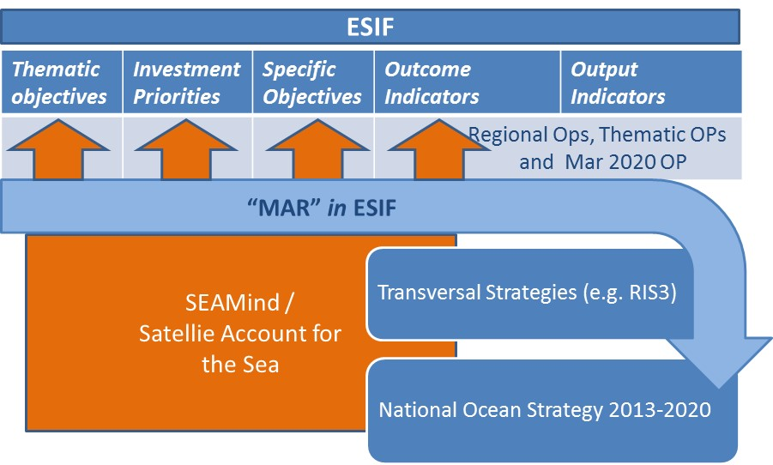
NOS 2013- 2020: Blue Integrated Territorial Investment (ITI-”Mar”)
Monitoring information fluxes
Notes:
And for finalizing the projects presentation I just inform that we have already in law an instrument “ITI for mar” that includes a mechanism to monitor and appraisal the ESIF in what respect the sea projects. This mechanism will benefit from SEAMind and Satellite Account for impact assessment and SEAmind will benefit because it could include a picture about results that come from projects supported by ESIF.

Slide 21
NOS 2013- 2020: Blue Integrated Territorial Investment (ITI-”Mar”)
CIC
PT 2020
Governance Model
CIAM
DGPM
Agência, IP
MA OP Mar 2020
MAs Thematic OP
MAs Regional OP (CCDRs)
MAs Territorial Cooperation OP
MA OP Technical Assistence
CIM/AM
Development of an initial frame of reference
Colaborative work coordinated by DGPM
Includes a monitoring mechanism
Decree-law n.º 200/2015, de 16 de september
Notes:
Soon we expect to distribute an English version of the law in which you can se how the collaborative work within ITI Mar is structured.

Slide 22
NOS 2013-2020: Strategic Monitoring Framework
SOME FINAL REMARKS ABOUT MONITORING OF BLUE ECONOMY :
Articulation between long-term and structural analysis and sort/medium-term and conjuntural analysis
Ocean Economy analysis grounded on National Accounts (GVA and Employment), complemented with aditional information on sectors
Ocean Economy definition coherente with future works on coastal and marine ecossystem services valoration
Sustainable development perspective, not only economic performence indicators
Articulation with UN SDG Ocean Stand Alone indicators – Post 2015 Development Agenda/Universal implementation
Coherent vertical and horizontal policy analysis, including in the Atlantic Area
COHERENT, REPRODUCTIVE AND SUSTAINABLE MONITORING FRAMEWORK
Notes:
Some final remarks to summarize the principles of Portuguese monitoring framework.

Slide 23
SEAMInd Project
THANK YOU
Conceição Santos
conceicao.santos@dgpm.mam.gov.pt

