Slide 1
EU4Algae in 2023 and looking forward

Slide 2
EU4Algae in 2023
EU Algae Initiative and EU4Algae tasks alignment on 9 February
EU4Algae participated in the 1st Mission Ocean Forum on 17 February
EU4Ocean met EU4Algae on 7 March
Workshops with EU policymakers on 23-24 March to addressed crucial aspects of licensing
Exchange session with the Knowledge Centre for bioeconomy (JRC) on 18 April
Webinar on the latest developments in hatchery, selective breeding, and seeding of macroalgae on 21 April
Meeting with EMODNET on 3 May focusing on deriving algae-related data
EU4Algae joined forces at the EU Open Doors Day on 6 May on algae visibility/awareness corner
EU4Algae exchanged with the European Committee for Standardisation (CEN) on 11 May
EU4Algae workshop at the European Maritime Day (EMD) 2023 in Brest on 24-25 May
EU4Algae participated in an EABA webinar on 31 May highlighting EU programs for the algae biomass sector
EU4Algae Info Session on 15 June: EU4Algae stakeholders' contribution to the EU Algae Initiative 23 Actions
1st EU Algae Awareness Summit on 5-7 October: quiz to test knowledge and consumer preferences.
BlueInvest e-Pitching event with EU4Algae on 11 October: 5 companies with algae innovative solutions

Slide 3
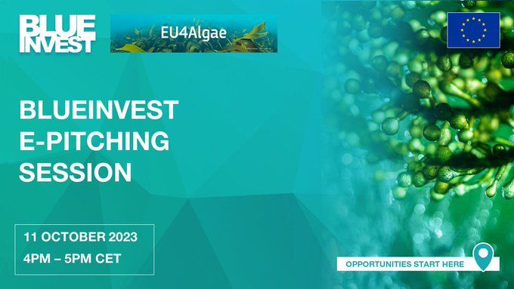
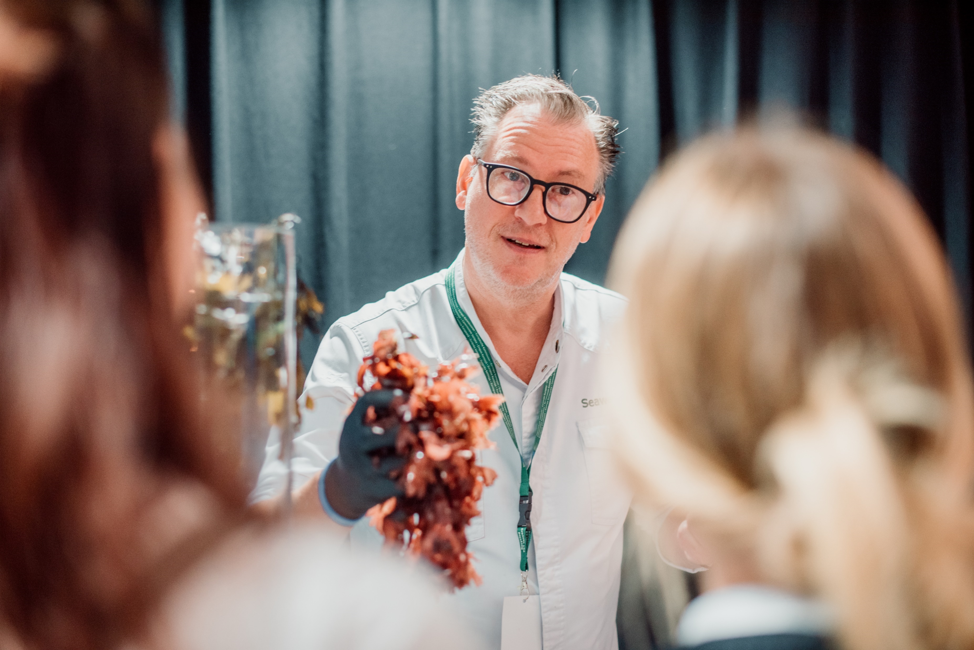
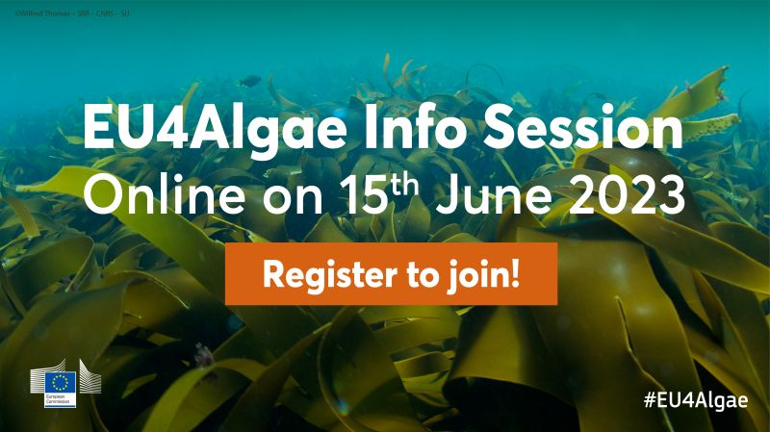
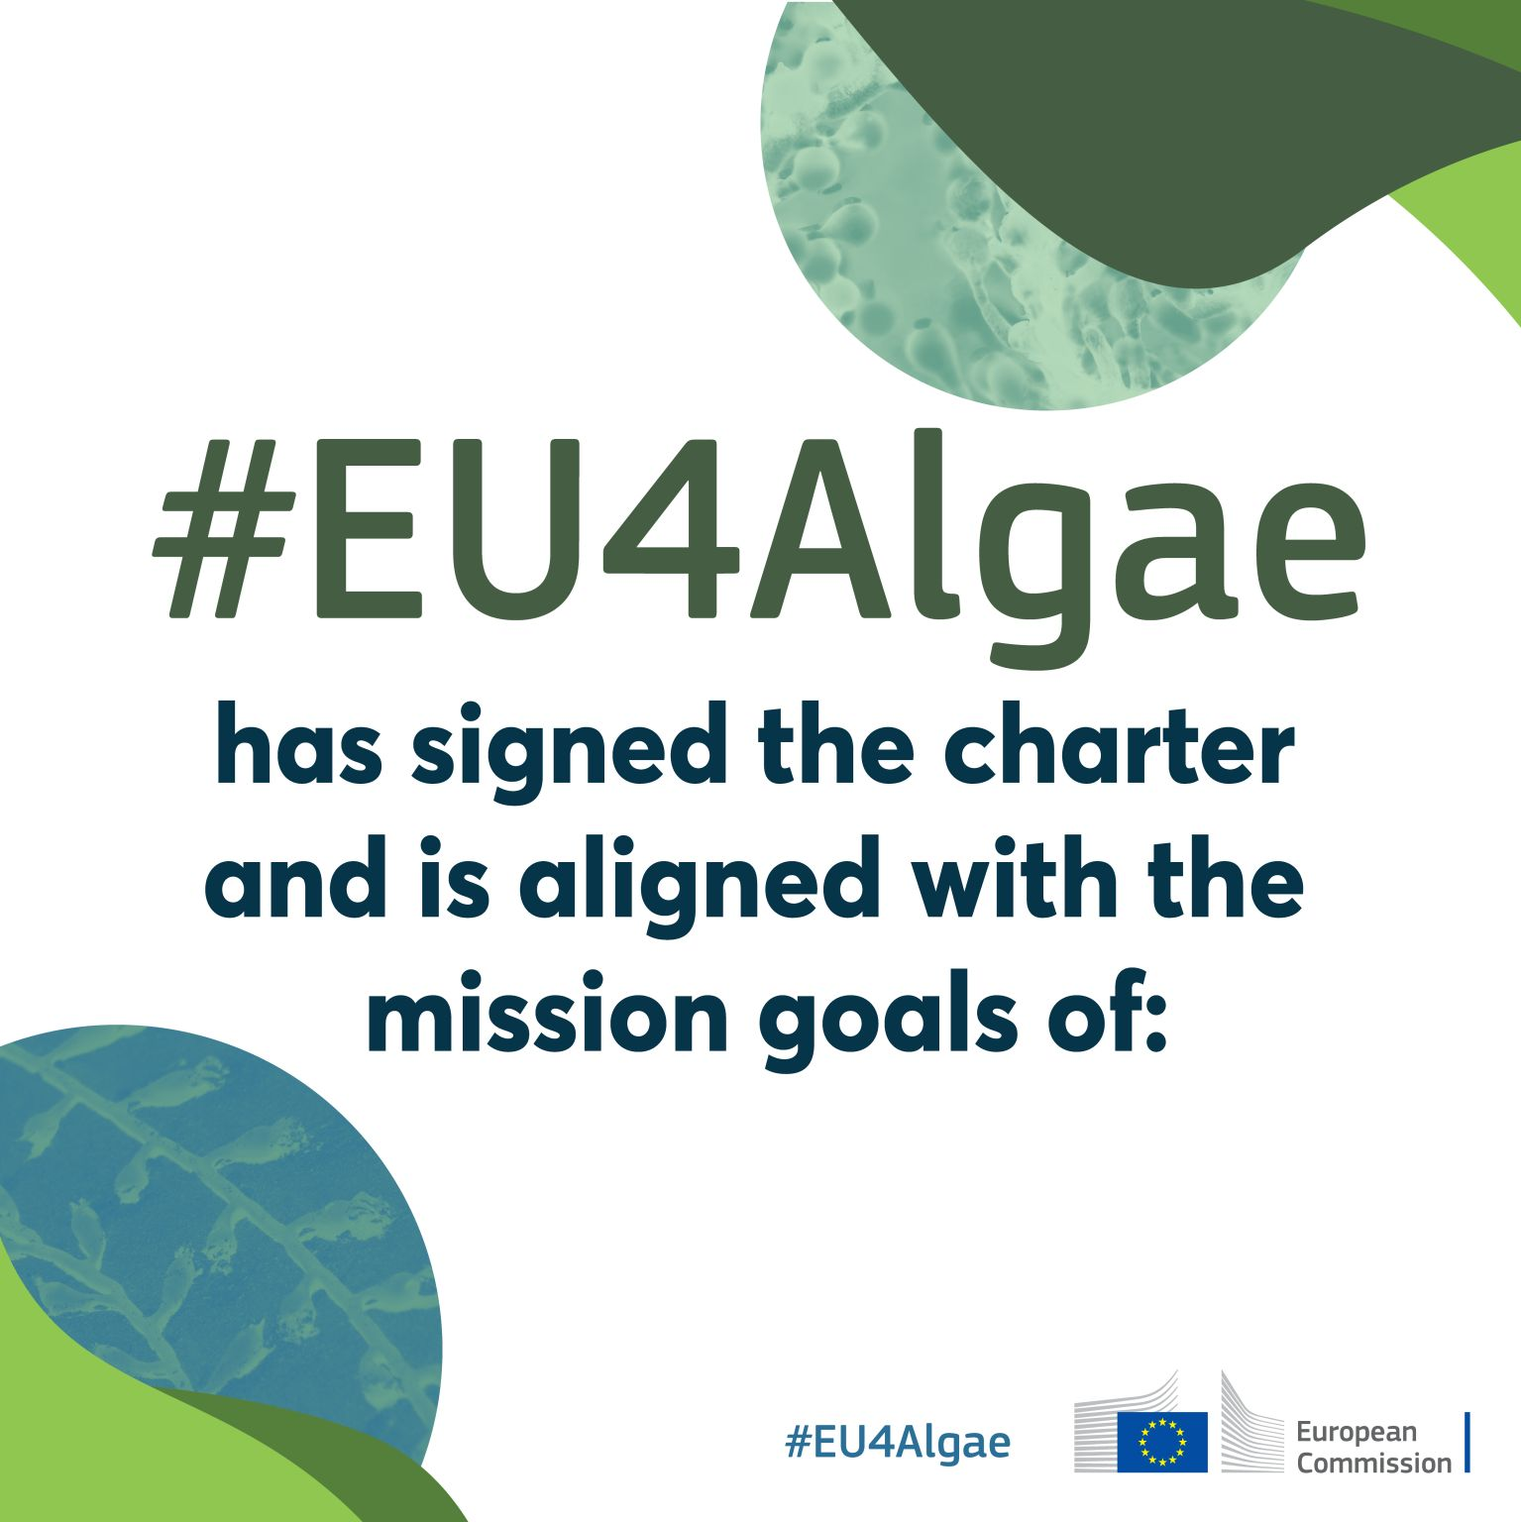
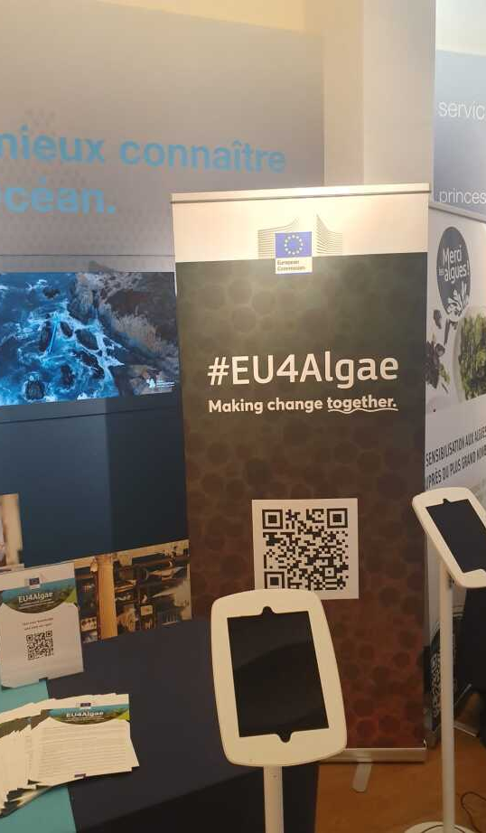
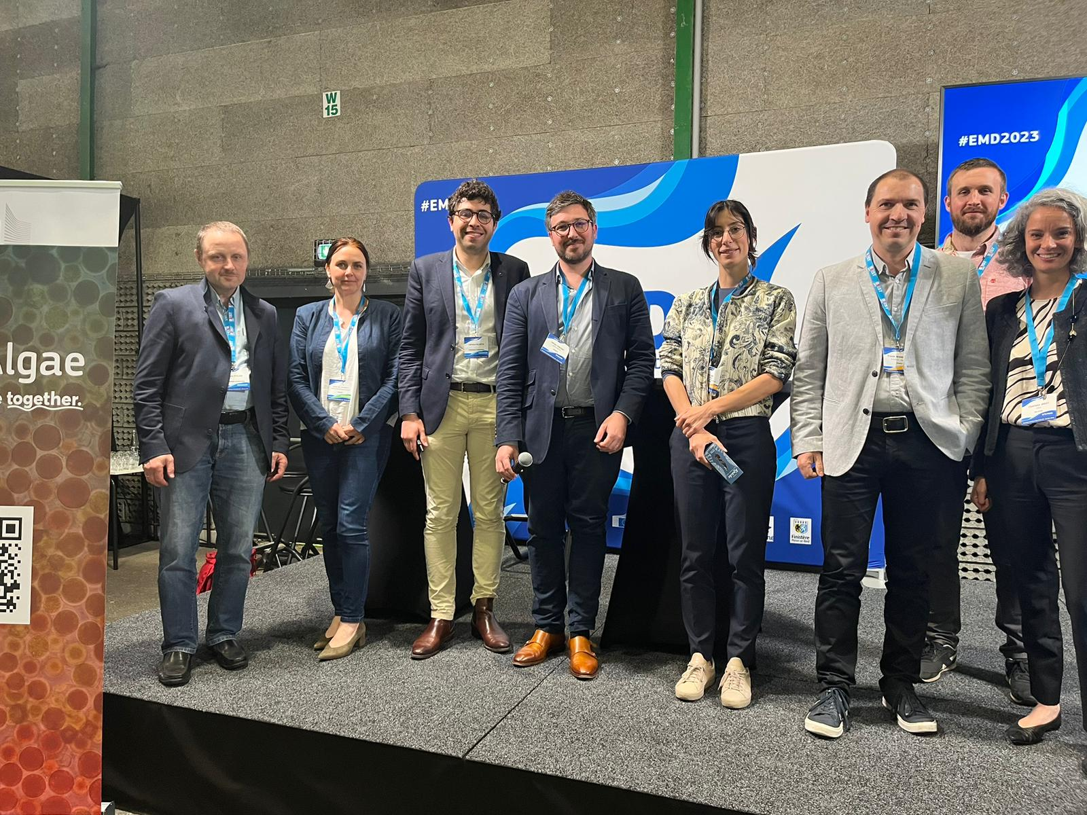
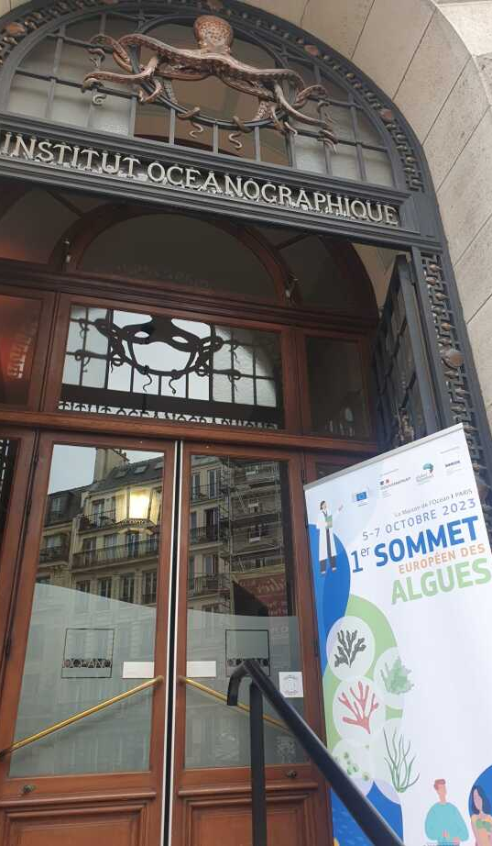
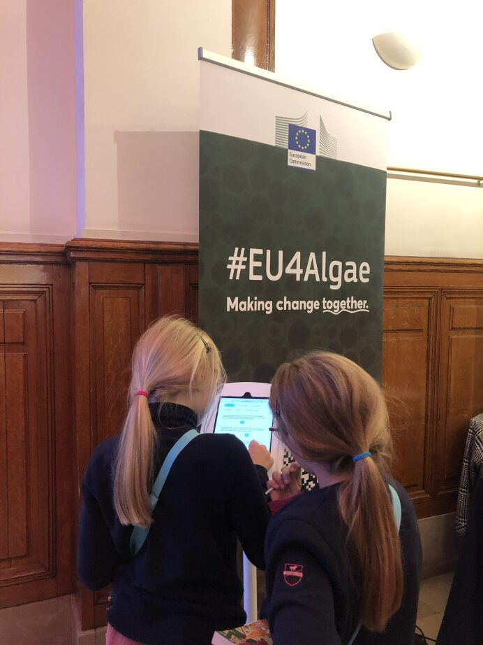
EU Open Doors Day
1st EU Algae Awareness Summit
EMD 2023

Slide 4
What is coming up under EU4Algae in 2024
Documents and outcomes coming up:
WG2 - micro (Fact Sheets): Biobanks in the EU; Composition & Nutritional Value of microalgae species; Impact of microalgae production systems.
WG3 - food: Food regulation Fact Sheet; Novel Food Candidate lists; Traditional Food Fact Sheet
Task 1.7 - List of social aspects related to the algae industry growth.
WG4 – feed – Gaps in the regulatory framework for bringing algae feed products to market
WG6 - materials: Database available pilot/demo facilities; Survey on processing-related companies and major needs; Position paper with academia and industry, regulators and policymakers
Task 1.6 - Overview of algae-related business support initiatives, effectiveness and gaps, and overview of existing support tools to engage young scientists/entrepreneurs/start-ups into algae Industry.
Task 1.9 - Summary of results by previous & ongoing projects/studies on bioremediation potential.
Seaweed Tea

