Slide 1
Biosensors for real time monitoring of marine contaminants
Jan Roelof van der Meer
Coordinator
www.braavoo.org/info@braavoo.org

Slide 2

Partners
4 Academic partners
4 SME partners
1 SME project coordination
Project duration: 3y
Project finished Nov 30, 2016

Slide 3
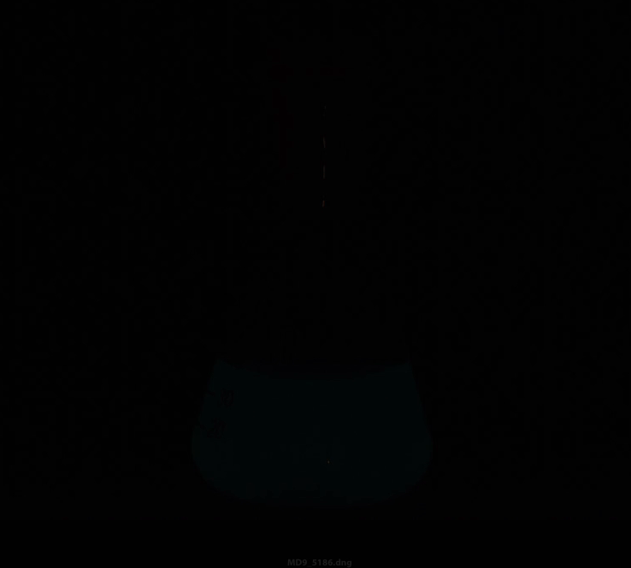
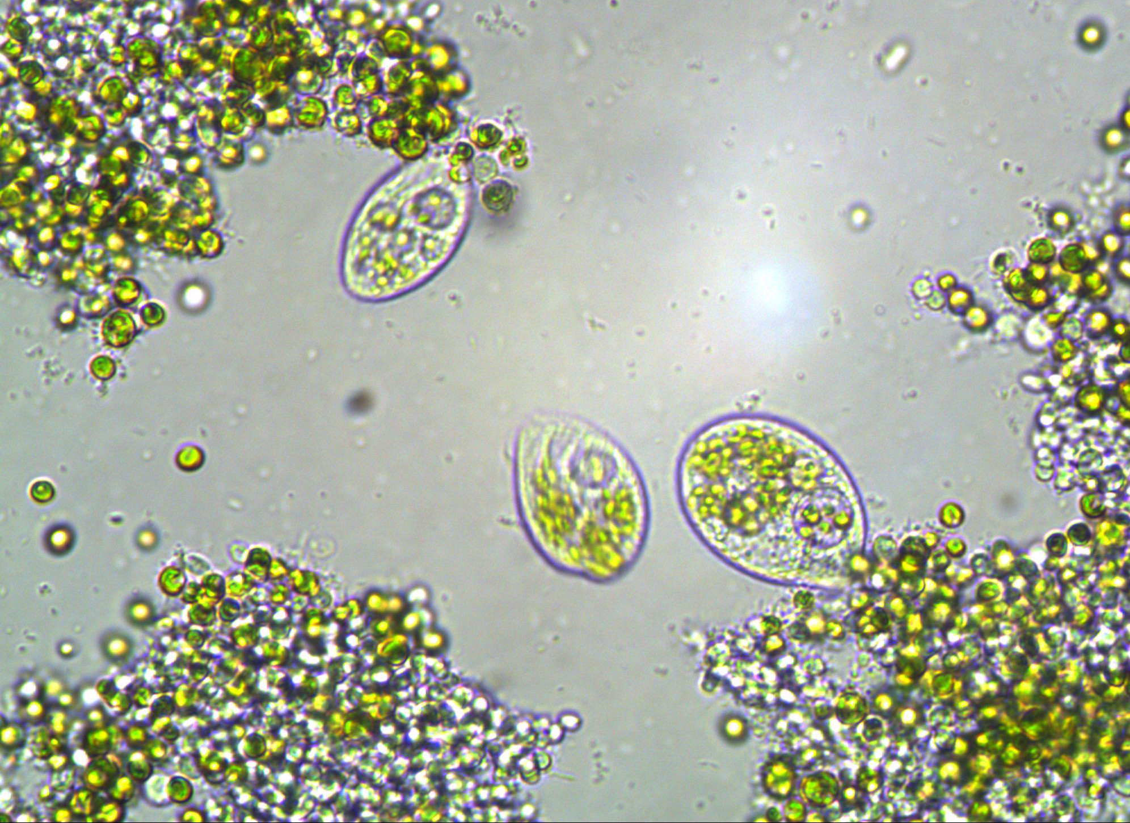






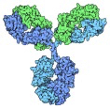




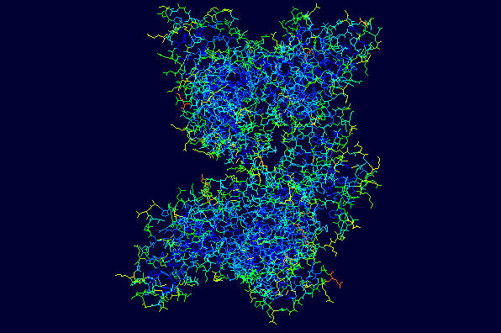
BRAAVOO developed three sensor types
1. Photosystem II fluorescence
of marine algae
2. Bioluminescence
from engineered bacteria
Sample + Ab
3. Immuno-
sensing by wave-
guide interference
Sensor surface
Sample analysis

Slide 4
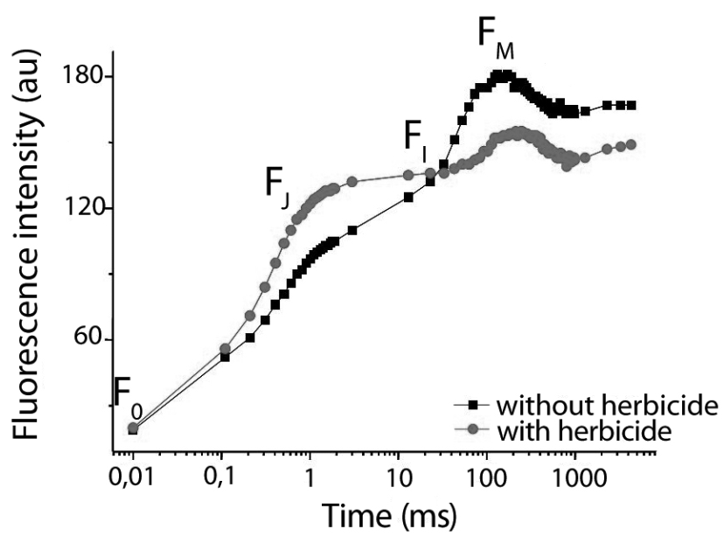
What do the sensors measure?
ALGAE: general toxicity
Multilight Sensor:
10 min dark, 11 s light, 10 s recording.
Immobilized algae with prior exposition to light at 50 µmol/m²s for 5 min.
Diuron at 0.5 µg/L.
Potentially anything that causes interference with photosystem fluorescence

Slide 5
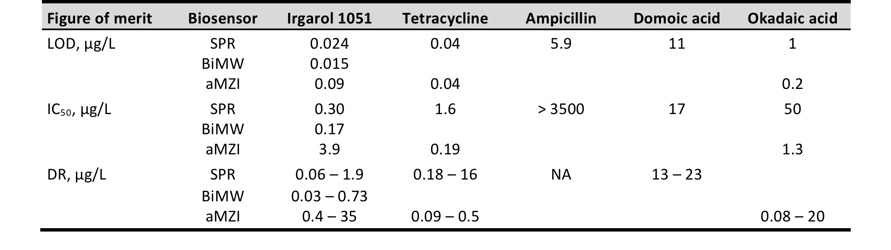
What do the sensors measure?
IMMUNOSENSORS: Individual compounds
Different antibodies (and chemistry) for each target
Different measurement strategies possible (e.g., direct, competition)

Slide 6
What do the sensors measure?
BACTERIA: Compound classes or toxicity
Different strains for each target
Carry genetic circuits that enable detection of specific compounds (e.g., Hg²⁺) or compound classes (e.g., BTEX), or general toxicity.
All strains maintain the same output (e.g., luciferase)

Slide 7
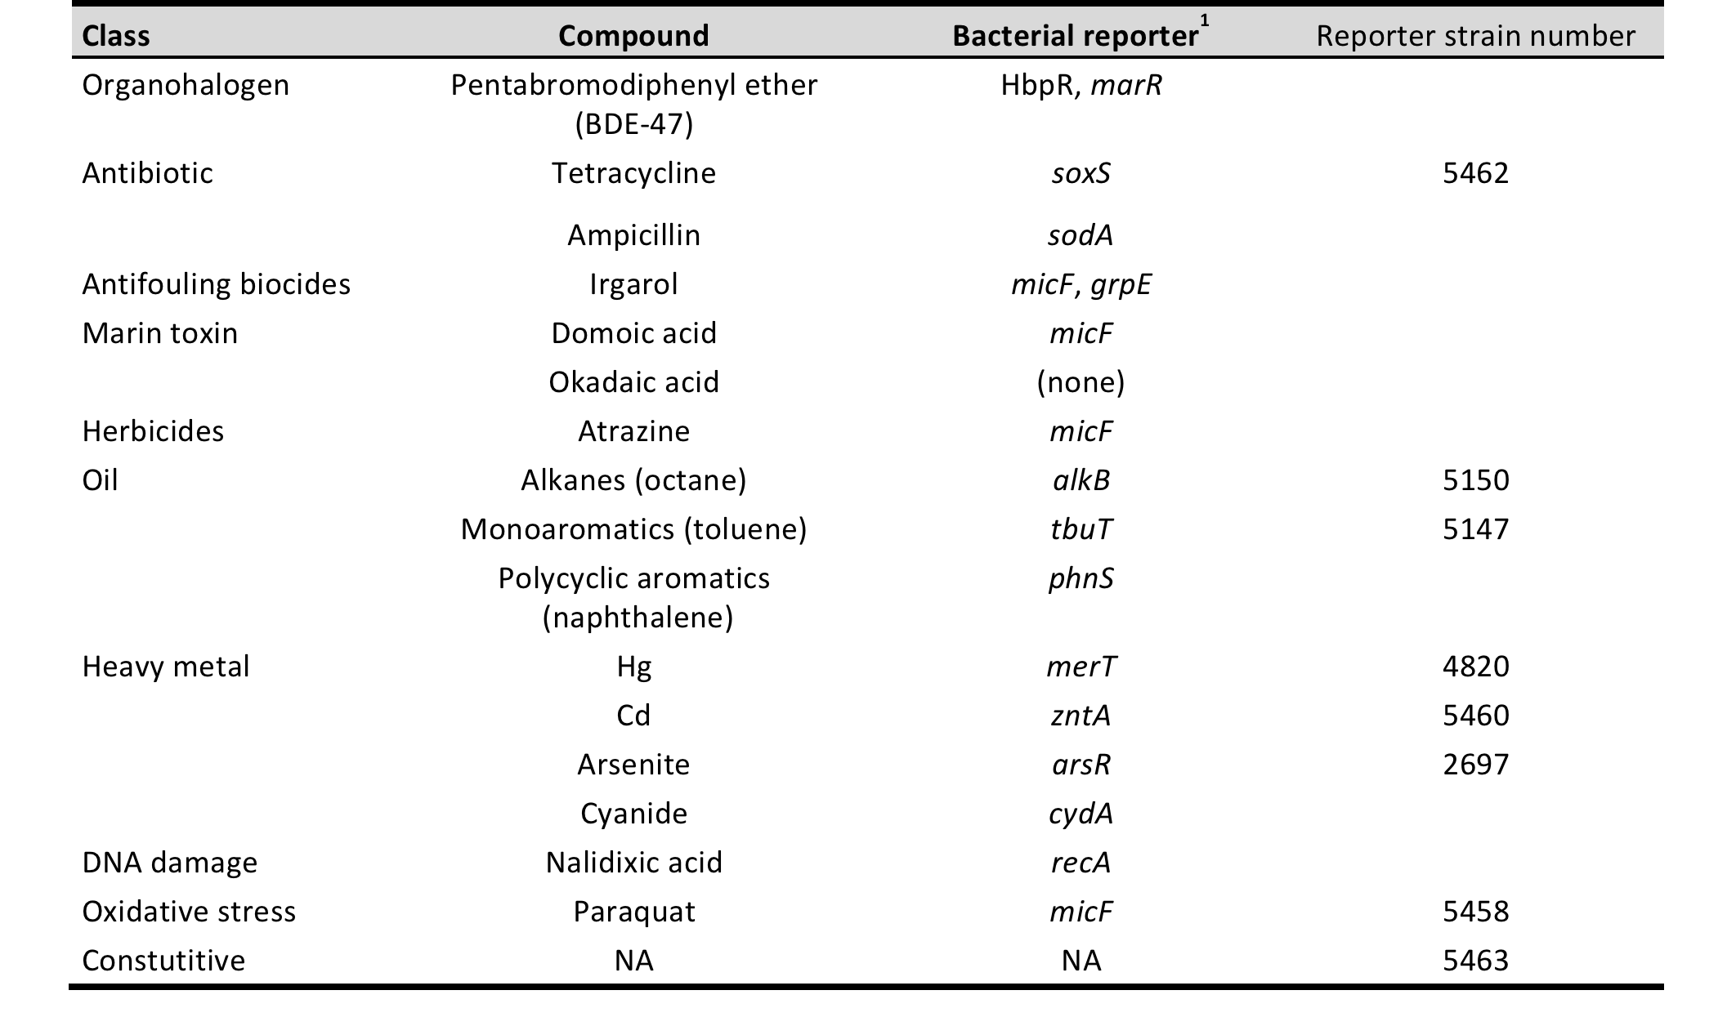
Example bioreporter strain specificities

Slide 8
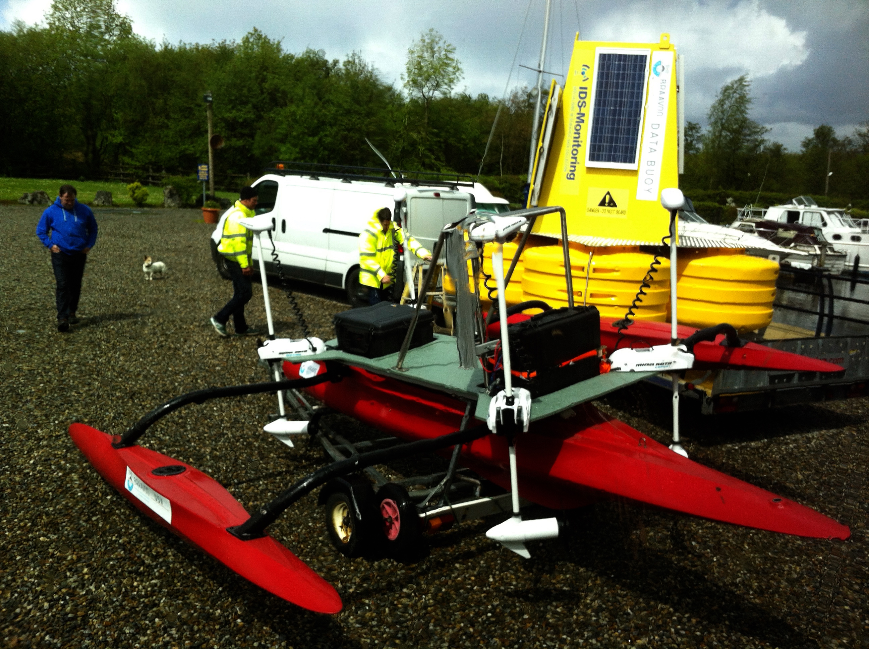
Biosensor integration in two platforms: a marine buoy and a USV
Long term monitoring
Specific campaign monitoring

Slide 9
How does integration work?
Six identical parallel algal reactors
Maintenance under low light – several weeks
Filtered sample flown over algae reactor
Instrument makes fluorescence measurement
Comparison to standard

Slide 10
Integration of a waveguide immunosensor
aMZI triple platform with empty control
Tight custom-made fluidic couplings
Specific rotary valves to operate the reagents and samples at smallest volumes

Slide 11
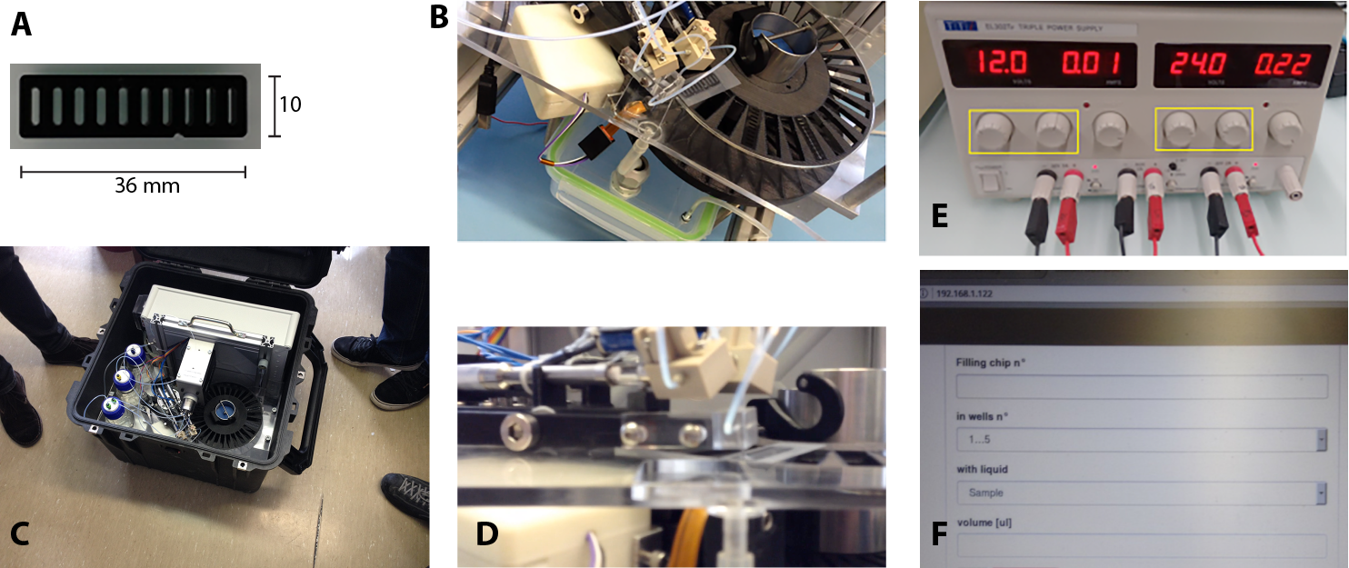
Integration of bacterial sensors
Multiwell holder for 2x5 lyophilized strains – a carroussel with 30 positions – automated sample and reagent injection and kinetic bioluminescence readout

Slide 12
Final deployment platforms
Robust buoy and USV – new waypoint control and obstacle removal implements – autonomous sampling systems

Slide 13
Light output from biosensors
Arsenic
Cadmium
Alkane
Mercury
STANDARDIZED CONDITIONS
As: 0, 10 and 100 µg/L
Cd: 0, 0.5 and 1 mg/L
OCT: 0, 5 and 50 µM
Hg: 0, 5 and 50 µg/L

Slide 14
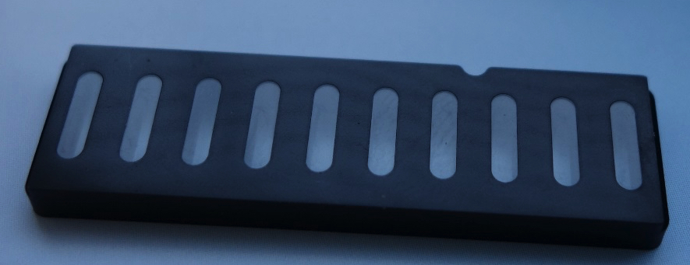
Automated? How to calibrate?
Hg²⁺
Cd²⁺
35 µg/L
Cells re-hydrated with 10 µL 0.9% NaCl
10 µL ONR7a (bl) or 10 µL sample (sa)
10 µL calibration solution
2.5 mg/L
3
bioluminescence
1,2
15 µg/L
20 µg/L
1 mg/L
1.5 mg/L
Time (min)
Time (min)
Wells 1-5: Mer, Cd, PQ, Oct, const + sa
Wells 6-10: Mer, Cd, PQ, Oct, const + bl

Slide 15
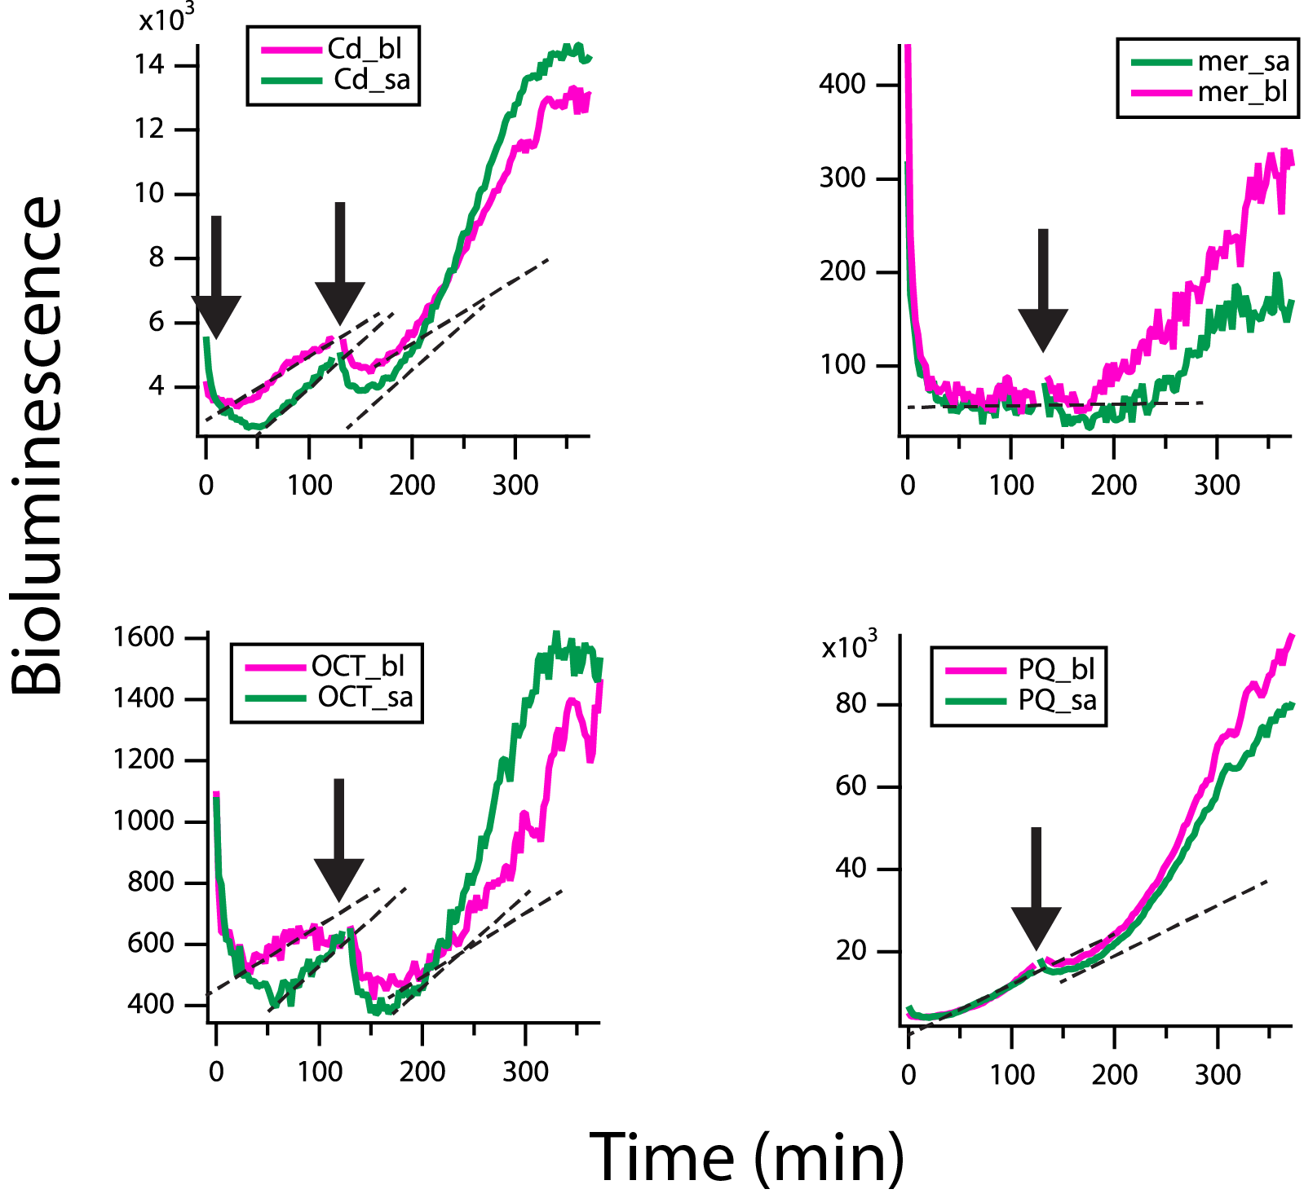
Harbor sample analysis with bacterial biosensor instrument
Different slopes to sample compared to clean seawater suggest presence of compounds inducing Cd and OCT sensors

Slide 16
Conclusions and final observations of the project
The market needs for biosensors for water analysis in marine environments are clearly present
Stakeholders highly appreciated the objectives of BRAAVOO, the technical solutions developed.
Accurate quantification and also “first-line warning” properties are attractive.
Ring-testing and calibration, plus testing in mesocosm facilities under realistic scenarios showed reasonable comparison between the biosensor measurements and classical high-end analytics
There is still a long way to go for biosensor assays and instruments, particularly in terms of robustness
The increasing growth of the global environmental sensing and monitoring market will surely have an impact on demand for floating platforms.

Slide 17
Panel questions
What are the key challenges for ocean observation in your area of interest?
What are the major impacts of improved measurements?
Where would be the first applications?
What is the future vision?
What is the potential market - size and timing?

